Slide 1

angular
part 5
kamil mijacz
Notes:
https://pl.wikipedia.org/wiki/Angular_(framework)#/media/File:Angular_full_color_logo.svg

Slide 2
plan
typescript basics
basic types
classes
functions
…

Slide 3
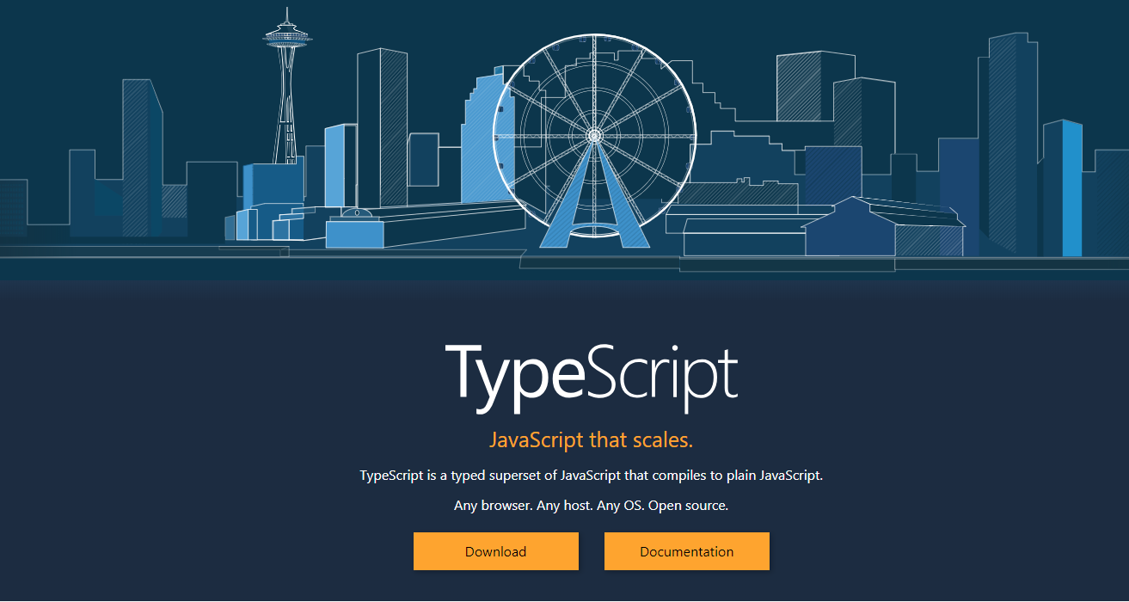

Slide 4
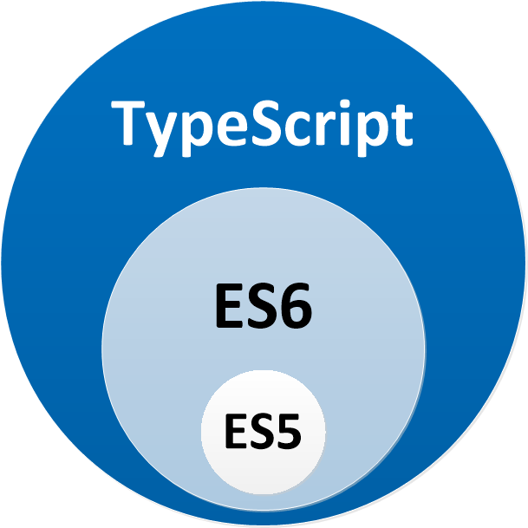
typescript
code transpiled into js
decorators (~annotations) - allow us to decorate classes with annotations and properties as well as meta-functionality
TS = ES6 + Types + Annotations
http://www.typescriptlang.org/
Notes:
This is our first time dealing with a TypeScript-specific feature, which are decorators (you can think of them as annotations).
Decorators allow us to decorate classes with annotations and properties as well as meta-functionality.
Angular heavily leverages this TypeScript feature across the board, such as using decorators for modules, components, and more
http://www.typescriptlang.org/play/index.html

Slide 5
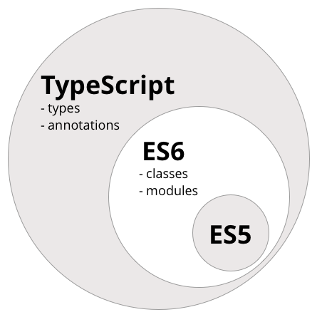
typescript
code transpiled into js
decorators (~annotations) - allow us to decorate classes with annotations and properties as well as meta-functionality
TS = ES6 + Types + Annotations
http://www.typescriptlang.org/
Notes:
This is our first time dealing with a TypeScript-specific feature, which are decorators (you can think of them as annotations).
Decorators allow us to decorate classes with annotations and properties as well as meta-functionality.
Angular heavily leverages this TypeScript feature across the board, such as using decorators for modules, components, and more
http://www.typescriptlang.org/play/index.html

Slide 6
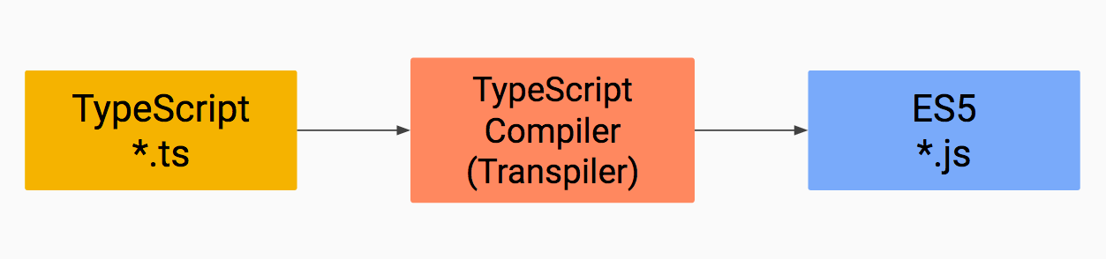
typescript transpilation
Notes:
https://www.google.pl/search?q=typescript+transpilation&source=lnms&tbm=isch&sa=X&ved=0ahUKEwixzviLnffeAhUImIsKHcSiBD0Q_AUIECgD&biw=1920&bih=938

Slide 7


typescript vs javascript
class Greeter {
greeting: string;
constructor(message: string) {
this.greeting = message;
}
greet() {
return "Hello, " + this.greeting;
}
}
let greeter = new Greeter("world");
var Greeter = /** @class */
(function () {
function Greeter(message) {
this.greeting = message;
}
Greeter.prototype.greet
= function () {
return "Hello, " + this.greeting;
};
return Greeter;
}());
var greeter = new Greeter("world");
Notes:
http://www.typescriptlang.org/play/index.html

Slide 8
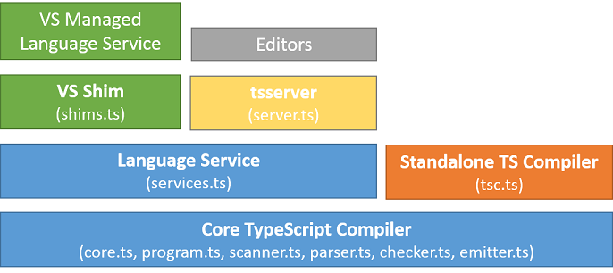
architectural overview
Notes:
https://github.com/Microsoft/TypeScript/wiki/Architectural-Overview

Slide 9
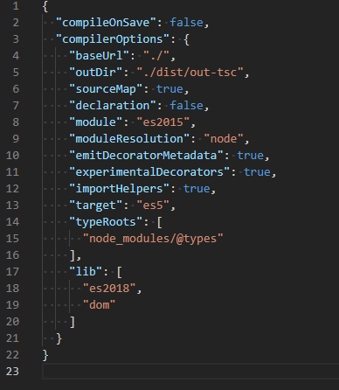
cli
files + options >> tsc >> core compiler >> js files
use:
cmd:
tsconfig.json:

Slide 10
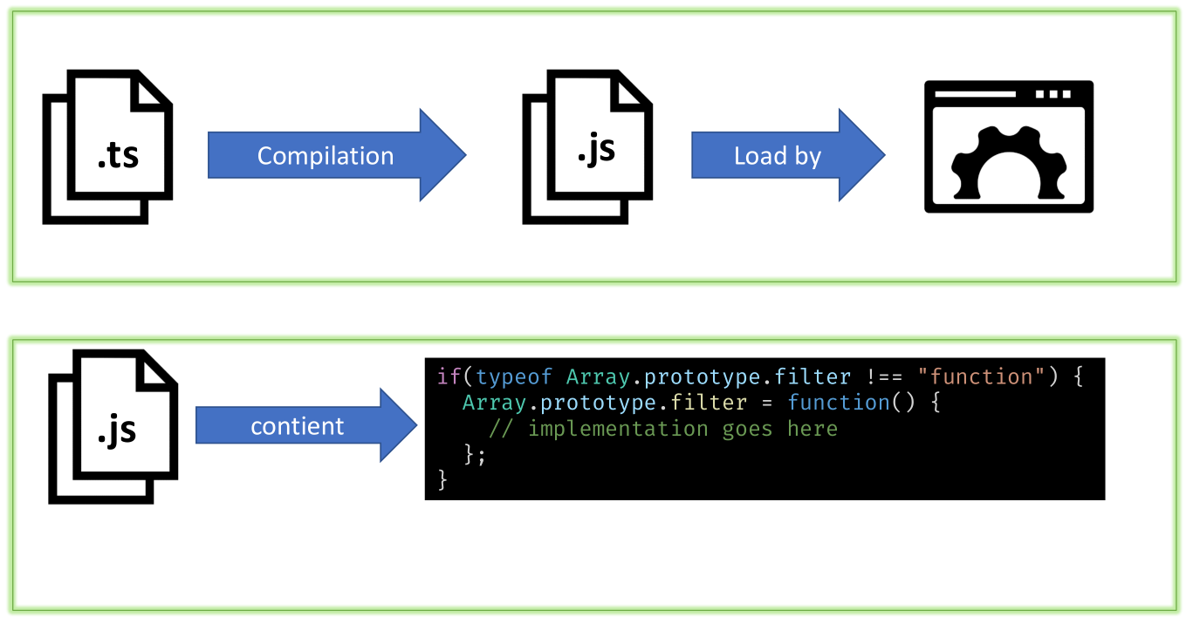
transpilation vs polyfill

Slide 11
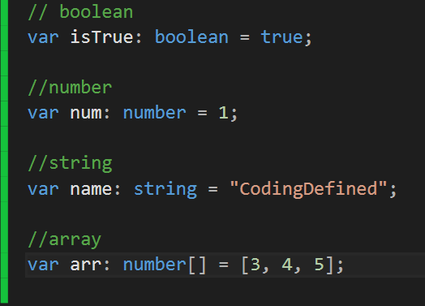
typescript basic types

Slide 12
typescript basic types
// Number
let decimal: number = 6;
let hex: number = 0xf00d;
let binary: number = 0b1010;
let octal: number = 0o744;

Slide 13
typescript basic types
// String
let color: string = "blue";
color = 'red';
let fullName: string = `Bob Bobbington`;
let age: number = 37;
let sentence: string = `Hello, my name is ${ fullName }.
I'll be ${ age + 1 } years old next month.`;

Slide 14
typescript basic types
// Array
let list: number[] = [1, 2, 3];
let list2: Array<number> = [1, 2, 3];
// Enum
enum Color {Red = 1, Green, Blue}
let c: Color = Color.Green;

Slide 15
typescript basic types
// any
let notSure: any = 4;
notSure.ifItExists(); // okay, …might exist at runtime
notSure.toFixed(); // okay, …exists (but the compiler doesn't check)
let prettySure: Object = 4;
prettySure.toFixed(); // Error: Property 'toFixed' doesn't exist on type 'Object'.

Slide 16
typescript basic types
// Void
function warnUser(): void {
console.log('This is my warning message');
}
// Not much else we can assign to these variables!
let u: undefined = undefined; // --strictNullChecks
let n: null = null; // --strictNullChecks

Slide 17
typescript basic types
// Function returning never must have unreachable end point
function error(message: string): never {
throw new Error(message);
}
// Function returning never must have unreachable end point
function infiniteLoop(): never {
while (true) {
}
}

Slide 18
type assertions
let someValue: any = "this is a string";
let strLength: number =
(<string>someValue).length;
let someValue: any = "this is a string";
let strLength: number =
(someValue as string).length;

Slide 19
union types
let data: string | number;
data = 10;
data = 'John';

Slide 20
functions
arrow functions
this keyword
optional and default parameters
can be overloaded

Slide 21
functions
function Book(title: string, length?: number) { …
}
function Book(title: string, length: number = 300) { …
}
function School (name: string, ...id: number[]) { …
}

Slide 22
function overloads
function getCustomer(name: string): string;
function getCustomer(id: number): string;
function getCustomer(property: any): string {
if (typeof property === 'string') {
// return customer info based on customer name
} else if(typeof property === 'number') {
// return customer info based on customer id
}
return 'customer';
};

Slide 23
classes in typescript
Inheritance
Polymorphism
Encapsulation
Abstraction

Slide 24
class definition
class Book {
public author: string;
public title: string;
public length: number;
getFullTitle(): string {
return `${this.title} by ${this.author}`;
}
}
let typeScript = new Book();
typeScript.title = 'TypeScript';
typeScript.author = Someone';
typeScript.length = 300;

Slide 25
class definition
class Book {
public author: string;
public title: string;
public length: number;
constructor(author: string, title: string, length: number) {
this.author = author;
this.title = title;
this.length = length;
}
}

Slide 26
class definition
class Book {
constructor(
public author: string,
public title: string,
public length: number) {
}
}

Slide 27
properties
class Book {
private _title: string;
get title(): string { return this._title; }
set title(value: string) {
if (value !== '') {
this._title = value;
}
}
}
let typeScript = new Book();
typeScript.title = 'TypeScript';

Slide 28
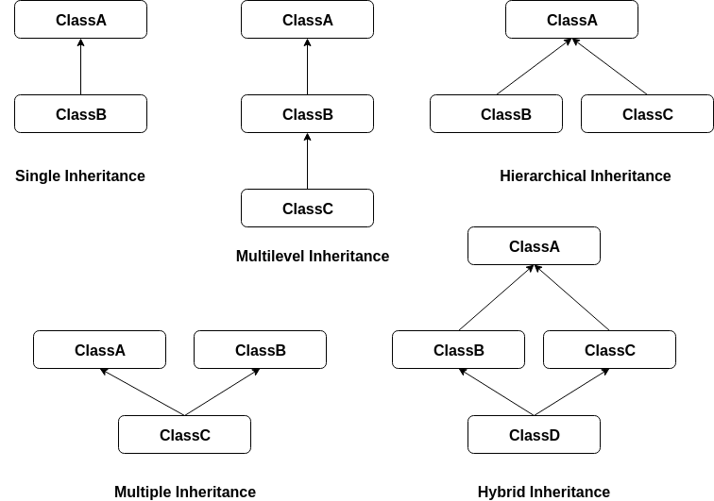
inheritance
single
multilevel
hierarchical

Slide 29
stuff
types unions & intersections
type aliases
interfaces
generics
…

Slide 30

https://github.com/Banndzior
#slack
kamil.mijacz@gmail.com
kamil.mijacz@softwarehut.com
Notes:
https://www.flickr.com/photos/jeffdjevdet/18027482924

