Slide 1

angular
part 6
kamil mijacz
Notes:
https://pl.wikipedia.org/wiki/Angular_(framework)#/media/File:Angular_full_color_logo.svg

Slide 2
plan
routing concepts
routing in angular

Slide 3
(url) routing
http://localhost:4200/
http://localhost:4200/home
http://localhost:4200/notes
http://localhost:4200/notes/15

Slide 4
(url) routing
http://localhost:4200/
http://localhost:4200/home?my=true&pr2=1
http://localhost:4200/notes#display=my
http://localhost:4200/notes/15

Slide 5
(url) routing
http://localhost:4200/
http://localhost:4200/home
http://localhost:4200/notes
http://localhost:4200/notes/15

Slide 6
(url) routing
/
/home
/notes
/notes/:id
/contacts

Slide 7
why do we need routing?
separate different areas of the app
maintain the state in the app
protect areas of the app based on ceratain rules

Slide 8
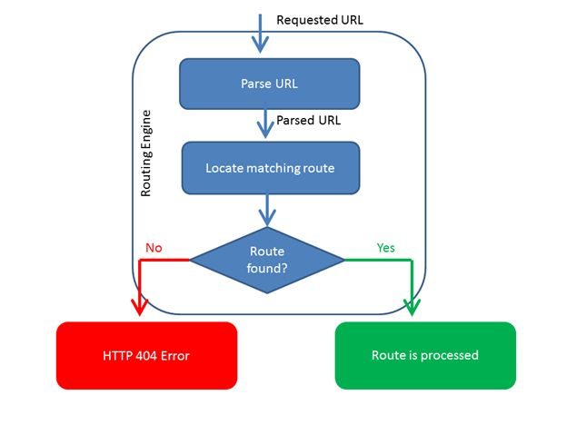
routing concept
http://www.onet.pl/wieści/bialystok
wieści
białystok

Slide 9
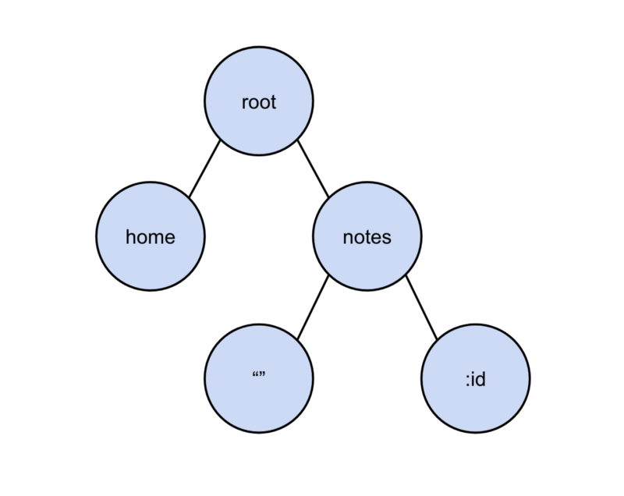
routing concept
AppComponent
tree of router states
HomeComponent
NotesComponent
NewsDetailsComponent
NotesComponent

Slide 10
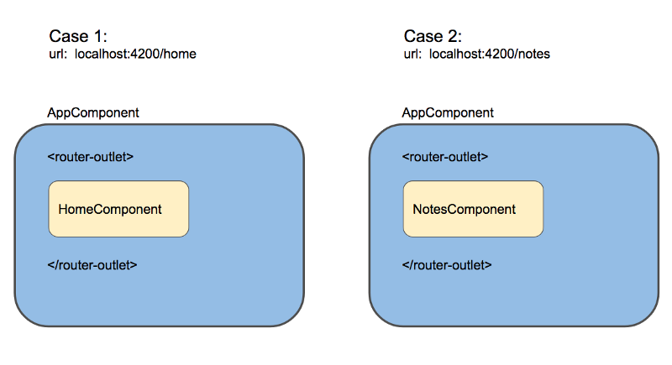
routing concept
component rendering based on path

Slide 11
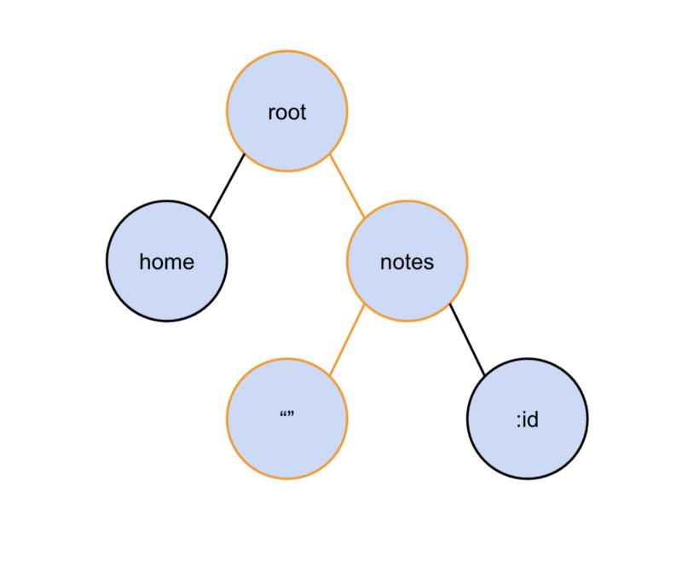
routing concept
/notes
one active route

Slide 12
setup
import {
RouterModule
} from '@angular/router’;
@NgModule({
imports: [RouterModule.forRoot(routes)],
exports: [RouterModule]
})
export class AppRoutingModule { }

Slide 13
setup
const routes: Routes = [
{ path: '', pathMatch: 'full’,
redirectTo: 'contacts' },
{ path: 'contacts', component: ContactListComponent },
{ path: 'contact/:id’,
component: ContactDetailComponent }
];

Slide 14
setup
app.component.html
<router-outlet></router-outlet>
app.module.ts
import { AppRoutingModule } from './app-routing.module’;
@NgModule({
declarations: […],
imports: [AppRoutingModule],
providers: [],
bootstrap: [AppComponent]
})
export class AppModule { }

Slide 15
navigation
<a [routerLink] = "'/contacts'">Contacts</a>
<a [routerLink]="['/contact', contact.id, …]">Go to details</a>

Slide 16
routing strategies
HashLocationStrategy ('#/’)
PathLocationStrategy (HTML 5 Mode)

Slide 17
RouteParams & RouteData services
export class AppComponent {
id: number; name: string;
constructor(
params: RouteParams, //ParamMap
data: RouteData
) {
this.id = params.get('id');
this.name = data.get('name');
}
}

Slide 18
router parameters in url
matrix url notation:
<a [routerLink]="['Product', {id:1,foo:3}]">Product 1</a>
localhost:3800/product/;id=1;foo=foo

Slide 19
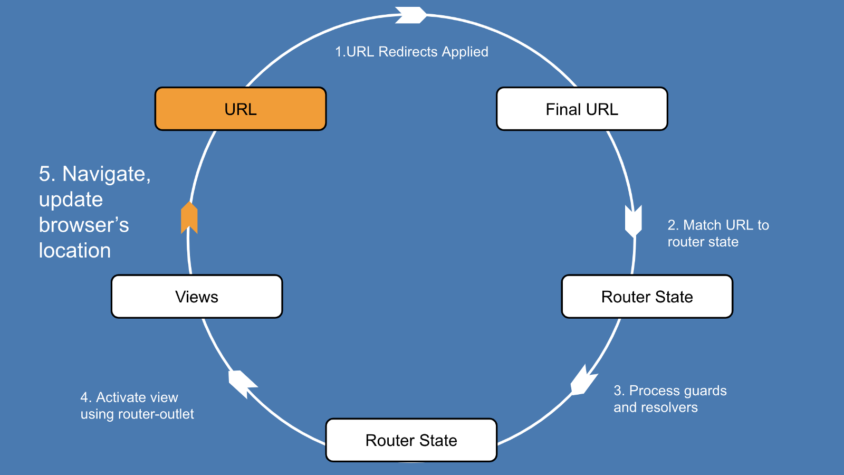
Router lifecycle events

Slide 20
stuff
route guards
child navigation
…
router events
custom resolver

Slide 21

https://github.com/Banndzior
#slack
kamil.mijacz@gmail.com
kamil.mijacz@softwarehut.com
Notes:
https://www.flickr.com/photos/jeffdjevdet/18027482924

