Slide 1

angular
part 7
kamil mijacz
Notes:
https://pl.wikipedia.org/wiki/Angular_(framework)#/media/File:Angular_full_color_logo.svg

Slide 2
plan
dependency injection…
pipes
directives
http

Slide 3

pipes

Slide 4
what is pipe?
classes
prepare data for display
transforming text into another
@Pipe decorator
for code reuse

Slide 5
understanding pipe
input
pipe
output

Slide 6
understanding pipe
{{ productName }}
{{ productName | uppercase | lowercase }}
"PRODUCTNAME"

Slide 7
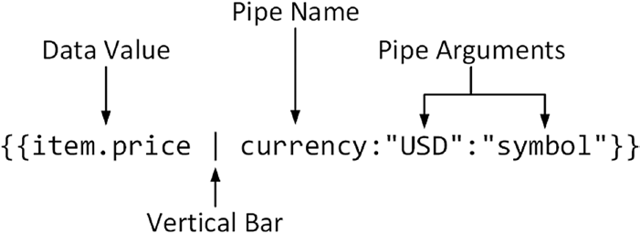
understanding pipe

Slide 8
types of pipes
pipes (chained, with parameters)
build-in
custom

Slide 9
types of pipes
pipes
stateless
statefull

Slide 10
examples
{{ 'Hello World' | uppercase }}
{{ 'hELLO wORLD' | lowercase }}
{{ 'jOHN' | titlecase }}
{{ currentDate | date }}
{{ currentDate | date:'shortDate' }}
{{ '12.123456' | number }}
{{ 150 | currency:'GBP' }}
{{ complexObject | json }}
…

Slide 11
custom pipe
import { Pipe, PipeTransform } from '@angular/core';
@Pipe({ name: 'fileSize’ })
export class FileSizePipe implements PipeTransform {
transform(bytes: number = 0, decimals: number = 2): string {
if (bytes === 0) return '0 Bytes';
const k = 1024, dm = decimals || 2,
sizes = ['Bytes', 'KB', 'MB', 'GB’, …];
i = Math.floor(Math.log(bytes) / Math.log(k));
return parseFloat((bytes / Math.pow(k, i)).toFixed(dm)) + ' ' + sizes[i];
} }

Slide 12


directives
Notes:
https://twitter.com/directivepod

Slide 13
directives
extend the behawior of the elements
can manipulate DOM
@Directive
3 types

Slide 14
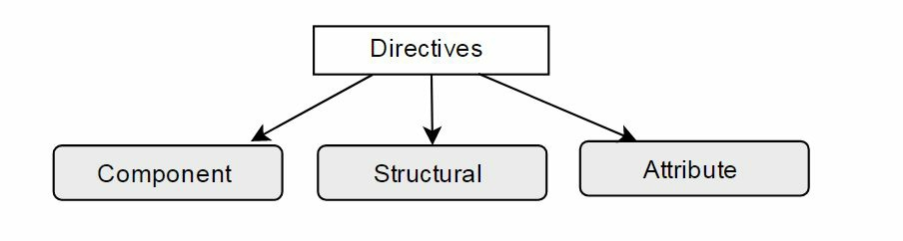
directive types

Slide 15
directive types

Slide 16
directive types
components
structural directives
attribute directives
directives with a template
change the DOM layout by adding and removing DOM elements
change the appearance or behavior of an element/component/directive

Slide 17
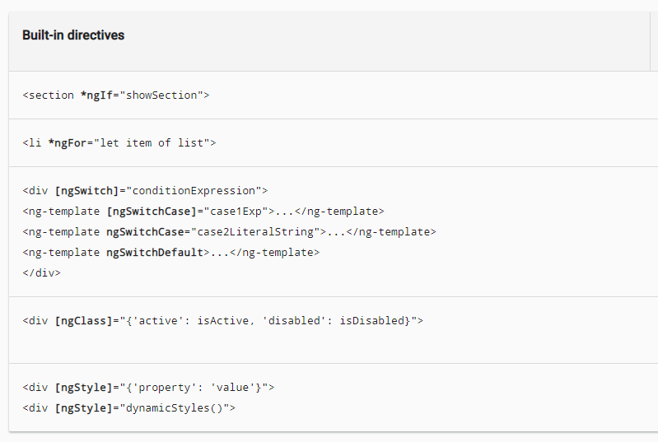
https://angular.io/guide/cheatsheet

Slide 18
custom directive
ng generate directive custom-directive

Slide 19
custom directive
<div sizer="72px">
{{title}}
</div>

Slide 20
custom directive
import {
Directive, ElementRef, Renderer
} from '@angular/core';
@Directive({ selector: '[sizer]' })
export class SizerDirective {
… constructor(
private element: ElementRef,
private renderer: Renderer
) { }
}

Slide 21
custom directive
@Directive({ selector: '[sizer]' })
export class SizerDirective implements OnInit {
@Input() sizer: string;
constructor(private element: ElementRef,private renderer: Renderer)
{ }
ngOnInit() {
this.renderer.setElementStyle(
this.element.nativeElement, 'font-size', this.sizer);
}
}

Slide 22
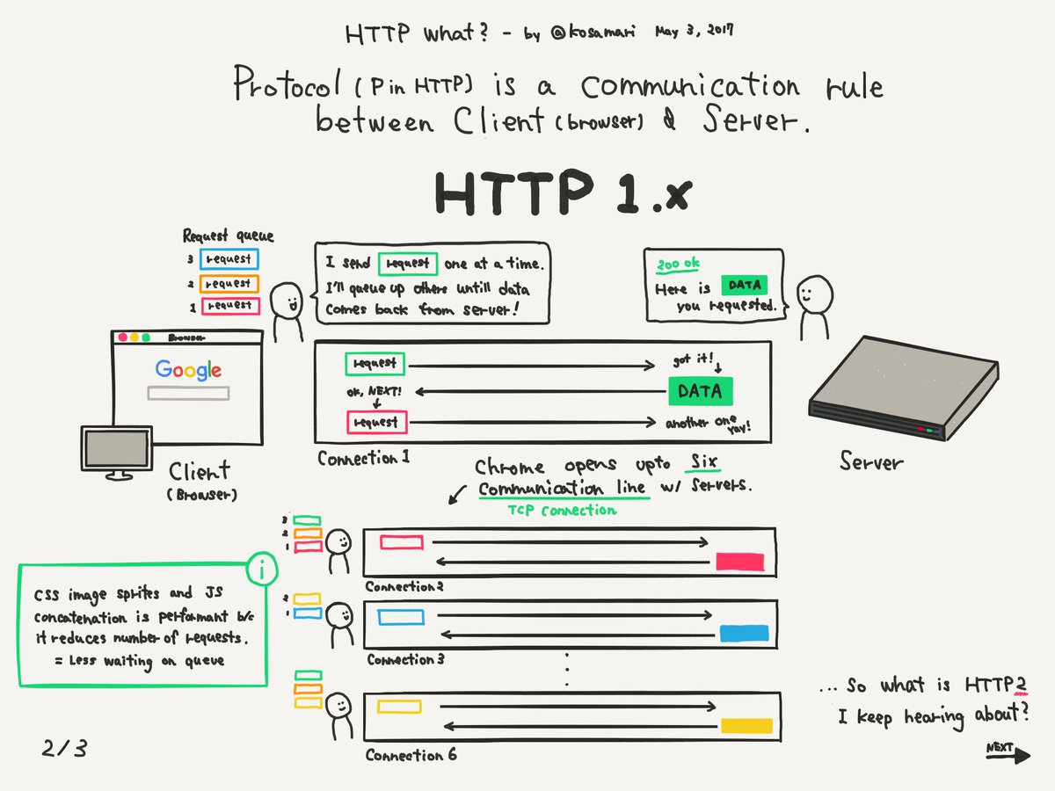
http communication
Notes:
https://www.google.com/url?sa=i&source=images&cd=&cad=rja&uact=8&ved=2ahUKEwj63KuU4M7hAhWixMQBHcO0DDgQjhx6BAgBEAM&url=https%3A%2F%2Ftwitter.com%2Fkosamari%2Fstatus%2F859958929484337152&psig=AOvVaw0arVLn2glRJOkm1vWYuFO6&ust=1555302674798553

Slide 23
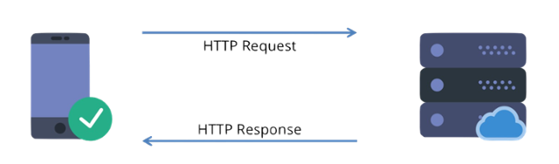
http(s) request/response
client
application
API server

Slide 24
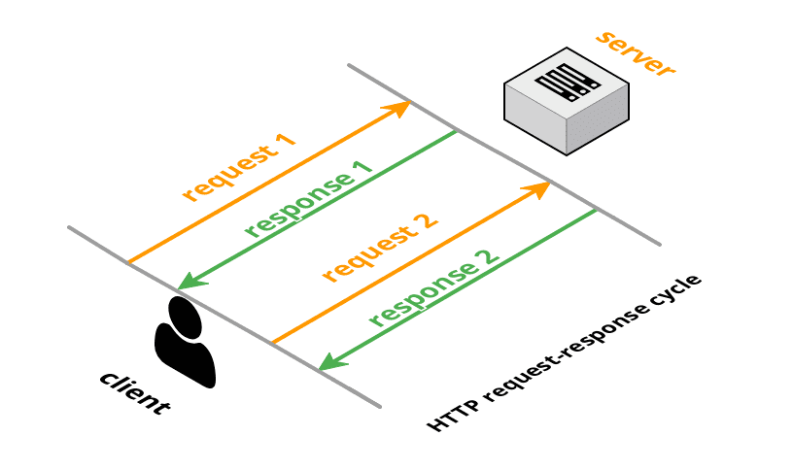
http(s) request-response cycle

Slide 25
HTTP methods
POST
GET
PUT
DELETE
modify
read
modify
delete

Slide 26
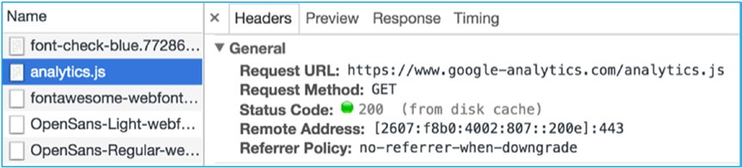
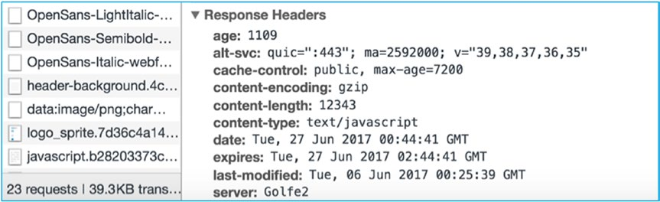
HTTP request and response headers

Slide 27
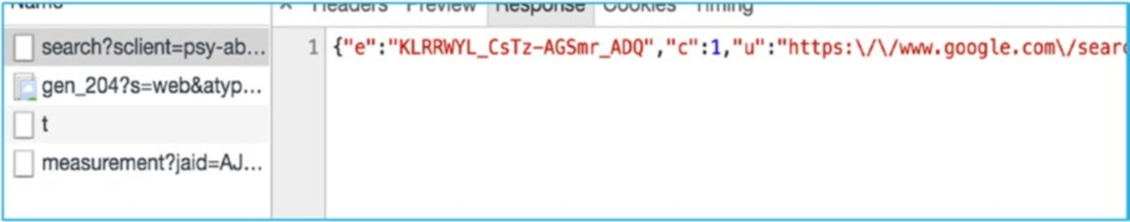
HTTP body
HTML
JSON
XML
Binary

Slide 28
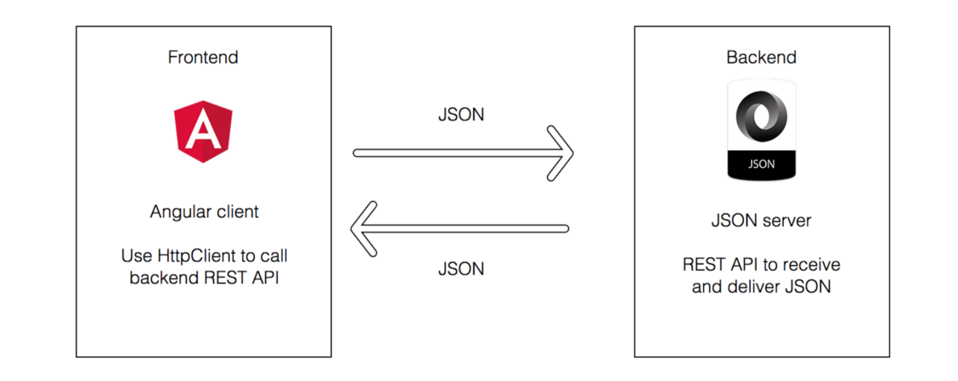
HTTP communication

Slide 29
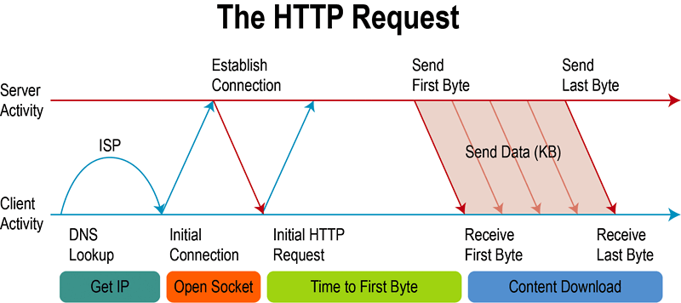

Slide 30
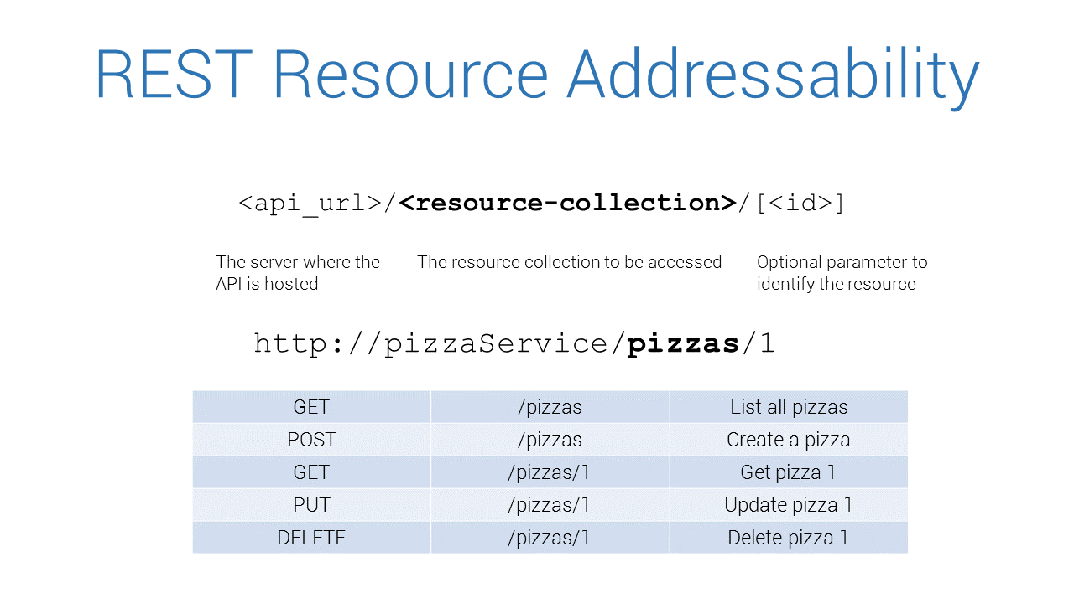
Notes:
https://medium.com/@krishna.acondy/a-generic-http-service-approach-for-angular-applications-a7bd8ff6a068

Slide 31
angular http communication
import {
HttpClientModule
} from '@angular/common/http';

Slide 32
angular http communication
export class PizzaService {
…
}
export class Pizza {
…
}

Slide 33
angular http communication
private url = 'http://pizzaService';
private endpoint = 'pizzas';
constructor(
protected httpClient: HttpClient
) { }

Slide 34
angular http communication
list(): Observable<Pizza[]> {
return
this.httpClient.get<Pizza[]>(
`${this.url}/${this.endpoint}`
);
}

Slide 35
angular http communication
read(id:number): Observable<Pizza> {
return
this.httpClient.get<Pizza>(
`${this.url}/${this.endpoint}/${id}`
);
}

Slide 36
angular http communication
public create(pizza:Pizza): Observable<Pizza>{
return
this.httpClient.post<Pizza>(
`${this.url}/${this.endpoint}`, pizza
);
}

Slide 38
bootstrapping

Slide 39
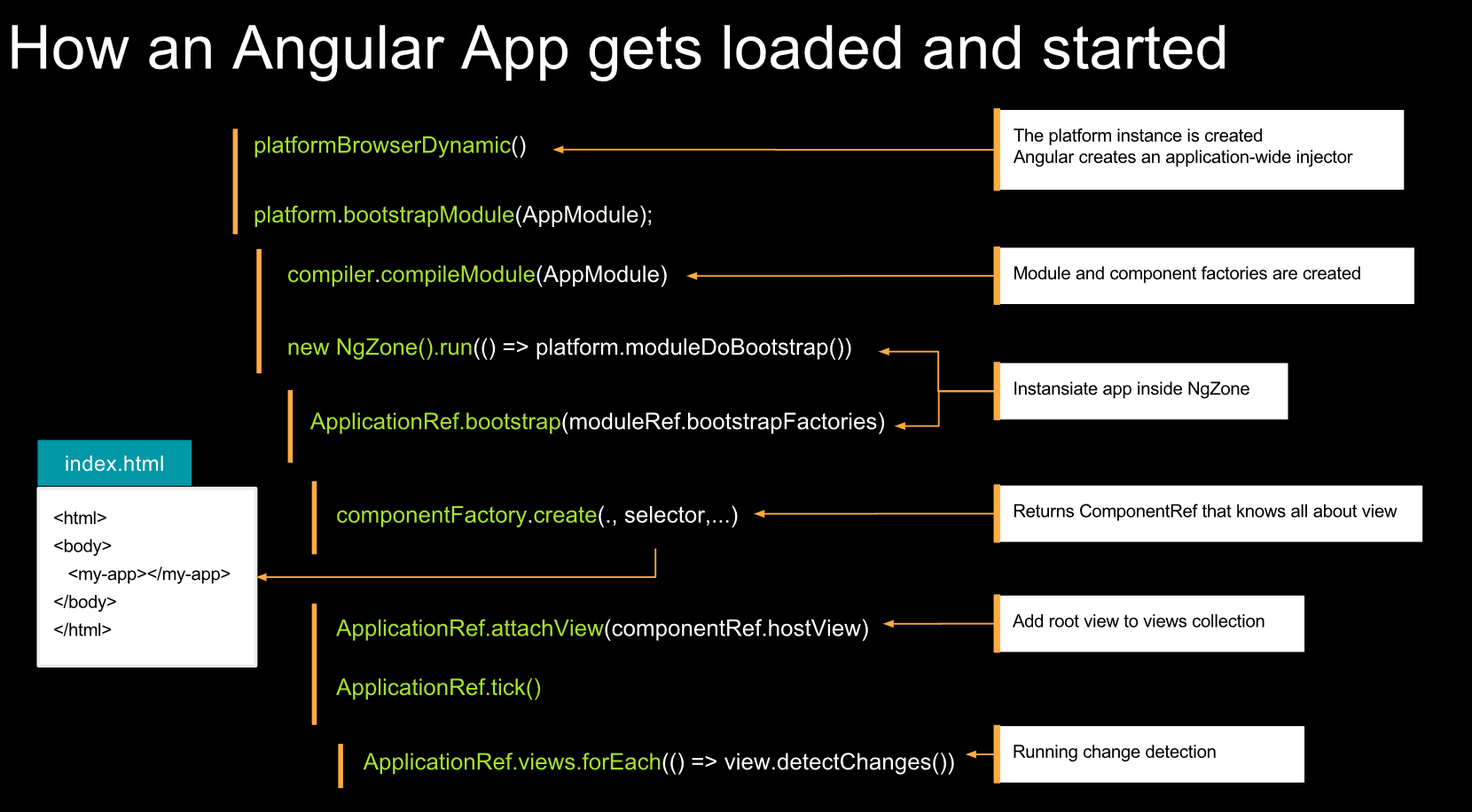
Notes:
https://i.stack.imgur.com/SQBU6.png
https://stackoverflow.com/questions/44077178/what-does-it-mean-to-bootstrap-an-angular-application
https://medium.com/learnwithrahul/ways-of-bootstrapping-angular-applications-d379f594f604

Slide 40
dependency injection

Slide 41

https://github.com/Banndzior
#slack
kamil.mijacz@gmail.com
kamil.mijacz@softwarehut.com
Notes:
https://www.flickr.com/photos/jeffdjevdet/18027482924

