Slide 1

angular
part 2
Notes:
https://pl.wikipedia.org/wiki/Angular_(framework)#/media/File:Angular_full_color_logo.svg

Slide 2
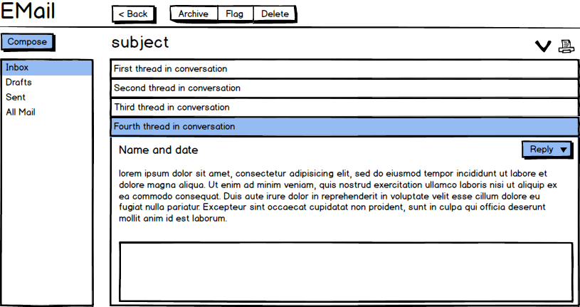
Notes:
https://www.google.pl/search?biw=1920&bih=938&tbm=isch&sa=1&ei=kTYUXJnwIfDRrgSG9aygBA&q=email+client+wireframe&oq=email+client+wireframe&gs_l=img.3...0.0..201287...0.0..0.0.0.......0......gws-wiz-img.oZ63m4hgDnc
https://www.visual-paradigm.com/learning/handbooks/agile-handbook/desktop-application-wireframe.jsp

Slide 3
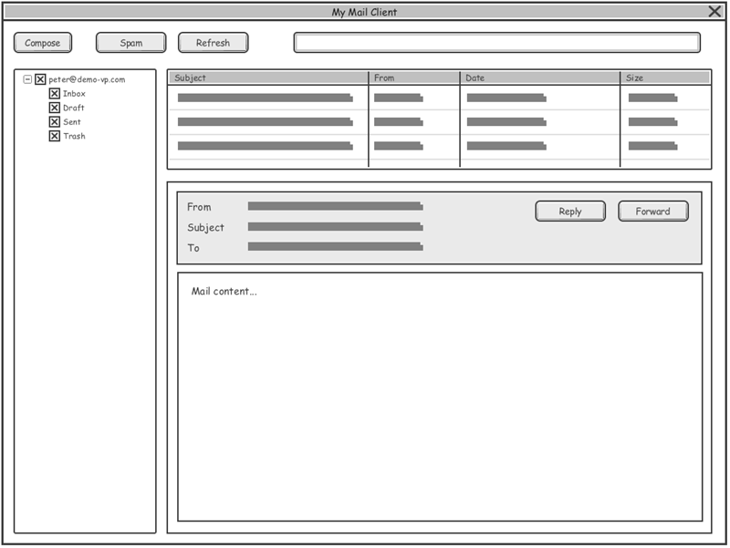
Notes:
https://www.google.pl/search?biw=1920&bih=938&tbm=isch&sa=1&ei=kTYUXJnwIfDRrgSG9aygBA&q=email+client+wireframe&oq=email+client+wireframe&gs_l=img.3...0.0..201287...0.0..0.0.0.......0......gws-wiz-img.oZ63m4hgDnc
https://www.visual-paradigm.com/learning/handbooks/agile-handbook/desktop-application-wireframe.jsp

Slide 4
plan
angular
review
component internals
…tech stuff
logic flow (component communication)

Slide 5

angular
Notes:
http://www.thebluediamondgallery.com/wooden-tile/images/review.jpg

Slide 6
component(s)
everything is component…
…web component
has structure, state & behaviour
user can interact with…
it’s rendered (visible?)

Slide 7
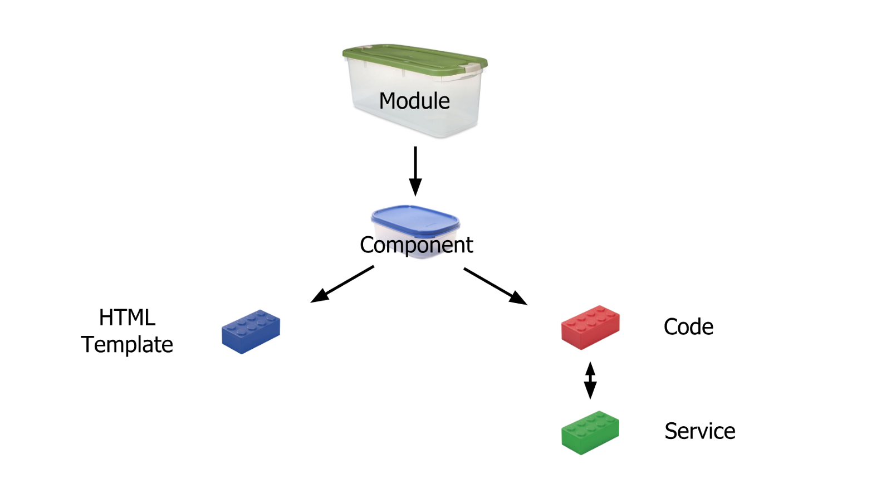
architecture

Slide 8
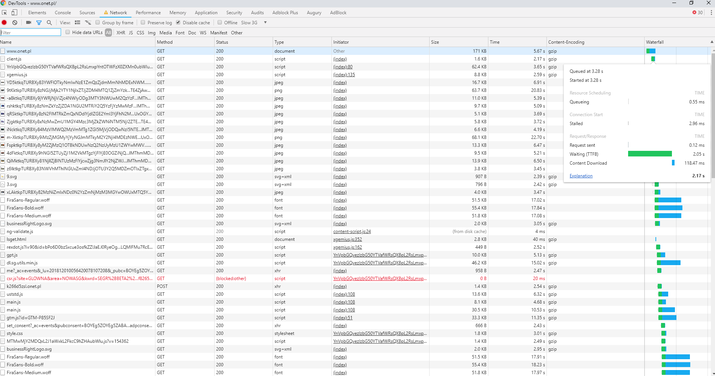
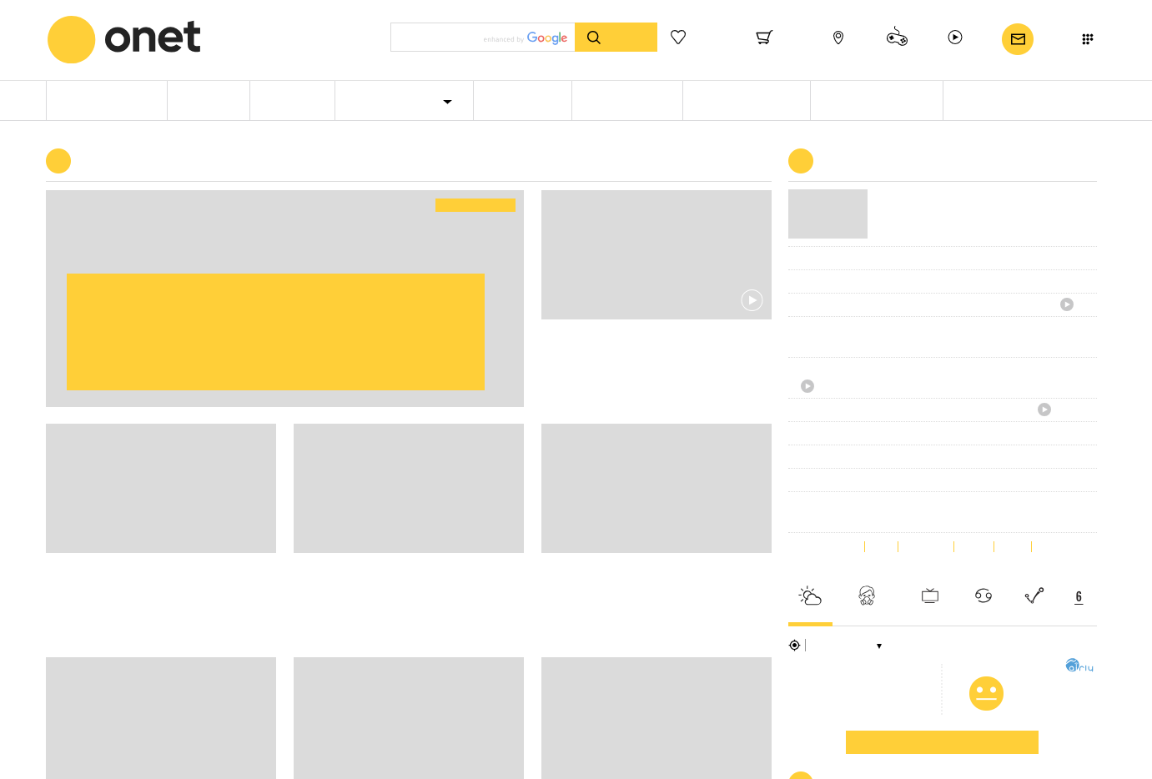


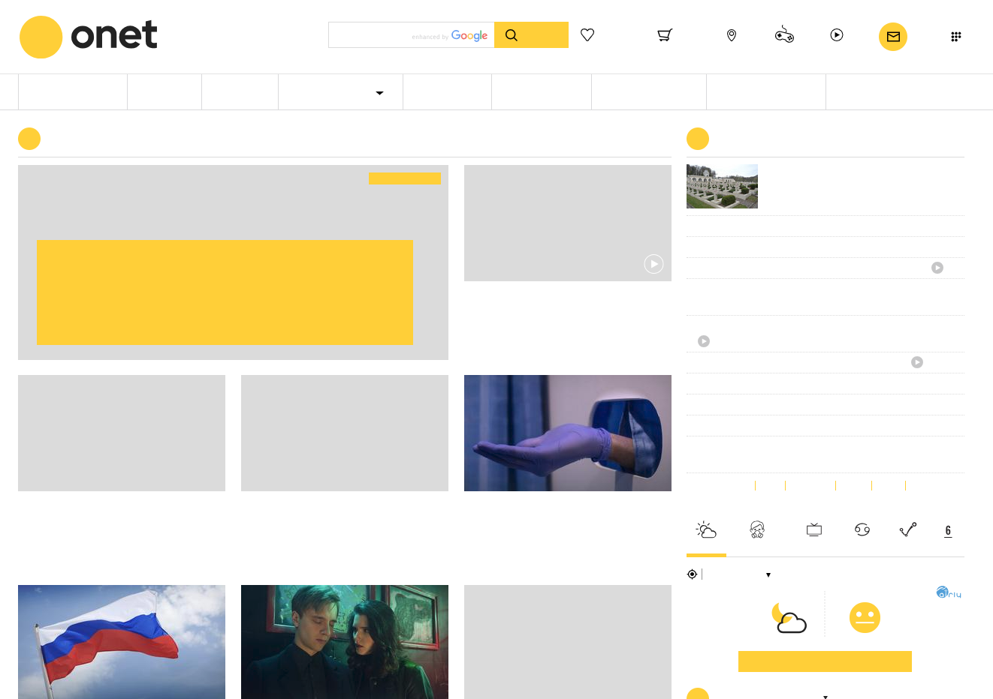
angular app start
load html/css/js dependencies
bootstrap application
run module
create components
render components
Notes:
chrome dev tools?

Slide 9
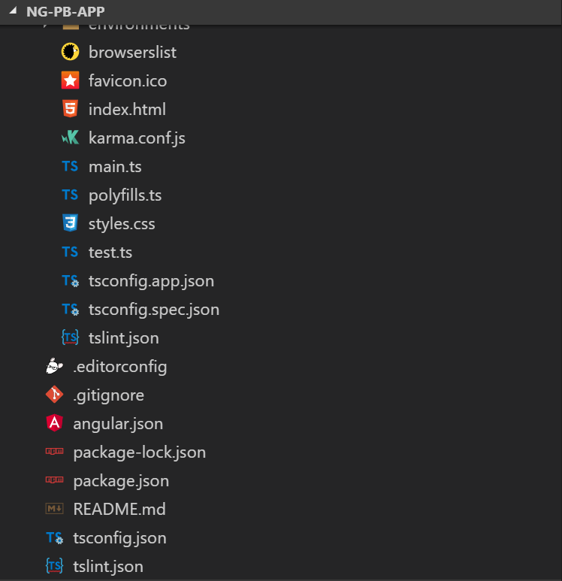
structure
root HTML (host)
app entry point
angular cli config
Notes:
Root HTML (host) - index.html
Entry point – main.ts
Main Module—app.module.ts
Root component - AppComponent
Angular CLI config

Slide 10
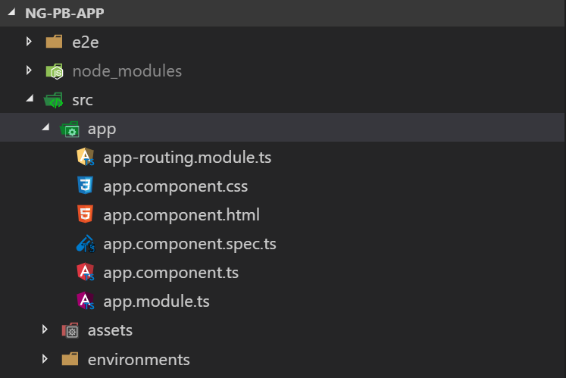
structure
root component
main module
Notes:
Root HTML (host) - index.html
Entry point – main.ts
Main Module—app.module.ts
Root component - AppComponent
Angular CLI config

Slide 11
?

Slide 12
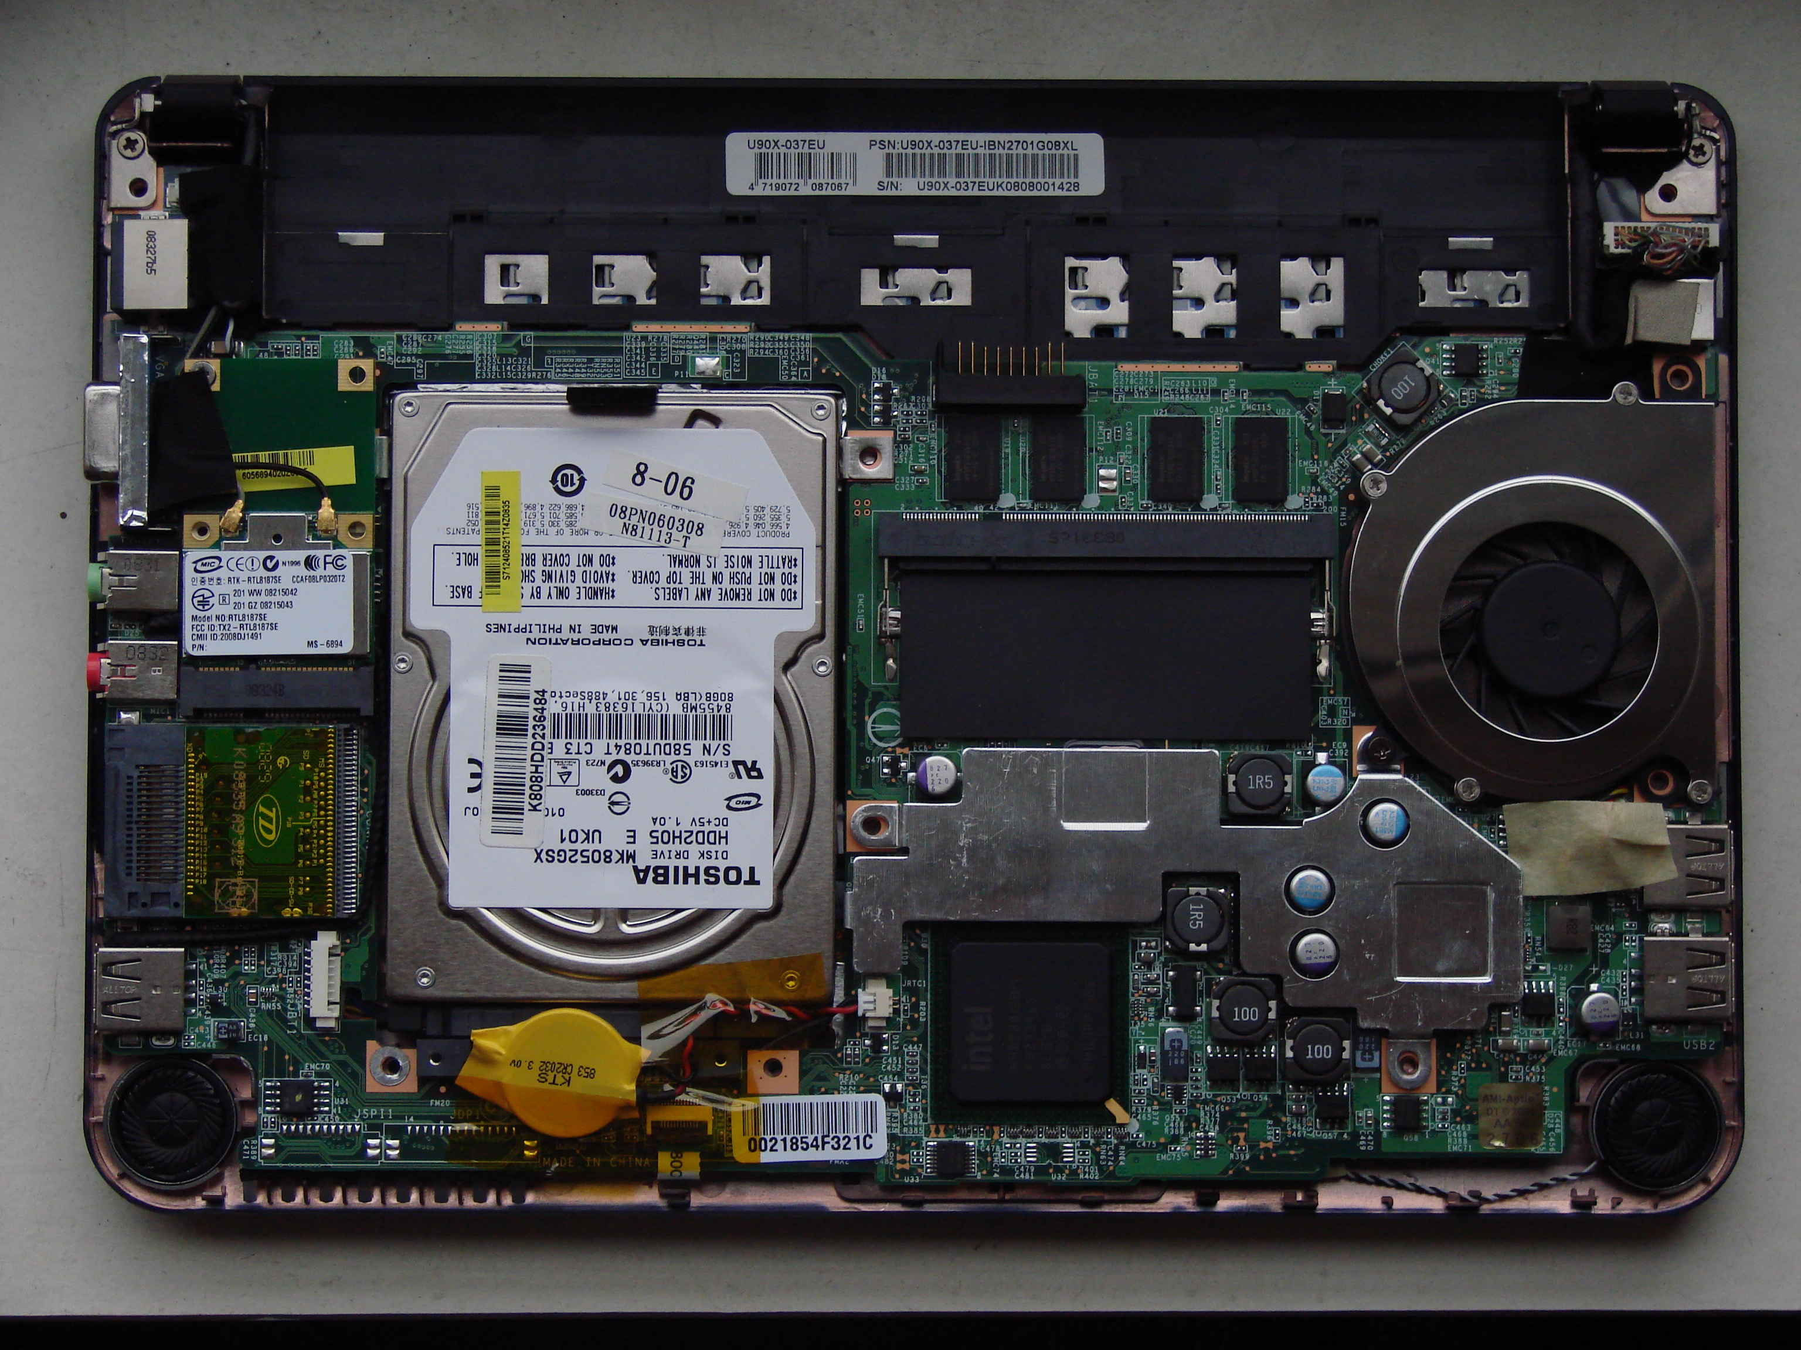
component internals
Notes:
https://commons.wikimedia.org/wiki/File:Msi_wind_netbook_U90x_internals.jpg

Slide 13
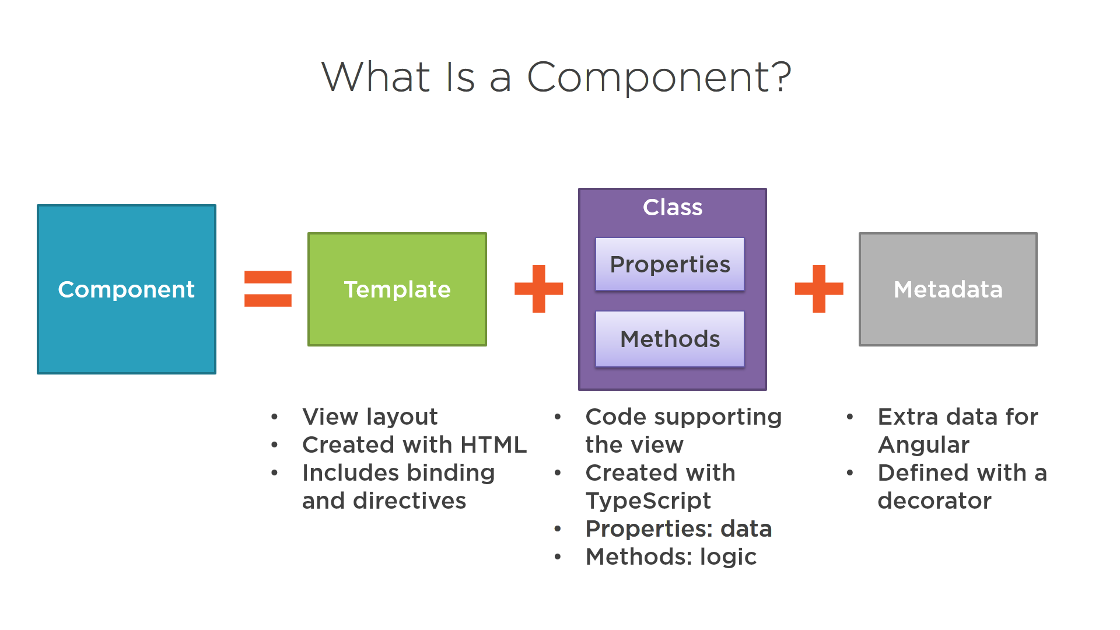

Slide 14
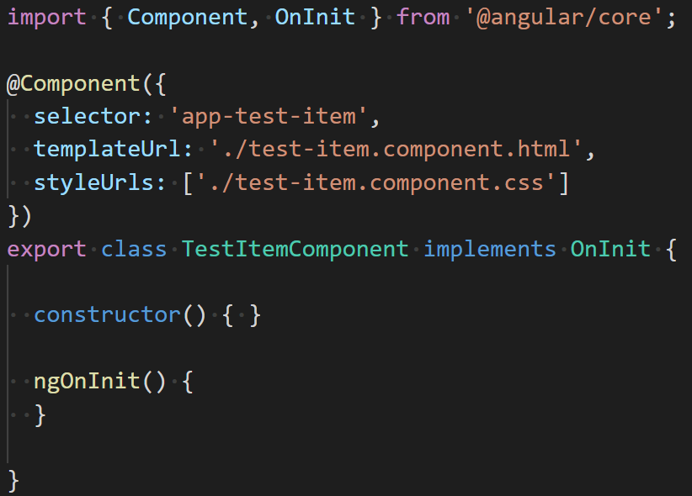
component fundamentals
component decorator
selector name
template & style
component internals

Slide 15
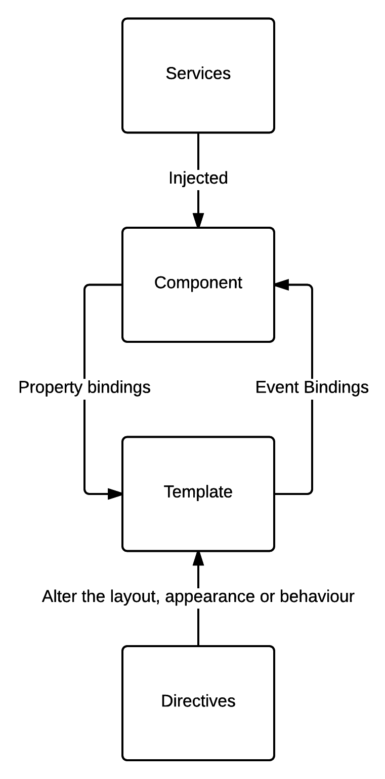
component internals
model definition
template html
depending classes injection
expression interpolation {{}}
(input) property binding [*]
output event binding (*), $event
build-in directives
Notes:
property != attribute

Slide 16
angular binding infrastructure
{{interpolation}}
[property /attribute binding]
class binding ngClass [class.name]
style binding ngStyle [style.name]
(event binding)

Slide 17
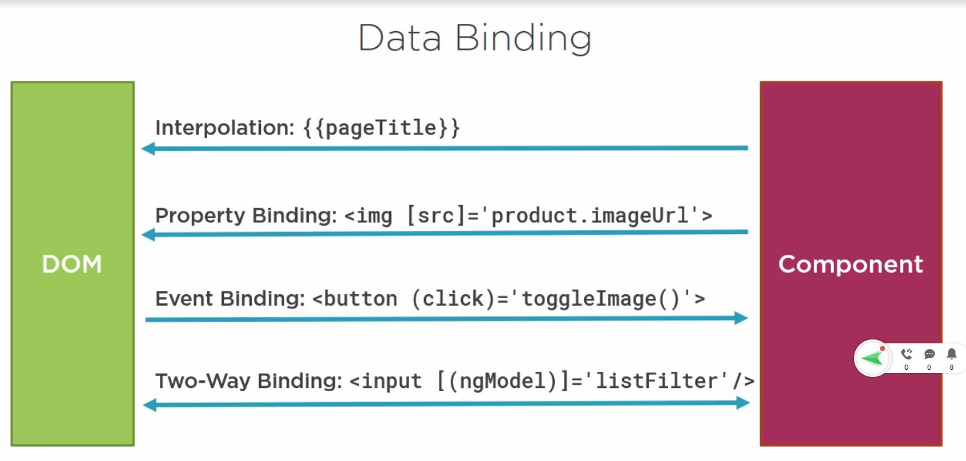
Notes:
http://www.prathapkudupublog.com/2017/01/data-binding-in-angular-2.html

Slide 18
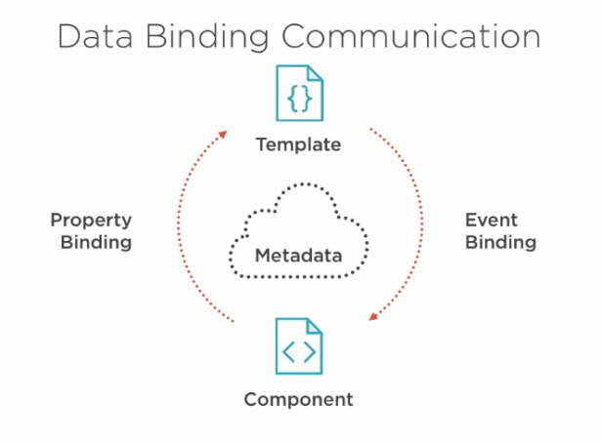
property binding
Notes:
https://hahoangv.wordpress.com/2016/05/30/display-data-in-angular-2/

Slide 19
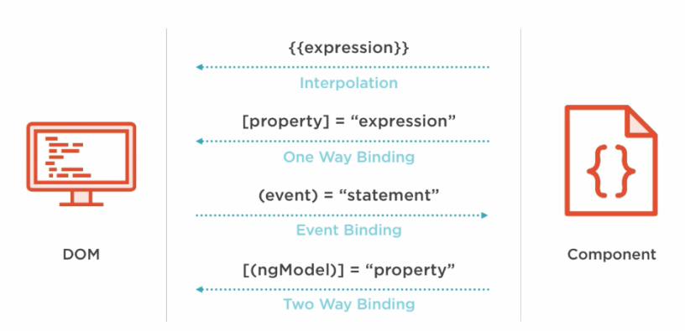
component data flows
Notes:
https://hahoangv.wordpress.com/2016/05/30/display-data-in-angular-2/

Slide 20
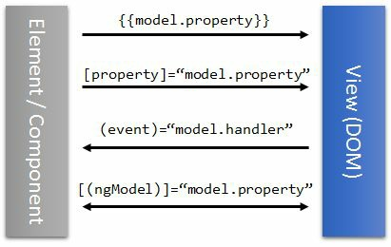
component data flows

Slide 21
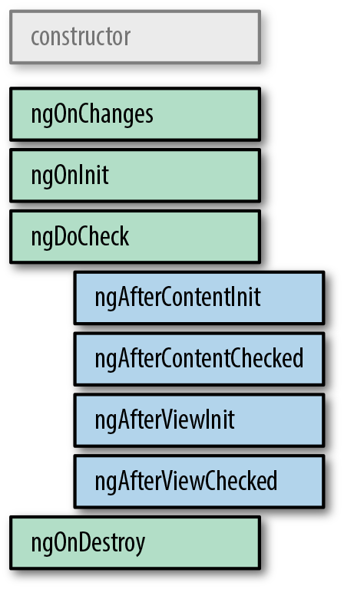
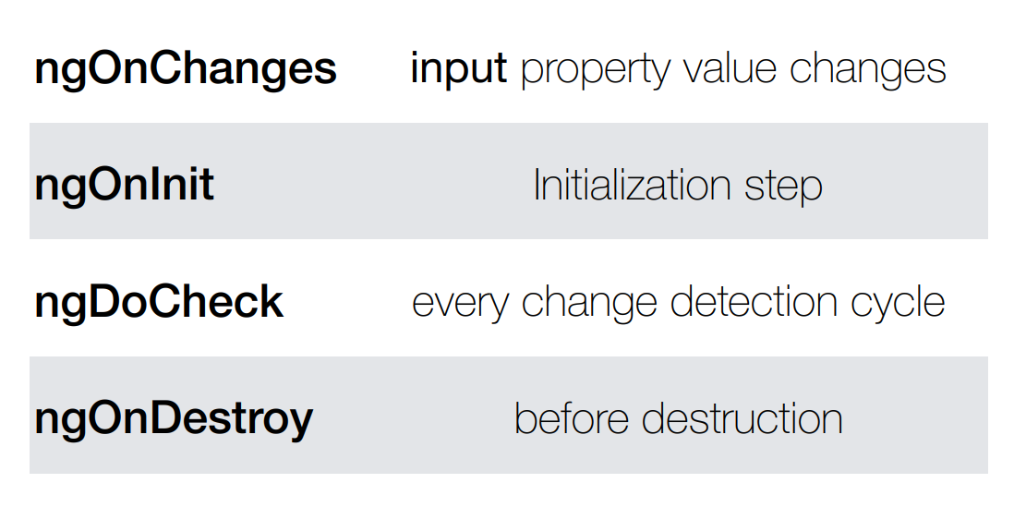
component lifecycle
Notes:
https://angular.io/guide/lifecycle-hooks

Slide 22
interfaces and methods
interface | method | description
OnChanges | ngOnChanges | Called when an input or output binding value changes
OnInit | ngOnInit | After the first ngOnChanges
DoCheck | ngDoCheck | Developer’s custom change detection
AfterContentInit | ngAfterContentInit | After component content initialized
AfterContentChecked | ngAfterContentChecked | After every check of component content
AfterViewInit | ngAfterViewInit | After component's view(s) are initialized
AfterViewChecked | ngAfterViewChecked | After every check of a component's view(s)
OnDestroy | ngOnDestroy | Just before the directive is destroyed

Slide 23
Interface | Method | Applicable to | Purpose
OnChanges | ngOnChanges(changes: SimpleChange) | Components and directives | ngOnChanges is called both right after the constructor to set and then later every time the input properties to a directive change. It is called before the ngOnInit method.
OnInit | ngOnInit() | Components and directives | This is your typical initialization hook, allowing you to do any one-time initialization specific to your component or directive. This is the ideal place to load data from the server and so on, rather than the constructor, both for separation of concerns as well as testability.
DoCheck | ngDoCheck() | Components and directives | DoCheck is Angular’s way of giving the component a way to check if there are any bindings or changes that Angular can’t or should not detect on its own. This is one of the ways we can use to notify Angular of a change in the component, when we override the defaultChangeDetectionStrategy for a component from Default toOnPush.
After​Con⁠tent​Init | ngAfterContent​Init() | Components only | As mentioned, the AfterContentInit hook is triggered during component projection cases, and only once during initialization of the component. If there is no projection, this is triggered immediately.
After​Con⁠tent​Checked | ngAfterContent​Checked() | Components only | AfterContentChecked is triggered each time Angular’s change detection cycle executes, and in case it is initialization, it is triggered right after the AfterContentInithook.
AfterView​Init | ngAfterView​Init() | Components only | AfterViewInit is the complement to AfterContent​Init, and is triggered after all the child components that are directly used in the template of the component are finished initializing and their views updated with bindings. This may not necessarily mean that the views are rendered into the browser, but that Angular has finished updating its internal views to render as soon as possible. AfterViewInit is triggered only once during the load of the component.
AfterViewChecked | ngAfterViewChecked() | Components only | AfterViewChecked is triggered each time after all the child components have been checked and updated. Again, a good way to think about both this and AfterContent​Checked is like a depth-first tree traversal, in that it will execute only after all the children components’AfterViewChecked hooks have finished executing.
OnDestroy | ngOnDestroy() | Components and directives | The OnDestroy hook is called when a component is about to be destroyed and removed from the UI. It is a good place to do all cleanup, like unsubscribing any listeners you may have initialized and the like. It is generally good practice to clean up anything that you have registered (timers, observables, etc.) as part of the component.

Slide 24
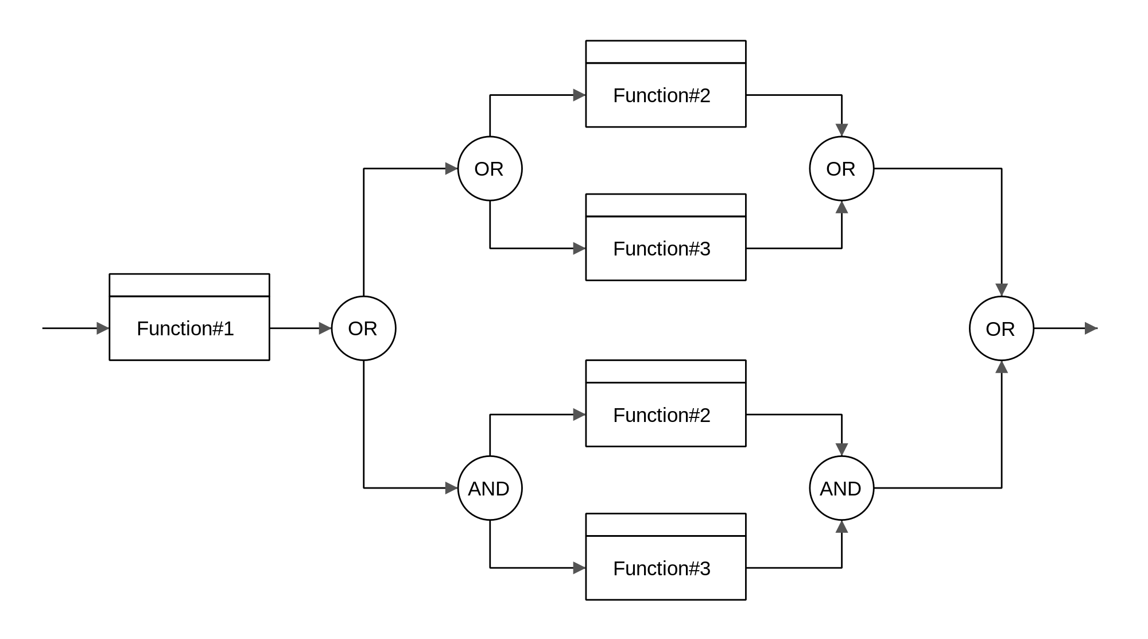
flow
(component
vommunication)
Notes:
https://commons.wikimedia.org/wiki/File:Msi_wind_netbook_U90x_internals.jpg

Slide 25
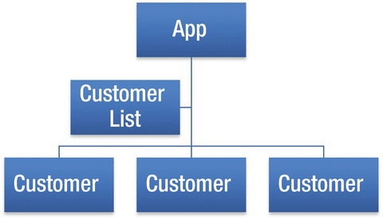
hierarchy of components

Slide 26
component communication
parent component
passing data via properties
emmiting custom events
(events)
[properties]
child component
Notes:
1-way data flow

Slide 27
component communication
parent component
referencing with a local variable
querying child components
@ViewChildren(…)
@ContentChildren(…)
#variable
variable
.action()
child component
Notes:
1-way data flow

Slide 28
component communication
parent component
dependency cycle with forwardRef
forwardRef()
child component
Notes:
1-way data flow

Slide 29
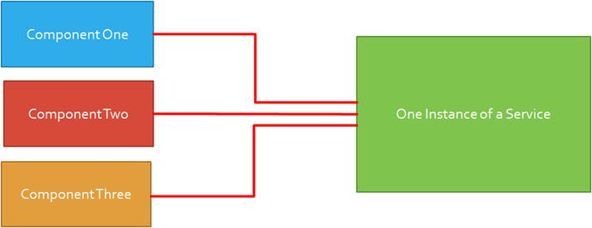
component communication
via service
Notes:
1-way data flow

Slide 30

https://github.com/Banndzior
#slack
kamil.mijacz@gmail.com
kamil.mijacz@softwarehut.com
Notes:
https://www.flickr.com/photos/jeffdjevdet/18027482924

