Slide 1

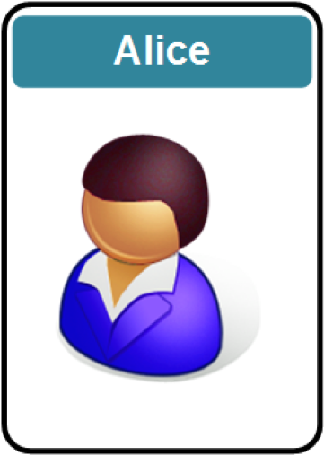
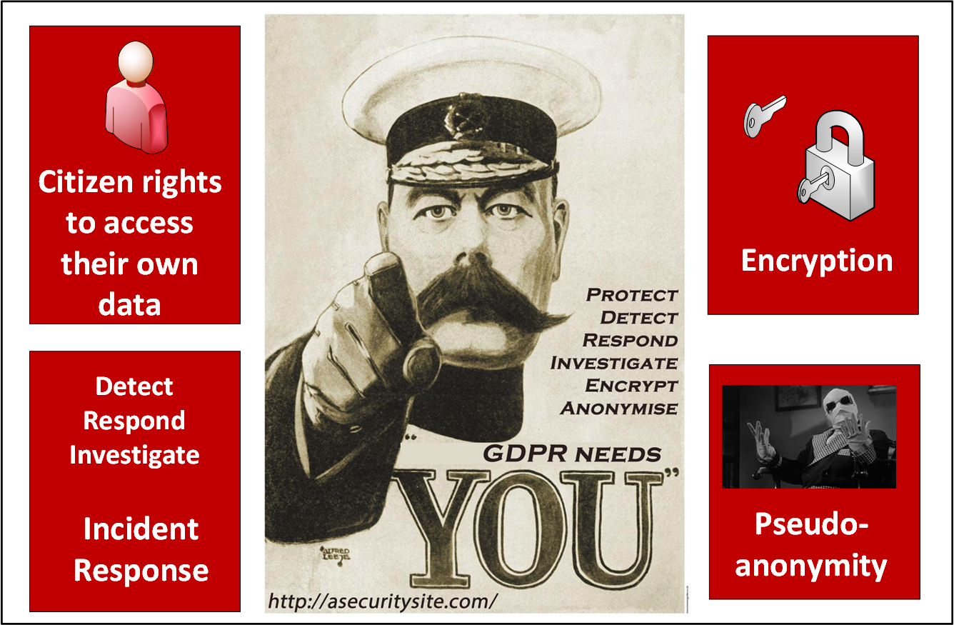
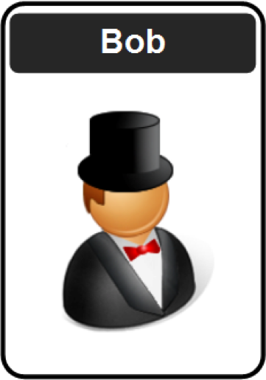
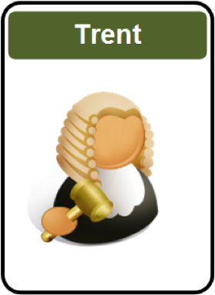
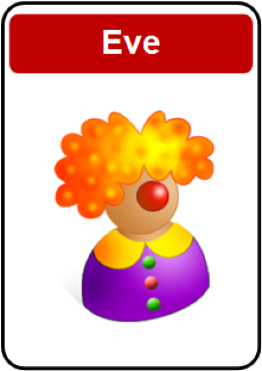
Applied Crypto: Introduction
1. Cryptography Fundamentals. 2. Symmetric Key Encryption. 3. Hashing and MAC.
4. Asymmetric (Public) Key Encryption.
5. Key Exchange.
6. Trust and Digital Certificates.
7. Tunnelling.
8. Cryptocurrencies and Blockchain.
9. Future Cryptography.
10. Host Security. Prof Bill Buchanan OBE https://asecuritysite.com/encryption https://github.com/billbuchanan/appliedcrypto

Slide 2

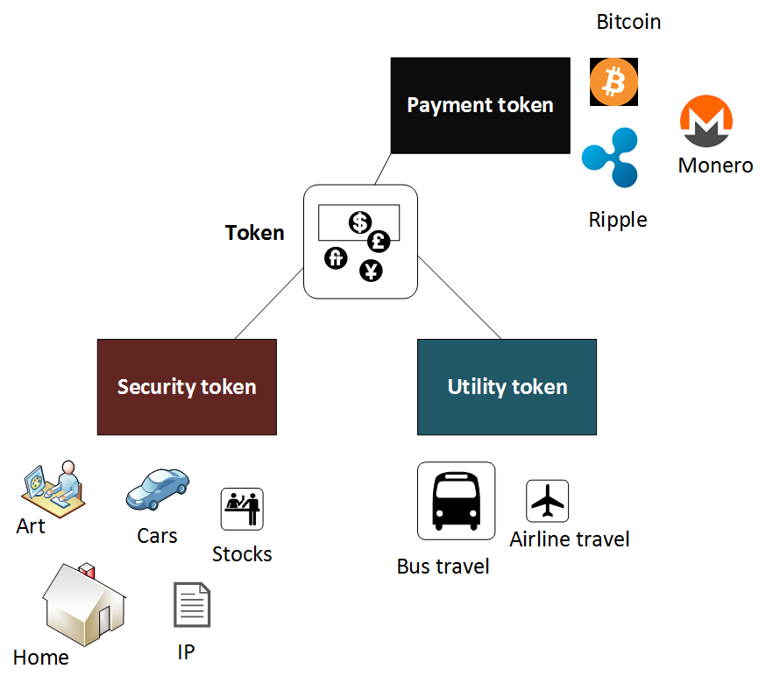

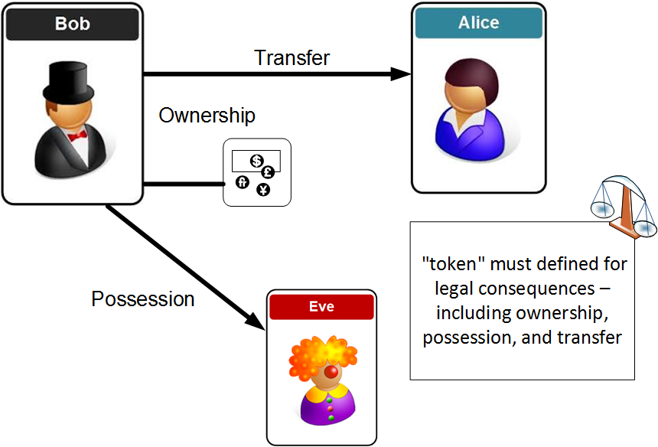

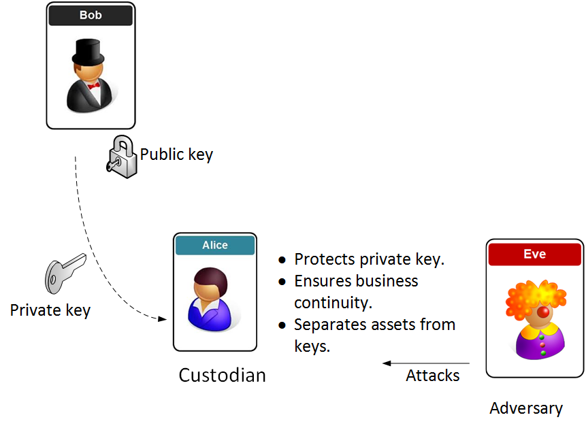

A Tokenized World …

Slide 3

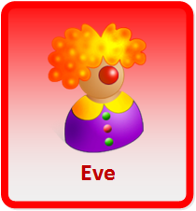
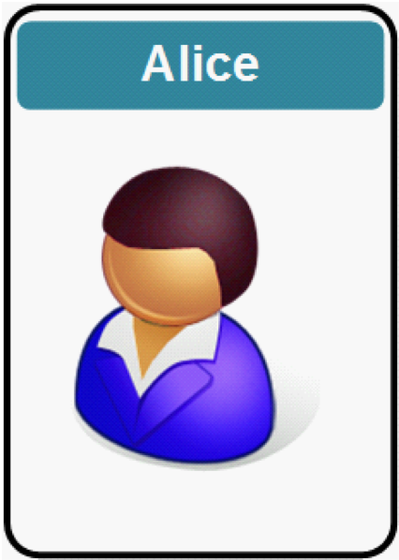
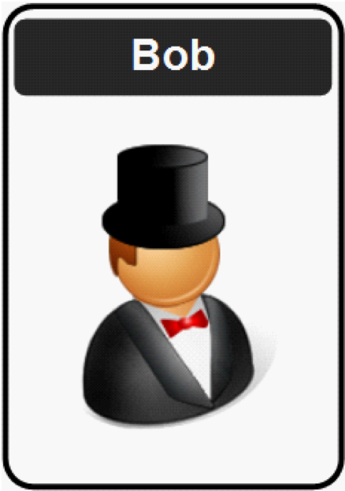
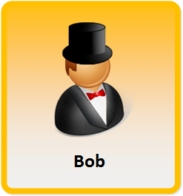
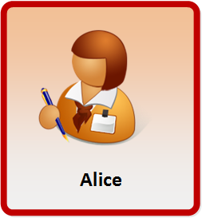
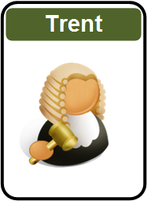
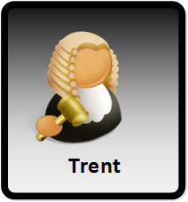
Disclaimer
Encryption works great, until it doesn't.
Encryption works great, as long as no one makes a mistake.
Encryption works great, unless something goes wrong.
Encryption works great, as long as everything works right.

Slide 4






Module Delivery
Web site
youtube.com
Teams
Overleaf
@billatnapier
asecuritysite.com
github.com/billbuchanan/appliedcrypto

Slide 5




Module Delivery
Web site
youtube.com
Overleaf
Lectures/Lab Demos
Coursework submission
Labs
github.com/billbuchanan/appliedcrypto

Slide 6
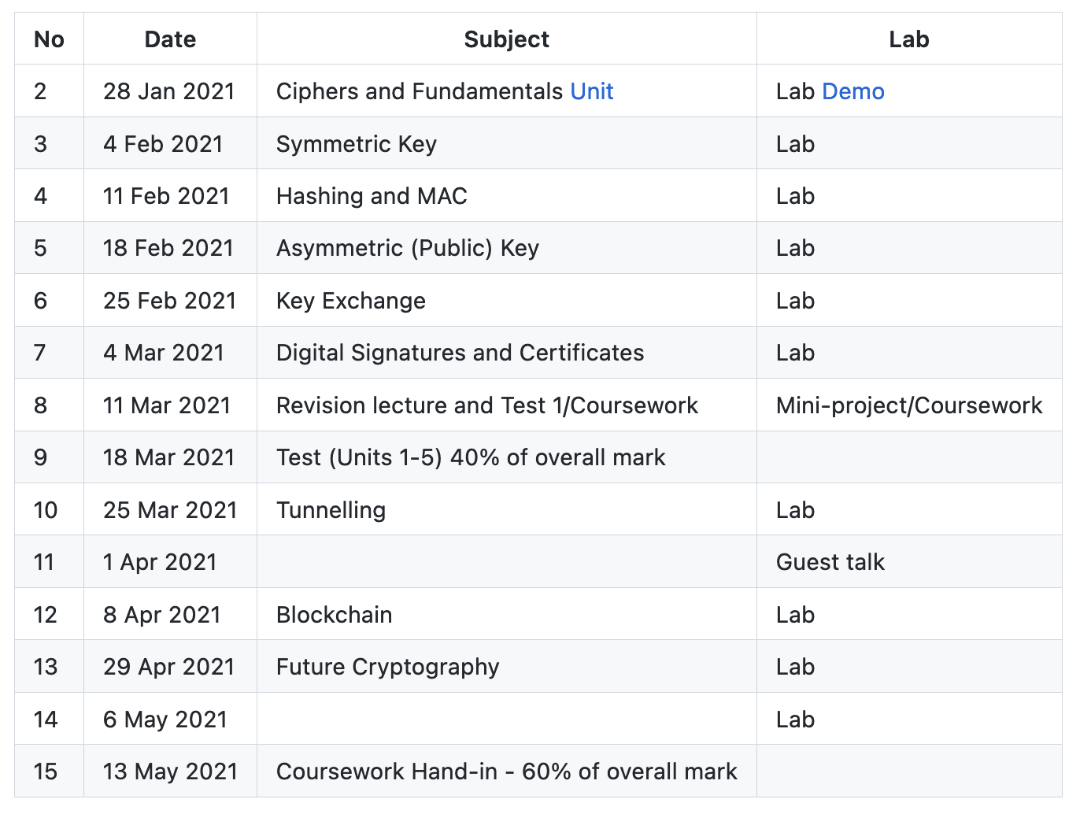
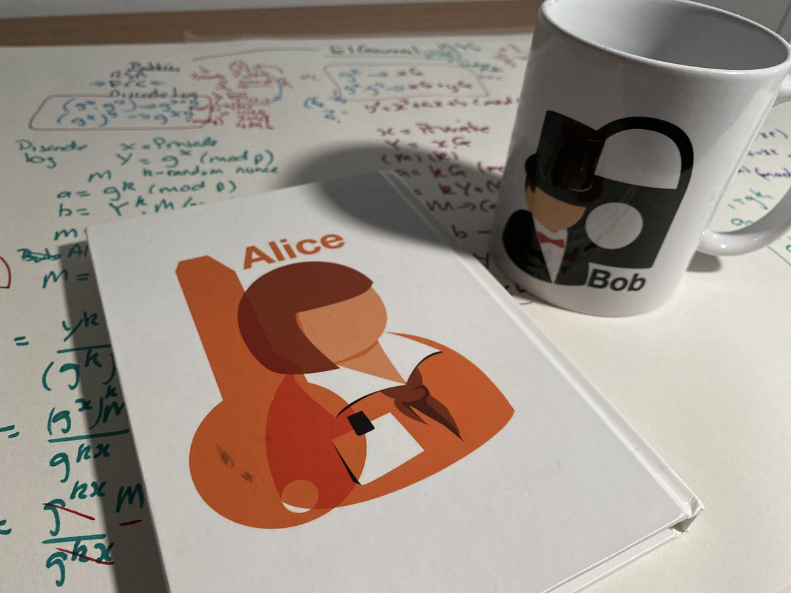
Draft Timetable
Web site

Slide 7
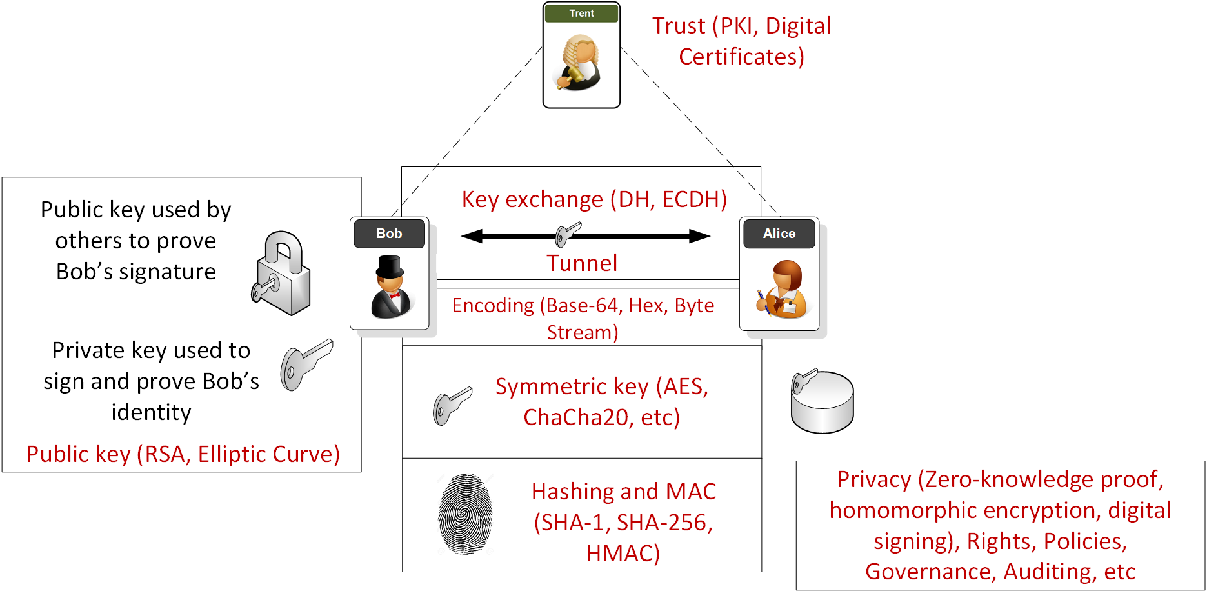
Overview

Slide 8
1. Fundamentals Traditional Ciphers. Key-based Encryption. Encoding Methods. Frequency Analysis. GCD. Random Numbers. Prime Numbers. Big Integers. Encryption Operators (MOD, XOR and Shift). Prof Bill Buchanan OBE https://asecuritysite.com/

Slide 9
2. Symmetric Key Basics Block or Stream? Secret Key Methods Salting AES 3DES
ChaCha20/Poly1305 Key Entropy Prof Bill Buchanan OBE https://asecuritysite.com/

Slide 10
3. Hashing and MAC Hashing Methods. Cracking. Typical Methods: MD5, SHA-1, SHA-3, LM, Bcrypt, PBKDF2 Hashed Passwords. Timed One Time Passwords. Message Authentication Codes (MACs). Prof Bill Buchanan OBE https://asecuritysite.com/

Slide 11
4. Asymmetric Key Principles. RSA. Elliptic Curve. Using Private Key to Authenticate. PGP: Signed Email. Prof Bill Buchanan OBE https://asecuritysite.com/

Slide 12
5. Key Exchange Principles. Diffie-Hellman (DH). Passing the secret key with key exchange.
Elliptic Curve Diffie-Hellman (ECDH) Prof Bill Buchanan OBE https://asecuritysite.com/

Slide 13
6. Signatures and Digital Certificates Principles.
Trust Infrastructures. PKI Infrastructure. Creating Signed Certificates.
Signatures (ECDSA, Hashed-based). Prof Bill Buchanan OBE https://asecuritysite.com/

Slide 14
7. Tunnelling SSL/TLS.
Key generation/key exchange.
SSH.
IPSec.
Prof Bill Buchanan OBE https://asecuritysite.com/

Slide 15
8. Blockchain & Cryptocurrencies Principles. Bitcoin. Ethereum. Smart Contracts. Prof Bill Buchanan OBE https://asecuritysite.com/

Slide 16
9. Future Crypto Zero knowledge proof.
Homomorphic encryption.
Light-weight crypto.
Quantum-robust cryptography. Prof Bill Buchanan OBE https://asecuritysite.com/

Slide 17
Applied Cryptography
1. Cryptography Fundamentals. 2. Symmetric Key Encryption. 3. Hashing and MAC.
4. Asymmetric (Public) Key Encryption.
5. Key Exchange.
6. Trust and Digital Certificates.
7. Tunnelling.
8. Cryptocurrencies and Blockchain.
9. Future Cryptography. Prof Bill Buchanan OBE https://asecuritysite.com/ https://github.com/billbuchanan/appliedcrypto

