Slide 1
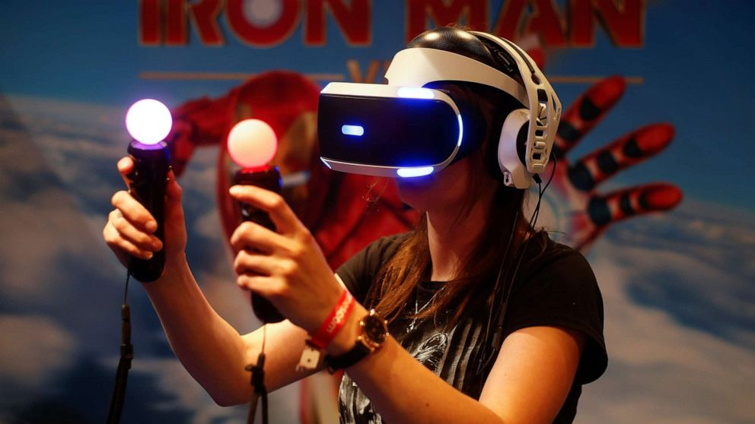
Cooktastrophe
A VR Gaming Experience
By Aisha, Jane, Karl and Tadhg

Slide 2
Application Idea
For our team project application idea, we produced the idea for a VR game which we have entitled “Cooktastrophe”.
This idea was born after brainstorming ideas for an application or game that we hoped everyone would be able to use.
We modelled it in the style of classic cooking and restaurant games like “Cooking Mama”, “Papa’s Pizzeria” and “Plate Up”.
We wanted it to be the kind of game that anybody and everybody could enjoy like Wii Sports where the whole family can get involved and the overall difficulty of the game isn’t too hard and it’s a relatively easy concept to understand.
With cute, retro style graphics, a calm, simple colour palette and light upbeat music we wanted it to have a nostalgic feel with added elements of modern games such as Minecraft. We wanted the main charm of Cooktastrophe to be its simplicity yet enjoyability.

Slide 3
Business plan
For our business plan as outlined in the big idea sketch pad our core competency was the VR experience of the game.
The offering experienced as a fun game for people of all ages to enjoy.
The offering being important to the buyer because the gaming market is a very big one and creating a game in which people of all ages may play and enjoy themselves that again further expands our market for the game.

Slide 4
Technologies, software and tools
The technologies software and tools being used for this project are:
VR Headsets (To play the game)
C#(Csharp for the coding of the game)
Unity(For the making of the game scenes, importing objects, overall look)
Blockbench(Used for creating objects within the game)
Github(For sharing and editing files between the group members)
Word(Writing up files such as the specification requirements)
PowerPoint(For creating our mid-point and final presentations)
Visual Studio Code(Text editor used for code)

Slide 5
Progress plan & current progress
Proposal
Specification Requirements

Slide 6
Challenges we’ve faced
Some challenges we have faced as a group are firstly our different skill sets.
We all possess different skill sets which have made working on this project a little more difficult than we would have liked. For example, only one of our group members Tadhg has much experience in making games the rest of us had to devote a lot of time into first figuring out how to make games with unity and first figure out how to use Blockbench etc

Slide 7
Q and A Session
Any questions ?

