Slide 1
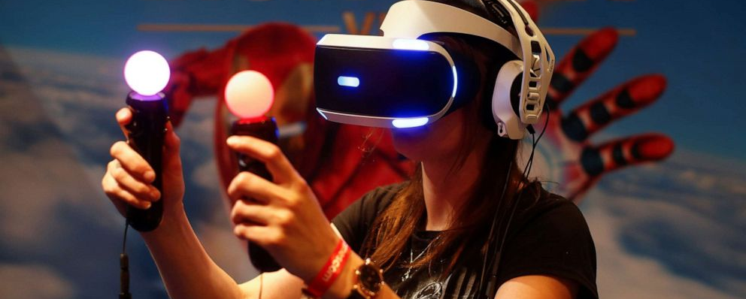
Cooktastrophe
A VR Gaming Experience
By Aisha, Jane, Karl and Tadhg

Slide 2
Application Idea
For our team project application idea, we produced the idea for a VR game which we have entitled “Cooktastrophe”.
This idea was born after brainstorming ideas for an application or game that we hoped everyone would be able to use.
We modelled it in the style of classic cooking and restaurant games like “Cooking Mama”, “Papa’s Pizzeria” and “Plate Up”.
We wanted it to be the kind of game that anybody and everybody could enjoy like Wii Sports where the whole family can get involved and the overall difficulty of the game isn’t too hard and it’s a relatively easy concept to understand.

Slide 3
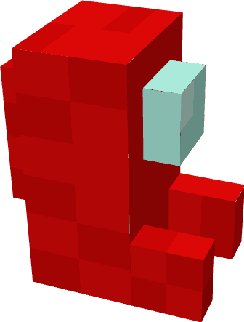
Stylization choice
We decided to go with a simple voxel art style mainly for it being a fairly easy way to make simple yet appealing objects that would catch the players eye but not so it would be distracting as a result.
The colour choice was rather simple because we were going for a bright and bubbly atmosphere for our game, this way it will be appealing to most audiences.
With cute, retro style graphics, a calm, simple colour palette and light upbeat music we wanted it to have a nostalgic feel with added elements of modern games such as Minecraft. We wanted the main charm of Cooktastrophe to be its simplicity yet enjoyability.
The software we use is called Blockbench, Blockbench is mostly used for simple cube shapes but does have more complicated “Mesh” features for other shapes, Fun fact this is the same software that Minecraft uses for their models and blocks.

Slide 4
Business plan
:Initially we release the game on Steam, Along with a free trial so people can try the game and see if they want to buy it.
:If sales are to a satisfactory degree we can also push the game onto other platforms such as PlayStation and Xbox.
:In the future we can have Downloadable content for our game and In game timed events for specific dishes themed around said time like Christmas can have turkey etc.
:Selling a special collectors bundle that could contain the game, A specialized artbook, and a download code for the soundtrack along with some special cosmetics for your kitchen.
:Possibly for the future we can make more kitchen layouts and paid cosmetics for changing the style of your kitchen.

Slide 5


Technologies, software and tools
The technologies software and tools being used for this project are:
Unity, the game engine our game is made with
C#, the programming language used to create Unity games
Head-Mounted Displays (HMDs), the target hardware
Blockbench, a voxel modelling software used for most in-game models
Blender, a general-use modelling software used to animate a select few models
Git and Github, the Version Control system used for file management between team members

Slide 6
Progress plan & current progress
We currently have the code for 3 Appliances, a system for moving appliances around the resteraunt, a system for defining food items and how they can be combined, and the groundwork for customer AI.
The AI will be improved to allow for multiple ways to take an order, dynamically order food based on what the restraint serves, as well as reward the player based on how quickly they were served
The gameplay will be split into 2 phases, Renovation and Dining. Appliances will only be purchasable and movable in the Renovation phase, and everything except Appliance movement/purchasing will happen during the dining phase.

Slide 7
Challenges we’ve faced
Some challenges we have faced as a group is the fact we needed to learn how to use unity effectively, 3 out of 4 of us have never touched Unity before, Fortunately Tadhg is very well versed in Csharp and has been teaching us how to use Unity and how to code in Csharp.
Next up was designing our Game, as previously mentioned we use Blockbench for our design needs, This was mostly for Karl since he is the one who is making most of the models for the game but we all needed to learn it since we have all been making models for this project.
A large problem is that there is only one of us that can test the gameplay because Out of the four of us Tadhg is the only one with a VR headset since the game is strictly in VR.

Slide 8
Q and A Session
Thank you for listening!, Any questions?

