Slide 1
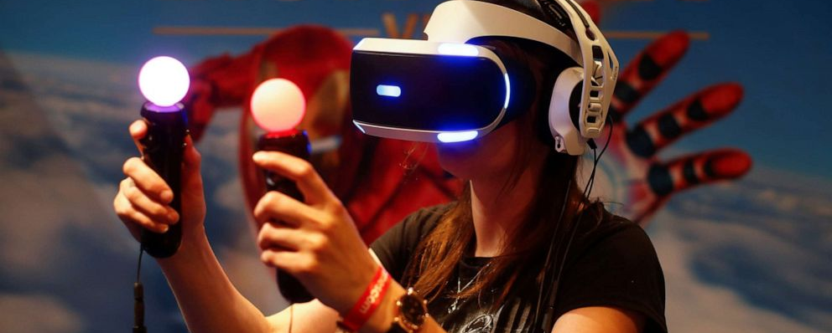
Cooktastrophe
A VR Gaming Experience
By Aisha, Jane, Karl and Tadhg

Slide 2
Application Idea
For our team project application idea, we produced the idea for a VR game which we have entitled “Cooktastrophe”.
This idea was born after brainstorming ideas for an application or game that we hoped everyone would be able to use.
We modelled it in the style of classic cooking and restaurant games like “Cooking Mama”, “Papa’s Pizzeria” and “Plate Up”.
We wanted it to be the kind of game that anybody and everybody could enjoy like Wii Sports where the whole family can get involved and the overall difficulty of the game isn’t too hard and it’s a relatively easy concept to understand.

Slide 3
Target Audience
For our target audience as we also previously outlined in our application idea. We really wanted to create an application that could be enjoyed by all.
We wanted it to be the kind of game that anybody could easily understand and quickly learn how to play no matter their age. Such as Wii Sports, which is known for providing fun for all the family from ages 6+ which we have identified as one of our inspirations for the game.
Although VR headsets are typically not recommended for children under 12 years of age. So, we would place our age rating at 12+ but we hope for the game to be enjoyed by people of all ages.

Slide 4


Technologies, software and tools
The technologies software and tools being used for this project are:
Unity, the game engine our game is made with
C#, the programming language used to create Unity games
Head-Mounted Displays (HMDs), the target hardware
Blockbench, a voxel modelling software used for most in-game models
Blender, a general-use modelling software used to animate a select few models
Git and Github, the Version Control system used for file management between team members

Slide 5
Who Did What ?
As we have mentioned previously Tadhg is our resident expert when it comes to creating and designing games and definitely spearheaded the majority of the coding and creation of the game in Unity and recording the demo videos.
Karl led us in the design area when it came to modelling in Blockbench and the overall look and feel for our game while also helping with documentation such as Powerpoints, diagram drawing, the wireframe and our initial project proposal.
Jane contributed to the project through writing up documentation, Blockbench modelling, diagram drawing and coding.
Aisha played her role by completing the technical report and other documentation write ups, Blockbench modelling, coding, diagram drawing, the idea sketchpad and Powerpoints.

Slide 6
Challenges we’ve faced and how we’ve overcome them
Some challenges we have faced as a group is the fact we needed to learn how to use unity effectively, 3 out of 4 of us have never touched Unity before, Fortunately Tadhg is very well versed in Csharp and has been teaching us how to use Unity and how to code in Csharp.
Next up was designing our Game, as previously mentioned we use Blockbench for our design needs, This was mostly for Karl since he is the one who is making most of the models for the game, but we all needed to learn it since we have all been making models for this project.
A large problem is that there is only one of us that can test the gameplay because Out of the four of us Tadhg is the only one with a VR headset since the game is strictly in VR.
We had our fair share of challenges pop up but managed to get a handle on them through patience, understanding, time and practice. Whether that was through more practice with Blockbench or having Tadhg guide us through coding the game.

Slide 7
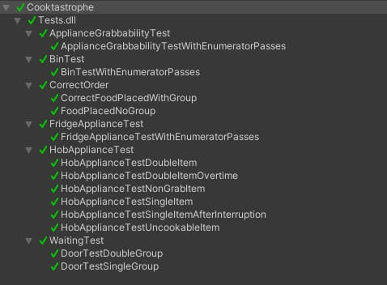
Completed Testing
Overview of completed successful tests
Live demonstration of unit tests

Slide 8
Who did what testing?
We all worked on equal parts of the testing.
Tadhg worked on making sure objects wouldn’t be able to be grabbed when starting a day in the game, He also worked on the hob appliances and how it works with food.
Aisha worked on how the Fridge holds and infinite supply of meat and they ability to grab food out of it, She also was testing to make sure the bin works accordingly to throwing unusable/unwanted food.
Karl worked on how the customers interact with the tables, Such as waiting at the doors depending on if there is an empty table, the customers will form a line if there is already a customer(s) in line waiting for a seat.
Jane was testing to see if the customers leave if they are given the food that they want or seeing if they stay at the table if they are given the incorrect food.

Slide 9
Pre-recorded demo video
https://drive.google.com/file/d/1BIrGVNEsN8nozrUCbU7HQbYSIlp6N1BC/view?usp=sharing

Slide 10
Q and A Session
Thank you for listening!, Any questions?

