Slide 1

SmartGreenHouse
Tommaso Giorgi

Slide 2





Introduction
Different sensor can be used inside a greenhouse. Monitoring them can help the appearance and shape, material metabolism, growth and development, quality, and yield of plants.
Data that can be monitored:
Temperature
Humidity
Soil PH
Soil Moisture
Light

Slide 3
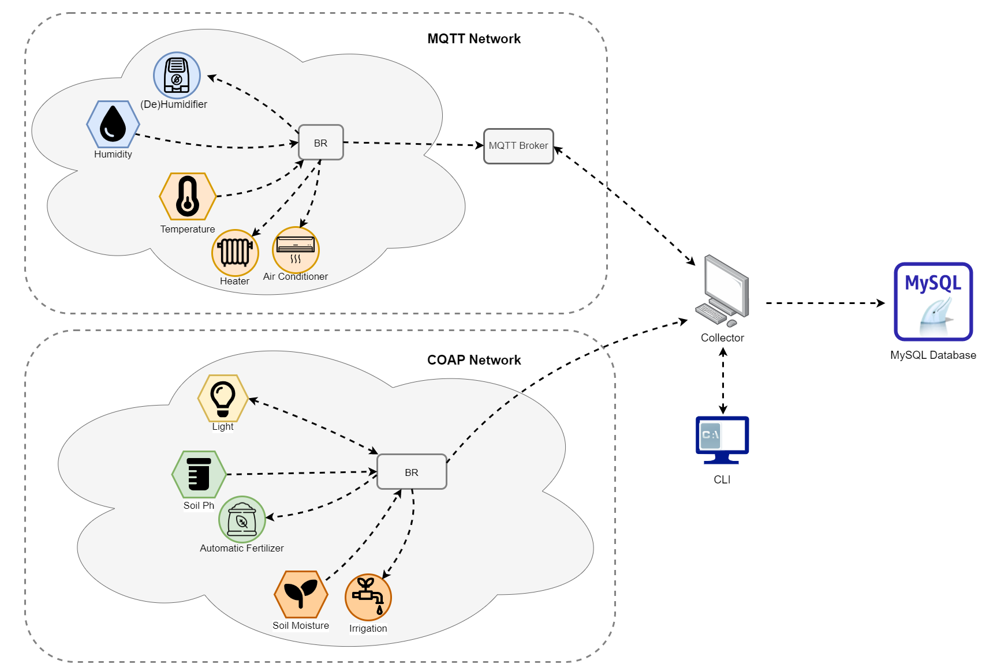
System Architecture
Two sensors networks have been used:
MQTT Network
Humidity + (De)Humidifier
Temperature + Heater/Air Conditioner
COAP Network
Light Sensor
Soil PH + Automatic Fertilizer
Soil Moisture + Irrigation System
Data are collected from the border router and sent to the Java Application (Collector)
The collector stores data on a MySQL database and exposes a CLI with commands that can be used to perform different actions with the sensors

Slide 4



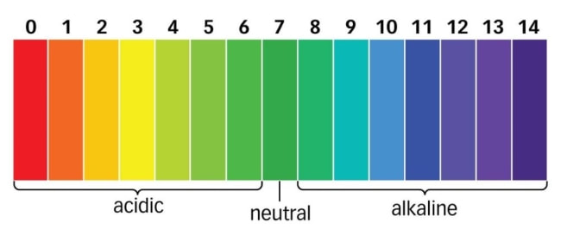

COAP
Soil PH
Soil Moisture
Light
Correct range
$$Soil moisture value = \frac{Wet Soil Weight}{Dry Soil Weight}$$
/light/light
GET: retrieve the current light intensity value
PUT intensity=<0,1,2>
Turn on or off the lights with the specified intensity
/soilph/sensorph
GET: retrieve the current soil ph value
EVENT: we want to notify observers about change of the sensor (change over time to simulate real behaviour)
/soilph/fertilizer
PUT quantity=<0,1,2,3>
Turn on or off the fertilizer with the specified quantity
/soilmoisture/moisture
GET: retrieve the current soil moisture value
EVENT: we want to notify observers about change of the sensor (change over time to simulate real behaviour)
/ soilmoisture /irrigation
PUT mode=<ON,OFF>
Turn on or off the Irrigation System
Intensity = 0
Intensity = 1
Intensity = 2

Slide 5


MQTT
Humidity
Temperature
humidity_s [TOPIC]
Topic in which the different values of the humidity are posted
humidity_act [TOPIC]
Topic used for commands:
ON_DEH: Turn on Dehumidifier
ON_HUM: Turn on Humidifier
OFF: Turn off all the actuators
temperature [TOPIC]
Topic in which the different values of the temperature are posted
actuator [TOPIC]
Topic used for commands:
ON_REF: Turn on Refrigerator
ON_HEA: Turn on Heater
OFF: Turn off all the actuators

Slide 6
Data Encoding
{
node_id = “nodeID”,
moisture_value = 1.48
}
{
node_id = “nodeID”,
ph_value = 8.37
}
All sensors return the data they have collected in JSON format:
JSON is lighter (less verbose and more flexible)
Better with little batteries devices
Non-text based format not fully supported on Contiki
{
node_id = “nodeID”,
humidity = 50
}
{
node_id = “nodeID”,
temperature = 24
}

