Slide 1
Heart disease: From Model Building to Deployment
Let’s talk about a special type of heartbreak!
1
Maximilien Eyengue

Slide 2
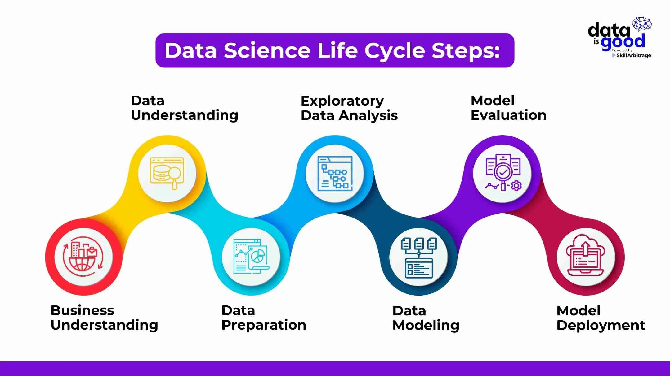
2
Maximilien Eyengue

Slide 3
Business Understanding
What?
So what?
Then what?
Disease
Diagnosis
Objective
33s
According to WHO, heart disease is the leading cause of deaths
Early prediction saves lives & reduces costs
Build a tool to accurately identify patients at risk
3
Maximilien Eyengue

Slide 4
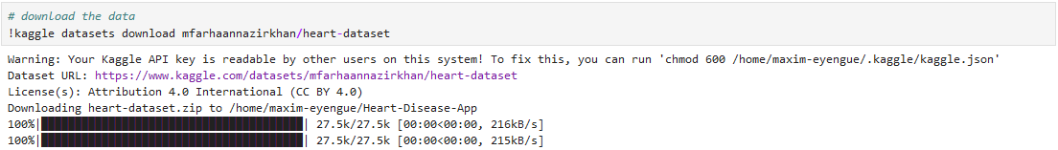
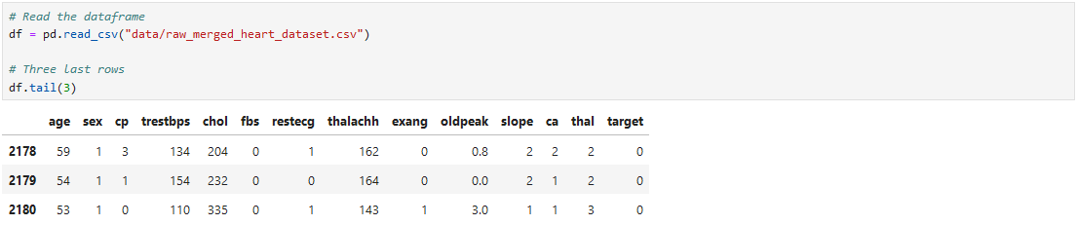
Data Understanding
Five datasets with patient data combined together for heart disease diagnosis
4
Maximilien Eyengue

Slide 5
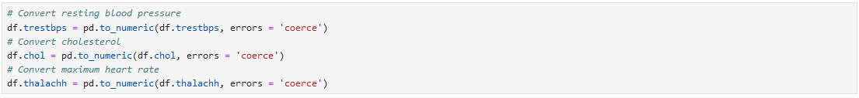
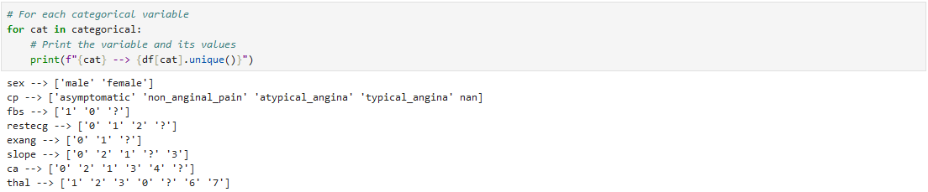
Data Preparation
No missing values? Watch out!
5
Maximilien Eyengue

Slide 6
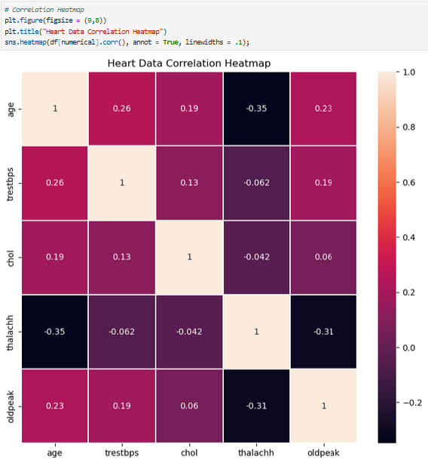
EDA
There is a low correlation between numerical features
6
Maximilien Eyengue

Slide 7
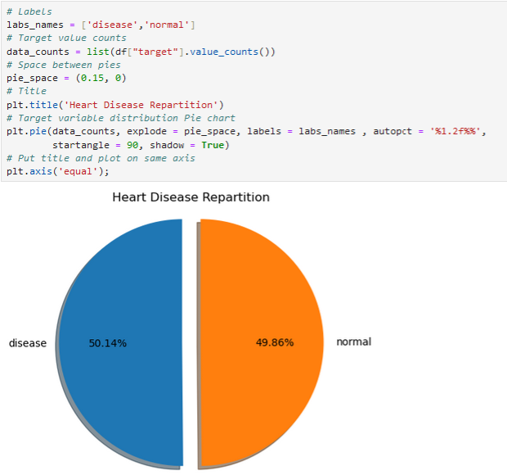
EDA -Target Analysis
The dataset contains approximately the same number of healthy and sick patients
Thus, we can use accuracy score to evaluate our models
7
Maximilien Eyengue

Slide 8
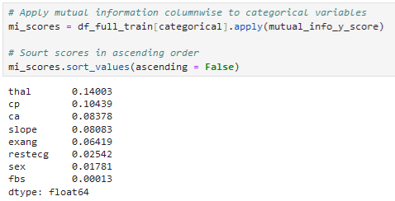
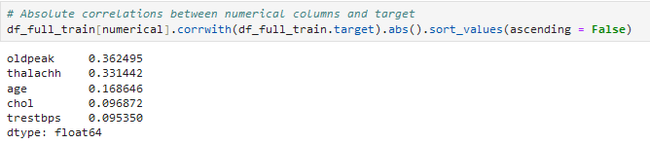
EDA – Feature Importance
Among categorical features, thalassemia and chest pain information seem to be the most important to determine the disease
The ST segment depression induced by exercise and the maximum heart rate are the most important numerical features
8
Maximilien Eyengue

Slide 9
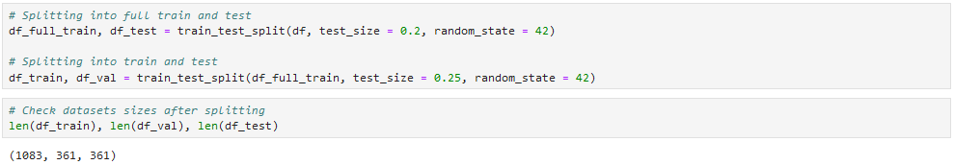
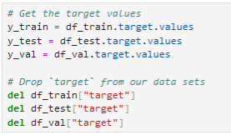
Data Modeling
Train – Validation – Test split:
Target & Features:
9
Maximilien Eyengue

Slide 10
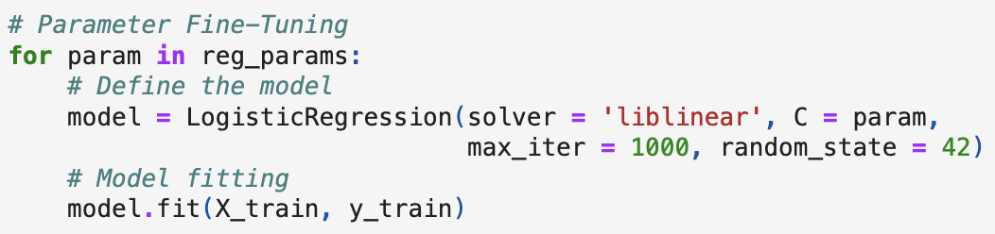
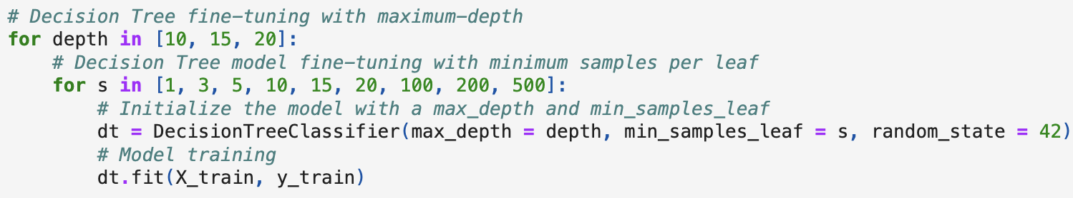
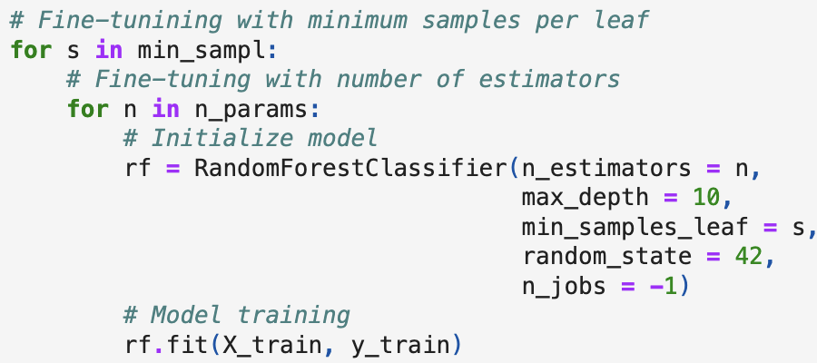
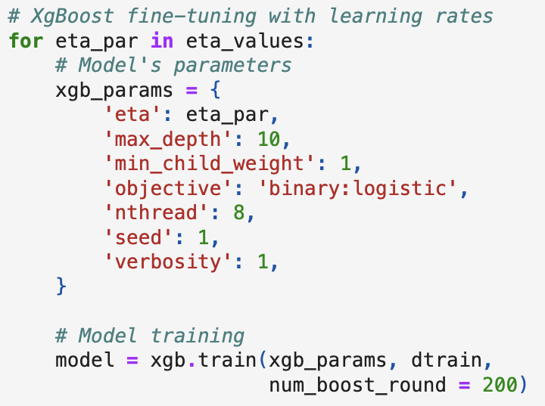
Data Modeling
Logistic Regression
Decision Tree
Random Forest
XG-Boost
97%
81%
98%
97%
10
Maximilien Eyengue

Slide 11
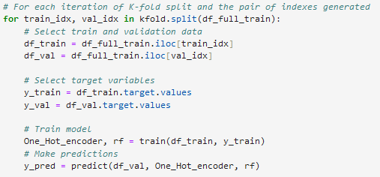
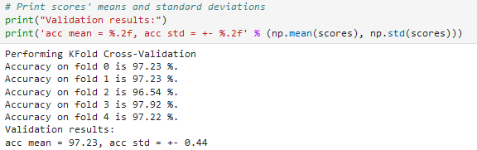
Model Evaluation
With K-Fold cross-validation, the selected model achieved an accuracy of 97.23%, with a standard deviation of 0.44
11
Maximilien Eyengue

Slide 12
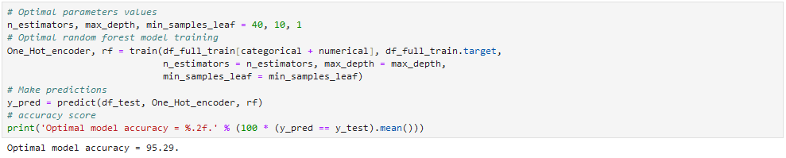
Model Evaluation
95.29%
The accuracy of our final model is very good:
Maximilien Eyengue
12

Slide 13



Model Deployment
To easily create an application for our model
To encapsulate the application
For deploying the application to the cloud
Maximilien Eyengue
13

Slide 14
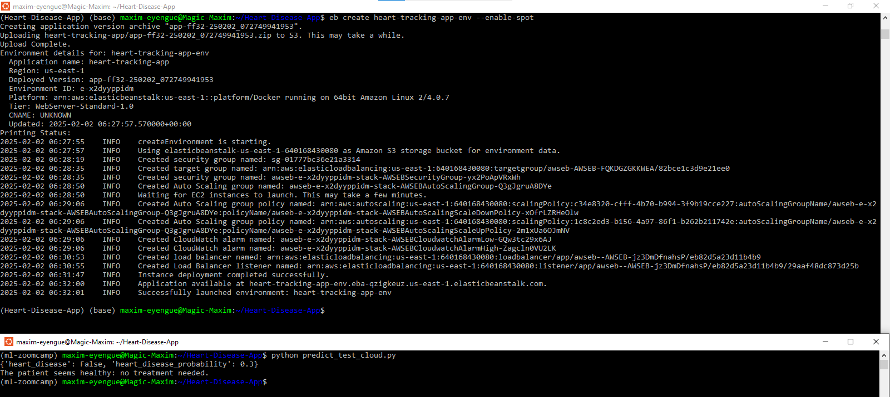
Model Deployment
Maximilien Eyengue
14

Slide 15
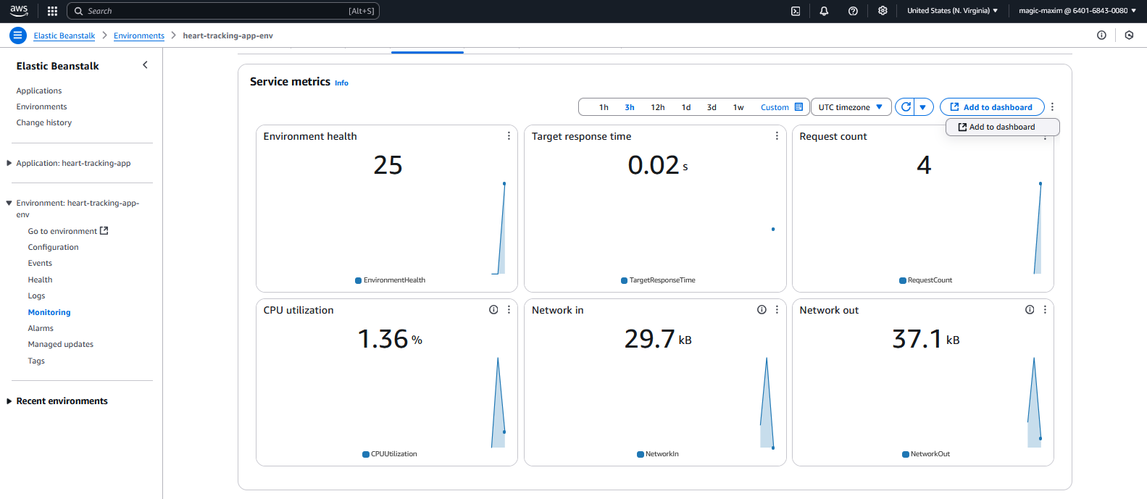
Model Deployment
Maximilien Eyengue
15

Slide 16
Key Takeaways
What to do
What not to do
● Be curious, judgmental and argumentative
● Think on how to improve
● Rush into projects
● Skip data cleaning
There is always room for improvement…
16
Maximilien Eyengue

Slide 17
?
17
Maximilien Eyengue

Slide 18



Thanks!
Do you have any questions? maximilien.boulou@aims-cameroon.org
+237 699 05 45 37
Thanks also to the DataTalks.Club
Github Project Link
18
Maximilien Eyengue

