Slide 1
Evaluate Technique for Wifi Locationing
Ubiqum – Task 3

Slide 2
Agenda
Background;
Objectives;
Data Management;
Dataset description;
Developed system description;
Models produced;
High-Level Recommendations;
Conclusions.

Slide 3
1. Background
A client is developing a wifi fingerprinting system to be deployed on a complex, unfamiliar interior space without getting lost;
Wifi fingerprinting uses the signals from multiple wifi hotspots within the building to determine location, analogously to how GPS uses satellite signals;
We have been asked to create a system capable of generating an accurate prediction of a client’s location.

Slide 4
2. Objectives
We have been provided with a large database of wifi fingerprints for a multi-building industrial campus with a location associated with each fingerprint.
Through this dataset we will create a system consisting of ML models capable of estimating the relative position:
Building;
Floor;
Relative Position (indoors or outside);
As well as the absolute position:
Latitude & Longitude.

Slide 5
3. Data Management
Two datasets have been retrieved from the “UCI ML repository”:
The first contains 19937 rows and 529 columns and is intended for training;
The second contains only 1111 rows and the same columns as the training dataset. This dataset is intended for validation.

Slide 6
4. Dataset description
The data covers three buildings of Universitat Jaume I with 4 or more floors.
Each data point corresponds to the metrics recorded by a client's mobile phone at a given instant (Timestamp) with the following characteristics:
Wireless Access Point (WAP) and its corresponding received signal strength, one column for each of the available 520 points;
Longitude, Latitude, Floor , Building ID, Space ID and relative position of the receiver;
User ID and phone ID to identify the client (these features were not considered for the purpose of this model).

Slide 7
5. Developed system description
Predicting all variables at once (or without the help of the more easily forecastable variables) is hard and prone to error;
Thus, we propose a system with cascade modeling:
Firstly we forecast the easiest features. We created one classification model for each of the categorical features:
Building ID, Floor & Relative Position;
Then, with two independent regression models, we forecast the final numerical features :
Longitude & Latitude;
We carefully started by forecasting the easiest features and progressed through the ones with lower accuracy with the intention of reducing the cumulative error.

Slide 8
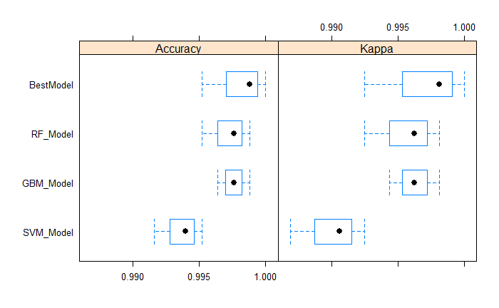
6. Models Produced – Building ID
This feature could be forecast with a great accuracy using only the WAP features, therefore this was the first classification model of the cascade system.
We managed to reach an accuracy and kappa of 99% with a Gradient Boosting Machine (Best_Model).

Slide 9
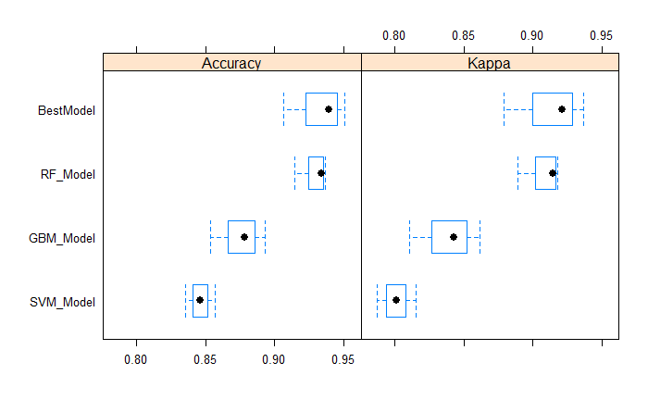
6. Models Produced – Floor
I took into account the WAP signals and the previously forecast Building ID into consideration for this second classification model.
We managed to reach an accuracy and kappa of ~95% with a Random Forest (Best_Model).

Slide 10
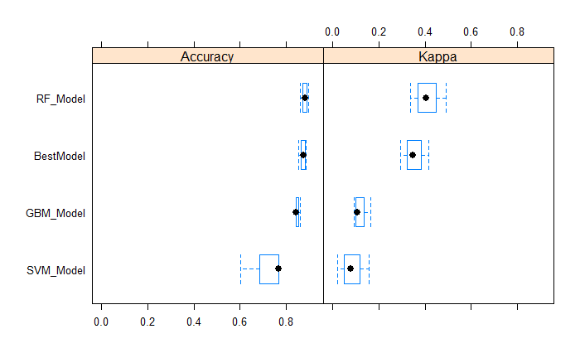
6. Models Produced – Relative Position
I took into account the WAP signals and the previously forecast Building ID and Floor into consideration for this second classification model.
I managed to reach an accuracy of 90% and kappa of 59% with a Random Forest (Best_Model), once again.

Slide 11
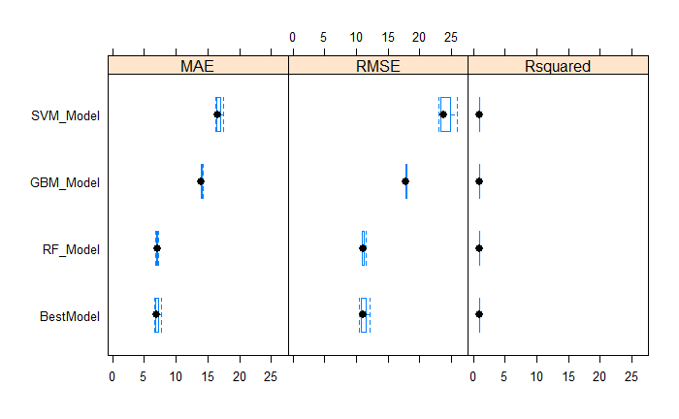
6. Models Produced – Longitude
I took into account the WAP signals and the previously forecast Building ID, Floor and Relative Position into consideration for this last round of regression models. This model is independent from the latitude model.
I managed to reach an Rsquared of 0.99 and an MAE of 5.8 with a Random Forest (Best_Model), once again.

Slide 12
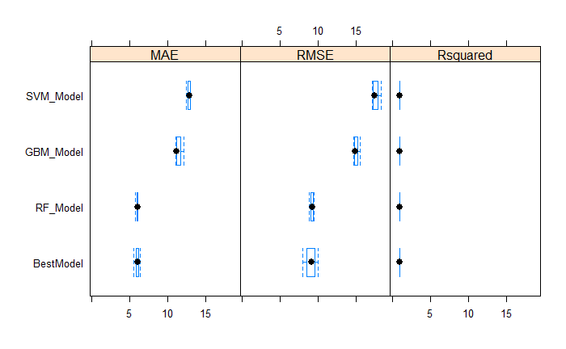
6. Models Produced – Latitude
I took into account the WAP signals and the previously forecast Building ID, Floor and Relative Position into consideration for this last round of regression models. This model is independent from the longitude model.
I managed to reach an Rsquared of 0.98 and an MAE of 4.8 with a Random Forest (Best_Model), once again.

Slide 13
6. Models Produced – Conclusions
We managed to develop a system of cascading models to forecast fairly accurately the position of each client;
It’s worth noting that the error/distances between two points in the coordinate system of this dataset (EPSG:3857) corresponds directly to meters. Therefore, the errors can be interpreted in meters.
Below follows a table containing a summary of the error:
Metric | Model | Minimum | 1st Quart. | Median | Mean | 3rd Quart. | Maximum
MAE | Latitude | 5.56 | 5.78 | 6.01 | 5.97 | 6.17 | 6.34
 | Longitude | 6.64 | 6.80 | 6.94 | 7.08 | 7.29 | 7.64
RMSE | Latitude | 7.99 | 8.55 | 9.12 | 9.04 | 9.56 | 10.01
 | Longitude | 10.42 | 10.70 | 10.99 | 11.16 | 11.52 | 12.06
R squared | Latitude | 0.978 | 0.981 | 0.983 | 0.983 | 0.985 | 0.996
 | Longitude | 0.991 | 0.991 | 0.992 | 0.992 | 0.993 | 0.993

Slide 14
7. High-level recommendations
As mentioned previously, the best models used at most 250 features in order to reduce the complexity and improve the robustness of each outcome. Therefore, if the sole purpose of these WAPs is to locate clients, many of them could be replaced or even removed to reduce operational costs.
Relative Position has the lowest accuracy and kappa out of the categorical features. WAPs that have not be utilized in any of the models, could be changed into strategic places to aid in forecasting this feature;

Slide 15
8. Conclusions
This system with the cascade models managed to gather a Mean Average Error of 6 meters in latitude and 7 meters in longitude;
The error above results in a vectorial error of under 9 meters which is comparable to the accuracy of the GPS system (sources vary between 4 and 15 meters) in an outside environment.
Because the users are inside a building, the GPS accuracy would worsen, therefore this model is a better option for locating users than GPS and most likely the best option around (because the WAP infrastructure already exists no additional costs for equipment are required).

