Slide 1
Household Electric Power Consumption
Ubiqum – Task 2

Slide 2
Agenda
Sub-meter power consumption visualization;
Time Series Visualization;
Linear Regression Forecast Visualization;
Decomposition Visualization;
Holt Winters Forecasts;
Useful Correlations;
Summary statement;
Business recommendations;
Lessons learned.

Slide 3
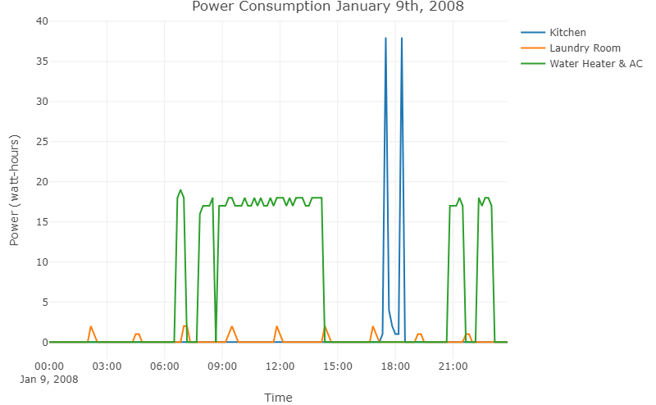
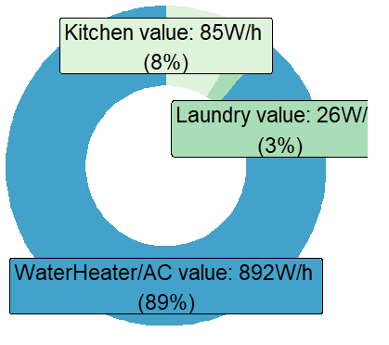
1. Daily sub-meter power consumption visualization;

Slide 4
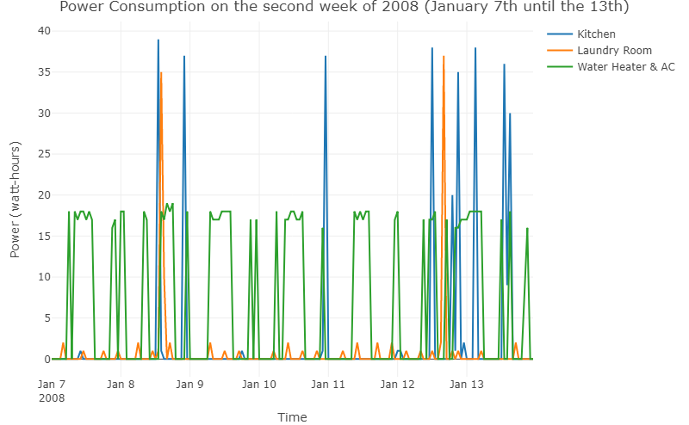
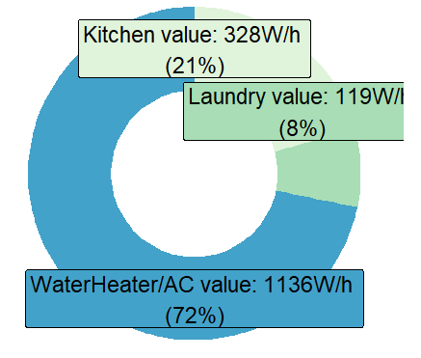
1. Weekly sub-meter power consumption visualization;

Slide 5
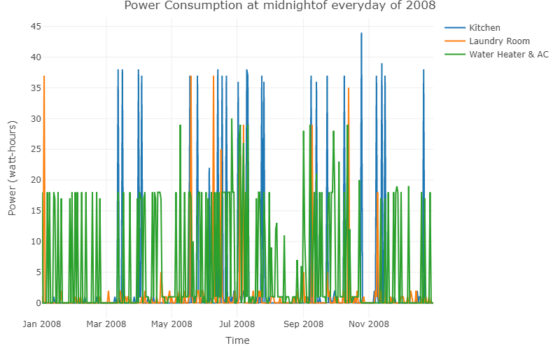
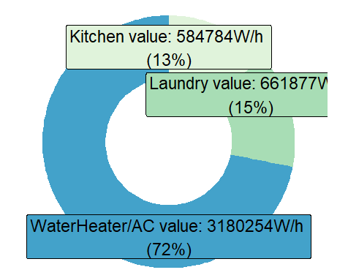
1. Yearly sub-meter power consumption visualization;

Slide 6
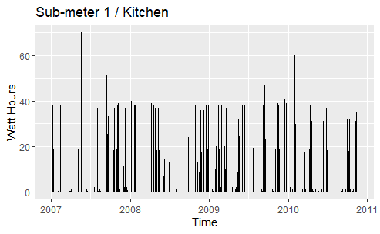
2. Weekly time series visualization for sub-meter 1:
Subset one observation per day at 12:00 pm

Slide 7
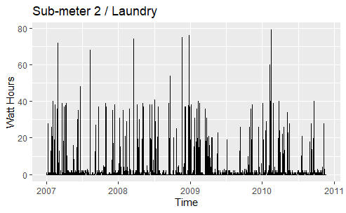
2. Weekly time series visualization for sub-meter 2:
Subset one observation per day at 3:00 pm

Slide 8
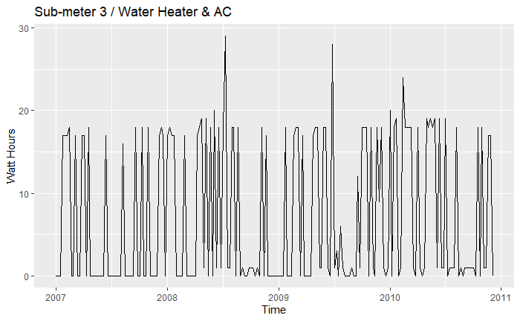
2. Weekly time series visualization for sub-meter 3:
Subset one observation per week on Mondays at 8:00 pm

Slide 9
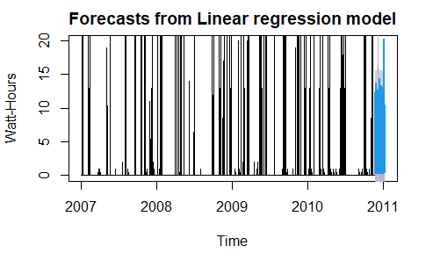
3. Linear regression forecast visualization for sub-meter 1
Forecast for the future 50 days with a level of confidence between [80, 90[ %

Slide 10
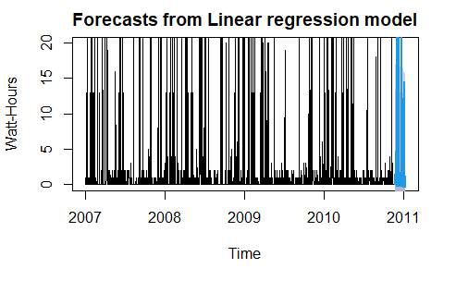
3. Linear regression forecast visualization for sub-meter 2
Forecast for the future 50 days with a level of confidence between [80, 90[ %

Slide 11
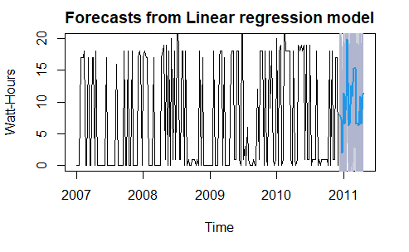
3. Linear regression forecast visualization for sub-meter 3
Forecast for the future 20 weeks with a level of confidence between [80, 90[ %

Slide 12
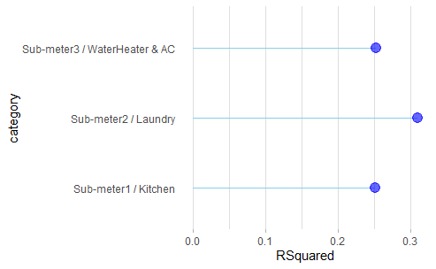
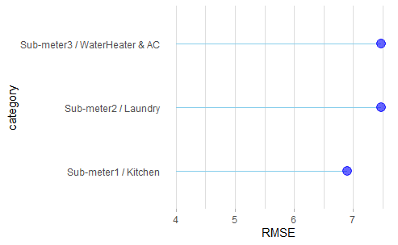
3.Comparison chart of forecast metrics:
Chart of the R squared metric for each sub-meter model
Chart of the Root mean square error metric for each sub-meter model

Slide 13
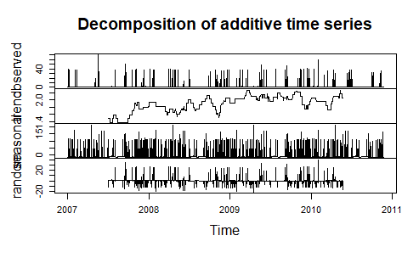
4. Decomposition Visualization for sub-meter 1:

Slide 14
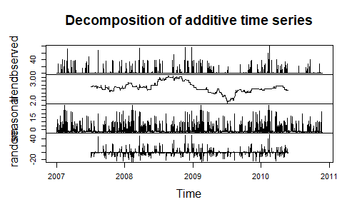
4. Decomposition Visualization for sub-meter 2:

Slide 15
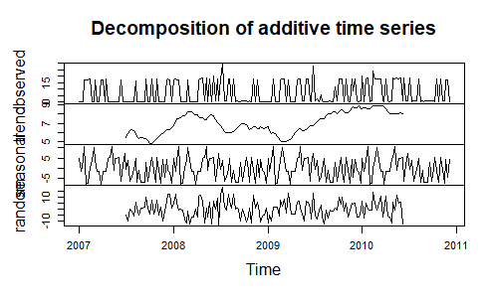
4. Decomposition Visualization for sub-meter 3:

Slide 16
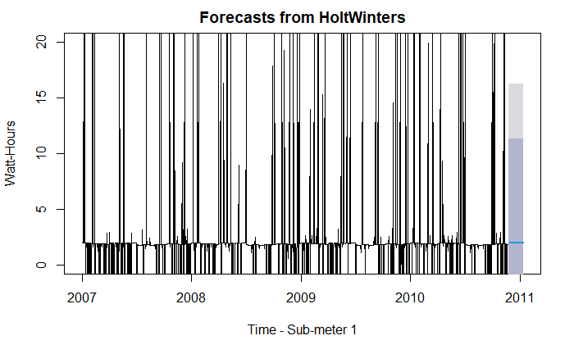
5. Holt Winters Forecast for Sub-meter 1:
Forecast for the future 50 days.

Slide 17
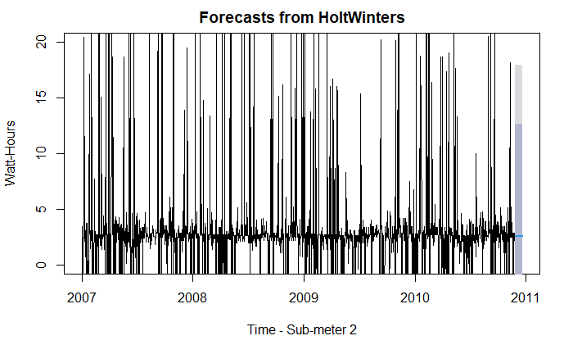
5. Holt Winters Forecast for Sub-meter 2:
Forecast for the future 50 days.

Slide 18
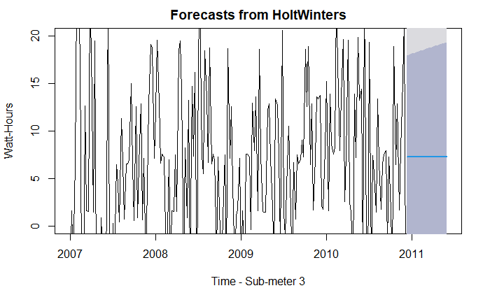
5. Holt Winters Forecast for Sub-meter 3:
Forecast for the future 25 weeks.

Slide 19
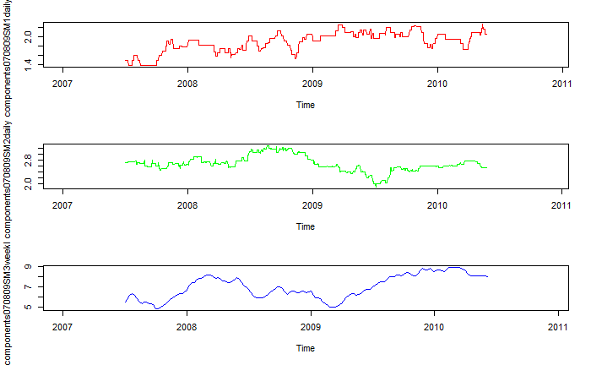
6. Useful correlations:
Looking at the trend graphs:
While sub-meter 1 (red) and 2 (green) are somewhat stable, 3 has been recently rising.
The last sub-meter records the highest power consumptions.

Slide 20
7. Summary Statement
The goal of this project was to analyse the power consumption patterns of several sub-meters and forecast future expenditure;
In this project, we managed to accomplish the pretended with a certain degree of confidence.
In the following slide, a set of reccomendations follows.

Slide 21
8. Business Recommendations
The appliances connected to the third sub-meter are by far the ones that require more power and are most constantly used. If the owner wants to reduce power consumption, the appliances connected to this sub-meter could be re-thought.
The AC and water heater should have been metered by independent sub-meters. One of them is the biggest spender, this way it is not clear which one.
The trends of each sub-meter could be connected to external factos. For instance, the third sub-meter could be correlated to the outsider temperature. These factos should be taken into account before making any big decision.

Slide 22
8. Business Recommendations 2
Granularity adjustment looking into a single moment does not seem to be ideal because too much information is lost. Because we have such a detailed dataset, one could take into account sums, averages or medians of power consumption. This would provide a richer analysis;
The decomposition of the observed signal into trend + seasonal + random noise could be extremelly valuable to the cliente. In particular the seasonal aspect. Power consumption related to seasonal expenditures could be easily corrected with a more eficient appliance(s).

