Slide 1
Household Electric Power Consumption
Ubiqum – Task 2

Slide 2
Agenda
Sub-meter power consumption visualization;
Time Series Visualization;
Linear Regression Forecast Visualization;
Decomposition Visualization;
Holt Winters Forecasts;
Useful Correlations;
Summary statement;
Business recommendations;
Lessons learned.

Slide 3
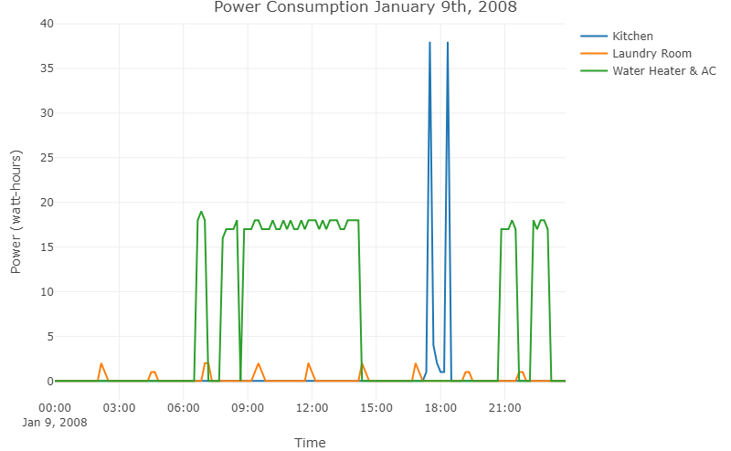
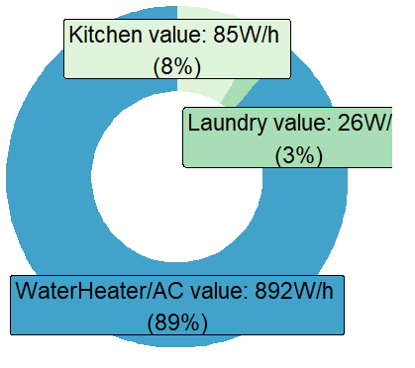
1. Daily sub-meter power consumption visualization;

Slide 4
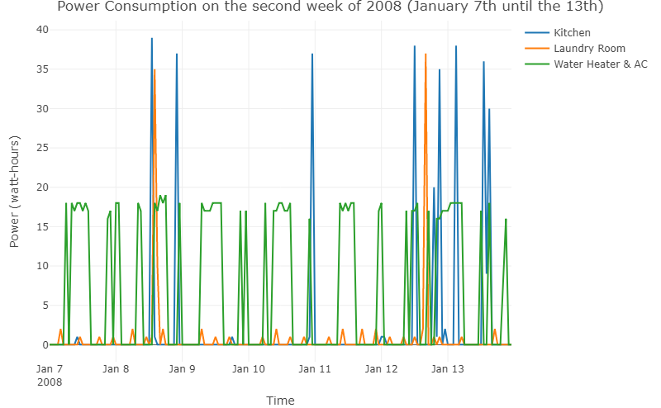
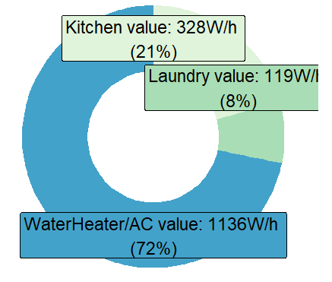
1. Weekly sub-meter power consumption visualization;

Slide 5
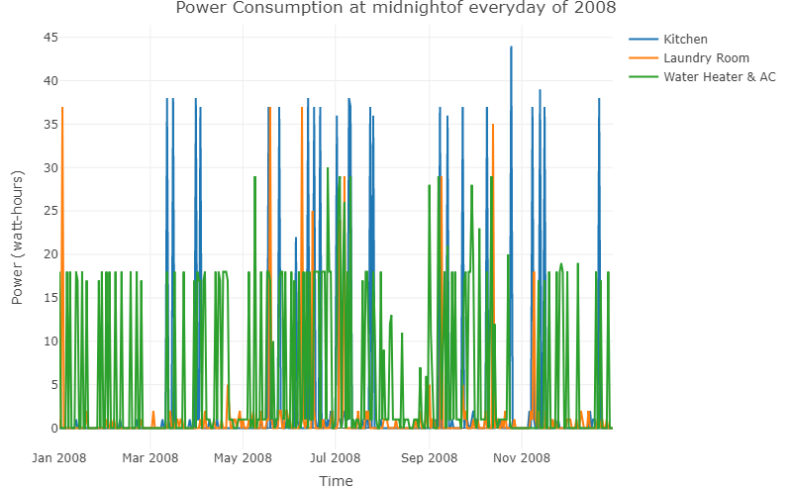
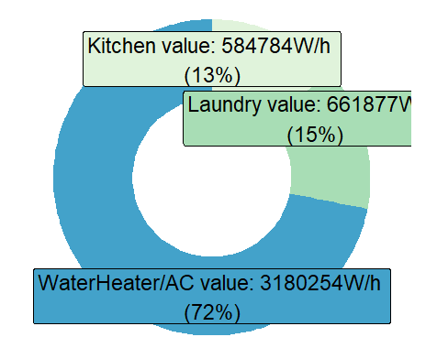
1. Yearly sub-meter power consumption visualization;

Slide 6
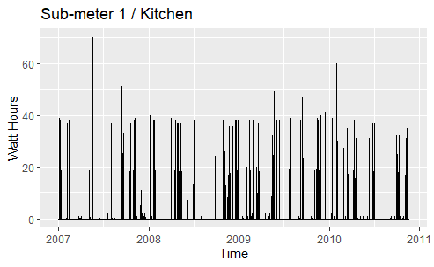
2. Weekly time series visualization for sub-meter 1:
Subset one observation per day at 12:00 pm

Slide 7
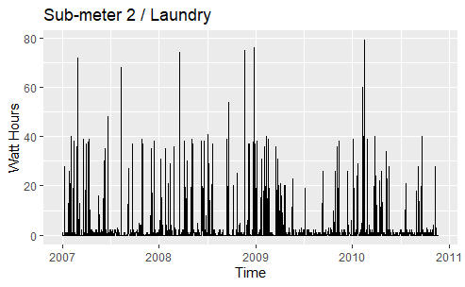
2. Weekly time series visualization for sub-meter 2:
Subset one observation per day at 3:00 pm

Slide 8
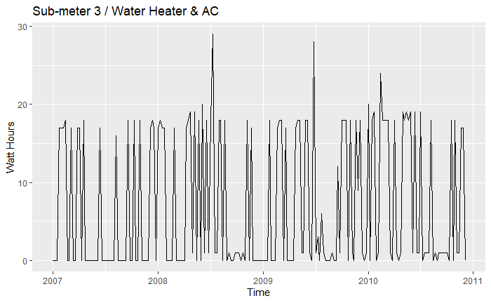
2. Weekly time series visualization for sub-meter 3:
Subset one observation per week on Mondays at 8:00 pm

Slide 9
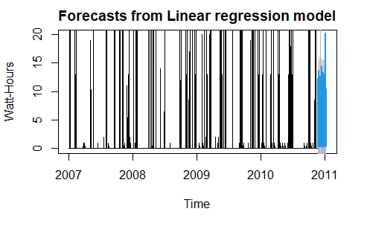
3. Linear regression forecast visualization for sub-meter 1
Forecast for the future 50 days with a level of confidence between [80, 90[ %

Slide 10
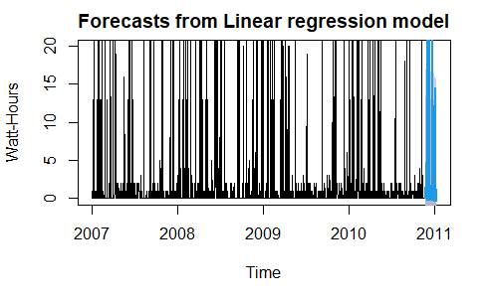
3. Linear regression forecast visualization for sub-meter 2
Forecast for the future 50 days with a level of confidence between [80, 90[ %

Slide 11
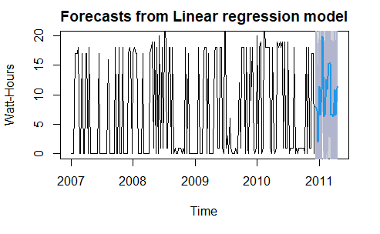
3. Linear regression forecast visualization for sub-meter 3
Forecast for the future 20 weeks with a level of confidence between [80, 90[ %

Slide 12
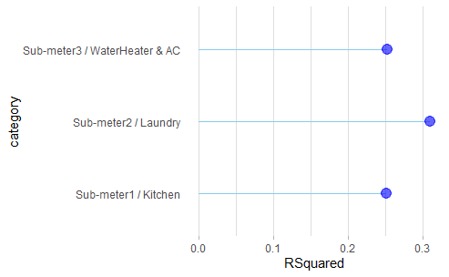
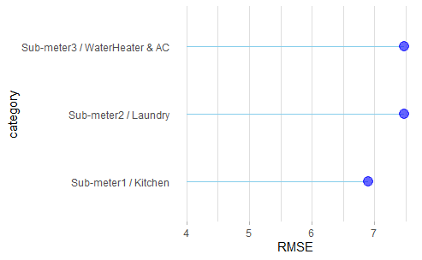
3.Comparison chart of forecast metrics:
Chart of the R squared metric for each sub-meter model
Chart of the Root mean square error metric for each sub-meter model

Slide 13
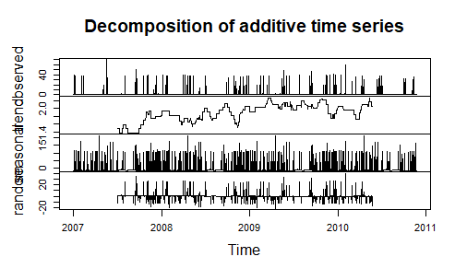
4. Decomposition Visualization for sub-meter 1:

Slide 14
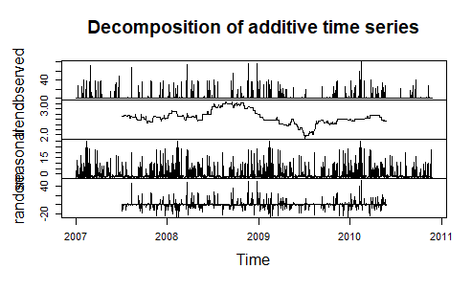
4. Decomposition Visualization for sub-meter 2:

Slide 15
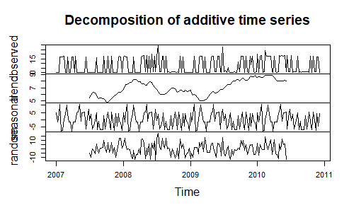
4. Decomposition Visualization for sub-meter 3:

Slide 16
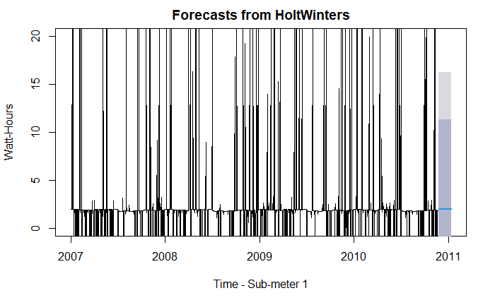
5. Holt Winters Forecast for Sub-meter 1:
Forecast for the future 50 days.

Slide 17
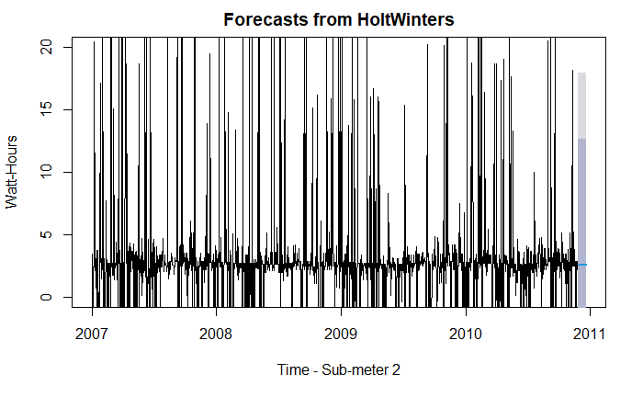
5. Holt Winters Forecast for Sub-meter 2:
Forecast for the future 50 days.

Slide 18
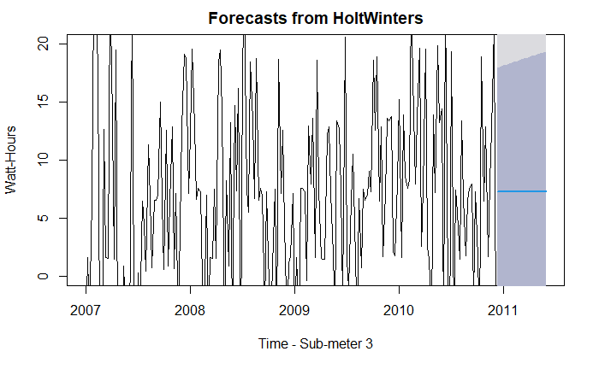
5. Holt Winters Forecast for Sub-meter 3:
Forecast for the future 25 weeks.

Slide 19
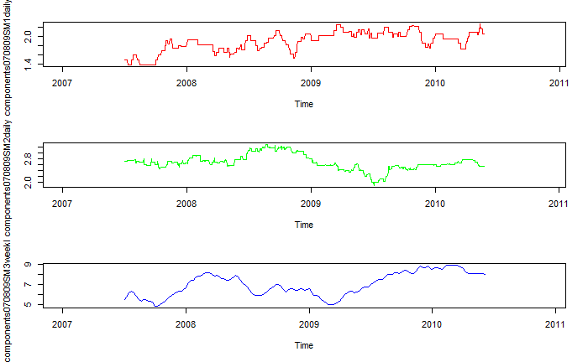
6. Useful correlations:
Looking at the trend graphs:
While sub-meter 1 (red) and 2 (green) are somewhat stable, 3 has been recently rising.
The last sub-meter records the highest power consumptions.

Slide 20
7. Summary Statement
The goal of this project was to analyse the power consumption patterns of several sub-meters and forecast future expenditure;
In this project, we managed to accomplish the pretended with a certain degree of confidence.
In the following slide, a set of reccomendations follows.

Slide 21
8. Business Recommendations
The appliances connected to the third sub-meter are by far the ones that require more power and are most constantly used. If the owner wants to reduce power consumption, the appliances connected to this sub-meter should be re-thought.
The AC and water heater should have been metered by independent sub-meters. One of them is the biggest spender, this way it is not clear which one.
The trends of each sub-meter could be connected to external factos. For instance, the third sub-meter could be correlated to the outsider temperature. These factos should be taken into account before making any big decision.

Slide 22
8. Business Recommendations
The appliances connected to the third sub-meter are by far the ones that require more power and are most constantly used. If the owner wants to reduce power consumption, the appliances connected to this sub-meter should be re-thought.
The AC and water heater should have been metered by independent sub-meters. One of them is the biggest spender, this way it is not clear which one.
The trends of each sub-meter could be connected to external factos. For instance, the third sub-meter could be correlated to the outsider temperature. These factos should be taken into account before making any big decision.

