Slide 1

Competitive Programming Kickoff
Etgar 18 and 19 - 2025

Slide 2
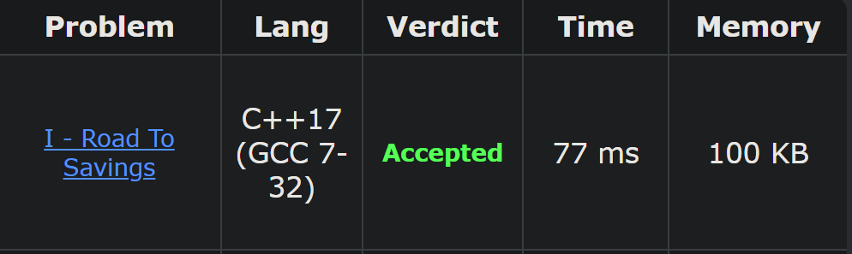
מבוא – מה הוא תכנות תחרותי
מקבלים שאלה מאוד דומה לסטייל של שאלות אלגוריתמים
חושבים על פתרון שעונה על דרישות הזמן ומקום
מתכנתים פתרון ומגישים לבדיקה שנעשית ע"י טסטים אוטומטים
אם הפתרון נכון – מקבלים ACCEPTED
אתם כנראה יודעים מה קורה אם הפתרון לא נכון

Slide 3
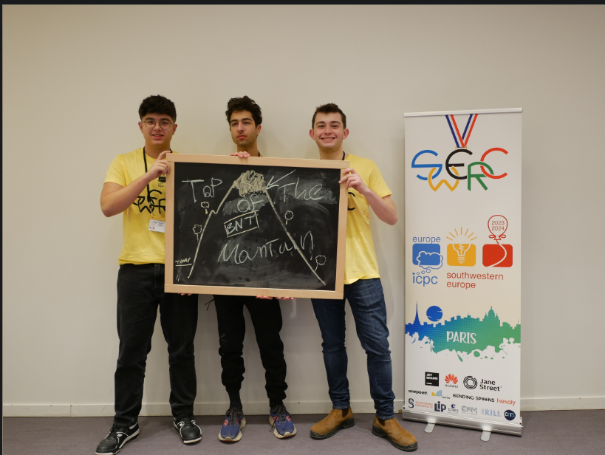
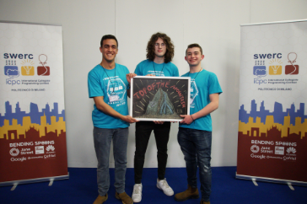

הנבחרת שלנו
נוסדה לפני 9~ שנים ע"י אתגר 8+9
כל שנה, הנבחרת טסה לתחרות ה SWERC באירופה – תחרות ה SWERC היא השלב האזורי של תחרות ה ICPC בדרום-מערב אירופה.
שולחים אחת או שתי קבוצות של 3 אנשים

Slide 4
פורמט אימונים
לפעמים פרונטלי ולפעמים בדיסקורד
בהתחלת האימון אנחנו נסביר פתרונות של בעיות מהאימון האחרון
אחרי זה נעביר דברים חדשים
ואז בעיות + בעיות לבית למי שרוצה (מישהו יכול לנחש מתי יוצגו הפתרונות ??!!)

Slide 5
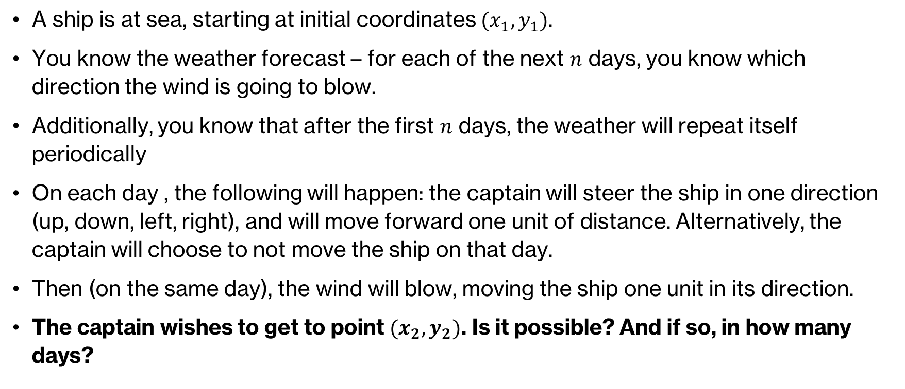
שאלת מבוא
A ship is at sea, starting at initial coordinates $(x_{1},y_{1})$.
You know the weather forecast – for each of the next $n$ days, you know which direction the wind is going to blow.
Additionally, you know that after the first $n$ days, the weather will repeat itself periodically
On each day , the following will happen: the captain will steer the ship in one direction (up, down, left, right), and will move forward one unit of distance. Alternatively, the captain will choose to not move the ship on that day.
Then (on the same day), the wind will blow, moving the ship one unit in its direction.
The captain wishes to get to point $(x_{2},y_{2})$. Is it possible? And if so, in how many days?

Slide 6
פתרון
The captain can simply pull down the sails of the ship, and so move without the effects of the wind.
Time complexity: O(1)
In Competitive Programming, it is important to read between the lines and think outside the box!
Lets now take a look at the code

Slide 7
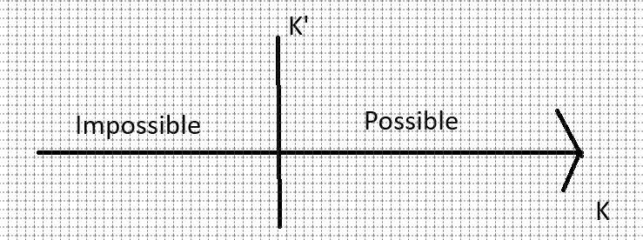
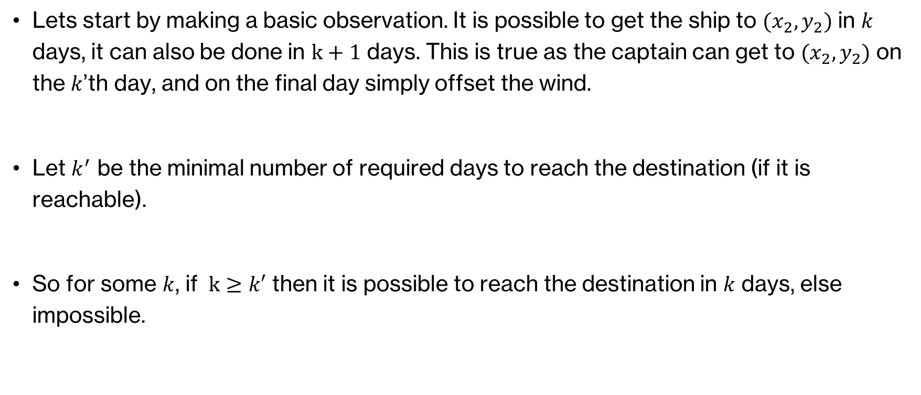
פתרון
Lets start by making a basic observation. It is possible to get the ship to $(x_{2},y_{2})$ in $k$ days, it can also be done in $k+1$ days. This is true as the captain can get to $(x_{2},y_{2})$ on the $k$’th day, and on the final day simply offset the wind.
Let $k^{′}$ be the minimal number of required days to reach the destination (if it is reachable).
So for some $k$, if $k≥k′$ then it is possible to reach the destination in $k$ days, else impossible.

Slide 8
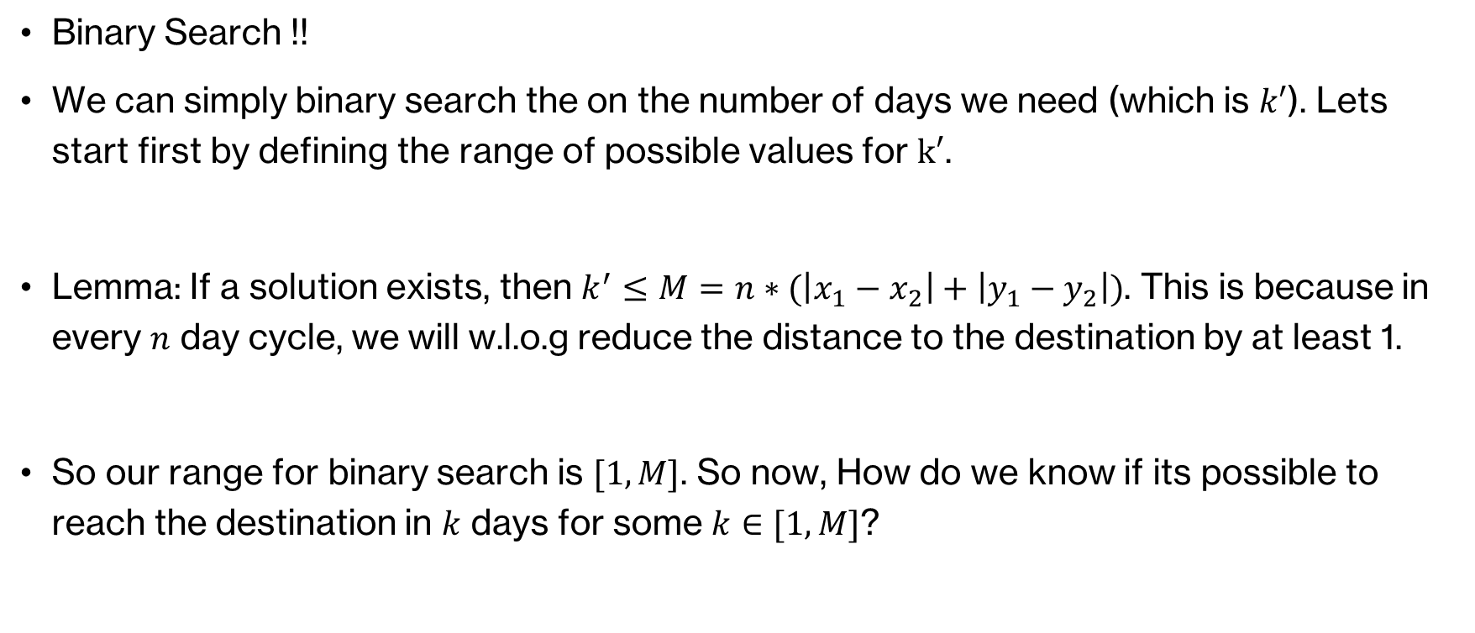
פתרון
Binary Search !!
We can simply binary search the on the number of days we need (which is $k′$). Lets start first by defining the range of possible values for $k′$.
Lemma: If a solution exists, then $k^{′}≤M=n∗(\left|x_{1}−x_{2}\right|+\left|y_{1}−y_{2}\right|)$. This is because in every $n$ day cycle, we will w.l.o.g reduce the distance to the destination by at least 1.
So our range for binary search is $[1,M]$. So now, How do we know if its possible to reach the destination in $k$ days for some $k∈[1,M]$?

Slide 9
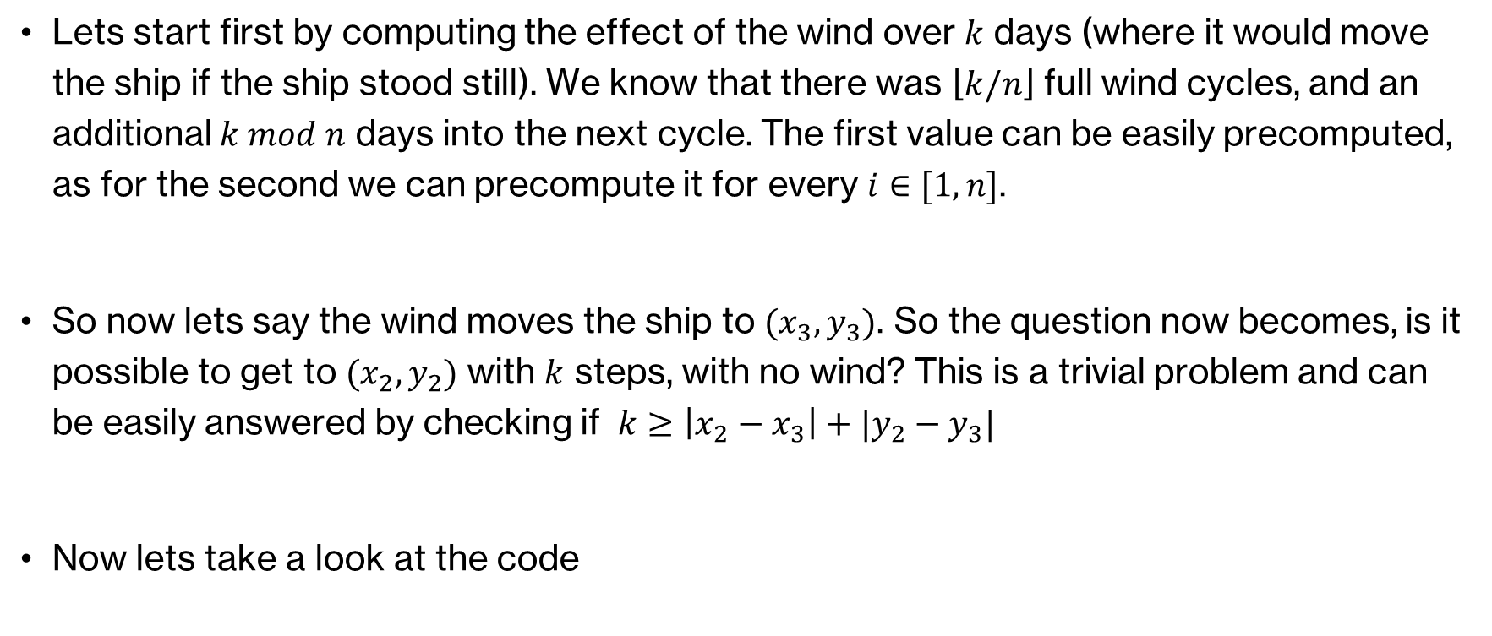
הפתרון
Lets start first by computing the effect of the wind over $k$ days (where it would move the ship if the ship stood still). We know that there was $\left\lfloor k/n\right\rfloor$ full wind cycles, and an additional $k mod n$ days into the next cycle. The first value can be easily precomputed, as for the second we can precompute it for every $i∈[1,n]$.
So now lets say the wind moves the ship to $(x_{3},y_{3})$. So the question now becomes, is it possible to get to $(x_{2},y_{2})$ with $k$ steps, with no wind? This is a trivial problem and can be easily answered by checking if $k≥\left|x_{2}−x_{3}\right|+|y_{2}−y_{3}|$
Now lets take a look at the code

