Slide 1

Competitive Programming Week III
Graphs
Etgar 18 - 2025

Slide 2
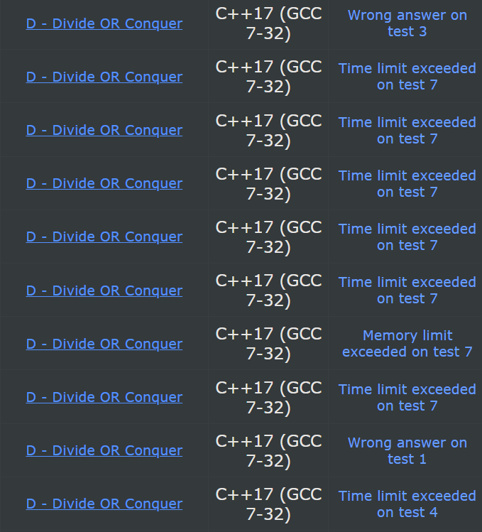
ייצוג גרפים בקוד
בתכנות תחרותי, נשתמש בשני ייצוגים של גרפים
נראה איך מייצגים גרפים פשוטים, שאולי מכוונים, ואולי ממושקלים.
הראשון,Adjacency list הוא מערך לכל צומת שמכיל את האינדיקסים של השכנים של הצומת
השני הוא טבלה דו-ממדים שמחזיקה בין כל שני צמתים האם יש קשת או לא.
נרחיב את ההגדרות

Slide 3
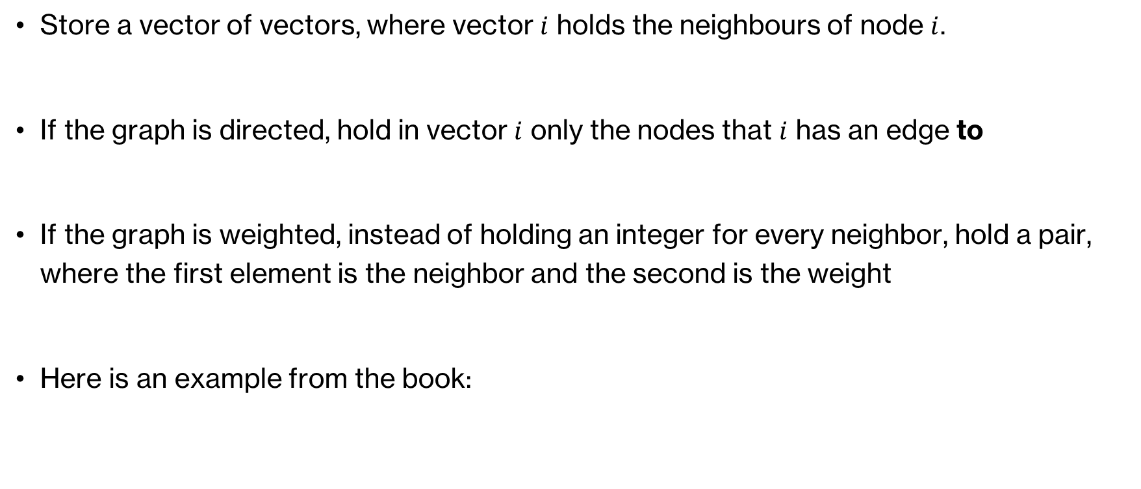
Adjacency list
Store a vector of vectors, where vector $i$ holds the neighbours of node $i$.
If the graph is directed, hold in vector $i$ only the nodes that $i$ has an edge to
If the graph is weighted, instead of holding an integer for every neighbor, hold a pair, where the first element is the neighbor and the second is the weight
Here is an example from the book:

Slide 4
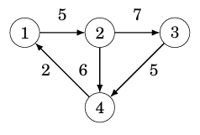
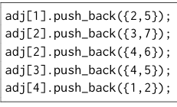
Adjacency list
Here is how the graph on the left can be transformed into adjacency list format

Slide 5

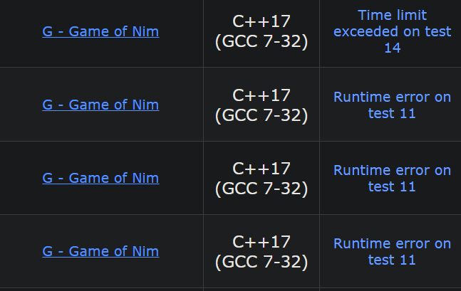

Adjacency list
Here is how we can iterate over all the neighbours of node $s$

Slide 6
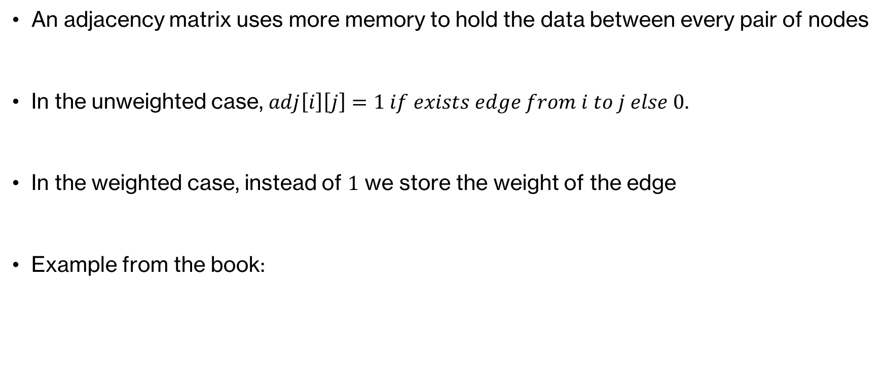
Adjancency Matrix
An adjacency matrix uses more memory to hold the data between every pair of nodes
In the unweighted case, $adj\left[i\right]\left[j\right]=1 if exists edge from i to j else 0$.
In the weighted case, instead of $1$ we store the weight of the edge
Example from the book:

Slide 7
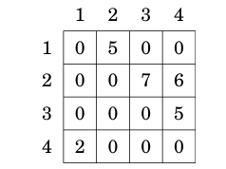
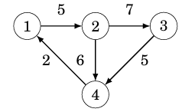
Adjacency matrix
On the right we have the adjacency matrix which corresponds to the graph on the left

Slide 8
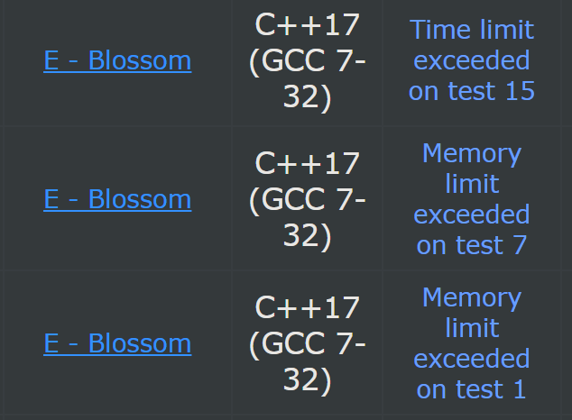
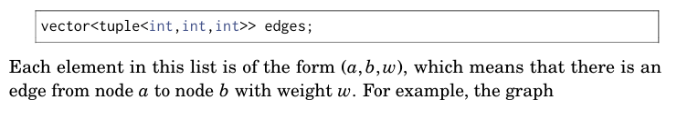
Edge list
Simply a list of all edges
From the book
This structure is less common and used mostly in some specific algorithms
U will most likely not encounter a question which requires use of this

Slide 9
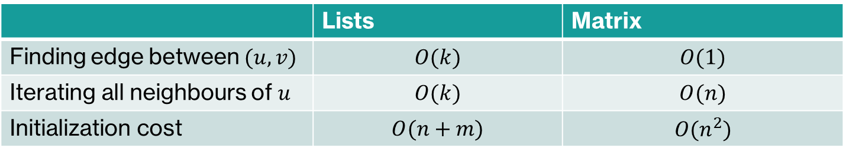

Adjacency Matrix vs Adjacency list
Let $u$ be a node with $k$ neighbours
Sometimes, it is not possible to even Initialize matrix within the time constraints!
Adj List is more common, so if you have to guess and don’t know which, go with Adj List.
 | Lists | Matrix
Finding edge between $(u, v)$ | $$O(k)$$ | $$O(1)$$
Iterating all neighbours of $u$ | $$O(k)$$ | $$O(n)$$
Initialization cost | $$O(n+m)$$ | $$O(n^{2})$$

Slide 10
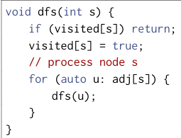


DFS
U know the algorithm, so here is the implementation in C++ from the book

Slide 11
Empty slide

Slide 12
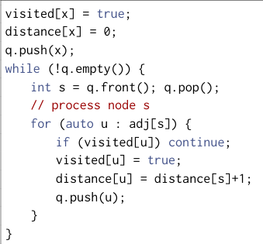

BFS
Again, lets see the implementation from the book

Slide 13
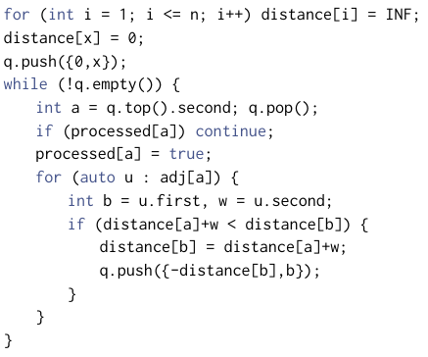
Dijkstra
Again, lets see the implementation from the book

Slide 14
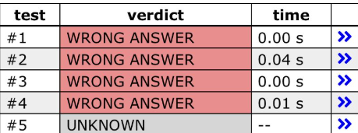
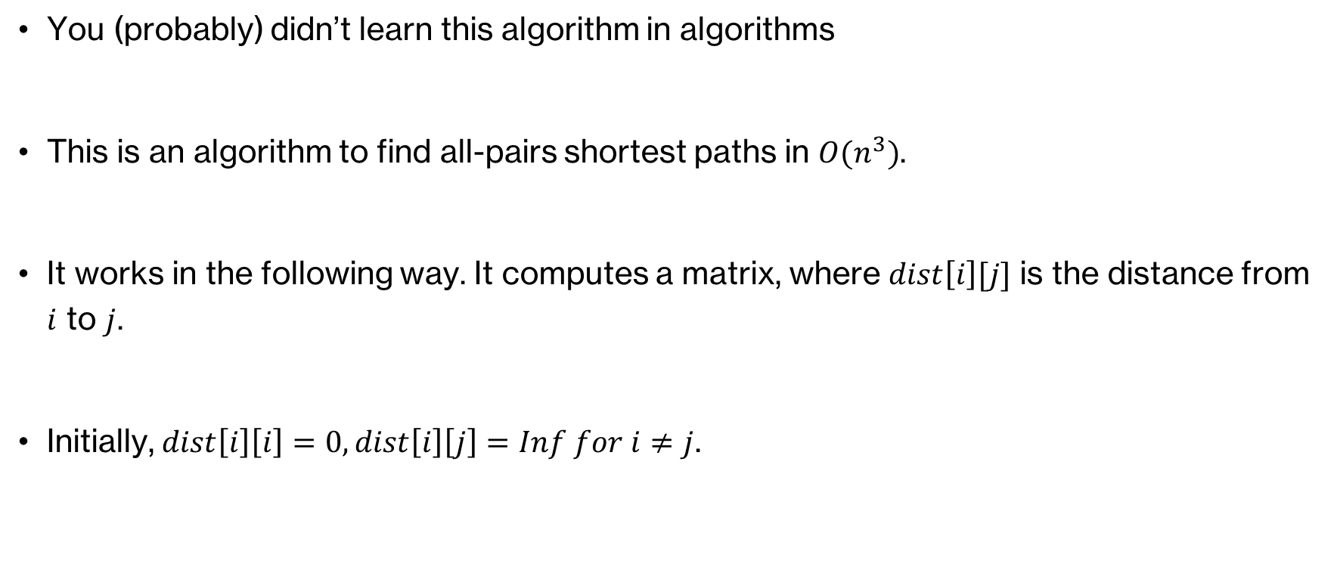
Floyd-Warshall
You (probably) didn’t learn this algorithm in algorithms
This is an algorithm to find all-pairs shortest paths in $O(n^{3})$.
It works in the following way. It computes a matrix, where $dist\left[i\right][j]$ is the distance from $i$ to $j$.
Initially, $dist\left[i\right]\left[i\right]=0, dist\left[i\right]\left[j\right]=Inf for i≠j$.

Slide 15
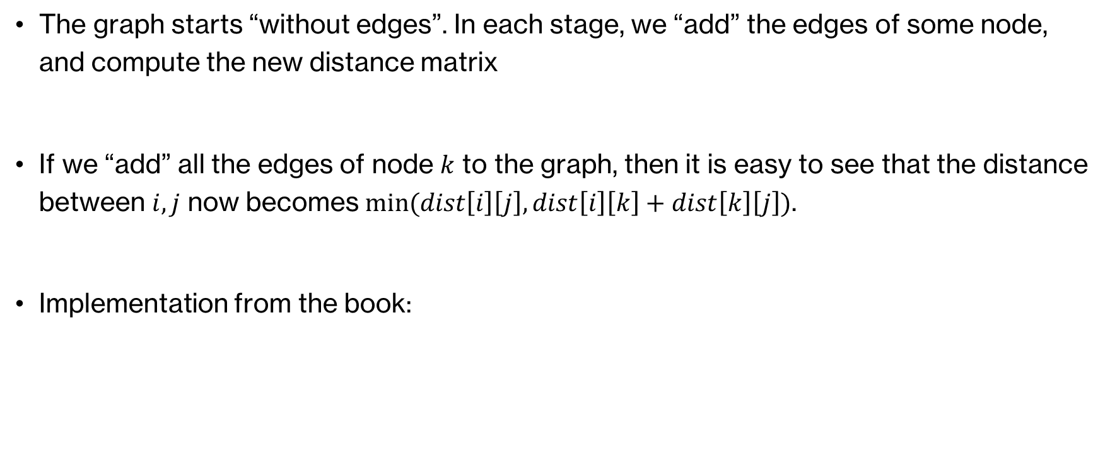
Floyd-Warshall
The graph starts “without edges”. In each stage, we “add” the edges of some node, and compute the new distance matrix
If we “add” all the edges of node $k$ to the graph, then it is easy to see that the distance between $i,j$ now becomes $min⁡(dist\left[i\right]\left[j\right],dist\left[i\right]\left[k\right]+dist\left[k\right]\left[j\right])$.
Implementation from the book:

Slide 16
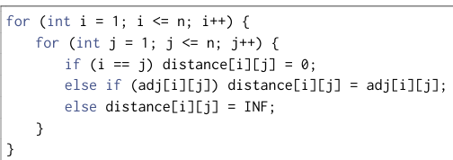
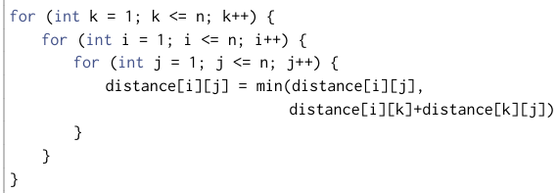
Floyd-Warshall Implementation

