Slide 1


Slide 2




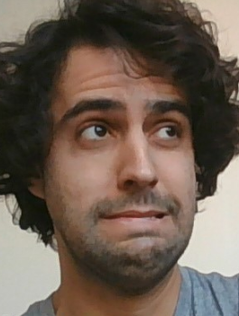



Slide 3
MBTRR

Slide 4
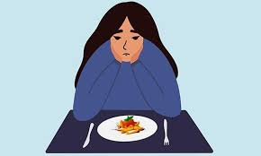
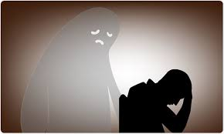

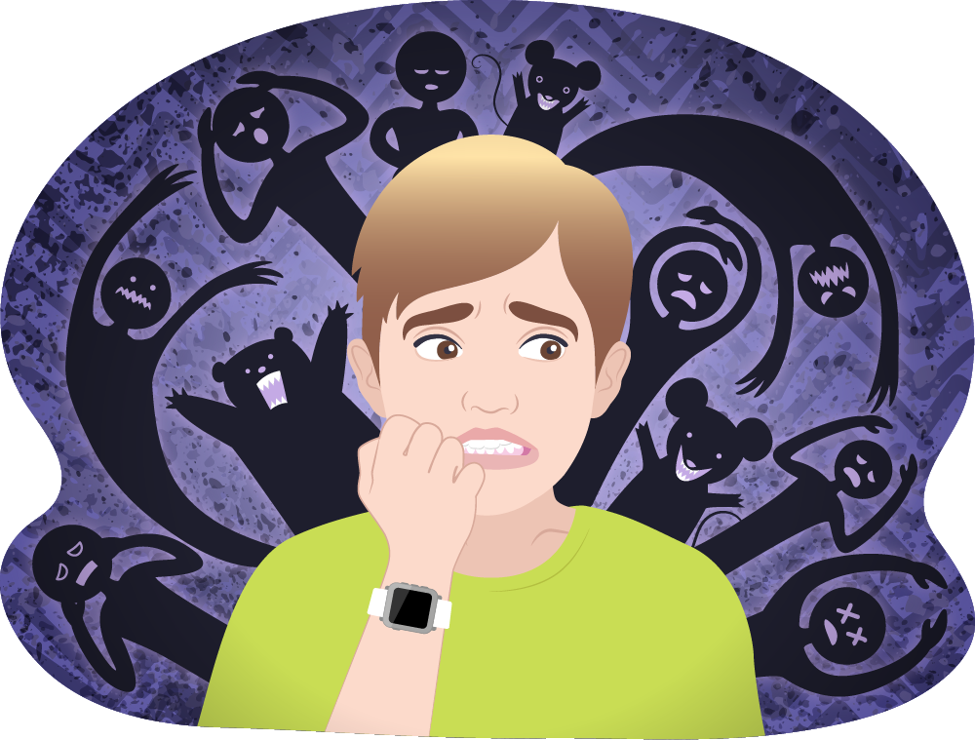
Attentional biases – key aspect of mental (ill) health Ruimi, Amir, Hadash, Goldstein & Bernstein, submitted; Amir, Ruimi, & Bernstein, submitted; Ehring & Watkins, 2008; Goldin, Manber, Hakimi, Canli, & Gross, 2009;
For example :
Eating disorders
Anxiety disorders
Affective disorder
Substance abuse and addiction
PTSD
etc.

Slide 5
The role of Attention
Attentional biases – key aspect of mental (ill) health Ruimi, Amir, Hadash, Goldstein & Bernstein, submitted; Amir, Ruimi, & Bernstein, submitted; Ehring & Watkins, 2008; Goldin, Manber, Hakimi, Canli, & Gross, 2009;
For example :
Eating disorders
Anxiety disorders
Affective disorder
Substance abuse and addiction
PTSD
etc.

