Slide 1

Audio Genre Classification Using XGBoost
Tomer Teperovich & Lukov Snir Meir

Slide 2
Introduction
Goal: Classify audio tracks into genres using machine learning
Why is this important? Applications in music recommendation, content tagging, etc.
Challenges in audio classification (high variability, small datasets, etc.)
Dataset: GTZAN (10 genres, 1000 tracks, 30s per track)

Slide 3
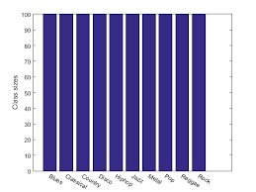
The Dataset
10 music genres (Blues, Classical, Country, Disco, Hip-Hop, Jazz, Metal, Pop, Reggae, Rock)
100 tracks per genre, 30-second audio clips
Sampled at 22,050 Hz

Slide 4
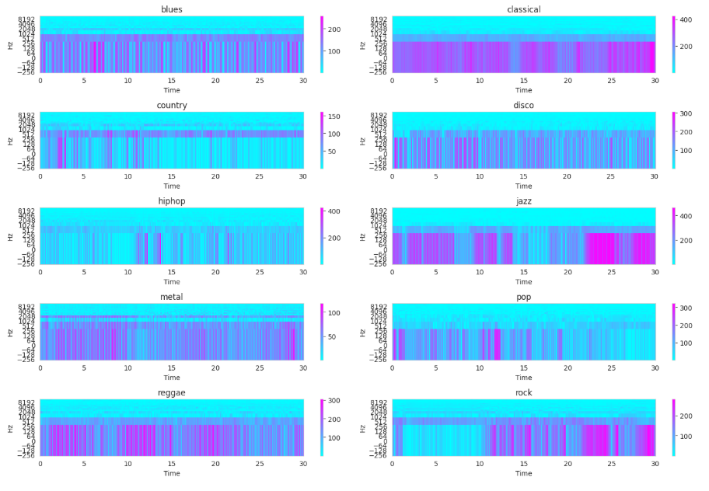
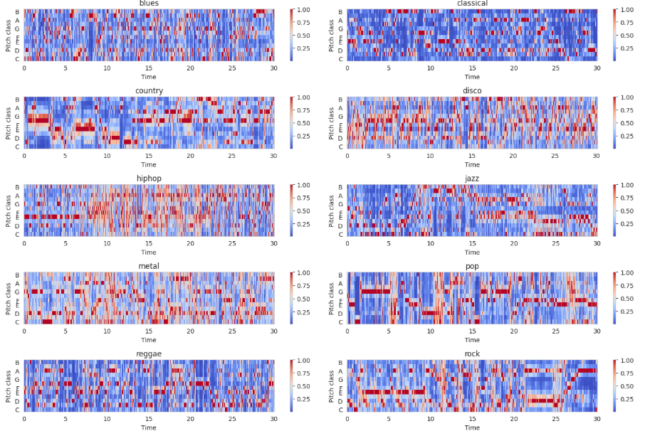
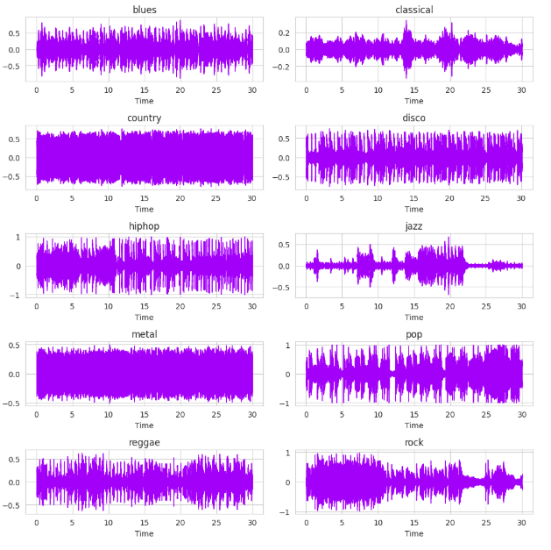
Feature Extraction
MFCCs
Chroma Features
Mel spectrogram

Slide 5
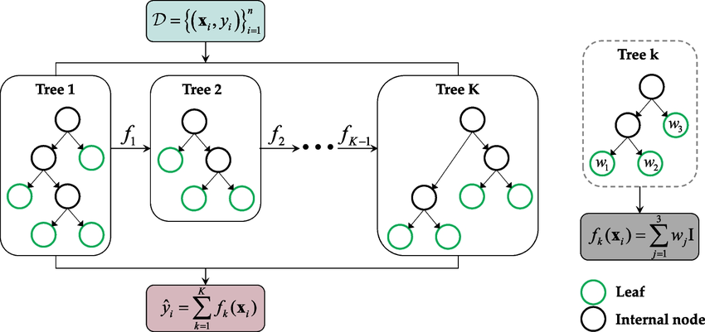
Model Selection: Why XGBoost?
Tried multiple models:
MLP (Multi-Layer Perceptron) – Accuracy: 59%
CNN (Convolutional Neural Network) – Accuracy: 64%
XGBoost (Gradient Boosting Trees) – Accuracy: 71% (initial), 93% (optimized)
Why XGBoost?
Handles small datasets well
More interpretable than deep learning models
Feature importance ranking
Robust to noise

Slide 6
Model Training & Optimization
Data Preprocessing Split tracks into 3-second clips → More training samples
XGBoost Training:
Hyperparameter tuning (grid search for best estimators, depth, learning rate)
Train-test split: 90%-10%
Cross-validation for robustness

Slide 7
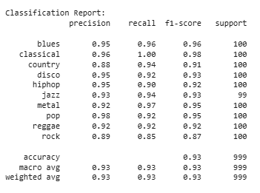
Results & Performance
Final Accuracy: 93%

Slide 8
Challenges & Problems Solved
Data Limitation:
Choosing the Right Model
Small Dataset and Its Limitations
Model Adaptation
Risk of Data Leakage or Overfitting
Audio Features

Slide 9
Future Work
1. Hybrid Model Approaches
Implement ensemble learning techniques to improve robustness and generalization.
2. Advanced Feature Engineering
Explore additional features such as tempo, zero-crossing rate, and spectral roll-off.
Apply self-supervised learning techniques to generate more informative features.
3. Data Augmentation and Transfer Learning
Expand augmentation strategies (e.g., adding noise, reverb, or equalization) to improve model generalization.
Utilize pre-trained deep learning models and fine-tune them for genre classification.
Leverage Look, Listen, and Learn (L3-like) embeddings such as OpenL3 for richer audio representations.
4. Explainable Artificial Intelligence (XAI)
Implement methods such as SHAP and LIME to interpret model decisions.
Provide transparency in genre classification by analyzing which features contribute most to the predictions.
Develop visualizations that help users and researchers understand why a specific genre was assigned to an audio track.

Slide 10
References
Musical Genre Classification of Audio Signals George Tzanetakis, Student Member, IEEE, and Perry Cook, Member, IEEE
Doras, R., Cohen-Hadria, A., and Richard, G. (2021). Music Genre Classification: A Review of Deep-Learning and Traditional Machine-Learning Approaches
Cramer, J., Wu, H., Salamon, J., Bello, J. P., Ellis, D. P. (2019). Look, Listen, and Learn More: Design Choices for Deep Audio Embeddings

