Slide 1
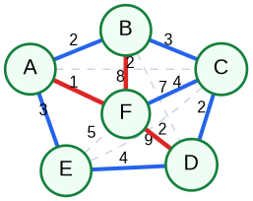
Sparse Spanners of Weighted Graphs
Implementation and experimental evaluation of the greedy weighted spanner algorithm
Mini-Project on Embeddings of Graphs
Alon Ganot
01
Notes:
Open the talk by framing the project: implement an algorithm from the selected paper, run experiments, and explain the observed distortion-sparsity tradeoff.

Slide 2

Project goal
Course requirement: read a paper, implement an algorithm, and evaluate it experimentally.
The project focuses on low-distortion graph representations: keep few edges, but preserve pairwise distances approximately.
Input: a connected, undirected, positively weighted graph G = (V, E).
Output: a subgraph H = (V, E_H) that is much sparser than G.
Guarantee: distances in H are at most a bounded factor longer than in G.
Evaluation: compare edge count, total weight, stretch, and runtime across graph families.
60%
40%
final talk
course final project
progress evaluation
final meeting
02
Notes:
Use this slide to connect the implementation directly to the syllabus: paper, algorithm, experiments, and final presentation.

Slide 3
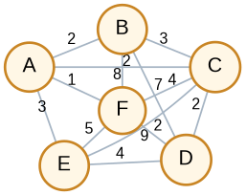
What is a t-spanner?
The object being built: a sparse subgraph that preserves distances up to multiplicative stretch.
Original graph G
Sparse spanner H
dist_H(u,v) ≤ t · dist_G(u,v)
03
Notes:
Explain the central tradeoff: fewer edges and lower total weight versus larger path distances.

Slide 4
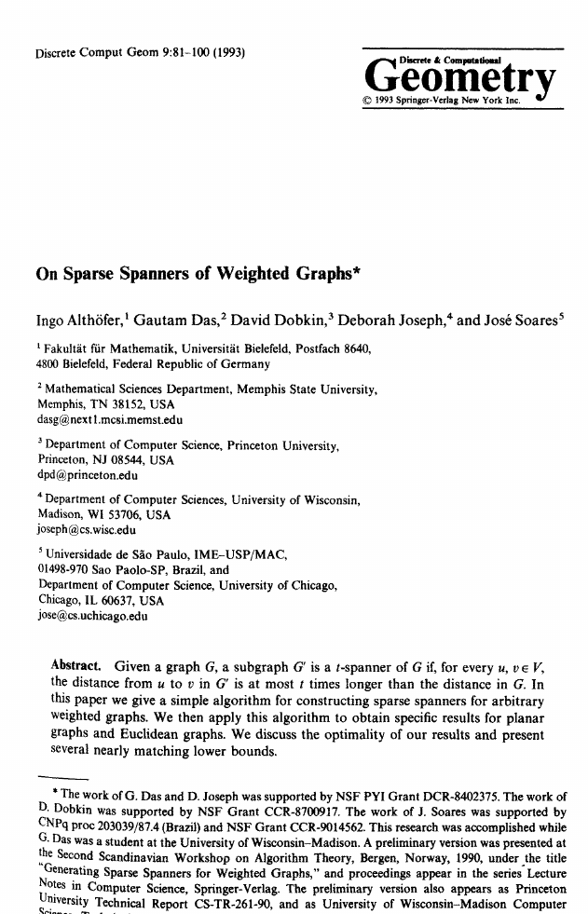
Paper used in the project
Althöfer et al. give a simple polynomial-time greedy construction for weighted graphs.
Key result implemented
For any weighted graph and parameter k, the greedy algorithm constructs a sparse spanner with stretch bounded by 2k + 1.
stretch increases
edge bound improves
04
Notes:
This is the theoretical basis for the experiments: increasing k allows more stretch, so the spanner should become sparser.

Slide 5
Greedy weighted spanner algorithm
Same idea as Kruskal: process edges from light to heavy, but keep an edge only when current paths are too long.
Sort edges
by weight
Scan edge
e = (u,v)
Run Dijkstra
in current H
If dist_H(u,v)
> r · w(e)
Add edge
to H
r = 2k + 1
Rejected edges already have a short replacement path. Added edges are exactly the ones needed to maintain the stretch guarantee.
Implementation detail: Dijkstra is valid because the project uses positive edge weights.
05
Notes:
Stress that the algorithm is deterministic and easy to test: every skipped edge is skipped only after an explicit shortest-path check in the partial spanner.

Slide 6
Implementation architecture
The project separates the algorithm, experiment runner, plotting, and reproducibility outputs.
Core implementation
Experiment pipeline
GreedyWeightedSpanner.java implements the sorted-edge greedy test.
Dijkstra is reused for shortest-path checks and stretch validation.
Tie-safe MST containment is checked because equal weights can create multiple valid MSTs.
ExperimentRunner generates graph families and k values.
CSV stores edge count, lightness, max stretch, violations, and runtime.
DOT and PNG outputs show original graph, spanner edges, MST edges, and weights.
06
Notes:
Mention that the repository is structured to allow rerunning experiments instead of manually editing plots.

Slide 7
Correctness checks
The implementation verifies the properties that matter for a weighted spanner.
Stretch validation
max dist_H / dist_G
No violations
for all tested pairs
MST containment
tie-safe check
Positive weights
Dijkstra assumption
Lightness
weight(H) / weight(MST)
Sparsity
|E_H| / |E|
A run is considered valid only when stretch violations are zero and all numerical metrics are consistent with the generated spanner.
07
Notes:
Keep this concise in the oral presentation: this is the testing layer that makes the experiments credible.

Slide 8

Experiment design
The experiments vary graph structure and k to test the stretch-sparsity tradeoff.
Graph families
Parameters and metrics
Dense weighted graphs
Random sparse/dense graphs
Planar grid graphs
Cycle threshold examples
Theta-style lower-bound examples
Equal-weight complete graphs
k = 1, 2, 3, 4, 5
edge_ratio = |E_H| / |E|
lightness = weight(H) / weight(MST)
max_stretch and violations
runtime_ms
The full run covers about 48 scenarios × 5 k-values, producing roughly 240 CSV rows plus rendered visual examples.
08
Notes:
Use this slide to explain why multiple graph families are necessary: the greedy algorithm behaves differently on dense, planar, random, and adversarial structures.

Slide 9
How to read the results
The expected pattern is not one number; it is the tradeoff curve as k changes.
Illustrative trend: larger k allows more rejected edges, so the spanner becomes sparser and usually lighter.
The observed stretch should stay below the bound. Violations must be zero; otherwise the implementation or measurement is wrong.
Exact empirical values should come from the generated results.csv and plots.
09
Notes:
This slide is intentionally about interpretation. In the final talk, use the actual generated plots from results/plots if you want exact values.

Slide 10
Visual examples
The visual outputs make the algorithm’s choices easy to inspect.
Original weighted graph
Spanner with highlighted kept edges
Planar/grid scenario
Blue/red edges indicate selected spanner/MST membership in the project visuals.
Edge weights are shown so a rejected edge can be checked against its replacement path.
These examples are useful for debugging and for explaining the algorithm during the presentation.
10
Notes:
Walk through one rejected heavy edge and show the short path that replaces it.

Slide 11
Conclusion
What the project demonstrates.
Sparse spanners give a controlled way to trade exact distances for much smaller graphs.
Algorithm implemented
weighted greedy spanner
Experiments built
multiple graph families
Validation included
stretch, lightness, MST
Main takeaway: as k grows, the permitted stretch grows, and the algorithm can reject more edges while preserving bounded pairwise distances.
11
Notes:
Close by tying the project back to the course: both combinatorial tradeoffs and algorithmic implementation were covered.

Slide 12
Sources
Primary material used for the presentation.
1. I. Althöfer, G. Das, D. Dobkin, D. Joseph, and J. Soares. “On Sparse Spanners of Weighted Graphs.” Discrete & Computational Geometry, 9, 81–100, 1993.
2. Ben-Gurion University course syllabus: Mini-Project on Embeddings of Graphs, 202-1-4071.
3. Project implementation notes: Java greedy weighted spanner, experiment runner, CSV metrics, plotting scripts, and DOT visual examples.
Backup talking points
Why shortest paths are computed repeatedly: every edge decision depends on the current partial spanner.
Why the result is not necessarily minimum: finding the sparsest t-spanner is hard; greedy gives a constructive guarantee.
Why MST appears in the metrics: it is the baseline for total weight and lightness.
12

