Slide 1
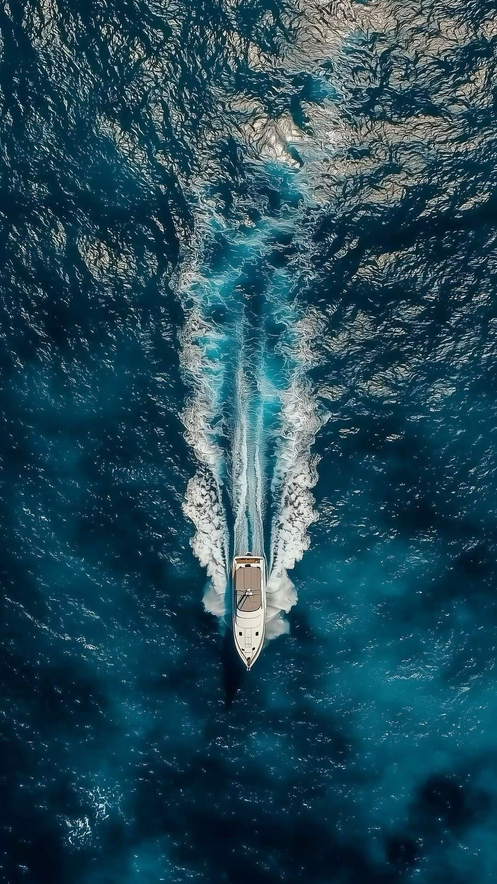
Maritime Communication Severity Classification & Information Extraction
SEAALERT
Presenter: Tomer Atia, Ilana Estrin

Slide 2

Review & Refined Project Definition
Maritime radio calls are made under extreme conditions storms, engine noise, and panic causing critical words like 'MAYDAY' to become unrecognizable in speech recognition. Furthermore, no labeled dataset of maritime radio transcriptions exists, making it impossible to train models on real-world data.
OUTPUT
INPUT
Noisy ASR transcript of a maritime radio communication
Classification: One of four severity levels
Distress | Urgency | Safety | Routine
Simulated VHF: Distress | Urgency | Safety Messages
Information Extraction: Structured fields
Location | Vessel Name | Persons on Board | Nature of Incident | Call Sign / MMSI (optional)
RoBERTa-> fine-tuned on synthetic clean text maritime messages (GPT-4 generated)

Slide 3
Review & Refined Project Definition
DATA
1,872 GPT-4 synthetic maritime messages (468 per class)
Clean | ASR text (SNR: 18 | 12 | 6 dB)
With | without codewords
Audio (TTS) + Whisper ASR
Multiple styles & scenarios
MODELS
Transformers: RoBERTa (selected) | DistilBERT
Baselines: TF-IDF (BoW) + Logistic Regression | Linear SVM | Naive Bayes
Infrastructure: GPT-4 | Faster-Whisper | Coqui TTS
RoBERTa-> fine-tuned on synthetic clean text maritime messages (GPT-4 generated)
METRICS
F1-score: primary classification metric
Accuracy: secondary comparison metric

Slide 4

Project achievements and novelty
PROJECT ACHIEVEMENTS
End-to-end pipeline for maritime message severity classification and information extraction
Realistic radio-communication pipeline: text → audio → noise → ASR → NLP
Controlled comparison: Traditional Models vs. Transformer (RoBERTa)
DELIVERABLES
Severity classification (Distress | Urgency | Safety | Routine)
Structured operational output (JSON): vessel, location, POB, incident
Synthetic maritime dataset (text + audio + noisy ASR)
The project’s novelty lies in training the system on noisy ASR outputs rather than assuming clean transcripts.

Slide 5
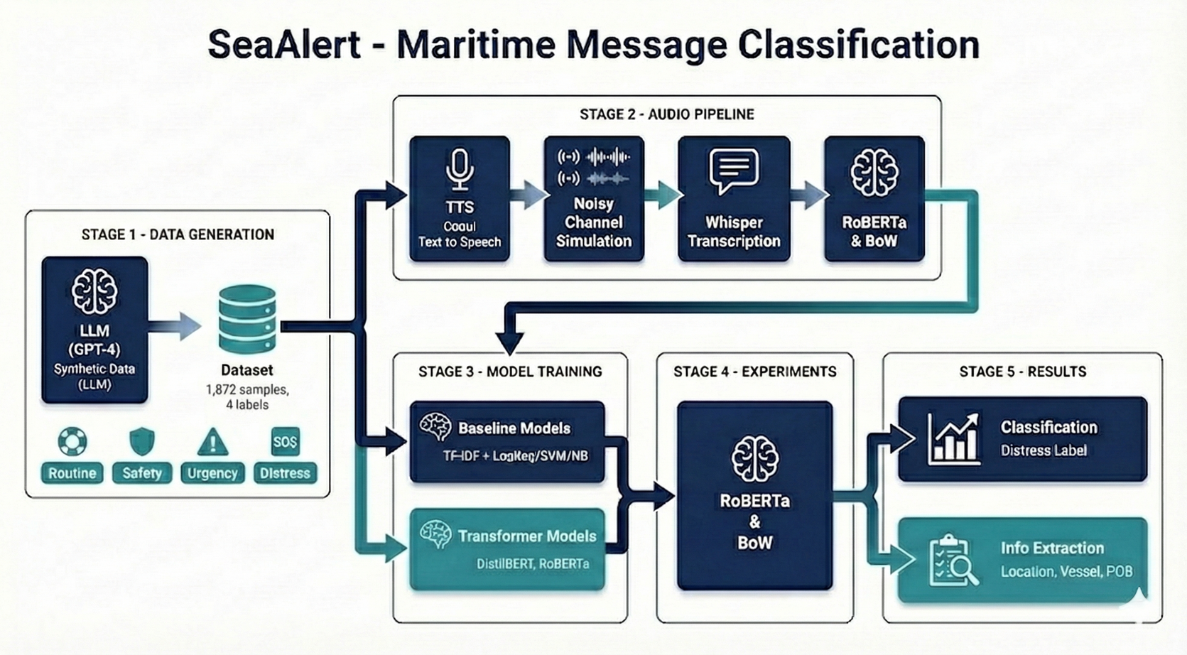
Review Methodology
Dual Augementation
TEXT → TTS → NOISE → ASR → CLASSIFIER → LABEL + EXTRACTION
Synthetic data generation (text + audio)
Controlled ASR noise simulation (SNR-based)
Model training & evaluation (F1, Accuracy)
Robustness & adversarial testing

Slide 6


Example
real example from dataset - demonstrating how severe ASR errors can be under high noise conditions
ORIGINAL MESSAGE
ASR OUTPUT
HIGH NOISE
MODEL OUTPUT
"MAYDAY, MAYDAY, MAYDAY! This is the sailing yacht 'Wind Whisper', uh, we're, um, having a steering failure—can't control the rudder. We're drifting, uh, southeast of, uh, Cape Cod, um, about 10 nautical miles off the shore, I think. Weather's, uh, kinda rough, waves are, like, 3 meters, and it's, um, getting windy. We've got, uh, three people onboard. Need assistance, like, right now! Over."
"maybe, maybe, maybe, this is the sailing yacht with this boat out here, I'm having a steering failure, can't control the rudder, we drifting, I've surfaced through, I kick hard, I'm about 10 knots, I come out as off as sure I think, where those are, can't laugh, waves are like three meters, and it's, I'm getting in the, we've got a few people on board, need the systems right right now, over."
Classification
DISTRESS
Extracted Information
Vessel: NONE
Location: NONE
POB: NONE
Nature: Steering failure, drifting
Critical ASR Errors Shown:
MAYDAY, MAYDAY, MAYDAY → maybe, maybe, maybe 🔴 (codeword completely lost!)
Wind Whisper → with this boat out here (vessel name destroyed)
Cape Cod → NONE (location corrupted)
nautical miles off the shore → knots, I come out as off as sure (nonsensical)

Slide 7
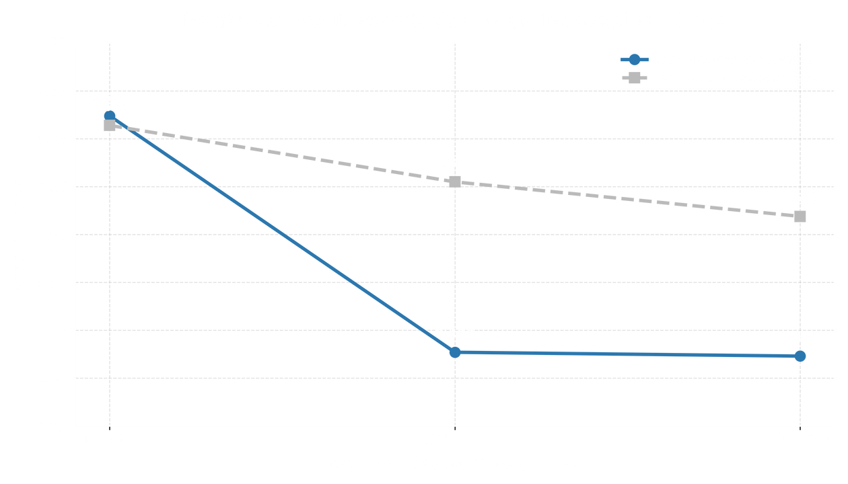
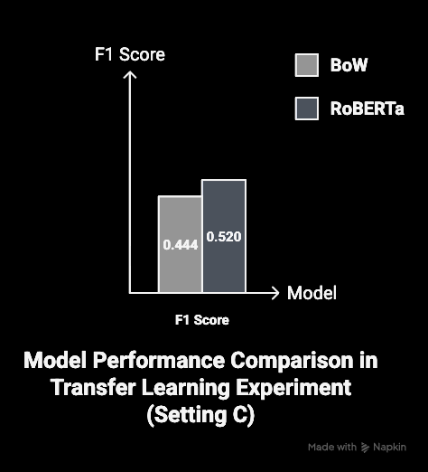
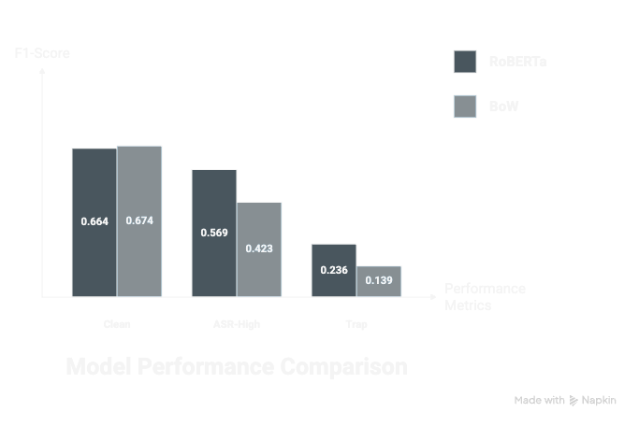
Results
Model Selection:
Validation F1 = 0.734 → RoBERTa selected
RoBERTa Final Performance:
F1 = 0.664 (clean)
F1 = 0.569 (noisy)
Transformers outperform traditional models
Performance remains stable under noisy ASR conditions
Masked Codewords
Final Model Comparison
Clean
ASR-High
Trap

Slide 8


Conclusion & Future Work
The pipeline successfully implements an end-to-end pipeline that transforms noisy ASR transcripts into a structured JSON output, including vessel name, location, and nature of distress
REMAINING CHALLENGES:
Continued reliance on explicit codewords (e.g., MAYDAY)
Improved classification of maritime messages (4 severity levels) under noisy ASR conditions
Further improvement of ASR robustness under high-noise conditions
Demonstrated improvement: RoBERTa is more robust than TF-IDF baselines to both adversarial phrasing and ASR transcription noise.
IMPROVEMENT ACTIONS
ADDITIONAL EXPERIMENTS
Increase Data Augmentation with Noisy ASR
Reduce Dependence on Codewords
Strengthen Contextual Learning
Mitigate Error Propagation Across the Pipeline
Re-evaluate Models Under Realistic Noise Conditions
Fine-tune ASR for Maritime Vocabulary
Add Adversarial Data Augmentation
Scale and Diversify the Dataset
Extend to Additional Languages and Acoustic Features

