Slide 1


SY0-701 – CompTIA Security+ Bootcamp
Content Creator - Instructor
CALIFORNIA INSTITUTE OF APPLIED TECHNOLOGY

Slide 2
Welcome to Day 1!

Slide 3
Day 1 Topics
Block 1 - Security Fundamentals & CIA Triad
Block 2 - Authentication & Access Controls
Block 3 - Cryptography Deep Dive
Block 4 - Network Security Architecture
LUNCH
Block 5 - Cloud Security Fundamentals
Block 6 - Physical & Environmental Security
Block 7 - Domain 1 PBQ Workshop
Block 8 - Day 1 Review & Test Prep

Slide 4
Day 1 – Block 1
Introduction to Security Fundamentals & CIA Triad
Confidentiality, Integrity, Availability
Security Controls Framework
CALIFORNIA INSTITUTE OF APPLIED TECHNOLOGY

Slide 5
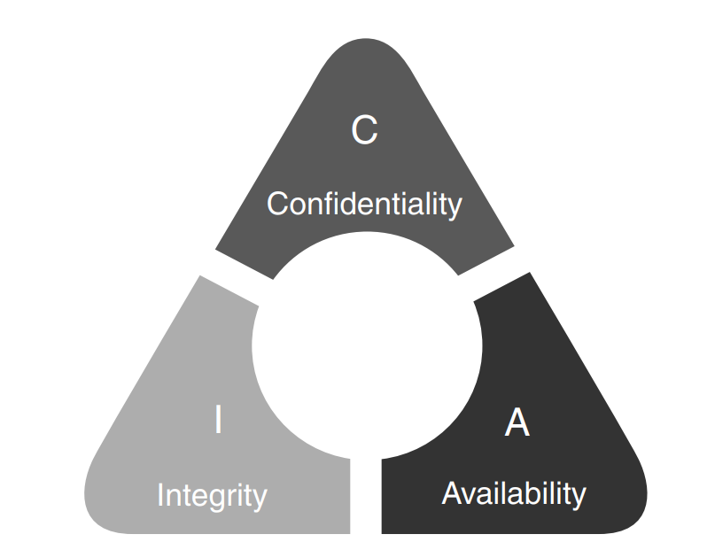
Confidentiality, Integrity, and Availability (CIA)
CIA Triad -
Confidentiality safeguards information from unauthorized access and disclosure.
Integrity ensures data remains accurate and trustworthy throughout its lifecycle.
Availability ensures systems and data are accessible and usable when needed by authorized users.
© 2024 by Pearson Education, Inc.

Slide 6
Non-Repudiation
Non-repudiation ensures that someone cannot deny the validity of something, such as authorship of a statement.
A legal concept widely used in information security to provide proof of the origin and integrity of data
Digital signatures are commonly used to provide non-repudiation in digital communications or storage.
© 2024 by Pearson Education, Inc.

Slide 7
Authentication, Authorization, and Accounting
AAA Framework -
Authentication ensures the validity of someone's identity and prevents unauthorized access.
Authorization determines what actions users are allowed to perform after they have been authenticated.
Accounting involves tracking and recording users' activities and resource use.
© 2024 by Pearson Education, Inc.

Slide 8
Gap Analysis
Gap analysis is a strategic planning tool used to evaluate differences between the current state and an ideal/desired state.
Helps pinpoint deficiencies in cybersecurity measures, whether in technology, software, personnel training, or policy enforcement
Enables organizations to address and close these gaps effectively
© 2024 by Pearson Education, Inc.

Slide 9
Control Categories
Technical Controls
Managerial Controls
Operational Controls
Physical Controls
© 2024 by Pearson Education, Inc.

Slide 10
Technical Controls
Technical controls are logical controls implemented by a computer, i.e., a technical system.
Examples
Authentication
Access control
Auditing
Cryptography
Firewalls
Session locks
Radius servers
RAID 5
© 2024 by Pearson Education, Inc.

Slide 11
Managerial Controls
Managerial controls reflect decisions made by an organization’s managers and executives.
These controls focus on risk management and how data security is administered.
Examples
Security policies and procedures
Personnel background checks
Security awareness training
Formal change-management procedures
© 2024 by Pearson Education, Inc.

Slide 12
Operational Controls
Operational controls are carried out by people (rather than technical systems) to enhance individual and group system security.
Examples
User training
Computer support
Baseline configuration development
Facility design details
Environmental security measures
Incident handling procedures
Disaster recovery plans
© 2024 by Pearson Education, Inc.

Slide 13
Physical Controls
Physical controls serve as the first line of defense in controlling access to an organization.
Examples
Ensuring that entrances are secure
Securing physical equipment
Logging and surveilling visitors
© 2024 by Pearson Education, Inc.

Slide 14
Control Types
Preventive Controls
Deterrent Controls
Detective Controls
Corrective Controls
Compensating Controls
Directive Controls
© 2024 by Pearson Education, Inc.

Slide 15
Preventive Controls
Preventive controls are implemented proactively to thwart incidents before they occur.
Examples
Access lists
Passwords
Fences
© 2024 by Pearson Education, Inc.

Slide 16
Deterrent Controls
Deterrent controls aim to deter threat actors from launching offensive assaults on an organization's environment.
Similar to preventive controls, but deterrent controls focus on discouraging attackers solely because the control exists
Examples
Alarm system signs
Web banner warning that unauthorized login attempts are being monitored
© 2024 by Pearson Education, Inc.

Slide 17
Detective Controls
Detective controls are designed to detect and monitor unauthorized behaviors and other hazards.
They issue alerts about failures in other controls; valuable during an attack and for post-incident analysis
Examples
Audit logs
Intrusion detection systems (IDSs)
Motion detection
Alarms
CCTV/video surveillance
Security Information and Event Management (SIEM) systems
Network intrusion detection systems (NIDSs)
© 2024 by Pearson Education, Inc.

Slide 18
Corrective Controls
Corrective controls are meant to be implemented after an incident to limit damage and facilitate quick recovery.
Essential for restoring systems and mitigating harmful effects post-incident
Examples
Tape backup
Hot sites
Quarantining an infected computer
© 2024 by Pearson Education, Inc.

Slide 19
Compensating Controls
Compensating controls are implemented to meet security requirements that are impractical or too challenging to implement.
Alternatives to costly or difficult-to-deploy security measures
Use with caution as they do not provide the same level of security as replaced controls
© 2024 by Pearson Education, Inc.

Slide 20
Directive Controls
Directive controls guide the operation and use of systems within an organization.
Direct individuals toward secure behavior and establish a security-conscious culture
Examples
Standards
Procedures
Policy guidelines
Security awareness training
© 2024 by Pearson Education, Inc.

Slide 21
Day 1 – Block 2
Authentication and Access Controls
Multi-Factor Authentication
SSO
PAM
Biometrics
CALIFORNIA INSTITUTE OF APPLIED TECHNOLOGY

Slide 22
Provisioning/De-provisioning User Accounts
Provisioning: Setting up a user account with necessary permissions and access settings
De-provisioning: Disabling or removing permissions and settings from a user account
Well-managed provisioning and de-provisioning are crucial for ensuring users always have appropriate access.
© 2024 by Pearson Education, Inc.

Slide 23
Permission Assignments and Implications
Permission assignment: Granting specific levels of access or activities (e.g., read, edit, delete) to users, groups, or system processes
Types of permission assignments
User-level
Group-level
Role-based
Resource-based
© 2024 by Pearson Education, Inc.

Slide 24
Identity Proofing
Identity proofing is the process of verifying a user's or system's identity within an organization.
Involves multiple levels of authentication ranging from passwords to biometric data
Extends beyond initial authentication; includes periodic re-authentication or session time-outs
© 2024 by Pearson Education, Inc.

Slide 25
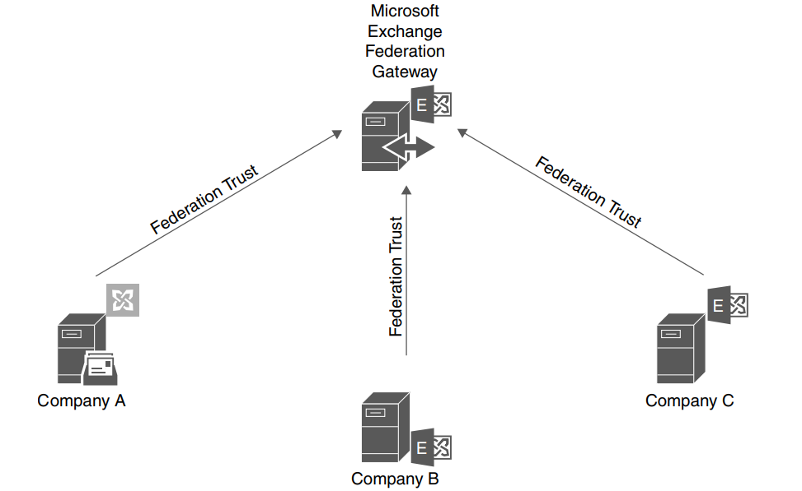
Federation
One system authenticates users and sends their authentication information to other systems.
© 2024 by Pearson Education, Inc.

Slide 26
Centralized versus Decentralized
Centralized access control
One entity is responsible for administering access to resources.
Characterized by consolidating control, data storage, and processing in a single location or server
Offers uniformity and consistency in decision-making
Decentralized access control
More than one entity is responsible for administering access to resources.
Distributes data and control across multiple locations, servers, or nodes
Offers higher resilience, flexibility, and autonomy
© 2024 by Pearson Education, Inc.

Slide 27
Single Sign-on (SSO)
SSO -
Single sign-on enables one set of credentials for access to multiple services or applications.
Minimizes the number of times a user needs to authenticate after initial login
SSO protocols
LDAP (Lightweight Directory Access Protocol)
OAuth (Open Authorization)
SAML (Security Assertion Markup Language)
© 2024 by Pearson Education, Inc.

Slide 28
Interoperability
Interoperability is the ability of different systems to work together. It’s crucial for identity and access management (IAM) systems.
IAM systems need to integrate seamlessly with various databases, applications, and authentication protocols. Lack of integration interferes with needs for access and auditing.
Collaboration with external partners requires secure cross-boundary authentication and authorization.
Interoperable IAM systems can adapt to new technologies and compliance requirements without overhauling existing infrastructure.
© 2024 by Pearson Education, Inc.

Slide 29
Attestation
Attestation provides evidence or proof, allowing one program or system to authenticate itself to another.
Remote attestation enables a system to make reliable statements about the software it's running to another system, which can make authorization decisions based on that information.
A TPM (Trusted Platform Model) quote operation verifies the contents of a TPM chip's platform configuration registers (PCRs) during provisioning.
Methods of attestation may be vulnerable to replay attacks, masquerading, and other cyberthreats.
© 2024 by Pearson Education, Inc.

Slide 30
Access Controls
Access controls organize and manage admission to physical areas and computer systems.
Role-based access control (RBAC) is controlled by the system, not the resource owner. When users are assigned a role, they get access to its resources.
Rule-based access control is also known as label-based access control. Example of a rule governing access: During certain hours each day, access is only permitted to specific IP addresses.
Mandatory access control (MAC) is the strictest control. It’s set by the system and uses security classifications for data.
© 2024 by Pearson Education, Inc.

Slide 31
Multifactor Authentication (MFA)
MFA -
Multifactor Authentication (MFA) is the process of authenticating a user by validating two or more claims from different categories of factors.
Two-Factor Authentication (2FA): A subset of MFA in which two factors are required to authenticate
Factor categories
Something you know
Something you have
Something you are
Biometrics (distinctive body measurements) and security keys (hardware devices) may be part of MFA.
© 2024 by Pearson Education, Inc.

Slide 32
Password Concepts
Password concepts are guidelines and practices for ensuring strong, secure passwords.
Passwords serve as the primary barrier to protect sensitive information and access controls.
Issues to consider when setting password requirements
Password length
Password complexity
Password reuse
Password expiration
Password age
© 2024 by Pearson Education, Inc.

Slide 33
Privileged Access Management (PAM) Tools
PAM -
PAM tools centrally manage access to privileged accounts based on the principle of least privilege.
Just-in-time (JIT) permissions give access for a limited period.
Ephemeral credentials are generated for specific sessions or tasks and invalidated shortly after completion. They expire more quickly than JIT permissions.
Password vaulting means using a centralized, encrypted repository to store various access credentials.
© 2024 by Pearson Education, Inc.

Slide 34
Permissions
Permissions define the rights to perform actions on a system and are associated with files, directories, or processes.
In Windows, permissions are managed using security identifiers (SIDs) and ACLs.
In Linux, file permissions are represented symbolically or numerically. Linux has fewer permissions than Windows.
Best practices for permissions include granting them to security groups rather than individual users and using central management for easier control.
© 2024 by Pearson Education, Inc.

Slide 35
Least Privilege
The principle of least privilege advocates for granting individuals or systems only the necessary access or permissions to perform their tasks.
Limiting access to the minimal level needed reduces potential damage from errors and malicious actions.
Examples
In a hospital, nurses may access patient medical records but not financial data.
IT technicians may update system software but cannot access HR records.
© 2024 by Pearson Education, Inc.

Slide 36
Day 1- Block 3
Cryptography Deep Dive
Symmetric / Asymmetric Encryption
Hashing
Digital Signatures
PKI
Key Management
CALIFORNIA INSTITUTE OF APPLIED TECHNOLOGY

Slide 37
Encryption
Encryption converts information into a coded format to prevent unauthorized access.
Different levels of encryption offer varying degrees of protection.
Full-disk encryption secures an entire hard drive, including data, files, and the operating system.
Partition encryption involves treating portions of a disk as separate units.
File encryption, or encrypting individual files, adds an additional layer of security.
© 2024 by Pearson Education, Inc.

Slide 38
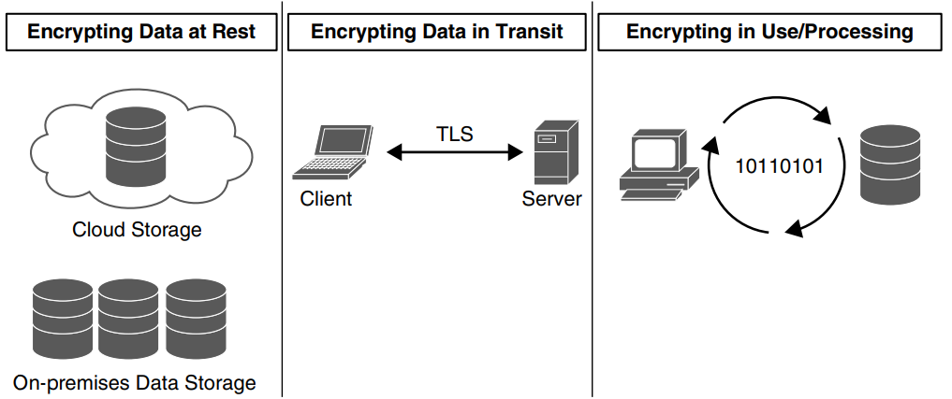
Transport/Communication
Data security and encryption are essential, whether the data is at rest, in transit, or in use.
© 2024 by Pearson Education, Inc.

Slide 39
Algorithms, Key Length, and Tools
Algorithms: Mathematical formulas used in cryptographic processes
Key length: The number of bits in an encryption algorithm's key; longer keys typically provide stronger encryption
Tools: Specialized technologies and protocols for securing and managing digital information throughout its lifecycle
© 2024 by Pearson Education, Inc.

Slide 40
Trusted Platform Module & Hardware Security Module
Trusted Platform Module (TPM): A hardware-based security technology using a secure cryptoprocessor chip to execute cryptographic operations, generate and manage cryptographic keys, authenticate platform devices, and ensure platform integrity by storing security measurements
Hardware Security Module (HSM): A physical device serving as a secure cryptoprocessor, providing faster encryption than software-based solutions, and generally tamper-proof
© 2024 by Pearson Education, Inc.

Slide 41
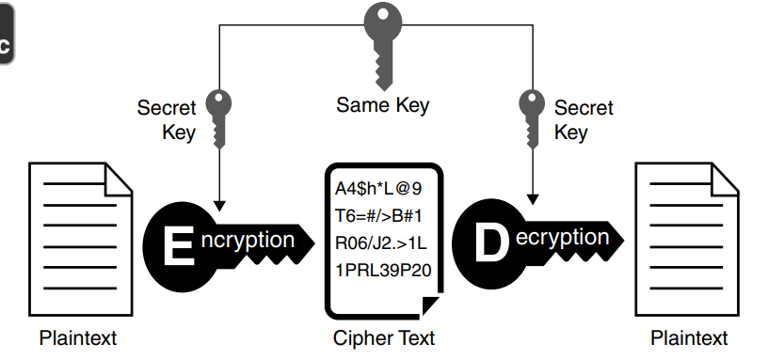
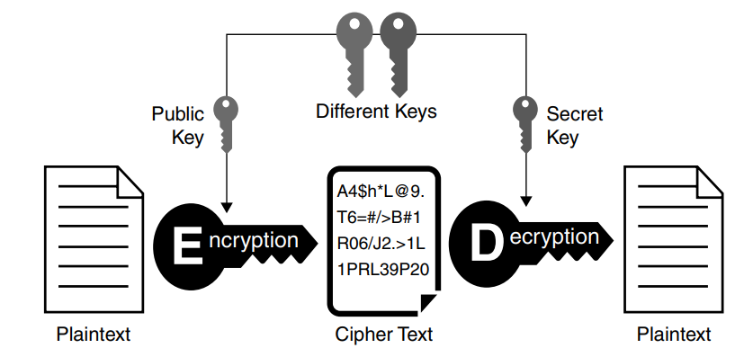
Symmetric versus Asymmetric Encryption
Symmetric encryption uses a single key for both encryption and decryption.
Asymmetric encryption employs a pair of keys: a public key for encryption and a private key for decryption.
Symmetric Encryption
Asymmetric Encryption
© 2024 by Pearson Education, Inc.

Slide 42
Hashing & Salting
Hashing: A one-way function that maps data to a fixed-length value, primarily for authentication and ensuring data integrity by verifying that it hasn't been altered
Salting: Adding random data to a password before hashing to enhance security
© 2024 by Pearson Education, Inc.

Slide 43
Digital Signatures
Digital signature: A mathematical scheme used to verify the authenticity and integrity of a digital message or document
Three algorithms used in a digital signature:
Key generation algorithm
Signing algorithm
Signature verifying algorithm
Two properties required for a digital signature:
Authenticity verification
Private key
© 2024 by Pearson Education, Inc.

Slide 44
Public Key Infrastructure (PKI)
PKI -
Public key infrastructure (PKI) encompasses key management, certificate authorities (CAs), intermediate CAs, and registration authorities (RAs).
PKI enables secure connections for websites, email transmissions, and remote access by utilizing asymmetric key pairs consisting of public and private keys.
Private keys are kept secret, while public keys can be distributed. Private key escrow may be provided by trusted third parties.
© 2024 by Pearson Education, Inc.

Slide 45
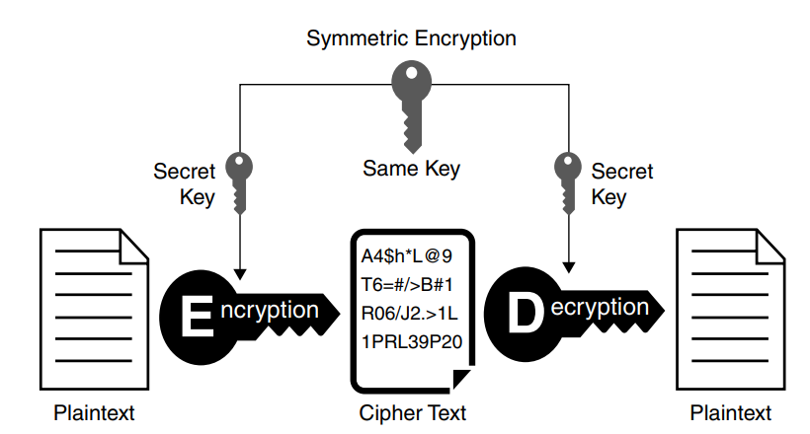
Key Exchange
Key exchange, also known as key establishment, is a cryptographic process that enables two parties to exchange cryptographic keys.
© 2024 by Pearson Education, Inc.

Slide 46
Key Management System
A Key Management System (KMS) safeguards digital data by managing codes used to lock and unlock data
Main functions:
Generates cryptographic keys
Stores keys securely
Exchanges keys
Key use and access control
Key replacement and rotation
© 2024 by Pearson Education, Inc.

Slide 47
Secure Enclave
A secure enclave is a hardware-based feature found in devices like iPhones.
It segregates encryption tasks and runs on a separate microprocessor with its own operating system.
Designed to resist tampering, it prevents access to its data through strict protocols.
The enclave is resistant to software and hardware attacks.
© 2024 by Pearson Education, Inc.

Slide 48
Obfuscation & Steganography
Obfuscation: A technique used to protect sensitive information by altering or disguising the original data to prevent easy comprehension or access by unauthorized users
Steganography: The practice of concealing secret messages within seemingly innocuous carriers
Audio steganography
Video steganography
Image steganography
© 2024 by Pearson Education, Inc.

Slide 49
Key Stretching
Key Stretching: A cryptographic technique used to enhance the security of weak keys against brute-force attacks
Salt: Randomly generated data added to a password before hashing to prevent the same password from producing the same hash value
Pepper: Another randomly generated value added to a password hash, kept secret and separate from the hashed password
© 2024 by Pearson Education, Inc.

Slide 50
Blockchain & Open Public Ledger
Blockchain: A secure and immutable digital ledger technology that records transactions across a network of computer systems in a decentralized manner
Prevents alteration or fraud
Open public ledger: A component of blockchain technology that organizes transaction information into blocks that are chained together chronologically
Verifies transaction authenticity
Prevents double-spending without the need for a central authority
© 2024 by Pearson Education, Inc.

Slide 51
Certificates
Certificate: A digital document issued by a Certificate Authority (CA) to verify the identity of the certificate holder and ensure the legitimacy of online communications
Certificate Authorities (CA): Entities, typically servers, responsible for issuing certificates to users in a Public Key Infrastructure (PKI) system, serving as trusted third parties to validate identities and secure digital exchanges
© 2024 by Pearson Education, Inc.

Slide 52
SY0-701 – CompTIA Security+ Bootcamp
Day 1 – Block 4
Network Security Architecture
Firewalls
IDS / IPS
Network Segmentation
VLANS
DMZ
CALIFORNIA INSTITUTE OF APPLIED TECHNOLOGY

Slide 53
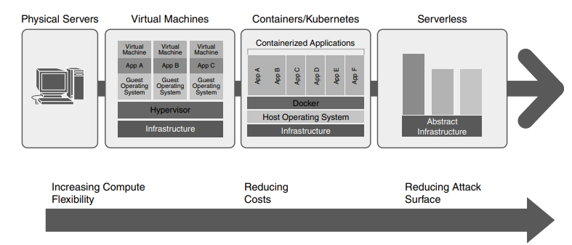
Network Infrastructure
Network infrastructure encompasses an organization’s essential hardware and software for network connectivity, communication, operations, and management.
Evolution of Network Infrastructure
© 2024 by Pearson Education, Inc.

Slide 54
Security Zones
Security zones: Segregated areas in a network under specific security policies and controls
Internal zones: Trusted segments in which sensitive or internal data is processed
External zones: Areas allowing connections from public Internet or other untrusted networks
Screened subnet: Specialized external zone that isolates public-facing services from the Internet
Specialized zones: Zones designed to meet regulatory compliance requirements
© 2024 by Pearson Education, Inc.

Slide 55
Attack Surface
Attack surface: All the vulnerabilities and potential access points an attacker could use to gain access to the system
Larger surface = Greater risk
Strategies to reduce the attack surface
Turn off unnecessary services
Close open ports
Apply patches and updates
Use firewalls
Implement strong authentication
© 2024 by Pearson Education, Inc.

Slide 56
Connectivity
Connectivity: How networks, systems, and applications connect and communicate
Security considerations
Encrypt data in transit
Secure connection endpoints
Employ secure protocols
Use VPNs or firewalls
Remember connectivity when designing new systems with other departments
© 2024 by Pearson Education, Inc.

Slide 57
Failure Modes
Fail-open configuration: System remains available if a portion fails
Fail-closed configuration: Entire system becomes inaccessible if a portion fails
Examples
DNS server: May fail open to continue servicing other zones, but the database server may fail closed to protect confidential information
Firewall: Would fail closed to maintain security
© 2024 by Pearson Education, Inc.

Slide 58
Device Attribute
Device attribute: A characteristic determining device operation in a network environment
Active vs. passive
Active/active: Devices share workload simultaneously; critical for failover or load balancing
Active/passive: One device active, another on standby; passive activates if active fails or is manually switched
Inline monitoring vs. tap/monitor mode
Inline monitoring: Device is placed directly in the traffic flow, allowing active intervention
Tap/monitor mode: Device observes traffic without interfering.
© 2024 by Pearson Education, Inc.

Slide 59
Network Appliances
Network appliances: Essential for network functionality, security, and efficiency
Types of network appliances
Jump server
Proxy server
Intrusion Prevention System (IPS)/Intrusion Detection System (IDS)
Load balancer
Sensors
© 2024 by Pearson Education, Inc.

Slide 60
Port Security
Port security is vital for safeguarding network access and preventing unauthorized devices from communicating through network ports.
The 802.1X authentication standard provides port-based network access control.
EAP is a universal authentication framework that defines message formats. It’s frequently used with 802.1X.
© 2024 by Pearson Education, Inc.

Slide 61
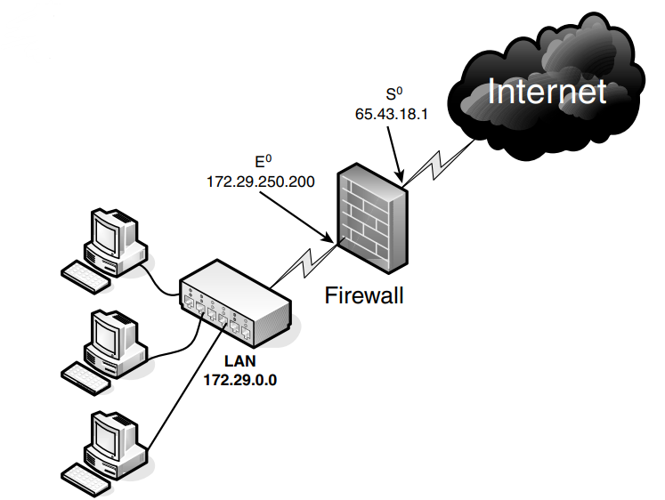
Firewall Types
A firewall is a network security device or software that acts as a barrier between a trusted internal network and untrusted external networks, such as the Internet.
© 2024 by Pearson Education, Inc.

Slide 62
Firewall
A firewall is a network security device or software that monitors incoming and outgoing network traffic.
Firewall rules control the flow of data packets.
Access control lists (ACLs) govern how traffic flows through the network.
Ports are virtual docks where network services can receive data.
Protocols are rules and conventions governing data transmission and acceptance.
A screened subnet is a segment that separates the internal network from an external network (e.g., the Internet).
© 2024 by Pearson Education, Inc.

Slide 63
IDS/IPS
Intrusion detection systems (IDSs) monitor and issue alerts about suspicious activities. Intrusion protection systems (IPSs) are proactive; they block known or potential threats.
These systems use predefined signatures (such as specific strings of data) to identify threats. However, known signatures could become irrelevant as new variants of malware emerge.
Trends identified in analyses of logs can indicate the presence of new vulnerabilities.
© 2024 by Pearson Education, Inc.

Slide 64
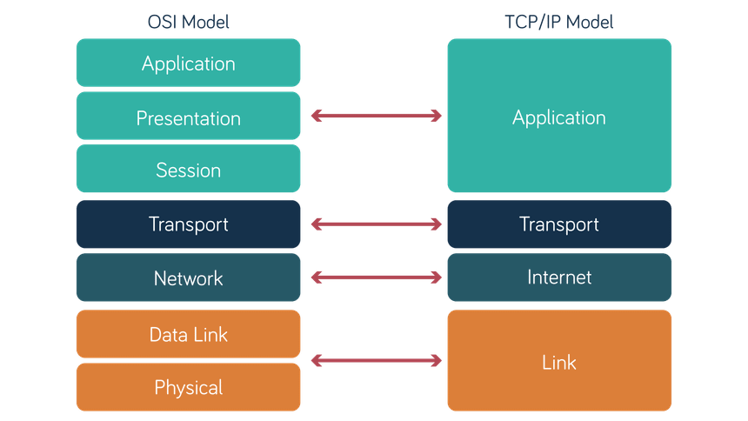
Lunch
OSI Model vs. TCP/IP Model
https://neosnetworks.com/resources/blog/what-is-osi-model/

Slide 65
SY0-701 – CompTIA Security+ Bootcamp
Day 1 – Block 5
Cloud Security Fundamentals
IaaS / PaaS / SaaS Security
Shared Responsibility
Cloud Controls
CALIFORNIA INSTITUTE OF APPLIED TECHNOLOGY

Slide 66
Cloud
Cloud computing offers on-demand services that extend computer or network capabilities.
Benefits
Lower cost
Reduced administration and maintenance
Increased reliability
Improved scalability
Higher performance (potentially)
Concerns
Lack of administrative control
Security
© 2024 by Pearson Education, Inc.

Slide 67
Virtualization
Virtualization technology is the creation of virtual instances of physical hardware. Vulnerabilities may lead to unauthorized use of virtual resources.
Virtual machine (VM) escape occurs when an attacker breaks out of a virtual machine to access the host system.
Resource reuse involves sharing physical resources among multiple virtual instances. It introduces the risk of data leaks between virtual environments.
© 2024 by Pearson Education, Inc.

Slide 68
Cloud Specific
The cloud offers various on-demand services to extend computer capabilities:
Software as a service (SaaS)
Infrastructure as a service (IaaS)
Platform as a service (PaaS)
Security as a service (SECaaS)
© 2024 by Pearson Education, Inc.

Slide 69
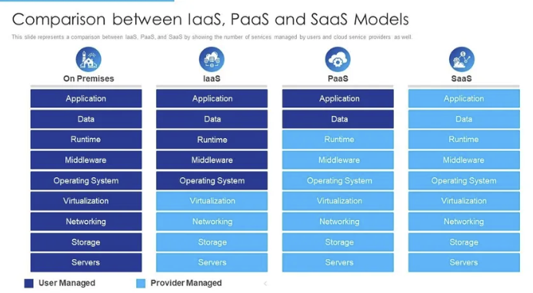
Cloud Specific
© 2024 by Pearson Education, Inc.

Slide 70
Cloud Environments
In cloud computing, availability is often determined by the storage class.
Different availability metrics influence cost.
Storage class selection should be based on a thorough risk analysis.
Recommendation: Select applications with greater storage availability for mission-critical uses.
© 2024 by Pearson Education, Inc.

Slide 71
Multi-Cloud System
A multi-cloud system involves using multiple cloud service platforms (e.g., AWS, Azure, Google Cloud) to fulfill diverse computational and storage needs.
Reduces dependency on a single cloud service provider
Benefits
Risk mitigation
High availability
Robust disaster recovery
© 2024 by Pearson Education, Inc.

Slide 72
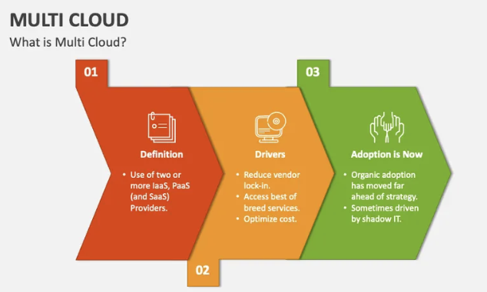
Multi-Cloud System
© 2024 by Pearson Education, Inc.

Slide 73
Cloud Specific
Cloud environments may be public, private, hybrid, or community.
Public: Applications and storage are offered to the general public over the Internet. Examples are free web email services and scalable pay-as-you-go business services.
Private: A private cloud is designed for a particular organization and gives the security administrator some control over data and infrastructure. Resources could come from the organization itself or a third party.
Hybrid: Mixing elements of public and private clouds, hybrid environments use servers from the organization and the cloud. Confidential data is typically kept in-house.
Community: In this type of public/private mix, multiple organizations can share the public portion.
© 2024 by Pearson Education, Inc.

Slide 74
Cloud Specific
Cloud Security Concerns
Lack of privacy
Lack of accountability
Improper authentication
Data recovery problems
Mitigation
Strict access policies
Strong passwords and MFA
Encryption
Documentation of stored items
© 2024 by Pearson Education, Inc.

Slide 75
Other Cloud Concerns
Social media security
Users post information that could compromise security
Difficult to track all social media platforms and applications; consider using allow lists and deny lists
Peer-to-peer (P2P) networks
Used for file sharing, gaming, and streaming media
Potential for malware and system infiltration
Dark web
A P2P system popular for facilitating illegal activities
Employees might connect cloud resources, so auditing is important.
Directly monitoring the dark web can introduce risk. Monitoring can be outsourced.
© 2024 by Pearson Education, Inc.

Slide 76
Infrastructure as Code (IaC)
IaC -
Infrastructure as Code (IaC) involves managing and provisioning computer data centers through machine-readable definition files.
Replaces physical hardware configuration and interactive configuration tools
Provides the scalability and integrations necessary for modern applications and deployments
© 2024 by Pearson Education, Inc.

Slide 77
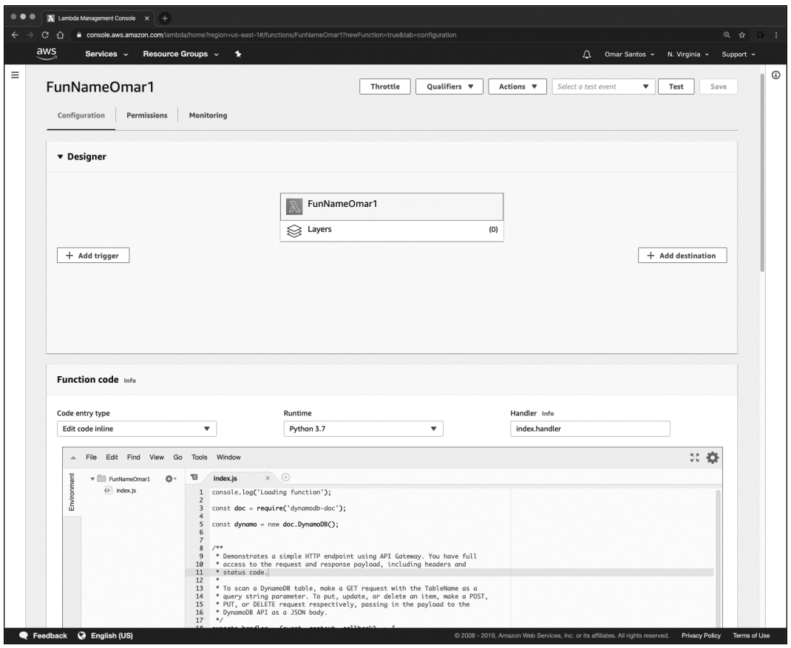
Serverless
Serverless architecture uses cloud platforms like AWS, Azure, and Google Cloud to host and develop code.
Doesn’t mean the absence of servers; rather, cloud providers dynamically manage server allocation and provisioning
Example: AWS Lambda is a popular serverless architecture. Shown here is a “function” or application in AWS Lambda.
© 2024 by Pearson Education, Inc.

Slide 78
SY0-701 – CompTIA Security+ Bootcamp
Day 1 – Block 6
Physical & Environmental Security
Physical Controls
Environmental Controls
Asset Security
CALIFORNIA INSTITUTE OF APPLIED TECHNOLOGY

Slide 79
Physical Controls
Physical controls serve as the first line of defense in controlling access to an organization.
Examples
Ensuring that entrances are secure
Securing physical equipment
Logging and surveilling visitors
© 2024 by Pearson Education, Inc.

Slide 80
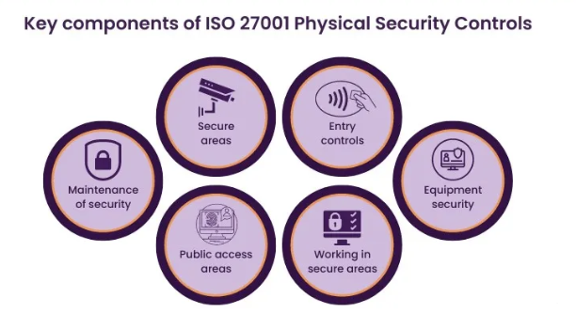
Physical Controls
© 2024 by Pearson Education, Inc.

Slide 81
Physical Attacks
Physical attacks target tangible components of information systems, such as hardware devices, data storage mediums, and physical locations.
Brute-force
Physical brute-force
RFID cloning
Environmental
© 2024 by Pearson Education, Inc.

Slide 82
On-Premises
On-premises computing architecture involves housing and managing hardware, software, servers, and network resources within an organization's physical location.
Organizations have complete control over and responsibility for their IT infrastructures, including management, maintenance, and security.
May involve increased costs and complexity, requiring dedicated personnel and equipment for effective management and maintenance
© 2024 by Pearson Education, Inc.

Slide 83
Power
Power management involves provisioning, controlling, and efficiently utilizing electricity to maintain uninterrupted facility operation.
Uninterruptible Power Supply (UPS) devices offer emergency power during main power failures by storing energy in batteries or supercapacitors.
Generators supply power during complete power loss or in areas without standard electrical service, converting mechanical or chemical energy into electrical energy.
© 2024 by Pearson Education, Inc.

Slide 84
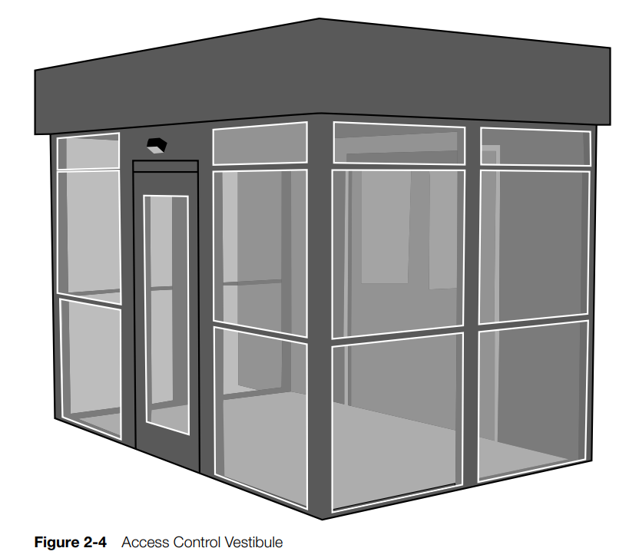
Physical Security
Bollards/ Barricades
Access Control Vestibules
Fencing
Video Surveillance
Security Guards
Access badges
Lighting
Sensors
Infrared
Pressure
Microwave
Ultrasonic
© 2024 by Pearson Education, Inc.

Slide 85
Day 1 – Block 7
Domain 1 PBQ Workshop
Hands-on PBQ Practice Session
Crucial Exams PBQs
Cryptographic Concepts PBQ
Network Components and Common Protocols PBQ
CALIFORNIA INSTITUTE OF APPLIED TECHNOLOGY

Slide 86
Day 1 – Block 8
Day 1 Review & Test Prep
Domain 1 Concept Review
Practice Exam 25 Questions
Crucial Exams
Review Quiz Results & Address Weak Areas
Evening Assignment
Google Research - OSI Model (7 Layers) | TCP/IP (4 Layers) | Defense-in-Defense Model
Crucial Exams
Flashcards - Protocol Acronyms; PBQ Practice - Network Security Protocols and Technologies
uCertify Lessons
CALIFORNIA INSTITUTE OF APPLIED TECHNOLOGY

Slide 87
Exam-Critical Topics
Foundational Reinforcements
CIA Triad & AAA — foundational exam anchors for confidentiality, integrity, availability, and identity management
Control Types — preventive, detective, corrective, and their role in layered defense
Authentication & Access Controls — MFA, SSO, RBAC/MAC/DAC/ABAC, least privilege, PAM
Cryptography Essentials — symmetric vs. asymmetric, hashing/salting, PKI, certificates, key exchange, KMS
Network Security Architecture — firewalls, IDS/IPS, segmentation, VLANs, DMZ
Cloud Fundamentals — deployment/service models, shared responsibility, virtualization, IaC, serverless
Physical Security Controls — access control, surveillance, fire suppression, secure areas
Control Categories — managerial, operational, physical
Identity Proofing, Federation, Interoperability — supporting IAM concepts
Secure Enclave, Steganography, Blockchain — contextual crypto concepts
Environmental Controls — HVAC, EMI shielding, hot/cold aisles
Multi‑Cloud & Cloud‑Specific Considerations — governance, visibility, misconfiguration risks

Slide 88
Questions?

Slide 89
Welcome to Day 2!

Slide 90
Day 2 Topics
Block 1 - Threat Landscape & Actors
Block 2 - Social Engineering & Human Factors
Block 3 - Malware Analysis & Defense
Block 4 - Attack Vectors & Techniques
LUNCH
Block 5 - Vulnerability Management
Block 6 - Wireless & Mobile Security
Block 7 - Domain 2 PBQ Workshop
Block 8 - Day 2 Review & Test Prep

Slide 91
Carry Forward Concepts
The CIA Triad and AAA as the basis for understanding how attacks impact confidentiality, integrity, and availability
Authentication and access control models (MFA, SSO, RBAC/ABAC/MAC/DAC, least privilege)
Cryptography fundamentals — symmetric vs. asymmetric, hashing, PKI, certificates, and key exchange
Network security architecture — firewalls, IDS/IPS, segmentation, VLANs, DMZ placement
Cloud security essentials — deployment/service models, shared responsibility, virtualization, IaC, serverless
Physical and environmental controls that protect infrastructure and reduce operational risk

Slide 92
Day 2 – Block 1
Threat Landscape & Actors
APT
Ransomware Groups
Insider Threats
Threat Intelligence
Crucial Exams
Threats, Vulnerabilities, and Mitigation
CALIFORNIA INSTITUTE OF APPLIED TECHNOLOGY

Slide 93
Threat Actors
Understanding the characteristics and traits of different types of attackers is crucial for effective cybersecurity defense.
Threat actors vary widely in their expertise and resources. They range from inexperienced individuals to highly skilled syndicates and agents of nation-states.
Threat actors have diverse motivations such as financial gain, intellectual property theft, and causing disruption/chaos.
© 2024 by Pearson Education, Inc.

Slide 94
Types of Threat Actors
Unskilled attackers, also known as script kiddies, lack technical skills and often rely on readily available malicious code copied from the Internet.
Hacktivists combine hacking skills with activist motives, targeting organizations or systems to promote social or political agendas.
Cybercriminals, operating either independently or in syndicates, are motivated mainly by financial gain. They may use considerable resources and sophistication in their attacks.
© 2024 by Pearson Education, Inc.

Slide 95
Types of Threat Actors (cont.)
Advanced Persistent Threats (APTs) are highly sophisticated and well-funded attackers with extensive resources and extremely high motivation. They’re often associated with nation-states.
Insider threats are individuals within organizations who exploit their authorized access for malicious purposes.
Shadow IT involves employees using an organization’s IT systems and services without the IT department’s knowledge.
© 2024 by Pearson Education, Inc.

Slide 96
Attributes of Actors
Hacktivists
Typically motivated by social or political issues
Often choose disruptive tactics such as DoS/DDoS attacks and website defacement
Criminals
Typically motivated by financial gain
Engage in activities such as theft and fraud to generate profit
© 2024 by Pearson Education, Inc.

Slide 97
Attributes of Actors
Nation-State Actors
Varied motivations such as advancing an industry or causing political instability
May engage in intellectual property theft or disrupt critical infrastructure
Internal Actors (Insiders)
Varied motivations such as ethical concerns, personal grievances, and financial gain
May engage in intellectual property theft, disrupt critical infrastructure, or exploit vulnerabilities for personal gain
© 2024 by Pearson Education, Inc.

Slide 98
Motivations
Motivation is the reason or drive behind an individual’s or group’s actions.
Common motivations are financial gain, ideological beliefs, revenge, and recognition.
Understanding these motivations is crucial for developing strategies to mitigate and respond to cybersecurity threats effectively.
© 2024 by Pearson Education, Inc.

Slide 99
Threat Actor Motivations
Data exfiltration: Transferring data from a computer system or network to an external location or entity without authorization
Espionage: Spying aimed at obtaining secret or confidential information
Service disruption: Action aimed at halting or interrupting services or operations
© 2024 by Pearson Education, Inc.

Slide 100
Threat Actor Motivations
Blackmail: Threatening to disclose embarrassing or damaging information unless certain demands, often financial, are met
Financial gain: Aiming to increase one's wealth or financial resources through illicit means
Philosophical/political beliefs: Acting upon deeply held convictions or ideologies related to political or philosophical concepts
© 2024 by Pearson Education, Inc.

Slide 101
Threat Actor Motivations
Ethics: Acting upon accepted standards of behavior; guided by principles of morality, integrity, and fairness
Revenge: Seeking retaliation or retribution against perceived injustices or wrongdoings
Disruption/chaos: Creating disorder to destabilize normal operations
© 2024 by Pearson Education, Inc.

Slide 102
War
Cyber warfare is a state-sponsored, politically motivated attack on an adversary's information systems.
Poses significant threats to national security
Often focuses on systems and assets vital to the functioning of a society or nation
Power grids
Communication networks
Government systems
© 2024 by Pearson Education, Inc.

Slide 103
Day 2 – Block 2
Social Engineering & Human Factors
Phishing
Pretexting
Baiting
Tailgating
Deepfakes
uCertify Lab
6.12.1 Using Social Engineering Techniques to Plan an Attack
CALIFORNIA INSTITUTE OF APPLIED TECHNOLOGY

Slide 104
Types of Social Engineering Attacks
Phishing involves fraudulent attempts to obtain private information by masquerading as someone else.
Vishing or voice phishing involves using voice calls, often over VoIP systems, to deceive individuals into revealing sensitive information.
Smishing, a combination of "SMS" and "phishing," involves sending deceptive SMS messages to trick recipients into clicking malicious links or downloading malware onto their mobile devices.
© 2024 by Pearson Education, Inc.

Slide 105
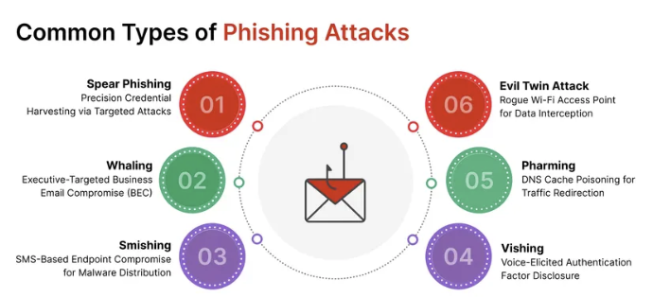
Types of Social Engineering Attacks
© 2024 by Pearson Education, Inc.

Slide 106
Phishing
Phishing: A Social engineering attack aimed at tricking individuals into sharing sensitive data
Often conducted via email, messaging apps, and websites
User education and awareness are vital to keeping systems secure
© 2024 by Pearson Education, Inc.

Slide 107
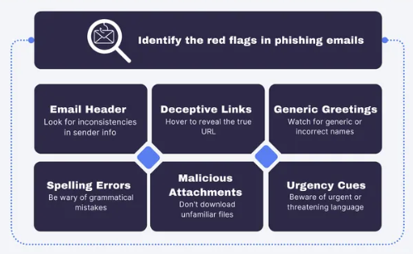
Anatomy of a Phishing Email
© 2024 by Pearson Education, Inc.

Slide 108
Types of Social Engineering Attacks
Misinformation refers to false or misleading information that’s spread without malicious intent.
Disinformation is false or misleading information that is intentionally deceptive.
Impersonation involves pretending to be someone else to gain trust or access.
Business Email Compromise (BEC) is a sophisticated scam that compromises legitimate business email accounts to conduct unauthorized transfers of funds.
© 2024 by Pearson Education, Inc.

Slide 109
Types of Social Engineering Attacks
In pretexting, the attacker invents a scenario (a pretext) to persuade a victim to divulge information.
In a watering hole attack, attackers load malware onto sites that the targets frequently visit.
Brand impersonation involves attackers posing as trusted brands such as banks and technology companies.
Typosquatting involves attackers maliciously using domain names that are typo versions of legitimate domains.
© 2024 by Pearson Education, Inc.

Slide 110
Human Vectors/Social Engineering
Human vectors are individuals manipulated into giving access to sensitive information or systems.
Social engineering encompasses a broad range of techniques aimed at manipulating the human psyche.
© 2024 by Pearson Education, Inc.

Slide 111
Day 2 – Block 3
Malware Analysis & Defense
Viruses
Worms
Trojans
Ransomware
Zero-Day
Fileless
Crucial Exams
Threats, Vulnerabilities, and Mitigations
CALIFORNIA INSTITUTE OF APPLIED TECHNOLOGY

Slide 112
Malware Attacks
Malware is software designed to infiltrate, damage, or gather information from a system without user consent.
Security professionals define and categorize malware to inform preventive measures.
When malware is identified, removal or quarantine is crucial.
© 2024 by Pearson Education, Inc.

Slide 113
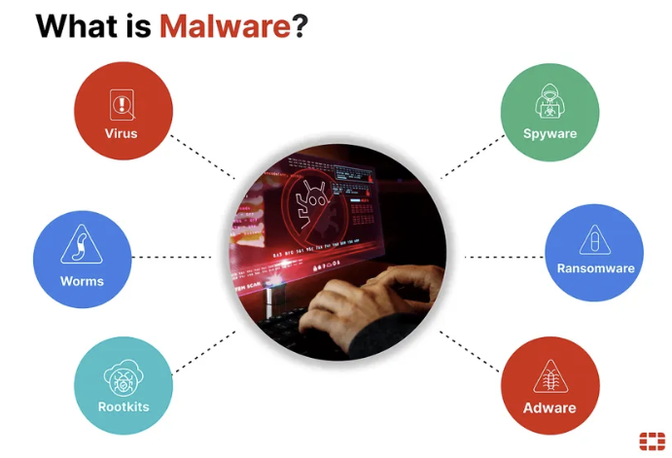
What is Malware
© 2024 by Pearson Education, Inc.

Slide 114
Types of Malware Attacks
Ransomware restricts access to a computer system and demands payment for decryption. It’s often propagated via phishing.
Trojans masquerade as legitimate software but perform malicious functions. They’re often downloaded unknowingly.
Worms self-replicate to spread across networks, exploiting security vulnerabilities in operating systems and applications.
Spyware secretly monitors and collects user activity, potentially compromising sensitive information.
Bloatware consumes excessive system resources and can hinder system performance.
© 2024 by Pearson Education, Inc.

Slide 115
Types of Malware Attacks (cont.)
Viruses infect computers when executed by users and spread copies of themselves throughout the system.
Keyloggers in hardware and software capture keystrokes to steal sensitive data.
Logic bombs initiate malicious functions under specific conditions, blurring the line between malware and malware delivery systems.
Rootkits gain administrator-level control over computer systems without detection.
© 2024 by Pearson Education, Inc.

Slide 116
Antivirus Software
Antivirus software prevents, detects, and removes malware.
Also known as anti-malware
Viruses and Trojans can damage networks and are costly to overcome; ransomware alone has cost victims billions of dollars.
Every endpoint device, including workstations, tablets, and phones, should have antivirus software to ensure comprehensive protection.
© 2024 by Pearson Education, Inc.

Slide 117
Zero Day
A Zero-Day (0-day) refers to a previously unknown software vulnerability that attackers discover and exploit before the vendor or developer becomes aware of it and releases a patch.
The term "zero-day" means the developers have had zero days to fix the vulnerability
© 2024 by Pearson Education, Inc.

Slide 118
Fileless
Fileless malware is a type of malicious software that does not rely on traditional files written to disk. Instead, it runs entirely in memory or abuses legitimate tools already present on the system.
Because it leaves little or no trace on disk, it is much harder for traditional antivirus solutions to detect.
© 2024 by Pearson Education, Inc.

Slide 119
Day 2 – Block 4
Attack Vectors & Techniques
Injection Attacks
XSS
CSRF
Buffer Overflow
Privilege Escalation
uCertify Lab
7.2.1 Performing SQL Injection in DVWA
CALIFORNIA INSTITUTE OF APPLIED TECHNOLOGY

Slide 120
Web-Based
Web-based vulnerabilities are weaknesses in web applications and services.
Structured Query Language injection (SQLi) vulnerabilities are flaws that attackers can use to manipulate SQL queries in web applications.
Cross-site scripting (XSS) vulnerabilities enable the injection of malicious scripts into web pages.
© 2024 by Pearson Education, Inc.

Slide 121
Intrusion Prevention System / Intrusion Detection System Logs
IPS / IDS -
An IPS and IDS work together to prevent and detect potentially harmful activities within a network. Their logs can alert you to various attacks such as SQL injections and cross-site scripting.
Generated by solutions like Snort and Suricata
Examples
2023-09-23 13:45:32 ALERT SQL Injection detected from 192.168.1.4
2023-09-23 13:46:10 ALERT Brute-force attempt from 203.0.113.7
© 2024 by Pearson Education, Inc.

Slide 122
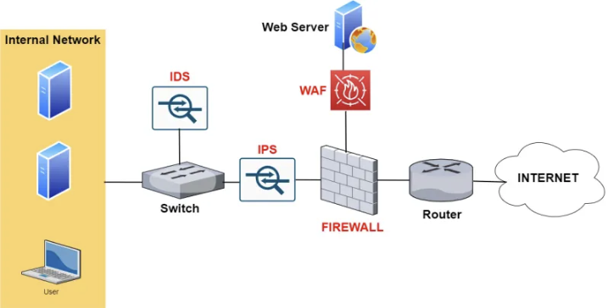
IPS - IDS – Firewall – WAF Network Layout
© 2024 by Pearson Education, Inc.

Slide 123
Application Security
Application security refers to the security measures implemented at the application level.
Input validation ensures data integrity by verifying the type and content of user or application input, preventing vulnerabilities like XSS and SQLi.
Secure cookies implement the secure attribute in HTTP response cookies to prevent unauthorized access and transmission of sensitive information.
© 2024 by Pearson Education, Inc.

Slide 124
Application Attacks
Application attacks exploit software application weaknesses, potentially resulting in unauthorized access, data theft, or system disruption.
Injection
Buffer overflow
Replay
Privilege escalation
Forgery
Directory traversal
© 2024 by Pearson Education, Inc.

Slide 125
Application Attacks (cont.)
CSRF (Cross-Site Request Forgery)
CSRF tricks a victim’s browser into performing an action on a website without their consent, using the victim’s authenticated session.
Privilege Escalation
Privilege escalation happens when a user or attacker gains higher-level permissions than intended by exploiting misconfigurations or vulnerabilities.
© 2024 by Pearson Education, Inc.

Slide 126
Application
The application layer is a gateway to user interactions and data, making it a common target of attacks.
Buffer overflow involves a program writing more data to a buffer than it can hold, introducing vulnerability.
Memory injection involves injecting malicious code into a system's memory.
A race condition weakness occurs when multiple processes or threads try to access a system at once.
A malicious update involves altering software or firmware with harmful code via an update that appears legitimate.
© 2024 by Pearson Education, Inc.

Slide 127
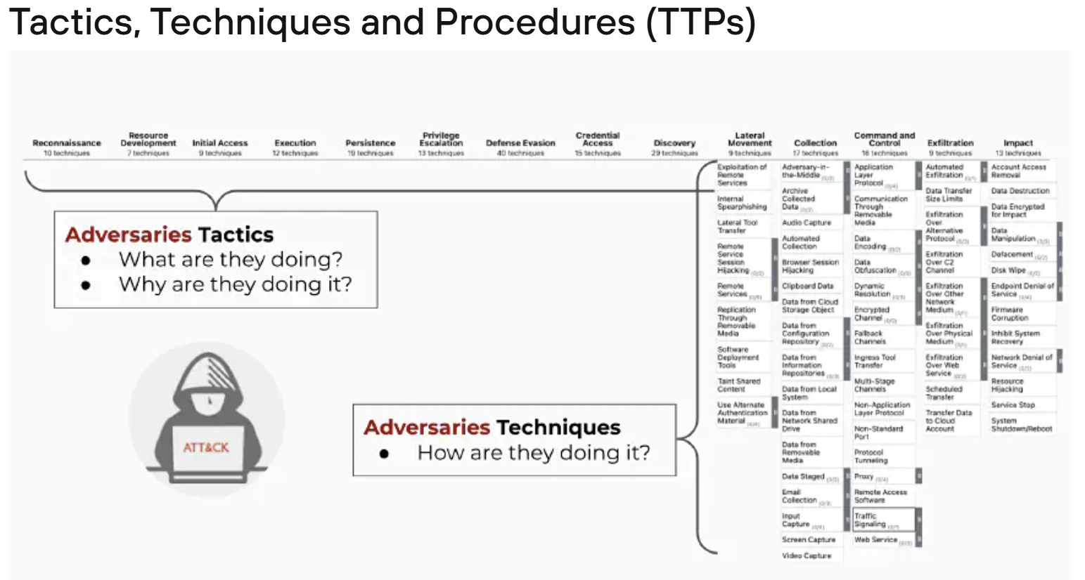
MITRE ATT&CK Framework
Reference - https://www.paloaltonetworks.com/cyberpedia/what-is-mitre-attack-matrix

Slide 128
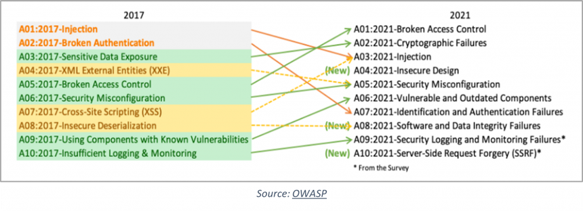
OWASP Top 10

Slide 129
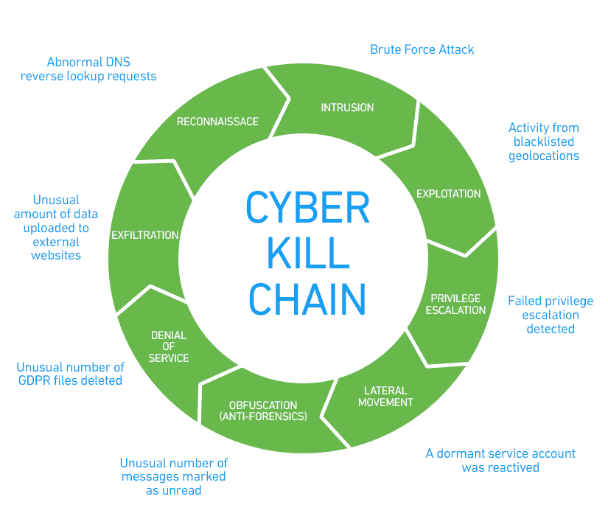
Lunch
https://www.exabeam.com/explainers/information-security/cyber-kill-chain-understanding-and-mitigating-advanced-threats/

Slide 130
Day 2 – Block 5
Vulnerability Management
Vulnerability Scanners
CVSS
Patch Management
Zero-Day Response
uCertify Lab
17.2.1 Conducting Vulnerability Scanning Using Nessus
CALIFORNIA INSTITUTE OF APPLIED TECHNOLOGY

Slide 131
Identification Methods
Identification methods help locate, identify, and document security flaws in an organization’s digital ecosystem.
Key identification methods are vulnerability scans and software composition analysis.
© 2024 by Pearson Education, Inc.

Slide 132
Vulnerability Scan Tools
Static Application Security Testing (SAST): Analyze source code or binaries without executing the program
Dynamic Application Security Testing (DAST): Test applications while running to find vulnerabilities not visible in the code
Interactive Application Security Testing (IAST): Combine SAST and DAST for comprehensive analysis
Threat intelligence platforms (TIPs): Gather data from various sources to provide threat insights
Security information and event management (SIEM) systems: Provide real-time analysis of security alerts generated by network hardware and applications
© 2024 by Pearson Education, Inc.

Slide 133
Application Security
Application security: Identifying and mitigating vulnerabilities in software applications
Static analysis (SAST) examines source code or binaries without execution, enabling early identification and resolution of security flaws
Dynamic analysis (DAST) tests applications during operation, simulating attacks to uncover vulnerabilities that static analysis might miss
Package monitoring continuously surveilles third-party software packages and libraries for security vulnerabilities.
© 2024 by Pearson Education, Inc.

Slide 134
Threat Feeds and Databases
Threat feed: Real-time repository and transmission channel for data points that indicate cyber threats
Proprietary/third-party feed: Specialized channel of threat feeds, typically requiring subscription
Open-source intelligence threats (OSINT): Threats shared in public forums, databases, and code repositories
Information sharing and analysis centers (ISACs): Repositories for organizations to share threats received and learn about others; organized by industry
© 2024 by Pearson Education, Inc.

Slide 135
Penetration Testing
Penetration testing: Simulating cyberattacks to identify vulnerabilities
Can be used to test a vendor’s security
Unknown environment tests
Known environment tests
Partially known environment tests
© 2024 by Pearson Education, Inc.

Slide 136
Penetration Testing
Penetration testing: Simulates real-world attacks to uncover vulnerabilities in systems, networks, or applications
Planning
Reconnaissance
Exploitation
Post-Exploitation
Reporting
© 2024 by Pearson Education, Inc.

Slide 137
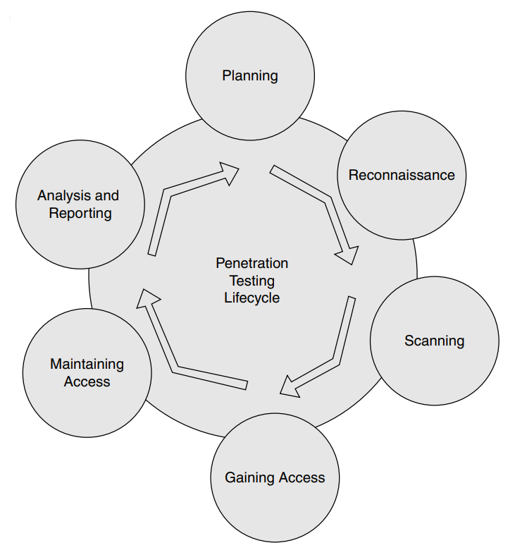
Penetration Testing Lifecycle
© 2024 by Pearson Education, Inc.

Slide 138
Types of Penetration Tests
Physical penetration testing: Targets physical barriers such as door locks and surveillance systems
Offensive penetration testing (Red teaming): Mimics the actions of threat actors to identify vulnerabilities
Defensive penetration testing (Blue teaming): Focuses on managing simulated attacks to evaluate defensive strategies
Integrated penetration testing (Purple teaming): Combines offensive and defensive methodologies
© 2024 by Pearson Education, Inc.

Slide 139
Types of Penetration Tests (cont.)
Known environment penetration testing (White box testing): Testers have comprehensive information about the system's architecture
Partially known environment penetration testing (Gray box testing): Testers have a subset of system information
Unknown environment penetration testing (Black box testing): Testers have no knowledge of the system's architecture
© 2024 by Pearson Education, Inc.

Slide 140
Responsible Disclosure Program
Responsible disclosure program: Framework encouraging ethical reporting of security vulnerabilities
Outlines secure procedures for external researchers to report discovered vulnerabilities
Incentives include monetary rewards and public recognition
© 2024 by Pearson Education, Inc.

Slide 141
Bug Bounty Program
Bug bounty program: Offers financial incentives for discovering and reporting software vulnerabilities
Organizations host bug bounty programs to leverage the collective expertise of security researchers
Incentives vary from nominal to substantial rewards
Ethical hackers often receive public acknowledgment for their contributions, enhancing their reputation and career prospects
© 2024 by Pearson Education, Inc.

Slide 142
System/Process Audit
Audit: Comprehensive examination and assessment of an organization's processes, controls, and systems
May use specialized tools such as Nessus or Wireshark to examine network traffic and configurations
© 2024 by Pearson Education, Inc.

Slide 143
Analysis
Analysis: Transforms raw data about vulnerabilities and threats into comprehensive insights
Common Vulnerability Scoring System (CVSS): Industry-standard tool for evaluating the severity and urgency of vulnerabilities; assigns scores from zero to 10
Common Vulnerability Enumeration (CVE): Standardized system for cataloging security flaws; provides historical data about remediation
Vulnerability Classification: Organized categorization of vulnerabilities based on nature, risk level, affected component, or potential impact
© 2024 by Pearson Education, Inc.

Slide 144
Analysis (cont.)
Exposure factor (EF): Percentage of loss that a company would experience if a specific asset were compromised
Environmental variables: Specific conditions or factors within an organization's context influencing the impact and exploitability of vulnerabilities
Industry/organizational impact: Potential consequences of vulnerabilities beyond an organization's boundaries
Risk tolerance: The Extent to which an organization is willing to accept exposure to threats
© 2024 by Pearson Education, Inc.

Slide 145
Message-Based
Message-based communication poses significant security risks due to its widespread use, users’ trust in platforms, and the potential for immediate damage.
Examples
Email
Short Message Service (SMS)
Instant Messaging (IM)
Spam and Spam over Internet Messaging (SPIM)
Mitigation
User training and awareness
Spam filters
Secure email gateways
© 2024 by Pearson Education, Inc.

Slide 146
Image-Based
Image-based threats involve using digital images to exploit vulnerabilities in software and systems.
Examples
Using images in a phishing attack
Disguising malware as an image file
Mitigation
User training and awareness
Using up-to-date antivirus/anti-malware software
© 2024 by Pearson Education, Inc.

Slide 147
File-Based
File-based threats leverage common file formats such as .doc and .jpg to conceal harmful scripts and execute malicious activities.
Malicious code is embedded within or attached to these files, which are distributed via email attachments, downloads from websites, and file-sharing services.
Mitigation
User training and awareness
File scanning
Strict file permissions
© 2024 by Pearson Education, Inc.

Slide 148
Voice Call
Voice call threats involve malicious activities conducted through phone calls.
Attackers aim to deceive or manipulate individuals into disclosing information by pretending to be trusted entities.
Mitigation
User training and awareness
Secure call authentication
Report suspicious calls
© 2024 by Pearson Education, Inc.

Slide 149
Removable Device
Removable device threats involve using portable storage devices that transmit malware. Examples are USB drives, external hard drives, and memory cards.
When an infected device connects to a computer, it may execute malicious code and spread malware to connected systems.
Mitigation
User training and awareness
Scan devices for malware
Restrict device use
© 2024 by Pearson Education, Inc.

Slide 150
Vulnerable Software
Vulnerable software has exploitable flaws or weaknesses in its code or design.
Two approaches help protect vulnerable software
Client-based security involves installing software agents on client devices for active monitoring and protection.
Agentless security is centralized; it enables monitoring and protection without installing software on individual client devices.
© 2024 by Pearson Education, Inc.

Slide 151
Unsupported Systems and Applications
Unsupported systems and applications are software tools or platforms lacking regular updates, security patches, or technical support from developers or vendors.
May occur when software reaches its official end-of-life (EOL) or a company goes out of business
Unaddressed vulnerabilities are prime targets for cybercriminals
© 2024 by Pearson Education, Inc.

Slide 152
Unsecure Networks
Unsecure networks lack appropriate security measures. They expose individuals and organizations to cyber threats such as data theft, unauthorized access, and remote device control. These include:
Wireless networks: Vulnerable to unauthorized access and eavesdropping if improperly configured or lacking encryption
Wired networks: More secure than wireless networks, but vulnerable without proper segmentation and access controls
Bluetooth networks: Exploitable if devices are set to “Discoverable" mode or if Bluetooth vulnerabilities are not patched
© 2024 by Pearson Education, Inc.

Slide 153
Open Service Ports
Open service ports are network communication endpoints that are accessible and unguarded.
Mitigation
Firewall configuration
Port scanning
Monitoring and logging
© 2024 by Pearson Education, Inc.

Slide 154
Default Credentials
Default credentials are the simple default passwords that ship with hardware and software.
Default credentials pose significant security risks, yet organizations often leave them unchanged.
Credential harvesting exacerbates the problem. Attackers post harvested usernames and passwords on platforms like Pastebin and GitHub.
© 2024 by Pearson Education, Inc.

Slide 155
Supply Chain
A supply chain is a network of organizations, resources, and processes involved in creating, producing, and delivering products or services.
Managed Service Providers (MSPs): Organizations that manage IT services for other companies, offering efficiency but potentially introducing risks
Vendors: Companies providing products or services to other businesses
Suppliers: Providers of raw materials or components used in manufacturing
© 2024 by Pearson Education, Inc.

Slide 156
Analysis
Analysis: Transforms raw data about vulnerabilities and threats into comprehensive insights
Common Vulnerability Scoring System (CVSS): Industry-standard tool for evaluating the severity and urgency of vulnerabilities; assigns scores from zero to 10
Common Vulnerability Enumeration (CVE): Standardized system for cataloging security flaws; provides historical data about remediation
Vulnerability Classification: Organized categorization of vulnerabilities based on nature, risk level, affected component, or potential impact
© 2024 by Pearson Education, Inc.

Slide 157
Zero-Day Vulnerabilities
A zero-day vulnerability is a flaw that’s disclosed before its patch is released.
Zero-day protection is a collective term for the related preventive measures:
Use a new OS with built-in protections
Use multiple firewall layers
Use approved application lists
Install updates/patches regularly
© 2024 by Pearson Education, Inc.

Slide 158
Day 2 – Block 6
Wireless & Mobile Security
Wi-Fi Security
Mobile Device Management
BYOD Policies
Crucial Exams
Threats, Vulnerabilities, and Mitigations
CALIFORNIA INSTITUTE OF APPLIED TECHNOLOGY

Slide 159
Wireless Devices
Wireless devices operate without physical wired connections. They use methods such as Wi-Fi, Bluetooth, and cellular networks to communicate.
Site surveys assess the current wireless environment and plan for Wi-Fi network optimization.
Heat maps visualize wireless activity to determine optimal access point placement for coverage and performance.
© 2024 by Pearson Education, Inc.

Slide 160
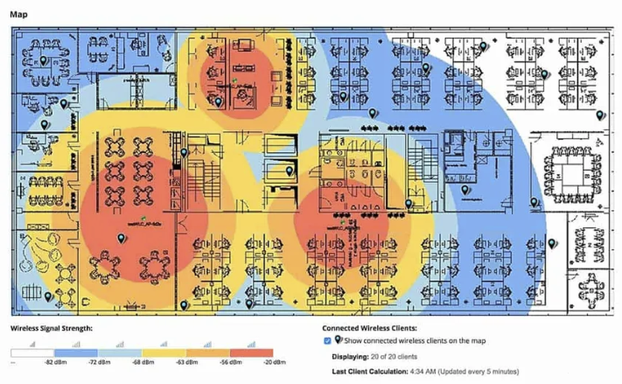
Wireless Heat Map
© 2024 by Pearson Education, Inc.

Slide 161
Mobile Solutions
Mobile device management (MDM) is crucial for successful implementation of bring your own device (BYOD) policies.
BYOD policies raise legal concerns regarding data ownership, privacy rights, and employee misconduct.
Ensure clear separation of organizational and personal information.
Encryption, regular software updates, and password complexity are essential for mitigating mobile device security risks.
© 2024 by Pearson Education, Inc.

Slide 162
Connection Methods
Bluetooth is susceptible to attacks like Bluejacking and Bluesnarfing.
Wi-Fi is vulnerable to various exploits. Example: Firmware flaws that lead to buffer overflow
Cellular connections including 2G, 3G, 4G, and 5G all raise security concerns. Using newer devices is generally best.
GPS and geolocation technologies raise privacy and security concerns.
Satellite communications (SATCOM) require firmware updates to address vulnerabilities and prevent exploits.
Infrared connections and wireless USB receivers are often overlooked in security reviews.
© 2024 by Pearson Education, Inc.

Slide 163
Unsecure Networks
Unsecure networks lack appropriate security measures. They expose individuals and organizations to cyber threats such as data theft, unauthorized access, and remote device control. These include:
Wireless networks: Vulnerable to unauthorized access and eavesdropping if improperly configured or lacking encryption
Wired networks: More secure than wireless networks, but vulnerable without proper segmentation and access controls
Bluetooth networks: Exploitable if devices are set to “Discoverable" mode or if Bluetooth vulnerabilities are not patched
© 2024 by Pearson Education, Inc.

Slide 164
Wireless Security Settings
WPA3 (Wi-Fi Protected Access 3) uses Simultaneous Authentication of Equals (SAE) to replace the vulnerable preshared key (PSK) system.
RADIUS federation enables secure communication among multiple RADIUS servers.
Cryptographic protocols: WPA3-Personal and WPA3-Enterprise offer robust encryption methods like AES-CCMP and HMAC-SHA for data protection.
Authentication protocols: LDAP, Kerberos, and 802.1X are authentication methods tailored to various environments.
© 2024 by Pearson Education, Inc.

Slide 165
Mobile Device
Side loading is installing applications from sources outside the official app store.
Mitigation
Device policies
User education
Jailbreaking refers to removing restrictions imposed by the manufacturer or carrier.
Mitigation
Device policies
User education
Jailbreaking detection
© 2024 by Pearson Education, Inc.

Slide 166
Day 2 – Block 7
Domain 1 PBQ Workshop
Hands-on PBQ Practice Session
Crucial Exams PBQs
Home WLAN Network Configuration PBQ
Public WLAN Network Configuration PBQ
CALIFORNIA INSTITUTE OF APPLIED TECHNOLOGY

Slide 167
Day 2 – Block 8
Day 2 Review & Test Prep
Domain 2 Concept Review
Practice Exam 25 Questions
Crucial Exams
Review Quiz Results & Address Weak Areas
Evening Assignment
Google - Research the MITRE ATT&CK Framework (14 Tactics); Cyber Kill Chain (7 Phases); Diamond Model of Intrusion Analysis
Crucial Exams Flashcards - All Acronyms
uCertify Lessons
CALIFORNIA INSTITUTE OF APPLIED TECHNOLOGY

Slide 168
Exam-Critical Topics
Foundational Reinforcements
Threat Landscape & Actors — motivations, capabilities, and classifications that drive attack behavior
Social Engineering & Human Factors — phishing, pretexting, influence techniques, and user‑centric vulnerabilities
Malware Analysis & Defense — viruses, worms, trojans, ransomware, fileless malware, indicators, and containment
Attack Vectors & Techniques — credential attacks, network‑based attacks, application exploits, physical vectors
MITRE ATT&CK, OWASP Top 10, Cyber Kill Chain — frameworks for mapping attacker behavior and identifying defensive gaps
Vulnerability Management — scanning, prioritization, remediation, and reporting workflows
Wireless & Mobile Security — Wi‑Fi protections, mobile OS hardening, device risks, and secure configurations
Threat intelligence concepts — TTPs, indicators, and adversary profiling
Human behavior patterns — cognitive biases and susceptibility factors
Malware delivery mechanisms — propagation paths and environmental triggers
Wireless fundamentals — SSID management, encryption standards, and signal exposure
Mobile ecosystem considerations — app permissions, sandboxing, and device posture

Slide 169
Questions?

Slide 170
Welcome to Day 3!

Slide 171
Day 3 Topics
Block 1 - Enterprise Security Architecture
Block 2 - Secure Network Design
Block 3 - Identity & Access Management
Block 4 - Endpoint Security Solutions
LUNCH
Block 5 - Secure Communications
Block 6 - Application Security
Block 7 - Domain 3 PBQ Workshop
Block 8 - Day 3 Review & Test Prep

Slide 172
Carrying Forward Concepts
Threat actors and motivations — understanding capability, intent, and targeting patterns
Social engineering fundamentals — phishing, pretexting, influence techniques, and human‑factor vulnerabilities
Malware behaviors — ransomware, trojans, worms, fileless attacks, and how they propagate
Attack vectors & techniques — credential attacks, network exploitation, application‑level attacks, and physical intrusion
Vulnerability management workflow — scanning, analysis, prioritization, remediation
Wireless & mobile security essentials — encryption standards, device risks, OS hardening

Slide 173
Day 3 – Block 1
Enterprise Security Architecture
Zero-Trust
SASE
Network Segmentation
Secure Design
Crucial Exams
Security Architecture
CALIFORNIA INSTITUTE OF APPLIED TECHNOLOGY

Slide 174
Zero Trust
Zero Trust is a network security concept centered on not trusting any entity or device by default.
Allows access based on various known factors rather than relying on inherent trust
Establishes trust through mechanisms such as authentication, authorization, and validation of security posture
© 2024 by Pearson Education, Inc.

Slide 175
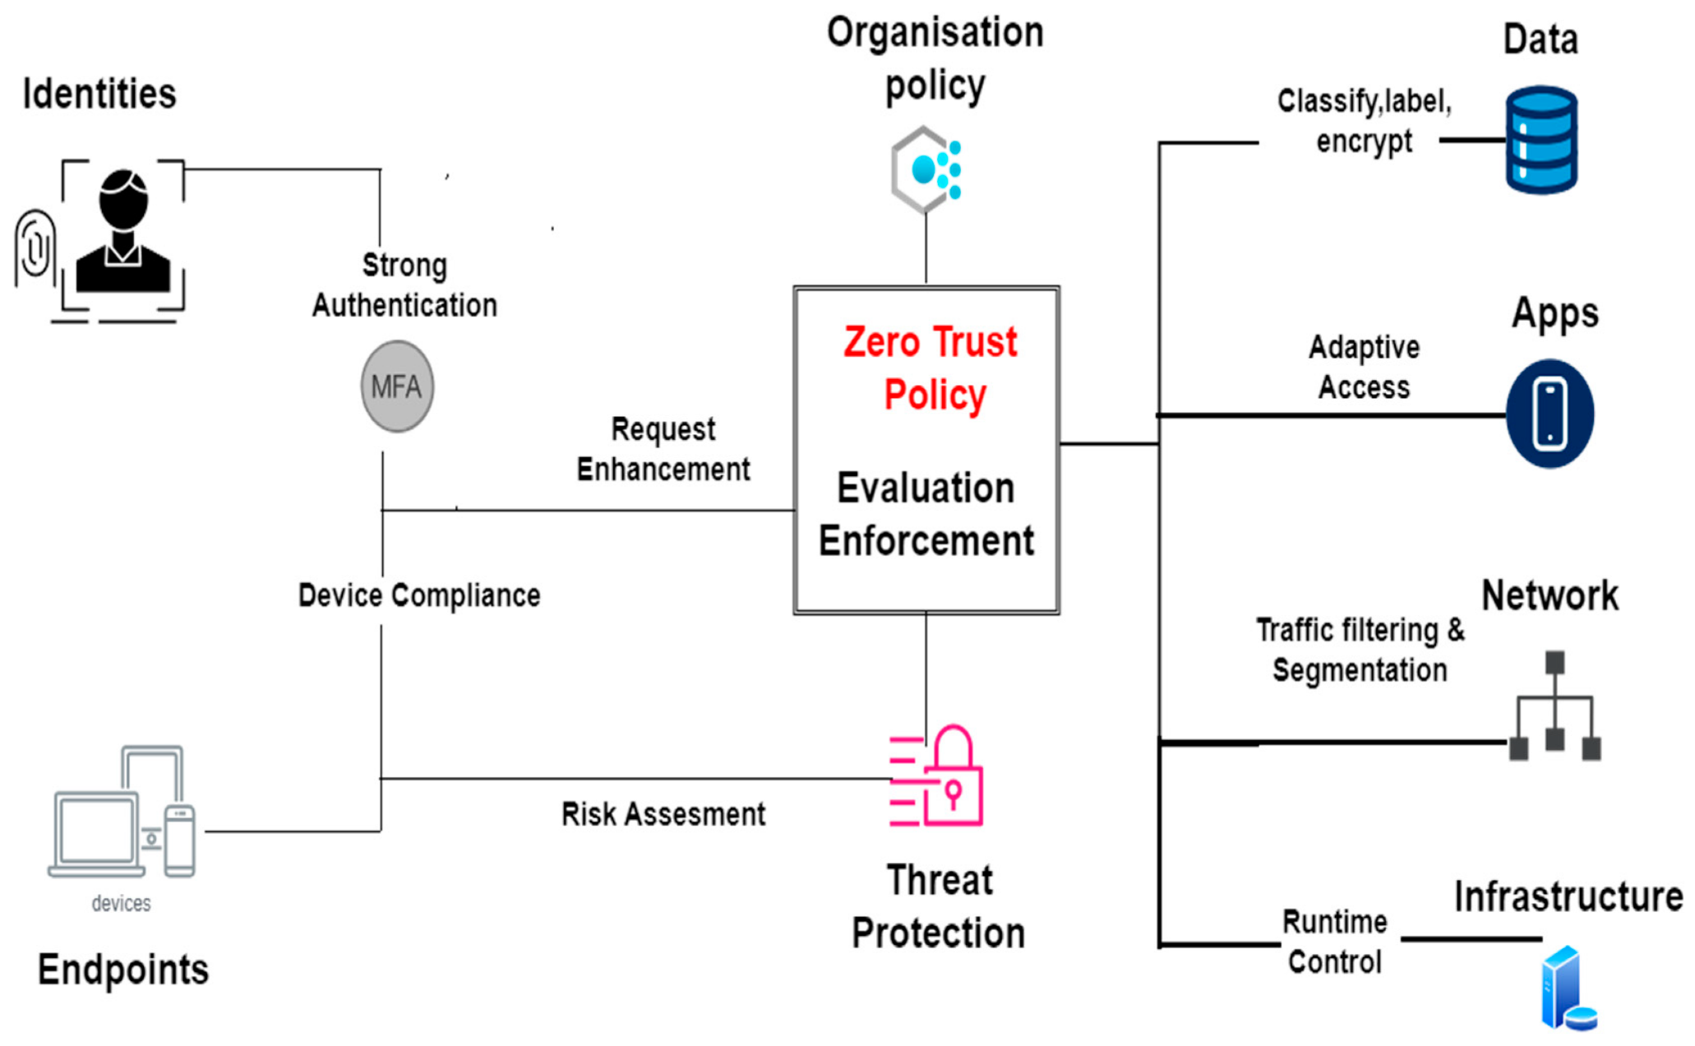
Zero Trust
© 2024 by Pearson Education, Inc.

Slide 176
Zero Trust – Control Plane
Adaptive identity
Threat scope reduction
Policy-driven access control
Secured zones
Policy engine
Policy administrator
© 2024 by Pearson Education, Inc.

Slide 177
Zero Trust – Data Plane
Subject/system
Policy enforcement point (PEP)
Implicit trust zones
© 2024 by Pearson Education, Inc.

Slide 178
Cloud
Cloud computing offers on-demand services that extend computer or network capabilities.
Benefits
Lower cost
Reduced administration and maintenance
Increased reliability
Improved scalability
Higher performance (potentially)
Concerns
Lack of administrative control
Security
© 2024 by Pearson Education, Inc.

Slide 179
Infrastructure as Code (IaC)
Infrastructure as Code (IaC) involves managing and provisioning computer data centers through machine-readable definition files.
Replaces physical hardware configuration and interactive configuration tools
Provides the scalability and integrations necessary for modern applications and deployments
© 2024 by Pearson Education, Inc.

Slide 180
Serverless
Serverless architecture uses cloud platforms like AWS, Azure, and Google Cloud to host and develop code.
Doesn’t mean the absence of servers; rather, cloud providers dynamically manage server allocation and provisioning
Example: AWS Lambda is a popular serverless architecture. Shown here is a “function” or application in AWS Lambda.
© 2024 by Pearson Education, Inc.

Slide 181
Network Infrastructure
Network infrastructure encompasses an organization’s essential hardware and software for network connectivity, communication, operations, and management.
Evolution of Network Infrastructure
© 2024 by Pearson Education, Inc.

Slide 182
On-Premises
On-premises computing architecture involves housing and managing hardware, software, servers, and network resources within an organization's physical location.
Organizations have complete control over and responsibility for their IT infrastructures, including management, maintenance, and security.
May involve increased costs and complexity, requiring dedicated personnel and equipment for effective management and maintenance
© 2024 by Pearson Education, Inc.

Slide 183
Centralized versus Decentralized
Centralized access control
One entity is responsible for administering access to resources.
Characterized by consolidating control, data storage, and processing in a single location or server
Offers uniformity and consistency in decision-making
Decentralized access control
More than one entity is responsible for administering access to resources.
Distributes data and control across multiple locations, servers, or nodes
Offers higher resilience, flexibility, and autonomy
© 2024 by Pearson Education, Inc.

Slide 184
Containerization and Virtualization
Containerization
Packaging applications in containers makes sharing and deployment easier
Applications consist of language runtimes, libraries, and source code, which can introduce dependencies
Virtualization
Creates multiple simulated environments or dedicated resources from a single physical hardware system
Benefits include cost reduction, resource optimization, and scalability
© 2024 by Pearson Education, Inc.

Slide 185
Internet of Things IoT
IoT encompasses interconnected physical devices that exchange data over the Internet or other networks.
Components
Sensors
Smart devices
Wearables
Facility automation
Weak Defaults
© 2024 by Pearson Education, Inc.

Slide 186
Industrial Control Systems ICS/Supervisory Control and Data Acquisition SCADA
ICSs and SCADA enable organizations to monitor equipment processes, collect data, perform analysis, and remotely control devices and processes.
Play a crucial role in maintaining efficiency, enabling data-driven decisions, and mitigating downtime in industrial settings
To defend against cyberattacks, SCADA networks should be isolated from corporate networks.
© 2024 by Pearson Education, Inc.

Slide 187
Real-Time Operating System RTOS
An RTOS rapidly switches between tasks, giving the illusion of simultaneous execution of multiple programs on a single processing core.
Provides hard real-time responses with fast and deterministic reactions to external events
Security measures
Minimize the attack surface by disabling unnecessary features, services, and access.
Assume that external systems are insecure.
© 2024 by Pearson Education, Inc.

Slide 188
Embedded Systems
Embedded systems are specialized computer systems designed for specific functions within larger systems, often with significant design constraints.
Constraints include cost, long lifecycle, real-time requirements, and reliability needs.
Often optimized for lifecycle and business-driven factors rather than security or maximum computing throughput
© 2024 by Pearson Education, Inc.

Slide 189
High Availability HA
High availability refers to operational performance, usually uptime. It ensures users' ability to access a system or service without interruptions.
Principles of system design
Eliminate single points of failure
Reliable crossover
Detection of failures
© 2024 by Pearson Education, Inc.

Slide 190
Considerations
Availability: Ensuring continuous business operations with redundant components, load balancing, and failover mechanisms
Resilience: Building comprehensive preventive measures and recovery strategies to withstand failures and attacks
Cost: Balancing expenses in acquisition, implementation, operation, and maintenance while optimizing resource utilization
Responsiveness: Optimizing performance and automating tasks to efficiently meet user demands
Scalability: Designing systems capable of growing or shrinking in response to changes in demand
Ease of deployment: Simplifying implementation through standardized configurations and automation
© 2024 by Pearson Education, Inc.

Slide 191
Considerations (cont.)
Risk transference: Strategically shifting risks to other parties while maintaining accountability
Ease of recovery: Establishing robust disaster recovery and business continuity plans to minimize downtime
Patch availability: Ensuring timely access to software updates and fixes
Inability to patch: The challenge of being unable to apply critical security updates, often because of legacy systems or technical constraints
Power: Optimizing energy efficiency and resilience against power-based attacks across the entire network
Computing resources: Effectively distributing and optimizing hardware and software components for data processing and computation
© 2024 by Pearson Education, Inc.

Slide 192
SASE (Secure Access Service Edge)
SASE is a cybersecurity and networking framework. It converges network security functions with WAN (Wide Area Network) capabilities into a single cloud-delivered service model.
SASE delivers secure, optimized access to users regardless of location by combining network connectivity and security services from the cloud.
© 2024 by Pearson Education, Inc.

Slide 193
Day 3 – Block 2
Secure Network Design
VPN Technologies
Network Access Control
Micro-segmentation
uCertify Lab
11.2.2 Configuring a VPN
CALIFORNIA INSTITUTE OF APPLIED TECHNOLOGY

Slide 194
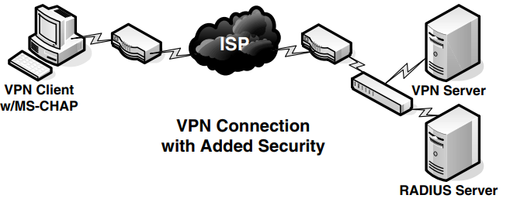
Virtual Private Network VPN
A virtual private network (VPN) establishes a secure connection between two or more devices over the Internet, even if they are not on the same private network.
© 2024 by Pearson Education, Inc.

Slide 195
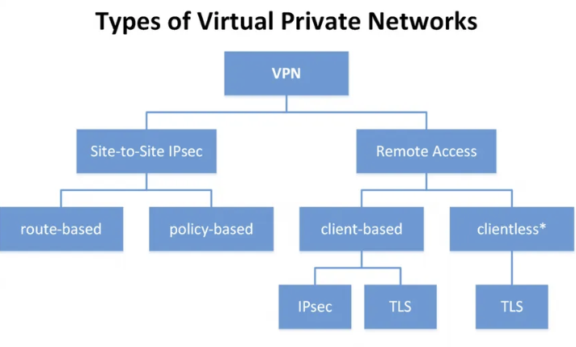
Types of Virtual Private Networks (VPN)
© 2024 by Pearson Education, Inc.

Slide 196
Remote Access
Remote access allows authorized users to connect to a network, system, or application from a location outside the organization's physical premises.
Remote access technologies
Remote Access Service (RAS)
Virtual Private Networks (VPNs)
Terminal Access Controller Access Control System Plus (TACACS+)
Challenge-Handshake Authentication Protocol (CHAP)
© 2024 by Pearson Education, Inc.

Slide 197
Tunneling
Tunneling creates a secure pathway for data transmission across networks via encapsulation.
Protocols like Transport Layer Security (TLS) and Internet Protocol Security (IPsec) enhance the security of tunneling by providing encryption and integrity mechanisms.
IKE, the key management protocol for IPsec, has two phases. Phase 1 negotiates the ISAKMP SA, and Phase 2 negotiates the IPsec Sas.
© 2024 by Pearson Education, Inc.

Slide 198
Network Access Control NAC
NAC is a method to enforce policy-driven security solutions at the network entry level.
Checks if devices comply with predefined security rules before granting access to the network
Drawbacks
Adds complexity to network administration
Can be circumvented, compromising network security
© 2024 by Pearson Education, Inc.

Slide 199
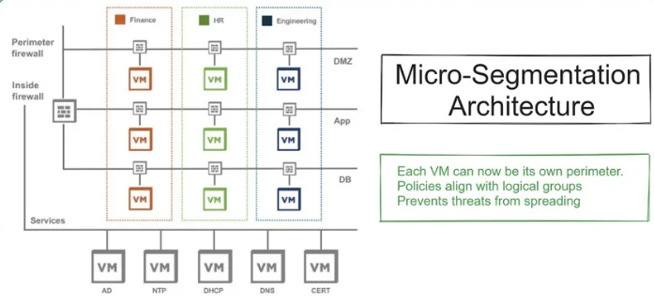
Micro-segmentation
Micro-segmentation divides the network into very small, isolated segments—down to individual workloads or applications
© 2024 by Pearson Education, Inc.

Slide 200
Secure Network Design Case Study
Scenario - Remote Access Gone Wrong
A contractor connects to the company network using a client‑based VPN from their personal laptop. The VPN uses SSL tunneling with only a username and a password. The device has no NAC check, and once connected, the VPN drops the user directly into the internal network with broad access.
Unbeknownst to the contractor, their laptop is infected with malware. After the VPN connection is established, the attacker uses the active tunnel to:
Scan internal hosts
Access an unsegmented file share
Move laterally into a sensitive application subnet
Exfiltrate data through the encrypted VPN tunnel
***The organization discovers the breach three days later during routine log review.
© 2024 by Pearson Education, Inc.

Slide 201
Day 3 – Block 3
Identity & Access Management
Active Directory
LDAP
Oauth
SAML
Federation
RBAC
ABAC
uCertify Lab
19.5.1 Examining Active Directory Objects
CALIFORNIA INSTITUTE OF APPLIED TECHNOLOGY

Slide 202
Interoperability
Interoperability is the ability of different systems to work together. It’s crucial for identity and access management (IAM) systems.
IAM systems need to integrate seamlessly with various databases, applications, and authentication protocols. Lack of integration interferes with needs for access and auditing.
Collaboration with external partners requires secure cross-boundary authentication and authorization.
Interoperable IAM systems can adapt to new technologies and compliance requirements without overhauling existing infrastructure.
© 2024 by Pearson Education, Inc.

Slide 203
Single Sign-On SSO
Single sign-on enables one set of credentials for access to multiple services or applications.
Minimizes the number of times a user needs to authenticate after initial login
SSO protocols
LDAP (Lightweight Directory Access Protocol)
OAuth (Open Authorization)
SAML (Security Assertion Markup Language)
© 2024 by Pearson Education, Inc.

Slide 204
Federation
One system authenticates users and sends their authentication information to other systems.
© 2024 by Pearson Education, Inc.

Slide 205
Types of Standards
Password standards define rules for creating, managing, and storing passwords.
Access control standards determine who has access to specific resources within the organization's network and systems.
Attribute-based access control (ABAC)
Role-based access control (RBAC)
Discretionary access control (DAC)
Mandatory access control (MAC)
© 2024 by Pearson Education, Inc.

Slide 206
Centralized versus Decentralized
Centralized access control
One entity is responsible for administering access to resources.
Characterized by consolidating control, data storage, and processing in a single location or server
Offers uniformity and consistency in decision-making
Decentralized access control
More than one entity is responsible for administering access to resources.
Distributes data and control across multiple locations, servers, or nodes
Offers higher resilience, flexibility, and autonomy
© 2024 by Pearson Education, Inc.

Slide 207
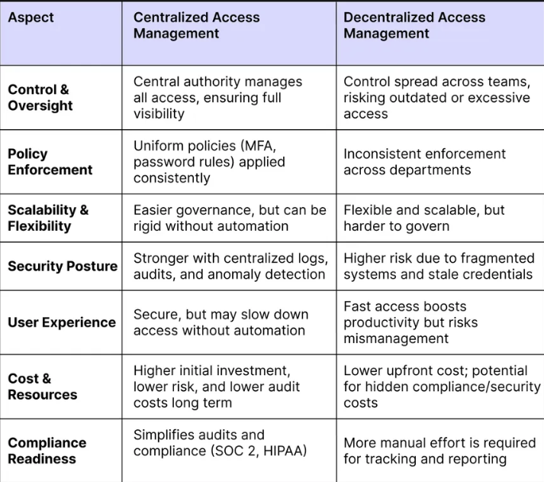
Centralized versus Decentralized
© 2024 by Pearson Education, Inc.

Slide 208
Day 3 – Block 4
Endpoint Security Solutions
EDR/XDR
Application Whitelisting
DLP
Mobile Device Management
Crucial Exams
Security Architecture
CALIFORNIA INSTITUTE OF APPLIED TECHNOLOGY

Slide 209
Data Loss Prevention
DLP is a comprehensive approach to preventing users from sending sensitive or critical information outside the corporate network.
Describes software products that let network administrators control data access and transfer
Alerts administrators to unauthorized data transfer attempts
Aids in incident response
© 2024 by Pearson Education, Inc.

Slide 210
Network Access Control NAC
NAC is a method to enforce policy-driven security solutions at the network entry level.
Checks if devices comply with predefined security rules before granting access to the network
Drawbacks
Adds complexity to network administration
Can be circumvented, compromising network security
© 2024 by Pearson Education, Inc.

Slide 211
Endpoint Detection and Response EDR/Extended Detection and Response XDR
Endpoint Detection and Response (EDR) systems
Monitor endpoints such as desktop computers, laptops, and mobile devices
Detect and respond to signs of malicious activities
Extended Detection and Response (XDR) systems
Take a holistic view of network security, correlating data across various channels and layers like email, cloud, and network traffic
Identify complex, multi-stage attacks that may evade EDR systems
© 2024 by Pearson Education, Inc.

Slide 212
User Behavior Analytics
User behavior analytics use machine learning algorithms to track, collect, and assess user behavior on a network.
Analytics help IT detect unusual activity that could indicate security threats, such as sudden changes in file access patterns.
Alert tuning is important to avoid excessive false positives.
© 2024 by Pearson Education, Inc.

Slide 213
Secure Baselines
Secure baselines are standardized sets of minimum configurations and security controls for systems and software.
Asset tagging: Assigning unique identifiers to each asset for easier tracking
Version control: Documenting all software versions used by the organization; helps identify outdated or unsupported versions that may pose security risks
Scheduled scans: Scheduling regular vulnerability scans to identify any new weaknesses
© 2024 by Pearson Education, Inc.

Slide 214
Secure Baselines (cont.)
Manual review: A human reviews data, logs, and systems to help prioritize vulnerabilities based on actual organizational risk. Human judgment and intuition can identify issues that automated tools miss.
Disable unnecessary services: Turn off services and features not required for the system’s primary function.
User access control: Limit user permissions to what is necessary for their roles.
Change log: Maintain a record of any changes made to the baseline, who made them, and why.
Audit trail: Ensure that documentation is in a format that can be easily audited for compliance purposes.
© 2024 by Pearson Education, Inc.

Slide 215
Secure Baselines (cont.)
Validation testing: Confirm that the baseline settings do not disrupt necessary functions.
Rollback plan: Have a plan to revert changes in the event of unforeseen issues during deployment.
Patch management: Regularly update software and systems to patch known vulnerabilities.
Review and update: Periodically review the secure baseline to ensure that it aligns with current best practices in cybersecurity.
© 2024 by Pearson Education, Inc.

Slide 216
Hardening Targets
Hardening targets is the process of strengthening the security defenses of computing resources to resist attacks.
Common hardening techniques
Firmware updates
Network segmentation
VLANs
Air-gapping
Disabling unnecessary features
Real-time monitoring
Data encryption
Changing default passwords
Ensuring network-level security
© 2024 by Pearson Education, Inc.

Slide 217
Containerization and Virtualization
Containerization
Packaging applications in containers makes sharing and deployment easier
Applications consist of language runtimes, libraries, and source code, which can introduce dependencies
Virtualization
Creates multiple simulated environments or dedicated resources from a single physical hardware system
Benefits include cost reduction, resource optimization, and scalability
© 2024 by Pearson Education, Inc.

Slide 218
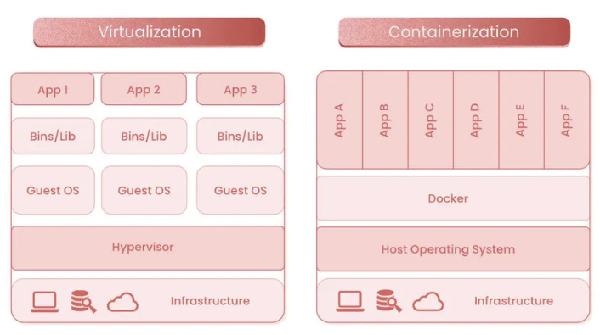
Containerization and Virtualization
© 2024 by Pearson Education, Inc.

Slide 219
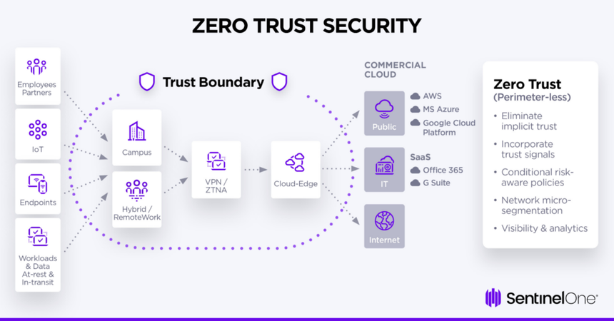
Lunch
https://www.sentinelone.com/cybersecurity-101/identity-security/zero-trust-architecture/

Slide 220
Day 3 – Block 5
Secure Communications
Email Security (S/MIME, PGP)
Secure Protocols (TLS, SSH, HTTPS)
Crucial Exams
Security Architecture
CALIFORNIA INSTITUTE OF APPLIED TECHNOLOGY

Slide 221
Virtual Private Network VPN
A virtual private network (VPN) establishes a secure connection between two or more devices over the Internet, even if they are not on the same private network.
© 2024 by Pearson Education, Inc.

Slide 222
Remote Access
Remote access allows authorized users to connect to a network, system, or application from a location outside the organization's physical premises.
Remote access technologies
Remote Access Service (RAS)
Virtual Private Networks (VPNs)
Terminal Access Controller Access Control System Plus (TACACS+)
Challenge-Handshake Authentication Protocol (CHAP)
© 2024 by Pearson Education, Inc.

Slide 223
Tunneling
Tunneling creates a secure pathway for data transmission across networks via encapsulation.
Protocols like Transport Layer Security (TLS) and Internet Protocol Security (IPsec) enhance the security of tunneling by providing encryption and integrity mechanisms.
IKE, the key management protocol for IPsec, has two phases. Phase 1 negotiates the ISAKMP SA, and Phase 2 negotiates the IPsec Sas.
© 2024 by Pearson Education, Inc.

Slide 224
Software-Defined Wide Area Network SD-WAN
SD-WAN is a networking architecture that uses software-based controls to optimize and manage data traffic across a wide-area network (WAN).
Enhances network management flexibility by separating control mechanisms from network hardware
Simplifies network management, improves performance, and enhances reliability
© 2024 by Pearson Education, Inc.

Slide 225
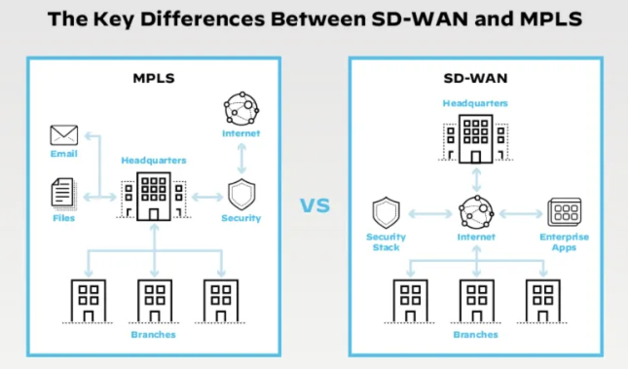
MPLS vs SD-WAN
© 2024 by Pearson Education, Inc.

Slide 226
Secure Access Service Edge SASE
Secure Access Service Edge (SASE) is a cloud-native architecture that merges network security functions with WAN capabilities.
Integrates network and security services into a unified platform, simplifying management and ensuring secure access
Provides secure and seamless access to resources regardless of user location
© 2024 by Pearson Education, Inc.

Slide 227
Implementation of Secure Protocols
The implementation of secure protocols refers to creating encrypted pathways for communication.
Protocol selection: Choosing the appropriate communication standard for data exchange (e.g., HTTPS)
Port selection: Choosing specific entry and exit points (ports) in the network for data
Transport method selection: Choosing a method of securely transporting data packets across the network
© 2024 by Pearson Education, Inc.

Slide 228
Transport/Communication
Data security and encryption is essential, whether the data is at rest, in transit, or in use.
© 2024 by Pearson Education, Inc.

Slide 229
Email Security
Email security involves measures used to secure the access and content of email accounts or services.
Domain-Based Message Authentication, Reporting and Conformance (DMARC) helps receivers verify the authenticity of emails from specific domains
DMARC process
SPF check
DKIM check
DMARC policy retrieval
Policy enforcement
Reporting
© 2024 by Pearson Education, Inc.

Slide 230
Day 3 – Block 6
Application Security
SAST
DAST
Code Review
Secure SDLC
DevSecOps
uCertify Lab
7.1.3 Examining Application Vulnerabilities
CALIFORNIA INSTITUTE OF APPLIED TECHNOLOGY

Slide 231
Application Security
Application security refers to the security measures implemented at the application level.
Input validation ensures data integrity by verifying the type and content of user or application input, preventing vulnerabilities like XSS and SQLi.
Secure cookies implement the secure attribute in HTTP response cookies to prevent unauthorized access and transmission of sensitive information.
© 2024 by Pearson Education, Inc.

Slide 232
Vulnerability Scan Tools
Static Application Security Testing (SAST): Analyze source code or binaries without executing the program
Dynamic Application Security Testing (DAST): Test applications while running to find vulnerabilities not visible in the code
Interactive Application Security Testing (IAST): Combine SAST and DAST for comprehensive analysis
Threat intelligence platforms (TIPs): Gather data from various sources to provide threat insights
Security information and event management (SIEM) systems: Provide real-time analysis of security alerts generated by network hardware and applications
© 2024 by Pearson Education, Inc.

Slide 233
Application Security
Application security: Identifying and mitigating vulnerabilities in software applications
Static analysis (SAST) examines source code or binaries without execution, enabling early identification and resolution of security flaws
Dynamic analysis (DAST) tests applications during operation, simulating attacks to uncover vulnerabilities that static analysis might miss
Package monitoring continuously surveilles third-party software packages and libraries for security vulnerabilities.
© 2024 by Pearson Education, Inc.

Slide 234
Application Security (cont.)
Static code analysis uses SAST tools to scan source code for vulnerabilities early in the development lifecycle.
Provides real-time feedback to developers
Enables prompt issue resolution
Code signing digitally signs executables and scripts to verify authenticity and integrity.
Ensures software has not been altered or corrupted
Prevents malicious tampering during transmission
© 2024 by Pearson Education, Inc.

Slide 235
Sandboxing
Sandboxing creates a confined execution environment for running untrusted or suspicious code safely.
Adds an additional layer of security
Reduces the risk of malware infection via email attachments while maintaining workflow efficiency for employees
© 2024 by Pearson Education, Inc.

Slide 236
Application
The application layer is a gateway to user interactions and data, making it a common target of attacks.
Buffer overflow involves a program writing more data to a buffer than it can hold, introducing vulnerability.
Memory injection involves injecting malicious code into a system's memory.
A race condition weakness occurs when multiple processes or threads try to access a system at once.
A malicious update involves altering software or firmware with harmful code via an update that appears legitimate.
© 2024 by Pearson Education, Inc.

Slide 237
Integrations and Application Programming Interfaces APIs
Integrations and APIs automate the linking of computing services and software applications to establish coherent systems.
APIs enable different software entities to seamlessly communicate with each other.
Automation is overall beneficial but requires ongoing maintenance and monitoring for errors
© 2024 by Pearson Education, Inc.

Slide 238
Web-Based
Web-based vulnerabilities are weaknesses in web applications and services.
Structured Query Language injection (SQLi) vulnerabilities are flaws that attackers can use to manipulate SQL queries in web applications.
Cross-site scripting (XSS) vulnerabilities enable the injection of malicious scripts into web pages.
© 2024 by Pearson Education, Inc.

Slide 239
Secure SDLC & DevSecOps
The Secure Software Development Lifecycle (SSDLC) builds security into every development phase.
Steps include:
Security requirements and threat modeling during planning
Secure coding during development
SAST/DAST during testing
Code signing and validation before release
Monitoring and patching in production
DevSecOps integrates these steps into automated pipelines — often called “shift-left security.”
Security tests run early and continuously inside CI/CD systems. It’s about collaboration: developers, operations, and security all share responsibility.
© 2024 by Pearson Education, Inc.

Slide 240
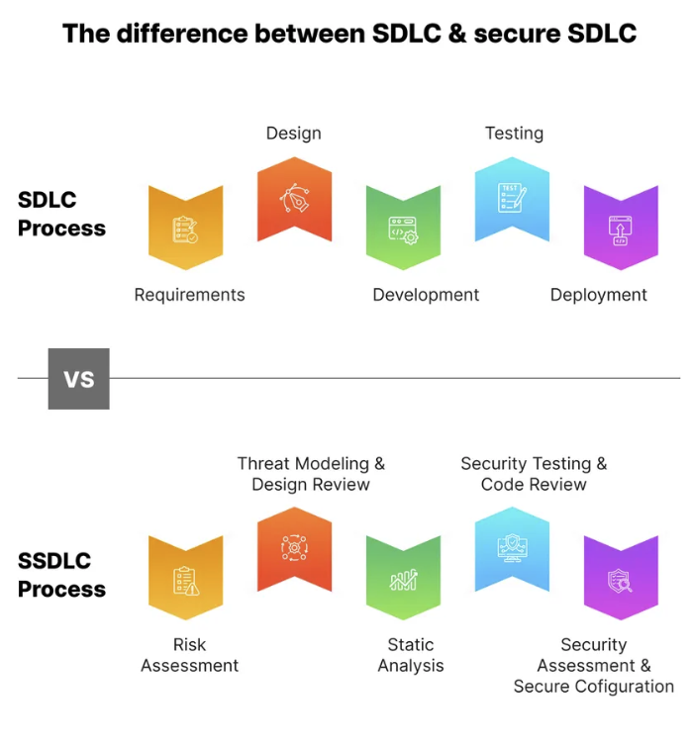
Secure SDLC
© 2024 by Pearson Education, Inc.

Slide 241
Day 3 – Block 7
Domain 3 PBQ Workshop
Complex Architecture PBQs
Crucial Exams
Cloud Web Application Firewall Setup PBQ
Mobile Device Management Enrollment PBQ
CALIFORNIA INSTITUTE OF APPLIED TECHNOLOGY

Slide 242
Day 3 – Block 8
Day 3 Review & Test Prep
Domain 3 Concept Review
Practice Exam 25 Questions
Crucial Exams
Review Quiz Results & Address Weak Areas
Evening Assignment
Google - Research the Zero Trust Maturity Model (5 Pillars); NIST Cybersecurity Framework (5 Functions); Shared Responsibility Model (Cloud) - IaaS vs PaaS vs SaaS
Crucial Exams Flashcards - Threat Management Terms and Concepts
CALIFORNIA INSTITUTE OF APPLIED TECHNOLOGY

Slide 243
Exam-Critical Topics
Foundational Reinforcements
Enterprise Security Architecture — layered defense, segmentation, trust boundaries, and secure design principles
Secure Network Design — zoning, subnetting, NAC, load balancers, proxies, and resilient architectures
Identity & Access Management (IAM) — authentication, authorization, federation, SSO, MFA, lifecycle management
Endpoint Security Solutions — EDR, antivirus/anti‑malware, host firewalls, device hardening, mobile/remote protections
Zero Trust Architecture — “never trust, always verify,” continuous validation, micro‑segmentation
Secure Communications — TLS, VPNs, email security, certificate usage, secure protocols
Application Security — secure coding practices, input validation, API security, SDLC integration
Enterprise design patterns — centralized vs. decentralized models
Network resilience concepts — redundancy, failover, high availability
Endpoint baselining — configuration standards and posture management
Application lifecycle considerations — testing, deployment, and maintenance practices

Slide 244
Questions?

Slide 245
Welcome to Day 4!

Slide 246
Day 4 Topics
Block 1 - Security Operations & Monitoring
Block 2 - Incident Response Procedures
Block 3 - Digital Forensics & Investigation
Block 4 - Business Continuity & DR
LUNCH
Block 5 - Automation & Orchestration
Block 6 - Vulnerability Management Operations
Block 7 - Domain 4 PBQ Workshop
Block 8 - Day 4 Review & Test Prep

Slide 247
Carrying Forward Concepts
Enterprise security architecture — layered defense, segmentation, trust boundaries, and secure design principles
Secure network design — zoning, NAC, load balancing, proxies, and resilient architectures
Identity & Access Management (IAM) — authentication, authorization, federation, SSO, MFA, and lifecycle management
Endpoint security solutions — EDR, anti‑malware, host firewalls, device hardening, and remote/mobile protections
Zero Trust principles — continuous verification, micro‑segmentation, identity‑centric access
Secure communications — TLS, VPNs, certificates, and protocol selection
Application security fundamentals — secure coding, input validation, API security, and SDLC integration

Slide 248
Day 4 – Block 1
Security Operations & Monitoring
SIEM
SOAR
Log Analysis
Security Metrics
KPIs
uCertify Lab
22.1.2 Viewing Windows Event Logs
22.1.1 Viewing Linux Event Logs (instructor optional)
CALIFORNIA INSTITUTE OF APPLIED TECHNOLOGY

Slide 249
Monitoring and Computing Resources
Monitoring computing resources means continuously overseeing an organization's IT assets to ensure they operate within normal parameters.
System monitoring: Ensures the entire system (servers, devices, and workstations) is vulnerability-free and performing optimally
Application monitoring: Ensures software applications are secure, responsive, and optimized for performance
Infrastructure monitoring: Ensures cohesive and secure operation of all technological components within an organization
© 2024 by Pearson Education, Inc.

Slide 250
Log Aggregation
Log aggregation involves gathering log data from various sources into a centralized repository for examination.
A critical process
Helps turn isolated data points into a coherent narrative
Log aggregation tools and processes
SIEM
syslog-ng
rsyslog
© 2024 by Pearson Education, Inc.

Slide 251
Alerting
Alerting is the early warning system for security infrastructure.
Using predefined rules, alerts indicate when immediate attention is required.
Alert turning refers to setting the alert sensitivity.
If too stringent, genuine alerts are likely to be ignored among many false positives
If too lax, alerts may not trigger when genuine threats occur
© 2024 by Pearson Education, Inc.

Slide 252
Security Information and Event Management SIEM
An SIEM system is a specialized device or software for security monitoring. It collects, correlates, and analyzes logs from multiple systems.
SIEM functions
Log collection
Log normalization
Log aggregation
Log correlation
Reporting
© 2024 by Pearson Education, Inc.

Slide 253
NetFlow
NetFlow is a protocol that collects and monitors network traffic data.
Provides various traffic insights
Source
Destination
Volume
Paths
Essential for traffic profiling and anomaly detection
© 2024 by Pearson Education, Inc.

Slide 254
Antivirus Software
Antivirus software prevents, detects, and removes malware.
Also known as anti-malware
Viruses and Trojans can damage networks and are costly to overcome; ransomware alone has cost victims billions of dollars.
Every endpoint device, including workstations, tablets, and phones, should have antivirus software to ensure comprehensive protection.
© 2024 by Pearson Education, Inc.

Slide 255
Data Loss Prevention DLP
Data loss prevention (DLP) is a comprehensive data protection strategy that uses tools to detect potential data breaches and prevent exfiltration.
Monitors, detects, and blocks data in use, in motion, and at rest
Enforces policies defined by regulatory bodies
HIPPA
PCI DCS
GDPR
© 2024 by Pearson Education, Inc.

Slide 256
Simple Network Management Protocol SNMP Traps
SNMPv3 is a popular protocol for managing and monitoring networks. SNMP traps are alerts sent from SNMP-enabled devices when they have status changes. This facilitates speedy response.
Optional SNMPv3 features
Authentication: Verifies the legitimacy of trap sources, preventing unauthorized devices from sending false alerts
Encryption: Offers encryption to maintain the confidentiality of trap content
© 2024 by Pearson Education, Inc.

Slide 257
Vulnerability Scanners
Vulnerability scanners automate the identification of weaknesses in systems and networks.
Work as digital sentries by constantly monitoring
Stages of vulnerability scanning
Pre-assessment
Scanning
Post-scan analysis
Remediation and verification
Continuous monitoring
© 2024 by Pearson Education, Inc.

Slide 258
Deception and Disruption Technology
Deception technology involves the use of decoys, traps, and other deceptive measures to mislead and thwart attackers.
Disruption technology involves techniques and tools that disrupt or impair attackers' ability to execute their malicious activities.
Examples
Honey files
Honeypots
Honeynets
Honeytokens
© 2024 by Pearson Education, Inc.

Slide 259
Honeyfile
Honey files are files created to serve as bait for potential attackers, designed to lure them into interaction.
Serve as decoys within a network
Security teams can study the attackers’ behavior without disturbing normal organizational operations.
© 2024 by Pearson Education, Inc.

Slide 260
Honeypot
A honeypot is a decoy system or network segment designed to attract and trap potential attackers.
Mimics legitimate systems or services to lure attackers into interacting with it, allowing security teams to monitor and analyze their behavior
© 2024 by Pearson Education, Inc.

Slide 261
Honeynet
A honeynet is a network of interconnected honeypots and other decoy systems designed to deceive and trap potential attackers.
Provides a comprehensive view of attacker tactics, techniques, and procedures (TTPs) by simulating a full-scale network environment
© 2024 by Pearson Education, Inc.

Slide 262
Honeytoken
Honeytokens are pieces of fake or fabricated data placed within a system or network to detect unauthorized access or activity.
Serve as indicators of compromise, alerting security teams to potential breaches or suspicious behavior
Designed to appear as legitimate or valuable data to attackers, which entices attackers to interact with or access them
© 2024 by Pearson Education, Inc.

Slide 263
Day 4 – Block 2
Incident Response Procedures
IR Lifecycle
Containment
Eradication
Recovery
Lessons Learned
Crucial Exams
Security Operations
CALIFORNIA INSTITUTE OF APPLIED TECHNOLOGY

Slide 264
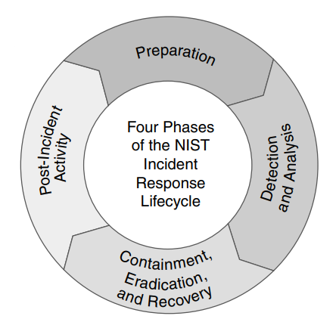
Incident Response Process
Preparation
Detection and Analysis
Containment, Eradication, and Recovery
Post-Incident Activity
© 2024 by Pearson Education, Inc.

Slide 265
Preparation
Preparation creates the plan for responding to and recovering from security incidents.
Designating a plan owner
Tech preparation
Training programs
© 2024 by Pearson Education, Inc.

Slide 266
Detection and Analysis
Detection and analysis are accomplished with a mix of automated monitoring and human expertise.
Early detection is best. An early indicator of compromise (IoC) might be unusual network traffic or multiple failed logins.
Analyze the IoC to understand the nature and scope of the threat.
© 2024 by Pearson Education, Inc.

Slide 267
Containment, Eradication, and Recovery
Containment involves isolating the threat from the rest of the network.
Short-term or long-term
Eradication involves completely removing the threat.
Ensure affected systems are backed up, then reimage
Apply patches and change passwords
Recovery involves choosing a restoration point and validating the system.
Increase monitoring for 30+ days following incident
© 2024 by Pearson Education, Inc.

Slide 268
Post-Incident Activity
Post-incident activity is the “lessons learned” phase of incident response.
Meet within two weeks.
Complete documentation about the incident.
Discuss the response process.
Change the response process if needed.
© 2024 by Pearson Education, Inc.

Slide 269
Training
Training equips teams with the knowledge and protocols for effectively managing security incidents.
Role-based training for individuals and departments
Tabletop exercises and simulations for practice responding
© 2024 by Pearson Education, Inc.

Slide 270
Testing
Testing is the rigorous examination of incident response procedures, plans, and capabilities.
Ensures the effectiveness of cybersecurity incident response
Identifies gaps in responding; serves as a feedback loop for refinement of response strategies
© 2024 by Pearson Education, Inc.

Slide 271
Tabletop Exercises
Tabletop exercises simulate hypothetical situations that mirror real-world threats.
Each participant plays a role corresponding to their actual emergency responsibilities.
Time pressure helps simulate the urgency of real incidents.
Decision points pause the action for strategic discussions about how to proceed.
Detailed records are kept of every action, decision, and discussion point.
© 2024 by Pearson Education, Inc.

Slide 272
Simulation Exercises
Simulation exercises build upon tabletop exercises with simulated tech environments such as sandboxed or isolated replicas of networks.
Tips for conducting a simulation
Define key performance indicators (KPIs) to evaluate response effectiveness.
Introduce unexpected elements (e.g., power outages) to test the team's adaptability.
Include a post-exercise discussion to identify gaps and discuss improvements.
© 2024 by Pearson Education, Inc.

Slide 273
Root Cause Analysis
Root cause analysis is critical for identifying the reasons underlying security incidents.
Data collection
Timeline analysis
Hypothesis development
Hypothesis confirmation or rejection
© 2024 by Pearson Education, Inc.

Slide 274
Threat Hunting
Threat hunting is a proactive search through networks and data sets to detect and isolate advanced threats.
Targets threats that evade traditional reactive security measures
Involves setting a specific type of threat, such as lateral moves or data exfiltration
Discoveries may lead to threat remediation and updated security measures.
© 2024 by Pearson Education, Inc.

Slide 275
Day 4 – Block 3
Digital Forensics & Investigation
Evidence Collection
Chain of Custody
Forensic Tools
Legal Holds
uCertify Lab
21.6.1 Completing the Chain of Custody
CALIFORNIA INSTITUTE OF APPLIED TECHNOLOGY

Slide 276
Digital Forensics
Digital forensics is a multidisciplinary approach to collecting, analyzing, and preserving data.
Involves the electronic data relevant to investigations or legal proceedings
Combines technical expertise with legal frameworks and ethical considerations
© 2024 by Pearson Education, Inc.

Slide 277
Legal Hold and Chain of Custody
Legal hold is the process of preserving electronic evidence related to a legal case or investigation. It prevents the alteration or deletion of specific data.
A chain of custody documents the path that evidence takes from acquisition to disposal.
Helps ensure the integrity and admissibility of evidence in legal proceedings
© 2024 by Pearson Education, Inc.

Slide 278
Acquisition
Acquisition is the systematic collection of digital evidence meant to maintain its authenticity.
Follows the order of volatility; captures the most volatile data first (CPU cache and registers)
Uses special tools to capture RAM
Creates a bit-by-bit image of the hard drive
Captures network traffic and logs
Looks for suspicious artifacts (residual data) such as changes in system settings
© 2024 by Pearson Education, Inc.

Slide 279
Reporting
Reporting is the documenting of activities and findings throughout the forensic process.
Serves as a record for internal review and may become critical evidence in legal proceedings
Elements of a well-structured report
Timeline of events
Tools used
Evidence found
Steps taken
© 2024 by Pearson Education, Inc.

Slide 280
Preservation
Preservation involves safeguarding evidence from identification to the end of its lifecycle.
Secure, climate-controlled environment
Tamper-evident storage
© 2024 by Pearson Education, Inc.

Slide 281
E-Discovery
E-discovery involves identifying, collecting, and producing electronically stored information in response to a legal request.
Subject to specific rules and protocols
Uses specialized software for searching, identifying, and collecting electronic information
Ensures that collected information is relevant and not privileged before production
© 2024 by Pearson Education, Inc.

Slide 282
Log Data
Log data is the systematically recorded information that’s generated by hardware, software, and operating systems.
Captures events, transactions, and other activities within a system or network
Serves as a chronological record for troubleshooting, security monitoring, and investigations
Required by various regulations (HIPAA, PCI DSS, SOX)
Syslog is a commonly used protocol for centralizing log data.
© 2024 by Pearson Education, Inc.

Slide 283
Firewall Logs
Firewall logs help IT monitor the traffic allowed and denied by a firewall.
Reveal typical traffic patterns and unauthorized access attempts
Common elements
Example
2023-09-23 14:32:10 ALLOW TCP 192.168.1.2 8.8.8.8 443 80
Timestamp
Action (ALLOW or DENY)
Protocol (TCP)
Source IP
Destination IP
Source port
Destination port
© 2024 by Pearson Education, Inc.

Slide 284
Application Logs
Application logs are records of services, events, and systems within an application.
Provide (nearly) end-to-end visibility of activity
It’s important to parse, partition, and analyze all logs related to security incidents.
Critical process data logged about the user, application, and system can help responders understand the nature and extent of an attack.
© 2024 by Pearson Education, Inc.

Slide 285
Endpoint Logs
Endpoint logs give detailed information about activities on individual devices connected to a network.
Help identify suspicious or unauthorized behaviors
Installation of unauthorized software
Attempts to access restricted files
Unrecognized application executions
Examples
2023-09-23 14:35:00 User "JohnDoe" initiated "New_Outbound_ Connection" to IP "203.0.113.42" on Port "8080"
2023-09-23 14:36:00 User "JohnDoe" executed "Unknown_ Application.exe"
© 2024 by Pearson Education, Inc.

Slide 286
OS-Specific Security Logs
Operating system (OS)-specific security logs provide information about events and activities on a specific system.
System processes, driver loading data, errors, warnings, and failures
In Windows, logs can be obtained via the Event Viewer and Windows Admin Center.
On Linux hosts, log files are typically found in the /var/log directory.
Collect system logs regularly and store them in a secure and separate location.
© 2024 by Pearson Education, Inc.

Slide 287
Intrusion Prevention System (IPS) Intrusion Detection System (IDS) Logs
An IPS and IDS work together to prevent and detect potentially harmful activities within a network. Their logs can alert you to various attacks such as SQL injections and cross-site scripting.
Generated by solutions like Snort and Suricata
Examples
2023-09-23 13:45:32 ALERT SQL Injection detected from 192.168.1.4
2023-09-23 13:46:10 ALERT Brute-force attempt from 203.0.113.7
© 2024 by Pearson Education, Inc.

Slide 288
Network Logs
Network logs capture data traffic across the network infrastructure.
Generated by network monitoring tools like Wireshark and SolarWinds
Provide insights into bandwidth usage, connection times, and protocol types
Examples
2023-09-23 14:20:15 INFO TCP Connection from 192.168.1.2 to 8.8.4.4
2023-09-23 14:21:00 WARNING Large data transfer to 203.0.113.8
© 2024 by Pearson Education, Inc.

Slide 289
Metadata
Metadata is information about data, such as activities performed on personal computers or mobile phones.
While individual metadata may seem irrelevant, it becomes valuable when combined with other data
Categories of metadata -
Descriptive
Structural
Preservation
Use
Provenance
Administrative
© 2024 by Pearson Education, Inc.

Slide 290
Packet Captures
Packet captures give a detailed view of network activity.
Analysts use packet captures to:
Identify suspicious patterns
Detect deviations from normal network behavior
Wireshark is commonly used to capture and analyze packets.
© 2024 by Pearson Education, Inc.

Slide 291
Day 4 – Block 4
Business Continuity & DR
BCP
DRP
RTO/RPO
Backup Strategies
High Availability
uCertify Lab
13.8.1 Scheduling a Server Backup
CALIFORNIA INSTITUTE OF APPLIED TECHNOLOGY

Slide 292
High Availability
High availability (HA) ensures that a system or application remains accessible and operational over an extended period.
Redundant hardware: Multiple instances of critical hardware components eliminate single points of failure.
Automated backups: Regularly scheduled backups are automated to ensure that the most recent data is always available for recovery.
Failover mechanisms: Configuration allows the system or network to switch to a standby system or network automatically if the primary one fails.
© 2024 by Pearson Education, Inc.

Slide 293
Cloud Environments
In cloud computing, availability is often determined by the storage class.
Different availability metrics influence cost.
Storage class selection should be based on a thorough risk analysis.
Recommendation: Select applications with greater storage availability for mission-critical uses.
© 2024 by Pearson Education, Inc.

Slide 294
Site Considerations
Hot site: A near duplicate of the organization’s original site that can be up and running within minutes
Warm site: Contains computers, phones, and servers but may require configuration before use
Cold site: Provides basic office infrastructure, but extensive computer configuration and data restoration would be needed before use
Geographically distant site: A computing environment, such as a data center, located at least 50 miles from the main compute campus data center
© 2024 by Pearson Education, Inc.

Slide 295
Platform Diversity
Platform diversity is the implementation of varied hardware or software platforms within an organization’s IT environment.
Reduces systemic risks associated with a single point of failure
Benefits
Resilience: Increased ability to withstand security incidents and technical failures
Enhanced recovery: Improved capacity to recover from incidents due to diversified platforms
© 2024 by Pearson Education, Inc.

Slide 296
Multi-Cloud System
A multi-cloud system involves using multiple cloud service platforms (e.g., AWS, Azure, Google Cloud) to fulfill diverse computational and storage needs.
Reduces dependency on a single cloud service provider
Benefits
Risk mitigation
High availability
Robust disaster recovery
© 2024 by Pearson Education, Inc.

Slide 297
Continuity of Operations
Continuity of operations planning (COOP) is a federal initiative encouraging organizations to plan for the continuation of critical operations under various emergency circumstances.
Procedures in a continuity plan
Alerting, activating, notifying, and deploying employees
Identifying critical business functions
Establishing an alternate facility or work-from-home process
Creating a roster of personnel with authority and knowledge of business operational functions
© 2024 by Pearson Education, Inc.

Slide 298
Capacity Planning
Capacity planning is the process of determining future resource requirements such as people, technology, and infrastructure.
Considerations
People: Staffing requirements to maintain and operate systems efficiently
Technology: Computational power, software, and hardware needed to meet future demands
Infrastructure: Physical or virtual resources to support technology and personnel
© 2024 by Pearson Education, Inc.

Slide 299
Testing
Tabletop Exercises
Validate and improve incident response plans (IRPs) through real-life scenario simulations
Gauge team performance against predefined questions and scenarios
Failover Testing
Involves switching operational functions from primary to secondary systems to assess continuity during system failures
Tests redundancy mechanisms and contingency plans
© 2024 by Pearson Education, Inc.

Slide 300
Testing (cont.)
Simulations
Provides structured exercises to practice incident response procedures in simulated, realistic scenarios
Helps identify deficiencies, improve response capabilities, and validate readiness
Parallel Processing
Runs same tasks concurrently in primary and secondary systems
Verifies backup system's operational reliability and accuracy
© 2024 by Pearson Education, Inc.

Slide 301
Backups
A backup is a duplicate copy of data and system configurations stored separately from the original.
Types of backups
Full backup
Incremental backup
Differential backup
Mirror backup
Continuous data protection (CDP)
Cloud backup
Virtual backup
Bare-metal backup
© 2024 by Pearson Education, Inc.

Slide 302
Power
Power management involves provisioning, controlling, and efficiently utilizing electricity to maintain uninterrupted facility operation.
Uninterruptible Power Supply (UPS) devices offer emergency power during main power failures by storing energy in batteries or supercapacitors.
Generators supply power during complete power loss or in areas without standard electrical service, converting mechanical or chemical energy into electrical energy.
© 2024 by Pearson Education, Inc.

Slide 303
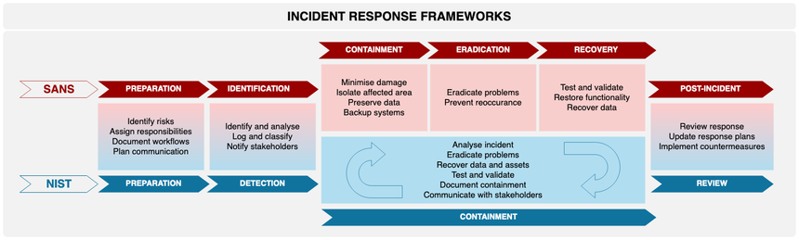
Lunch
© 2024 by Pearson Education, Inc.

Slide 304
Day 4 – Block 5
Automation & Orchestration
Security Automation
Orchestration Platforms
Response Automation
Crucial Exams
Security Operations
CALIFORNIA INSTITUTE OF APPLIED TECHNOLOGY

Slide 305
Use Cases of Automation and Scripting
Automation and scripting are vital in cybersecurity.
Handle repetitive tasks efficiently and effectively
Support policy compliance by consistently applying rules and configurations
Examples
User provisioning
Resource provisioning
Policy enforcement
Incident response
API integrations
© 2024 by Pearson Education, Inc.

Slide 306
User Provisioning
User provisioning involves setting up user accounts with appropriate permissions and roles.
Manual user provisioning can be time-consuming and is prone to errors.
Automation tools integrated with HR software can automate user provisioning, ensuring the right access for employees at the right time.
Deprovisioning can also be automated.
© 2024 by Pearson Education, Inc.

Slide 307
Resource Provisioning
Resource provisioning automates the setup, modification, or removal of digital assets such as virtual machines, databases, and storage units.
Automated resource provisioning helps ensure uniformity, compliance, and time savings.
Avoids the errors associated with manual provisioning
© 2024 by Pearson Education, Inc.

Slide 308
Guard Rails
Guard rails are automated safety measures or rules implemented within a system.
Designed to restrict or control activities that could be harmful or noncompliant with security policies
Act as internal checkpoints or barriers guiding user behavior and system interactions
Enforce compliance with data privacy regulations like HIPAA
© 2024 by Pearson Education, Inc.

Slide 309
Security Groups
A security group is a group of users who are categorized together based on security policies.
Access to system resources can be automatically updated or modified.
Security group automation applies templates based on resource roles or functions instead of configuring firewall rules individually.
Using security groups helps maintain a consistent security posture.
© 2024 by Pearson Education, Inc.

Slide 310
Ticket Creation and Escalation
Automation streamlines ticket creation and ticket escalation in incident response scenarios.
An automated system detects irregularities, such as unauthorized login attempts, and generates tickets or incident reports accordingly.
In case of escalation, such as multiple unauthorized login attempts, tickets are automatically forwarded to higher levels of expertise or authority.
Automation lets admins control permissions by enabling or disabling services and access based on specific conditions (e.g., regular work hours) or security incidents.
© 2024 by Pearson Education, Inc.

Slide 311
Continuous Integration and Testing (CI/CT)
CI/CT involves the automated integration of code changes contributed by multiple developers into a single repository.
Key processes
Code commitment
Static analysis
Automated build process
Automated testing
Deployment
© 2024 by Pearson Education, Inc.

Slide 312
Integrations and Application Programming Interfaces (APIs)
Integrations and APIs automate the linking of computing services and software applications to establish coherent systems.
APIs enable different software entities to seamlessly communicate with each other.
Automation is overall beneficial but requires ongoing maintenance and monitoring for errors
© 2024 by Pearson Education, Inc.

Slide 313
Benefits of Automation
Efficiency: Accelerates task execution, freeing human resources for other work
Workforce multiplier: Enhances team productivity
Employee retention: Improves job satisfaction and retention rates by removing tedious manual tasks
Reaction time: Facilitates quick response to security incidents or operational events
Baseline enforcement: Ensures consistent application of predefined security settings
Standardized infrastructure configurations: Maintains uniformity in system setups, reducing misconfigurations
Secure scaling: Helps organizations securely expand their digital infrastructures
© 2024 by Pearson Education, Inc.

Slide 314
Other Considerations About Automation
Complexity: Automation often requires specialized skills for design, implementation, and maintenance.
Cost: Automation involves initial investments in software, hardware, and human resources.
Single points of failure: Systems without redundancies and fail-safes can become single points of failure.
Ongoing supportability is needed for the effective, long-term operation of automated systems.
Technical debt may accrue. That’s the long-term cost of using outdated systems, shortcuts, and temporary fixes to implement an automation rollout.
© 2024 by Pearson Education, Inc.

Slide 315
Day 4 – Block 6
Vulnerability Management Operations
Patch Management
Change Management
Asset Management
Crucial Exams
Security Operations
CALIFORNIA INSTITUTE OF APPLIED TECHNOLOGY

Slide 316
Vulnerability Response and Remediation
Vulnerability response and remediation: The systematic process of identifying and addressing vulnerabilities in an organization's technology
Patching: Applying updates to software components to fix known vulnerabilities
Segmentation: Network segmentation divides a network into smaller segments to contain breaches and minimize damage
Compensating controls: Alternate measures to reduce the risk of existing or potential control weaknesses
Insurance: Provides financial risk transfer in case of data compromise
Exceptions and exemptions: Exceptions and exemptions are granted for vulnerabilities accepted due to business needs or technical constraints
© 2024 by Pearson Education, Inc.

Slide 317
Validation of Remediation
Validation of remediation ensures that vulnerabilities have been adequately addressed.
Rescanning: Running vulnerability scans again after applying patches or making changes
Audit: Involves a thorough manual review, often conducted by an independent third party or internal audit team
Verification: Synthesizes insights from rescanning and auditing activities to affirm the success or failure of remediation efforts
© 2024 by Pearson Education, Inc.

Slide 318
Reporting
Reporting turns scanning, patching, verification, and validation into actionable insights.
Serves as organizational memory for cybersecurity efforts
Reports vary depending on audience
Technical teams
Senior management
Regulatory bodies
Information-sharing organizations
© 2024 by Pearson Education, Inc.

Slide 319
Patching
Patching involves updating or fixing software applications, drivers, and operating systems by applying patches or updates.
Updates can address known security vulnerabilities, enhance performance, and introduce new features.
Regular patching is crucial for system security.
Industries vary in their approaches to patching based on operational demands and threat environments.
© 2024 by Pearson Education, Inc.

Slide 320
Configuration Enforcement
Configuration enforcement ensures that system settings, policies, and controls are consistently applied throughout an organization's network, systems, and devices.
Strategies for enforcement
Group policy
Ensuring uniform compliance with security standards
Reducing exploitable weaknesses such as common passwords
© 2024 by Pearson Education, Inc.

Slide 321
Backout Plan, Maintenance Window, & Standard Operating Procedure (SOP)
A backout plan is a detailed procedure aimed at reversing changes that negatively affect security or business operations in IT systems or processes.
A maintenance window is a scheduled timeframe for implementing system updates or changes, chosen strategically to minimize disruptions.
SOPs are step-by-step instruction sets designed to guide workers through complex routine operations, ensuring consistency and adherence to best practices.
© 2024 by Pearson Education, Inc.

Slide 322
Updating Policies / Procedures
Policies dictate the rules governing the use and security of IT systems. Procedures outline the specific steps to implement these rules.
Regular revision of policies and procedures is essential to keep them aligned with technological advancements, environmental changes, or system modifications.
© 2024 by Pearson Education, Inc.

Slide 323
Version Control
Version control is a system that records changes made to a file or set of files over time.
Allows users to:
Track modifications
Identify when and by whom changes were made
Revert to earlier versions if necessary
© 2024 by Pearson Education, Inc.

Slide 324
Day 4 – Block 7
Domain 4 PBQ Workshop
Operations & Response PBQs
Crucial Exams
SIEM Alert Configuration PBQ
Incident Response Procedures PBQ
CALIFORNIA INSTITUTE OF APPLIED TECHNOLOGY

Slide 325
Day 4 – Block 8
Day 4 Review & Test Prep
Domain 4 Concept Review
Practice Exam 25 Questions
Crucial Exams
Review Quiz Results & Address Weak Areas
Evening Assignment
Google - Research the NIST Incident Response Lifecycle (SP 800-61), SANS Incident Response Process (6 Phases), ITIL Service Management Framework (SecOps Focus)
Crucial Exams Flashcards - Identity and Access Management Terms and Concepts
uCertify Lessons
CALIFORNIA INSTITUTE OF APPLIED TECHNOLOGY

Slide 326
Exam-Critical Topics
Foundational Reinforcements
Security Operations & Monitoring — log analysis, SIEM functions, alerting, baselining, anomaly detection
Incident Response Procedures — preparation, identification, containment, eradication, recovery, lessons learned
Digital Forensics & Investigation — evidence handling, chain of custody, acquisition methods, preservation, analysis
Business Continuity & Disaster Recovery — RTO/RPO, continuity planning, backup strategies, failover, resilience
Automation & Orchestration — SOAR, playbooks, automated response actions, workflow integration
Vulnerability Management Operations — scanning, validation, prioritization, patching cycles, reporting
Operational visibility: log sources, telemetry, monitoring points
Forensic readiness: documentation, imaging, volatile vs. non‑volatile data
Continuity frameworks: tabletop exercises, communication plans, recovery tiers
Automation considerations: false positives, tuning, human‑in‑the‑loop controls

Slide 327
Questions?

Slide 328
Welcome to Day 5!

Slide 329
Day 5 Topics
Block 1 - Governance & Risk Management
Block 2 - Compliance & Regulatory Requirements
Block 3 - Privacy & Data Protection
Block 4 - Security Awareness & Training
LUNCH
Block 5 - Comprehensive Domain Review
Block 6 - Final PBQ Workshop
Block 7 - Final Exam Strategies & Tips
Block 8 - Final Practice Exam & Scheduling

Slide 330
Carrying Forward Concepts…
Security operations & monitoring — SIEM functions, log analysis, alerting, baselining, anomaly detection
Incident response lifecycle — preparation, identification, containment, eradication, recovery, lessons learned
Digital forensics fundamentals — evidence handling, chain of custody, acquisition methods, preservation, analysis
Business continuity & disaster recovery — RTO/RPO, backup strategies, failover, continuity planning
Automation & orchestration — SOAR, playbooks, automated response actions, workflow integration
Vulnerability management operations — scanning, validation, prioritization, patching cycles, reporting

Slide 331
Day 5 – Block 1
Governance & Risk Management
Risk Assessment Methodologies
Risk Treatment
Governance Frameworks
CALIFORNIA INSTITUTE OF APPLIED TECHNOLOGY

Slide 332
Risk Identification
Risk identification: Systematically recognizing, documenting, and understanding potential threats, vulnerabilities, and hazards that could impact an organization's assets, operations, or objectives
Cybersecurity threats
Natural disasters
Regulatory risks
Supply chain risks
Human errors
© 2024 by Pearson Education, Inc.

Slide 333
Risk Assessment
Risk assessment: Evaluating identified risks to determine their potential likelihood and impact
Ad hoc
Recurring
One-time
Continuous
© 2024 by Pearson Education, Inc.

Slide 334
Risk Analysis
Risk analysis: Delving deep into each identified risk, examining specific details and characteristics
Identify assets
Identify vulnerabilities
Identify threats and threat likelihood
Assess potential impact
A risk register is useful for tracking issues and remedies.
© 2024 by Pearson Education, Inc.

Slide 335
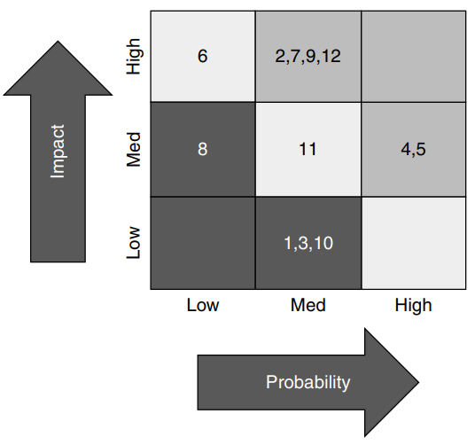
Risk Matrix / Heat Map
Results of a risk assessment
© 2024 by Pearson Education, Inc.

Slide 336
Qualitative Risk Analysis vs Quantitative Risk Analysis
Qualitative
Assigns numeric values based on the probability and impact of risks, without assigning monetary values
Uses ranges to represent probability and impact, such as 1 to 10 or 1 to 100
Quantitative
Assigns exact monetary values to risks and losses
Calculates expected yearly loss in dollars for specific risks
© 2024 by Pearson Education, Inc.

Slide 337
Quantitative Risk Calculations
Three key values used in quantitative risk calculations:
Single loss expectancy (SLE): The loss of value in dollars based on a single incident of a given type
Annualized rate of occurrence (ARO): The number of times per year that the type of incident occurs
Annualized loss expectancy (ALE): Total loss in dollars per year from a type of incident
SLE x ARO = ALE
© 2024 by Pearson Education, Inc.

Slide 338
Exposure Factor (EF)
Exposure factor is the percentage of loss that an asset would experience if a threat materialized. It helps calculate SLE (single loss expectancy).
SLE = Asset value x EF
© 2024 by Pearson Education, Inc.

Slide 339
Probability vs Likelihood
The terms are similar, but probability uses numbers.
Probability quantifies the likelihood of a risk occurring. It’s often expressed as a percentage, and it can be used in calculations.
Likelihood qualitatively describes the chance of an event occurring, often with a term like “likely” or “highly unlikely.”
© 2024 by Pearson Education, Inc.

Slide 340
Risk Register
Risk register: Centralized repository for recording identified risks, their characteristics, and management plans. Each risk receives a risk ID for easy tracking.
Key risk indicators (KRIs): Metrics for measuring the potential impact and likelihood of identified risks
Risk owners: Individuals or departments responsible for managing specific risks
Risk threshold: Level of risk that an organization is willing to accept before taking action
© 2024 by Pearson Education, Inc.

Slide 341
Risk Tolerance
Risk tolerance: The amount of risk an organization is willing to accept as it pursues objectives
Shapes cybersecurity investment
Low risk tolerance leads to heavy investment in multilayered security
High risk tolerance prioritizes growth over stringent security protocols
© 2024 by Pearson Education, Inc.

Slide 342
Risk Appetite
Risk appetite: Level of risk an organization is willing to accept to pursue its objectives
Expansionary: Willing to accept higher risk in exchange for rapid growth
Conservative: Prefers lower levels of risk, prioritizing stability and sustainable growth
Neutral: Balanced approach; accept risk, but not at the expense of stability
© 2024 by Pearson Education, Inc.

Slide 343
Risk Management Strategies
Risk management strategies: Systematic approaches to managing and mitigating risks
Accept some or all consequences of the risk.
Mitigate the risk.
Transfer the risk to a third party.
Avoid the risk.
© 2024 by Pearson Education, Inc.

Slide 344
Risk Reporting
Risk reporting: Documenting and sharing with stakeholders an organization’s risk assessments, analysis findings, and risk management strategies
Executive summary
Detailed findings
Recommendations
Action plan
© 2024 by Pearson Education, Inc.

Slide 345
Business Impact Analysis
Business impact analysis (BIA): Determines potential impacts of interrupting critical processes
Recovery time objective (RTO): Time by which a process should be restored to avoid unacceptable consequences
Recovery point objective (RPO): Maximum amount of data that can be lost due to a disruption
Mean time to repair (MTTR): Average time required to repair a failed device or system
Mean time between failures (MTBF): Expected average time between failures for a system or component
© 2024 by Pearson Education, Inc.

Slide 346
Guidelines
Guidelines are general recommendations aimed at steering organizational behavior and decision making.
Provide directional advice; suggestions and best practices for various security-related activities
More relaxed than policies or standards, allowing for flexibility in implementation
© 2024 by Pearson Education, Inc.

Slide 347
Policies
Policies are formal, high-level statements or plans that outline an organization’s general beliefs, goals, objectives, and acceptable procedures.
Essential for setting the organization’s approaches to various issues
Govern various aspects of business, including employee behavior and emergency procedures
© 2024 by Pearson Education, Inc.

Slide 348
Types of Policies
Acceptable use policy (AUP): Defines rules for the use of technology infrastructure
May conflict with a BYOD policy
Information security policy: Provides guidelines and procedures for protecting data and technology assets
Examples: Password policy, software update policy
Business continuity policy: Aims to ensure that essential operations continue despite a disruption
Examples: Daily remote backup policy, crisis communications policy
© 2024 by Pearson Education, Inc.

Slide 349
Types of Policies (cont.)
Disaster recovery policy: Focuses on restoring IT infrastructure and operations post-crisis
Example: Data recovery policy
Incident response policy: Outlines procedures to follow during cybersecurity incidents
Example: Quarantine policy
Software development lifecycle (SDLC) policy: Governs the software development process, incorporating security and quality at every phase
Examples: Coding policy, software retirement policy
© 2024 by Pearson Education, Inc.

Slide 350
Types of Policies (cont.)
Change management policy: Guides how changes to IT systems and processes are proposed, reviewed, and implemented
Example: Requiring board approval for an IT system change
© 2024 by Pearson Education, Inc.

Slide 351
Standards
Standards provide specific, detailed instructions for implementing security measures.
Help ensure that practices align with policies
Promote consistency and uniformity in security implementation
© 2024 by Pearson Education, Inc.

Slide 352
Types of Standards
Password standards define rules for creating, managing, and storing passwords.
Access control standards determine who has access to specific resources within the organization's network and systems.
Attribute-based access control (ABAC)
Role-based access control (RBAC)
Discretionary access control (DAC)
Mandatory access control (MAC)
© 2024 by Pearson Education, Inc.

Slide 353
Types of Standards (cont.)
Physical security standards safeguard tangible assets like buildings, hardware, and personnel.
Encryption standards govern how data should be encrypted and decrypted within the organization.
© 2024 by Pearson Education, Inc.

Slide 354
Procedures
Procedures implement policies and standards through specific, detailed instructions.
Change management procedures help transition individuals, teams, and the organization to a desired state.
Proposal, planning, testing, implementation, and review
Onboarding and offboarding procedures help integrate users or remove them from identity and access management systems.
Examples: Background checks, user training, adding or removing user permissions
© 2024 by Pearson Education, Inc.

Slide 355
Procedures (cont.)
Playbooks are step-by-step guides to approaching various security scenarios. They aim to minimize the impacts of emergency incidents.
Typical sections
Incident identification
Assessment
Response strategy
Recovery and restoration
Lessons learned
© 2024 by Pearson Education, Inc.

Slide 356
Types of Governance Structures
Board: Sets strategic direction, approves policies, oversees risk management, ensures legal compliance
Committee: Provides detailed oversight, advises on specific issues, monitors and audits, facilitates stakeholder communication
Government entities: Set standards and regulations, enforce legal compliance, collaborate with private sector; subject to oversight committees
© 2024 by Pearson Education, Inc.

Slide 357
Types of Governance Structures (cont.)
Centralized governance concentrates decision-making authority, allows for uniform implementation. May lack responsiveness and can create a single point of failure.
Decentralized governance distributes decision-making authority, fostering innovation and adaptability. May lead to inconsistencies and gaps in security.
© 2024 by Pearson Education, Inc.

Slide 358
Day 5 – Block 2
Compliance & Regulatory Requirements
GDPR
HIPAA
SOX
PCI-DSS
Audit Processes
Control Frameworks
CALIFORNIA INSTITUTE OF APPLIED TECHNOLOGY

Slide 359
Compliance Reporting
Compliance reporting provides insights to internal stakeholders and fulfills external obligations by creating detailed documents.
Documents adhere to industry-specific regulations and standards.
Internal stakeholders might be interested in metrics involving employee security training and thwarted attacks.
External compliance reports are often required within strict time frames. Late or inaccurate reports may result in fines, legal action, and other negative consequences.
© 2024 by Pearson Education, Inc.

Slide 360
Compliance Reporting Examples
FCPA compliance: Shows measures taken to prevent corruption (e.g., due diligence programs and accounting controls)
PCI DSS compliance: Details how customer payment data is protected
HIPAA compliance: Shows measures taken to protect patient health records
GDPR compliance: Shows protocols for safeguarding personal data and privacy rights
© 2024 by Pearson Education, Inc.

Slide 361
Consequences of Non-Compliance
Fines: Monetary penalties for non-compliance
Sanctions: Restrictions or limitations imposed on organizations until compliance is achieved
Reputational damage: Negative impact on an organization's public image and credibility
Loss of license: One of the most severe consequences; the organization might need to shut down
Contractual impacts: Contracts may be terminated and legal disputes may result from not complying with contractual obligations
© 2024 by Pearson Education, Inc.

Slide 362
Compliance Monitoring
Compliance monitoring: Ensuring adherence to regulatory guidelines and internal policies
Involves a range of activities such as due diligence, attestation, and acknowledgment
Uses internal and external monitoring mechanisms
Is streamlined by automation
© 2024 by Pearson Education, Inc.

Slide 363
Due Diligence / Care
Due diligence: Gathering information and assessing risks before making decisions
Includes comprehensive reviews of systems, processes, and policies to identify vulnerabilities
Due care: Maintaining established systems or processes
Applying information gathered during due diligence
Updating security protocols
Conducting regular audits
© 2024 by Pearson Education, Inc.

Slide 364
Attestation
Attestation: Formal act of affirming or certifying validity of a process, system, or data set
Adds trust and integrity to an organization’s cybersecurity posture
Confirms that specific security controls are in place and functioning as intended
Often takes the form of signed statements or digital certificates
© 2024 by Pearson Education, Inc.

Slide 365
Attestation and Acknowledgement
Attestation: Formal declaration or confirmation that specific criteria, processes, or systems meet the security standards
Provides assurance that data is being handled securely
Acknowledgment: Formally accepting or recognizing a policy
Compliance certificates and signed agreements are legally-binding acknowledgments that an organization will adhere to certain security protocols or standards.
© 2024 by Pearson Education, Inc.

Slide 366
Attestation Process
Evaluation
Documentation
Approval
Issuance
Review and Update
© 2024 by Pearson Education, Inc.

Slide 367
Automation in Compliance Monitoring
Software can automate various tasks that help ensure compliance monitoring. Examples:
Configuration management tools
Automated vulnerability scanners
SIEM systems
© 2024 by Pearson Education, Inc.

Slide 368
Internal
Internal audits: Self-audits conducted internally by the organization to ensure alignment with external requirements and internal policies
Proactive
Self-assessments are audits conducted by staff responsible for the assessed areas.
Internal compliance audits are overseen by internal committees.
© 2024 by Pearson Education, Inc.

Slide 369
External
External audits: Evaluations conducted by entities outside the organization
Regulatory audit: Mandated by law or industry standards
Independent third-party audit: Conducted by an unbiased organization
Examination: Verifies specific claims or compliance assertions
Assessment: Evaluates the overall security posture
© 2024 by Pearson Education, Inc.

Slide 370
Reconnaissance
Reconnaissance: Collecting preliminary data or intelligence about the target
Passive reconnaissance
Low-profile approach to gathering information
Identifies potential vulnerabilities or areas of interest without alerting the target
Active reconnaissance
Involves direct interaction with the target system; may target intrusion detection systems
Provides more detail about system vulnerabilities
© 2024 by Pearson Education, Inc.

Slide 371
Vendor Assessment
Vendor assessment: Evaluating a vendor to ensure they meet organizational requirements before engaging in a business relationship
Contracts can help protect the organization.
Service level agreement (SLA): Defines each party’s responsibilities, including vendor’s protocol in case of service failure
Business partners agreement (BPA): Defines each party's responsibilities, the profit arrangement, and exit strategies
© 2024 by Pearson Education, Inc.

Slide 372
Right-to-Audit Clause
Right-to-audit clause: Grants one party the authority to conduct audits on another to ensure compliance with specific criteria
Fosters transparency and accountability
Scope and types of audits permitted should be clearly defined
May be invoked in case of suspected non-compliance or following a security incident involving the vendor
© 2024 by Pearson Education, Inc.

Slide 373
Evidence of Internal Audits
Evidence of internal audits: Documentation and findings of audits conducted within the vendor’s organization
Evidence may include audit reports, corrective action plans, and compliance certificates
Evaluates compliance with legal requirements and internal policies
Focus could be finances, security, or operations
Essential when evaluating a vendor’s risk
© 2024 by Pearson Education, Inc.

Slide 374
Independent Assessments
Independent assessment: Evaluation by a third party not directly involved in a vendor’s business operations
Provides an unbiased view of the vendor’s compliance and risk management status
Examples
SOC 2 reports
ISO certifications
Results of third-party penetration tests
© 2024 by Pearson Education, Inc.

Slide 375
Supply Chain Analysis
Supply chain analysis: Thoroughly evaluating every element and process in a vendor’s supply chain
Weak links can expose the organization to risks
Tools and techniques
Supplier audits
SWOT analysis
Data analytics
Machine learning predictions
© 2024 by Pearson Education, Inc.

Slide 376
Vendor Selection
Vendor selection: Evaluating and choosing a third-party service or product provider that best aligns with an organization’s needs, goals, and risk tolerance
Due diligence: A comprehensive appraisal of a vendor’s business practices, financial stability, reputation, and compliance with relevant laws and regulations
Conflict of interest: A vendor's competing professional or personal interests could interfere with their ability to act in the best interests of the organization
© 2024 by Pearson Education, Inc.

Slide 377
Agreement Types
Service-level agreement (SLA): Defines the expected level of service from a service provider
Memorandum of agreement (MOA): Specifies a cooperative, generally non-legally binding relationship
Memorandum of understanding (MOU): Less formal than an MOA, it outlines mutual roles and responsibilities in a project or partnership
Master service agreement (MSA): Parties agree to most of the terms that will govern future projects
© 2024 by Pearson Education, Inc.

Slide 378
Agreement Types (cont.)
Work order/statement of work (WO/SOW): Describes work activities, deliverables, and timeline
Non-disclosure agreement (NDA): Legally binding contract establishing a confidential relationship; involves sensitive information
Business partners agreement (BPA): Outlines terms and conditions of a partnership
© 2024 by Pearson Education, Inc.

Slide 379
Vendor Monitoring
Vendor monitoring: Continuous oversight and evaluation of vendors to ensure they meet or exceed contractual obligations
Covers various areas such as reliability, data protection, and ethical considerations (e.g., labor practices)
Periodic reviews assess vendors' capabilities in response to evolving regulations and emerging threats
© 2024 by Pearson Education, Inc.

Slide 380
Questionnaires
Vendor questionnaires: Forms used to gather nuanced information about a vendor's operational resilience, data handling practices, and corporate culture
Probe topics such as:
Data encryption
Multifactor authentication
Incident response
© 2024 by Pearson Education, Inc.

Slide 381
Rules of Engagement
Rules of engagement: Agreed-upon guidelines dictating how activities and interactions should occur between an organization and a vendor
Ensure clear expectations and responsibilities
Procedures for:
Security vulnerability reporting
Escalating issues
Changing the service provided
© 2024 by Pearson Education, Inc.

Slide 382
Day 5 – Block 3
Privacy & Data Protection
Data Classification
Data Loss Prevention
Privacy by Design
CALIFORNIA INSTITUTE OF APPLIED TECHNOLOGY

Slide 383
Data Types
Regulated data: Subject to laws and regulations due to sensitivity, such as medical records regulated by HIPAA
Trade secret: Confidential information providing a competitive advantage, like a proprietary algorithm
Intellectual property (IP): Protected creative works, inventions, and designs, including copyrighted source code
Legal information: Data related to legal processes or obligations, such as signed contracts or employee agreements
© 2024 by Pearson Education, Inc.

Slide 384
Data Types (cont.)
Financial information: Data concerning financial operations and performance, regulated by laws like SOX and GLBA, including balance sheets, income statements, and tax records
Human- and non-human-readable data: Human-readable data (e.g., text documents) and non-human-readable data (e.g., encrypted files)
© 2024 by Pearson Education, Inc.

Slide 385
Data Classifications
Confidential or proprietary: Information or assets that could cause grave damage to an organization if accessed without authorization
Sensitive: Data that could cause some damage to an organization if accessed without authorization
Public: Information openly available without causing harm or presenting risks if exposed
Private: Information or assets that could cause severe damage to an organization if accessed without authorization (e.g., payroll data)
© 2024 by Pearson Education, Inc.

Slide 386
Data Classifications (cont.)
Restricted: Data requiring the highest level of security measures due to its sensitive nature or stringent legal obligations
Critical: Data essential to the continued function of a business, the loss of which would result in significant monetary loss for the organization
© 2024 by Pearson Education, Inc.

Slide 387
General Data Considerations
Data states: The states in which data exists: at rest, in transit, and in use
Handling procedures: Establish clear procedures for handling data throughout its lifecycle, from creation and storage to sharing and disposal.
Security measures: Implement robust security measures, including encryption, access controls, monitoring, and incident response protocols to help safeguard data against unauthorized access, breaches, and other security threats.
© 2024 by Pearson Education, Inc.

Slide 388
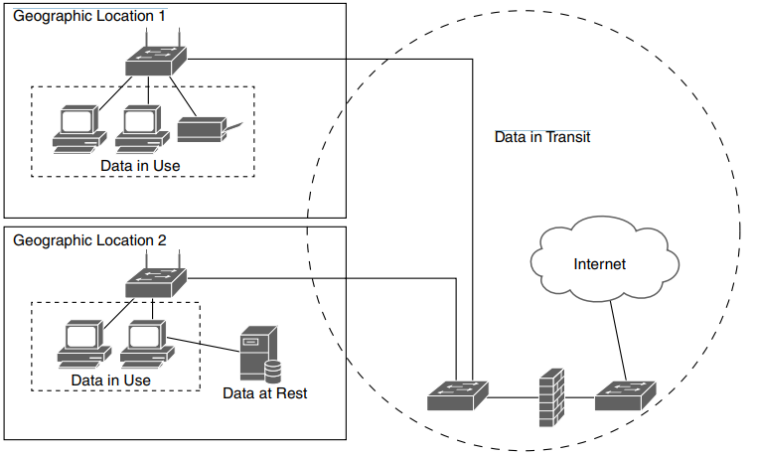
Data States
© 2024 by Pearson Education, Inc.

Slide 389
Data Sovereignty & Geolocation
Data sovereignty
Legal and regulatory requirements for data based on its collection or processing location
Mandates often dictate that data must remain within a country's borders
Geolocation
Identification or estimation of real-world geographic location based on digital information
Uses technologies like GPS tagging, geofencing, and IP-based location services
© 2024 by Pearson Education, Inc.

Slide 390
Methods to Secure Data
Geographic Restriction: Limits access to data based on user's geographic location
Encryption: Converts readable data to an encoded format
Hashing: Converts data to fixed-length strings for verifying integrity
Masking: Replaces specific data with fictitious but structurally similar data
Tokenization: Replaces sensitive information with a placeholder, reducing the risk of data breaches
Obfuscation: Makes data unintelligible without affecting functionality
© 2024 by Pearson Education, Inc.

Slide 391
Segmentation
Segmentation: Divides a network into segments that isolate data
Examples
Finance segment: Highly secure area of the network for sensitive financial information
Firewall segment: Also known as a screened subnet; a buffer zone between the external network (Internet) and internal network
Engineering segment: Isolated environment for development and testing purposes
Sales segment: For customer relationship management (CRM) systems, sales records, and customer-related data
© 2024 by Pearson Education, Inc.

Slide 392
Permission Restrictions
Permission restrictions specify who can perform which actions within a system or network.
Methods
Role-based access control (RBAC): Access permissions are assigned to organizational roles.
Attribute-based access control (ABAC): Access is granted based on attributes like location, time, or device type.
Principle of least privilege: Ensures that users have only the minimum access necessary to perform their tasks
© 2024 by Pearson Education, Inc.

Slide 393
Privacy
Privacy: An ethical obligation and a legal mandate
Involves safeguarding data against unauthorized access and ensuring data is used properly
Legal frameworks govern cybersecurity privacy at various jurisdictional levels
© 2024 by Pearson Education, Inc.

Slide 394
Legal Implications
Legal implications: An organization's responsibilities, liabilities, and potential penalties related to handling personal data. Vary by jurisdiction, data type, and data use.
Local and regional examples
CCPA (California)
SHIELD Act (New York)
GDPR (European Union)
National examples
COPPA (USA)
PIPEDA (Canada)
© 2024 by Pearson Education, Inc.

Slide 395
Data Roles
Data subject: An individual whose personal data is being processed.
Controller: Decides how and why data will be processed
Processor: Processes personal data on behalf of the controller, complying with security measures
Ownership: Refers to who has legal rights and control over data (e.g., the power to set access levels and give auditing permissions)
© 2024 by Pearson Education, Inc.

Slide 396
Data Inventory and Retention
Data inventory: A catalog or map that identifies where different types of data are stored
Crucial for risk assessment and data protection strategies
Data retention policies: Dictate how long specific data types should be stored
© 2024 by Pearson Education, Inc.

Slide 397
Right to Be Forgotten
The right to be forgotten lets individuals request the deletion of their personal data. Security analysts follow up with data erasure in accordance with regulations.
Locate and erase specified data from all systems, including backups.
Run verification checks to confirm complete removal of data.
Keep detailed documentation of the entire process.
© 2024 by Pearson Education, Inc.

Slide 398
Day 5 – Block 4
Security Awareness & Training
Training Program Development
Security Culture
Metrics
CALIFORNIA INSTITUTE OF APPLIED TECHNOLOGY

Slide 399
Phishing
Phishing: Social engineering attack aimed at tricking individuals into sharing sensitive data
Often conducted via email, messaging apps, and websites
User education and awareness are vital to keeping systems secure
© 2024 by Pearson Education, Inc.

Slide 400
Signs of Phishing Attempts
Mismatched URLs
Errors in grammar and spelling
Requests for sensitive information
Unexpected attachments
“Too good to be true” offers
© 2024 by Pearson Education, Inc.

Slide 401
Suspicious Message Protocol
Isolate the threat
Analyze the content
Notify security team
Make users aware
Update security measures
© 2024 by Pearson Education, Inc.

Slide 402
Anomalous Behavior Recognition
Anomalous behavior recognition: Identifies actions or patterns deviating from established norms in a network or system
May indicate malicious threats or unintentional (but still risky) behaviors
Crucial for preemptive threat detection
© 2024 by Pearson Education, Inc.

Slide 403
Anomalous Behaviors
Unexpected behaviors: Deviations from established norms or baseline behaviors
Unusual login times
High data transfer rates
Multiple failed login attempts
Risky behaviors: Actions that expose an organization to vulnerabilities or threats; may be deliberate or have malicious intent
Unintentional behaviors: Actions that inadvertently jeopardize cybersecurity; usually involve lack of awareness
© 2024 by Pearson Education, Inc.

Slide 404
User Guidance and Training
User guidance: Empowers employees with security knowledge and training to help protect the organization
Policy documents
Acceptable use policy
Information security policy
Remote/hybrid work policies
Incident response handbook
Training
Password management
Social engineering
Insider threats
Operational security
© 2024 by Pearson Education, Inc.

Slide 405
Reporting and Monitoring
Reporting and monitoring are both initial and recurring.
Initial reporting: Documenting and communicating details of security incidents or vulnerabilities as the first response
Initial monitoring: Working to contain a threat with help of real-time log data
Recurring reporting: Periodically reviewing and auditing to assess security measures
Recurring monitoring: Continuously scanning networks and systems for new vulnerabilities and threats
© 2024 by Pearson Education, Inc.

Slide 406
Development
Development phase: Lay the groundwork for a security awareness program by defining its objectives, scope, and measurable goals.
Create a detailed project plan outlining a timeline, resources, and budget.
Identify key stakeholders and define their roles
Create training materials and assessments.
© 2024 by Pearson Education, Inc.

Slide 407
Execution
Execution phase: Put the security awareness program into action.
Use real-time monitoring to ensure the program is effective.
Make program adjustments as needed.
Periodically review the program to keep it relevant and effective.
© 2024 by Pearson Education, Inc.

Slide 408
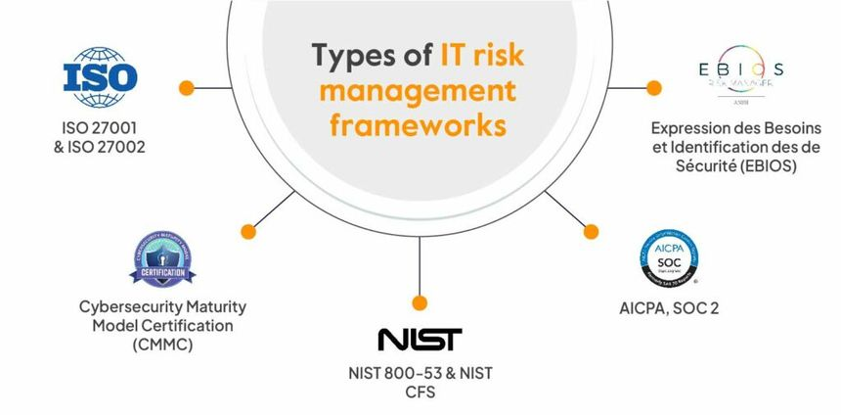
Lunch
© 2024 by Pearson Education, Inc.

Slide 409
Day 5 – Block 5
Comprehensive Domain Review
Cross-Domain Integration
Weak Area Reinforcement
CALIFORNIA INSTITUTE OF APPLIED TECHNOLOGY

Slide 410
Day 5 – Block 6
Final PBQ Workshop
Advanced Multi-Domain PBQs
Crucial Exams
Revisit Challenging PBQs:
Cloud WAF Setup
SIEM Alert Config PBQ
CALIFORNIA INSTITUTE OF APPLIED TECHNOLOGY

Slide 411
Day 5 – Block 7
Day 5 Final Practice Exam & Scheduling
Full 90-Question Practice Exam
Crucial Exams
Timed Practice Exam: 90 minutes
CALIFORNIA INSTITUTE OF APPLIED TECHNOLOGY

Slide 412
Day 5 – Block 8
Finish Practice Test
Final Q&A
CALIFORNIA INSTITUTE OF APPLIED TECHNOLOGY

Slide 413
Exam-Critical Topics
Foundational Reinforcements
Governance & Risk Management — policies, standards, risk assessments, risk responses, frameworks, and oversight
Compliance & Regulatory Requirements — legal obligations, industry mandates, data handling requirements, audit readiness
Privacy & Data Protection — data classifications, retention, minimization, consent, privacy roles, and safeguarding sensitive information
Security Awareness & Training — user education, role‑based training, reporting culture, and reducing human‑factor risk
Comprehensive Domain Review — cross‑domain integration, exam‑level reasoning, and concept reinforcement
Final Exam Strategies & Tips — time management, question analysis, distractor identification, PBQ approach
Governance structures: policies, procedures, guidelines
Risk concepts: likelihood, impact, qualitative vs. quantitative methods
Regulatory landscapes: sector‑specific requirements and global considerations
Training program development and continuous improvement
Exam mindset: pattern recognition, elimination strategies, confidence building

Slide 414
Questions?

Slide 415
Appendix – Review Key Terms

Slide 416
Review Key Terms
confidentiality
integrity
availability
non-repudiation
authentication
authorization
accounting (AAA)
authenticating people
authenticating systems
authorization model
gap analysis
Zero Trust
control plane
adaptive identity
threat scope reduction
policy-driven access control
© 2024 by Pearson Education, Inc.

Slide 417
Review Key Terms
secured zone
policy engine
policy administrator
data plane
subject/system
policy enforcement point (PEP)
implicit trust zones
bollard
barricade
access control vestibule
closed-circuit television (CCTV)
security guard
honeypot
honeynet
honeyfile
honeytoken
© 2024 by Pearson Education, Inc.

Slide 418
Review Key Terms
technical controls
managerial controls
operational controls
physical controls
deterrent controls
detective controls
corrective controls
compensating controls
directive controls
© 2024 by Pearson Education, Inc.

Slide 419
Review Key Terms
business process
approval process
ownership
stakeholder
impact analysis
test result
backout plan
maintenance window
standard operating procedure (SOP)
technical implications
allow list
deny list
restricted activity
downtime
service restart
application restart
legacy application
dependency
documentation
updating diagrams
policy
procedure
version control
© 2024 by Pearson Education, Inc.

Slide 420
Review Key Terms
public key infrastructure (PKI)
private key
public key
key escrow
encryption
level
full-disk encryption
partition
file encryption
volume encryption
database encryption
record-level encryption
transport/communication
symmetric encryption
asymmetric encryption
key exchange
algorithm
key length
tools
Trusted Platform Module (TPM)
Hardware Security Module (HSM)
© 2024 by Pearson Education, Inc.

Slide 421
Review Key Terms
key management system (KMS)
secure enclave
obfuscation
steganography
tokenization
data masking
hashing
salting
digital signature
key stretching
blockchain
open public ledger
certificate
certificate authority (CA)
certificate revocation list (CRL)
Online Certificate Status Protocol (OCSP)
self-signed certificate
certificate-signing request (CSR)
third-party certificate
root of trust
wildcard
© 2024 by Pearson Education, Inc.

Slide 422
Review Key Terms
threat actor
unskilled attacker
hacktivist
organized crime
nation-state actor
insider threat
shadow IT
resource
funding
motivation
data exfiltration
espionage
service disruption
blackmail
financial gain
philosophical/political beliefs
ethical
revenge
disruption/chaos
war
© 2024 by Pearson Education, Inc.

Slide 423
Review Key Terms
Short Message Service (SMS)
spam
image-based threats
file-based threats
voice call threats
removable device threats
vulnerable software
client-based security
agentless security
unsupported systems and applications
wireless network
wired network
Bluetooth network
open service ports
supply chain
phishing
vishing
smishing
misinformation
disinformation
pretexting
watering hole attack
brand impersonation
typosquatting
© 2024 by Pearson Education, Inc.

Slide 424
Review Key Terms
memory injection
buffer overflow
race condition
malicious update
operating system-based vulnerability
Structured Query Language injection (SQLi) vulnerability
cross-site scripting (XSS) vulnerability
firmware vulnerability
end-of-life (EOL)
legacy platform or device
virtual machine (VM) escape
resource reuse
service provider
hardware provider
software provider
cryptographic vulnerability
misconfiguration
side loading
jailbreaking
zero-day vulnerability
© 2024 by Pearson Education, Inc.

Slide 425
Review Key Terms
malware
ransomware
Trojan
worm
spyware
bloatware
virus
keylogger
logic bomb
rootkit
brute-force attack
radio frequency identification (RFID) cloning
environmental threat
network attack
distributed denial-of-service (DDoS) attack
amplified DDoS attack
reflected DDoS attack
Domain Name System (DNS) attack
wireless attack
© 2024 by Pearson Education, Inc.

Slide 426
Review Key Terms
on-path attack
credential replay
malicious code
application attack
injection attack
buffer overflow attack
replay attack
privilege escalation
forgery attack
directory traversal
cryptographic attack
downgrade attack
collision
birthday attack
password attack
indicator
account lockout
concurrent session usage
© 2024 by Pearson Education, Inc.

Slide 427
Review Key Terms
segmentation
access control
access control list (ACL)
permissions
application allow list
isolation
patching
encryption
monitoring
principle of least privilege
configuration enforcement
decommissioning
hardening techniques
installation of endpoint protection
host-based firewall
host-based intrusion prevention system (HIPS)
disabling unused or unnecessary ports and protocols
default usernames and passwords
unnecessary software
© 2024 by Pearson Education, Inc.

Slide 428
Review Key Terms
cloud computing
responsibility matrix
hybrid cloud
third-party vendor
infrastructure as code (IaC)
serverless architecture
microservices
network infrastructure
physical isolation
air gapping
logical segmentation
software-defined networking (SDN)
on-premises
centralized system
decentralized system
container image
virtualization
Internet of Things (IoT)
Supervisory Control and Data Acquisition (SCADA) systems and Industrial Control Systems (ICSs)
© 2024 by Pearson Education, Inc.

Slide 429
Review Key Terms
real-time operating system (RTOS)
embedded system
high availability (HA)
availability
resilience
cost
responsiveness
scalability
ease of deployment
risk transference
ease of recovery
patch availability
inability to patch
power consumption
compute resource
© 2024 by Pearson Education, Inc.

Slide 430
Review Key Terms
device placement
security zones
attack surface
connectivity
fail-open
fail-closed
device attributes
active/active
active/passive
inline monitoring
tap (or monitor) mode
jump server
proxy server
Intrusion Detection System (IDS)
Intrusion Prevention System (IPS)
load balancing
sensor
port security
802.1X
Extensible Authentication Protocol (EAP)
web application firewall (WAF)
Unified Threat Management (UTM)
Next-Generation Firewall (NGFW)
Layer 4 firewall
Layer 7 firewall
virtual private network (VPN)
remote access
Transport Layer Security (TLS)
Internet Protocol Security (IPsec)
Software-Defined Wide Area Network (SD-WAN)
Secure Access Service Edge (SASE)
selecting effective controls
© 2024 by Pearson Education, Inc.

Slide 431
Review Key Terms
regulated data
trade secret
intellectual property (IP)
legal information
human-readable data
non-human-readable data
data classification
unauthorized access
sensitive data
public data
restricted data
private data
critical data
data at rest
data in transit
data in use
data sovereignty
geolocation
geographic restriction
encryption
hashing
data masking
tokenization
obfuscation
segmentation
permission restrictions
© 2024 by Pearson Education, Inc.

Slide 432
Review Key Terms
high availability (HA)
load balancing
clustering
hot site
warm site
cold site
geographic dispersion
platform diversity
multi-cloud system
continuity of operations planning (COOP)
capacity planning
technology capacity planning
infrastructure
testing
tabletop exercise
failover testing
simulation
parallel processing
backup
onsite backup
offsite backup
backup frequency
encryption algorithm
snapshot
recovery
replication
journaling
power management
uninterruptible power supply (UPS)
generator
© 2024 by Pearson Education, Inc.

Slide 433
Review Key Terms
secure baseline
deployment
hardening targets
mobile device
workstation
switch
router
cloud infrastructure
server
Supervisory Control and Data Acquisition (SCADA) systems/ Industrial Control Systems (ICSs)
embedded system
real-time operating system (RTOS)
Internet of Things (IoT) device
site survey
heat map
bring your own device (BYOD)
mobile device management (MDM)
choose your own device (CYOD)
corporate-owned, personally enabled (COPE)
Bluetooth
Wi-Fi
cellular connection
Wi-Fi Protected Access 3 (WPA3)
authentication protocol
application security
input validation
secure cookie
static code analysis
code signing
sandboxing
monitoring
© 2024 by Pearson Education, Inc.

Slide 434
Review Key Terms
acquisition process
assignment and accounting process
ownership
monitoring and asset tracking
inventory
enumeration
decommission
sanitization
destruction
certification
data retention
© 2024 by Pearson Education, Inc.

Slide 435
Review Key Terms
identification method
vulnerability scan
application security
static analysis
dynamic analysis
package monitoring
threat feed
open-source intelligence (OSINT)
proprietary threat teed
information-sharing organization
dark web
penetration testing
responsible disclosure program
bug bounty program
system or process audit
analysis
confirmation
false positive
false negative
prioritization
© 2024 by Pearson Education, Inc.

Slide 436
Review Key Terms
Common Vulnerability Scoring System (CVSS)
Common Vulnerability Enumeration (CVE)
vulnerability classification
exposure factor (EF)
environmental variable
industry/organizational impact
risk tolerance
vulnerability response and remediation
patching
cybersecurity Insurance
segmentation
compensating control
exception or exemption
validation of remediation
rescanning
audit
verification
reporting
© 2024 by Pearson Education, Inc.

Slide 437
Review Key Terms
monitoring computing resources
monitoring systems
application monitoring
infrastructure monitoring
cybersecurity activity
log aggregation
alerting
scanning
reporting
archiving
alert response process
quarantining
alert tuning
cybersecurity tool
Security Content Automation Protocol (SCAP)
benchmark
agent-based solution
agentless solution
security information and event management (SIEM) system
NetFlow
antivirus software
Data Loss Prevention (DLP)
Simple Network Management Protocol (SNMP) trap
vulnerability scanner
© 2024 by Pearson Education, Inc.

Slide 438
Review Key Terms
firewall
rule
access control list (ACL)
port
protocol
screened subnet
intrusion detection system (IDS)
intrusion prevention system (IPS)
trend
signature
web filtering
agent-based web filtering approach
centralized proxy
URL scanning
content categorization
block rule
reputation-based filtering
operating system security
group policy
SELinux
implementation of secure protocols
© 2024 by Pearson Education, Inc.

Slide 439
Review Key Terms
protocol selection
port selection
transport method selection
DNS filtering
email security
Domain-Based Message Authentication Reporting and Conformance (DMARC)
DomainKeys Identified Mail (DKIM)
Sender Policy Framework (SPF)
gateway
file integrity monitoring
data loss prevention (DLP)
network access control (NAC)
endpoint detection and response (EDR)
extended detection and response (XDR)
user behavior analytics (UBA)
© 2024 by Pearson Education, Inc.

Slide 440
Review Key Terms
provisioning
de-provisioning
permission assignment
identity proofing
federation
single sign-on (SSO)
Lightweight Directory Access Protocol (LDAP)
Open Authorization (OAuth)
Security Assertion Markup Language (SAML)
interoperability
attestation
access control model
role-based access control (RBAC)
rule-based access control
mandatory access control (MAC)
discretionary access control (DAC)
attribute-based access control (ABAC)
time-of-day restriction
least privilege
© 2024 by Pearson Education, Inc.

Slide 441
Review Key Terms
multifactor authentication (MFA)
biometric identifier
factor
something you know
something you have
something you are
somewhere you are
password concepts
password
password best practices
password length
password complexity
password reuse
password expiration
password age
password manager
passwordless authentication
privileged access management (PAM)
just-in-time (JIT) permissions
password vaulting
ephemeral credentials
© 2024 by Pearson Education, Inc.

Slide 442
Review Key Terms
user provisioning
resource provisioning
guard rails
security group
ticket creation system
escalate
enabling or disabling services and access
continuous integration and testing
integrations and application programming interfaces (APIs)
efficiency and time saving
enforcing baselines
standard infrastructure configurations
scaling in a secure manner
employee retention
improving reaction time
workforce multiplier
complexity
cost
single point of failure
technical debt
ongoing supportability
© 2024 by Pearson Education, Inc.

Slide 443
Review Key Terms
preparation
detection
analysis
containment
eradication
recovery
lessons learned
training
testing
tabletop exercise
simulation
root cause analysis
threat hunting
digital forensics
legal hold
chain of custody
acquisition
reporting
preservation
e-discovery
© 2024 by Pearson Education, Inc.

Slide 444
Review Key Terms
log data
firewall log
application log
endpoint log
operating system (OS)-specific security log
intrusion prevention system (IPS) and intrusion detection system (IDS) logs
network log
metadata
data source
vulnerability scan
automated report
dashboard
packet capture
© 2024 by Pearson Education, Inc.

Slide 445
Review Key Terms
guideline
policy
acceptable use policy (AUP)
Information security policy
business continuity policy
disaster recovery policy
incident response policy
software development lifecycle (SDLC) policy
standards
password standards
access control standards
physical security standards
encryption standards
procedures
change management
onboarding
offboarding
playbook
external considerations
regulatory rules
board
committee
centralized governance structure
decentralized governance structure
owner
controller
custodian (or steward)
© 2024 by Pearson Education, Inc.

Slide 446
Review Key Terms
risk identification
risk assessment
ad hoc risk assessment
recurring risk assessment
one-time risk assessment
continuous risk assessment
risk analysis
qualitative risk assessment
quantitative risk assessment
single loss expectancy (SLE)
annualized rate of occurrence (ARO)
annualized loss expectancy (ALE)
probability
likelihood
exposure factor (EF)
impact
risk register
key risk indicators (KRIs)
© 2024 by Pearson Education, Inc.

Slide 447
Review Key Terms
risk owner
risk threshold
risk tolerance
risk appetite
expansionary risk appetite
conservative risk appetite
neutral risk appetite
risk management strategy
risk transference
risk acceptance
risk exemption
risk exception
risk avoidance
risk mitigation
risk reporting
business impact analysis (BIA)
recovery time objective (RTO)
recovery point objective (RPO)
mean time to repair (MTTR)
mean time between failures (MTBF)
© 2024 by Pearson Education, Inc.

Slide 448
Review Key Terms
penetration testing
right-to-audit clause
evidence of internal audits
independent assessment
supply chain analysis
vendor selection
due diligence
conflict of interest
service-level agreement (SLA)
memorandum of agreement (MOA)
memorandum of understanding (MOU)
master service agreement (MSA)
work order (WO)/Statement of work (SOW)
non-disclosure agreement (NDA)
business partners agreement (BPA)
vendor monitoring
questionnaire
rules of engagement
© 2024 by Pearson Education, Inc.

Slide 449
Review Key Terms
compliance reporting
internal compliance reporting
external compliance reporting
fine
sanction
reputational damage
losing a license
contractual impact
due diligence
due care
attestation
acknowledgment
internal compliance monitoring
external compliance monitoring
automation
legal implications
national privacy laws
data subject
controller
processor
ownership
data inventory
data retention
right to be forgotten
© 2024 by Pearson Education, Inc.

Slide 450
Review Key Terms
attestation
internal audit
compliance
audit committee
self-assessment
external audit
regulatory audit
examination
assessment
independent third-party audit
physical penetration testing
offensive penetration testing
defensive penetration testing
integrated penetration testing
known environment penetration testing
partially known environment penetration testing
unknown environment penetration testing
reconnaissance
passive reconnaissance
active reconnaissance
© 2024 by Pearson Education, Inc.

Slide 451
Review Key Terms
campaign
anomalous behavior recognition
risky behavior
unexpected behavior
unintentional behavior
policies and handbooks
situational awareness
insider threat
password management
social engineering
operational security (OpSec)
hybrid and remote work environments
initial reporting
recurring reporting
development
execution
© 2024 by Pearson Education, Inc.

