Slide 1
Alaska Slides
Global Adventure Travel

Slide 2
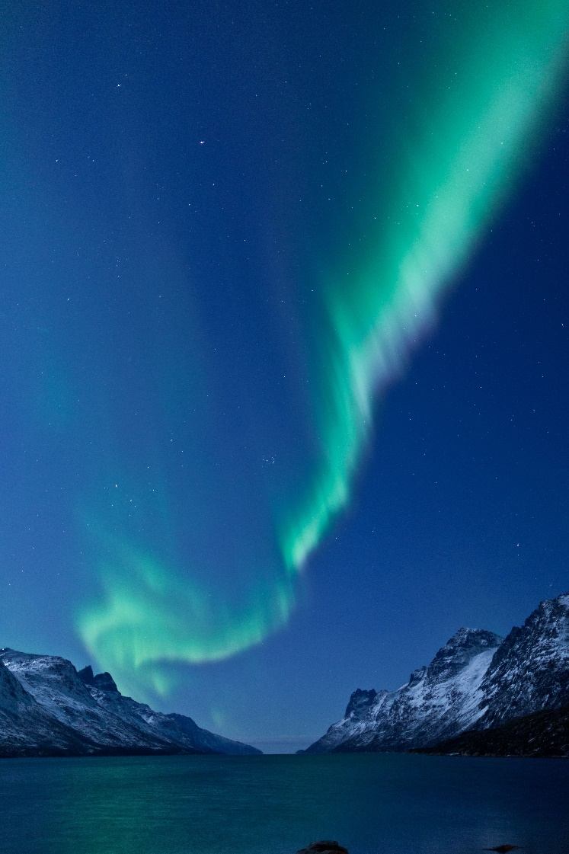
The Aurora Borealis
Ribbons of blue, green, pink, and purple luminescence that are caused by the collisions of electrically charged particles in the atmosphere.

Slide 3
Viewing the Lights from Fairbanks
Cleary Summit
Chena Lakes Recreation Area
Steese Highway
Ester Dome

