Slide 1
SmartPark: Real-Time Parking Spot Object Detection
AASD 4014 — Deep Learning II — Final Project
Object Detection Track · July 2026 · Group [FILL IN]

Slide 2
The Problem
Drivers waste time and money searching for parking
• Camera-based occupancy detection can surface spot-level availability before drivers arrive.
• Prior work (PKLot / CNRPark-EXT) classifies pre-cropped, pre-calibrated spot images — it assumes spot locations are already known.
• This project targets the assignment's Object Detection requirement directly: find AND classify spots (empty_spot / occupied_spot) in a full, uncalibrated photo — no manual calibration step.

Slide 3
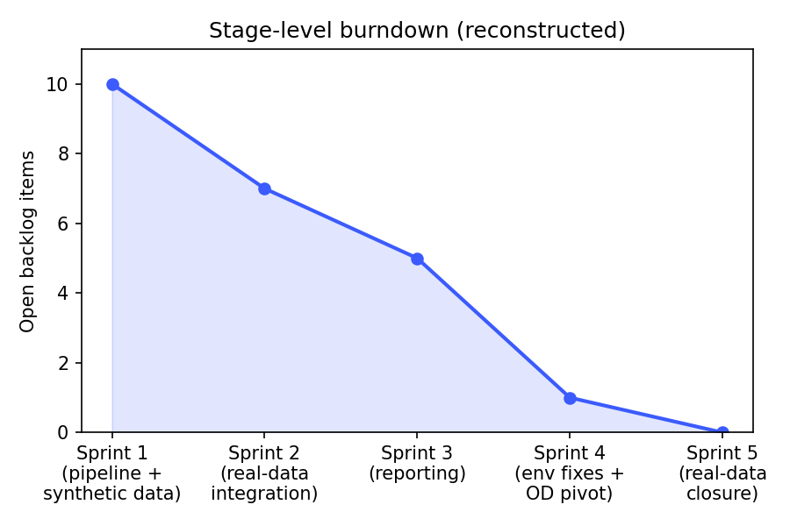
Plan of Attack & Agile Process
5 real development stages, reconstructed from project file history
Sprint | Goal | Key deliverables
1 (Jul 17) | Pipeline scaffolding | Synthetic data, CNN classifier, geometry check, first demo UI
2 (Jul 18) | Real-data integration | PKLot conversion, classifier retrained on real data (97.04%)
3 (Jul 19) | Reporting | Initial report/slides, architecture diagram
4 (Jul 20) | Env fixes + OD pivot | Rebuilt as a real 2-class object detector after rubric audit
5 (Jul 21) | Real-data closure | Fine-tuned detector on real boxes (47.71% mAP); classifier 98.69%

Slide 4
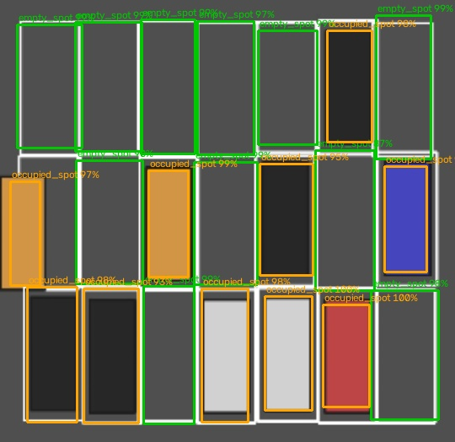
The Dataset
Full-scene detection annotations, two object classes
• 300 synthetic full-lot images, randomized grid layout (rows/cols/spot size/margin + per-spot jitter)
• 4,422 labeled spot instances: 2,027 empty_spot / 2,395 occupied_spot
• occupied_spot boxes track the actual car footprint (shifts when misparked) — real localization signal
• 255 train / 45 val images (85/15 split)
• Both classes clear the 200-images-per-class minimum comfortably

Slide 5
Model: Single-Shot Detector
Trained from scratch — YOLOv1-style, one box per grid cell
Layer | Output
Input | 256×256×3
Conv2D(16)+Pool | 128×128×16
Conv2D(32)+Pool | 64×64×32
Conv2D(64)+Pool | 32×32×64
Conv2D(128)+Pool | 16×16×128
Conv2D(128)×2 | 16×16×128
Head (1×1 conv) | 16×16×7
• 393,511 parameters
• Per cell: objectness, box (tx,ty,tw,th), 2-class softmax
• Loss: YOLOv1-style — coordinate (×5), objectness, no-object (×0.5), classification
• Post-processing: per-class NMS (cv2.dnn.NMSBoxes)
• Secondary pipeline: CNN classifier (1.14M params) + IoU geometry check for calibrated cameras

Slide 6
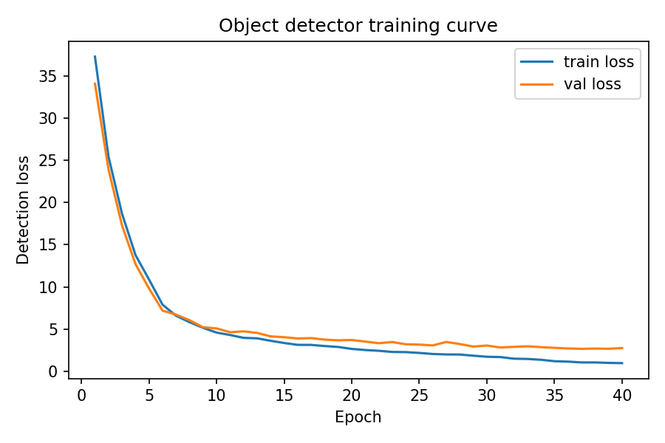
Training
40 epochs, Adam + ReduceLROnPlateau, early stopping patience 6 (not triggered)

Slide 7
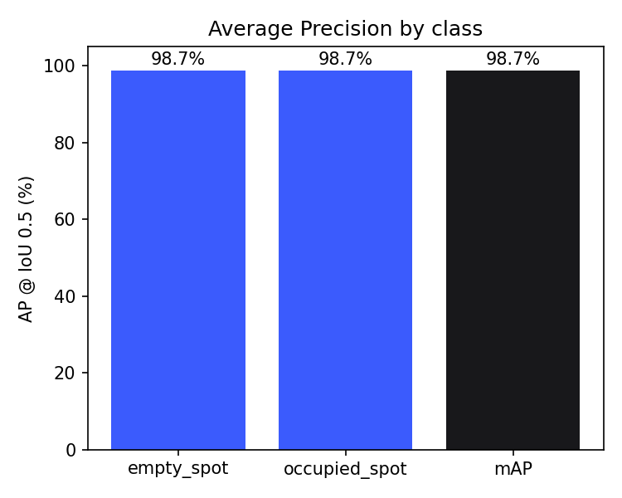
Evaluation
Held-out validation: 45 images, 721 spot instances
Class | GT | AP@0.5 | Precision | Recall | F1
empty_spot | 337 | 98.73% | 95.5% | 94.1% | 94.8%
occupied_spot | 384 | 98.68% | 99.7% | 96.1% | 97.9%
mAP@0.5 | — | 98.71% | — | — | —

Slide 8
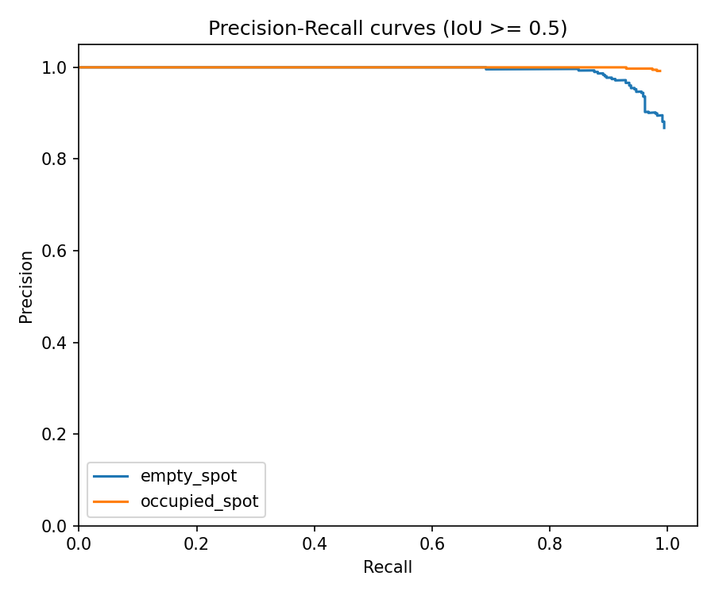
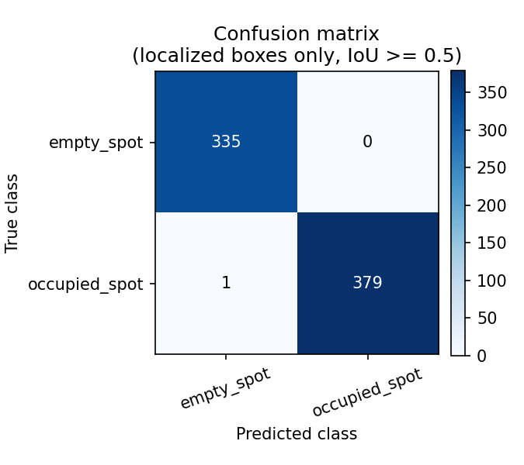
Where the Errors Are
Localization misses, not class confusion

Slide 9
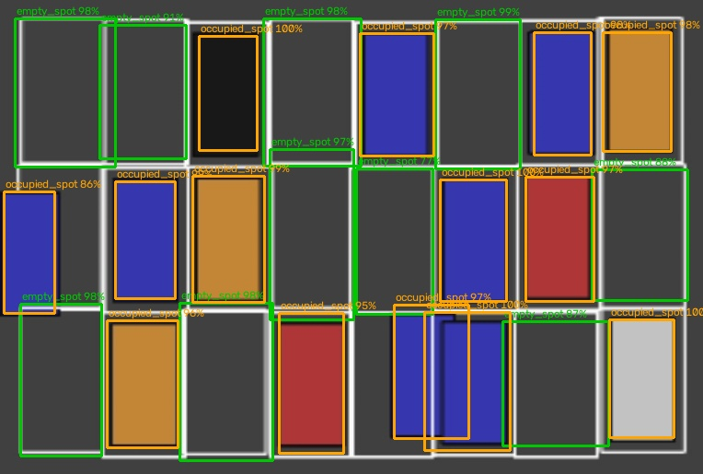
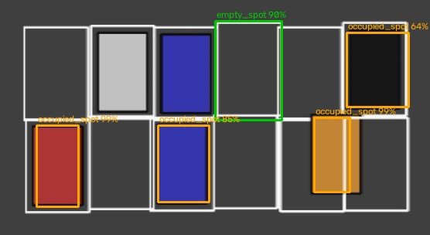
Qualitative Results
A clean match, and an honest failure case
24/24 spots, exact match
Missed several cars incl. a low-contrast gray car

Slide 10
Hyperparameter Tuning
Two real, measured comparisons
Grid resolution vs. collision rate
Coordinate loss weight (15 epochs each)
Grid | Dropped | Rate
8×8 | 111/4,422 | 2.51%
16×16 ✓ | 12/4,422 | 0.27%
32×32 | 3/4,422 | 0.07%
lambda_coord | Val loss | mAP
5.0 ✓ | 3.91 | 96.72%
1.0 | 16.36 | 0.00%
lambda_coord=1.0 collapsed to 0% mAP within the short budget — a known YOLO pathology when coordinate loss is underweighted relative to the flood of no-object cells. Confirms the YOLOv1 default rather than assuming it.

Slide 11
Benchmarking vs. Baselines
Same validation spots, three methods
Method | Accuracy
Majority-class baseline | 53.26%
Classic-CV heuristic (this project's original approach) | 82.66%
Trained detector (given correct localization) | 99.86%
The classic-CV heuristic was this project's own first approach to occupancy. It beats a naive prior but misses ~1 in 6 spots — exactly the gap a learned model should close.

Slide 12
Secondary Pipeline: Calibrated Cameras
Occupancy classifier + geometric misparking check
• For cameras with known spot boundaries: crop each spot → CNN classifies Empty/Occupied → IoU/overflow check flags cars parked across the boundary
• Trained on real PKLot data (1,242 photos, 70,684 labeled spaces) → 98.69% validation accuracy, consistent with (slightly ahead of) published PKLot/CNRPark-EXT results
• Same real PKLot export also used to fine-tune the object detector (next slide)
• Adds a feature the general detector doesn't attempt: flagging improperly parked cars

Slide 13
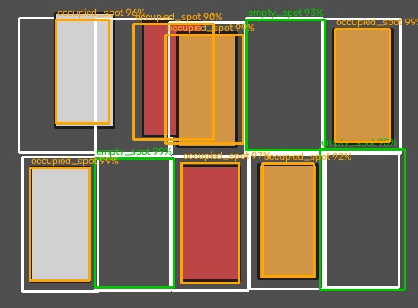
Live Demo
Flask REST API + browser upload UI — no install needed

Slide 14
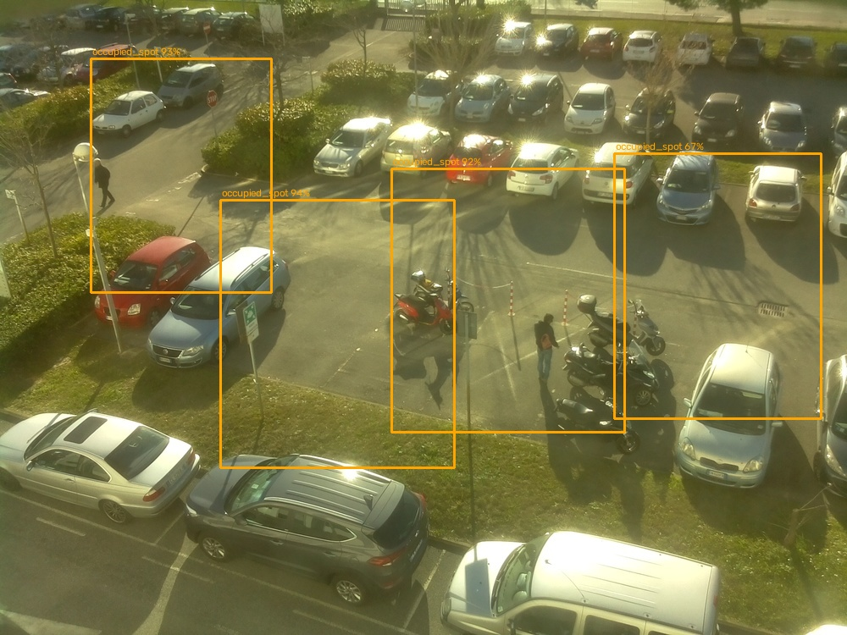
Zero-Shot Cross-Domain Test (CNRPark-EXT)
A totally unfamiliar camera angle and marking style
• 115 real photos tested, no painted lines, steep real camera angle
• Boxes loosely cluster near real cars — some transferable signal
• Misses most vehicles; box shapes imprecise
• empty_spot almost never fires — no painted bays in this domain
• Matches this project's earlier classifier result: 40% on the same cross-domain test
• Contrast with next slide: same-domain fine-tuning tells a very different story

Slide 15
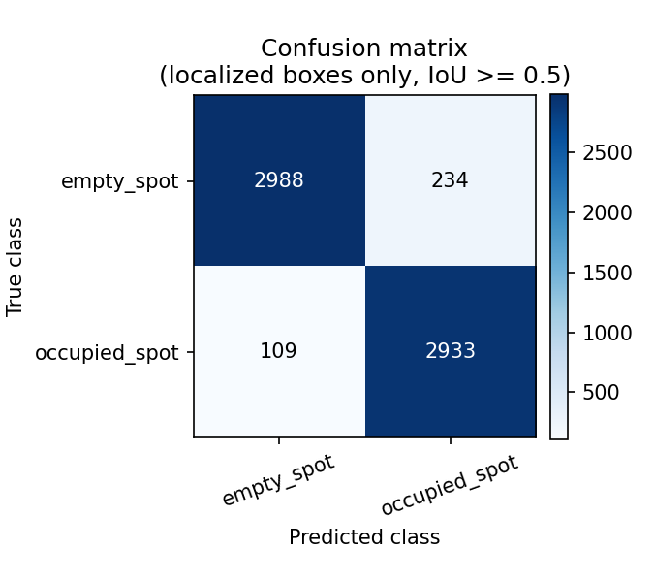
Real-Data Fine-Tuning (PKLot)
Same-domain real photos — a very different result from zero-shot
Class | GT | AP@0.5 | Precision | Recall
empty_spot | 5,345 | 46.84% | 77.6% | 53.2%
occupied_spot | 4,975 | 48.59% | 72.6% | 57.1%
mAP@0.5 | — | 47.71% | — | —
47.71% mAP on real, dense PKLot photos — a genuine result, far below synthetic (98.71%) but a huge step up from zero-shot (previous slide). Classification given correct localization: 94.5% (vs. 99.86% synthetic) — almost as reliable. The gap is recall: real lots average ~57 spots/image vs. ~15 synthetic, so the 16×16 grid drops 28.2% of real boxes to cell collisions. That alone caps achievable recall near ~72% — the concrete next fix is a finer grid or anchor-based head, not more real data.

Slide 16
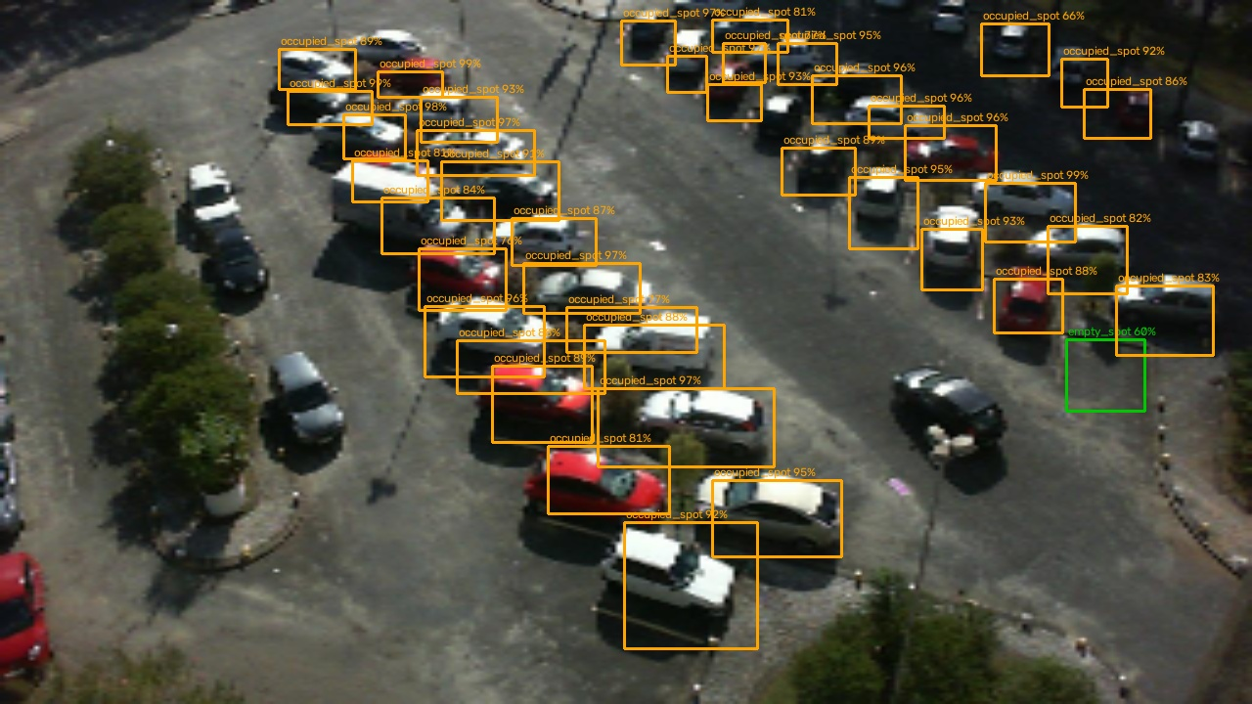
Real-Data Fine-Tuning — Qualitative
A dense, cluttered real PKLot photo

Slide 17
Discussion & Limitations
Honest accounting
• Worked: staged synthetic-first build let the whole pipeline be validated cheaply before real data
• Had to be revisited: the original classifier-only version didn't satisfy Object Detection — only caught by auditing against the rubric, requiring a genuine architecture change in Sprint 4
• Zero-shot to an unfamiliar camera (CNRPark-EXT) mostly fails; fine-tuning on same-domain real data (PKLot) reaches 47.71% mAP — real data helps a lot, but the model needs to actually see it
• The real-data bottleneck is recall from grid-cell collisions on dense lots, not classification — a specific, measured next fix, not a vague call for "more real data"

Slide 18
Conclusion
A from-scratch object detector for two classes (empty_spot / occupied_spot): 98.71% mAP@0.5 on synthetic data, and 47.71% mAP@0.5 after fine-tuning on real PKLot photos — beating both a majority-class baseline (53.3%) and this project's own earlier classic-CV heuristic (82.7%). Classification stays reliable on real data (94.5%, vs. 99.86% synthetic); the real-data gap is concentrated in localization recall on dense lots, with a specific, measured cause (grid-cell collisions) and a specific next fix (finer grid / anchor-based head). Served live through a REST API and browser demo, alongside a real-data-validated occupancy classifier (98.69%) for calibrated cameras.

Slide 19
Team
[FILL IN before submission]
Name | Role | Contribution
[FILL IN — PM] | Project Manager | [FILL IN]
[FILL IN] | [FILL IN] | [FILL IN]
[FILL IN] | [FILL IN] | [FILL IN]
[FILL IN] | [FILL IN] | [FILL IN]
[FILL IN] | [FILL IN] | [FILL IN]

