Slide 1
ReadFit
Will this text fit this reader?
A trained readability model + a deterministic phonics decodability check
Moyinoluwa Ajibola 101610734 · Adelabu Emmanuel 101571971
Ameer Hamza Manzoor 101630890 · Diwakar Saini 101592939
Lalit Kumar 101572828 · Innocent Amos Mchechesi 101628648
AASD 4016 Full Stack Data Science Systems

Slide 2
Agenda
Problem
Significance
Past projects
Methodology – ML Canvas
Model Benchmarking
Model Deployment
Demo
Q&A

Slide 3
Problem Statement
A Grade 1 teacher has 25 students at 25 different points in the phonics sequence.
Ontario has mandated systematic, explicit phonics since September 2023.
To practise reading, a child needs text made only of letter-sound patterns they have already been taught.
One untaught word and the child falls back on guessing - the exact habit structured literacy exists to remove.
Existing tools answer "what grade is this text?"
Nobody answers "can THIS child read THIS text?"
Notes:
60s. Land the gap: grade level is a class-level answer to a student-level question.

Slide 4
Why this problem
Policy: Ontario Right to Read inquiry (OHRC) drove a full curriculum revision, implemented Sept 2023.
Scale: every Grade 1-2 classroom in the province now runs a structured phonics sequence.
Cost of getting it wrong: mis-levelled text trains guessing, which collapses when books get harder.
Current workaround: teachers hand-write passages from a ~40-word legal vocabulary, at night.
→ A two-second check is worth real classroom time.
Notes:
45s. Policy is real and cited. Don't linger.

Slide 5
Literature Review
Past available projects:
Flesch-Kincaid (1975), Flesch Reading Ease, Dale-Chall, SMOG, ARI - surface-count formulas
Lexile - proprietary commercial levelling
Similar projects:
CommonLit Readability Prize (Kaggle, 2021) - ML readability regression on human-rated excerpts
Produced the CLEAR corpus, which we train on
Drawbacks:
All output ONE number for a whole class - none identify which words fail which learner
Formulas use only sentence and syllable counts: Flesch-Kincaid reaches only R2 = 0.27 against human judgement
No published tool models grapheme-level decodability against a phonics sequence
Notes:
60s. The drawback bullets are the setup for our contribution.

Slide 6
ML Canvas
Value Proposition: in under 2 seconds, tell a teacher whether a passage fits a specific student - overall difficulty AND every word they cannot yet decode.
LEARN - Data sources: CLEAR Corpus 6.01 (4,724 excerpts, human-rated); GPC table; UFLI-style lesson sequence.
LEARN - Collecting data: fixed public release for training; every live prediction logged to SQLite for future retrains.
LEARN - Features: 15 linguistic (sentence length, syllable + polysyllable rate, type-token ratio, common-word rate, Flesch scores) + 3,000 TF-IDF uni/bigrams.
LEARN - Building models: offline batch, 25 seconds on CPU; artifact ships inside the Docker image.
PREDICT - ML task: supervised regression. In: raw passage text. Out: BT_easiness (continuous, higher = easier), binned to 5 grade bands.
PREDICT - Decisions: teacher accepts, rejects, or edits the flagged words. Model informs; it does not act.
PREDICT - Making predictions: on demand, synchronous, one passage per request, sub-second, POST /predict.
PREDICT - Offline evaluation: RMSE / MAE / R2 on held-out 20% (seed 42) vs two baselines. Deployed: RMSE 0.7061, R2 0.5625.
EVALUATE - Live: every prediction logged; dashboard tracks volume, mean readability, mean decodability, band distribution. Drift = band shift vs training.
Notes:
60s. Do not read all ten. Point at the three blocks and say the rest is in the report.

Slide 7
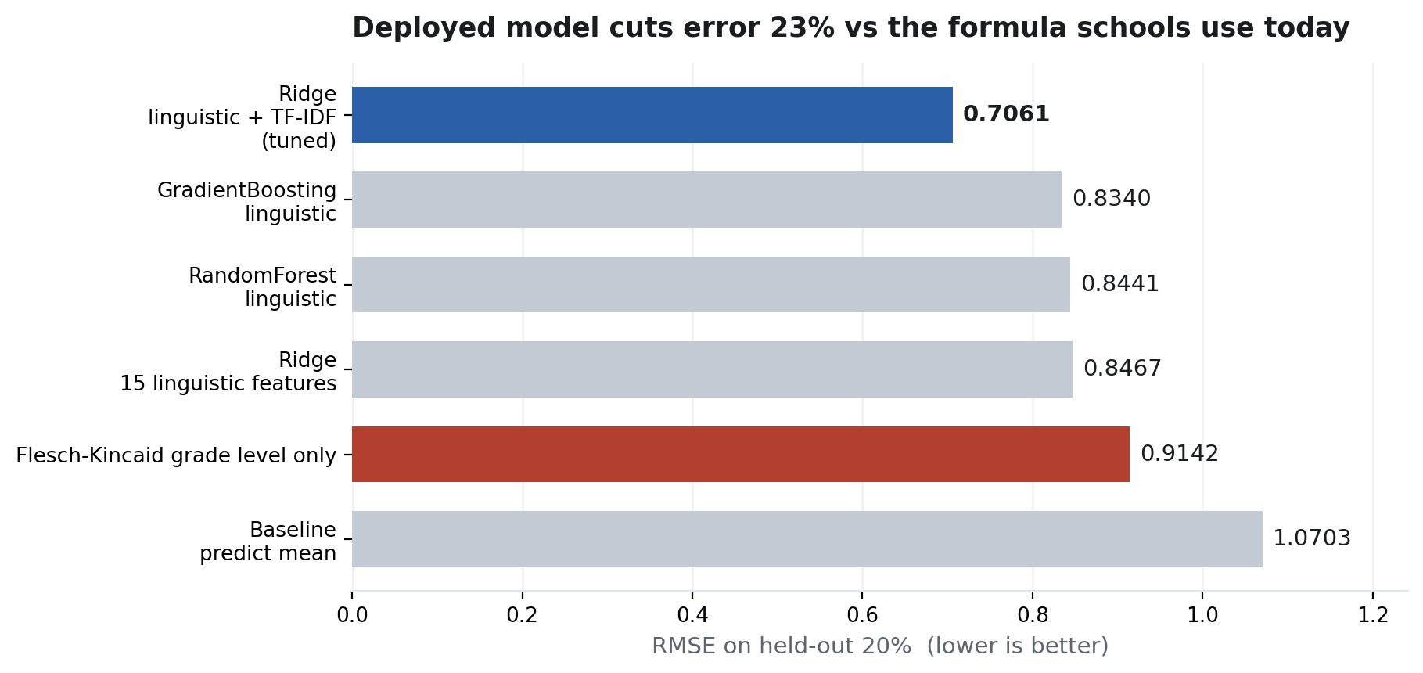
Model Benchmarking
Dataset: CLEAR Corpus 6.01
Excerpts: 4,724 (3,779 train / 945 test)
Target: BT_easiness - human pairwise judgements, not a formula
Split: 80/20, seed 42
Tuning: GridSearchCV, Ridge alpha over 5 values, 5-fold
Flesch-Kincaid RMSE: 0.9142
Deployed model RMSE: 0.7061
Improvement: 23% lower error
R2: 0.267 → 0.5625
Notes:
75s. THE slide. Say: 'the formula schools use today scores 0.9142; our deployed model scores 0.7061 - 23% less error, on human-labelled data.' Then tuning + features.

Slide 8
Model Deployment
Notebook → Script: notebooks/01_eda.ipynb → src/train.py (Module 1)
Script → Flask: app.py, 9 endpoints, model loaded once at boot (Modules 2-3)
Docker: python:3.11-slim, gunicorn, .dockerignore keeps context at ~180 KB (Module 4)
Dockerhub: docker tag / docker push (Module 5)
GCP Compute Engine: e2-micro, us-east1, firewall tcp:5000 + tcp:8501, tag demo-1 (Module 5)
Tested public endpoints: curl, POSTMAN, browser client (Modules 3 + 5)
→ Live at http://<VM_IP>:5000 · Dashboard at http://<VM_IP>:8501
Notes:
60s. Put the curl + POSTMAN screenshots here before you present.

Slide 9
Challenges & Issues encountered
One working day, solo execution - forced hard scope cuts, documented in the report.
e2-micro has 1 GB RAM: ruled out sentence-embedding models; chose Ridge + TF-IDF (136 KB artifact).
Rule-based GPC table has no CMUdict validation - it mis-splits some words and fails closed.
BT_easiness is an abstract scale, not grade levels - bands are quantile-calibrated on training data, so they are relative not absolute.
R2 = 0.56 means real variance is still unexplained; readability is genuinely hard.
Flask dev server warns against production use - switched to gunicorn.
Notes:
30s. Honesty scores here. Do not oversell.

Slide 10
Demo
1. Browser → http://<VM_IP>:5000/ (say the IP out loud)
2. Academic passage, lesson 34 → Grades 11-12, 73.9% decodable, word-by-word table
3. Decodable passage → Grades 2-3, 100% decodable
4. Terminal: curl -X POST /predict → raw JSON [outcome 6]
5. Dashboard on the public IP: benchmark, tuning, feature importance, live scatter [outcomes 2 + 5]
6. Score a passage from inside the dashboard, against production
Notes:
3m15s live. Fallback recording is on the desktop if the network dies.

Slide 11
Q & A
Repo: github.com/<user>/readfit Image: hub.docker.com/r/<user>/readfit
Live API: http://<VM_IP>:5000/health
Anticipated: Where is the ML? → Ridge regression on 3,015 features, trained on 4,724 human-rated excerpts.
Why not just Flesch-Kincaid? → We benchmarked it. R2 0.27 vs our 0.56.
Why Ridge over GradientBoosting? → It won on held-out RMSE (0.706 vs 0.834) and fits in 1 GB.

