Slide 1



BB84 Quantum Key Distribution with Qiskit
Toma Sulava-Sulaberidze
Nikoloz Kharadze
Demetre Abramishvili
Anna Maria Vibliani

Slide 2
What is Quantum Key Distribuion

Slide 3


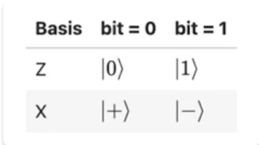
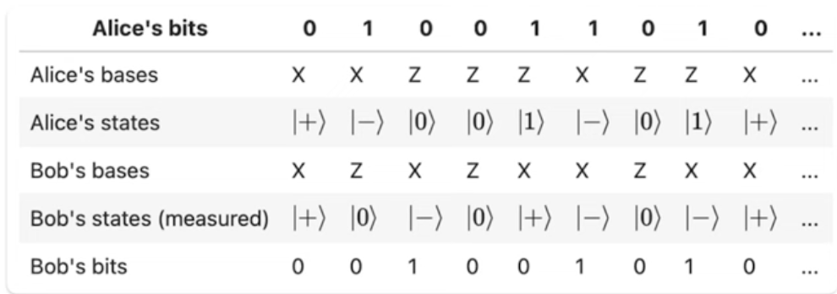
BB84

Slide 4
How our BB84 works

Slide 5
What can BB84 be used for ?

Slide 6
Thank You!
-

