Slide 1

Chapter : 6 CONTROLLING ACCESS TO FILES
Linux File System Permissions
Managing File System Permissions from the Command Line
Managing Default Permissions and File Access

Slide 2
Linux File System Permissions
Access to files by users are controlled by file permissions
The Linux file permissions system is simple but flexible
Easy to understand and apply

Slide 3
UGO concept
Owner user: The file is owned by a user, normally the one who created the file.
Group owner: The file is also owned by a single group, usually the primary group of the user who created the file, but this can be changed
Others: All other users on the system that are not the user or a member of the owning group

Slide 4
Three categories of permission
There are also just three categories of permissions which apply: read, write, and execute.
These permissions affect access to files and directories as follows:
Permission | Effect on files | Effect on directories
Read(r) | Contents of the file can be read | Contents of the directory (file names) can be listed.
Write(w) | Contents of the file can be changed | Any file in the directory may be created or deleted.
Execute(x) | Files can be executed as commands | Contents of the directory can be accessed (dependent on the permissions of the files in the directory).

Slide 5
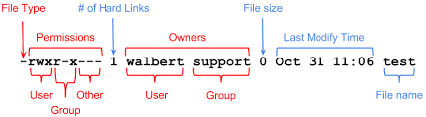
Viewing file/directory permissions and ownership
#ls -l <filename> - File listing to include both the permissions of a file and the ownership
Sample output:

Slide 6
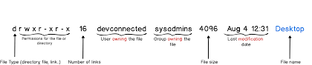
#ls –ld <directoryname> - Display directory permission and ownership sample output:

Slide 7
Changing file/directory permissions
Symbolic method keywords:
chmod WhoWhatWhich <file l directory >
• Who is u, g, o, a (for user, group, other, all)
• What is +, -, = (for add, remove, set exactly)
• Which is r, w, x (for read, write, executable)
Numeric method:
chmod ### <file l directory >
• Each digit represents an access level: user, group, other.
• # is sum of r=4, w=2, and x=1.

Slide 8
Examples:
Remove read and write permission for group and other on filel:
#chmod go-rw filel
Add execute permission for everyone on file2:
# chmod a+x file2
Set read, write, and execute permission for user, read, and execute for group, and no permission for other on sampledir:
#chmod 750 sampledir
Recursively setting permissions on an entire directory tree
# chmod -R g+rwX demodir

Slide 9
Changing file/directory user or group ownership
#chown username <filename|directory>: To change ownership of the file
#chown :groupname <filename|directroy>: To change group ownership of the file
#chown user:group <filename|directroy>: To change the ownership and group ownership
#chgrp group <filename|directroy>: To change group ownership of the file

Slide 10
Examples:
#chown student foofile: To grant ownership of the file foofile to student
#chown -R student foodir: To recursively change the ownership of an entire directory tree.
chown :admins foodir : To grant group ownership of the directory foodir to admins
chown visitor:guests foodir: To change the ownership of foodir to visitor and the group to guests
chgrp admins foodir: To grant group ownership of the directory foodir to admins

Slide 11
Managing Default Permissions and File Access

Slide 12
Special permissions
Effects of special permissions on files and directories:
Special permission | Effect on files | Effect on directories
u+s (suid) | File executes as the user that owns the file, not the user that ran the file. | No effect
g+s (sgid) | File executes as the group that owns the file. | Files newly created in the directory have their group owner set to match the group owner of the directory.
o+t (sticky) | No effect. | Users with write on the directory can only remove files that they own; they cannot remove or force saves to files owned by other users.

Slide 13
Setting special permissions
Symbolically:
setuid = u+s; setgid = g+s; sticky = o+t
Numerically (fourth preceding digit):
setuid = 4; setgid = 2; sticky = 1
Examples:
• Add the setgid bit on directory:
# chmod g+s directory
• Set the setgid bit, and read/write/execute for user and group on directory:
#chmod 2770 directory

Slide 14
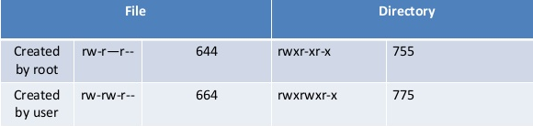
Default file permissions

Slide 15
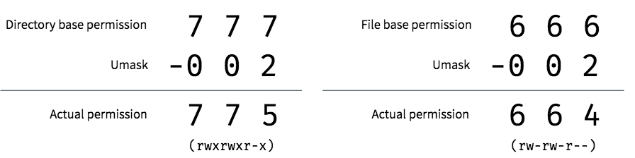
Umask:
Every process on the system has a umask
Umask is an octal bitmask that is used to clear the permissions of new files and directories that are created by the process.
If a bit is set in the umask, then the corresponding permission is cleared in new files.
The leading zeros indicate the special, user, and group permissions are not cleared..

Slide 16
Umask examples: #umask: Display the umask of currently login user #umask 000: Setting umask to 000(temporarly)
Note:
Modify /etc/bashrc and /etc/profile to change the default umask for Bash shell users.
Users can override the system defaults in the .bash_profile and .bashrc files in in their home directories

Slide 17
Thank you

