Slide 1

CNN Based Mel-Spectrogram Analysis and Speaker Recognition
Tommaso Mattei 1884019
Mattia de Luca 1883820
Academic Year 2025/26

Slide 2


Introduction ●○○
What is Speaker Recognition
Speaker recognition is the identification of a person from characteristics of voices. It is used to answer the question "Who is speaking?"
There are two major applications of speaker recognition technologies and methodologies.

Slide 3
Introduction ○●○
What is Speaker Recognition
If the speaker claims to be of a certain identity and the voice is used to verify this claim, this is called verification or authentication.
On the other hand, identification is the task of determining an unknown speaker's identity.
speaker verification is a 1:1 match where one speaker's voice is matched to a particular template whereas speaker identification is a 1:N match where the voice is compared against multiple templates.

Slide 4
Introduction ○○●
Potential Use Cases
Voice-based verification adds an extra layer of security, making it difficult for unauthorized users to gain access. It is useful where additional authentication is needed, such as secure access to sensitive information or systems. The user-friendly nature of voice verification also enhances user experience, providing a seamless authentication process.
Voice Recognition can also be used to ensure a higher level of accessibility by allowing for an easier understanding of audio segments

Slide 5


Sources and Inspirations ●○○○
Related Works
This project’s work is largely based on the following papers:
Arsha Nagraniy, Joon Son Chungy, A. Z. Voxceleb: a
large-scale speaker identification dataset. 2016.

Slide 6
Sources and Inspirations ○●○○
Related Works
This project’s work is largely based on the following papers:
T. A. E. F. Text-independent speaker identification using audio looping with margin based loss functions.
arXiv:2509.22838, 2025.

Slide 7
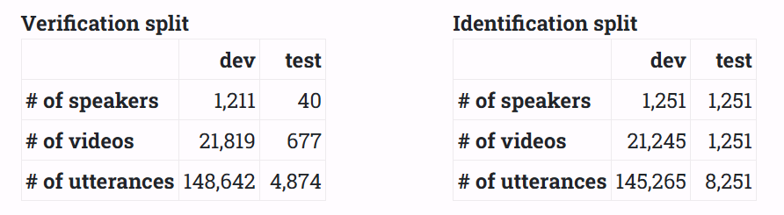
Sources and Inspirations ○○●○
VoxCeleb
VoxCeleb is an audio-visual dataset consisting of short clips of human speech, extracted from interview videos uploaded to YouTube

Slide 8
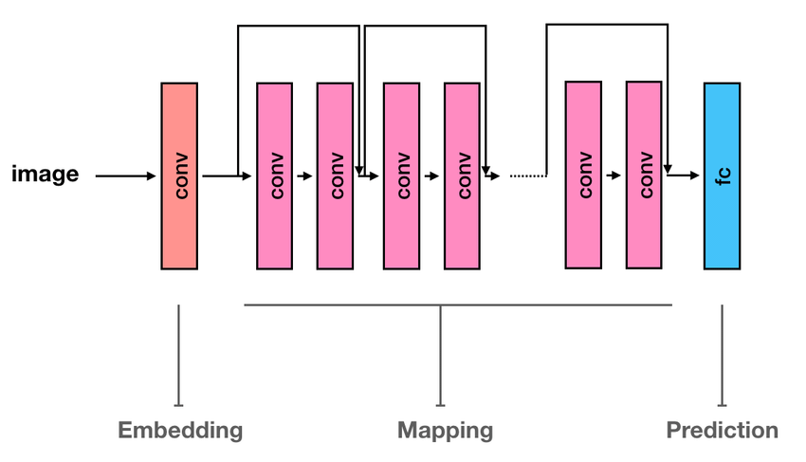
Sources and Inspirations ○○○●
ResNet
ResNet is a deep learning architecture in which the layers learn residual functions with reference to the layer inputs.

Slide 9
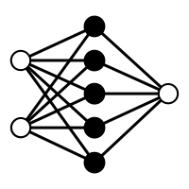
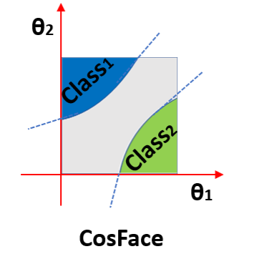
Methodology ●○○○○○
Model & Loss definition
The ResNet50 architecture is taken as a backbone
The fully connected layer is substituted by a linear layer
The final result of the model is an embedding
The loss used is the CosFace loss
  Better suited for inter class separation

Slide 10



Methodology ○●○○○○
DataSet Analysis
The dataset is structured as follows:
Speaker IDs
A reference to the original video
A series of audio segments of varying lengths

Slide 11


Methodology ○○●○○○
Data Preprocessing
Before Training the data was processed in order to improve the model’s quality
  This was done in three main steps:
Audio files trimming

Slide 12

Methodology ○○○●○○
Data Preprocessing
Before Training the data was processed in order to improve the model’s quality
  This was done in three main steps:
length equalization

Slide 13

Methodology ○○○○●○
Data Preprocessing
Before Training the data was processed in order to improve the model’s quality
  This was done in three main steps:
Mel-Spectrograms
Representation

Slide 14

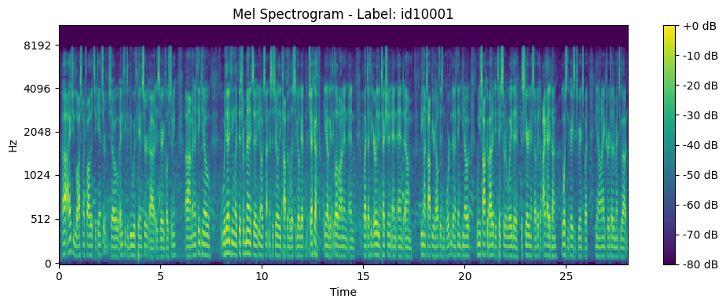
Methodology ○○○○○●
Why Mel-Spectrograms?
Mel-Spectrograms use a Logarithmic scale which better represents Human Sound Perception
Better in Neural Networks due to the heightened significance of learned features because the frequency scale matches perceptual importance

Slide 15


Evaluation ●○○○○○○
Evaluation
To evaluate the System’s performance the test data was split into two groups
Gallery Dataset
Probe Dataset

Slide 16

Evaluation ○●○○○○○
Evaluation
A distinct validation set was also used to find an optimal Threshold for Speaker Verification
By collecting evaluation metrics for all possible thresholds we were able to collect these statistics

Slide 17
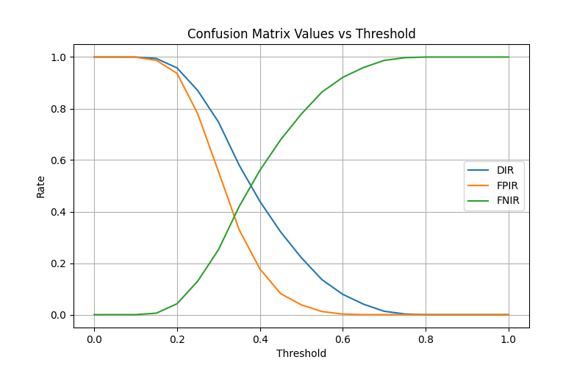
Evaluation ○○●○○○○
Evaluation
Detection and Identification Rate
False Negative Identification Rate
False Positive Identification Rate

Slide 18
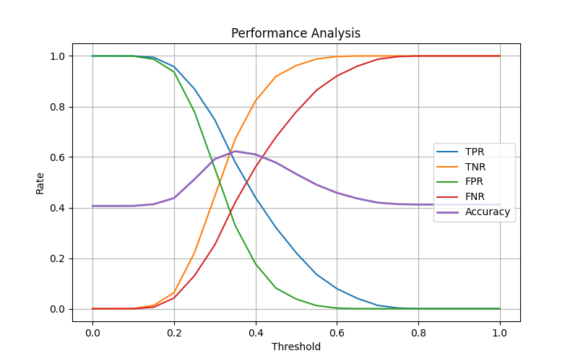
Evaluation ○○○●○○○
Evaluation
Rates
Accuracy

Slide 19
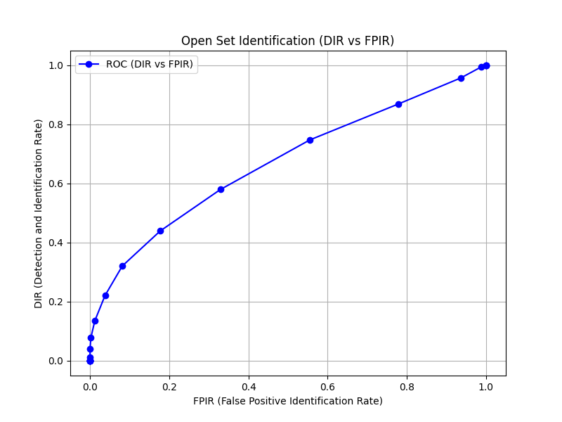
Evaluation ○○○○●○○
Evaluation
Roc Open Curve

Slide 20
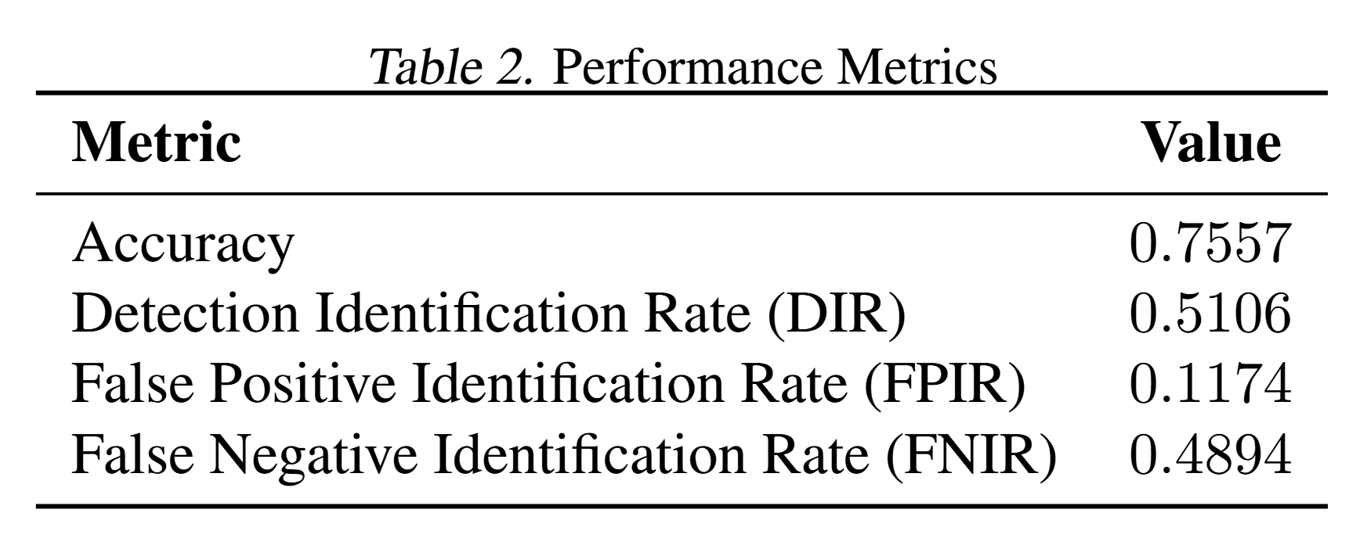
Evaluation ○○○○○●○
Evaluation
Based on these results a threshold of 0.375 was chosen:

Slide 21
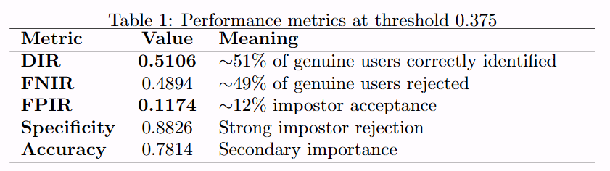
Evaluation ○○○○○○●
Evaluation
The choice of an accurate threshold is important and largely depends on the system’s use case
A higher threshold (0.4) prioritizes security by minimizing false accepts, while a lower threshold (0.35) improves usability at the cost of higher false positives. A mid-range threshold (0.375) provides the best balance between security and user convenience.

Slide 22

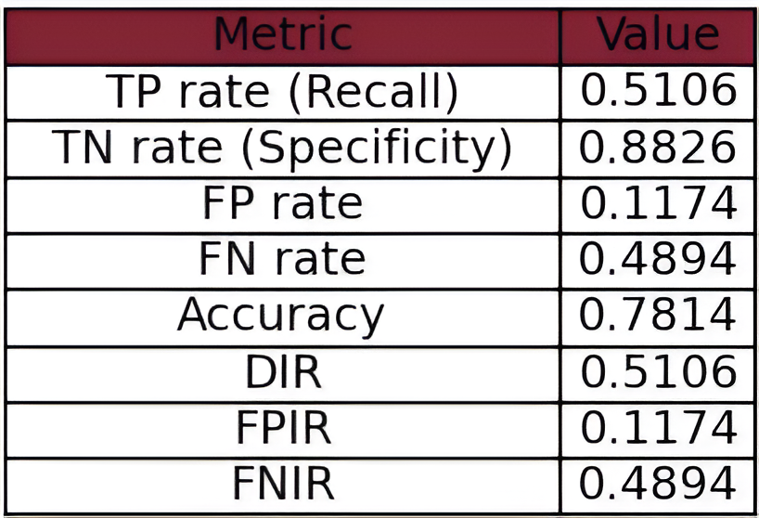
Conclusions ●○○
Results
This threshold was then used to evaluate the test set Giving us the following results:
BUT HOW DO WE INTERPRET THESE RESULTS?
Table showing the results of testing with one of the chosen values

Slide 23
Conclusions ○●○
Results
The system can be considered conservative, secure, and accurate overall, but misses nearly half of legitimate users.
Performance tuning should focus on improving DIR while controlling FPIR, depending on application requirements.
Suitable for high-security environments where false accepts are costly
Not ideal for user-convenience-focused applications

Slide 24


Conclusions ●○○
Future Works
An application dependant fine tuning process
Improving the training by utilizing more data and processing power

Slide 25

CNN Based Mel-Spectrogram Analysis and Voice Identification
Thank you for the attention!

