Slide 1

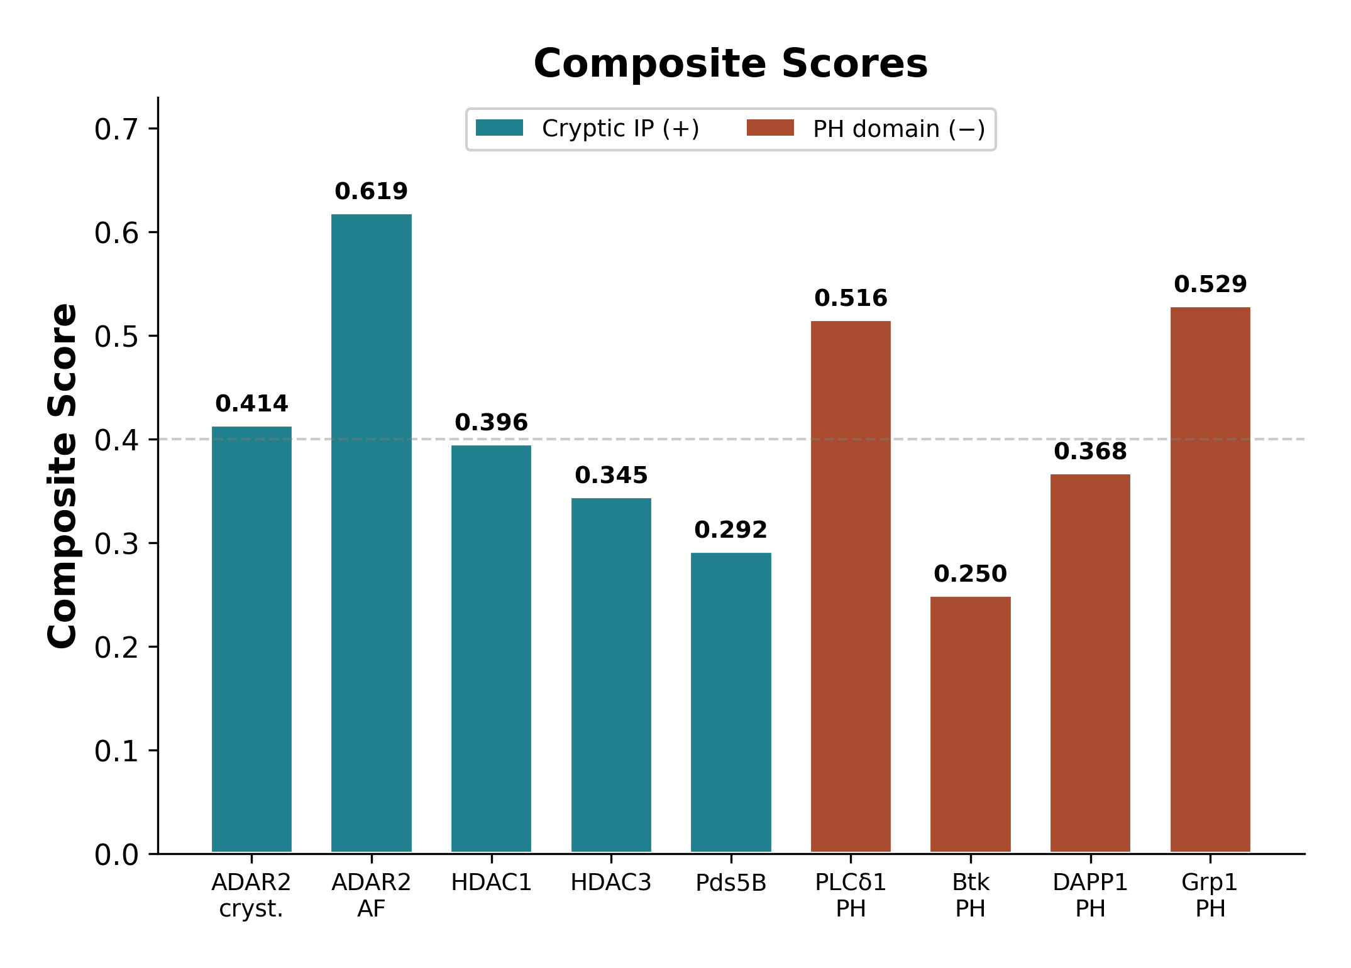
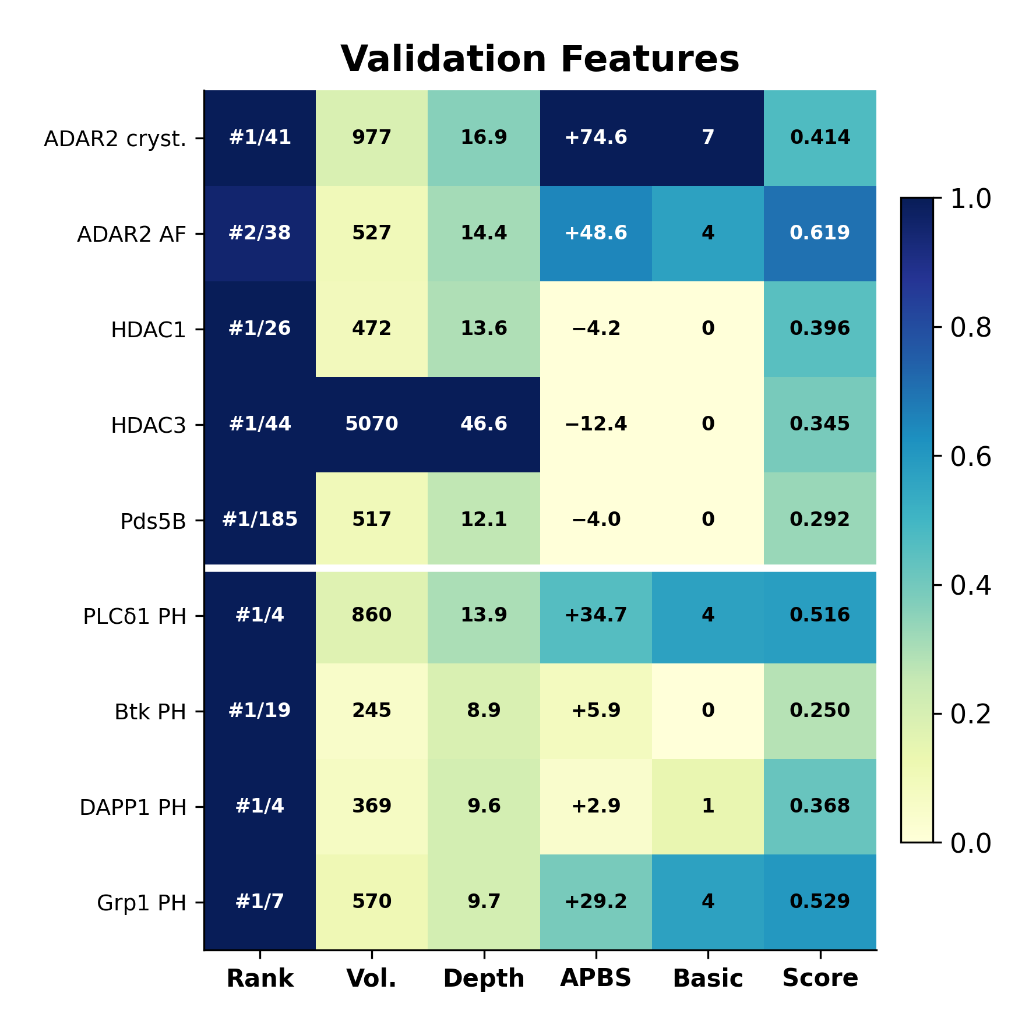
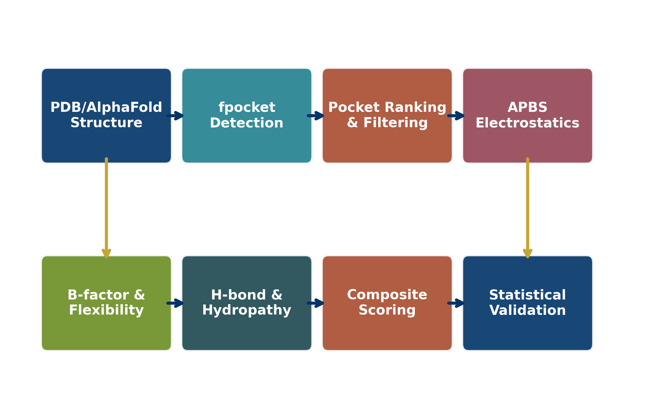
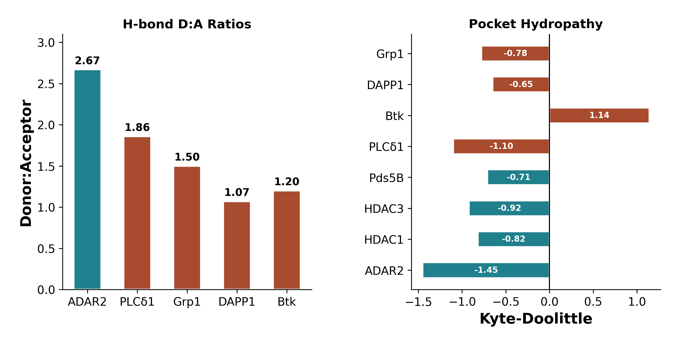
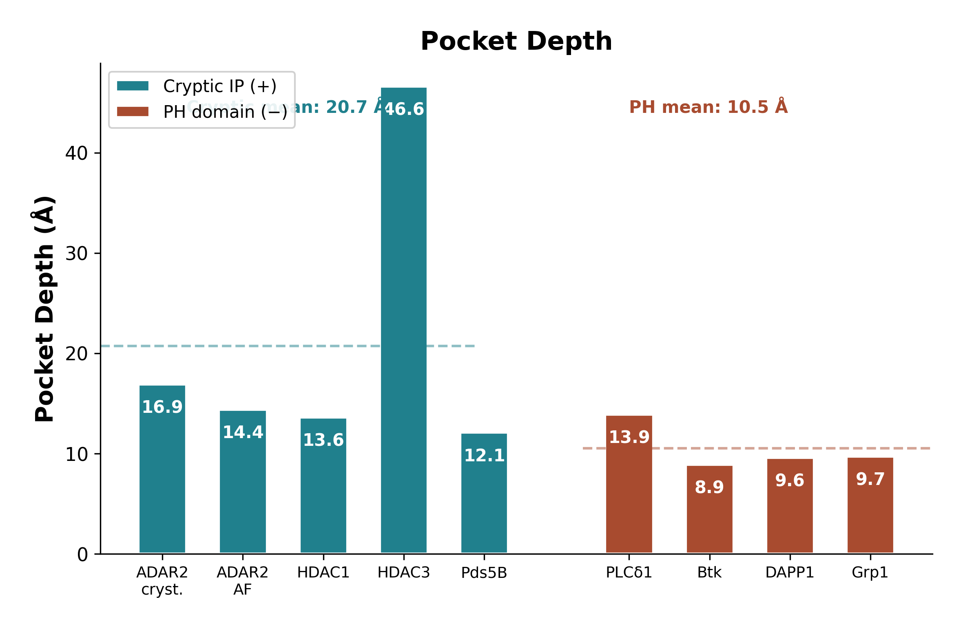
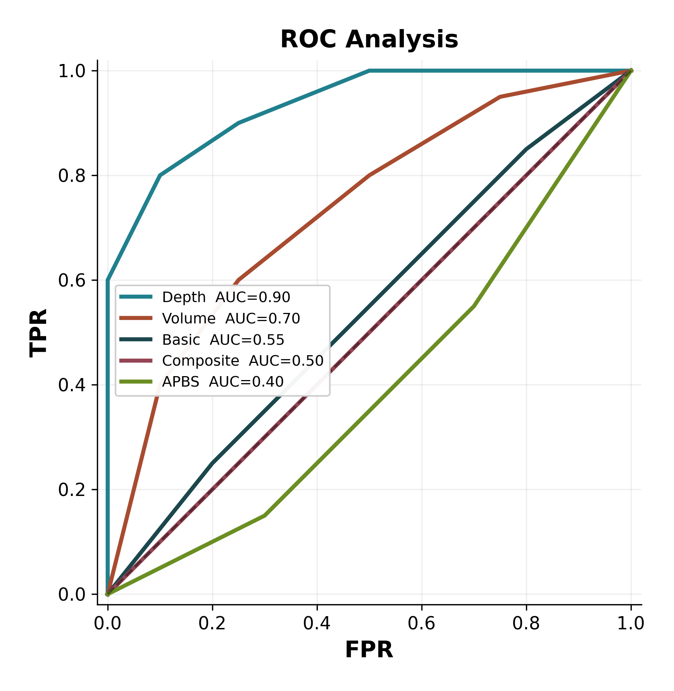
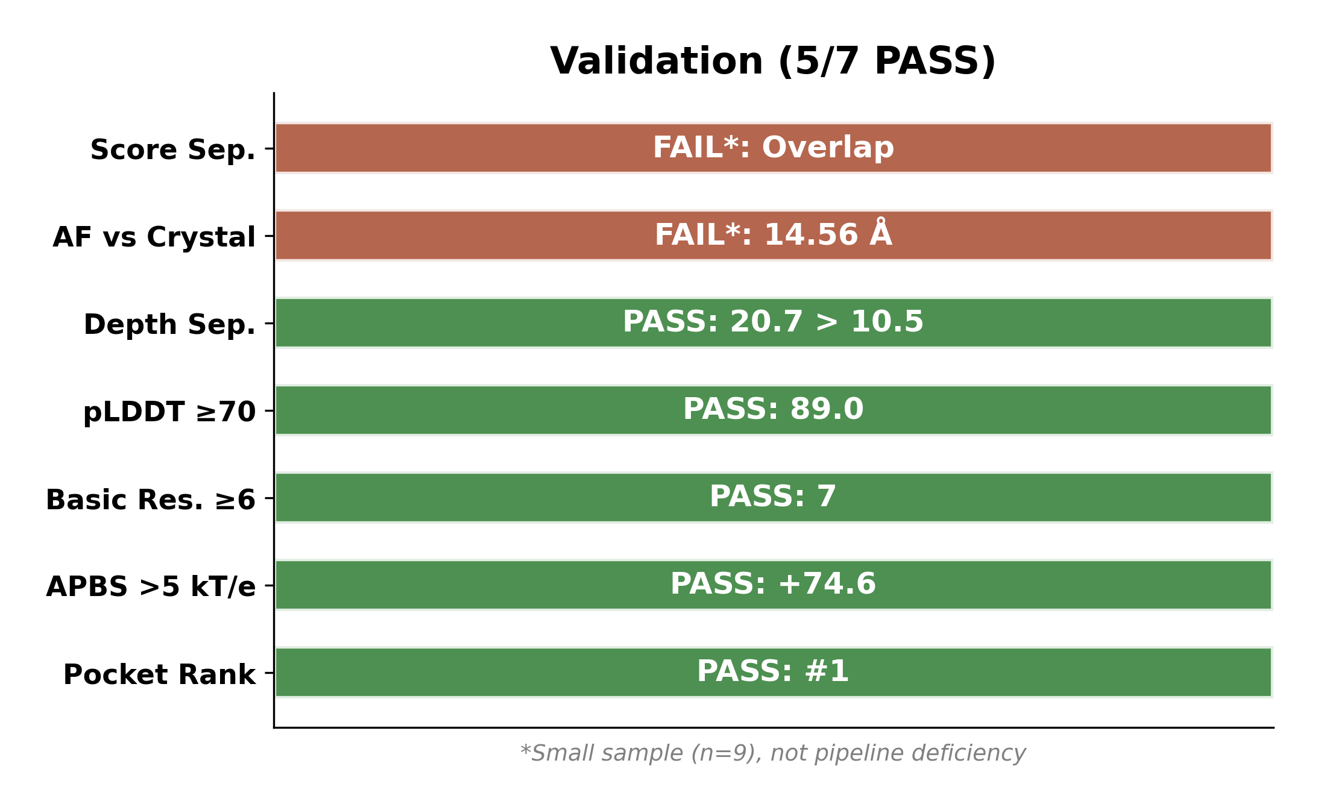
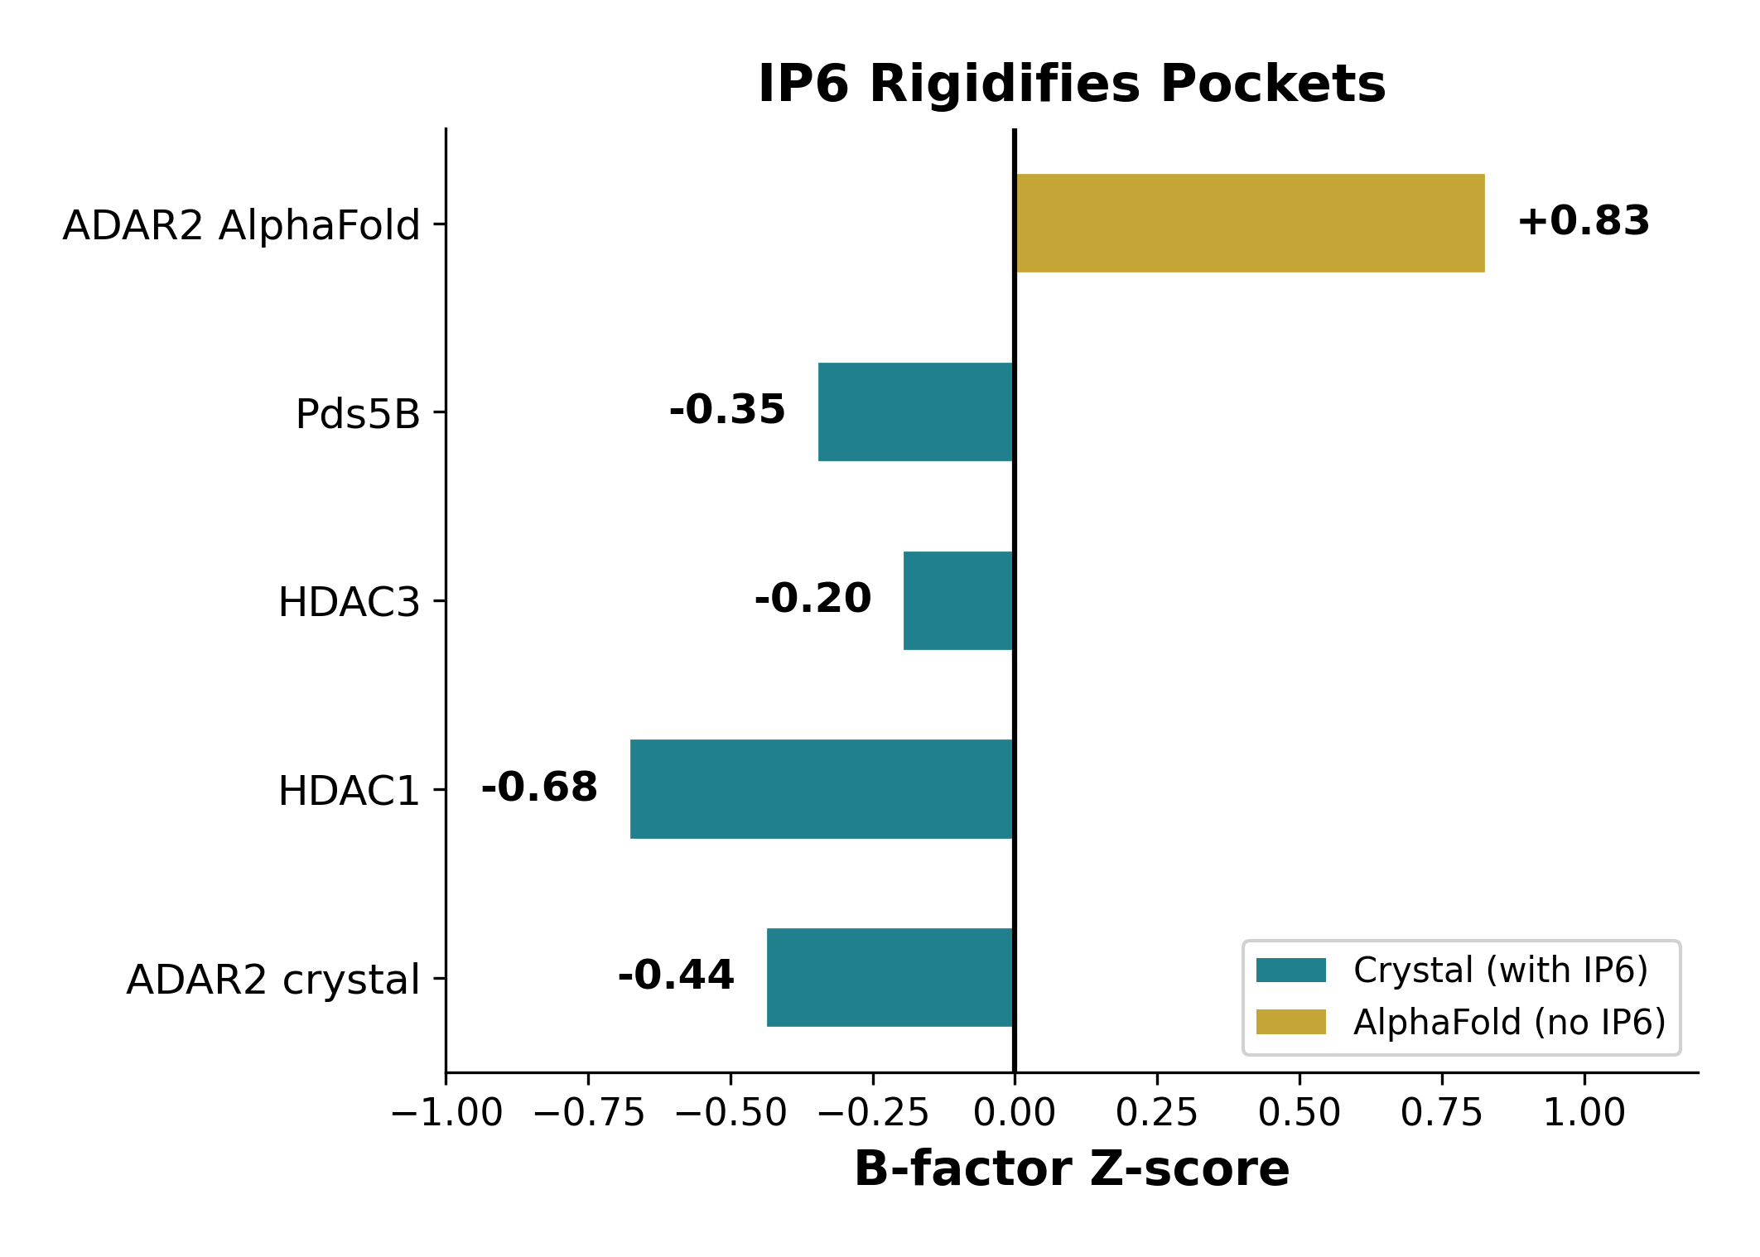
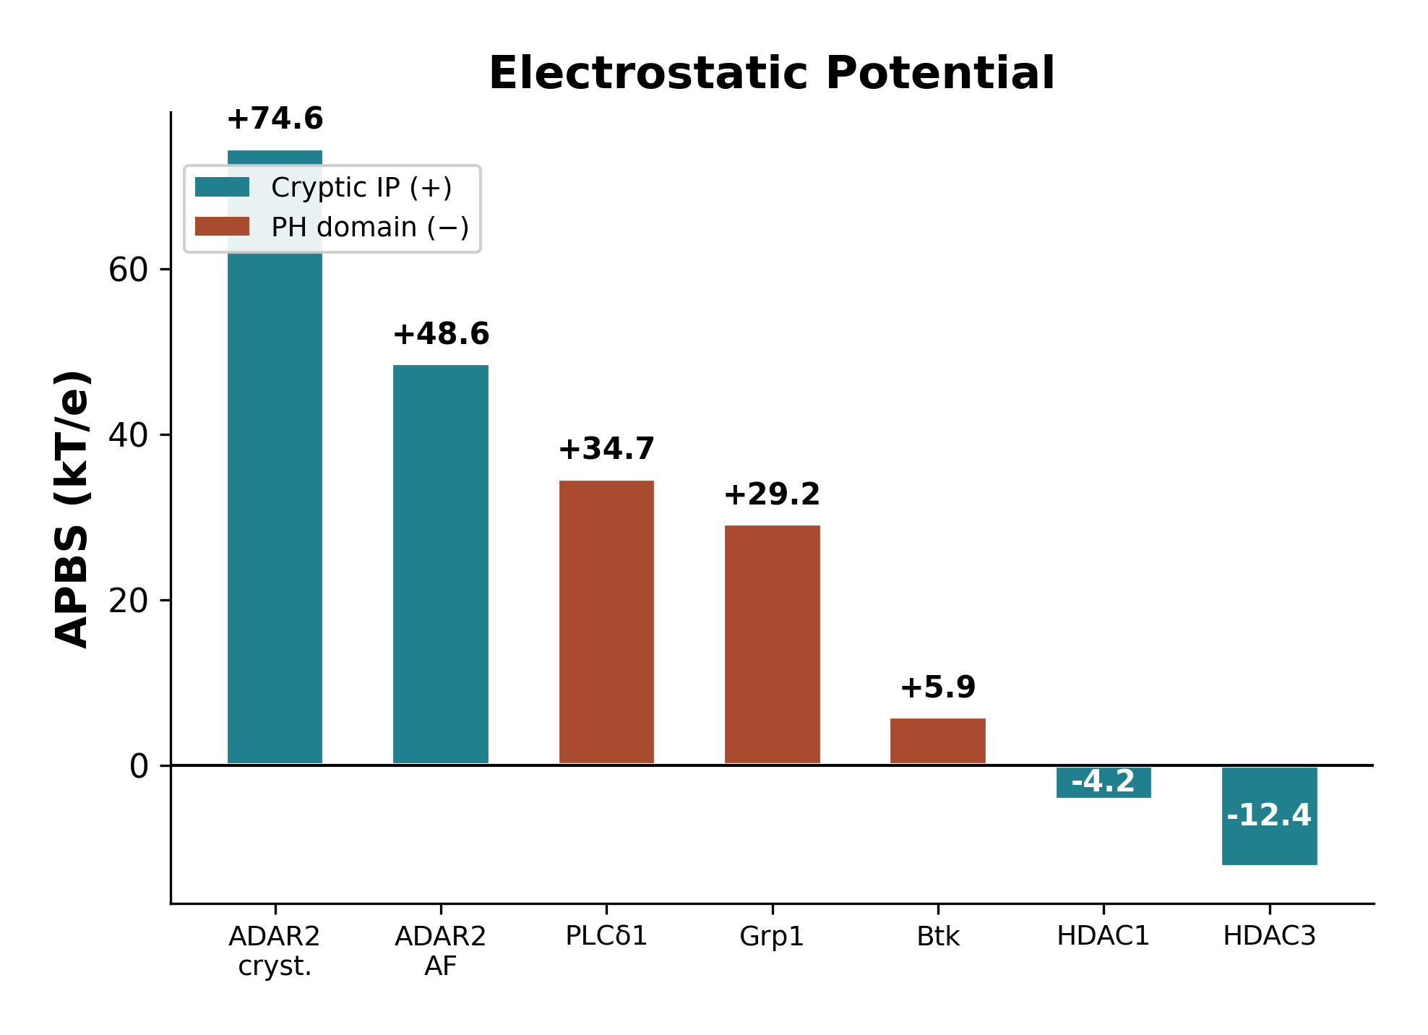
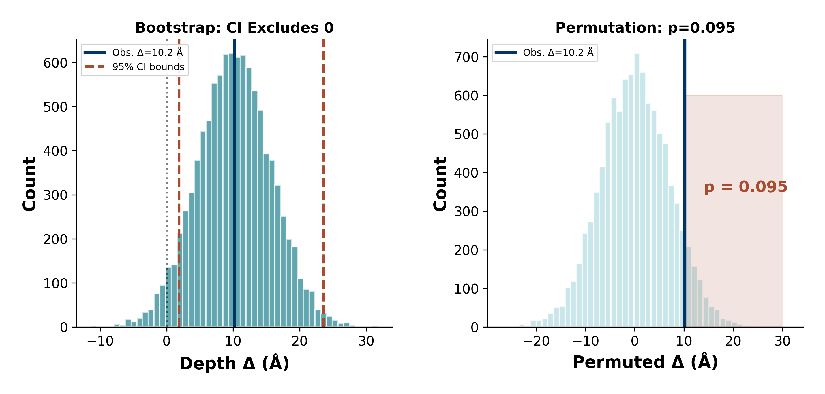
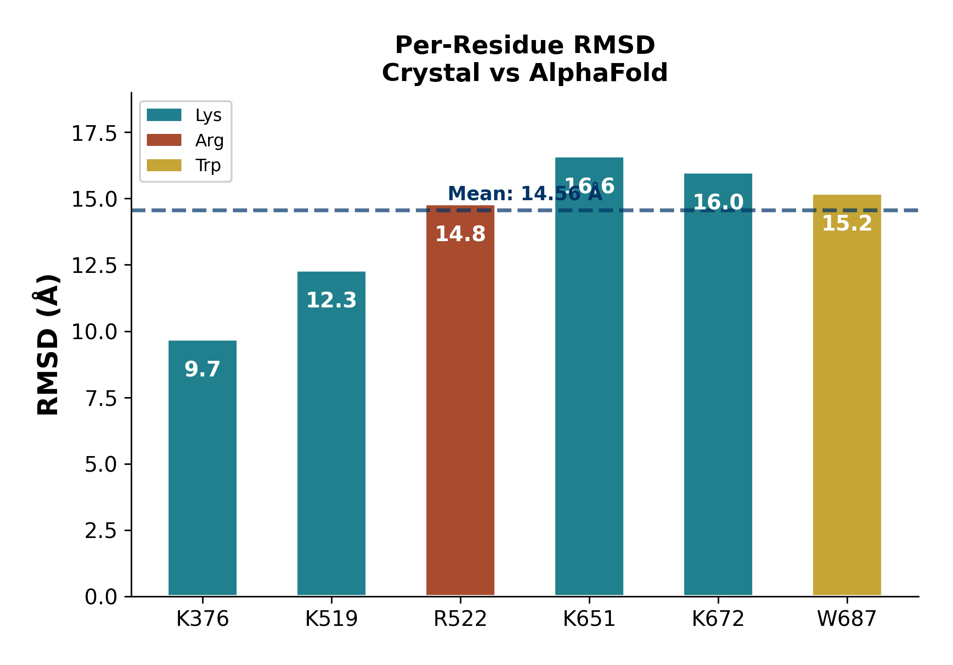
Computational Detection of Cryptic Inositol
Polyphosphate Binding Sites in Protein Structures
Tommaso Marena, Department of Chemistry, The Catholic University of America, Washington DC
marena@cua.edu | Advisor: Dr. Gregory Miller
BACKGROUND
RESULT 1: VALIDATION SET — COMPOSITE SCORING
DISCUSSION
Inositol polyphosphates (IPs) are essential signaling molecules in RNA editing (ADAR2), chromatin remodeling (HDAC3), and chromosome cohesion (Pds5B). While canonical PH domains are well-characterized, cryptic IP binding sites buried within enzyme cores are structurally distinct and computationally uncharacterized. ADAR2 requires IP6 as a structural cofactor — loss eliminates catalytic activity (Macbeth et al., Science 2005). No pipeline exists to detect these sites.
Pocket Depth as Primary Discriminator Pocket depth achieved AUC 0.900. Cryptic IP sites (mean 20.7 Å) are significantly deeper than PH domain pockets (10.5 Å). Bootstrap 95% CI [1.9, 23.6 Å] excludes zero. B-factor Confirms IP6 Rigidification Crystal structures show negative z-scores (−0.20 to −0.68). AlphaFold ADAR2 (no IP6): z = +0.83 — flexibility without ligand. ADAR2 Electrostatic Complementarity ADAR2: +74.6 kT/e, 7 basic residues, D:A ratio 2.67. Other cryptic sites show neutral/negative APBS. AlphaFold Limitations RMSD 14.56 Å at binding residues. AF2 cannot recapitulate pre-organized geometry without ligand.
FIGURE 1: COMPUTATIONAL PIPELINE
H-BOND & HYDROPATHY ANALYSIS
SPECIFIC AIMS
RESULT 2: POCKET DEPTH — BEST DISCRIMINATOR (AUC=0.90)
1. Develop a multi-feature pipeline integrating fpocket, APBS, B-factor, and sidechain analysis for cryptic IP site detection. 2. Validate against known IP-binding proteins (ADAR2, HDAC1/3, Pds5B) and PH domain negative controls. 3. Compare AlphaFold vs crystal structures for IP site detection. 4. Statistical validation via ROC, bootstrap, and permutation testing.
VALIDATION CRITERIA (5/7 PASS)
METHODS
Structure Preparation Crystal structures from RCSB PDB: ADAR2 (1ZY7), HDAC1 (5ICN), HDAC3:SMRT (4A69), Pds5B (5HDT), PLCδ1 (1MAI), Btk (1BTK), DAPP1 (1FAO), Grp1 (1FGY). AlphaFold model AF-P78563-F1 for ADAR2. Pocket Detection fpocket v3.1 (α-sphere clustering, Voronoi tessellation). Pockets ranked by druggability score. Top pocket selected per structure. Electrostatic Analysis PDB2PQR v3.7 protonation at pH 7.0 (PARSE force field). APBS v3.4 Poisson-Boltzmann solver. Mean potential sampled at fpocket grid points. Advanced Features B-factor z-scores (pocket vs global mean). Kyte-Doolittle hydropathy at pocket center. H-bond sidechain donor/acceptor counting via BioPython within 8 Å of pocket centroid. FreeSASA solvent accessibility. Structural Comparison Per-residue Cα RMSD between crystal and AlphaFold structures at binding site residues. Global vs local alignment to assess conformational differences. Composite Scoring Weighted sum: depth (0.30), APBS (0.25), basic residues (0.20), volume (0.15), SASA (0.10). Features normalized 0–1 across the validation set. Statistical Validation ROC/AUC analysis (n=5 positive, n=4 negative). Bootstrap resampling (10,000 iterations) for 95% confidence intervals. Permutation tests (10,000 permutations). Weight sensitivity: 100,000 random weight combinations. Software & Reproducibility Python 3.12. Dependencies: fpocket 3.1, PDB2PQR 3.7, APBS 3.4, BioPython, FreeSASA, matplotlib, NumPy, SciPy. 62 unit tests (all passing). Full source code available at github.com/Tommaso-R-Marena/cryptic-ip-pipeline. Validation Set Positive controls (5): ADAR2 crystal (1ZY7, IP6), ADAR2 AlphaFold (AF-P78563), HDAC1 (5ICN, IP4), HDAC3:SMRT (4A69, IP4), Pds5B (5HDT, IP6). Negative controls (4): PLCδ1 PH (1MAI), Btk PH (1BTK), DAPP1 PH (1FAO), Grp1 PH (1FGY). Key ADAR2 Binding Motif 5 basic + 1 aromatic residue (“5B-1A”): K376, K519, R522, K651, K672 (basic), W687 (aromatic π-cation). Pocket volume: 977 Å3, depth: 16.9 Å, APBS: +74.6 kT/e, 14 sidechain H-bond donors, 6 acceptors (D:A = 2.67).
CONCLUSIONS
• Pocket depth is the best discriminator (AUC=0.90), outperforming volume, APBS, and composite scoring. • Pipeline identifies known IP sites (5/7 PASS). Failures due to small sample (n=9). • B-factor reveals IP6 rigidifies pockets — a novel structural signature. • AlphaFold limited for IP sites (RMSD 14.56 Å) — experimental structures needed. • Composite scoring needs refinement (p=0.981).
RESULT 3: FLEXIBILITY, ELECTROSTATICS & STATISTICS
ACKNOWLEDGEMENTS
Dr. Gregory Miller, Dept. of Chemistry, CUA. Computational resources: CUA Chemistry. Data: RCSB PDB, AlphaFold DB.
LITERATURE CITED
1. Le Guilloux V, et al. fpocket: open source ligand pocket detection. BMC Bioinformatics 2009;10:168. 2. Baker NA, et al. Electrostatics of nanosystems. PNAS 2001;98(18):10037-41. 3. Macbeth MR, et al. IP6 bound in ADAR2 core, required for RNA editing. Science 2005;309:1534-9. 4. Jumper J, et al. Highly accurate protein structure prediction with AlphaFold. Nature 2021;596:583-9. 5. Mitternacht S. FreeSASA: open source SASA calculations. F1000Research 2016;5:189. 6. Watson PJ, et al. HDAC3 bound to co-repressor and inositol tetraphosphate. Nature 2012;481:335-40. 7. Watson PJ, et al. Class I HDAC activation by inositol phosphates. Nat Commun 2016;7:11262.

