Slide 1
DD
FEDERICO BETTI – TOMMASO BIANCHI

Slide 2
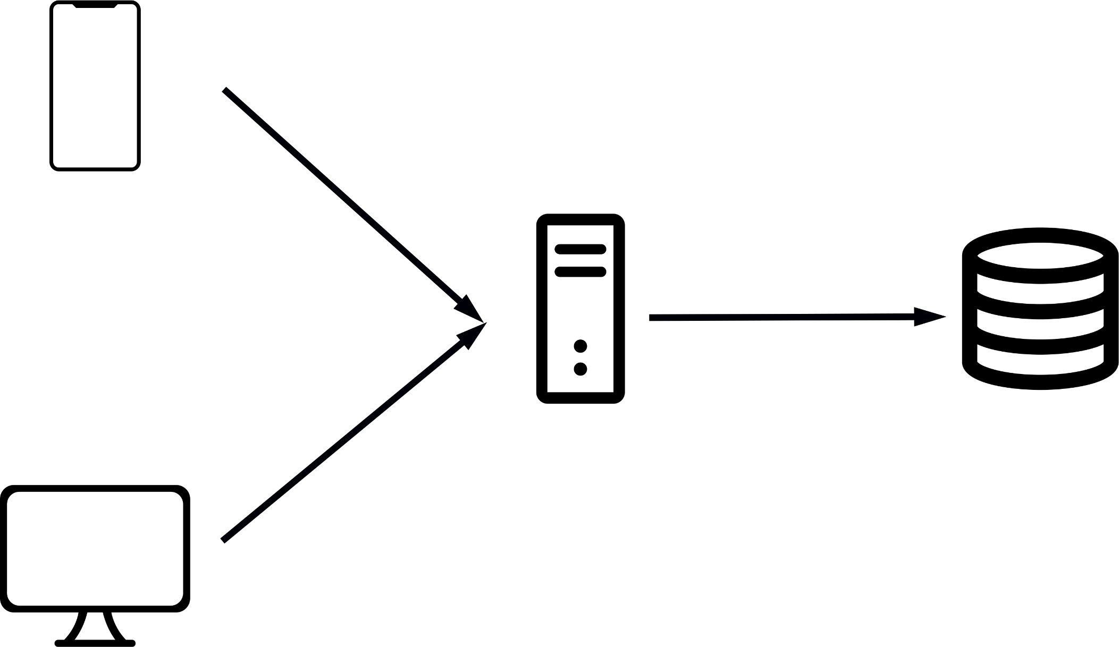
Architectural Style

Slide 3
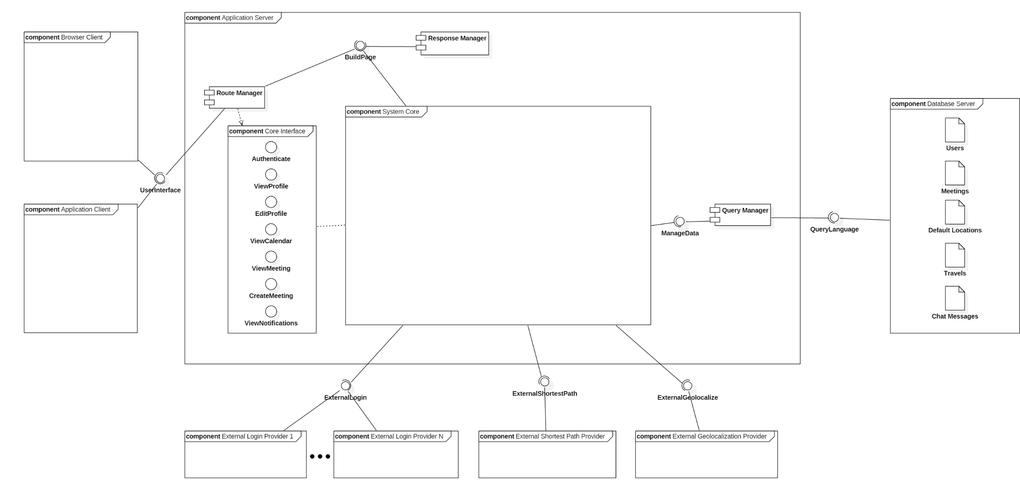
High Level Component Diagram

Slide 4
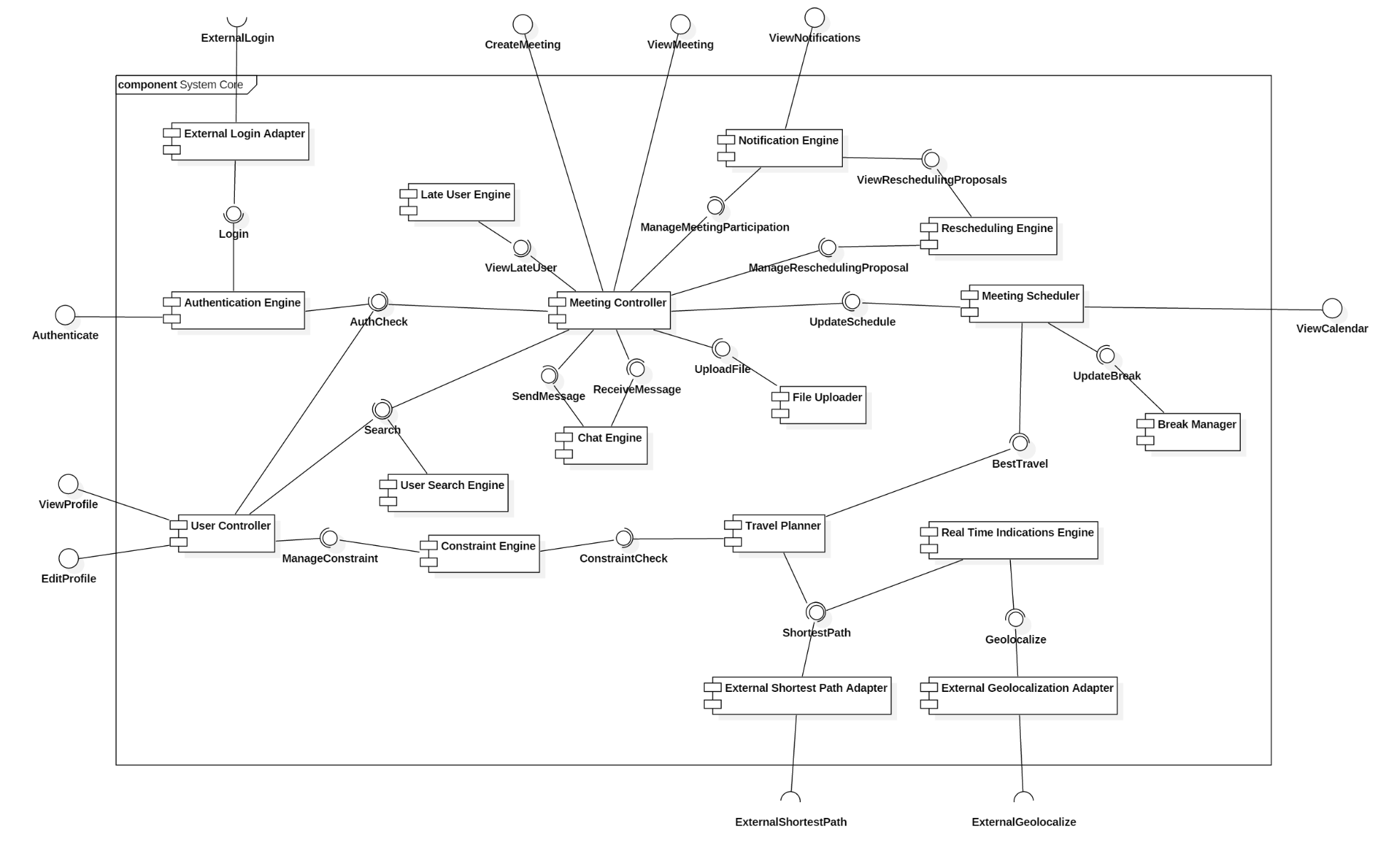
System Core Component Diagram

Slide 5
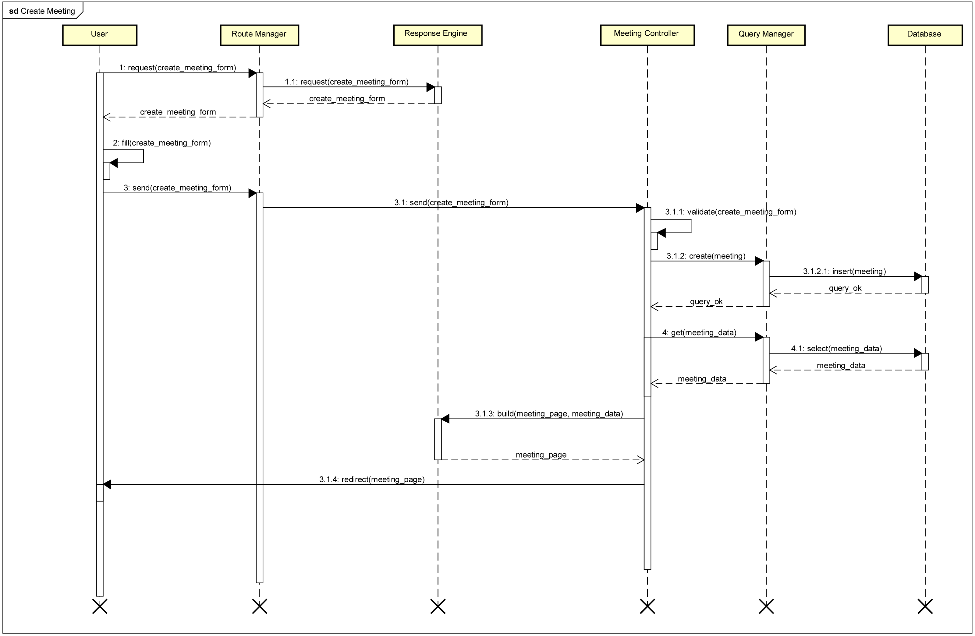
Create Meeting Runtime Diagram

Slide 6
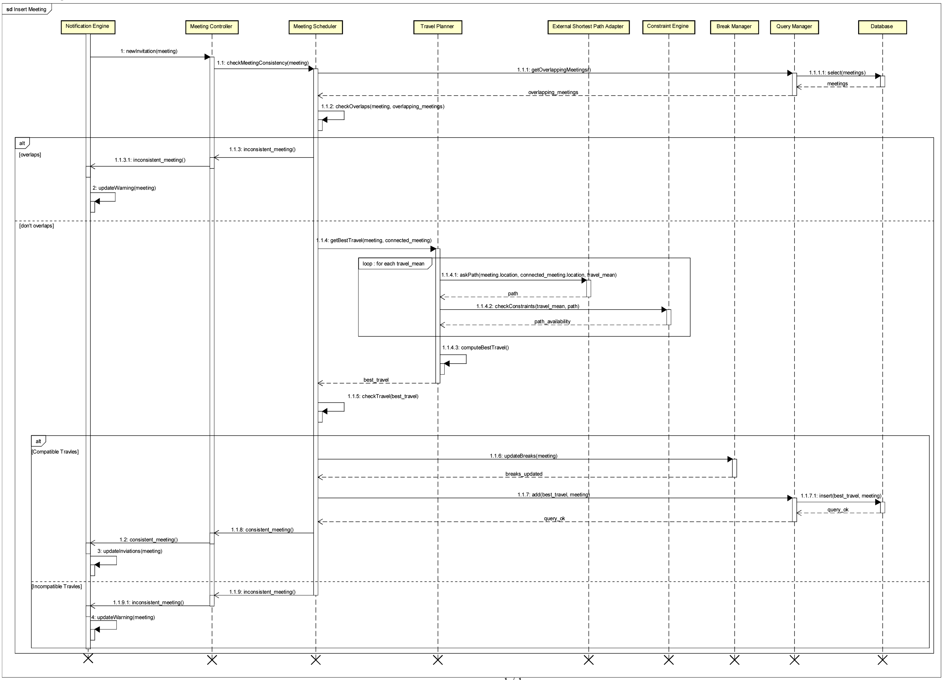
Insert Meeting Runtime Diagram

Slide 7
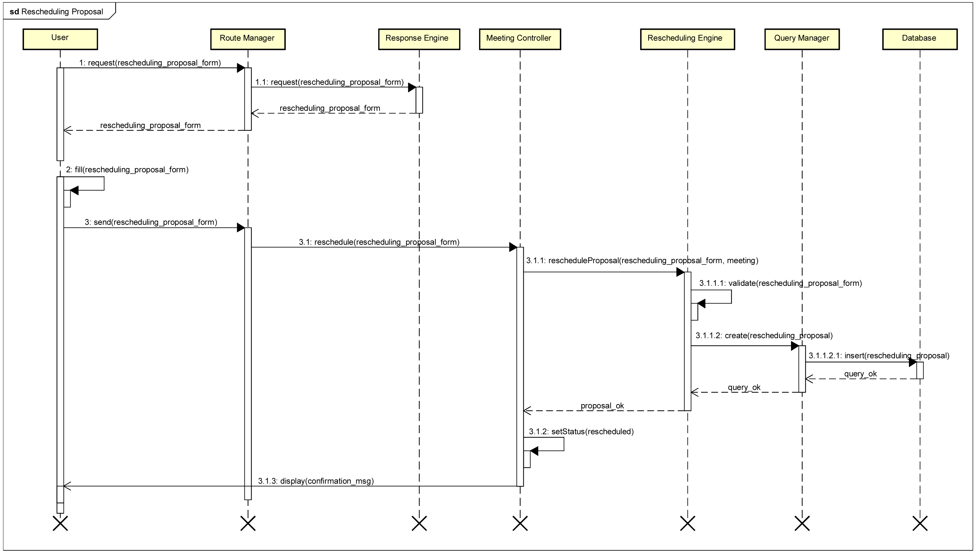
Rescheduling Proposal Runtime Diagram

Slide 8
Design Patterns
Model View Controller
Publish – Subscribe
Adapter

Slide 9
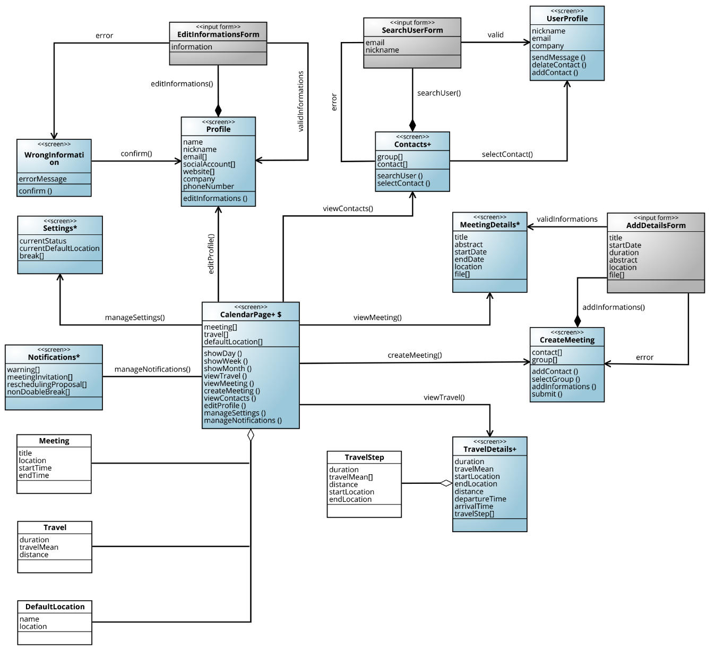
Calendar Page UX Diagram

Slide 10
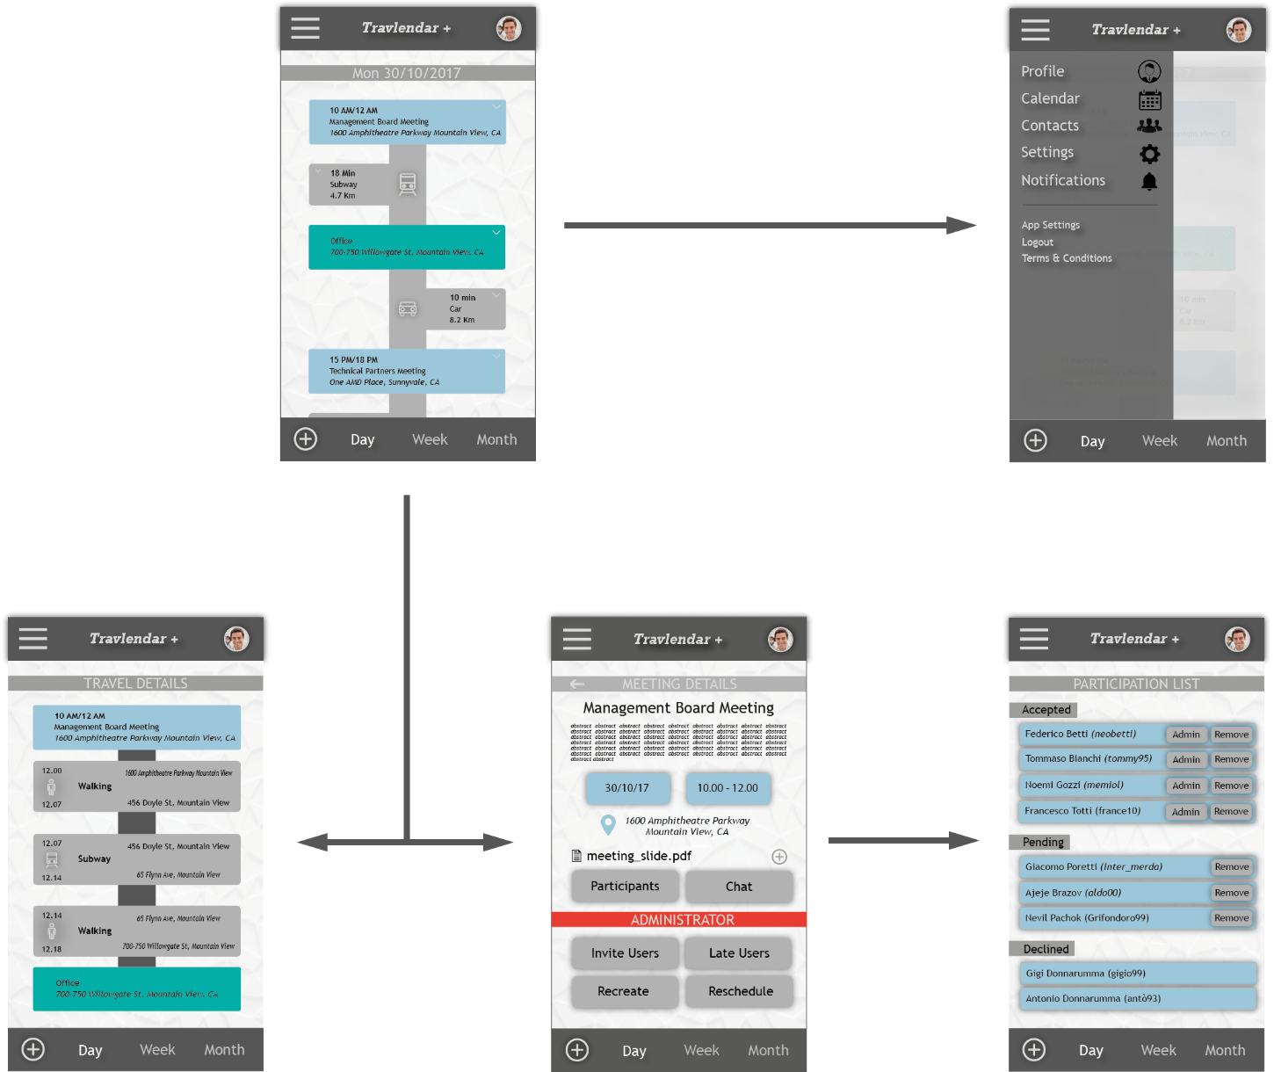
Calendar Page Mockups

Slide 11
Algorithm Design
Insert_meeting function main steps:
Find all the meetings overlapping with the one that we are inserting and mark them as inconsistent; if at least a meeting is found, mark also the new one as inconsistent and terminate the function.
Try to compute a travel for arriving and for leaving the newly inserted meeting taking into account the previous meeting, the following one and the default locations; if this is not possible, terminate the function marking the new meeting and the conflicting one as inconsistent.
Adjust the effective time of all the flexible breaks overlapping with the new meeting; if this is not possible, mark the break as not doable.
Link the travels to the meeting and store everything, then terminate successfully.

Slide 12
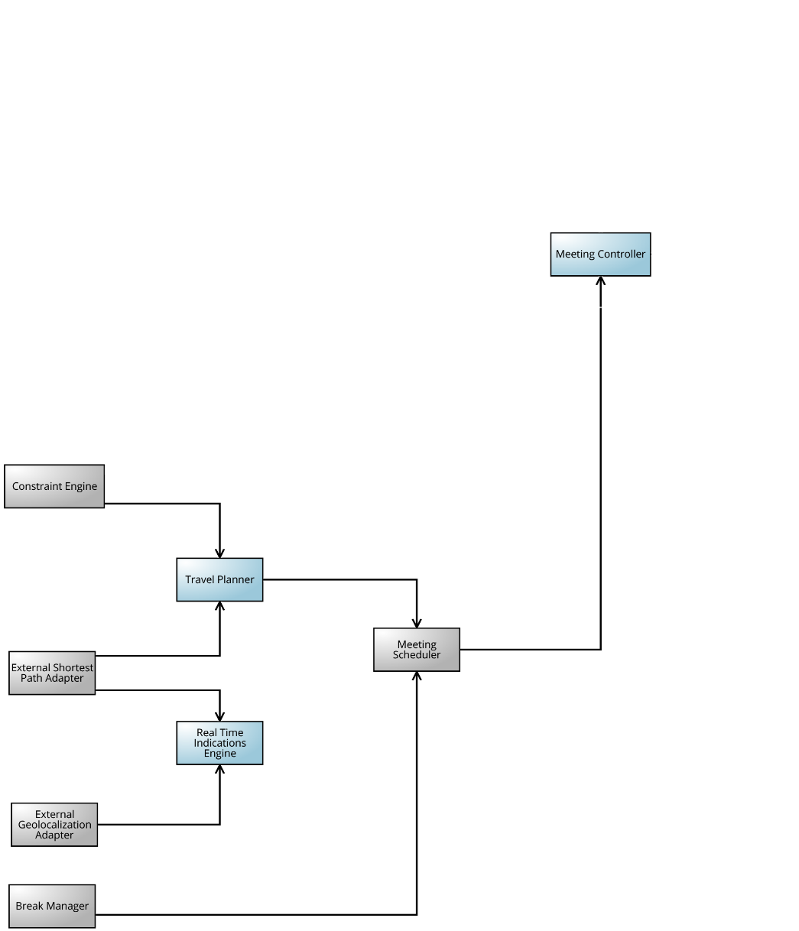
Implementation & Integration

Slide 13
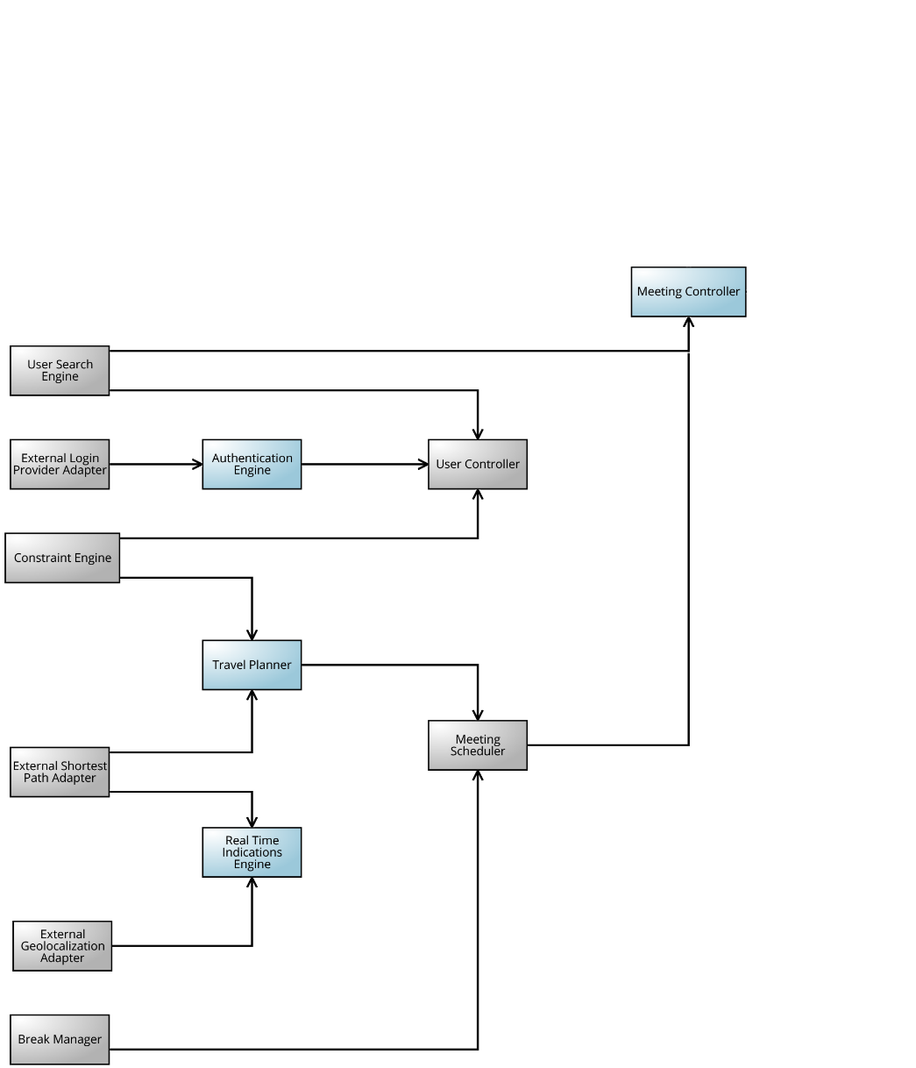
Implementation & Integration

Slide 14
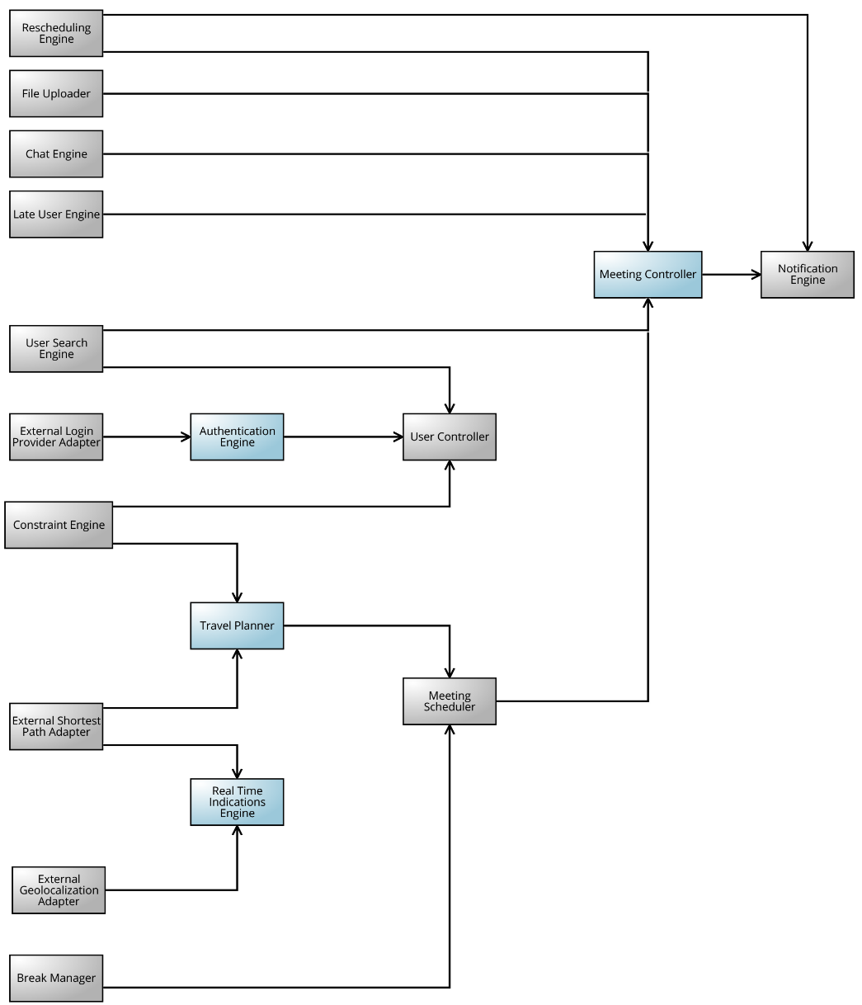
Implementation & Integration

Slide 15
Test Plan
Continuous and Automated Testing
Unit Tests
Integration Tests

