Slide 1
RASD
Federico Betti – Tommaso Bianchi

Slide 2
Product Functions
Travel
Meeting
Meeting-meeting or
default location-meeting
Biking, Driving, Walking,
Public Transportation
Preference list
Constraint
Real-time indications
Title, date and location
Administrators
Accept, decline or reschedule the invitation
Chat, upload files and notes
Categories and subcategories
Instant Meetings

Slide 3
User Characteristics
Guest
  Registration
User
  Login
  Create Meeting
  Calendar
  Groups and Contacts
Administrator
  Manage Meeting
  Invite/Remove Users
  Recreate Meeting
  Monitor Participants Delays
System Manager
  Travlendar+ employee

Slide 4
Goals
G1 Allow someone to visit the homepage of the system and to register himself providing a valid email, a password and a unique nickname. As an alternative, an external login provider, such as Google+, can be used.
G2 Users can log into the system.
G3 Allow a user to visit its profile and to see a detailed schedule of any day containing all the meetings he is attending and all the travels the system has planned him.
G4 Allow a user to edit all information in its profile (e.g. displayed name, phone number, company, website, social accounts).
G5 Allow a user to create a meeting and to invite other users to attend it.
G6 Create a warning each time it is not possible to reach a meeting location from the previous one in time.
G7 Allow a user to specify flexible breaks during the day.
G8 Manage users’ travels between subsequent meetings, suggesting the best mobility option according to their preference list.

Slide 5
Goals
G1 Allow someone to visit the homepage of the system and to register himself providing a valid email, a password and a unique nickname. As an alternative, an external login provider, such as Google+, can be used.
G2 Users can log into the system.
G3 Allow a user to visit its profile and to see a detailed schedule of any day containing all the meetings he is attending and all the travels the system has planned him.
G4 Allow a user to edit all information in its profile (e.g. displayed name, phone number, company, website, social accounts).
G5 Allow a user to create a meeting and to invite other users to attend it.
G6 Create a warning each time it is not possible to reach a meeting location from the previous one in time.
G7 Allow a user to specify flexible breaks during the day.
G8 Manage users’ travels between subsequent meetings, suggesting the best mobility option according to their preference list.

Slide 6
Allow a user to create a meeting
G5.1 Allow the administrator to categorize the meeting.
G5.2 Allow the administrator to change title, abstract and location of the meeting.
G5.3 Allow the administrator to nominate other administrators.
G5.4 Allow the administrator to send invitations and remove participants.
G5.5 Allow the team to communicate between them, to share files and to save personal notes about the meeting.
G5.6 Allow the invited users to accept or decline the meeting or to propose a rescheduling in a different time slot.
G5.7 Allow the administrator to change the date of the meeting after a rescheduling has been proposed.
G5.8 Allow the administrator to poll the team to reschedule the meeting; if everyone accepts the rescheduling, the date changes.
G5.9 Allow the administrator to create a copy of a meeting with the same team and settings on another date.
G5.10 Allow the administrator to see who’s late at the meeting.

Slide 7
Allow a user to create a meeting
[R5] A user must be logged into the system to perform any action except registering and logging in.
[R11] Each meeting has at least two participants.
[R12] Each meeting has at least one administrator.
[R13] Each meeting has a title, a date and a location.
[R14] Each participant in a meeting can access shared files and the chat.
[R15] Users participate in a meeting if and only if they accept the invitation.
[R16] Users do not participate in a meeting if they decline the invitation.
[R17] Users can write in the chat of a meeting if and only if they have received and accepted an invitation to it.

Slide 8
Allow a user to specify flexible breaks
[R5] A user must be logged into the system to perform any action except registering and logging in.
[R18] The system suggests you a time, according to your settings, to have a break such that no meeting overlaps with it; if no time slot is valid, a warning is generated.
[D6] Users can take a break everywhere.
Notes:
Infinite breaks
duration, start time, end time and a default time.
isDoable: as in alloy model
After resoving became true: also possible not to do the break
Lunch everywhere

Slide 9
Manage users’ travels
G8.1 Allow a user to create a preference list and constraints about the way he wants to travel.
[R5] A user must be logged into the system to perform any action except registering and logging in.
[R19] At least one travel mean is available in the preference list.
[R20] The travel mean suggested by the system is always the first in the weighted preference list that satisfied all the constraints; if no travel mean satisfied all the constraints than the system suggests the fastest one.
Notes:
Preference list: what is it
Constraints on using of travel means (length, weather…)
Weighted pref list (example)

Slide 10
Manage users’ travels
[D5] Each user has at least one default location.
[D7] Each user has a preference list.
[D8] All users always have a position.
[D9] External shortest path provider is always able to retrieve a path between any two locations.
[D10] Each user is always able to communicate with our servers.
[D11] The system does not differentiate between a travel mean that is shared and one that is owned.
[D12] The system treats the taxis as a driving travel mean and not as public transportation.
[D13] If a user accepts the invitation to a meeting, then he really attends to it.
Notes:
Position: to give real time info
Diff shared/owned: the presence of mixed travel means in the system; be difficult to deal with, from constraints.
No diff taxi/car:assumend also by external provider

Slide 11
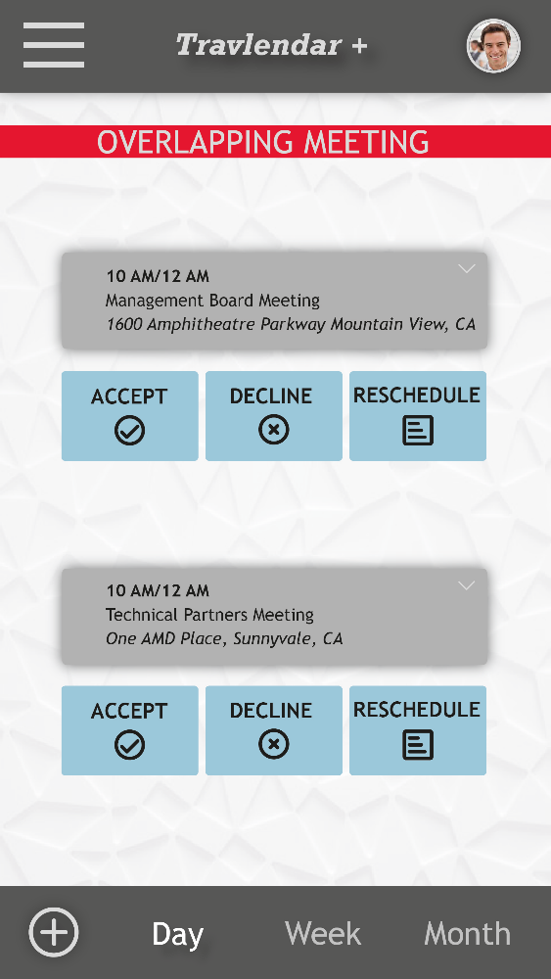
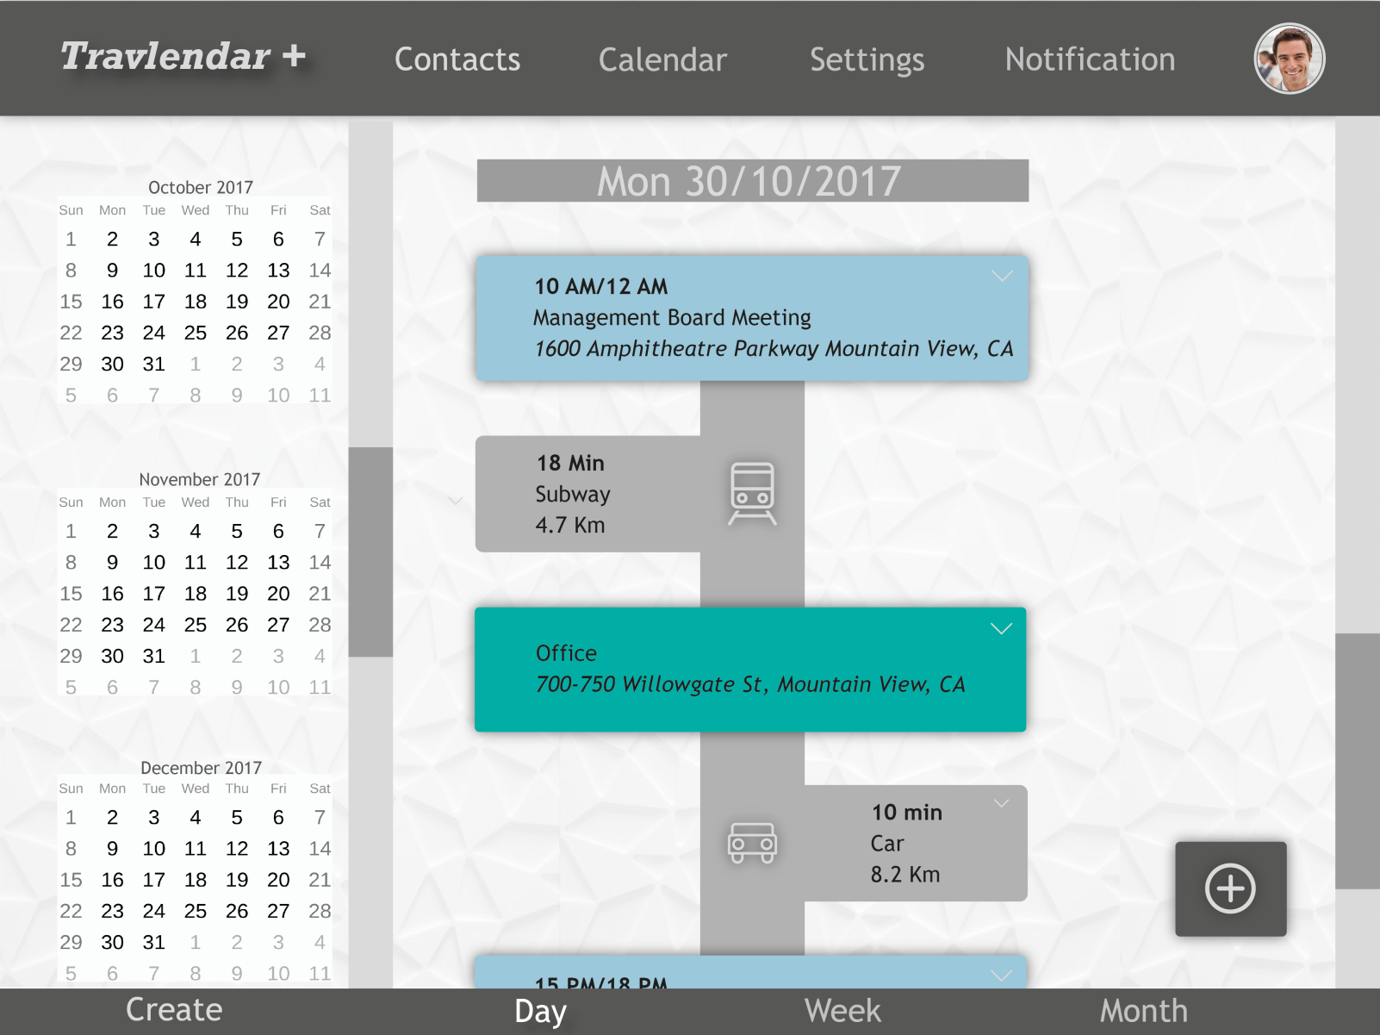
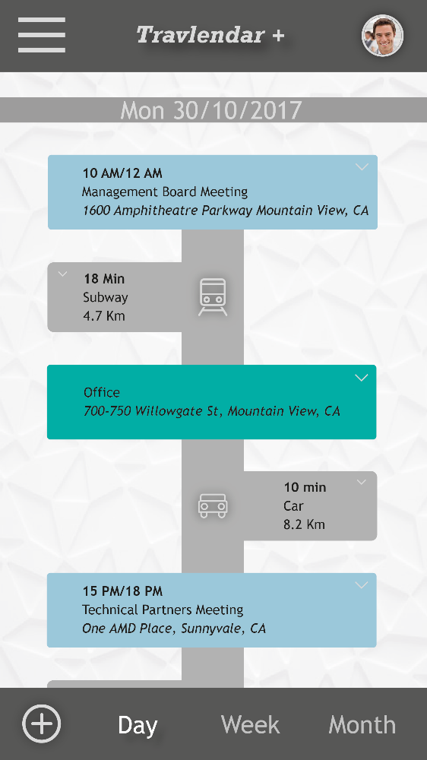
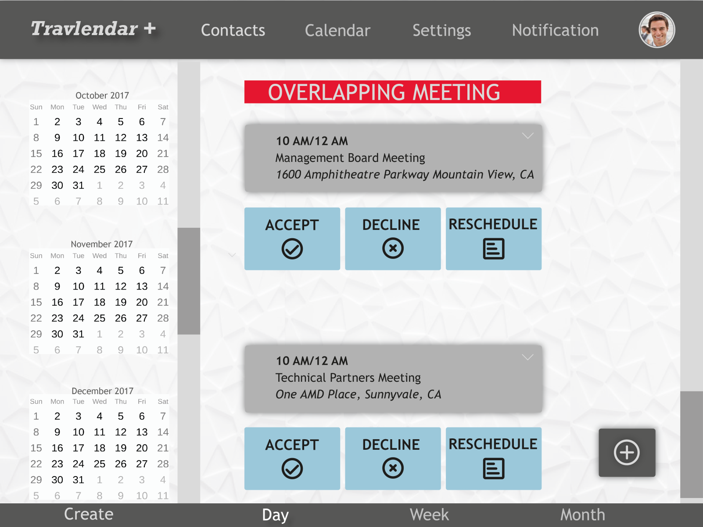
Mockup - Calendar
Notes:
Click on blocks
Green block = default location

Slide 12
Mockup - Warning
Notes:
Can be more or meeting-break

Slide 13
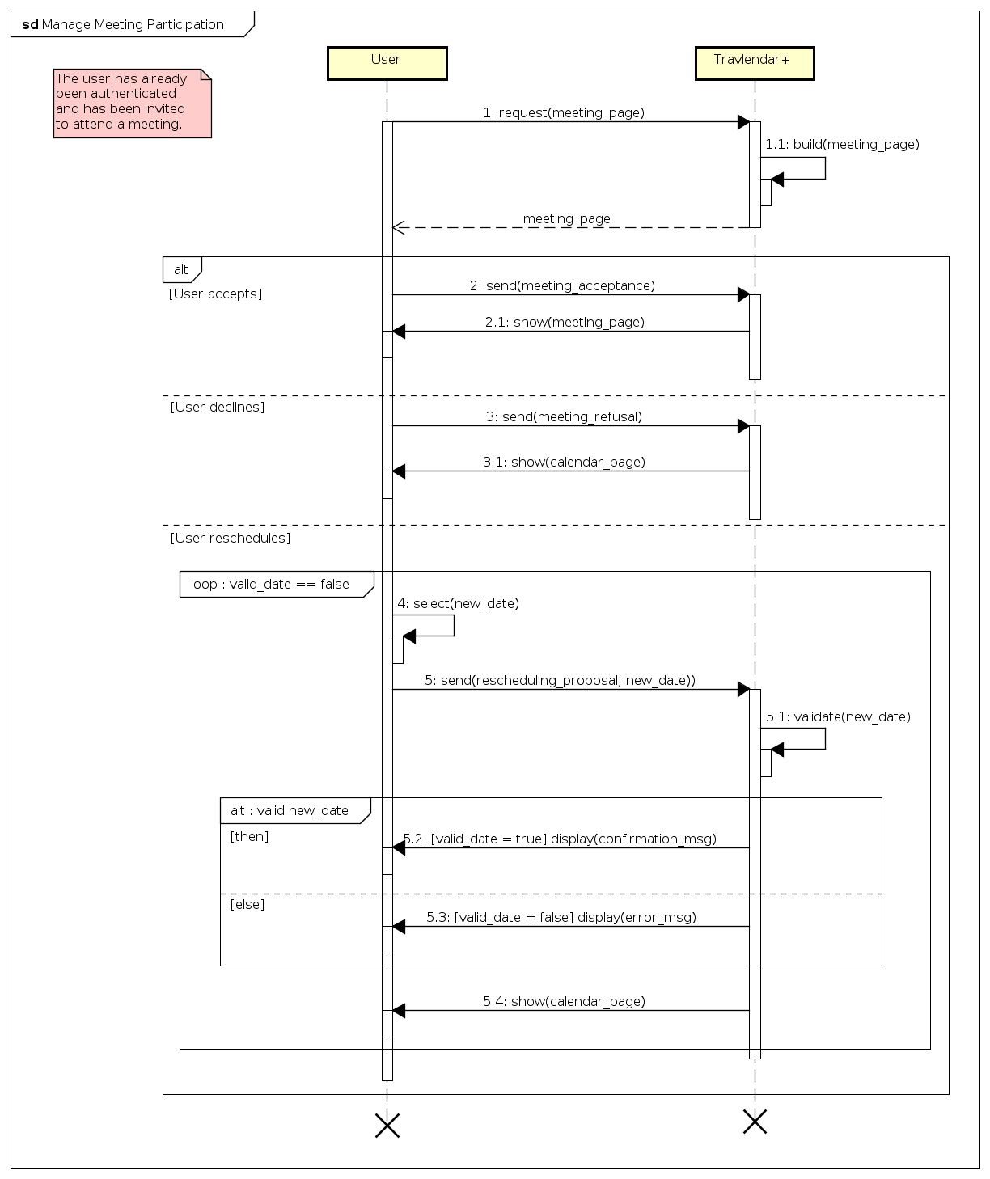
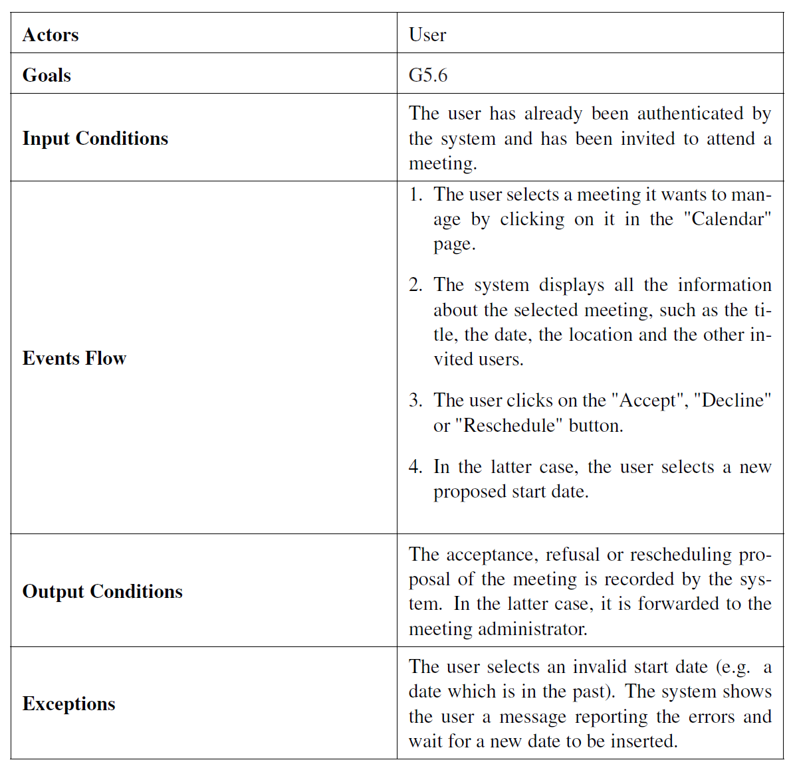
Manage Meeting Participation
Notes:
One of 15
Similar to slide before
Exception represented also in sequence diagram

Slide 14
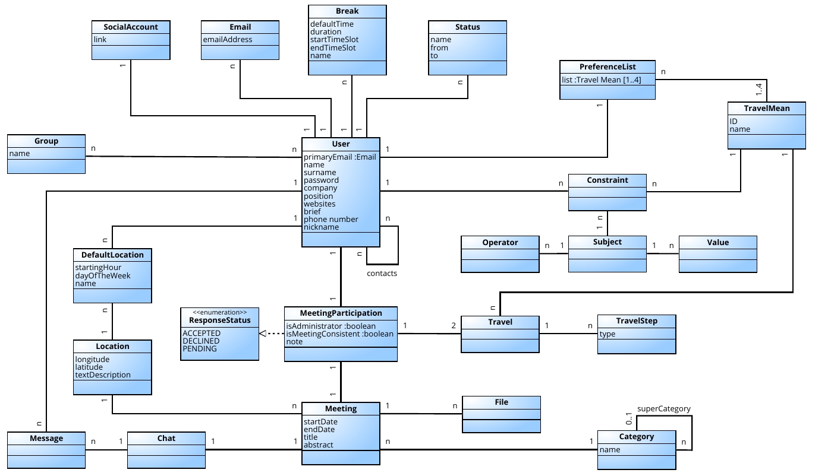
Class Diagram
Notes:
This is our class diagram: we have thought about all possible relations between agents in the system.
The main classe obviously are the user and the meeting. As we can see in this image the meeting participation is an important class that join each user to its meeting. It contains very usefull informations as if the user is an adniministrator or the arriving and leaving travel of each user and the response status.
As we can see here we have modeled the travel as a sequence of travel steps.
Here are shown some of the features that the user have such as emails, social accounts, breaks, status, its contacts and groups, default location.

Slide 15
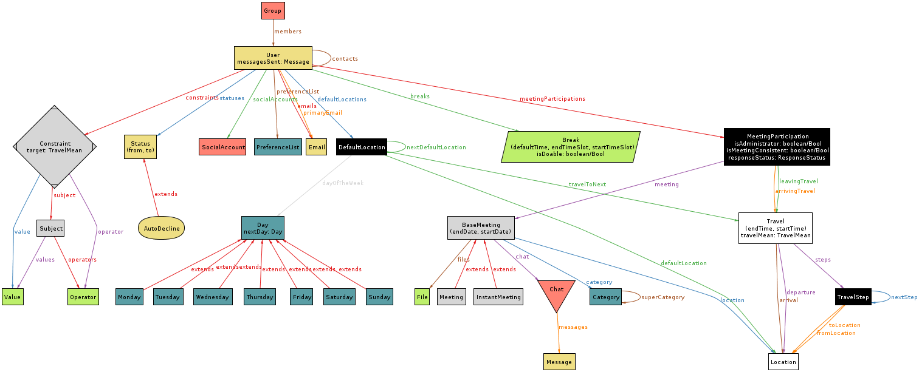
Alloy Metamodel
Notes:
Shows signatures and how realted
Relation with class
Days of the week to provide travel between default location(e.g home - office)

