Slide 1
Aerodynamic

Slide 2

Outline
Introduction
Rim and tyre influence on car aerodynamic
Rim and tyre influence on motorbike aerodynamic
Conclusions

Slide 3
Introduction: General Context
Importance of Aerodymics:
Aerodymics plays a crucial role in vehicle performance and effiency, affecting fuel consumption, speed and stability.
Rims and tyres are key components, capable of generating significant effects on airflow.
Study Objectives:
Analyze the impact of rims and tires on cars and motorcycles.
Examine the differences between rotating and stationary wheels, tyre geometry and rim configurations.
Notes:
Good morning, everyone. Today, we will talk about the influence of rims and tires on vehicle aerodynamics, focusing on both cars and motorcycles.
First, let’s consider the importance of aerodynamics. Aerodynamics significantly impacts vehicle performance, affecting fuel consumption, speed, and stability. Among the various components, rims and tires play a crucial role in shaping airflow around the vehicle. The objectives of this study are to analyze the effects of these components and understand how differences, such as rotating vs. stationary wheels or tire geometries, influence the overall aerodynamic performance.
For cars, we’ll explore how wheel rotation creates vortexes, how tire deformations and grooves impact airflow, and how rim designs affect drag and lift. For motorcycles, the interaction between the tires and the fairing is even more critical, as it directly affects stability.

Slide 4
Specific Topics
Cars:
Effects of wheel rotation
Influence of tyre deformations
Contribution of rim openings and tyre grooves.
Impacts of tyre profiles on aerodynamic forces.
Motorcycles:
Unique roles of tyres and rims on aerodynamics and stability.
Greater influence of wheel-fairing interaction compared to cars.

Slide 5
Rim and tyre influence on car aerodynamic
Rotating vs stationary wheels
Influence of tyre deformation
Influence of rim openings
Influence of tyre grooves
Influence of tyre profile
Notes:
First of all we focus our attention on the influence of different geometries and configurations of rim and tyre on the car aerodynamic, tyre pattern and rim configurations as most important parameters

Slide 6
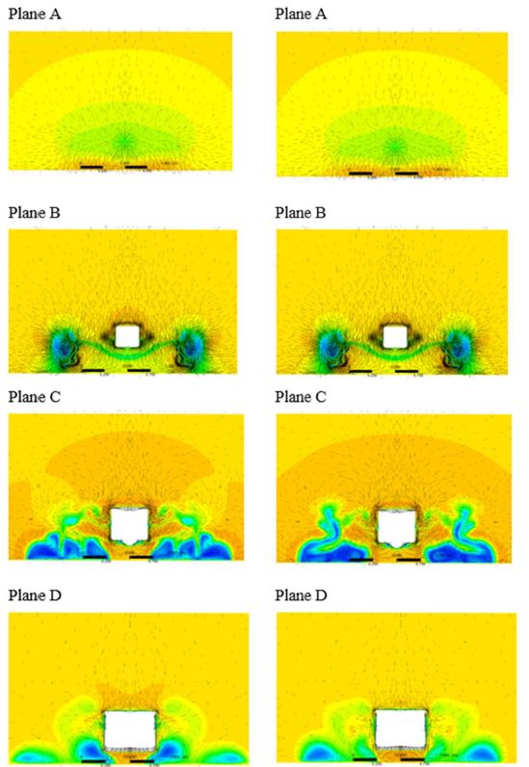
Stationary vs rotating wheels
Stationary wheels
Rotating wheels
Flow pushed outward the car.
Flow pushed outward the car.
Genereation of vortexes.
Generation of vortexes.
High gradient in pressure reduction.
Gradual pressure reduction.
Source: «Computational investigation of the aerodynamics of a wheel installed on a race car with a multi-element front wing», Carlo Cravero, Davide Marsano
Notes:
The first aspect that we consider is fundamendal to correcty develop CFD simulations and the wind tunnel measurements, that is the influence of the rotation of the wheel. In this case a race car has been analyzed (like a formula 1 car), by a CFD simulation considering 4 different sections planes located at different distances from the front wing of the car to the rear part (from A to D) and two different configurations has been examined: one with rotating wheels (the column on the right) and another one with stationary wheels (the column on the left). From the reported pictures it can be noticed the generation of low speed regions and vortexes structure for both configurations, the shape of the vortexes is different, for example we can notice that in the stationary case the vortex is close to the car body. Another important difference is that in the rotating wheel case there is a gedual pressure reduction while in the stationary one it is greater.

Slide 7
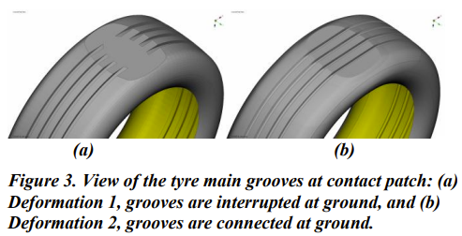
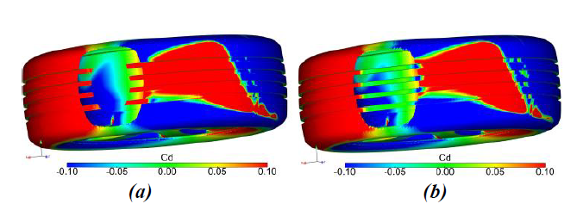
Tyre deformation and contact patch
2 kinds of tyre deformations proposed:
Grooves not preserved
Grooves preserved
Drag distribution:
Drag distribution:
Deformation closer to reality..
Source: «Investigation of the influence of tyre geometry on the aerodynamics of passenger cars», Teddy Hobeika , Simone Sebben
Notes:
Here we are analyzing the effect of the deformation on the wheel and the contact patch, two solutions are proposed in order to find the best one to be used in further CFD simulations. We can notice a different drag distribution particularly in the contact patch zone with an increase drag effect for the case in which grooves are not preserved, in both cases by analyzing the impact on the whole vehicle we can see that this change does not have a significant influence on the rear wake. In any case since the case B is the one closer to reality the following analysis are performed with that configuration.

Slide 8
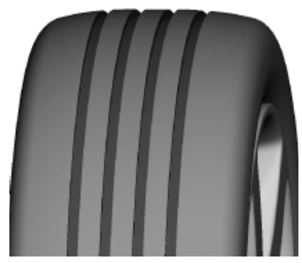
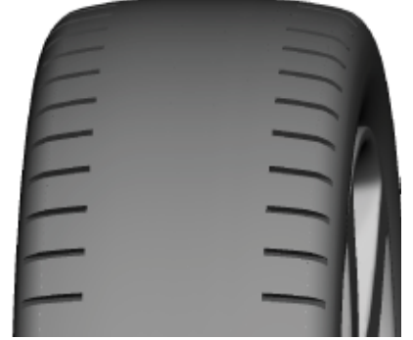
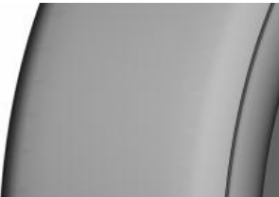
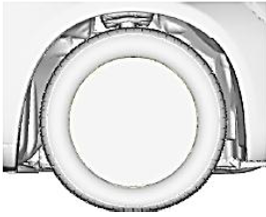
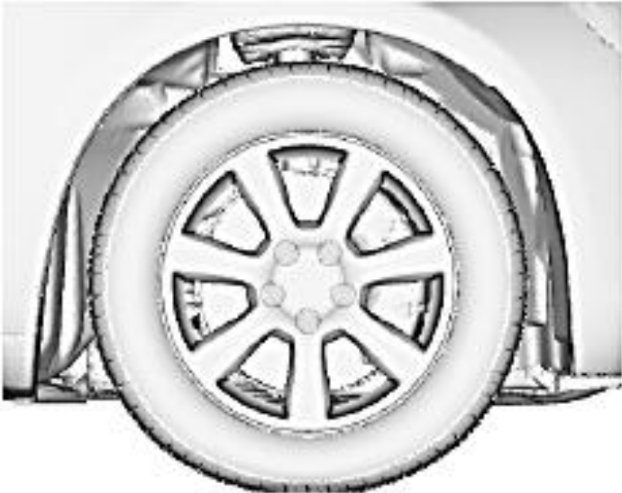
Influence of tyre grooves and rim openings
3 tyre patterns analysed:
Rain grooved
Lateral grooved
Side grooved
2 rims analysed:
Closed rim
Open rim
Source: «Investigation of the influence of tyre geometry on the aerodynamics of passenger cars», Teddy Hobeika , Simone Sebben
Notes:
With this paper we are analyzing the effect of the wheel pattern and of the rim openings. In particular 3 different pattern for the tyre are considered and 2 configurations for the rim, the closed and the open one, the idea is to fix one parameter and by changing the others, study the effect that it has on the drag and lift coefficients.

Slide 9
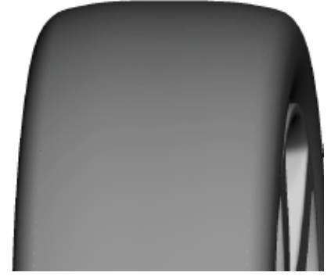
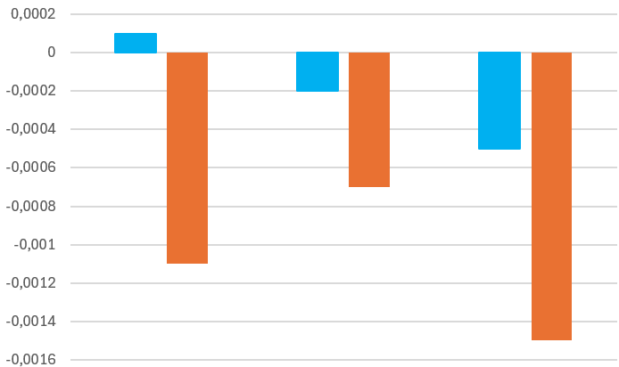
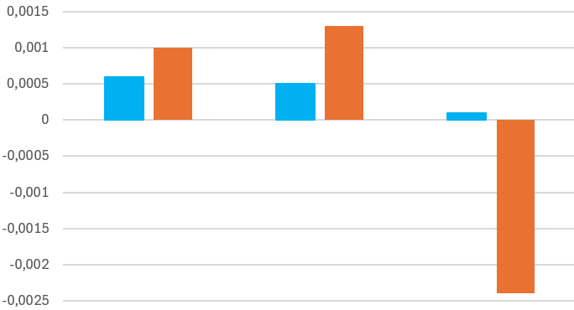
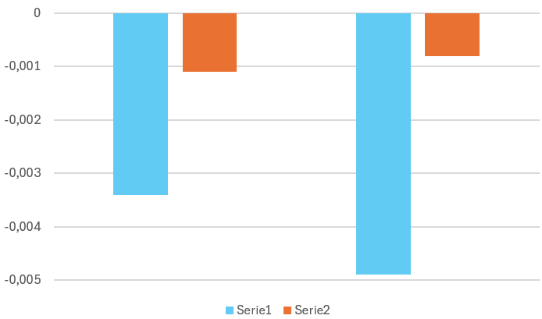




Influence of tyre grooves
Rain grooves addition:
Lateral grooves addition:
+
+
CR
Slick
CR
Lat.
CR
Side
CR
Slick
CR
Rain
CR
Side
+
+
+
+
+
+
$$∆c_{D}$$
$$∆c_{L}$$
$$∆c_{D}$$
$$∆c_{L}$$
Source: «Investigation of the influence of tyre geometry on the aerodynamics of passenger cars», Teddy Hobeika , Simone Sebben
Notes:
Here we want to start by analyzing the influence of the tyre grooves, in the case on the left we consider a wheel with rain grooves and closed rim and we study the impact on the aerodynamic coefficients when we add the lateral grooves and the side one. We can see that the general drag reduction is related to the fact that the main grooves allows the connection between the high pressure region in front of the tyre to the low pressure one behind it. The same procedure has been followed for the lateral grooves addition and in this case is even more complicated to identify a clear trend.

Slide 10
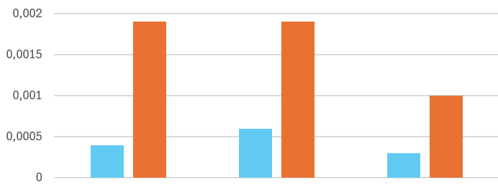
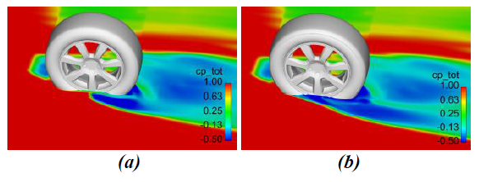


Influence of tyre grooves
Side grooves addition:
+
OR
Slick
OR
Rain
OR
Lat.
Increase in drag due to:
+
+
+
OR
Slick
OR
Side
+
+
$$∆c_{D}$$
$$∆c_{L}$$
Source: «Investigation of the influence of tyre geometry on the aerodynamics of passenger cars», Teddy Hobeika , Simone Sebben
Notes:
Finally we consider the presence of the side grooves, a general increase both in the drag and in the lift coefficient is present and by looking at the picture on the right we can identify a greater flow separation in the case with side grooves tyre with respect to the slick one, this behavior generates a general increase in the drag for the whole vehicle. For the closed rim the effect is not as bad as for the open rim solution.

Slide 11
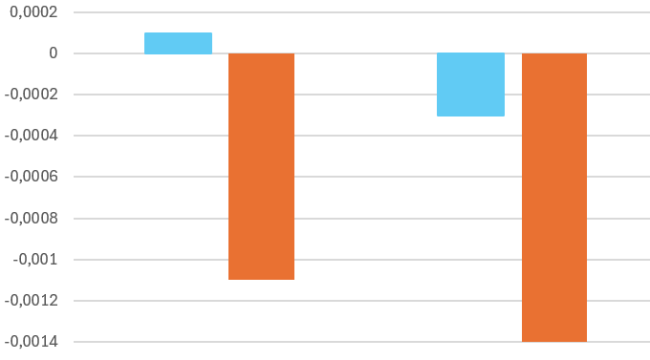
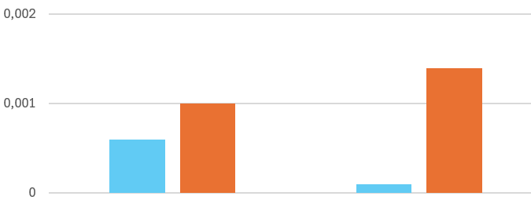
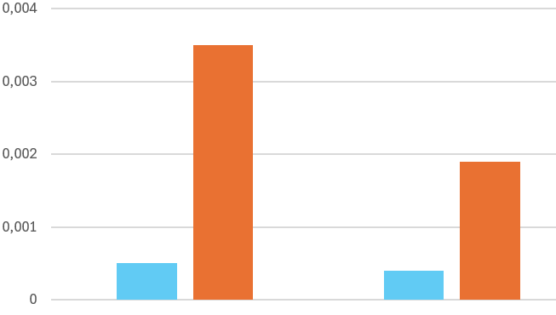




Influence of rims openings
Rain grooved tyres
Lateral grooved tyres
Side grooved tyres
+
+
+
CR
OR
CR
OR
CR
OR
$$∆c_{D}$$
$$∆c_{L}$$
$$∆c_{D}$$
$$∆c_{L}$$
$$∆c_{D}$$
$$∆c_{L}$$
Source: «Investigation of the influence of tyre geometry on the aerodynamics of passenger cars», Teddy Hobeika , Simone Sebben
Notes:
Here we want to study the effect of the rim opening by chaging them on the same tyre pattern. We can see that there is not a uniform trend for all the tyres configurations, in general the trend is positive or negative for both coefficients for the closed and for the open rim solutions, the only exception is present when we are considering the drag and combing rain grooves and closed or open rim. We can say that with lateral and side grooved tyre there is a worsening of the aerodynamic behavior with both rim configurations.

Slide 12
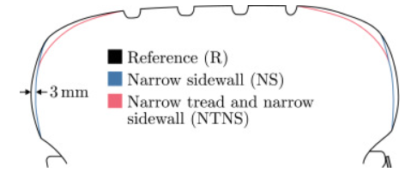
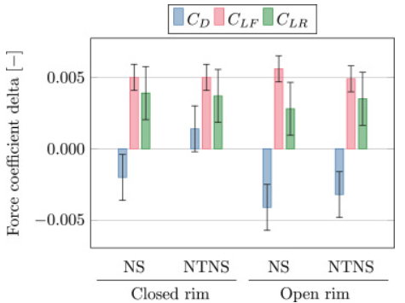
Influence of tyre profile
Drag reduction with closed rim in the NS configuration.
Increased drag with NTNS configuration.
Same flow mechanism in both rims configurations.
Larger drag delta for the open rim
Source: «Characterisation of the flow around passenger vehicle wheels with varying tyre profiles », Erik Josefsson, Simone Sebben, Magnus Urquhart
Notes:
Drag reduction with closed rim in NS configuration due to reduction in the flow separation, increase in drag with NTNS configuration since generation of vortex downstream the tyre, larger drag delta for the open rim beacuse of the generation of the wake going aout of the rim

Slide 13
Rim and tyre influence on motorbike aerodynamic
Influence of Rim Design on Drag and Lift Forces
Rotation Effects on Aerodynamic Performance
Impact of Tire Profiles on Aerodynamics
Design Trade-offs: Stability vs. Efficiency

Slide 14
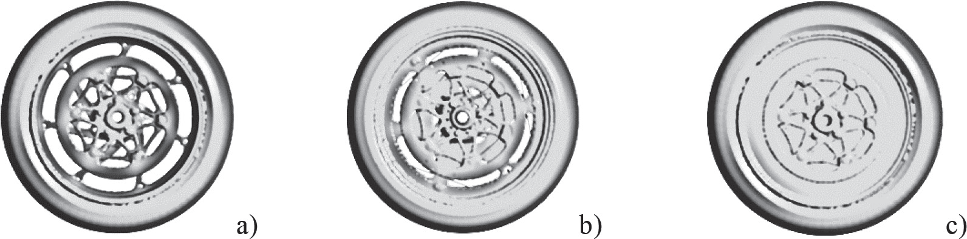
Influence of Rim Design on Drag and Lift Forces
Source: «Aerodynamic Study of Motorcycle Racing Wheels», Concli et al.
Highlights:
Fewer spokes or solid designs improve aerodynamic performance by minimizing turbulence and airflow separation
However, solid disk wheels (fig. c), have increased axial forces which may compromise handling and maneuverability
Wheel type | C_{d} | C_{L}
REF7 (a) | 0.45 | 0.16
MGD6 (b) | 0.47 | 0.12
DSKW (c) | 0.36 | 0.14
Reference speed of 60 m/s

Slide 15
Design Trade-offs: Stability vs Efficiency
Source: «Aerodynamic Study of Motorcycle Racing Wheels», Concli et al.
Pros:
Solid disk wheels reduce drag by 15-20%, making them ideal for high-speed performance.
Reduced turbulence around solid designs can enhance straight-line stability.
Improved efficiency contributes to better fuel economy and higher speed thresholds.
Cons:
Lift forces increased by 8–12%, introducing destabilizing vertical forces that compromise handling.
Solid wheels lack airflow through spokes, which may affect heat dissipation in brakes.
Higher axial forces require structural reinforcements, potentially adding weight.
Design Implications:
Hybrid designs with partial spokes or aerodynamic inserts can balance drag reduction and stability, requiring further testing for optimization

Slide 16
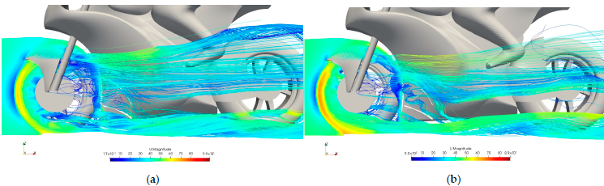
Rotation Effects on Aerodynamics Performance
Source: «Aerodynamic Study of MotoGP Motorcycle Flow Redirectors», B. Gonzàles-Arcos, P.J. Gamez-Montero
Highlights:
Rotating wheel has important drag and lift effects both for straight (S.) and leaning (L.) motorcycle models, as displayed in the table referred to a motorcycle without under-fairings.
The main rotation effect is directing the vortexes under the motorcycle and creating downforce.
The rotation lifts the wheel’s wake and creates high speed flow near the possible underbody fairing, whereas a non-rotating wheel (a) let part of the flow to pass around it. Moreover, the rotating wheels (b) simulations show that the low pressure-wake on the back of the vehicle is reduced.
Model | C_{d} | C_{L}
S. Non-Rotating | 0.420 | 0.04
S. Rotating | 0.411 | 0.05
L. Non-Rotating | 0,462 | 0,09
L. Rotating | 0,447 | 0,12
Straight model
Notes:
Rotating wheels Cd=0,41131 Cl=0,05076 ; Non-rotating wheels Cd=0,42033 Cl=0,04197 ; -2,15% and +20,94%
Wheel rotation creates downforce even if we don’t have flow redirectors, wheel’s wake is crucial to being able to create vortexes in the lower part in straight and leaning cases.
How rotating or non-rotating wheels affect the global aerodynamics, directing the flow trough other under-fairings in different ways and creates downforce.
STRAIGHT:
Rotating: More flow on the flow redirector when the wheel is rotating, moreover the wake is lifted, creating a high-speed flow near the fairing. (1:1)
Non-rotating wheels: flow redirector has more flow around and not inside, generating vortex on the exit but less energetic. (6:1)

Slide 17
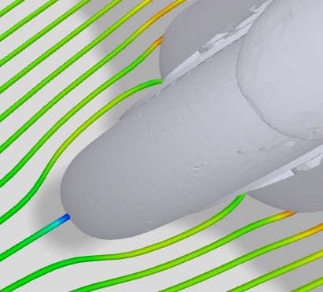
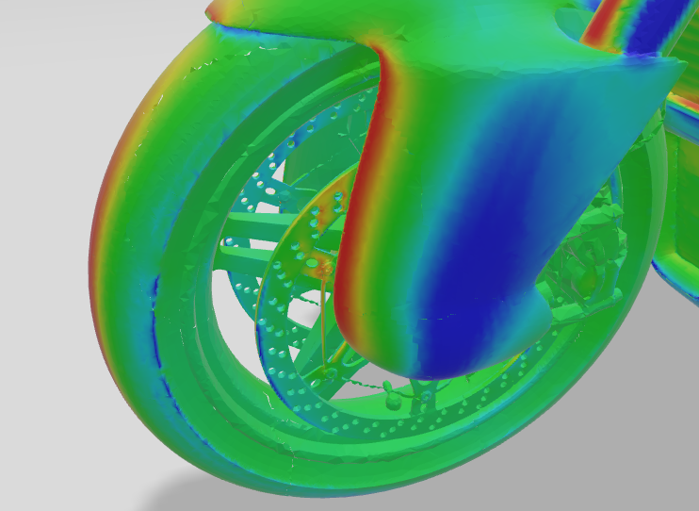
Impact of Tire Profiles on Aerodynamics
Source: «Motorbike CFD Analysis Explained», airshaper.com
Highlights:
Motorcycle’s tires have a more rounded shape:
- More rounded tires will have an early flow separation
- Less rounded/wider tires will keep the flow attached until the edge
- Trade-off between flow separation and useful flow direction
Drag Resistance: Slick tires will generate less drag than road tires.
Front Wheel: it’s a big disturbance for the lower part of the vehicle aerodynamics and on the flow pressure which hits the radiator.

Slide 18
Conclusions: Reflections on Car Aerodynamics
Rotatings vs Stationary Wheels:
Generation of multiple vortices and different pressure distributions.
Reduction in aerodynamic drag thanks to optimezed geometries
Tyre Geometry:
Deformations and grooves significantly influence airflow.
Targeted improvements reduce drag and increase effiency.
Notes:
To summarize the findings for cars, rotating wheels generate multiple vortex structures and distinct pressure distributions, which can be optimized to reduce aerodynamic drag. Tire geometry, such as deformations and grooves, plays a significant role in shaping airflow and improving efficiency.
For motorcycles, rims and tires have a much greater influence due to their interaction with the fairing. These interactions are essential for ensuring stability and maneuverability, especially at higher speeds.
In conclusion, optimizing rims and tires not only enhances performance but also improves safety. Future research should focus on real-world scenarios to further explore the synergies between aerodynamic and dynamic components.
Thank you for your attention.

Slide 19
Impacts on Motorcycles and General Conclusions
Motorcycle Aerodynamics:
Higher sensitivity to vatiations in rims and tyres compared to cars.
Tyre-fairing interactions are crucial for stability, maneuverability and drag resistance.
General Conclusions:
Optimizations in rims and tyres improve both performance and safety.
Next steps: further explore the synergy between aerodynamic and dynamic components in real-world scenarios.

Slide 20
Thank you

