Slide 1
Clickbait Detector
Business and Project Management
Simone Bensi, Tommaso Nocchi

Slide 2
Introduction: what is clickbait ?
It’s a content whose main purpose is to attract attention
Clickbait tends to exploit “the gap of curiosity”, giving just enough away to peak your curiosity but not enough to satisfy it without going deeper.
Application fields: web browsers and companies marketing strategies

Slide 3
Integration with web browsers
Nowadays there are about 2 billion websites on the internet of which at least 500 million are clickbait
Web browsers can use a clickbait detector to automatically filter out from search results titles classified as clickbait, optimizing users research time
This browser functionality would be particularly recommended for people with poor browsing experience who, otherwise, would likely visit unreliable websites

Slide 4


Integration with companies marketing strategy
Clickbait detector can be used in:
traditional marketing to produce some effective slogans
digital marketing strategies when performing the Search Engine Optimization (SEO)
To use this tool, a company marketing team just has to elaborate a text and check if it is engaging or not.

Slide 5
Dataset
https://www.kaggle.com/amananandrai/clickbait-dataset
This dataset contains 16000 titles labeled as clickbait and 16000 titles labeled as non-clickbait
Samples of clickbait titles found:
Which Candy Is The Best
Millennials At Work: Expectations Vs. Reality
27 Insane Pizza Mashups You Need Right Now
Samples of non-clickbait titles found:
Coordinated terrorist attack hits London
Botswana holds parliamentary elections
US government stops Haiti evacuations

Slide 6
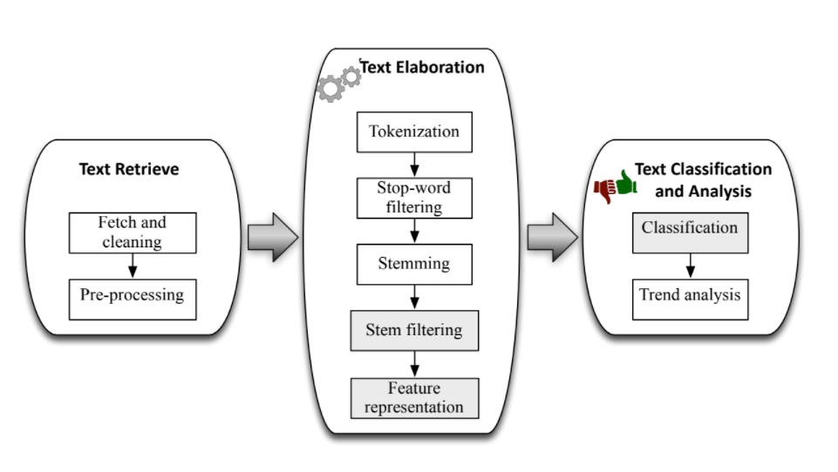
Text classification process

Slide 7

Dataset cleaning
No missing, inconsistent or duplicated values detected
Removed punctuation marks
Removed useless meta-information, such as links, hashtags, timestamp and emoticon

Slide 8

Tokenization
Tokenization consists in transforming a stream of characters into a vector of processing units called tokens, namely words

Slide 9

Stop word filtering
Stop words are words presumed to be uninformative in representing the content of a text, and which may be removed.
However, some stop words can be useful for prediction, such as in classifying writing style. Therefore, we decided to create a customized stop-words list in order to do not exclude some relevant words for our purpose.

Slide 10
Stemming and stem filtering
Stemming is the process of reducing each token to its stem or root form, by removing its suffix, in order to group words having closely related semantics.
During stem filtering, the number of stems of each text are reduced, by removing noisy stems and maintaining only the most relevant ones.

Slide 11
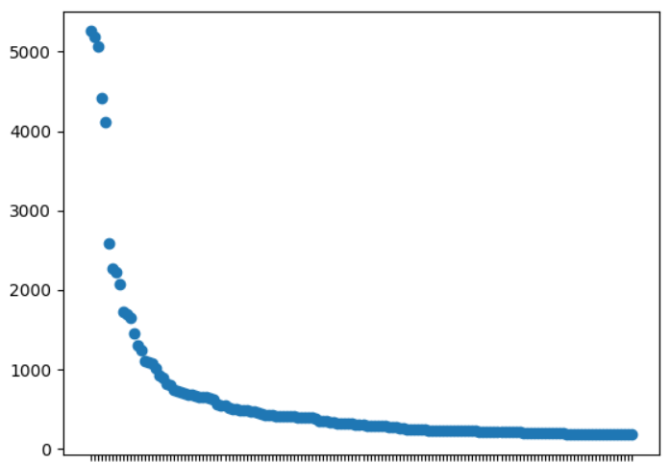
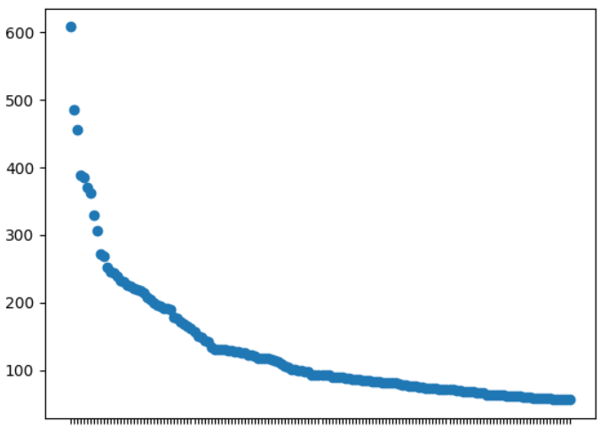
N-gram vectorization
The N-grams vectorization method counts combinations of adjacent words of length N in the title. We decided to test 1-gram vectorization and 2-gram vectorization.
From this analysis we found the 150 most frequent 1-gram and 2-gram tokens, having the following frequency distribution.
1-gram Vectorization
2-gram Vectorization
[‘love’, ‘life’, ‘people’, ‘photos’, ‘reasons’, ‘times’, ‘favorite’, ‘kills’, ‘dead’, ‘how’, ‘way’, ‘like’, ‘police’]
['the internet’, 'the most’, 'the new’, 'the world’, 'things that’, 'your favorite’, 'your life’, 'when you’, 'who are’, 'should be' 'should you’, 'dead in’, 'dies aged’]

Slide 12
Feature selection
Feature selection is a process which selects those features in the dataset that contribute most to the prediction variable or output in which we are interested
The benefits of performing feature selection before modeling your data are overfitting avoidance and training time reduction

Slide 13
Classification phase
We decided to select the following configurations for training 8 classifiers
Configuration name | Stop-word | N-gram | Chi-square
1 | None | 1 | None
2 | None | 1 | 50%
3 | None | 2 | None
4 | None | 2 | 50
5 | Custom | 1 | None
6 | Custom | 1 | 50%
7 | Custom | 2 | None
8 | Custom | 2 | 50%

Slide 14
Configuration name | Stop-word | N-gram | Chi-square
1 | None | 1 | None
2 | None | 1 | 50%
3 | None | 2 | None
4 | None | 2 | 50
5 | Custom | 1 | None
6 | Custom | 1 | 50%
7 | Custom | 2 | None
8 | Custom | 2 | 50%
0.001 s
0.001 s
0.001 s
0.002 s
0.021 s
0.002 s
0.001 s
0.004 s

Slide 15
Configuration name | Stop-word | N-gram | Chi-square
1 | None | 1 | None
2 | None | 1 | 50%
3 | None | 2 | None
4 | None | 2 | 50
5 | Custom | 1 | None
6 | Custom | 1 | 50%
7 | Custom | 2 | None
8 | Custom | 2 | 50%
0.001 s
0.003 s
0.002 s
0.001 s
0.001 s
0.002 s
0.001 s
0.001 s

Slide 16
Configuration name | Stop-word | N-gram | Chi-square
1 | None | 1 | None
2 | None | 1 | 50%
3 | None | 2 | None
4 | None | 2 | 50
5 | Custom | 1 | None
6 | Custom | 1 | 50%
7 | Custom | 2 | None
8 | Custom | 2 | 50%
0.001 s
0.001 s
0.001 s
0.001 s
0.001s
0.001 s
0.001 s
0.002 s

Slide 17
Configuration name | Stop-word | N-gram | Chi-square
1 | None | 1 | None
2 | None | 1 | 50%
3 | None | 2 | None
4 | None | 2 | 50
5 | Custom | 1 | None
6 | Custom | 1 | 50%
7 | Custom | 2 | None
8 | Custom | 2 | 50%
0.004 s
0.003 s
0.001 s
0.002 s
0.005 s
0.022 s
0.005 s
0.006 s

Slide 18
Configuration name | Stop-word | N-gram | Chi-square
1 | None | 1 | None
2 | None | 1 | 50%
3 | None | 2 | None
4 | None | 2 | 50
5 | Custom | 1 | None
6 | Custom | 1 | 50%
7 | Custom | 2 | None
8 | Custom | 2 | 50%
0.003 s
0.003 s
0.002 s
0.001 s
0.020 s
0.003 s
0.002 s
0.002 s

Slide 19
Configuration name | Stop-word | N-gram | Chi-square
1 | None | 1 | None
2 | None | 1 | 50%
3 | None | 2 | None
4 | None | 2 | 50
5 | Custom | 1 | None
6 | Custom | 1 | 50%
7 | Custom | 2 | None
8 | Custom | 2 | 50%
0.005 s
0.003 s
0.002 s
0.003 s
0.005 s
0.002 s
0.002 s
0.002 s

Slide 20
Configuration name | Stop-word | N-gram | Chi-square
1 | None | 1 | None
2 | None | 1 | 50%
3 | None | 2 | None
4 | None | 2 | 50
5 | Custom | 1 | None
6 | Custom | 1 | 50%
7 | Custom | 2 | None
8 | Custom | 2 | 50%
0.010 s
0.016 s
0.012 s
0.010 s
0.010 s
0.009 s
0.022 s
0.024 s

Slide 21
Configuration name | Stop-word | N-gram | Chi-square
1 | None | 1 | None
2 | None | 1 | 50%
3 | None | 2 | None
4 | None | 2 | 50
5 | Custom | 1 | None
6 | Custom | 1 | 50%
7 | Custom | 2 | None
8 | Custom | 2 | 50%
0.013 s
0.012 s
0.009 s
0.009 s
0.009 s
0.011 s
0.009 s
0.013 s

Slide 22
Final results
Best performance were reached by
Linear SVC with configuration 1 and 2
Random forest with configuration 1 and 2
Decision tree with configuration 2
AdaBoost with configuration 1 and 2
We selected Linear SVC with configuration 1 because it has the best trade-off between performance and speed

Slide 23
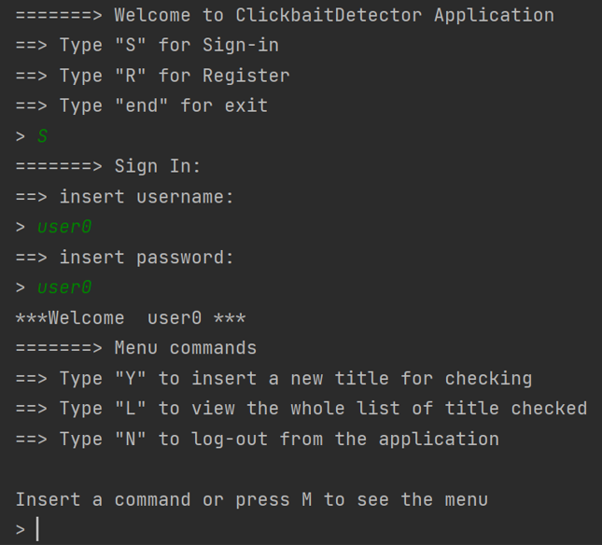
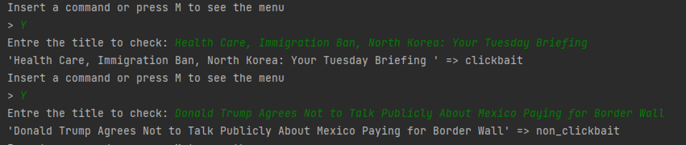
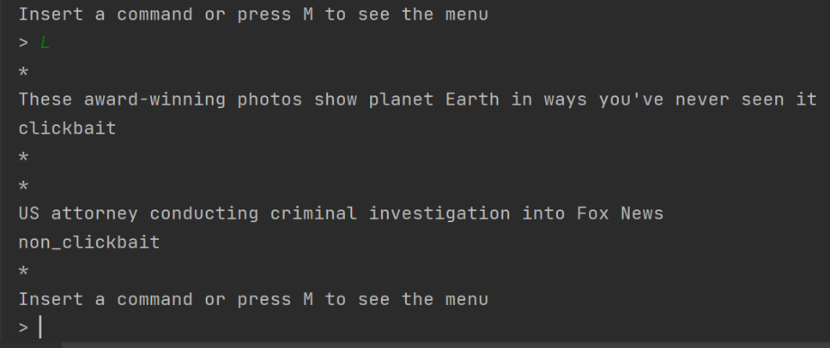
Implementation
Login phase
Text check
Previous texts list

Slide 24

Thanks for your attention!

