Slide 1
Aimotion
Jonathan Lo, Tommaso Peletta

Slide 2

Our team

Slide 3
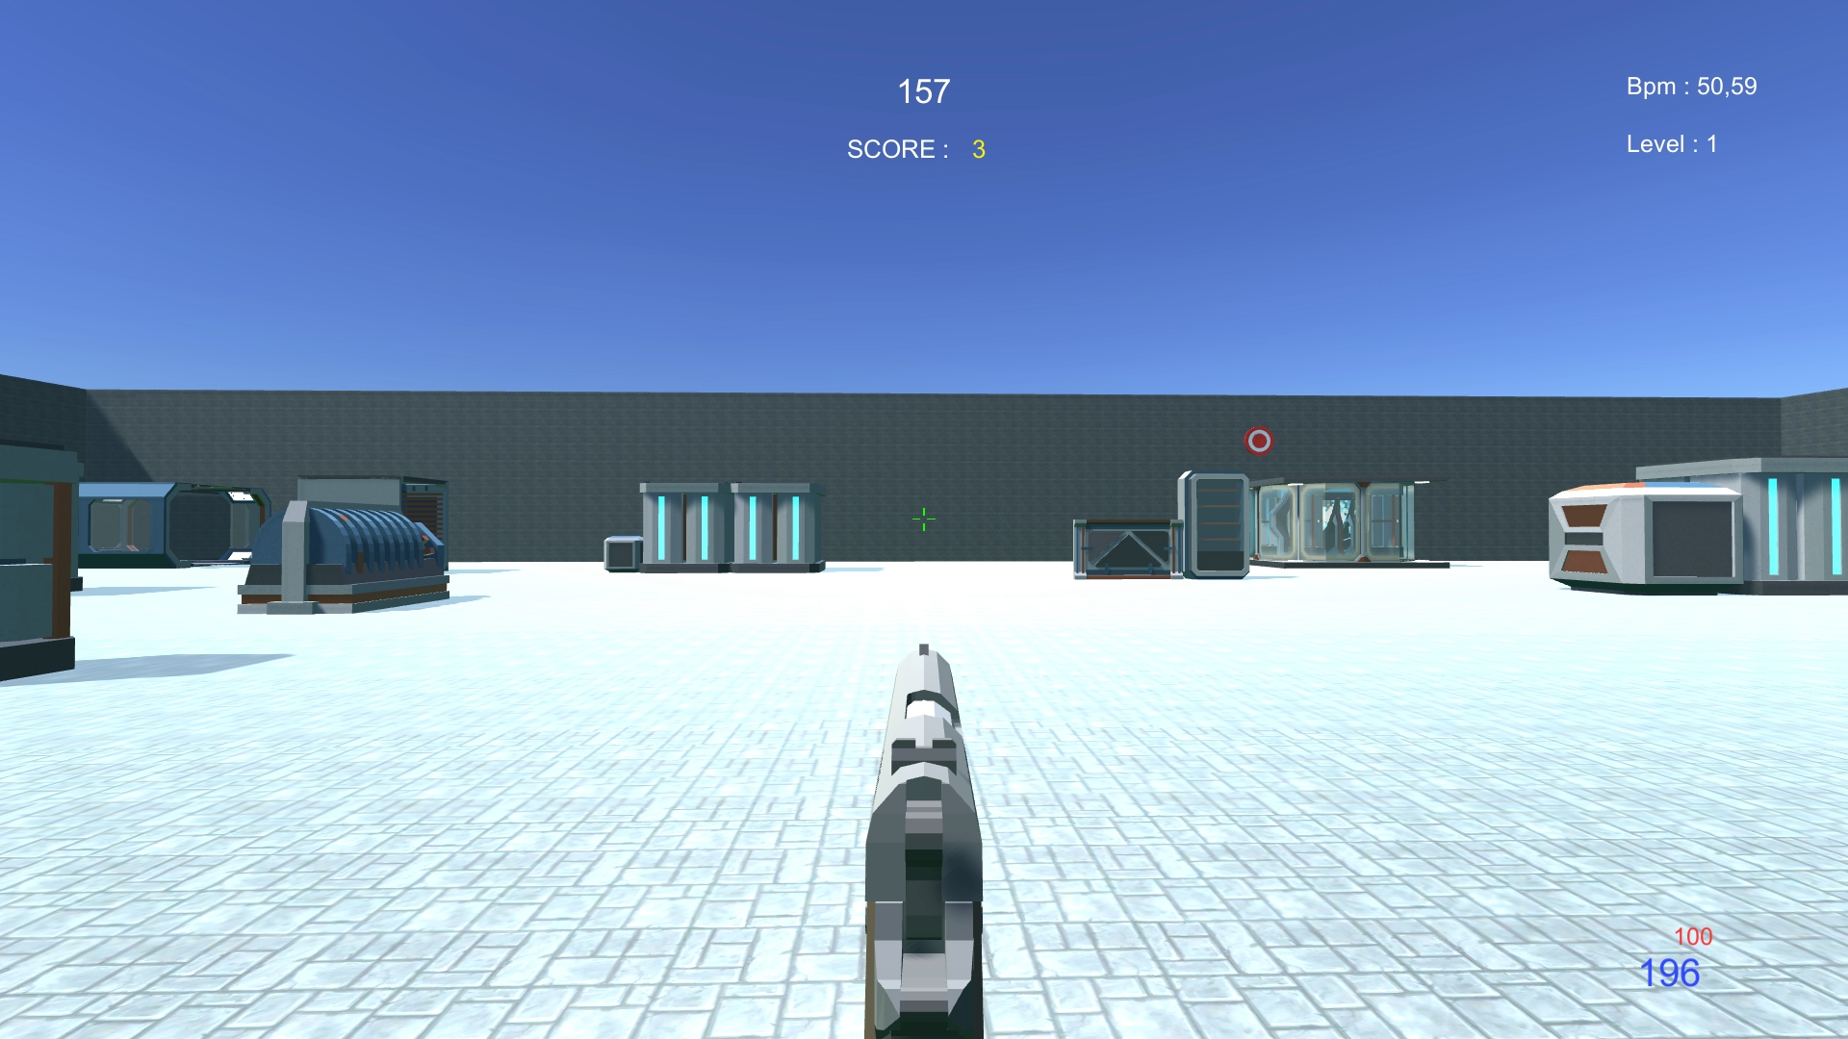
Introduction
FPS Aim trainer
Adaptive environment
Heartbeat input

Slide 4
Our goal
Use the bpm to adapt the difficulty
Keep a reasonable level of stress
Push the players to their limits

Slide 5
Gameplay explanation

Slide 6

Stress
Heart rate mesurament using camera

Slide 7

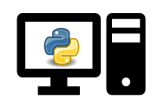

Our system
Send/receive bpm
Read bpm
Display
Retrieve bpm
Play

Slide 8
Levels
5 levels
Different targets’ behaviours
Different background and sound

Slide 9

Levels
Movement speed
Size
Spawn rate
Speed = 6 + level * 2
Scale = 1 – level * 1.3
Spawn = 5 – level * 0.5 [s]

Slide 10



Background and sound
Level 0
Level 4

Slide 11
Level treshold
Bpm refreshed every second
Level adaptation every 10 seconds
Average bpm for the last 5 seconds
Last average bpm < current average bpm x 0.02
Increase level
Otherwise decrease level

Slide 12
User evaluation : before experiment
Initial questionnaire
User manual
Task explanation

Slide 13
User evaluation : during experiment
Observation grid
Time
Errors
Comment

Slide 14
User evaluation : after experiment
Presence questionnaire (PQ)
System Usability Scale (SUS)
Game Experience Questionnaire (GEQ)

Slide 15

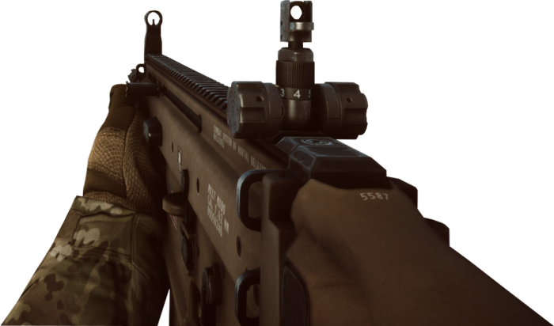

Task repartition
Tommaso Peletta
Target and player
Jonathan Lo
Environment and background

Slide 16
Conclusions
Positive feedback for the moment
Heartbeat measurement accuracy
Accessible to players of all level

Slide 17
Aimotion
Jonathan Lo, Tommaso Peletta

