Slide 1
Aimotion
Jonathan Lo, Tommaso Peletta

Slide 2
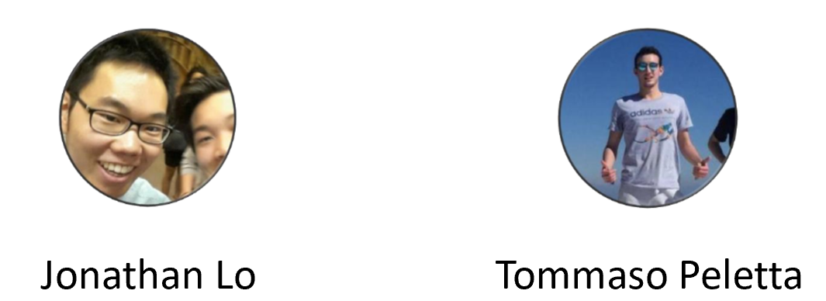
Our team

Slide 3
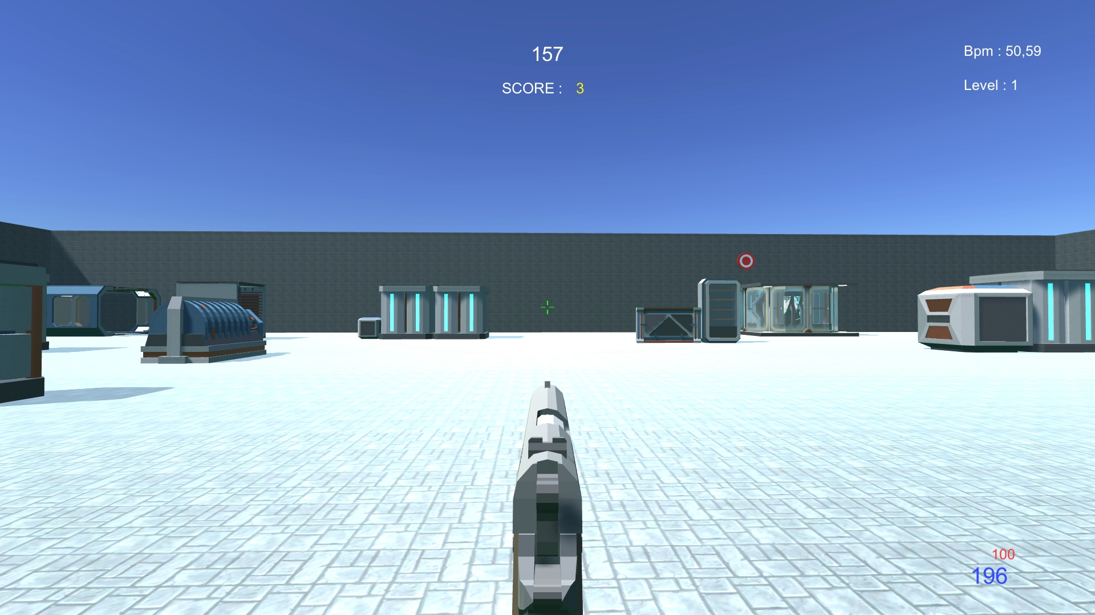
Introduction
FPS Aim trainer
Adaptive environment
Heartbeat input

Slide 4
Our goal
Use the bpm to adapt the difficulty
Keep a reasonable level of stress
Push the players to their limits

Slide 5
Participants
4 hommes 3 femmes
31,57 – 5 entre 20-25 et 2 entre 50-60
Differente experience with fps

Slide 6



User evaluation : before experiment
Initial questionnaire
User manual
Task explanantion

Slide 7



User evaluation : during experiment
Observation grid
Time
Error
Comments

Slide 8
User evaluation : after experiment
Presence questionnaire (PQ)
System Usability Scale (SUS)
Game Experience Questionnaire (GEQ)

Slide 9
Tasks
Execute the game and play one round entirerly
Launch a round and reach at least a score of 20
Shoot at least 5 targets during level 4

Slide 10
Tasks execution results
Everyone succeeded task 1 and 2
71% of participants succeeded task 3
Avarage difficulty level different among participants

Slide 11
PQ results
High variance on aspects concerning movement
High score on «Self evaluation of performance»
Sounds score depends on participant’s audio devices

Slide 12
SUS results
High variance of possible usage frequence
Good score on interface simplicity

Slide 13
GEQ results
High score on «Flow» and «Challange»
High score but High variance on «Competence»
Low score on «Imaginative Immersion», «Tension/Annoyance», «Positive» and «Negative» affects

Slide 14
User test conclusion
Less interesting for unexperimented player
Low score in aesthetic and movement limitation
Some people found the game boring and monotone

Slide 15
Possibility of improvement
Better graphics
Several game modes
Customization and achievement system

Slide 16
General Conclusion
Learn to use Unity and external tools
Learn about multimodale applications
Experience in a practical project

Slide 17
Our Github repository
https://github.com/TommasoPeletta/Aimotion

Slide 18
Aimotion
Jonathan Lo, Tommaso Peletta

