Slide 1
SUPSI · DTI — DIPLOMA THESIS ● bleeding ● ischaemia
CATE Estimation and Use in the MASTER DAPT Study
Can we find, validate, and act on individual treatment effect heterogeneity in a randomized cardiology trial — and if we can't, why not?
CANDIDATE
Tommaso Pioda
SUPERVISOR
Prof. Laura Azzimonti
CO-SUPERVISOR
Gabriele Maroni
CLIENT
EOC
PROGRAMME
Data Science & AI
CATE IN MASTER DAPT · T. PIODA
01 / 19

Slide 2
● THE PROBLEM
One trial, two ways to be wrong
After a coronary stent, dual antiplatelet therapy (DAPT) sits on two axes that pull in opposite directions: longer therapy protects against ischaemic events, shorter therapy protects against bleeding.
MASTER DAPT randomized 4,579 high-bleeding-risk patients between abbreviated and prolonged DAPT, and concluded in favour of abbreviation — non-inferior on ischaemia, superior on bleeding.
↓ bleeding
ABBREVIATED DAPT
↑ ischaemia risk
IF THERAPY IS TOO SHORT
That is an average result. A favourable trial-level effect is compatible with subgroups that gain nothing — or are harmed.
CATE IN MASTER DAPT · T. PIODA
02 / 19

Slide 3
● THE PROBLEM
Why “treat the highest-risk patient” is not an answer
● A risk model ranks patients by P(event | treatment received) — one world, the one we observed.
● A treatment decision needs the difference between two worlds, and only one of them is ever observed for any patient. This is the fundamental problem of causal inference.
● The highest-risk patient may gain the most from shortening therapy, the least, or be harmed by it — risk alone cannot tell the three apart.
Risk does not rank benefit.
CATE IN MASTER DAPT · T. PIODA
03 / 19

Slide 4
● RESEARCH QUESTIONS
Two questions, in order
Q1 — ESTIMATE & VALIDATE
Can the individual treatment effect (CATE) be estimated at all — and, since the true individual effect is never observed, can it be validated?
Q2 — EXPLOIT
If a credible effect exists, can enrolment be concentrated on the patients where it is visible — reaching the same precision with fewer patients?
Five estimator families answer Q1. Five enrolment mechanisms answer Q2 — once Q1's answer changes what Q2 has to test.
CATE IN MASTER DAPT · T. PIODA
04 / 19

Slide 5
● METHOD — ESTIMATION
Five estimator families, chosen to err differently
META-LEARNER
Two outcome models, one per arm; CATE is their difference. Simple, inherits every model error.
CAUSAL FOREST
Estimates heterogeneity directly; double ML removes confounding, honest splits avoid overstating structure.
BAYESIAN CAUSAL FOREST
Regularizes the effect surface separately from the prognostic one — a confounder can't disguise itself as heterogeneity.
IN-CONTEXT MODEL
Pre-trained on synthetic causal problems, not tuned to this dataset — a bias-driven, variance-independent control.
INTERACTION FOREST
One model on [X, T, X·T]; pools information across arms, compresses weak interactions toward zero.
WHY FIVE?
Not “which is best” — a result that survives all five stops being attributable to any single algorithm's quirks.
CATE IN MASTER DAPT · T. PIODA
05 / 19

Slide 6
● METHOD — VALIDATION
Validating what can never be observed
● τ(x) is never observed for any patient — CATE can't be checked prediction-vs-truth like a risk model.
● Instead, validate the ranking: the TOC curve — treat the top q%, gain vs. treating everyone. AUTOC weights the head of the ranking, where the decision happens.
● Evaluation is doubly-robust, plus a group-calibration check between estimated and observed CATE bands.
● Hyperparameters are tuned on the same metric used to validate — the model is trained for exactly the objective that matters.
THE NOISE FLOOR
Even a random CATE produces some ranking dispersion. So: permute the treatment labels, re-run the whole pipeline — that distribution is chance. A result counts only if it clears this floor, not zero.
CATE IN MASTER DAPT · T. PIODA
06 / 19

Slide 7
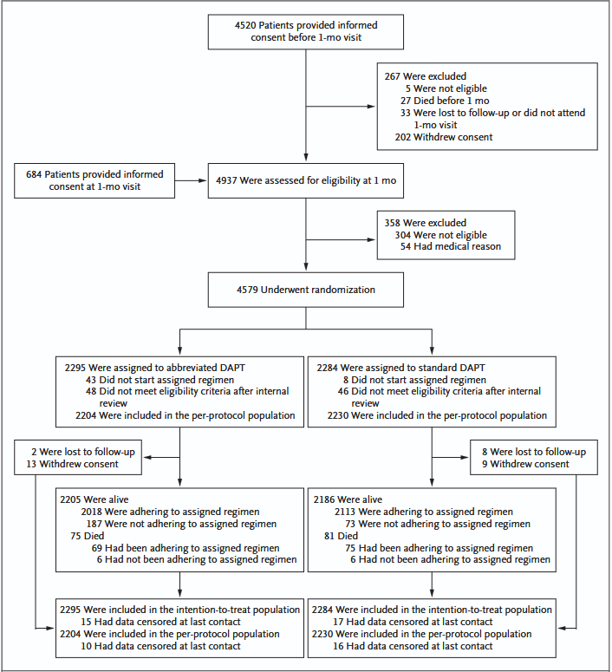
● CASE STUDY — DATA
MASTER DAPT: the cohort
ENDPOINT (335 D)
EVENTS
RATE
Bleeding
506
11.1%
BARC 2/3/5
359
7.8%
Myocardial infarction
109
2.4%
CV death
81
1.8%
Stroke
35
0.8%
4,579 randomized · 63 baseline covariates · T=1 = prolonged, so CATE always reads as the benefit of shortening.
All 4,579 patients were enrolled because they were at high bleeding risk — a design criterion, not a coincidence.
CATE IN MASTER DAPT · T. PIODA
07 / 19

Slide 8
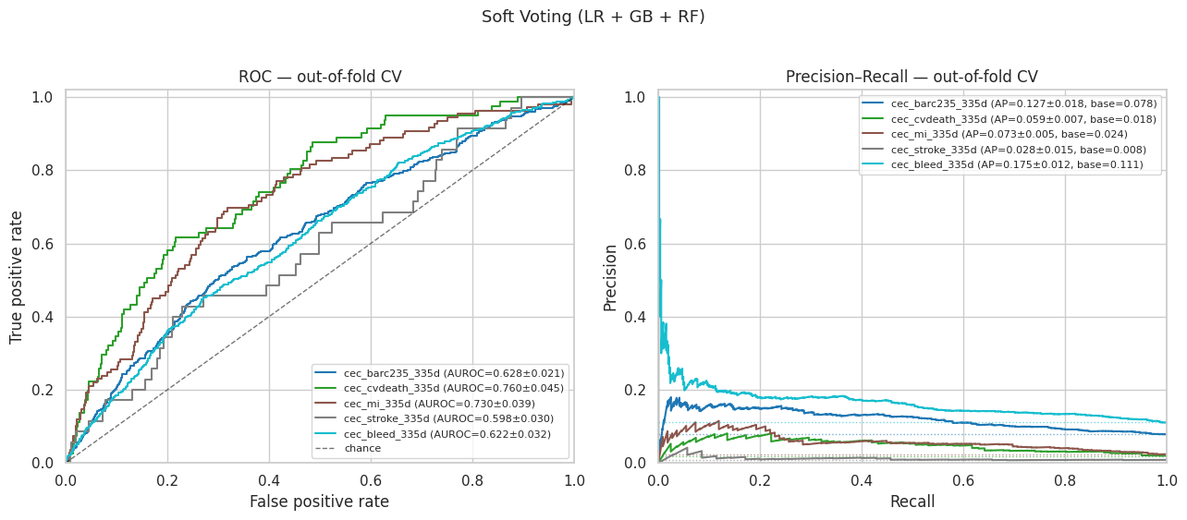
● CASE STUDY — RISK MODELS
A predictive anomaly, left open on purpose
If risk tracked event frequency, bleeding — 506 events — should be the easiest endpoint to predict. It is the hardest.
0.76
0.72
CV DEATH · 81 EV.
MI · 109 EV.
0.62
BLEEDING · 506 EV.
Explained in full only in chapter 7 — the same cause reappears there for the causal result.
Five endpoint-specific risk models, evaluated out-of-fold, threshold-free, over the whole cohort.
CATE IN MASTER DAPT · T. PIODA
08 / 19

Slide 9
● RESULTS — 1 OF 2
The positive control: the tools work
All five estimator families independently recover the trial's average effect.
+0.045 → +0.055
≈ 0
5 / 5
BLEEDING CATE, MEAN (ABBREVIATING HELPS)
ISCHAEMIC CATE, MEAN
ESTIMATOR FAMILIES AGREE
Consistent with the published trial, across five families that make different mistakes. The average effect is not in question.
CATE IN MASTER DAPT · T. PIODA
09 / 19

Slide 10
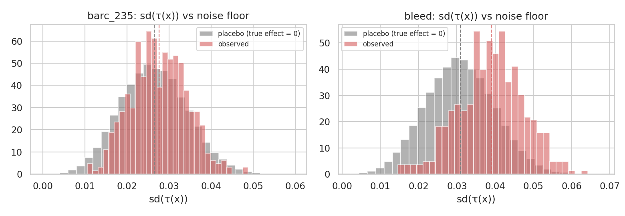
● RESULTS — 2 OF 2
The negative result: no heterogeneity above chance
● Individual CATE dispersion sits on the permutation noise floor, not above it.
● AUTOC is compatible with zero; credible bands cover the ATE across the whole ranking.
● Holds for all five independent estimator families.
Observed sd(τ(x)) (red) overlapping the placebo floor (grey) — bleeding and BARC 2/3/5.
Not “I found nothing” — “I searched with tools proven to work, and there is nothing.”
CATE IN MASTER DAPT · T. PIODA
10 / 19

Slide 11
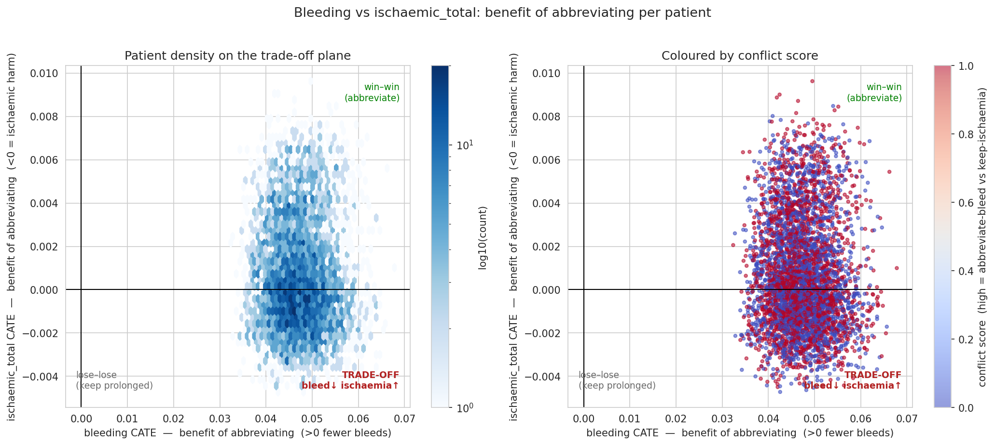
● RESULTS — THE TRADE-OFF PLANE
Where is the dilemma patient?
A personalized rule only pays off if a quadrant of real dilemma cases exists — large gain on one axis, real harm on the other.
Instead: a compact cloud around the trial's average effect. No quadrant to split on.
Every patient placed by bleeding-benefit (x) and ischaemic-benefit (y) of abbreviating.
CATE IN MASTER DAPT · T. PIODA
11 / 19

Slide 12
● RESULTS — DECISION VALUE
Even the weaker question gives the same answer
Not “does the model rank well” — does following the ranking produce a measurable clinical gain, evaluated with cross-fitted AIPW policy value.
BEST RULE VS. EVERYONE
No rule beats “abbreviate for everyone.” Net-neutral.
7 PRE-SPECIFIED SUBGROUPS
Bleeding risk, ACS, diabetes, renal function, age, anaemia, OAC — none exclude zero.
TRADE-OFF FRONTIER
Risk-magnification frontier is empty at every bleeding/ischaemic weight.
CATE IN MASTER DAPT · T. PIODA
12 / 19

Slide 13
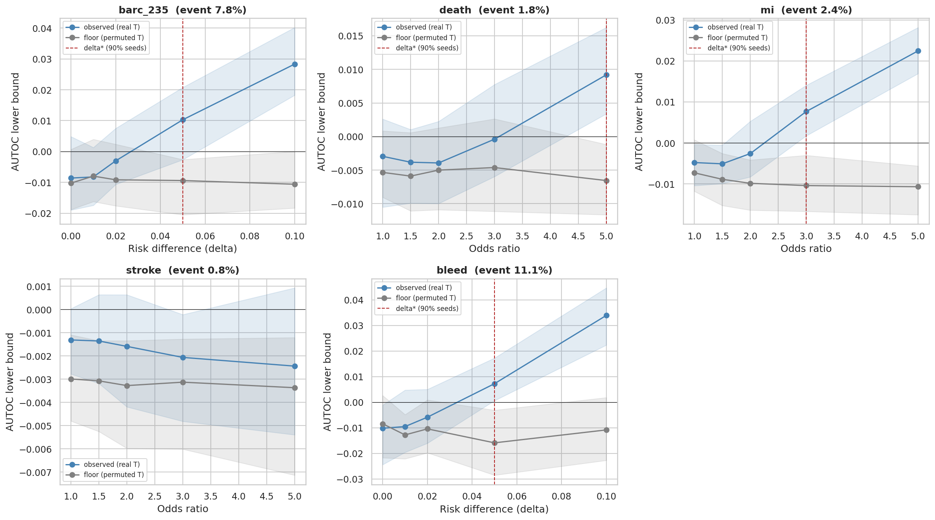
● RESULTS — HOW SURE ARE WE?
The minimum detectable δ
ENDPOINT
Δ*
Bleeding
0.05 risk-diff
BARC 2/3/5
0.05 risk-diff
MI
OR 3.0
CV death
OR 5.0
On bleeding, δ* ≈ the entire average effect. It was not found — that is not the same claim as it does not exist.
Synthetic heterogeneity of known size δ, injected and re-estimated; compared against the floor recomputed at the same δ.
CATE IN MASTER DAPT · T. PIODA
13 / 19

Slide 14
● WHY — THREE CONVERGING EXPLANATIONS
Not just “nothing found” — a mechanism
01 · CANCELLATION
The aggregate ischaemic score sums MI and stroke, which move in opposite directions — the sum hides both.
02 · RANGE RESTRICTION
Enrolling only high-bleeding-risk patients compresses bleeding-risk variance before any model sees a datum — the same cause behind the ch.5 anomaly.
03 · RARE EVENTS
MI, death, stroke: 35–109 events. Three endpoints of five are not measurable here, not “flat.”
The same feature of the trial's design — range restriction on bleeding risk — explains both the ch.5 predictive anomaly and the ch.6 absence of heterogeneity.
CATE IN MASTER DAPT · T. PIODA
14 / 19

Slide 15
● TESTING IT END-TO-END
Guided enrolment: an exploitability test
● 7 acquisition mechanisms — offline ceiling, pairwise duel, UCB1 / Thompson bandits, whole-pool ranking, ±45° geometry — over 100 paired cohorts.
● Mechanisms do move the enrolled cohort on the estimated-CATE plane, stably and distinguishably from random.
● On observed outcomes, the shift is ≈ zero — even for the adaptive bandits.
Ρ ≈ 0.91
Win-win score correlates with the bleeding axis alone — confirms the cancellation.
The adaptive cohort still loses to a plain randomized trial at equal enrolled n.
The machinery selects well on a signal that does not exist.
CATE IN MASTER DAPT · T. PIODA
15 / 19

Slide 16
● CONCLUSIONS — WHAT HOLDS
Six claims, each independently supported
● The trial's average effect is confirmed by five independent estimators.
● No exploitable heterogeneity — validated against the noise floor, not against zero.
● The same conclusion arrives a second time, from ch.8's observed events, without touching a single estimated CATE.
● The limit is in the cohort, not the tools — shown twice, by the positive control and by δ*.
● The mechanism is known: HBR range restriction, which also explains the ch.5 predictive anomaly.
● Two reusable findings beyond the case study: selecting ≠ allocating; linear scores collapse onto the higher-variance axis.
CATE IN MASTER DAPT · T. PIODA
16 / 19

Slide 17
● CONCLUSIONS — LIMITS
What doesn't hold, said before it's asked
● δ* = 0.05 is large — these data exclude heterogeneity the size of the whole ATE, not any heterogeneity.
● 3 of 5 endpoints (35–109 events) are not assessable at all — “not measurable,” not “absent.”
● Stroke sensitivity analysis is not yet interpretable.
● Subgroup analyses are in-sample and descriptive; no external cohort; multiplicity declared but not formally corrected.
CATE IN MASTER DAPT · T. PIODA
17 / 19

Slide 18
● WHERE TO ASK THE SAME QUESTION NEXT
The infrastructure is ready — the cohort wasn't
● A cohort not selected purely on bleeding risk — where the bleeding axis keeps its full variance.
● Longer follow-up, or a higher-ischaemic-risk population — 35 stroke events measure nothing, whatever the estimator.
● A trial sized on the interaction, not the average effect — δ* is exactly the tool to pre-register that target.
The guided-enrolment machinery of ch.8 is built, measured, and already equipped with its two known failure modes — ready for a cohort where heterogeneity actually exists.
CATE IN MASTER DAPT · T. PIODA
18 / 19

Slide 19
● THANK YOU
Questions
Tommaso Pioda · CATE Estimation and Use in the MASTER DAPT Study
Supervisor: Prof. Laura Azzimonti — Co-supervisor: Gabriele Maroni
CATE IN MASTER DAPT · T. PIODA
19 / 19

