Slide 1

答辩
王天成
QG STUDIO
主讲人：魏晓

Slide 2
1
Apriori算法
CONTENTS
2
k-means算法
3
knn算法

Slide 3

PART 1
QG STUDIO

Slide 4
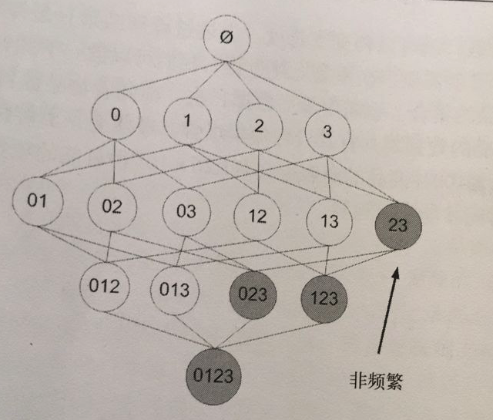
Delete a linked list

Slide 5

PART 2
QG STUDIO

Slide 6
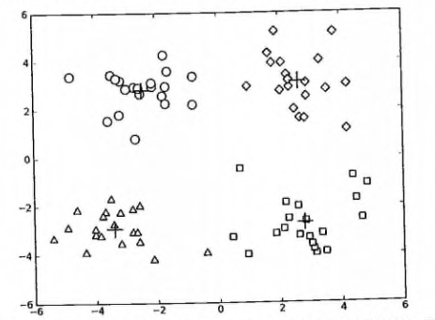
Delete a linked list

Slide 7
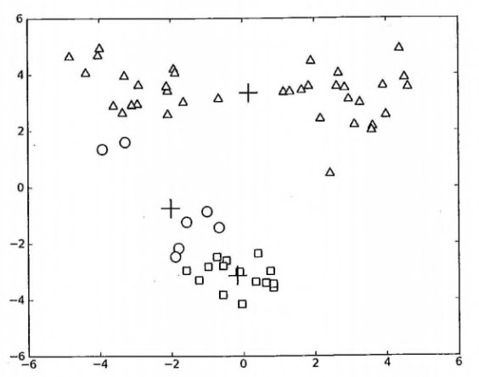
Delete a linked list

Slide 8

PART 3
QG STUDIO

Slide 9
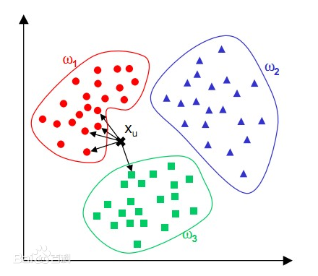
Delete a linked list

Slide 10
Thanks
QG STUDIO
No Quest , No Gain

