Slide 1
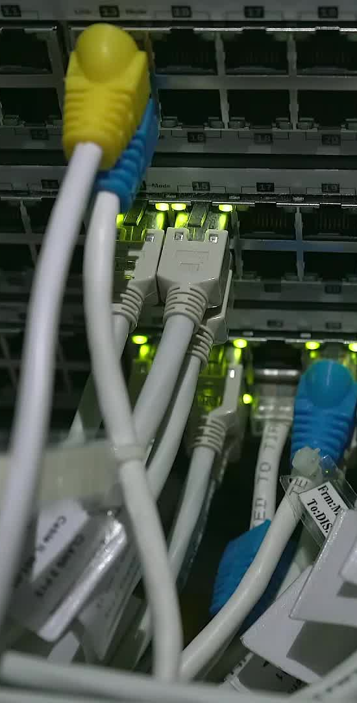
Telecom Churn Prediction
Final Project Report

Slide 2
Introduction
Customer churn is a critical issue in the telecom industry. This project focuses on predicting customer churn using machine learning models, which can help in taking preemptive measures to retain customers.

Slide 3

Problem Description
The goal is to develop a predictive model to identify customers likely to churn. The data includes customer demographics, account information, and usage patterns. The problem is a binary classification task where the target variable is churn (1) or no churn (0).

Slide 4
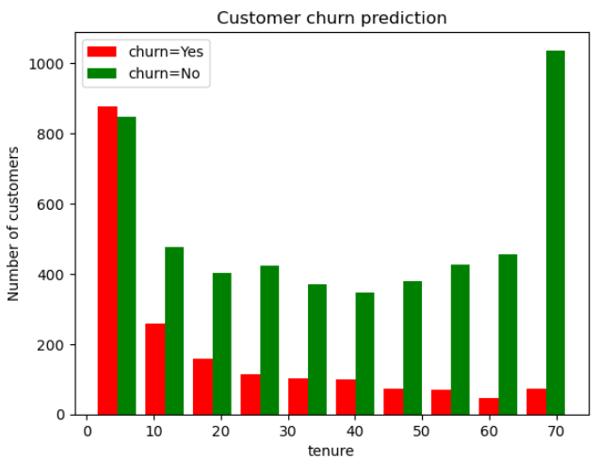
Data Exploration
A graph showing customer churn as relate to tenure. The longer the customer stays with the network the more they are less likely to churn.

Slide 5
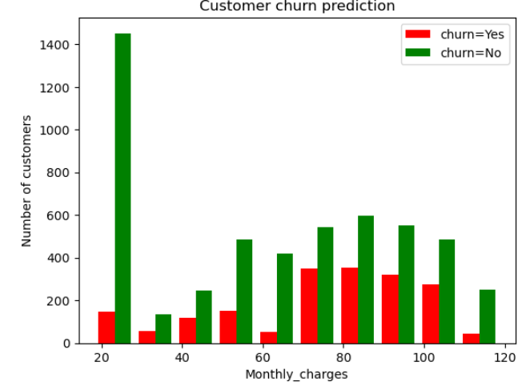
Churn vs Monthly Charges
A graph showing customer churn as it relates to monthly charges. The lower the monthly charge of the customer the less likely for that customer to churn.

Slide 6
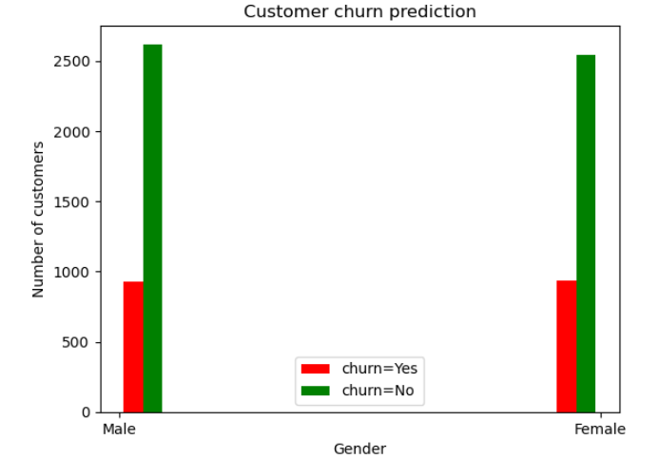
Churn vs Gender
A graph showing customer churn vs Gender. There is a slight difference between Female and male in their likely hood to churn but not a lot.

Slide 7
Pearson Correlation
A Pearson correlation was carried out between numeric key features.
Tenure and Total charges have a strong positive correlation(0.83)
Monthly charges and Total charges have a moderately strong positive correlation(0.65)
Tenure and Monthly charges have a weak positive correlation(0.25)

Slide 8
Chi square test
For the categorical features in dataset. Chi – square test was used to analyze the relationship between them.

Slide 9

Data Preprocessing
Data cleaning, handling missing values, encoding categorical variables, and normalizing the dataset were key preprocessing steps. These steps ensured that the data was suitable for machine learning model training.

Slide 10

Model Development
Three models were developed: Logistic Regression, Random Forest, and Support Vector Classifier (SVC). Each model was trained on the preprocessed dataset and tuned for optimal performance.

Slide 11
Logistic Regression
A baseline linear model, Logistic Regression, was used. It achieved an accuracy of 79%, indicating a reasonable predictive power for identifying customer churn.

Slide 12
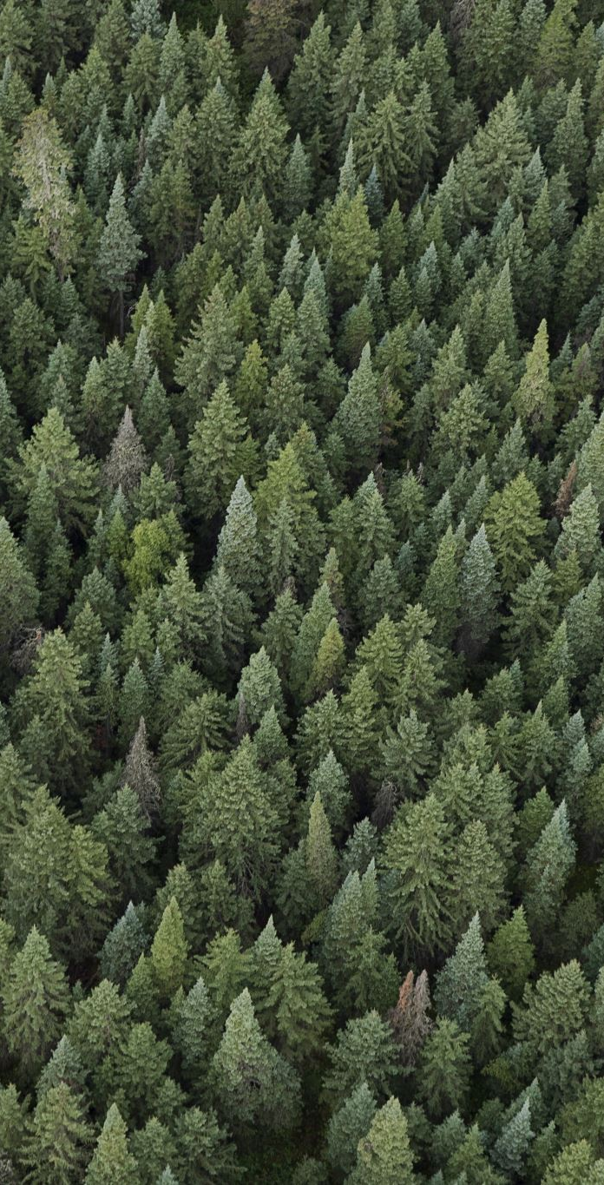
Random Forest
The Random Forest model, an ensemble of decision trees, was the best performer with an accuracy of 80%. It provided insights into the most important features contributing to customer churn.

Slide 13
Support Vector Classifier (SVC)
The SVC model, utilizing a non-linear kernel, achieved an accuracy of 79%. This model showed that the problem could also be effectively addressed using non-linear methods.

Slide 14
Model Evaluation
The models were evaluated based on accuracy. Random Forest slightly outperformed the other models, offering a good balance of accuracy and interpretability.

Slide 15

Findings
Random Forest was identified as the best model, with key features such as tenure, monthly charges, and contract type being the most influential in predicting churn. The overall model performance suggests a reliable predictive capacity for customer churn.

Slide 16
Recommendations
1. Use the Random Forest model to identify high-risk customers and implement targeted retention strategies.
2. Improve customer experience in areas highlighted by the model, such as reducing churn among customers with high monthly charges.
3. Explore further research opportunities, including additional data collection and advanced modeling techniques.

Slide 17
Conclusion
This project demonstrated the effectiveness of machine learning models in predicting telecom customer churn. The Random Forest model provided the best balance of performance and interpretability, offering actionable insights for reducing churn rates.

