Slide 1
Building a Personalized Recommendation System for E-Commerce
Using Collaborative Filtering and Matrix Factorization (SVD)

Slide 2
Problem Overview
The project aims to build a recommendation system to provide personalized product recommendations for users in an e-commerce platform, increasing user engagement, and conversion rates.

Slide 3
Data Collection
Datasets Used: Kaggle datasets
1. category_tree.csv
2. events.csv
3. item_properties_part1.csv
4. item_properties_part2.csv
Data contains information about events (views, add to cart, transactions), items, categories, and user interactions.

Slide 4
Data Preprocessing
Steps Taken:
- Merged data from multiple sources (events, properties, categories)
- Handled missing values (NaNs) and removed duplicates
- Converted timestamps to readable datetime formats
- Dropped columns with inconsistent data.

Slide 5
Exploratory Data Analysis (EDA)
Analyzed event distribution (views, add to cart, transactions).
Top items by views, transactions, and add-to-cart actions.
Most active users and temporal analysis of events over time.

Slide 6
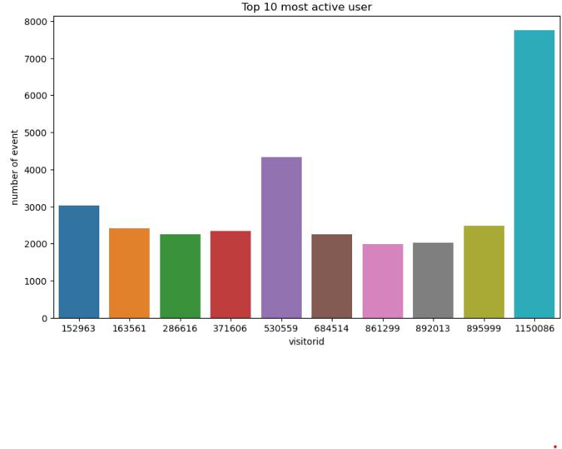
Top 10 most active user

Slide 7
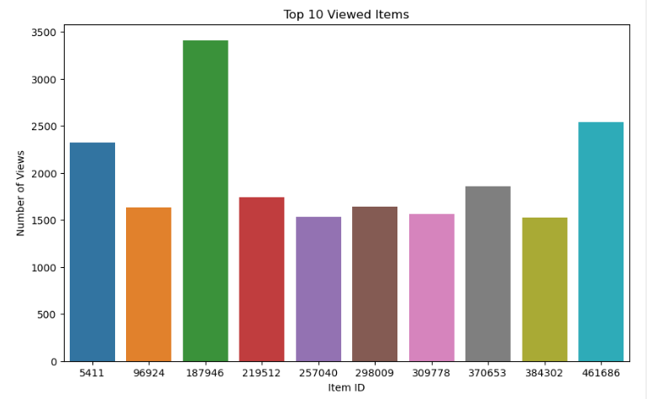
Top 10 viewed items

Slide 8
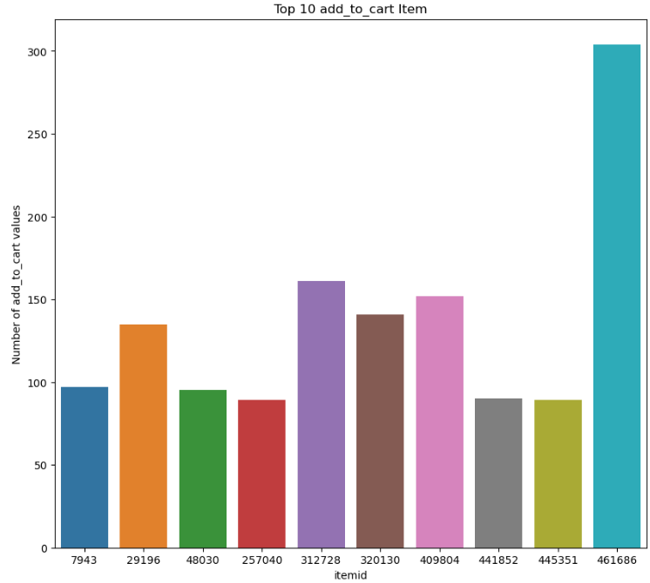
Top 10 add to cart item

Slide 9
Feature Engineering - User Features
Created user-based features:
- Item count: Number of items a user interacted with
- Property count: Number of unique item properties
- Category count: Number of unique categories interacted with
- Time-based features: Time on platform, time between actions.

Slide 10
Feature Engineering - Item Features
Created item-based features:
- User count: Number of users who interacted with the item
- Event counts: Count of views, add to cart, and transactions for each item
- Conversion rate: Transactions divided by add to cart actions.

Slide 11
Train-Test Split
The data was split into training and test sets.
A random sample of 100,000 interactions was taken from the dataset.
20% of the data was used for testing, and 80% for training.

Slide 12
Model Selection - Collaborative Filtering
We employed matrix factorization-based collaborative filtering using Singular Value Decomposition (SVD).
The model attempts to factorize the user-item interaction matrix into lower-dimensional matrices representing latent factors.

Slide 13
Hyperparameter Tuning
GridSearchCV was used to tune hyperparameters for the SVD model.
Parameters tuned include:
- n_factors: Number of latent factors
- n_epochs: Number of epochs
- lr_all: Learning rate
- reg_all: Regularization term.

Slide 14
Best Hyperparameters
The best hyperparameters obtained from GridSearchCV were:
- n_factors: 10
- n_epochs: 20
- lr_all: 0.002
- reg_all: 0.1

Slide 15
Model Evaluation Metrics
The performance of the SVD model on the test set:
- Mean Absolute Error (MAE): 0.0206
- Mean Squared Error (MSE): 0.0319
- Root Mean Squared Error (RMSE): 0.1787

Slide 16
Model Evaluation - Comparison
The RMSE of 0.1787 indicates strong predictive performance.
The low MAE suggests accurate prediction of interaction counts between users and items.

Slide 17
Conclusion
successfully built a recommendation system using collaborative filtering with SVD.
The model performed well with low error metrics and can be further improved by incorporating real-time interactions.

Slide 18
Future Work
1. Incorporating content-based filtering to handle cold-start problems.
2. Improving recommendations with deep learning-based models.
3. Real-time recommendation systems to capture dynamic user behavior.

Slide 19
Business Impact
1. The recommendation system can improve user engagement and satisfaction.
2. Personalized recommendations can increase conversion rates and revenue.
3. Better targeting of user preferences and trends over time.

