Slide 1

Interview test Case study: update the new version game
Personal Project By
Do Tan Tai

Slide 2
I. Introduction
Case study: Analyzing the Impact on Game Update New Version
Situations:
Version 1.5.2: It was discovered that the instructional section does not align with the user experience.
Version 1.6.0: The in-game instructions have been improved with the goal of enhancing the user experience.
Trial release date: 28-10-2023 to 10-11-2023
User allocation: 50% of new users continue to play version 1.5.2, and the remaining 50% play version 1.6.0.
Aims:
How can we know if the improvement of Tutorial in-game version 1.6.0 has impacted the User Experience better than in-game version 1.5.2?
Can we roll out 100% game version 1.6.0 to all users or not?
Based on the data and your experience with the game, do you have any ideas to improve our User Experience?

Slide 3
Data Description
Drop unnecessary columns: day0 and “Unnamed: 0”.
Day_diff = Day_diff + 1: Calculate from the start date to the present and count the first day as 1 day.
Filter outliers of columns such as: quantity and level.
Data size: 584,634 rows and 10 columns.
Event_name: records user activities in the game | day_time: records the time when the event_name was recorded
version: represents the version of the app that the user is using | User: identifies each user
mode_game: Describes the mode of the game (e.g., session start or user engagement) | day_diff: users' playing time (day_time - day0 + 1 day)
win: Records whether the user won (1) or lost (0) in the game_end event | level: Indicates the level of event_name in the game
reason_to_die: records the reason why the user lost in the game_end event | quantity: records properties of event_names (e.g., time duration in seconds, steps completed in the tutorial)

Slide 4
II. User Experience in each version

Slide 5
1. Metrics to measure user experience
Metrics:
User Retention Rate: Percentage of users returning to play the game after a certain period of time.
Tutorial Completion Rate: Percentage of users who complete the tutorial.
Average Time Spent on Game: Average time users spend engaging in-game.
Expected results:
User retention rate: Expected increase in version 1.6.0 if tutorials improve user experience.
Tutorial completion rate: Expected to be higher in version 1.6.0 if tutorials are easier to understand and more engaging.
Average time spent on Game: Expected to increase if new tutorials are clearer and more effective.

Slide 6
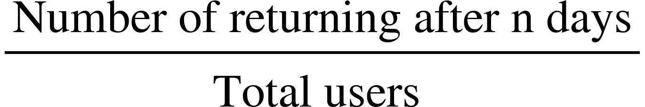
2. User retention rate
Retention rate1.5.2 – T2 = 27%
Retention rate version – Day n =
Retention rate1.6.0 – T2 = 29%
Retention rate1.5.2 – T8 = 2.61%
Day_diff |  | 1 | 2 | 3 | 4 | 5 | 6 | 7 | 8
1.5.2 | Users | 6663 | 1780 | 888 | 511 | 379 | 265 | 193 | 174
1.6.0 | Users | 6901 | 1980 | 1031 | 707 | 511 | 412 | 319 | 271
Retention rate1.6.0 – T8 = 3.93%
Retention rate of version 1.6.0 was higher than version 1.5.2 day by day namely:
After 2 days of participating, the retention player rate of new version is about 29% while the old version is only about 27%.
On day 8, the retention rate in the new and old versions is 3.93% and 2.61% respectively.

Slide 7
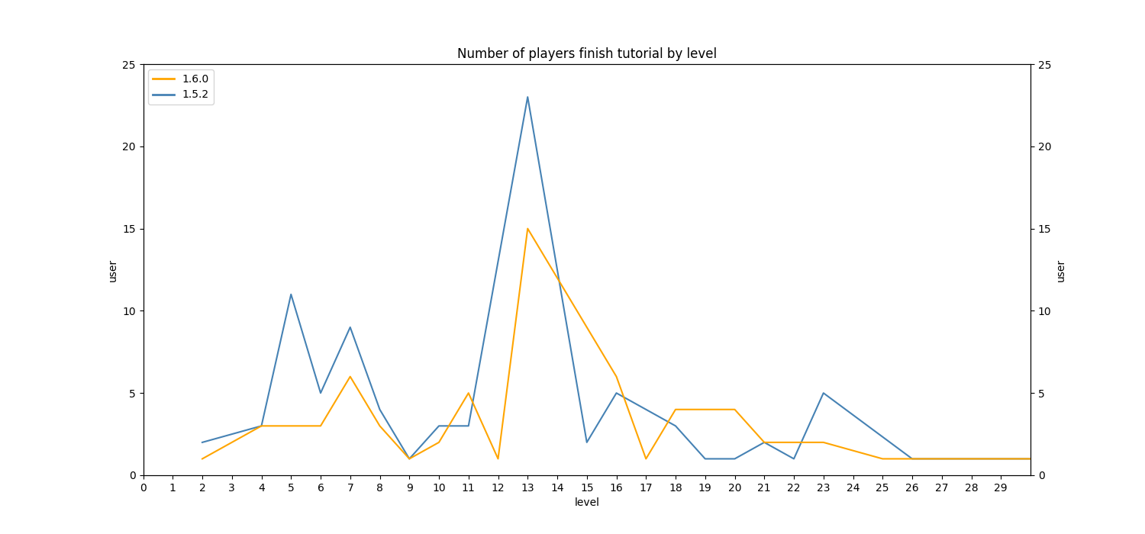
3. TUTORIAL completion rate
Tutorial Completion Rate
We will skip Level 1 to maintain objectivity and will focus on subsequent levels to analyze, using unique visitors to measure the number of players completing each level.
Across levels, the number of unique players completing tutorials in version 1.5.2 is higher than in version 1.6.0 at early levels such as levels 5, 7, 13, and 23.
Especially, the players in the new version 1.6.0 (7.11%) had a percentage of tutorial finish lower than the old version 1.5.2 (12.15%).

Slide 8
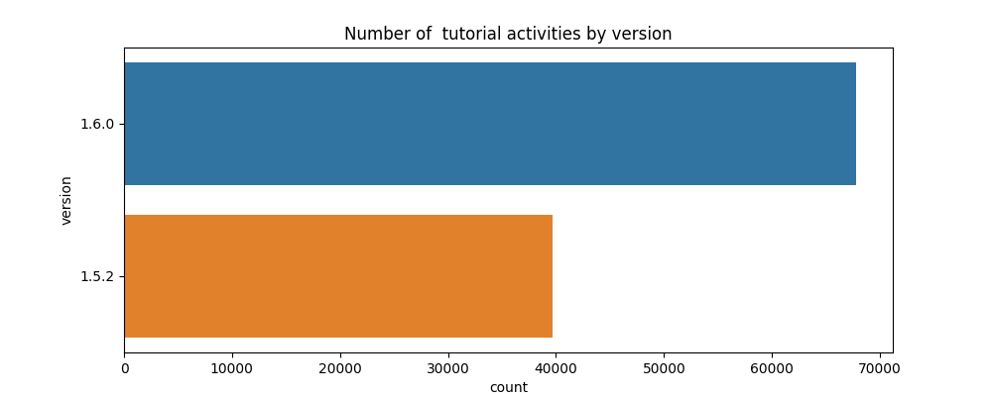
Tutorial Activities
The total number of tutorial activities in version 1.6.0 is double times higher than in version 1.5.2.
The number of people completing the steps has increased in the later version and the number of people finishing the tutorial is also higher than the former version.
The number of people skipping the tutorial increased in later versions 1.6.0. The reason is that the number of tutorial steps has doubled, causing players to want to skip through instructions. As a result, the completion tutorial rate decreases in version 1.6.0.
Quantity | Number of Steps
 | 1.5.2 | 1.6.0
-2 | 6453 | 6663
-1 | 6853 | 7081
0 | 353 | 370
1 | 6593 | 6806
2 | 6516 | 6740
3 | 6486 | 6717
4 | 6462 | 6701
5 |  | 6693
6 |  | 6683
7 |  | 6675
8 |  | 6665
8

Slide 9
4. Average Time Spent on Game
Roll-out Period: 28-10-2023 to 10-11-2023
Average number of logins per player
Average user engagement per player
Average playing time per player
The average number of logins per player during the upgrade period in version 1.6.0 is 2.48 times higher than 2.26 times in version 1.5.2
The average number of user engagement per player during the upgrade period in version 1.6.0 is 6.85 times higher than 6.27 times in version 1.5.2.
The average playing time per player during the upgrade period in version 1.6.0 is 2.08 days higher than 1.90 days in version 1.5.2.

Slide 10
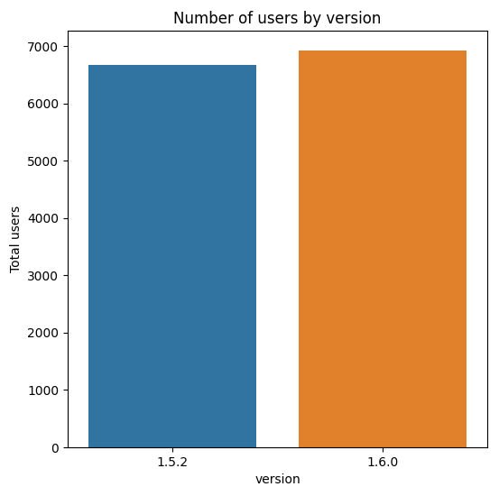
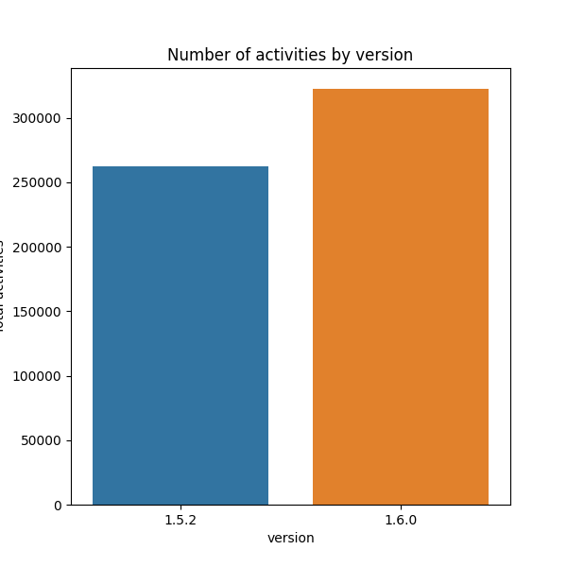
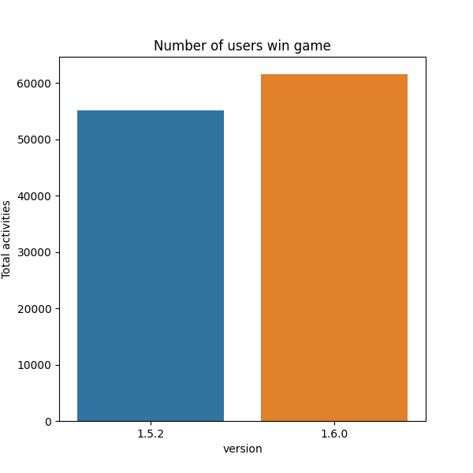
5. Activities of players
The number of players participating in each version is quite balanced
The number of activities on version 1.6.0 is more positive than 1.5.2
The number of winners in the new version is more than the old version

Slide 11
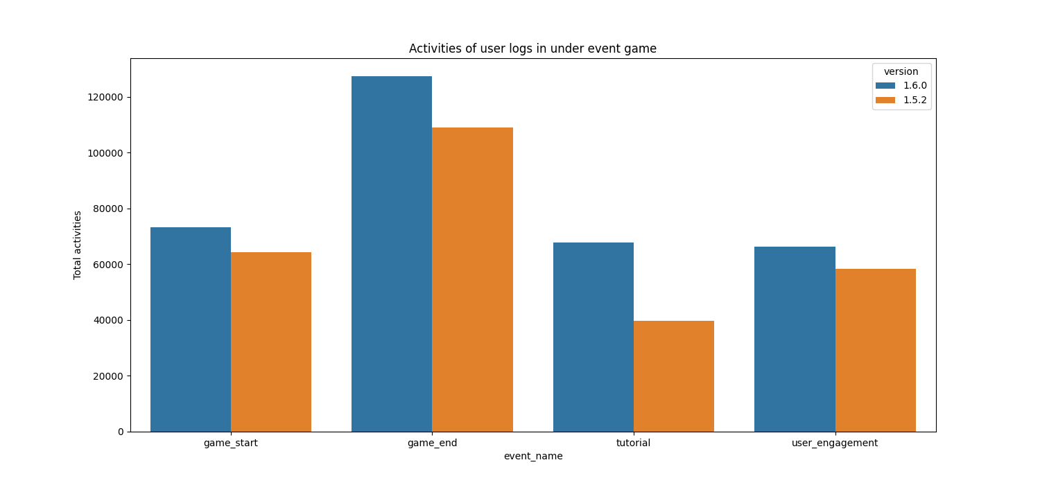
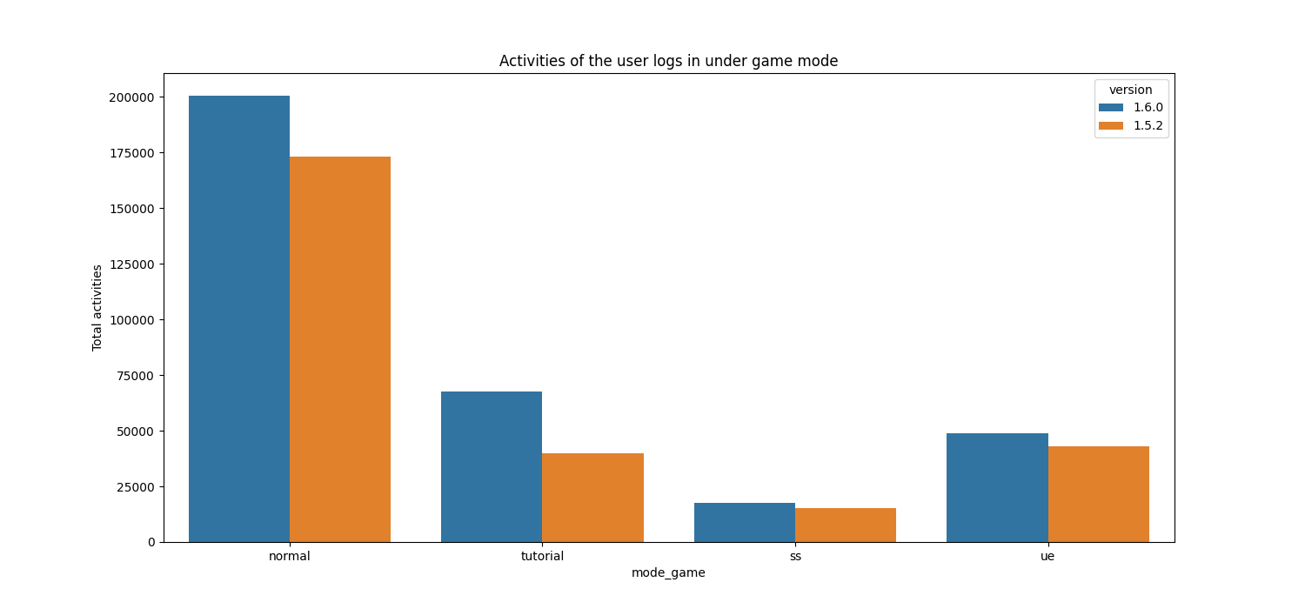
6. Event and mode game
During game events, version 1.6.0 had more active users than version 1.5.2.
Especially, the end-of-game and tutorial events show that the number of people interacting with version 1.6.0 is significantly higher than other events.
During game mode, version 1.6.0 had more active users than version 1.5.2.
Additionally, the normal and tutorial mode illustrates that the number of people interacting with the new version is higher than other events.

Slide 12
7. conclusion
The improvement of tutorial in-game version 1.6.0 has impacted the User Experience better than in-game version 1.5.2 though metrics:
User retention rate: the ratio increases in version 1.6.0.
Tutorial completion rate: In version 1.6.0, the completion rate is lower than in version 1.5.2 because the tutorials are twice as long. (I will propose solutions in the next chapter)
Average time spent on Game: During the upgrade period in version 1.6.0, there is an increase in the average number of logins per player, the average level of user engagement per player, and the average playing time per player compared to version 1.5.2.
Activities of players: The number of activities event and mode game on the new version is more than old version.
Under the current circumstances, where features remain unchanged except for the upgraded tutorial.
We should upgrade 100% version 1.6.0 to all users.

Slide 13
We should roll out 100% game version 1.6.0

Slide 14

iII. Improve user experience
Now, based on experience, knowledge of games and insight data. I will suggest some solutions to improve user experience!
Notes:
Để những thứ negative để improve mục này

Slide 15
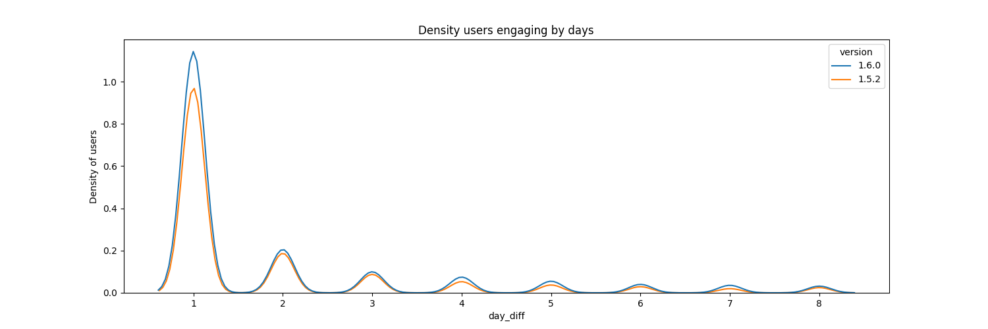
1. churn rate
Pay attention: the day 2 and day 4 which is a sensitive period.
From day 1 to day 2, this chart illustrated quite a large number of players leaving. However, the number of players leaving starts to decrease on day 4.
In general, each version has a large number of users leaving, especially in the first 4 days. As a result, there needs to be attractive gifts to retain players and easy-to-understand tutorials for them to form a gaming habit.

Slide 16
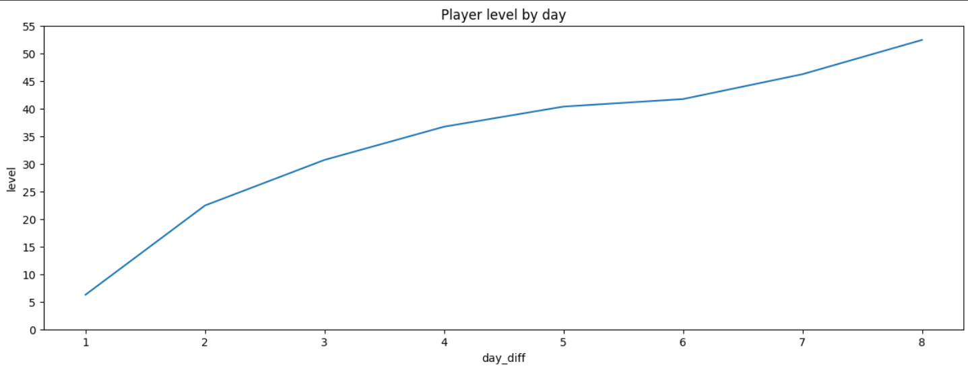
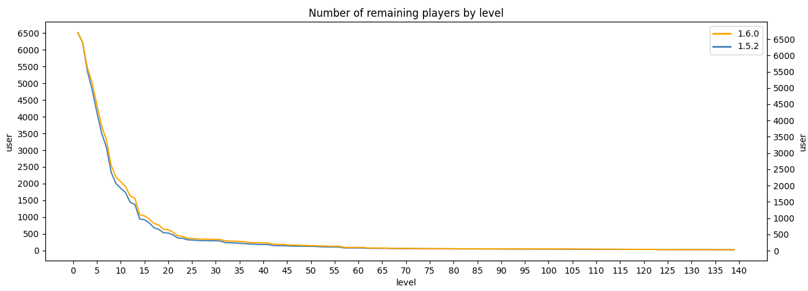
Solutions
We will concentrate on players' days 2 and 4 based on the Density Users chart on page 15, levels 25 and 40 respectively.
The charts remaining players expose that the number of users leaving starts to decrease at level 25 and stable users at level 40.
On day 1, from levels 1 to 25, introduce side quests and mini-challenges to enhance enjoyment and rewards.
Additionally, development engaging stories and characters will motivate players to explore further.
We need to convert new players in day 1 into loyal players.
Level<40
Level<25

Slide 17
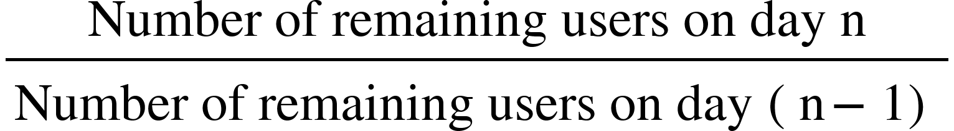
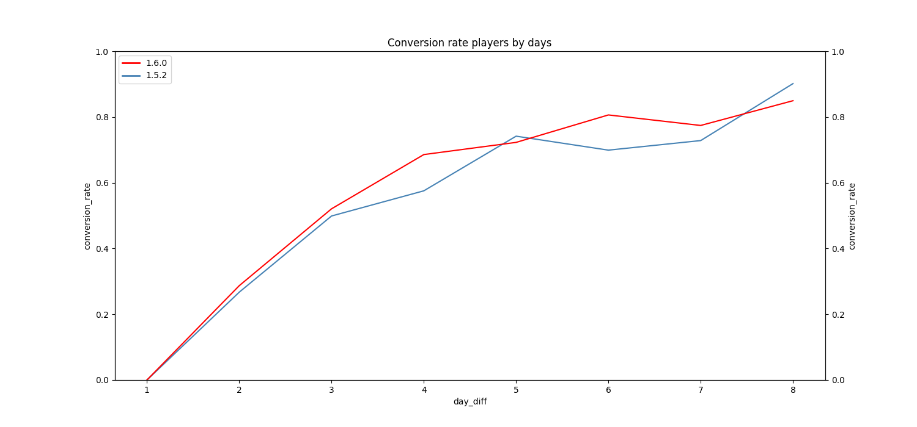
Conversion rate on day n =
In general, the longer a player stays, the higher the conversion rate.
The chart illustrate that the conversion rate skyrocket from day 1 to day 4.
On day 4, we will focus on providing special gifts to loyal players to encourage them to reach level 40, which can help increase conversion rate loyal players in previous page.

Slide 18
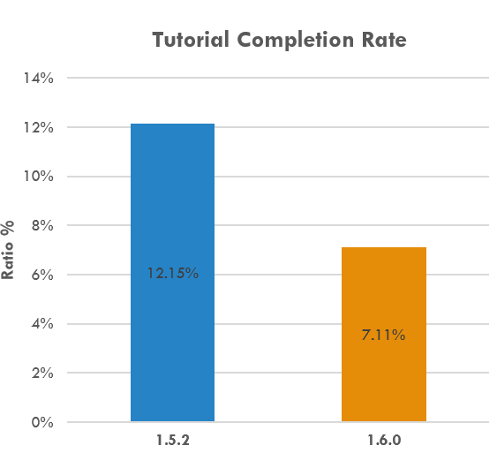
2. Win rate
Average time overcome each level
Level | 1.5.2 | 1.6.0
1 | 21.31098 | 22.73934
2 | 14.46766 | 14.53366
3 | 12.40173 | 12.18363
4 | 16.62484 | 16.8247
…. | …. | ….
9 | 18.5233 | 19.40836
10 | 23.31515 | 24.39942
11 | 46.96337 | 48.29484
12 | 46.13084 | 48.04991
13 | 89.15191 | 92.40699
14 | 26.29167 | 28.12247
15 | 60.25504 | 61.75915
The average time to complete each level in version 1.6.0 is 38.24 seconds, longer than the 35.21 seconds in version 1.5.2.
The win ratio of old version at 53.51% is higher than new version at 51.52%. This mean loss rate in new version high, leading to players need to spend more time to pass assignments.
Insight data from the tutorial event shows that players in version 1.6.0 had a lower completion rate (7.11%) compared to version 1.5.2 (12.15%). This has resulted in a lower win ratio and increased average time to complete assignments in the new version.

Slide 19
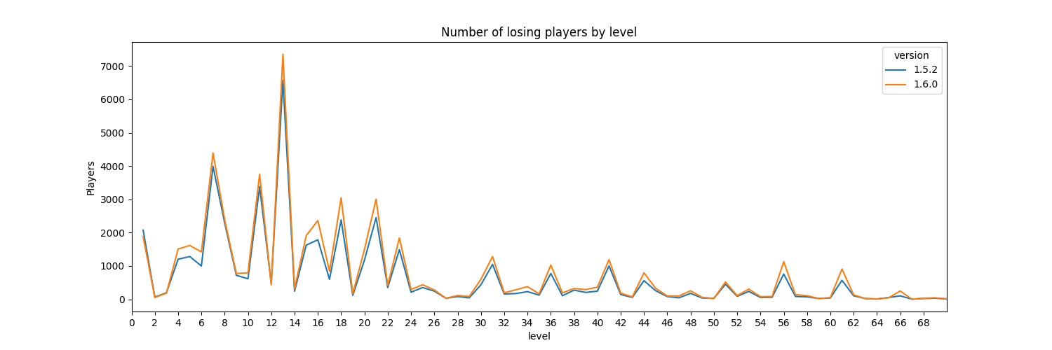
Solutions
Instead of upgrading the tutorial for all levels, we should focus on specific levels where the number of losing players is high, such as 1, 7, 11, 13, 18, 21, and 23. In contrast, the remaining levels should have simplified tutorials to enhance the player experience and encourage more interaction with the game.
By optimizing the tutorials at appropriate levels, we can boost the tutorial completion rate and help players increase their win rates. This solution addresses the weaknesses in version 1.6.0 while ensuring enhanced user engagement with the game.

Slide 20

conclusion
With the 50% rollout of version 1.6.0, we have observed positive indicators in user engagement, such as increased user retention rates and longer average time spent in the game.
Although the new version 1.6.0 still exhibits weaknesses in tutorials, implemented solutions aid in reducing churn rate, increasing conversion rate, and enhancing players' win rates. Thanks to these methods, I aim assisting and enhancing user experience in the upcoming version.
Based on insight data, my experience, and knowledge in the gaming sector, I believe that:
We should roll out 100% version 1.6.0 to all users in next update.

