Slide 1



Slide 2


Slide 3


Slide 4



Slide 5


Slide 7



Slide 8


Slide 9
Hi
CodingMentor!

Slide 10
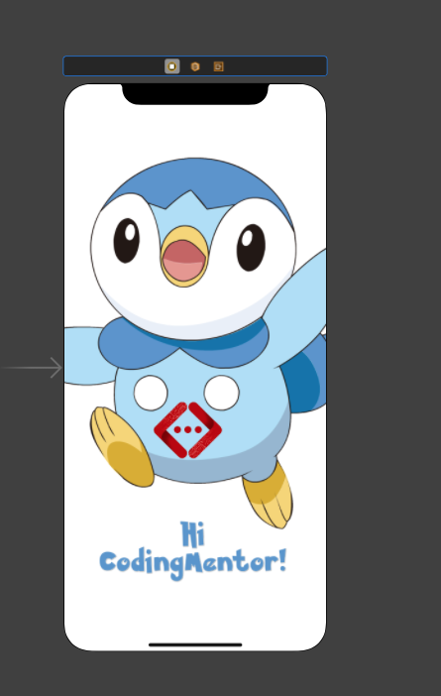
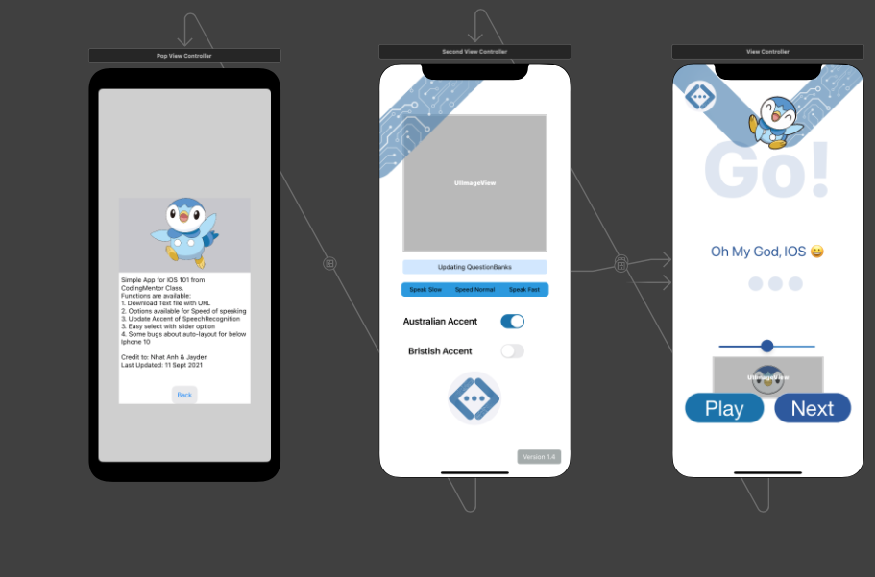
Final App for IOS 101 Class
Credit: NgocAnh & Jayden

