Slide 1
Audio Processing and Ambient Light Control Device
Notes:
One-sentence purpose: A real-time system that processes audio signals, visualizes them, and drives ambient lighting.

Slide 2
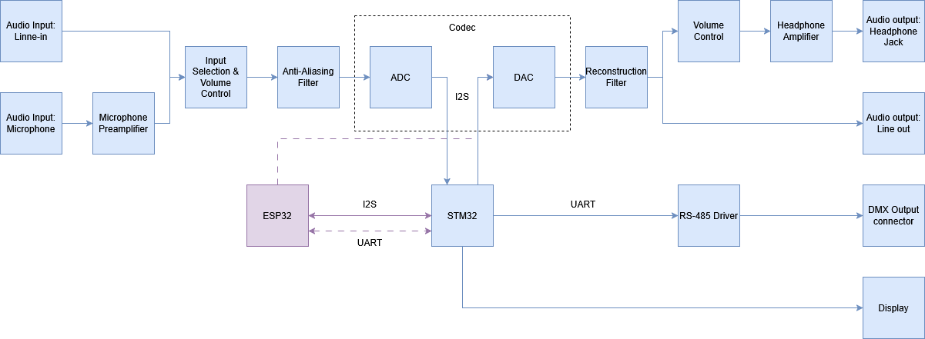
System Overview & Signal Flow

Slide 3
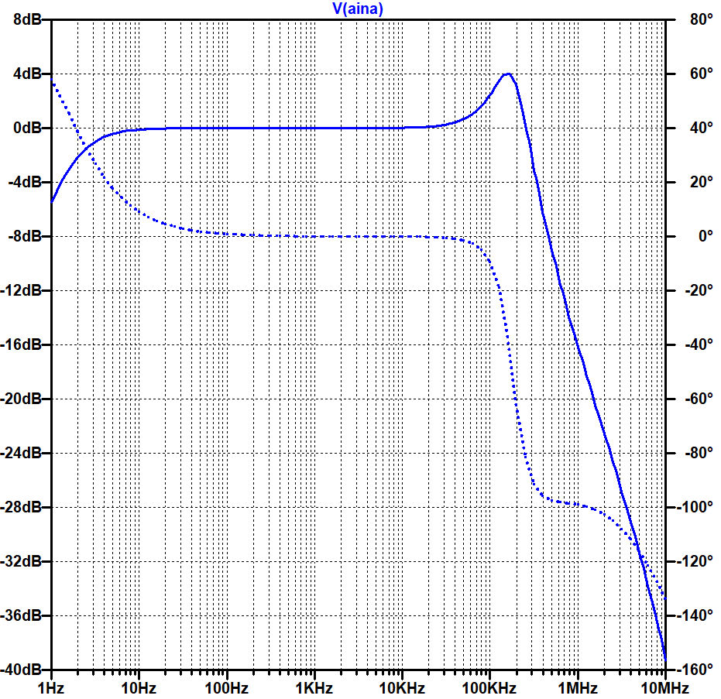
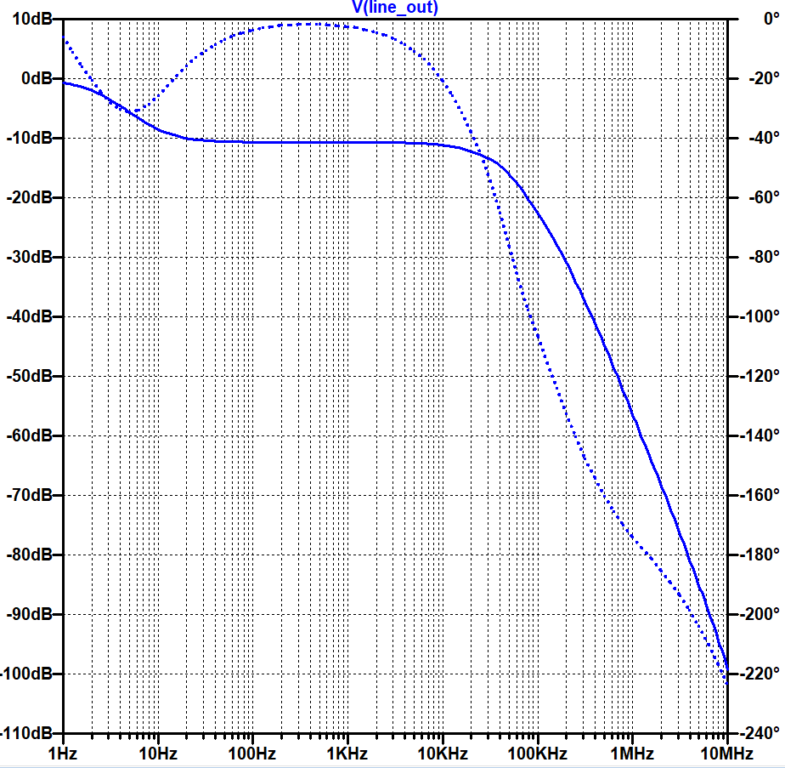
Analog Front-End & Output Path
Sind unsere Simulationen richtig?
Evtl. mit Bildern aus dem Internet ersetzten
Anti-aliasing Filter
Reconstruction Filter

Slide 4
Digital Signal Processing & Analysis

Slide 5
Ambient Light Control

Slide 6
User Interface & Visualization

Slide 7
Highlight: Audio Effects & Filter Menu

Slide 8
Conclusion

