Slide 1

Privacy Attacks and Countermeasures
in Biometric Gait Identification
Master’s Degree in Cybersecurity | Academic Year 2025/2026
Tommaso Danieli
Student ID: 2152871
Supervisor: Prof. Simone Milani
University of Padova — Master's Degree in Cybersecurity
[Defense Date]

Slide 2
INTRODUCTION
The Problem: Continual Learning Meets Privacy
Gait recognition from wearable IMUs authenticates users continuously, without active cooperation. But real systems enroll new users over time, thus the model must adapt without erasing old identities or leaking private information.
New subject cohorts arrive sequentially:
T1
30 subj.
T2
30 subj.
T3
30 subj.
T4
30 subj.
Catastrophic Forgetting
Model overwrites knowledge of earlier users
Sequential Model Updates: M1 → M2 → M3 → M4
Privacy Attacks
(MIA · IIA · FSI · Backdoor)
Adversary queries the model to infer enrolled identities
Evaluated via two standard metrics — average accuracy (Ā) and backward transfer (BWT), which quantifies forgetting.

Slide 3
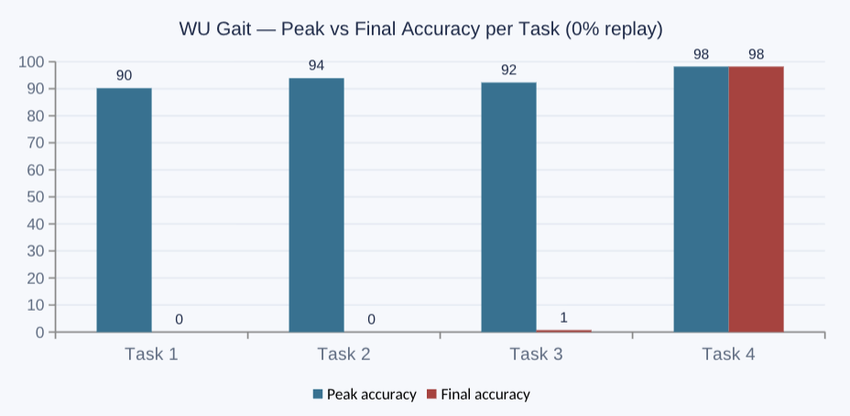
BACKGROUND & RELATED WORK
Catastrophic Forgetting: Why Naïve Fine-Tuning Fails
Under standard sequential fine-tuning with no protection mechanism, accuracy on each task collapses almost to zero as soon as the next task is learned.
3 Approaches to mitigate Catastrophic Forgetting
Regularization - Penalize drift on important weights
(Knowledge Distillation, LiDER)
Replay - Buffer or generative rehearsal of past tasks
(Standard with 15% Replay, Wavelet Generative Replay)
Architectural - Dedicated per-task parameters
(CDML, LoRA)
Backward transfer (BWT): −90.2 pp (Task 1) | −93.9 pp (Task 2) | −91.6 pp (Task 3) | Task 4 unaffected, as it is the last task trained.

Slide 4
BACKGROUND & RELATED WORK
Four Privacy Attacks Against Trained Models
Membership Inference (MIA)
Black-box, per-sample — was window x used in training? · AUC, EER
score = −L_CE(f(x), y) — exploits the train/test loss gap (≈0.01–0.05 vs ≈0.4–1.5)
MIA
Identity Inference (IIA)
Black-box, per-subject — was person s ever enrolled? · AUC, EER
Aggregates N=20 query windows per subject; mean CE score thresholded at τ
IIA
Feature Space Inference (FSI)
White-box — k-NN probe directly on the embedding layer · AUC, accuracy
k-NN (k=5) on raw backbone embeddings h — bypasses the classifier head entirely
FSI
Backdoor Attack
Training-time — poisons data to implant a trigger → target mapping · ASR, clean accuracy
Sinusoidal trigger on 15% of Task 3 windows, relabeled to the target subject of Task 4
BD
Each attack is evaluated under two attacker modes: a realistic no-seed / no-adapter attacker, and a worst-case oracle who knows the secret key.

Slide 5
EXPERIMENTAL SETUP
Three Datasets, One Protocol
All three datasets share the same six-channel IMU structure and the same four-task continual learning split approach.
Property | WU Gait | UCI HAR | WISDM
Subjects | 118 | 30 | 51
Channels | 6 | 6 | 6
Window size (samples) | 128 | 128 | 200
Sampling rate | 50 Hz | 50 Hz | 20 Hz
Window duration | 2.56 s | 2.56 s | 10.0 s
Task splits (T1–T4) | 30 / 30 / 30 / 28 | 8 / 9 / 7 / 6 | 13 / 13 / 13 / 12
Spans 30–118 subjects, 20–50 Hz, and 128–200-sample windows — testing generality across different deployment conditions.

Slide 6
EXPERIMENTAL SETUP
GaitCNN: The Shared Backbone
Input
6×128 or 6×200
4× ConvBlocks
32→64→128→128f
Flatten → FC
1024 → 128
Embedding h
ℝ¹²⁸
CDML (optional)
h ⊙ sₖ
Classifier
FC → n → ŷ
Single-task upper bound (100 training epochs, no continual constraint):
92.1%
95.1%
96.6%
WU Gait · chance 0.85%
UCI HAR · chance 3.33%
WISDM · chance 1.96%
Confirms sufficient model capacity on all three datasets before the continual-learning constraint is introduced.

Slide 7
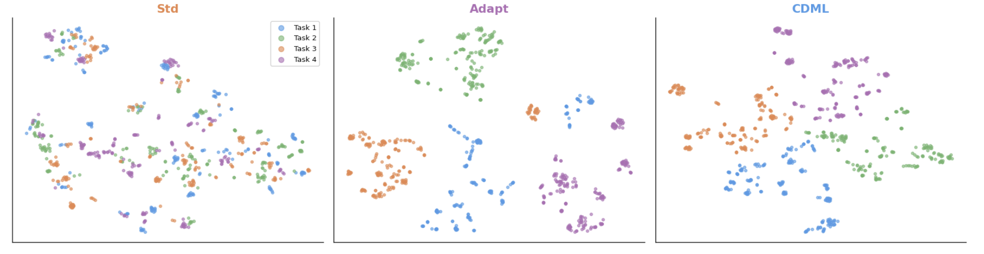
CODE DIVISION MODULATION LAYERS (CDML)
CDML Cuts Forgetting at the price of 4 Bytes per Task
The embedding is multiplied by a task-specific ±1 sequence, m = sₖ ⊙ h. Sequences are near-orthogonal (cosine similarity ≈ 0), so tasks occupy separate regions of the embedding space.
Method | Peak acc. T1 | Final acc. T1 | Forgetting (Δ) | Bytes / task
Std (0% replay) | 90.2% | 0.0% | −90.2 pp | 0 B
Adapt (FiLM) | 89.2% | 89.2% | 0.0 pp | 1024 B
CDML (0% replay) | 89.8% | 48.1% | −41.7 pp | 4 B
Sequence Design
PCG-64 uniform sampling, threshold 0.5 → ±1
Seed schedule: σₖ = 1000 + (k−1)
ρ | s₁ | s₂ | s₃ | s₄
s₁ | 1.000 | 0.031 | 0.109 | −0.063
s₂ | 0.031 | 1.000 | −0.047 | 0.031
s₃ | 0.109 | −0.047 | 1.000 | 0.016
s₄ | −0.063 | 0.031 | 0.016 | 1.000
Pairwise cosine similarity (d=128) — off-diagonal ≈ 0 confirms near-orthogonality.
t-SNE projections confirm CDML spreads the four task clusters more uniformly across the embedding space than Std or Adapt — visual evidence of the orthogonal modulation at work.

Slide 8
CODE DIVISION MODULATION LAYERS (CDML)
Privacy Protection Collapses Without the Seed
Across all four attacks, the no-seed attacker performs near chance, however an oracle who knows the seed recovers full identity information: CDML's protection is access-control, not representation obfuscation.
Attack | Metric | Std | CDML no-seed | CDML oracle
MIA | AUC | 56.9% | 51.0% | 56.0%
IIA | AUC (avg) | 66.4% | 48.7% | 99.2%
FSI | k-NN acc. | 87.7% | 1.6% | 93.6%
Backdoor | ASR | 42.9% | 3.2% | 64.7%*
*"Oracle" for Backdoor = tested with the poisoned task's own sequence (Task 3, seed 1002); any other sequence gives ≤8% ASR.
Sequence-Dependent Backdoor
Only the poisoned task's own seed reactivates the trigger, a compromised backdoor stays contained to the users holding that one sequence.
Seed-Identification Risk
Given the list of 4 seeds, an attacker recovers the most recent task's seed 95.2% of the time by probing for max confidence , thus the seed list itself must stay secret.

Slide 9
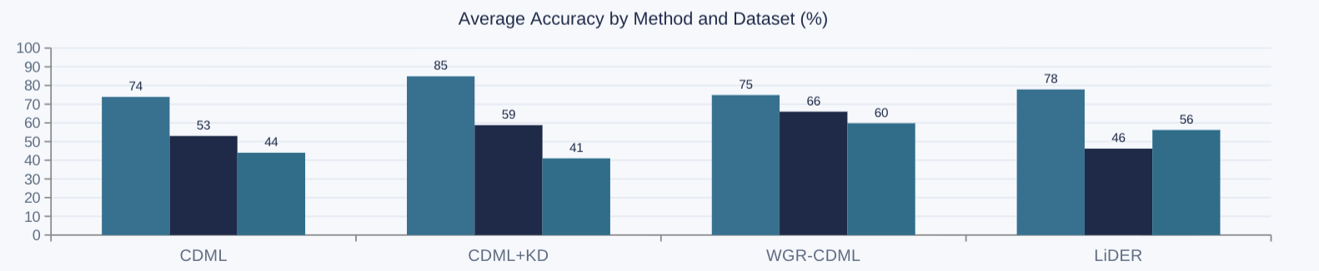

CDML EXTENSIONS AND HYBRID METHODS
Three Extensions to Close CDML's Forgetting Gap
KD
CDML + Knowledge Distillation
Focal distillation anchors the student to the teacher on samples it already got right -> targets negative flips
$$L_{total}(x,y)=L_{CE}(f_{θ}^{(k)}(x),y)+λ⋅(α+β⋅1[{\overset{̂}{y}}_{old}=y])⋅∥f_{θ}^{(k)}(x)-f_{θ}^{(k-1)}(x)∥_{2}^{2}$$
WGR
CDML + Wavelet Generative Replay
Synthesizes windows from stored DWT statistics (db4, level 3) -> no raw data retained
LiDER
CDML + Lipschitz Regularization
Bounds the embedding layer's spectral norm, plus a small 10% raw-replay buffer
$$L_{LiDER}=L_{CE}+w⋅max(0,∥W_{emb}∥_{σ}-κ)^{2}$$

Slide 10
CDML EXTENSIONS AND HYBRID METHODS
Privacy & Backdoor Trade-offs (WU Gait)
Method | Accuracy | IIA (no-seed) | FSI | Backdoor ASR
Std 15% (replay) | 87.7% | 51.1% | 90.3% | 42.9%
CDML | 73.9% | 48.7% | 1.6% | 3.2%
CDML+KD | 84.9% | 51.0% | 0.4% | 36.1%
WGR-CDML | 74.9% | 44.8% | 2.2% | 2.8%
LiDER | 77.9% | 47.6% | 3.2% | 50.4%
Best overall balance: WGR-CDML — strong accuracy, no raw data retained and good privacy resilience against all the attacks
LiDER: Replay Buffer Leaks
HighWU Gait accuracy (77.9%), but the 10% raw-replay buffer carries poisoned windows forward — worst backdoor ASR of any method (50.4%).
CDML+KD: Distillation Chain Leaks
Helps smaller datasets (UCI HAR), but the distillation buffer propagates a poisoned Task 3 forward — 36.1% ASR on WU Gait.

Slide 11
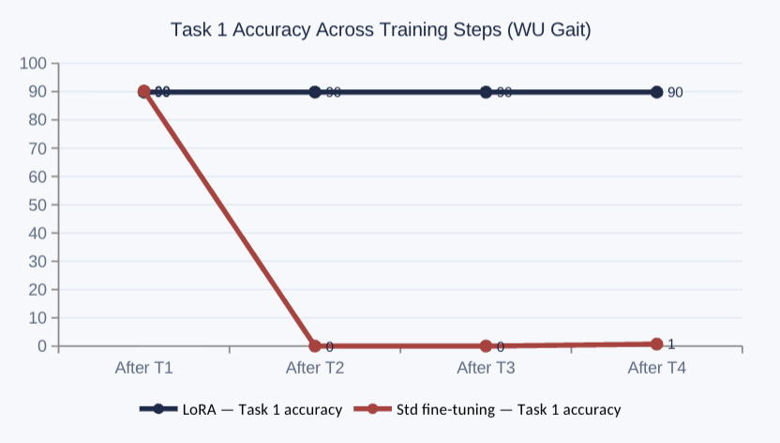
LORA FOR CONTINUAL GAIT IDENTIFICATION
Frozen Backbone + Per-Task Adapters = Zero Forgetting
After Task 1, the CNN backbone and base weights are frozen forever. Each new task gets its own small rank-8 adapter pair for the embedding and classifier layers.
Input
6×W
CNN Backbone
(frozen after T1)
Embed + LoRA
Aₖᵉ,Bₖᵉ (r=8)
CDML (optional)
h ⊙ sₖ
Classifier + LoRA
Aₖᶜ,Bₖᶜ (r=8)
Output
ŷ
1. Freeze (after T1)
CNN backbone + base weights Wₑ, W_c locked forever
2. Adapt (per task)
Rank-8 pair (Aₖ, Bₖ) trained for the embedding + classifier layers only
3. Restore (at inference)
Load task k's saved adapter — full isolation, no cross-task interference
Zero forgetting is structural, not learned: Task 1's adapter is never modified after it is saved, so Task 1 accuracy is bit-for-bit identical at every later step.

Slide 12
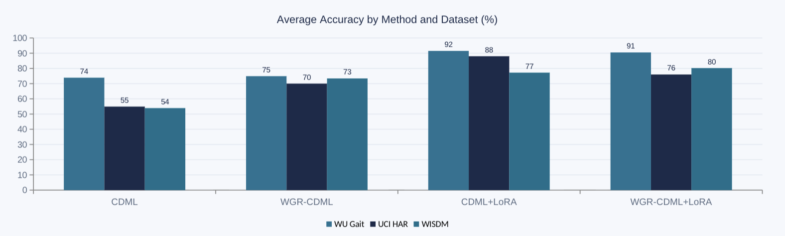
LORA FOR CONTINUAL GAIT IDENTIFICATION
CDML+LoRA: Zero Forgetting Plus Full Privacy
Freezing the backbone (LoRA) and scrambling the embedding (CDML) solve forgetting and privacy independently. Combining them costs nothing on either axis.
CDML+LoRA is the first method to beat the 15% replay baseline (87.7% / 76.0% / 71.6%) on accuracy, on all three datasets, while keeping full privacy protection.

Slide 13
LORA FOR CONTINUAL GAIT IDENTIFICATION
LoRA Alone Leaks — CDML Closes the Gap
LoRA's frozen backbone still carries Task 1's signature, and does nothing to hide embedding geometry. CDML fixes both by scrambling the representation itself.
Model (WU Gait) | IIA (realistic) | FSI | Backdoor ASR
LoRA only (no-adapter) | 26.7%* | 86.0% | 0.1%
CDML+LoRA (no-seed, no-adapter) | 56.5% | 3.3% | 1.7%
*Average masks a sharp asymmetry, see focus below.
Task 1 Is Structurally Exposed
LoRA-only IIA hits 96.8% on Task 1 — concentrated into the frozen backbone — but only 3.2–3.4% on Tasks 2–4, which live in private adapters. CDML scrambles the backbone itself, closing this gap for every task.
Small Datasets Still Need WGR
CDML+LoRA's backdoor ASR spikes to 32.6% on UCI HAR — its tiny per-task adapter overfits the trigger with so few samples. WGR-CDML+LoRA cuts this to 3.3% via the added wavelet-replay regularization.

Slide 14
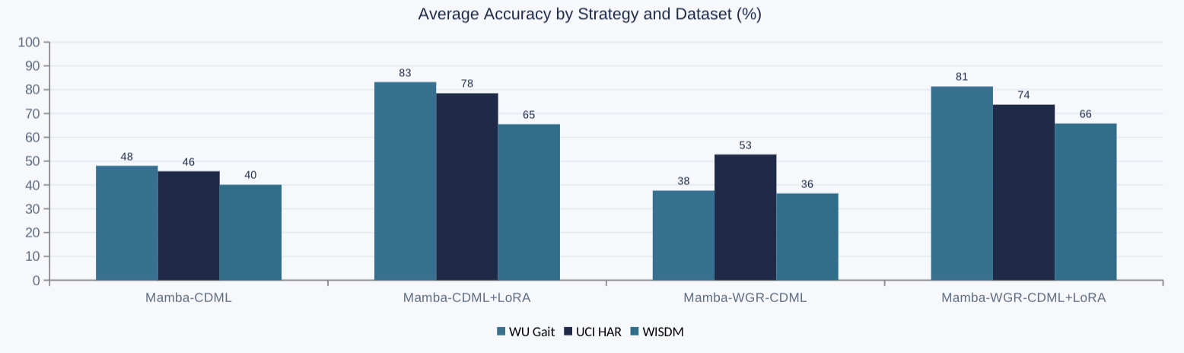
FB-MAMBA FOR CONTINUAL GAIT IDENTIFICATION
Swapping the CNN for a Bidirectional State-Space Model
GaitMamba replaces the CNN with two parallel selective state-space branches, one reading the window forward, one backward, fused by a learned gate. CDML, LoRA and WGR all plug in exactly as before.
Extremely lightweight: 26K–38K total parameters across datasets — LoRA adapters add just 2.4K–3.1K per task.
Same pattern as GaitCNN: only the LoRA-based strategies reach zero backward transfer — the backbone choice doesn't change the anti-forgetting story.

Slide 15
FB-MAMBA FOR CONTINUAL GAIT IDENTIFICATION
Privacy Holds apart from the Backdoor
IIA and FSI follow the same access-control pattern seen throughout this thesis: near-chance without the seed, fully exposed with it. The backdoor attack tells a very different story on this backbone.
Strategy (WU Gait) | IIA (no-seed → oracle) | FSI (no-seed → oracle) | Backdoor ASR
Mamba-CDML | 0.37 → 0.91 | 0.02 → 0.89 | 90.0%
Mamba-CDML+LoRA | 0.35 → 0.99 | 0.07 → 0.87 | 92.0%
Mamba-WGR-CDML | 0.47 → 0.84 | 0.04 → 0.92 | 90.8%
Mamba-WGR-CDML+LoRA | 0.35 → 0.81 | 0.06 → 0.86 | 87.3%
MIA Stays Silent
Membership inference sits at chance (0.47–0.53 AUC) even under full oracle access, no detectable per-sample memorization on this backbone, across every strategy and dataset.
Backdoor Defeats Every Defense
Unlike on GaitCNN, none of CDML, LoRA, or WGR meaningfully suppress the backdoor here — ASR stays 87–92% on WU Gait and WISDM regardless of defense. UCI HAR's smaller task size (686 windows) is the only thing that helps (31–40% ASR).

Slide 16
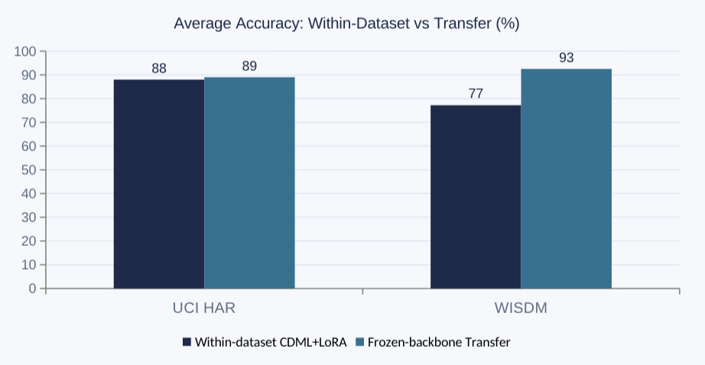
CROSS-DATASET GENERALIZATION AND TRANSFER
Pre-trained WU Gait Features Transfer
A GaitCNN backbone pre-trained on all 118 WU Gait subjects is frozen and reused as-is; only a LoRA embedding adapter and a CDML sequence are trained per task on the target dataset.
Why the Asymmetry?
UCI HAR keeps three walking variants (flat, upstairs, downstairs); the WU Gait backbone was trained on flat walking only. Its filters are a good, but imperfect, match for staircase dynamics — capping the transfer gain at +1.0 pp, versus +15.3 pp on WISDM's matching flat-walking data.
A frozen, pre-trained backbone is a cheap option when adding a new, smaller gait dataset to an already-deployed system.

Slide 17
CROSS-DATASET GENERALISATION AND TRANSFER
Two More Angles: Warm-Starting and the Joint Ceiling
A lighter form of transfer (initializing LoRA adapters from another dataset) and a theoretical ceiling (training on all subjects at once) bound the problem from both sides.
Experiment | UCI HAR | WISDM
Baseline (fresh init) | 79.25% | 91.88%
Order A (UCI → WISDM) | 79.25% | 92.24% ▲
Order B (WISDM → UCI) | 78.40% ▼ | 91.88%
98.2%
95.5%
WU Gait
UCI HAR
+6.0 pp vs 92.1%
+0.4 pp vs 95.1%
96.7%
97.3%
WISDM
Overall (199 subj.)
+0.1 pp vs 96.6%
joint multi-dataset ceiling
Warm-starting yields only marginal, asymmetric gains (±0.4–0.9 pp) — joint training remains the hard ceiling. Continual learning methods trail it most on UCI HAR (89.0% vs. 95.5%), leaving room for future work.

Slide 18
CROSS-DATASET GENERALIZATION AND TRANSFER
The Full Transfer Spectrum
Experiment | UCI HAR | WISDM
Single-dataset baseline (ceiling) | 95.1% | 96.6%
Within-dataset CDML+LoRA | 88.0% | 77.2%
Frozen-backbone transfer | 89.0% | 92.5%
Adapter warm-starting | 78.4% | 92.2%
Joint multi-dataset training | 95.5% | 96.7%
Dataset compatibility matters more than model capacity: WISDM gains up to +15 pp from transfer since it shares WU Gait's flat-walking dynamics; UCI HAR's staircase variants cap the benefit, leaving ~6.5 pp of headroom versus the joint ceiling for future continual learning work.

Slide 19
CONCLUSIONS
CDML+LoRA: The Best Overall Configuration
Dataset | Avg Accuracy | Forgetting | IIA AUC | FSI acc. | Backdoor ASR
WU Gait | 91.5% | 0.0 pp | 56.5% | 3.3% | 1.7%
UCI HAR | 88.0% | 0.0 pp | 50.2% | 3.9% | 32.6%
WISDM | 77.2% | 0.0 pp | 52.1% | 3.4% | 0.0%
Alternative: WGR-CDML+LoRA — when backdoor robustness matters (cuts UCI HAR ASR to 3.3%) or WISDM is the primary target (80.2% vs 77.2%).
Catastrophic forgetting and privacy leakage can be solved together, without trading one off against the other.
Freezing the backbone (LoRA) and scrambling the embedding (CDML) are independent, composable mechanisms and their combination costs nothing on either axis.

Slide 20
CONCLUSIONS
Limitations & Future Directions
Limitations
Future Directions
Seed & adapter secrecy: every privacy guarantee collapses once the seed or adapters leak; secure distribution and rotation were never studied.
Small datasets behave differently: task size interacts unpredictably with both forgetting and privacy mechanisms.
Privacy untested after transfer: Chapter 8 measured only accuracy on the transfer models, not attack resistance.
No dedicated backdoor defense: the robustness observed is a side effect of other mechanisms, not a designed countermeasure.
Seed rotation policies: rotate more frequently for recently enrolled subjects to close the seed-ID asymmetry.
Better generative replay: combine wavelet statistics with a small learned correction.
Backdoor-aware adapter checks: anomaly-check new adapters before acceptance.
Extending the evaluation: re-run privacy attacks on transfer models; consistent MIA; adaptive attackers.
Larger, heterogeneous datasets: different sensor placements and a wider variety of activities.

Slide 21
Thank You!
Questions & Discussion
Tommaso Danieli · University of Padova — MSc. In Cybersecurity · Supervisor: Prof. Simone Milani
github.com/Tommy270602/Gait_Continual_Learning

