Slide 1
Python基础
特征
通用语言、丰富的库支持
解释型语言
并行模式对应
程序模块由缩进构成
计算机科学，数据分析，生物信息，学术界社区流行
Google， Dropbox， Pinterest， Instagram， Reddit， BitTorrent， Civilization IV等网站是Python构筑

Slide 2

特徴
面向对象
与自然语言相近简单，易读，易记
具有高级动态数据类型（list,dict）
与其他语言接口容易（C/C++, Java, .NET）
社区活跃

Slide 3
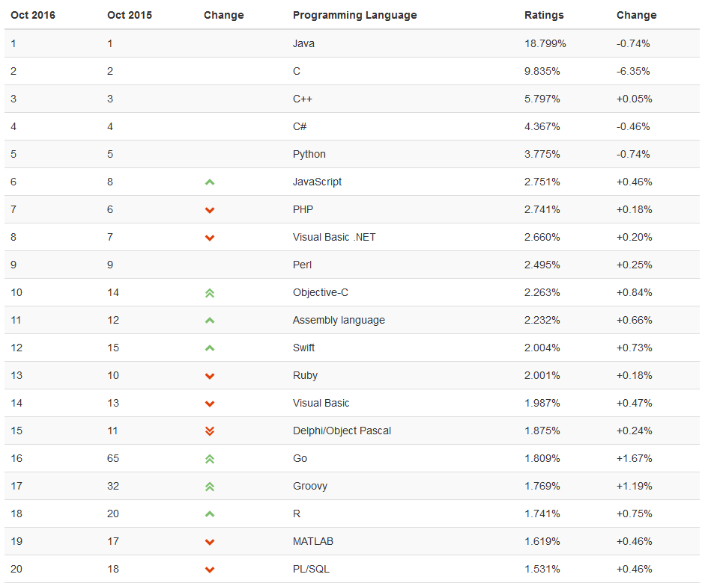
编程语言RANK

Slide 4
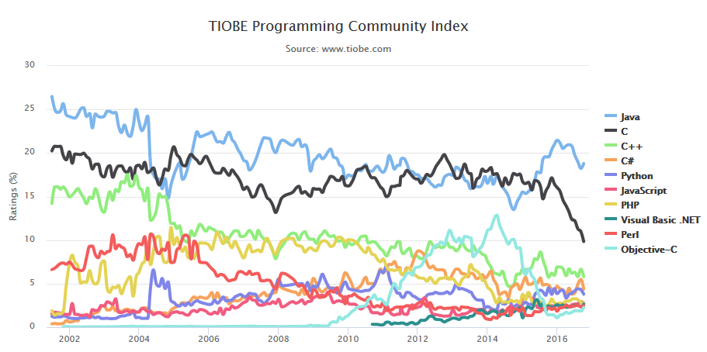
TIOBE趋势

Slide 5
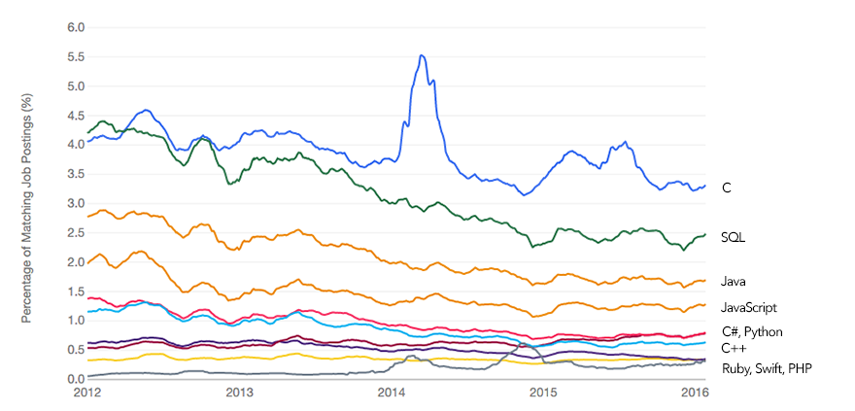
招聘趋势

Slide 6
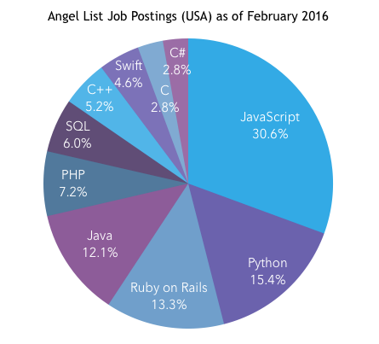
新兴企业招聘

Slide 7
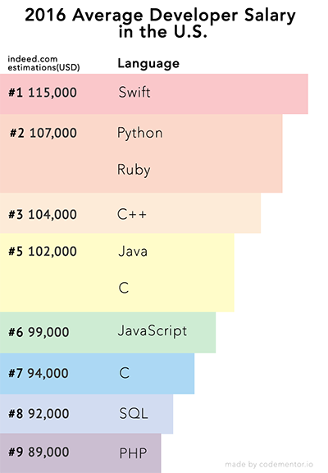
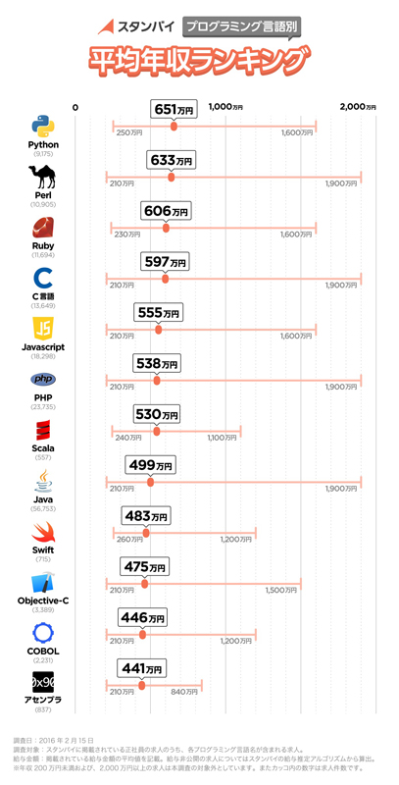
语言别招聘

Slide 8
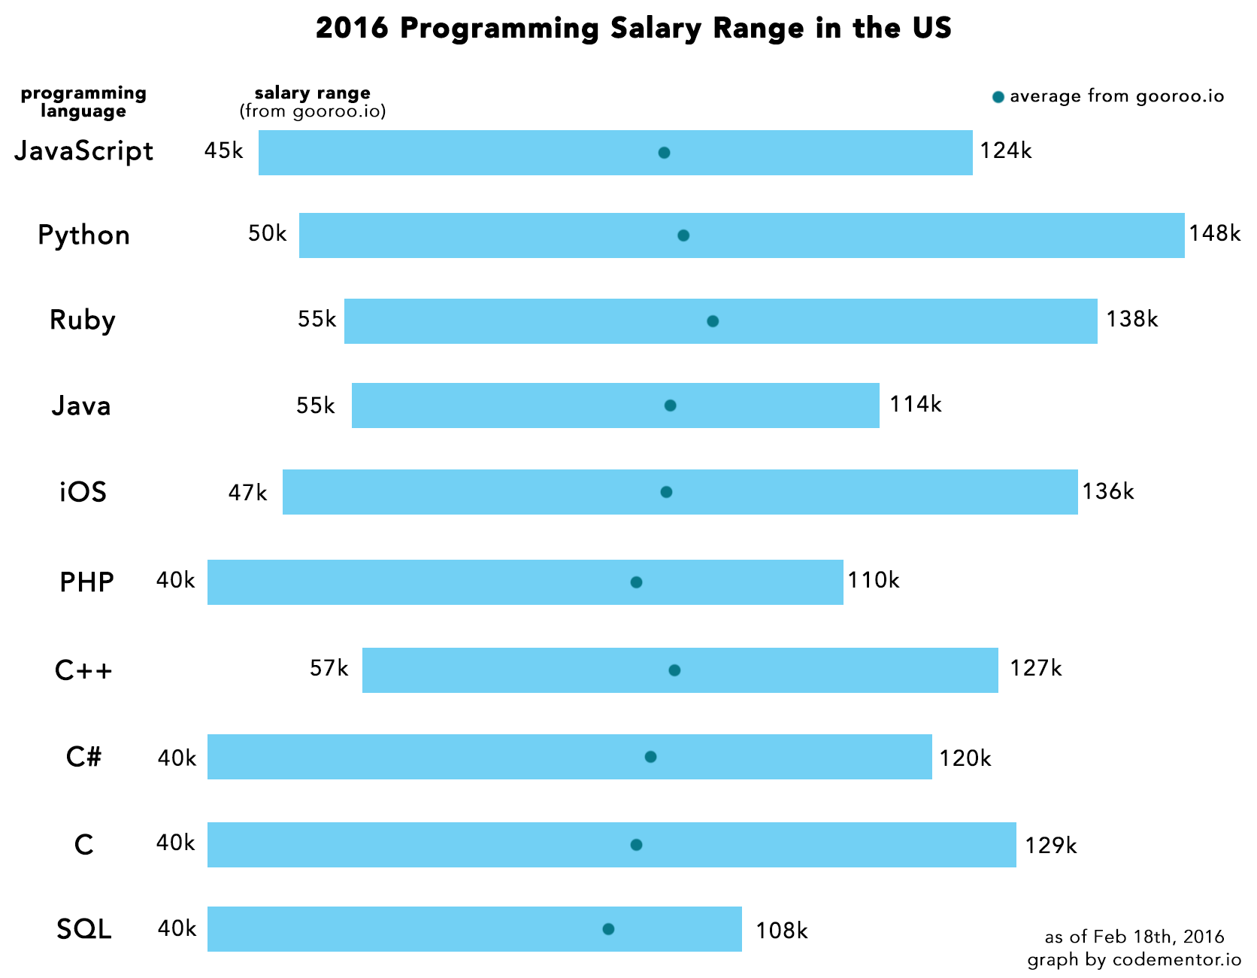
语言别薪金排行

Slide 9
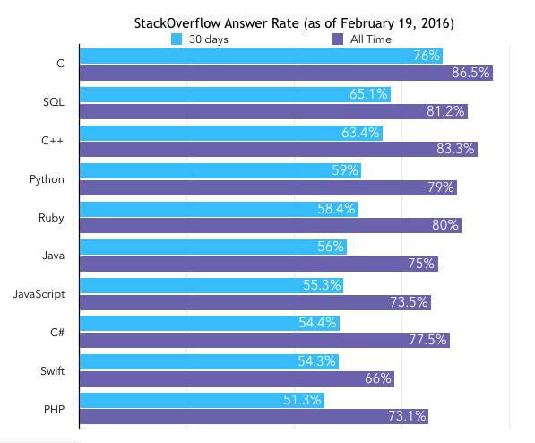
StackOverFlow回答率

Slide 10
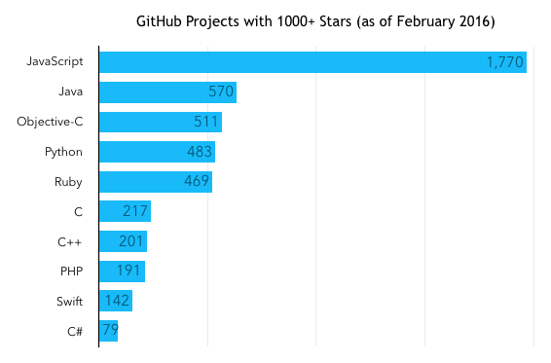
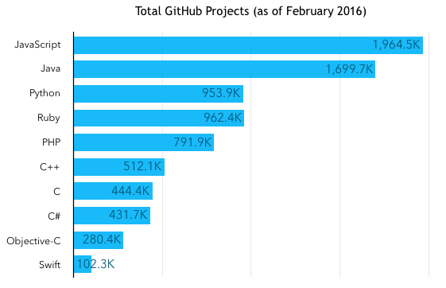
GitHub项目
流行度⇒
总计⇒

Slide 11
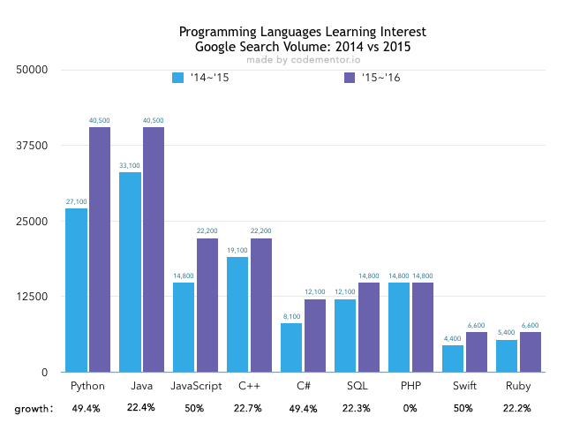
未来性

Slide 12
Python基础
机器学习常用模块（本讲座使用）：
Numpy
Scipy
Pandas
Matplotlib⇒画像
https://www.tutorialspoint.com/execute_python_online.php
以下示例代码来源于：
http://cs231n.github.io/python-numpy-tutorial/#python-basic

Slide 13
数据类型
基础
数值型⇒ Numbers
布尔型
⇒ True、 False
字符串⇒String
容器类型
list
dict

Slide 14
数値型
x = 3
print type(x) # Prints "<type 'int'>"
print x # Prints "3"
print x + 1 # Addition; prints "4"
print x - 1 # Subtraction; prints "2"
print x * 2 # Multiplication; prints "6"
print x ** 2 # Exponentiation; prints "9"
x += 1
print x # Prints "4"
x *= 2
print x # Prints "8"
y = 2.5
print type(y) # Prints "<type 'float'>"
print y, y + 1, y * 2, y ** 2 # Prints "2.5 3.5 5.0 6.25"

Slide 15
Boolean型
常量第一个字母大写
t = True
f = False
print type(t) # Prints "<type 'bool'>"
print t and f # Logical AND; prints "False"
print t or f # Logical OR; prints "True"
print not t # Logical NOT; prints "False"
print t != f # Logical XOR; prints "True“
while True:
(処理A)

Slide 16
文字列型
hello = 'hello' # String literals can use single quotes
world = "world" # or double quotes; it does not matter.
print hello # Prints "hello"
print len(hello) # String length; prints "5"
hw = hello + ' ' + world # String concatenation
print hw # prints "hello world"
hw12 = '%s %s %d' % ("hello", "world", 12) # sprintf style string formatting
print hw12 # prints "hello world 12"
s = "hello"
print s.capitalize() # Capitalize a string; prints "Hello"
print s.upper() # Convert a string to uppercase; prints "HELLO"
print s.rjust(7) # Right-justify a string, padding with spaces; prints " hello"
print s.center(7) # Center a string, padding with spaces; prints " hello "
print s.replace('l', '(ell)') # Replace all instances of one substring with another;
# prints "he(ell)(ell)o"
print ' world '.strip() # Strip leading and trailing whitespace; prints "world"

Slide 17
流程控制
if __name__ == '__main__':
print “hello world”
条件
if expression:
statement(s)
else:
statement(s)
循环
fruits = ['banana', 'apple', 'mango']
for fruit in fruits: # Second Example
print 'Current fruit :', fruit

Slide 18
容器--list
声明变量
mylist = [ ]
xs = [3, 1, 2] # Create a list
print xs, xs[2] # Prints "[3, 1, 2] 2"
print xs[-1] # Negative indices count from the end of the list; prints "2"
xs[2] = 'foo' # Lists can contain elements of different types
print xs # Prints "[3, 1, 'foo']"
xs.append('bar') # Add a new element to the end of the list
print xs # Prints "[3, 1, 'foo', 'bar']"
x = xs.pop() # Remove and return the last element of the list
print x, xs # Prints "bar [3, 1, 'foo']"

Slide 19
容器--list
slicing
nums = range(5) # range is a built-in function that creates a list of integers
print nums # Prints "[0, 1, 2, 3, 4]"
print nums[2:4] # Get a slice from index 2 to 4 (exclusive); prints "[2, 3]"
print nums[2:] # Get a slice from index 2 to the end; prints "[2, 3, 4]"
print nums[:2] # Get a slice from the start to index 2 (exclusive); prints "[0, 1]"
print nums[:] # Get a slice of the whole list; prints ["0, 1, 2, 3, 4]"
print nums[:-1] # Slice indices can be negative; prints ["0, 1, 2, 3]"
nums[2:4] = [8, 9] # Assign a new sublist to a slice
print nums # Prints "[0, 1, 8, 9, 4]“

Slide 20
List comprehension
Loops
animals = ['cat', 'dog', 'monkey']
for animal in animals:
print animal
# Prints "cat", "dog", "monkey", each on its own line.
animals = ['cat', 'dog', 'monkey']
for idx, animal in enumerate(animals):
print '#%d: %s' % (idx + 1, animal)
Prints "#1: cat", "#2: dog", "#3: monkey", each on its own line

Slide 21
List comprehension
普通LOOP
nums = [0, 1, 2, 3, 4]
squares = []
for x in nums:
squares.append(x ** 2)
print squares # Prints [0, 1, 4, 9, 16]
List comprehension
nums = [0, 1, 2, 3, 4]
squares = [x ** 2 for x in nums]
print squares # Prints [0, 1, 4, 9, 16]

Slide 22
List comprehension
LOOP条件
nums = [0, 1, 2, 3, 4]
even_squares = [x ** 2 for x in nums if x % 2 == 0]
print even_squares # Prints "[0, 4, 16]“
l = [22, 13, 45, 50, 98, 69, 43, 44, 1]
result = [x+1 if x >= 45 else x+5 for x in l]
print result
#Print " [27, 18, 46, 51, 99, 70, 48, 49, 6] "
nabla_b = [np.zeros(b.shape) for b in self.biases]
nabla_b = [nb+dnb for nb, dnb in zip(nabla_b, delta_nabla_b)]

Slide 23
容器--dict
声明变量
mydict = { }
d = {'cat': 'cute', 'dog': 'furry'} # Create a new dictionary with some data
print d['cat'] # Get an entry from a dictionary; prints "cute"
print 'cat' in d # Check if a dictionary has a given key; prints "True"
d['fish'] = 'wet' # Set an entry in a dictionary
print d['fish'] # Prints "wet"
print d['monkey'] # KeyError: 'monkey' not a key of d
print d.get('monkey', 'N/A') # Get an element with a default; prints "N/A"
print d.get('fish', 'N/A') # Get an element with a default; prints "wet"
del d['fish'] # Remove an element from a dictionary
print d.get('fish', 'N/A') # "fish" is no longer a key; prints "N/A“
d = {'person': 2, 'cat': 4, 'spider': 8}
for animal in d:
legs = d[animal]
print 'A %s has %d legs' % (animal, legs)
# Prints "A person has 2 legs", "A spider has 8 legs", "A cat has 4 legs"

Slide 24
Dictionary comprehensions
普通LOOP
d = {'person': 2, 'cat': 4, 'spider': 8}
for animal, legs in d.iteritems():
print 'A %s has %d legs' % (animal, legs)
# Prints "A person has 2 legs", "A spider has 8 legs", "A cat has 4 legs “
Dictionary comprehensions
nums = [0, 1, 2, 3, 4]
even_num_to_square = {x: x ** 2 for x in nums if x % 2 == 0}
print even_num_to_square
# Prints "{0: 0, 2: 4, 4: 16}

Slide 25
函数
def sign(x):
if x > 0:
return 'positive'
elif x < 0:
return 'negative'
else:
return 'zero'
for x in [-1, 0, 1]:
print sign(x)
# Prints "negative", "zero", "positive“
def hello(name, loud=False):
if loud:
print 'HELLO, %s!' % name.upper()
else:
print 'Hello, %s' % name
hello('Bob') # Prints "Hello, Bob"
hello('Fred', loud=True) # Prints "HELLO, FRED!"

Slide 26
类
class Greeter(object):
# Constructor
def __init__(self, name):
self.name = name # Create an instance variable
# Instance method
def greet(self, loud=False):
if loud:
print 'HELLO, %s!' % self.name.upper()
else:
print 'Hello, %s' % self.name
g = Greeter('Fred') # Construct an instance of the Greeter class
g.greet() # Call an instance method; prints "Hello, Fred"
g.greet(loud=True) # Call an instance method; prints "HELLO, FRED!"

Slide 27
Numpy
Arrays
import numpy as np
a = np.array([1, 2, 3]) # Create a rank 1 array
print type(a) # Prints "<type 'numpy.ndarray'>"
print a.shape # Prints "(3,)"
print a[0], a[1], a[2] # Prints "1 2 3"
a[0] = 5 # Change an element of the array
print a # Prints "[5, 2, 3]"
b = np.array([[1,2,3],[4,5,6]]) # Create a rank 2 array
print b.shape # Prints "(2, 3)"
print b[0, 0], b[0, 1], b[1, 0] # Prints "1 2 4"

Slide 28
Numpy--Arrays
import numpy as np
a = np.zeros((2,2)) # Create an array of all zeros
print a # Prints "[[ 0. 0.]
# [ 0. 0.]]"
b = np.ones((1,2)) # Create an array of all ones
print b # Prints "[[ 1. 1.]]"
c = np.full((2,2), 7) # Create a constant array
print c # Prints "[[ 7. 7.]
# [ 7. 7.]]"
d = np.eye(2) # Create a 2x2 identity matrix
print d # Prints "[[ 1. 0.]
# [ 0. 1.]]"
e = np.random.random((2,2)) # Create an array filled with random values
print e # Might print "[[ 0.91940167 0.08143941]
# [ 0.68744134 0.87236687]]"

Slide 29
Numpy--Arrays
Array indexing
import numpy as np
# Create the following rank 2 array with shape (3, 4)
# [[ 1 2 3 4]
# [ 5 6 7 8]
# [ 9 10 11 12]]
a = np.array([[1,2,3,4], [5,6,7,8], [9,10,11,12]])
# Use slicing to pull out the subarray consisting of the first 2 rows
# and columns 1 and 2; b is the following array of shape (2, 2):
# [[2 3]
# [6 7]]
b = a[:2, 1:3]
# A slice of an array is a view into the same data, so modifying it
# will modify the original array.
print a[0, 1] # Prints "2"
b[0, 0] = 77 # b[0, 0] is the same piece of data as a[0, 1]
print a[0, 1] # Prints "77“

Slide 30
Numpy--Arrays
import numpy as np
# Create the following rank 2 array with shape (3, 4)
# [[ 1 2 3 4]
# [ 5 6 7 8]
# [ 9 10 11 12]]
a = np.array([[1,2,3,4], [5,6,7,8], [9,10,11,12]])
# Two ways of accessing the data in the middle row of the array.
# Mixing integer indexing with slices yields an array of lower rank,
# while using only slices yields an array of the same rank as the
# original array:
row_r1 = a[1, :] # Rank 1 view of the second row of a
row_r2 = a[1:2, :] # Rank 2 view of the second row of a
print row_r1, row_r1.shape # Prints "[5 6 7 8] (4,)"
print row_r2, row_r2.shape # Prints "[[5 6 7 8]] (1, 4)"
# We can make the same distinction when accessing columns of an array:
col_r1 = a[:, 1]
col_r2 = a[:, 1:2]
print col_r1, col_r1.shape # Prints "[ 2 6 10] (3,)"
print col_r2, col_r2.shape # Prints "[[ 2]
# [ 6]
# [10]] (3, 1)"

Slide 31
Numpy--Arrays
import numpy as np
a = np.array([[1,2], [3, 4], [5, 6]])
# An example of integer array indexing.
# The returned array will have shape (3,) and
print a[[0, 1, 2], [0, 1, 0]] # Prints "[1 4 5]"
# The above example of integer array indexing is equivalent to this:
print np.array([a[0, 0], a[1, 1], a[2, 0]]) # Prints "[1 4 5]"
# When using integer array indexing, you can reuse the same
# element from the source array:
print a[[0, 0], [1, 1]] # Prints "[2 2]"
# Equivalent to the previous integer array indexing example
print np.array([a[0, 1], a[0, 1]]) # Prints "[2 2]"

Slide 32
Numpy--Arrays
import numpy as np
# Create a new array from which we will select elements
a = np.array([[1,2,3], [4,5,6], [7,8,9], [10, 11, 12]])
print a # prints "array([[ 1, 2, 3],
# [ 4, 5, 6],
# [ 7, 8, 9],
# [10, 11, 12]])"
# Create an array of indices
b = np.array([0, 2, 0, 1])
# Select one element from each row of a using the indices in b
print a[np.arange(4), b] # Prints "[ 1 6 7 11]"
# Mutate one element from each row of a using the indices in b
a[np.arange(4), b] += 10
print a # prints "array([[11, 2, 3],
# [ 4, 5, 16],
# [17, 8, 9],
# [10, 21, 12]])

Slide 33
Numpy--Arrays
import numpy as np
a = np.array([[1,2], [3, 4], [5, 6]])
bool_idx = (a > 2) # Find the elements of a that are bigger than 2;
# this returns a numpy array of Booleans of the same
# shape as a, where each slot of bool_idx tells
# whether that element of a is > 2.
print bool_idx # Prints "[[False False]
# [ True True]
# [ True True]]"
# We use boolean array indexing to construct a rank 1 array
# consisting of the elements of a corresponding to the True values
# of bool_idx
print a[bool_idx] # Prints "[3 4 5 6]"
# We can do all of the above in a single concise statement:
print a[a > 2] # Prints "[3 4 5 6]"

Slide 34
Numpy--Arrays
Datatypes
import numpy as np
x = np.array([1, 2]) # Let numpy choose the datatype
print x.dtype # Prints "int64"
x = np.array([1.0, 2.0]) # Let numpy choose the datatype
print x.dtype # Prints "float64"
x = np.array([1, 2], dtype=np.int64) # Force a particular datatype
print x.dtype # Prints "int64“
文档链接
https://docs.scipy.org/doc/numpy/reference/arrays.dtypes.html

Slide 35
Numpy--Arrays
Array math
import numpy as np
x = np.array([[1,2],[3,4]], dtype=np.float64)
y = np.array([[5,6],[7,8]], dtype=np.float64)
# Elementwise sum; both produce the array
# [[ 6.0 8.0]
# [10.0 12.0]]
print x + y
print np.add(x, y)
# Elementwise difference; both produce the array
# [[-4.0 -4.0]
# [-4.0 -4.0]]
print x - y
print np.subtract(x, y)
import numpy as np
# Elementwise product; both produce the array
# [[ 5.0 12.0]
# [21.0 32.0]]
print x * y
print np.multiply(x, y)
# Elementwise division; both produce the array
# [[ 0.2 0.33333333]
# [ 0.42857143 0.5 ]]
print x / y
print np.divide(x, y)
# Elementwise square root; produces the array
# [[ 1. 1.41421356]
# [ 1.73205081 2. ]]
print np.sqrt(x)

Slide 36
Numpy--Arrays
import numpy as np
x = np.array([[1,2],[3,4]])
y = np.array([[5,6],[7,8]])
v = np.array([9,10])
w = np.array([11, 12])
# Inner product of vectors; both produce 219
print v.dot(w)
print np.dot(v, w)
# Matrix / vector product; both produce the rank 1 array [29 67]
print x.dot(v)
print np.dot(x, v)
# Matrix / matrix product; both produce the rank 2 array
# [[19 22]
# [43 50]]
print x.dot(y)
print np.dot(x, y)

Slide 37
Numpy--Arrays
import numpy as np
x = np.array([[1,2],[3,4]])
print np.sum(x) # Compute sum of all elements; prints "10"
print np.sum(x, axis=0) # Compute sum of each column; prints "[4 6]"
print np.sum(x, axis=1) # Compute sum of each row; prints "[3 7]“
import numpy as np
x = np.array([[1,2], [3,4]])
print x # Prints "[[1 2]
# [3 4]]"
print x.T # Prints "[[1 3]
# [2 4]]"
# Note that taking the transpose of a rank 1 array does nothing:
v = np.array([1,2,3])
print v # Prints "[1 2 3]"
print v.T # Prints "[1 2 3]"

Slide 38
Numpy--Arrays
Broadcasting
最原始做法
import numpy as np
# We will add the vector v to each row of the matrix x,
# storing the result in the matrix y
x = np.array([[1,2,3], [4,5,6], [7,8,9], [10, 11, 12]])
v = np.array([1, 0, 1])
y = np.empty_like(x) # Create an empty matrix with the same shape as x
# Add the vector v to each row of the matrix x with an explicit loop
for i in range(4):
y[i, :] = x[i, :] + v
print y # Now y is the following
# [[ 2 2 4]
# [ 5 5 7]
# [ 8 8 10]
# [11 11 13]]

Slide 39
Numpy--Arrays
效率更高做法
import numpy as np
# We will add the vector v to each row of the matrix x,
# storing the result in the matrix y
x = np.array([[1,2,3], [4,5,6], [7,8,9], [10, 11, 12]])
v = np.array([1, 0, 1])
vv = np.tile(v, (4, 1)) # Stack 4 copies of v on top of each other
print vv # Prints "[[1 0 1]
# [1 0 1]
# [1 0 1]
# [1 0 1]]"
y = x + vv # Add x and vv elementwise
print y # Prints "[[ 2 2 4
# [ 5 5 7]
# [ 8 8 10]
# [11 11 13]]"

Slide 40
Numpy--Arrays
使用broadcasting
import numpy as np
# We will add the vector v to each row of the matrix x,
# storing the result in the matrix y
x = np.array([[1,2,3], [4,5,6], [7,8,9], [10, 11, 12]])
v = np.array([1, 0, 1])
y = x + v # Add v to each row of x using broadcasting
print y
# Prints "[[ 2 2 4]
# [ 5 5 7]
# [ 8 8 10]
# [11 11 13]]"

Slide 41
Numpy--Arrays
测试
import numpy as np
# Compute outer product of vectors
v = np.array([1,2,3]) # v has shape (3,)
w = np.array([4,5]) # w has shape (2,)
print np.reshape(v, (3, 1)) * w
x = np.array([[1,2,3], [4,5,6]])
print x + v
print (x.T + w).T
print x + np.reshape(w, (2, 1))
print x * 2

Slide 42
Numpy--Arrays
# To compute an outer product, we first reshape v to be a column
# vector of shape (3, 1); we can then broadcast it against w to yield
# an output of shape (3, 2), which is the outer product of v and w:
# [[ 4 5]
# [ 8 10]
# [12 15]]
# x has shape (2, 3) and v has shape (3,) so they broadcast to (2, 3),
# giving the following matrix:
# [[2 4 6]
# [5 7 9]]
# Multiply a matrix by a constant:
# x has shape (2, 3). Numpy treats scalars as arrays of shape ();
# these can be broadcast together to shape (2, 3), producing the
# following array:
# [[ 2 4 6]
# [ 8 10 12]]

Slide 43
SciPy
图像处理
提供处理图像的基本函数
读取图像⇒numpy array
写入图像←numpy array
图像缩放
计算距离
欧几里德距离
相关系数
曼哈顿距离
信号处理
数值积分
高速傅里叶变换
线性代数计算

Slide 44
Matplotlib
Plotting
import numpy as np
import matplotlib.pyplot as plt
# Compute the x and y coordinates for points on a sine curve
x = np.arange(0, 3 * np.pi, 0.1)
y = np.sin(x)
# Plot the points using matplotlib
plt.plot(x, y)
plt.show() # You must call plt.show() to make graphics appear.

Slide 45
参照
http://techacademy.jp/magazine/8735

