Slide 1
Predicting Billboard Hit Songs
Thomas DeNezza, Syed Sabeeh Hassany, Jackson Winslow, Jason Wu

Slide 2


Introduction

Slide 3
Approach
Data generation
Curating our own dataset by combining information from Spotify and Billboard API’s
Model creation and augmentation
Training base models on a binary classification, hypertuning these models to achieve best prediction accuracy
Analysis
Analyzing our results in the context of each of our evaluations

Slide 4
Approach
Evaluating our ability to predict whether a song was a hit or not individually across the four genres as well as all together (and which models perform best)
Evaluating which features are most influential in a song becoming a hit for each genre

Slide 5

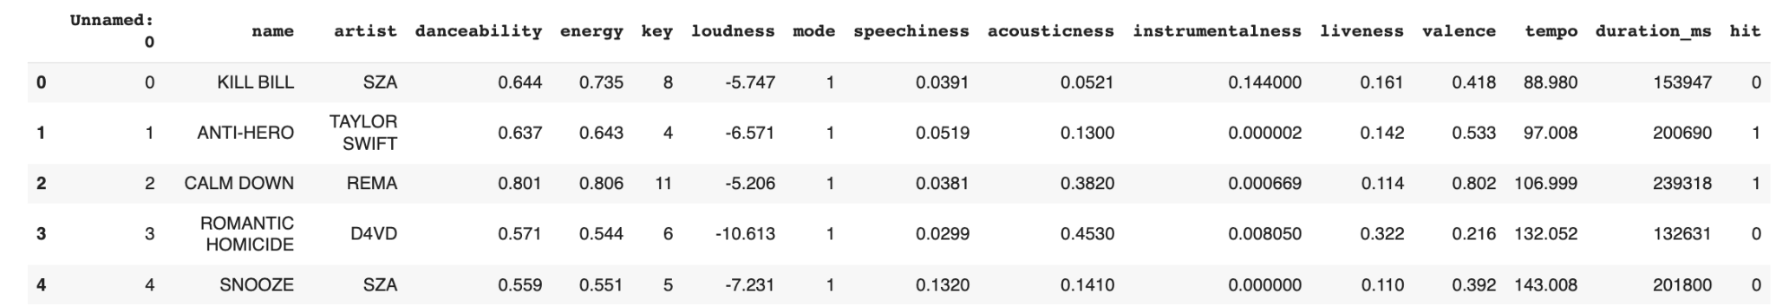
Data Sourcing
Rap: 22.69% hits, 77.31% non-hits
Jazz: 3.21% hits, 96.79% non-hits
Pop: 16.17% hits, 83.83% non-hits
Country: 23.51% hits, 76.47% non-hits
Mixed: 16.39% hits, 83.61% non-hits

Slide 6
Models
Logistic Regression
K-Nearest Neighbors
Decision Tree
Random Forest
Support Vector Machine (Linear Kernel)
Support Vector Machine (RBF Kernel)
Gradient Boost
AdaBoost (uses Random Forest as base estimator)

Slide 7
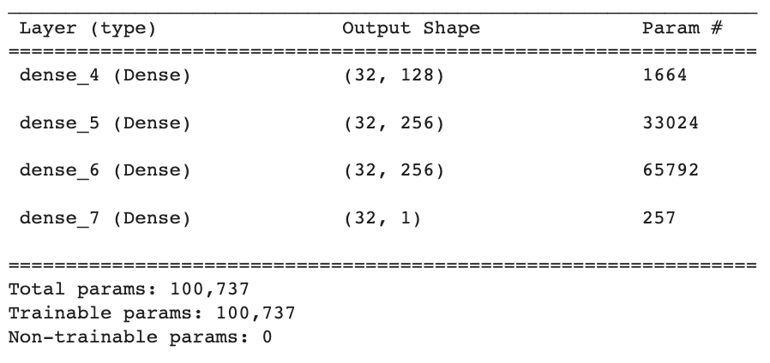
Neural Network

Slide 8
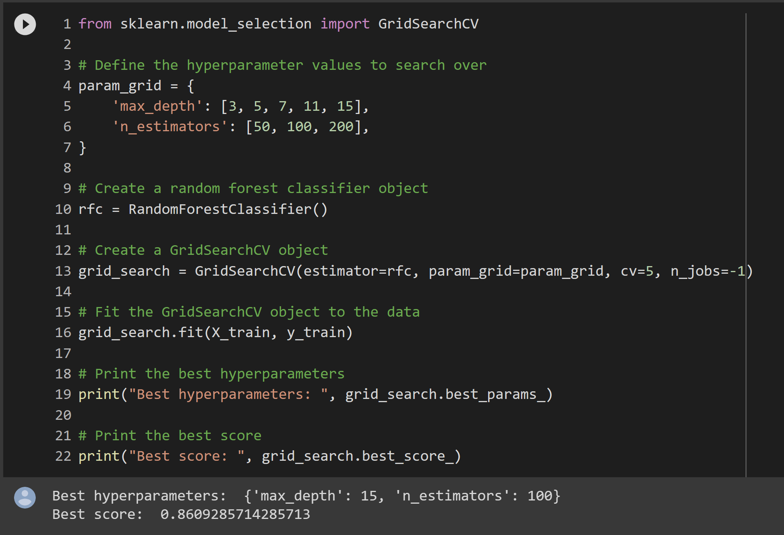
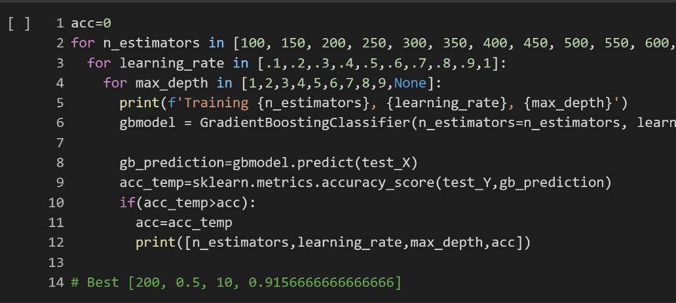
Hyperparameter Tuning

Slide 9
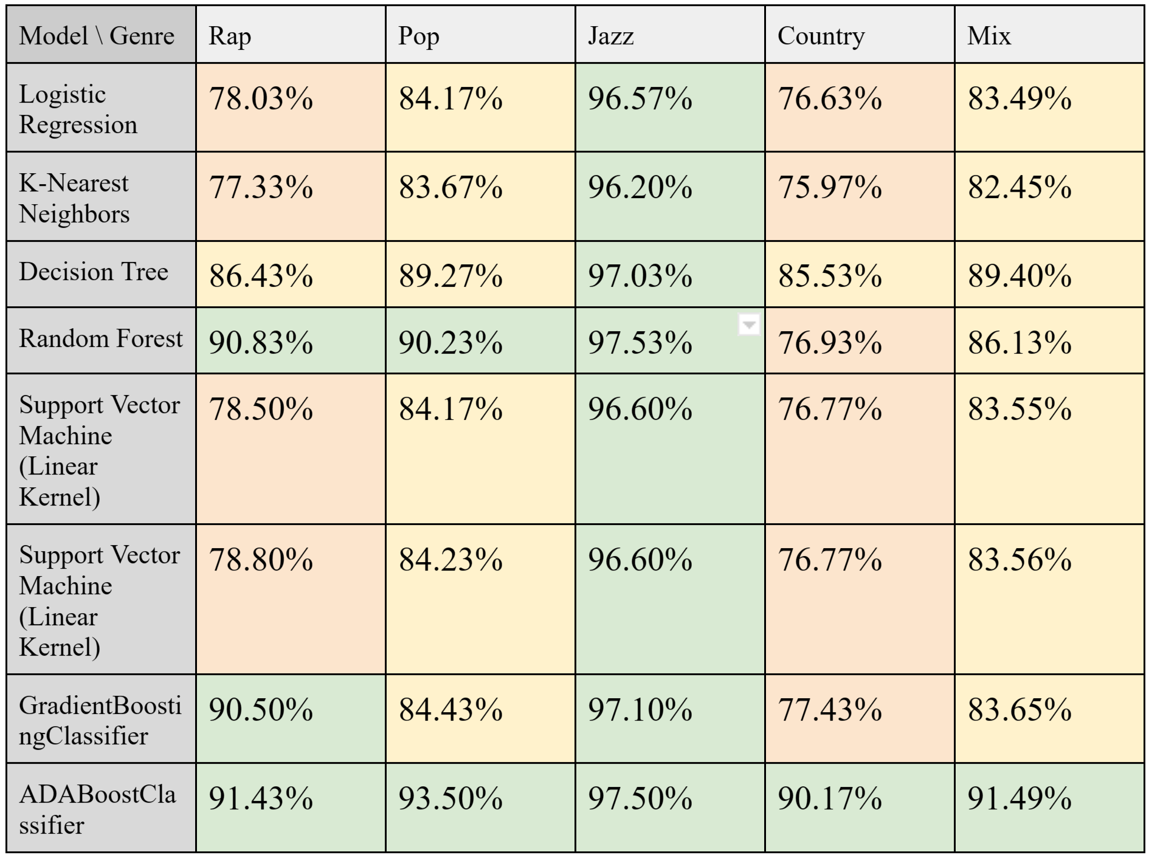
Classic Model Analysis

Slide 10
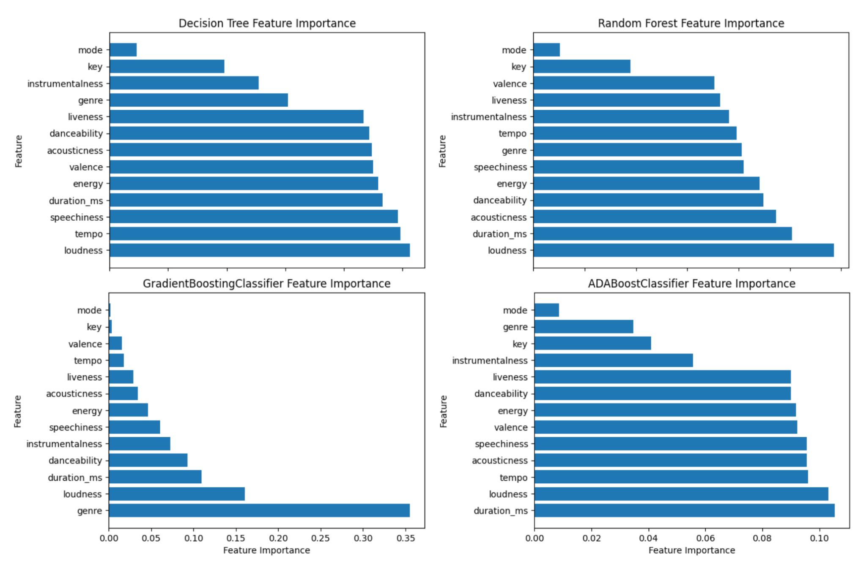
Feature Importance Analysis

Slide 11
Neural Network Analysis
Genre | Accuracy
Rap | 90.65%
Pop | 90.70%
Jazz | 96.40%
Country | 87.35%
All Genres | 90.19%
All Genres (with genre as a feature) | 91.74%

Slide 12
Future Actions
An analysis of changes in time period
Number of artist followers as a parameter
Analyze different genres
Create a balanced labeled dataset

Slide 13
Conclusion
Models failed to predict hit songs effectively
More balanced dataset recommended for better results
Tuning focused on accuracy, not F1 score
Lessons learned about building quality datasets and model

