Slide 1
Post-Polio Syndrome (PPS)
Neuro 3
a.k.a
Late Effects of Polio
Post-Polio Sequelae
Post-Polio Muscular Atrophy
Postpoliomyelitis syndrome

Slide 2
Learning Objectives
Discuss typical onset (time, risk factors, and clinical diagnostic features) of PPS
Discuss etiology, pathology, and disease course of PPS and relate it to presenting primary impairments
Discuss secondary impairments and effects in PPS and discuss the application of this information to treatment planning
Identify the components of PT assessment that would be appropriate to PPS and discuss appropriate methods of assessment for each
Discuss applications of PT treatment philosophies of restoration, prevention/maintenance, and compensation to the management of PPS
Discuss management of generalized and muscle specific fatigue; biomechanical pain; acute muscle pain and cramping; exercise guidelines, precautions and contra-indications.
Design a treatment plan for a case study client with PPS

Slide 3
Post-polio syndrome (PPS):
affects polio survivors, years after recovery from initial poliomyelitis virus
ONLY a polio survivor can get PPS
While polio is contagious PPS is not
PPS is not caused by re-infection with the poliovirus, but is related to the original polio infection
The exact incidence and prevalence of PPS is unknown
It is estimated to affect 25-40% of polio survivors

Slide 4
Acute Poliomyelitis
Viral infection causing inflammation of LMNs (lower motor neurons) in:
Anterior horn of the spinal cord and also
Less commonly in:
Bulbar cranial nerve nuclei
Other brain stem cells including
Respiratory centers of the medulla
Inflammation causes LMN cell death, which results in denervation of muscle fibers

Slide 5

Polio Clinical Presentation
Recall Classical LMN signs:
Flaccid paralysis/paresis
Hyporeflexia/areflexia
Rapid and marked muscle atrophy/wasting

Slide 6
Polio Clinical Presentation (recall it affects LMN in anterior horn of spinal cord, +/- bulbar and respiratory)
Bulbar Cranial Nerve Nuclei Signs
Impaired cough
Impaired swallow
Impaired speech
Respiratory Center Signs
SOB (shortness of breath)
Increasing CO2 (hypercarbia)
Decreasing O2 (hypoxemia)
Respiratory failure

Slide 7
Polio - Clinical Presentation
Original polio virus most commonly affects the legs
Less commonly affects head, neck, diaphragm
Some show no signs at all
Some develop complete paralysis (severe)
Polio affects are typically graded as mild, moderate, severe

Slide 8
Expected Clinical Course
From Original Polio:
Most recover
~ 5% of children and ~20% of adults die
Of those surviving most make full recovery
1 in 200 persons infected with the virus become permanently paralyzed
Recovery Mechanism (from original polio):
Neuroplastic – collateral sprouts
Muscular – hypertrophy of remaining innervated muscle fibers

Slide 9
HOWEVER, the cost of recovery:
Increased motor unit size: each surviving motor neuron may innervate 5-15X muscle fibers as it did prior to disease onset
Affected muscles contain fewer muscle fibers (because those not re-innervated by collateral sprouts die)
These motor units gradually become enlarged and with time leads to gradual motor unit failure (…and onset of PPS)

Slide 10
Post-Polio Syndrome (PPS)
Development of neurological signs and symptoms most commonly 20-35 years after the acute polio episode
Cases have been reported occurring as little as 15 years and as long as 50 years after polio recovery; mean is 35 years
Exact cause unknown

Slide 11
Assumed etiologies…
The effects of overuse leading to degeneration of:
Lower Motor Neurons
Muscle Fibers
Frail Neuromuscular Junctions

Slide 12
Assumed etiologies…
Basically, due to compensations from original polio virus you get enlarged motor units
Years of use of these enlarged motor units adds extra stress to neuronal cell body and results in slow deterioration
Attempt to compensate, but eventually breaks down leading to progressive weakness
New progressive weakness is a cardinal sign of PPS
Weakness is often seen together with severe global fatigue, pain in muscles and joints, and decreased muscle endurance during activities (local fatigue)

Slide 13
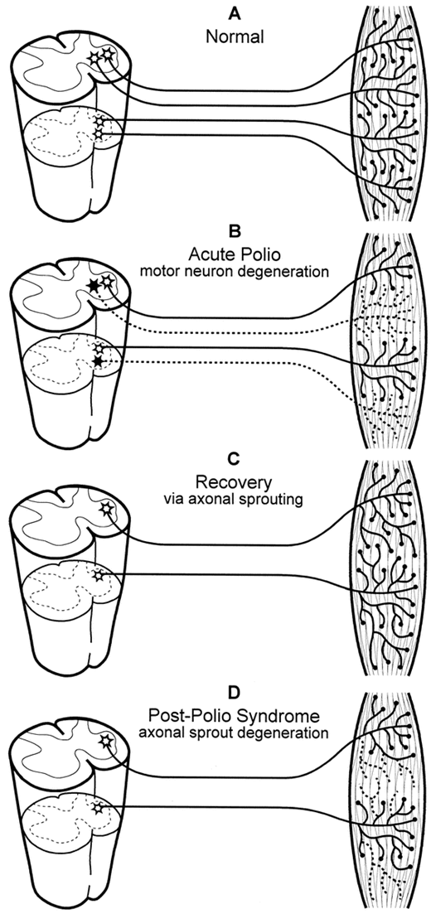
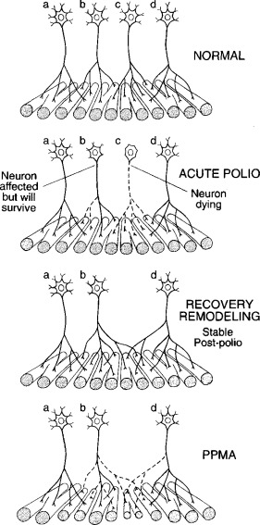

Slide 14
Epidemiology
In North America, rare due to polio vaccination
However paralytic original polio disease still exists in certain parts of Africa, India and southeast Asia
Risk still exists to Canadian’s based on travels and immigration
https://polioeradication.org/

Slide 15
Epidemiology
From 1947-1962:
Canada >30,543 cases Polio
Sask >3514 cases Polio
In 1991 Poliovirus was eradicated from entire Western Hemisphere
In 2019 ~ 40 cases in Canada (immigration)
2014 there are approximately 31,000 Canadian polio survivors

Slide 16
Consider:
If polio was eradicated in 1991 what do you think your chances of seeing a post-polio patient are?
Why are we learning about post-polio?

Slide 17
Epidemiology
Estimates of polio survivors who will develop PPS varies
~ 25-40% (have seen up to 80% referenced in research)
Those at most risk for developing PPS:
Contracted polio after age 10
Led physically active lives
Required a respirator during acute episode
Made good recovery from severe polio

Slide 18
Clinical Diagnosis of PPS
Confirmed history of Polio
Minimum 10 years stable (after initial polio)
Recurrence of paresis/new paresis
Fatigue and/or pain in previously affected muscles and/or surrounding joints
Deterioration in function
especially ambulation
EMG, muscle biopsies and nerve conduction studies
Exclusion of other neuromuscular problems as cause of symptoms
Notes:
In severe cases may be mis-diagnosed with ALS

Slide 19
PPS Presentation
While motor dysfunction (progressive paresis) is a hallmark feature of the condition other primary and secondary impairments combine to to have considerable quality of life implications in PPS
e.g. sleep disturbances, chronic pain
Notes:
In severe cases may be mis-diagnosed with ALS

Slide 20
PPS Clinical Presentation/Symptoms
PPS Primary Impairments:
Motor
Progressive Muscle Paresis and Atrophy
Localized Muscle Fatigue
Acute Muscle Pain and/or Cramping
Oral Motor (if bulbar affected by original polio)
Recall lower limbs most often affected in original polio – therefore the functional impact of PPS is often decreasing gait, balance, and mobility.
Fatigue
Generalized Fatigue

Slide 21
PPS Clinical Presentation/Symptoms
Autonomic Nervous System
Cold intolerance
Dependent edema
Headache, sweating, dizziness
Respiratory Centers
Hypercarbia/ hypoxemia
Sleep apnea
Headache

Slide 22
PPS Clinical Presentation/Symptoms
Secondary + Composite Impairments:
Musculoskeletal
2. Respiratory
3. Cardio-vascular
4. Cognitive
5. Emotional/Behavioural
6. Posture

Slide 23
PPS Clinical Presentation/Symptoms
As PTs most commonly dealing with
Weakness/paralysis
Fatigue
Both focal and general
Pain
Typically in affected muscles
May also be in joints due to altered biomechanics
And the overall impact on function

Slide 24
Clinical Course of PPS
Gradual progression of paresis
Continuous or stepwise with plateaus of stability
Factors affecting rate of progression are UNCLEAR
Usually progresses slowly
Tend to see PPS more in females, but affects males worse
Notes:
Restoration of nerve function may occur in some fibers a second time, but eventually nerve terminals malfunction and permanent weakness occurs

Slide 25
Watch video of Karim
http://www.youtube.com/watch?v=veS3_qLtyP4&feature=related
What are your initial thoughts? Concerns? Priorities?
PT assessment?
Where is Karim most likely to develop PPS?
Interventions?

Slide 26
PPS PT Assessment
In addition to your general subjective and objective key components for PPS:
Acute Polio history
Detailed history of Present Complaints
Fatigue
Muscle Strength

Slide 27
PPS PT Assessment
Muscle Strength Ax Guidelines:
Priority for initial objective exam and for monitoring
1 or 2 Reps max do MMT plus fatigue
Muscle specific fatigue = 30 sec hold
It’s a challenge to try and figure out what is deconditioning vs disease related atrophy also with training you may not improve MMT grade but instead endurance
Typically, a 30 hold (or repetitions over a 30 sec period e.g., 30 sec sit to stand test) are considered ‘norms’ for endurance of a muscle group – might be more sensitive to change in addition to traditional MMT
Be aware of:
Time of day fluctuations
Do at Room Temperature
muscle substitution and fasciculation

Slide 28
PPS PT Assessment
Considering secondary impairments:
Muscle Atrophy
Pain
MSk System
Posture
CV Status
Respiratory Status
And ultimately their impact on functional activities/ client priorities

Slide 29
PPS Treatment
Medically
Currently no effective pharmacological treatment to prevent deterioration or reverse deficits caused by the syndrome
Focus on symptom mx and QoL
# 1 treatment is exercise
a number of controlled studies have demonstrated that non-fatiguing exercises improve muscle strength and reduce tiredness
WHY DO YOU THINK THAT IS?

Slide 30
PPS PT Treatment
Recall PT Treatment Philosophies
Restoration
Prevention/Maintenance
Compensation
Karim…?

Slide 31
PPS PT Treatment
Focus on symptom management and exercise
Symptom management focus primarily fatigue and pain
Exercise aerobic fitness and preserving and maintaining strength

Slide 32
PPS PT Treatment
Symptom Management - Fatigue:
Lifestyle Modification
Energy Conservation/ Conservation of Mm Function as PPS progresses
Stress Management
Aerobic Fitness

Slide 33
PPS PT Treatment
Symptom Management – Pain:
Muscle Pain and Cramping
Rest
Stretching/massage
Heat
Ice (caution)
Relaxation/meditation/yoga
NSAIDS (caution)
Tonic water
Musculoskeletal Pain (biomech)
Devices/Orthotics/Splints
Surgical Interventions
Posture Correction
Resting Postures
Weight Loss

Slide 34
PPS PT Treatment
Aerobic Fitness
Contraindications
If 3 or more extremities present with strength grades ranging from 3/5 to 4/5 do not prescribe aerobic exercise (functional reserve)

Slide 35
PPS PT Treatment
Aerobic Guidelines/Precautions:
Low impact or no impact activities.
Work extremity muscle groups that are not presenting with progressive paresis, muscle fatigue or cramping.
Warm up and cool down
Watch for signs of localized and generalized fatigue
Schedule ½ hour rest after
Notes:
35

Slide 36
PPS PT Treatment
Localized muscle fatigue
a sensation of fatigue from the muscle
decrease in quality of movement, e.g. jerky
a decrease in the excursion of the movement
a perceived increase in effort to perform the movement
the commencement of compensatory movement
Notes:
36

Slide 37
PPS PT Treatment
Aerobic – DURATION
Total time as low as 15 minutes. Increase gradually, to a maximum of 30-45 minutes
Sedentary individuals: interval training (i.e., discontinuous) may be necessary initially to prevent general fatigue, muscle fatigue and pain
Notes:
37

Slide 38
PPS PT Treatment
Aerobic – INTENSITY
Build gradually from 30-40% to 50-60% of maximal aerobic capacity
Use Borg Scale of perceived level of exertion as a guide: progress gradually from fairly light
perceived exertion (10-11) to somewhat hard (13)
Notes:
38

Slide 39
PPS PT Treatment
Aerobic – FREQUENCY
3 – 5 x/week
Improving the aerobic capacity in PPS is difficult through exercise primarily focusing on the lower extremities, and may require a more individualized approach, including the use of other large muscle groups instead
Voorn et al. 2016
Notes:
39

Slide 40
PPS PT Treatment
Aerobic Implementation:
Discontinue/limit activities as deemed appropriate on an individual basis
Set Priorities
Local muscle fatigue = STOP and REST NOW!
Pace and plan ahead
Work/Activity simplification/modification--
Adaptive/assistive devices
Delegate

Slide 41
PPS PT Treatment
Muscle Strength
Education
Exercise Guidelines

Slide 42
PPS PT Treatment
Strength - Education
etiology of progressive paresis in affected muscles
detrimental effects of repeated/excessive tiring of affected muscles

Slide 43
PPS PT Treatment
Strength Exercise Guidelines
Muscles must have at least grade 3 strength (i.e., full range tested against gravity)
Muscles must have more strength in reserve than that required for minimum daily function.
To assess this in lower extremities: measure strength before and immediately following a 1-2 minute walk. If the individual experiences any decline in strength after the walk, there is no reserve
Schedule ½ hour rest following completion of strengthening program.

Slide 44
PPS PT Treatment
Strength – FREQUENCY:
No more than 3x/week
Strength - Fatigue/Pain:
Strengthening exercises must be symptom limited: stop if either muscle pain/cramping or muscle fatigue develop

Slide 45
PPS PT Treatment
Strength - INTENSITY
Endurance is a higher priority than power: less than maximal intensity
Commence: 5-10 reps, at a perceived exertion of 10-11 on Borg scale (light – fairly light muscle contraction)
Gradually increase reps to a maximum of 30

Slide 46
PPS PT Treatment
Strength – INTENSITY Progression
If 30 reps do not cause muscle specific fatigue or pain, add 1-2 lb. weight
Perceived exertion on Borg scale of 12-13, but decrease reps back to 5
Gradually increase reps again to a max of 30
An individual should reach a maintenance level of 30 reps within 3-6 months

Slide 47
PPS PT Treatment
Strength – INTENSITY Modifications
If muscle fatigue or pain/cramping commonly develop during or following completion:
Reduce or remove any weight resistance that has been added
If fatigue or pain/cramping occur despite removal/reduction of resistance, decrease reps
If muscle fatigue or pain/cramping continues:
Discontinue strength training for the affected muscle/muscle group

Slide 48
Please watch: Post-Polio Syndrome – Individual Perspective
http://www.youtube.com/watch?v=-niuToVsL9A&feature=channel

Slide 49
Reflection Questions
What other health care professionals do you think you would collaborate with as part of comprehensive care for someone living with PPS?
What would you educate a client with PPS on in your first session?
How do you assess for LMN signs (consider actually practicing this)?

Slide 50
Resources
March of Dimes
https://www.marchofdimes.ca/en-ca/programs/postpolio/
Post polio international
http://www.post-polio.org
Lit Review: Shing et al. 2019, Post-polio Syndrome: More Than Just a Lower Motor Neuron Disease in Frontiers in Neurology
CBC video (FYI) about polio and post polio
http://www.cbc.ca/archives/entry/post-polio-syndrome-the-sequel

