Slide 1
Guillain-Barré Syndrome GBS
Named after the 2 french physicians who first described it…
Neuro 3

Slide 2
Objectives
Briefly discuss epidemiology, etiology, pathophysiology and prognosis
Discuss reasons for variation in clinical course and recovery
Compare pathology and primary impairments of GBS to other pathologies (such as PPS or MS)
Discuss presentation and causes of secondary impairments and complications
Discuss, compare and contrast physiotherapy treatment objectives and treatment methods that would be appropriate in the acute (Phase 1 and 2) and rehab (Phase 3) periods of GBS
Discuss necessary treatment precautions and implementation guidelines
Describe exercise precautions and implementation guidelines for GBS

Slide 3
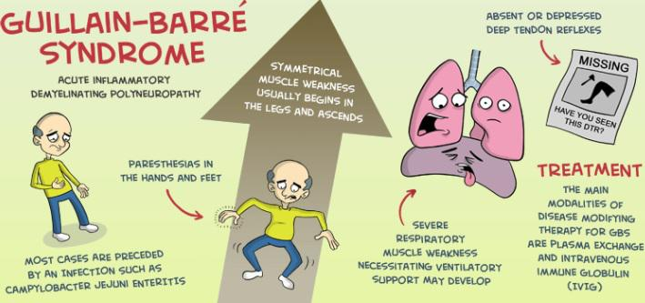
Guillain-Barre Syndrome (GBS)
Immune system attacks part of the PNS
Presents as acute generalized weakness
Typically presents following some sort of infection (viral, respiratory)

Slide 4
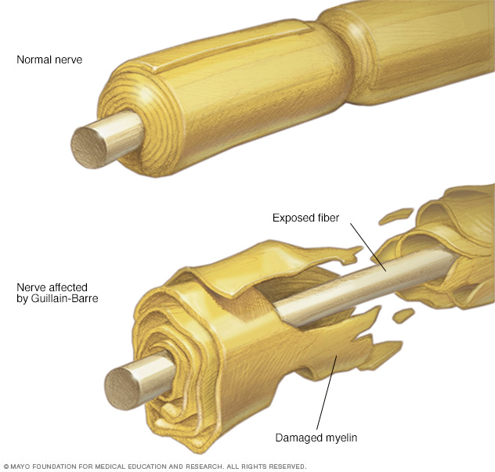
Notes:
CNS vs PNS myelinating cells oligodendrocytes (CNS) vs. Schwann cells (PNS)
CNS demyelinating conditions (MS) CNS axons do not spontaneously regenerate after injury
PNS axons readily regenerate, allowing recovery of function after peripheral nerve damage

Slide 5

Pathoanatomy and Physiology
Acute inflammatory polyneuropathy
Results in demyelination and axonal damage
Largely motor dysfunction
+/- sensory and ANS
May also hear it referred to as:
Acute idiopathic polyneuritis
Acute inflammatory demyelinating polyneuropathy (AIDP)
Post-infectious polyneuropathy

Slide 6
Pathoanatomy and Physiology
Affects PNS
Inflammatory lesions occur predominantly in proximal parts of PNS (i.e. nerve roots)
Spinal nerve roots:
Cervical, thoracic and lumbar mainly
sacral typically spared
Cranial Nerves ~ 50% of cases
Mostly VII = Facial
Others may include: III (oculomotor), V (trigeminal), VI (abducens), IX (glossopharyngeal), X (vagus), XII (hypoglossal)

Slide 7
Pathoanatomy and Physiology
Inflammation typically low grade
Continues about 1 month before plateau
Causes demyelination
Resulting in:
Slowed conduction of impulses
dispersion of impulses
If more severe, blocked conduction of impulses
If inflammation becomes severe
Necrosis of axons may occur

Slide 8
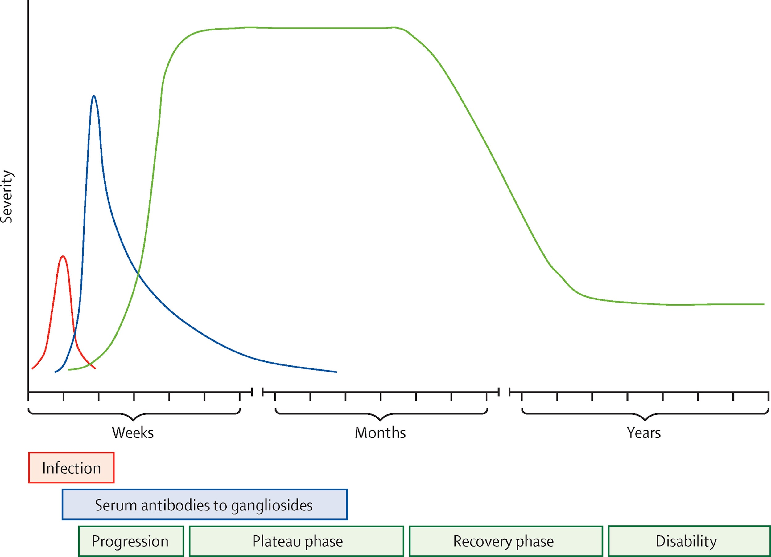
Figure 1
Willison et al. GBS. 2016. The Lancet;388(10045): 717-27 DOI: (10.1016/S0140-6736(16)00339-1)
Notes:
Guillain-Barré syndrome time course

Slide 9


Neural Plasticity
Mechanisms responsible for recovery
Recovery = restoration of effective transmission of electrical impulses
Remyelination
Axonal Regeneration (ie. Axonal sprouting)

Slide 10
Etiology
Evidence of immune mediated disease
Analysis of CSF (cerebral spinal fluid) shows elevated protein levels
sensitization of T lymphocytes to protein in the myelin sheath
Systemic infection or insult usually trigger immune response
Majority of patients have had a preceding illness 1-6 wks prior to GBS onset (e.g. gastro or respiratory infection)

Slide 11
Etiology
Common Infectious Triggers
~ 40%: Campylobacter jejuni – food borne, causing gastrointestinal bacterial infection
Mycoplasma pneumoniae - respiratory bacterial infection
Herpes viruses (cytomegalovirus, Epstein Barr, and others)
Some cases have been preceded by influenza vaccination (rare now)
Side note: As of April 23, 2021 People who have previously had GBS may receive a COVID-19 vaccine. To date, no cases of GBS have been reported following COVID vaccine

Slide 12
Epidemiology
Incidence:
world wide = ~ 1.3/100,000
Canada = 1.6/100,000
much lower than incidence of MS
But most common cause of non traumatic paralysis
Males : females = 2:1
higher incidence with advancing age
Onset: two peaks between ages 16-25 and 50-74
Mortality: low
but increases 6 fold after age 60
Causes of death: respiratory or autonomic dysfunction

Slide 13
Clinical Course
3 phases:
1.Progressive deterioration
over the course of approximately 1-4 weeks
2. Plateau
no further deterioration
3. Recovery
taking from 6 months to more than a year

Slide 14
Clinical Course
Why this much variation in recovery?
Depends upon the extent of axonal destruction
The more axonal destruction that has occurred, the longer the recovery phase takes
Axonal regeneration takes significantly longer than remyelinization.
Re-innervation may take quite some time, as the lesion sites are typically in the proximal parts of the PNS

Slide 15
Prognosis
50% of patients reach their peak severity of disease at about 2 weeks
80% by 3 weeks
Recovery usually starts within 2–4 weeks after disease onset
Care can be difficult but favourable outcome in the majority of cases

Slide 16
Prognosis
80% are ambulatory within 6 months of disease onset
85% recover sufficiently to have no permanent disabilities, although half of this 85% are left with mild impairments
(e.g.) hyporeflexia, weakness of small muscles of hands and face, pain and fatigue
15% are left with activity limitations of varying severity

Slide 17
Prognosis
Factors associated with a poorer prognosis:
Older age
Requirement for respiratory support
Subgroup of GBS with primary axonal degeneration
Patients with rapid onset
Severe disease at presentation
Campylobacter jejuni infection
Patients showing no improvement at 3 weeks of plateau of disease

Slide 18
Prognosis
Epidemiological studies have not identified any factors predictive of recurrence
Recurrence risk low less than 4%

Slide 19
Clinical Context:
Most patients require hospitalization
Patients are closely monitored for signs of respiratory distress
About 30% require ventilator support during the acute stage
A common scenario post ventilator would be inpatient rehabilitation for 3–6 weeks followed by a community and home based rehabilitation program for 3–4 months, followed by sometime to regain global strength/endurance back

Slide 20
Clinical Presentation
effects vary from mild to severe
motor signs predominate
typical first signs and symptoms:
acute muscle tenderness and aching
distal lower extremity paresis
distal paresthesia or hypoesthesia (stocking and/or glove distribution)

Slide 21
Clinical Presentation
Primary Impairments (LMN)
Paresis
Hypotonia/reflexia and atrophy
Pain
Fatigue
Paresthesia
ANS
Secondary Impairments
MSK, CV and Skin

Slide 22
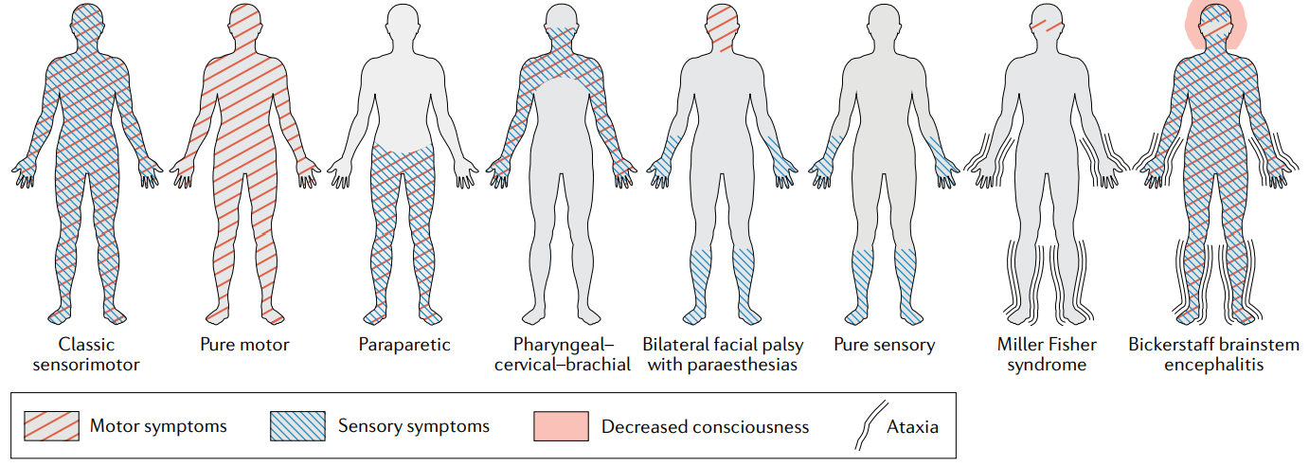
Pattern of symptoms in variants of Guillain–Barré syndrome
Diagnosis and management of Guillain–Barré syndrome in ten steps Nature reviews-Neurology 2019

Slide 23
Primary impairments
Paresis
Lower extremities>upper, trunk
Progresses from distal to proximal
Typically bilateral and symmetrical
Respiratory muscles (phrenic nerve) affected in 30% of cases
May see CN involvement (facial droop, dysphagia etc)
Hypotonia, hyporeflexia and atrophy as per paresis

Slide 24
Primary impairments
Pain
Back and leg muscle most common
‘deep aching and throbbing’
May also see systemic joint pain associated with stiffness in phase 3
Fatigue
Not as severe or long lasting as focal fatigue in MS but may be exacerbated by over working muscle, also have generalized fatigue, becomes a composite impairment

Slide 25
Primary Impairments
Sensory
Typically burning, tingling or shock-like pain in distal stocking or glove distribution
Autonomic (most common in quadriparesis and respiratory failure)
Fluctuating BP
Orthostatic intolerance (due to decreased vasomotor tone)
Trachy or bradycardia
Arrhythmia
Skin changes
CRPS

Slide 26
Secondary Impairments
MSK
ROM
Biomechanical pain
Joint integrity
CV
Edema, decreased fitness and work capacity (generalized fatigue)
Skin
Risk of pressure sores

Slide 27
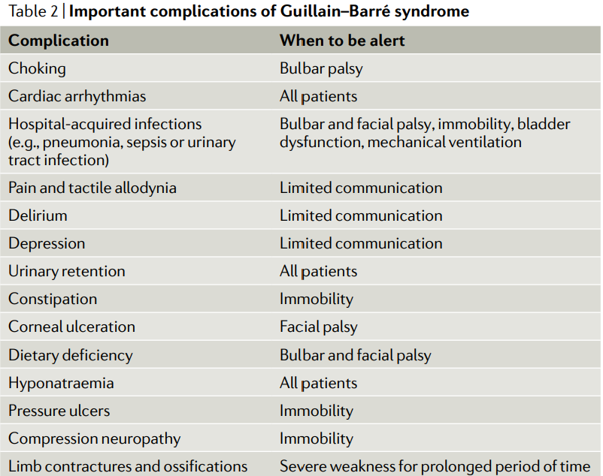
Diagnosis and management of Guillain–Barré syndrome in ten steps Nature reviews-Neurology 2019

Slide 28
Features of syndrome Frequency
Weakness in the legs 95%
Weakness in the arms 90%
Areflexia 90%
Paresthaesia 85%
Sensory loss 75%
Oropharyngeal weakness 50%
Pain 30%
Respiratory failure 30%
Ophthalmoparesis 15%
Ataxia Sphincter involvement 15%

Slide 29
Medical Management
Management of impaired respiratory and autonomic functions are first priority
Intubation and assisted ventilation
Corticosteroids:
to decrease inflammation in the hope of preventing axonal destruction
Immunoglobulin and Plasmaphoresis
Pain management: NSAIDs, analgesics
Prevention/management of medical complications

Slide 30
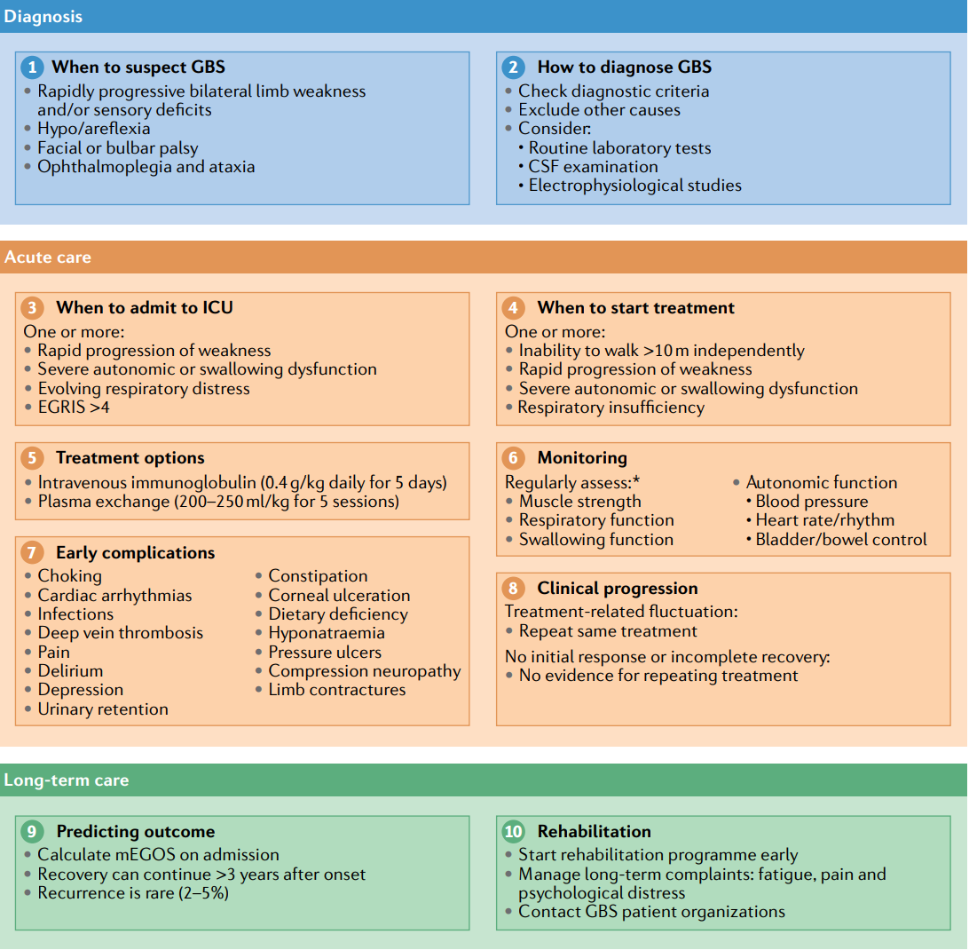
Medical Management Continued
Diagnosis and management of Guillain–Barré syndrome in ten steps Nature reviews-Neurology 2019

Slide 31
PT Management
Phase 1 and 2: Acute and Subacute
Prevent respiratory complications
Prevent pressure sores, pressure palsies, CRPS and DVT
Maintain structural mobility and joint integrity
Reduce pain
Avoid fatigue
EDUCATE

Slide 32
PT Management
Phase 3
Rehab…
Minimize activity limitations
Improve respiratory function
Prevent complications and secondary impairments
Reduce pain
Increase muscle strength (with precautions)
Improve aerobic fitness and work capacity
Improve postural orientation and stability
Educate – fatigue and energy conservation

Slide 33
Please watch this video on Holly’s journey with GBS:
https://www.goodreads.com/videos/134392-holly-s-journey-from-guillain-barre-syndrome-to-happily-ever-after

Slide 34
See word document ‘additional lecture notes GBS’ for more detail on impairments

