Slide 1
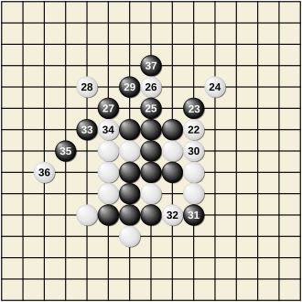
Gomoku AI through Reinforcement Learning and Monte Carlo Tree Search

Slide 2
Overview and Motivation
Gomoku has simple rules but a very large search space
Traditional AI relies on handcrafted pattern scores
Rule-based AI may struggle with long-term strategy
Goal: Build a playable Gomoku AI and train it using reinforcement learning

Slide 3
Prior Work
Traditional Gomoku methods:
Pattern-based evaluation
Immediate win and block
Minimax search
Modern board-game AI: self-play generates training data
MCTS explores possible future moves
Refer to AlphaGO

Slide 4
Proposal Method
Build a 19*19 Gomoku Board and make all the graphics using Pygame
Use MCTS to explore future moves, prioritize promising positions, and select moves using visit counts
Train it using self-play by renting a 5090 GPU
Modules that will be used: Pygame, numpy, pytorch

Slide 5
Challenges
High GPU requirements
Low-quality early self-play games
Disadvantage for white

Slide 6


The project will be sponsored by GPT 5.6 Sol and Claude Opus 5😀

Slide 7
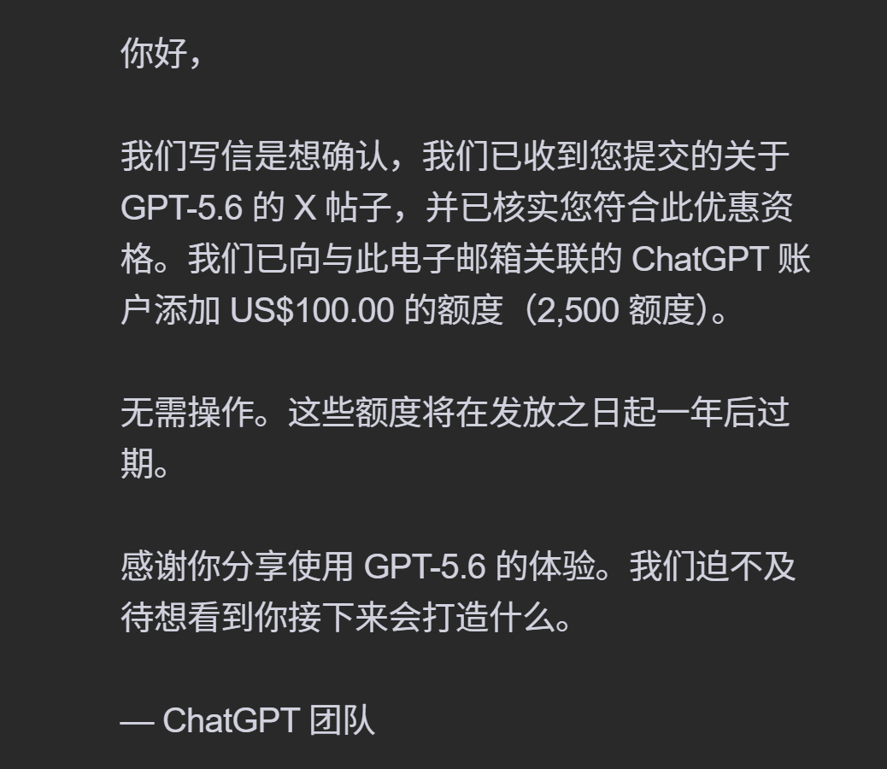

Thanks to Tibo! @thsottiaux

