Slide 1

AirBNB In NYC
Data Visualization
By Tomas Nivon

Slide 2
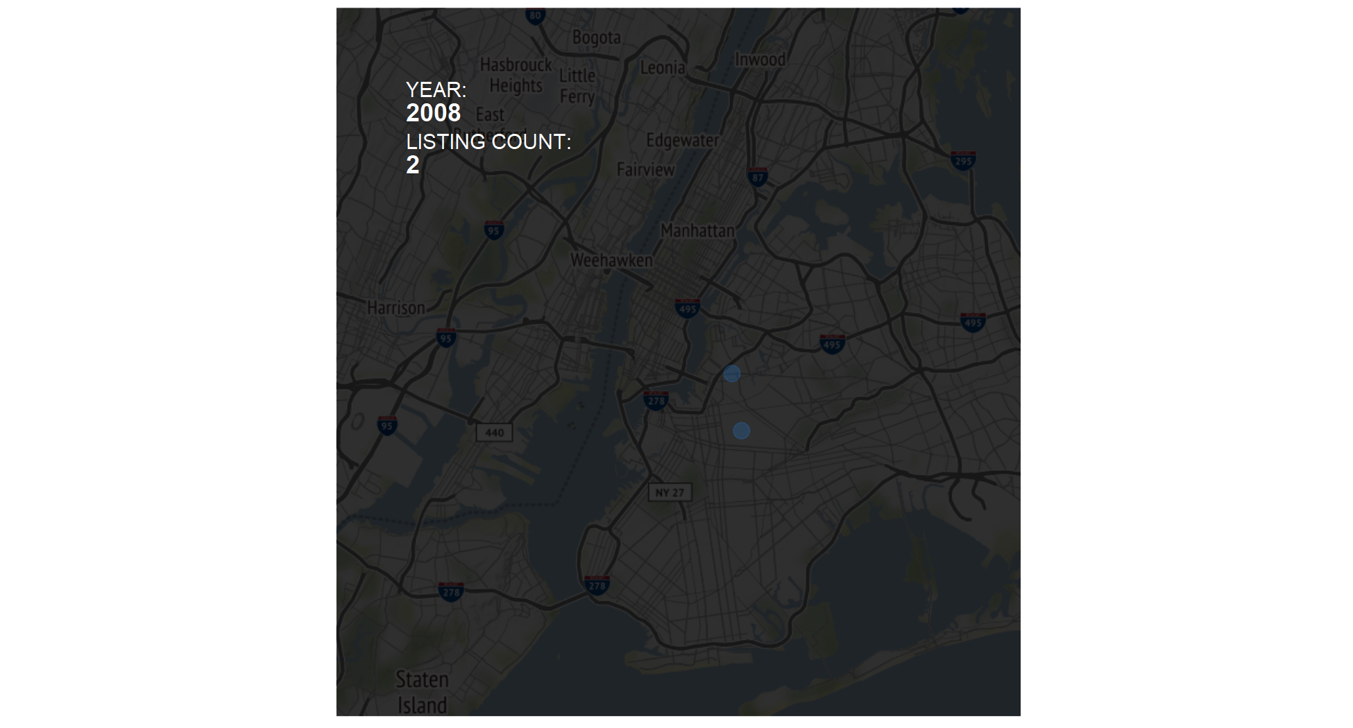
AirBNB Growth: 2008 - Present

Slide 3
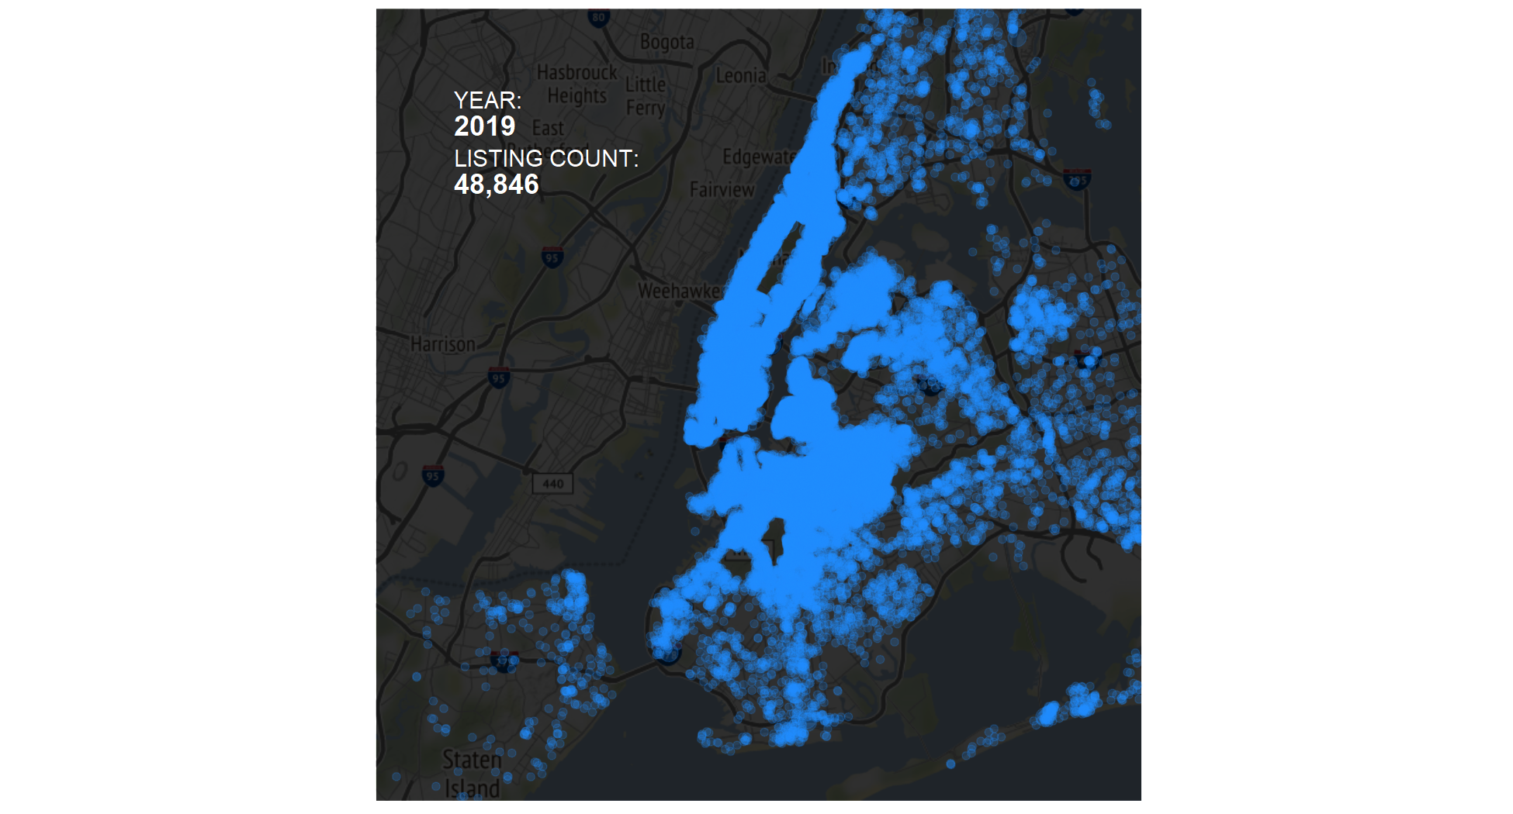
AirBNB Growth: 2008 - Present

Slide 4
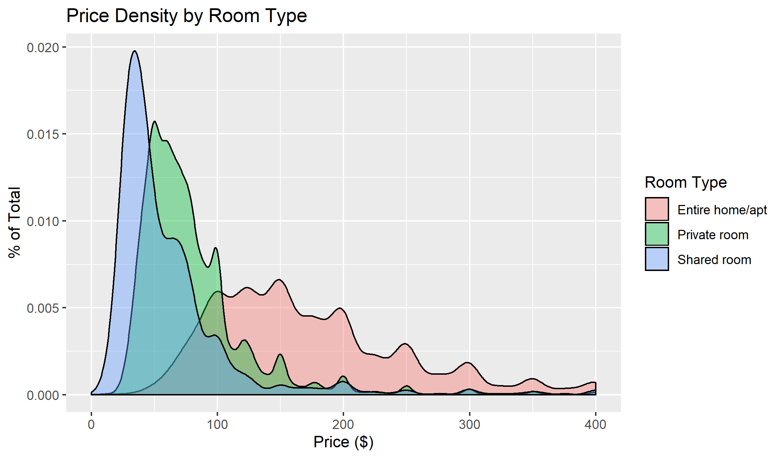
AIRBNB in NYC – Summary Statistics
85% of all listings are in Manhattan and Brooklyn
Listings are split between Entire Home/apartments (52%), Private Room(46%), and Shared Room (2%)
Price range is from $10 - $10,000 with half of all observations falling under $105/night

Slide 5
AirBNB in NYC – Project Motivation
What is the pricing landscape in NYC?
As a customer of AirBNB, where can I get the best value?
What impact do subways have on AirBNB pricing and location rating?

Slide 6
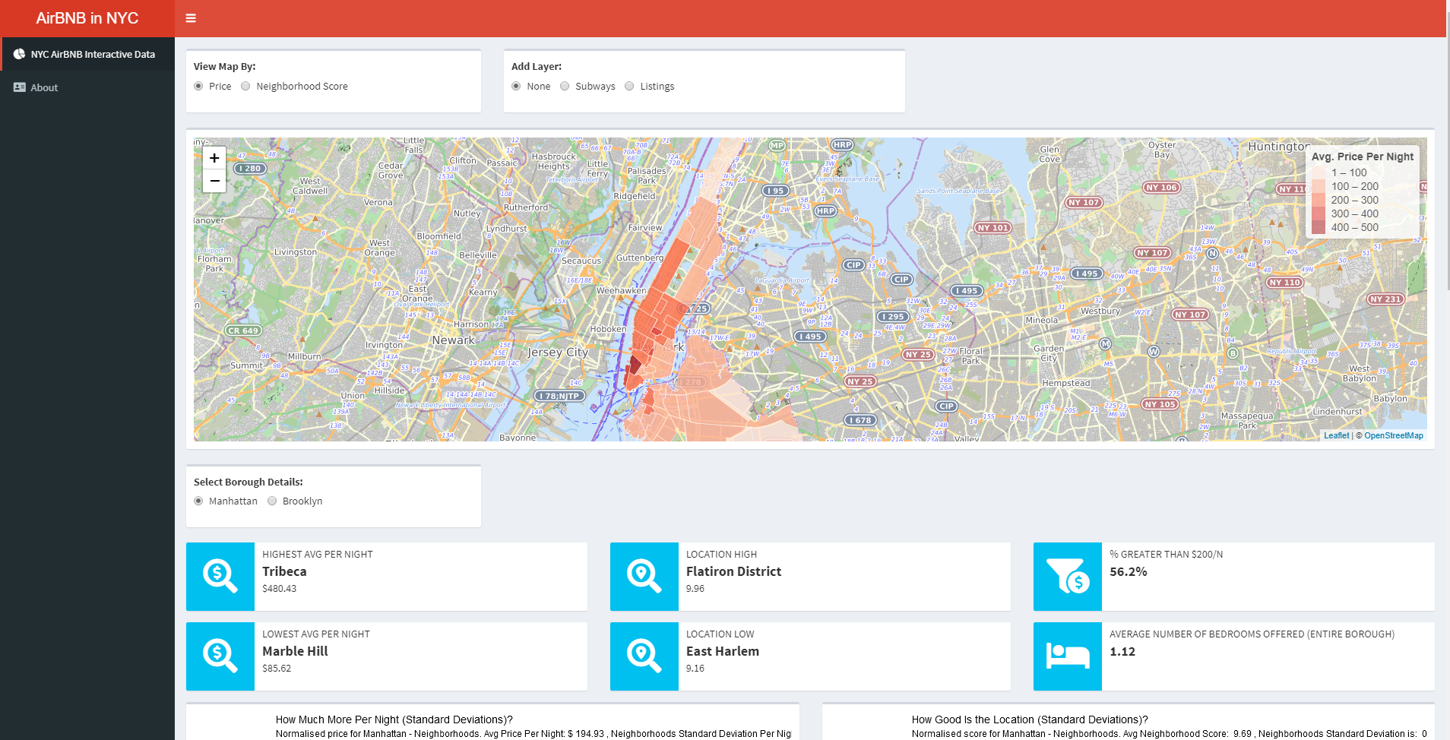
Shiny App

Slide 7

Future Research
What impact do different subway lines have? Which subway line is the most ‘valuable’?
What neighborhoods/boroughs have the largest impact?
What impact does day of the week and different times of year have on pricing? i.e. Christmas, weekends etc.

