Slide 1
Data Science – intro 2
Course text, Jupyter Notebooks, arithmetic (the computer way), variables

Slide 2
Course TAs
Arpan Nayak
Thomas Roberts
Poppy Aves

Slide 3
Keep learning
I have learned and used lots of languages in my data science journey
assembly, Basic, FORTRAN, COBOL, Perl, C, C++, R, Python
At the same time, I am relatively new to Python
I can make mistakes. Making mistakes is part of coding.
If it looks like I am doing something wrong, ask. I may be and we will correct it together.
Seeing the process of making and correcting mistakes is important (how to find and correct mistakes is one of the main things coders need to learn)
The goal is not to make no mistakes. That is impossible.
The goal is to learn to test for, find and fix mistakes
No prior knowledge is assumed for this course

Slide 4
Outline – What we will cover – Getting set up for the course
Course resources
VLab and jupyter notebooks
Piazza (Q & A)
CANVAS page
e-textbook
Student Whatsapp group?
Surviving the computer – some advice
Our first exercise – Dracula

Slide 5
Course organization – course map
Week | Data concepts | Python | Examples
1-2 | Sampling and distributions | Python basics: Variables, operations, functions
3-5 | Simulations | Arrays, loops, data frames | Births of boys/girls, Ethnicity of the jury
7 | Permutations | Random shuffle, ‘if’ statement, compare means (t-tests) | McDonalds/Starbucks, Mosquitos and beer
8 | Linear relationship | Handling missing data, correlation | Fertility and GDP
9 | Linear relationship | Optimization, regression | Cholesterol levels and heart disease
10 | Count data | chi-square test | Titanic
The course runs on two tracks in parallel:
Python programming concepts
Data science concepts
These don’t always look connected (and sometimes they aren’t), but you need both.
More detailed map for each week

Slide 6
Guide to course tools
CANVAS page – has links to tools and announcements
Lecture notes and exercises – Vlab - notes have runnable sections of python if you want to experiment with them
Exercises – Vlab – Make sure you do the exercises
This is the one most important tip for success
The computer provides feedback to guide you during the exercises
If you don’t understand something in an exercise, please post to piazza and/or ask in class – Questions are essential and you do everyone else a service by asking them
Online textbook – Information to support lectures and activities – Make sure you read the weekly sections.
Piazza discussion board – Q&A

Slide 7
Assessment
Homework 1 – formative
Homework 2 – summative (counts for your mark)
Group project
Individual reflective statement covering your project work

Slide 8
A note about AI
AI is NOT always a positive force when learning to program. It depends how you use it.
I suggest you just use google search at the beginning and not AI
Why?
You might have the impression that ChatGPT is a better programmer than you (now)
You are probably right
Guess what? There are lots of humans who are also better programmers than you.
Do you want to learn to program or just learn to copy things?

Slide 9
A note about AI
There is a level of programming and data analysis that AI can’t do (and has no immediate prospect of doing)
This is the thinking part
This is a valuable skill
You can’t learn it without going through the beginning phase where ChatGPT (and other humans) are better than you
No change – it has always been this way
There is no substitute for learning it yourself and that means doing it yourself

Slide 10
A note about AI
I cannot determine how you use the course
If you want a valuable skill, you will do things yourself
You might be able to get by by doing very little work and copying ChatGPT. Many have tried. Some have failed. You won’t know until it is too late if your strategy has worked
If you adopt the AI-dependency route you will have a ‘skill’ that is guaranteed to have ZERO value
Who will hire you when they can hire ChatGPT

Slide 11
A note about AI
There is lots of good information for programmers on the internet
Stackoverflow is one site you will frequently see
Use these sources, but use them to learn, not to copy
Our assessments (e.g. projects) are much more weighted to understanding now, and less to coding. Coding is just a basic level on the way to understanding. We will ask you to explain code and also to explain what data mean.

Slide 12
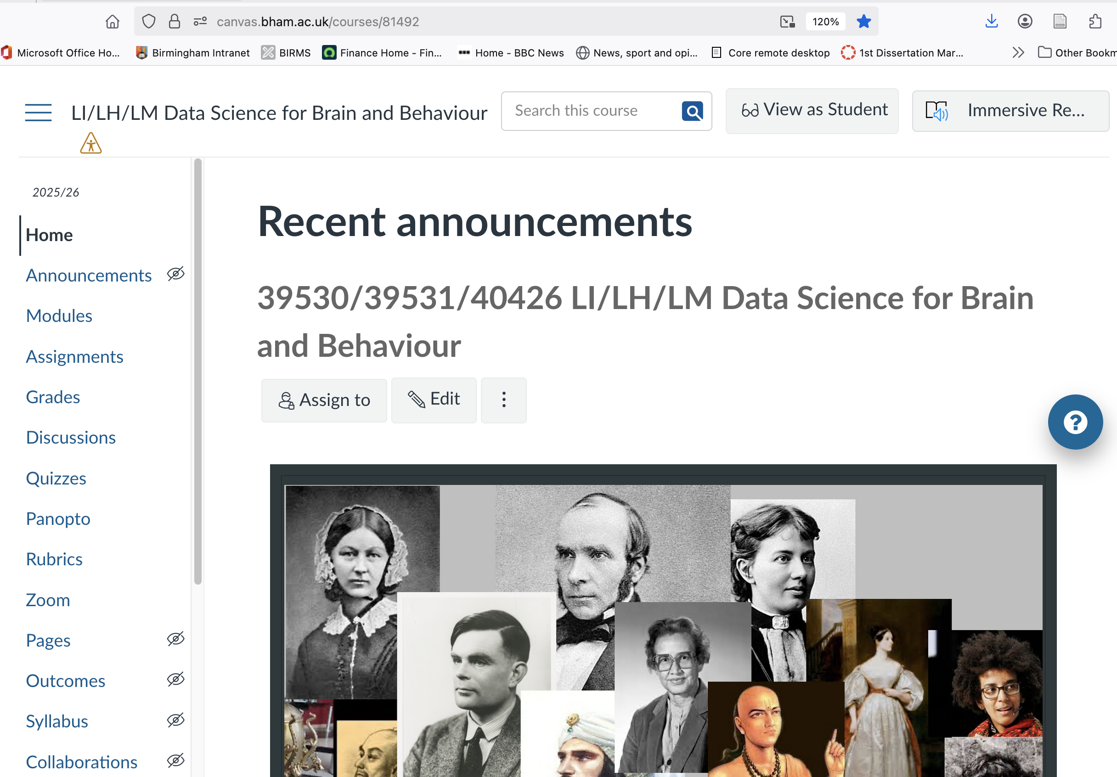
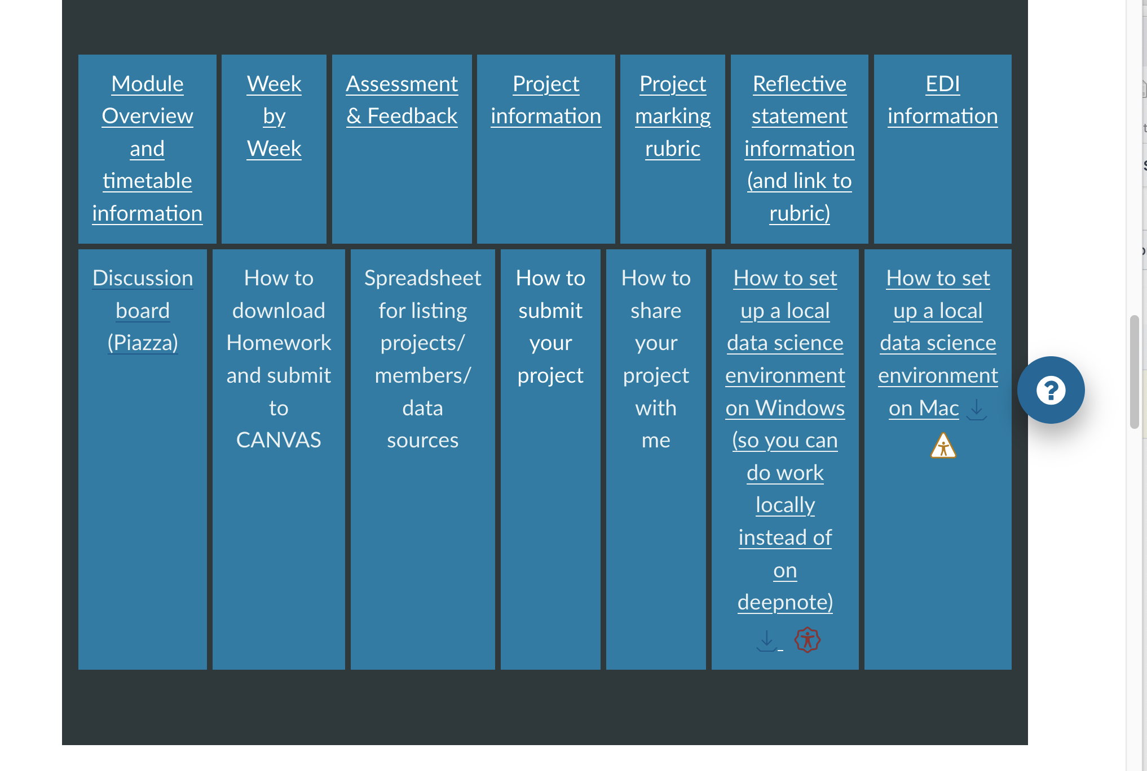
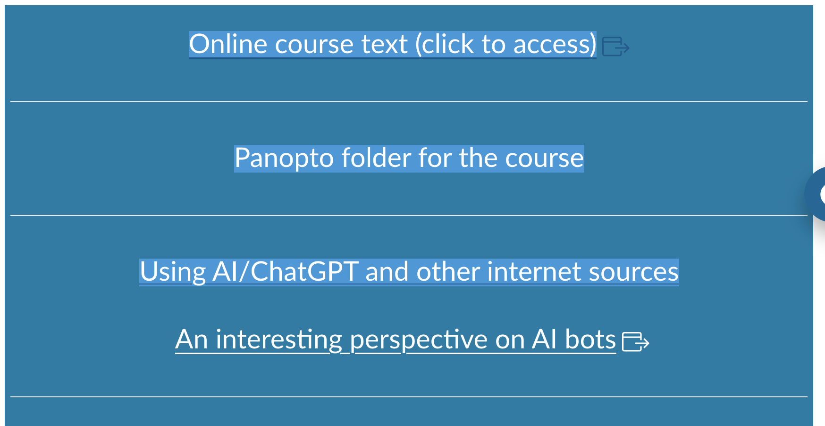
Guide to the CANVAS page: https://canvas.bham.ac.uk/courses/81492

Slide 13
Accessing VLab
You should be able to sign in to Vlab with your normal login. Try it.
https://vlab.oc1.aws.cs.bham.ac.uk/
This gives you a ‘personal space’ to:
Do exercises
Do your homework
Do your projects
View lectures (and run examples from lecture)
You need to copy exercises from a course repository to your personal space in order to work on them
We will set that up together today.
If you can’t log in using your UoB login, don’t panic
There are always some people who are not on the course lists for one reason or another.
Let me know your email address and I will get you put on
You will not be falling far behind.

Slide 14
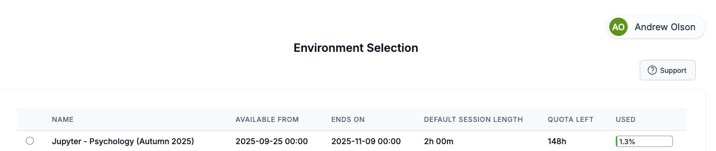
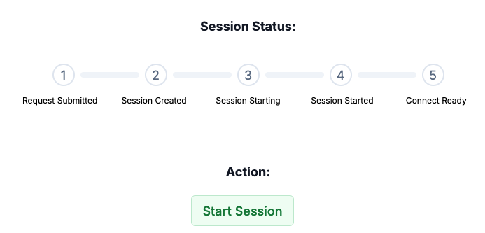
Type the link in your browser (or click on it) You will see something like this…
Select the environment
click on “start session”

Slide 15
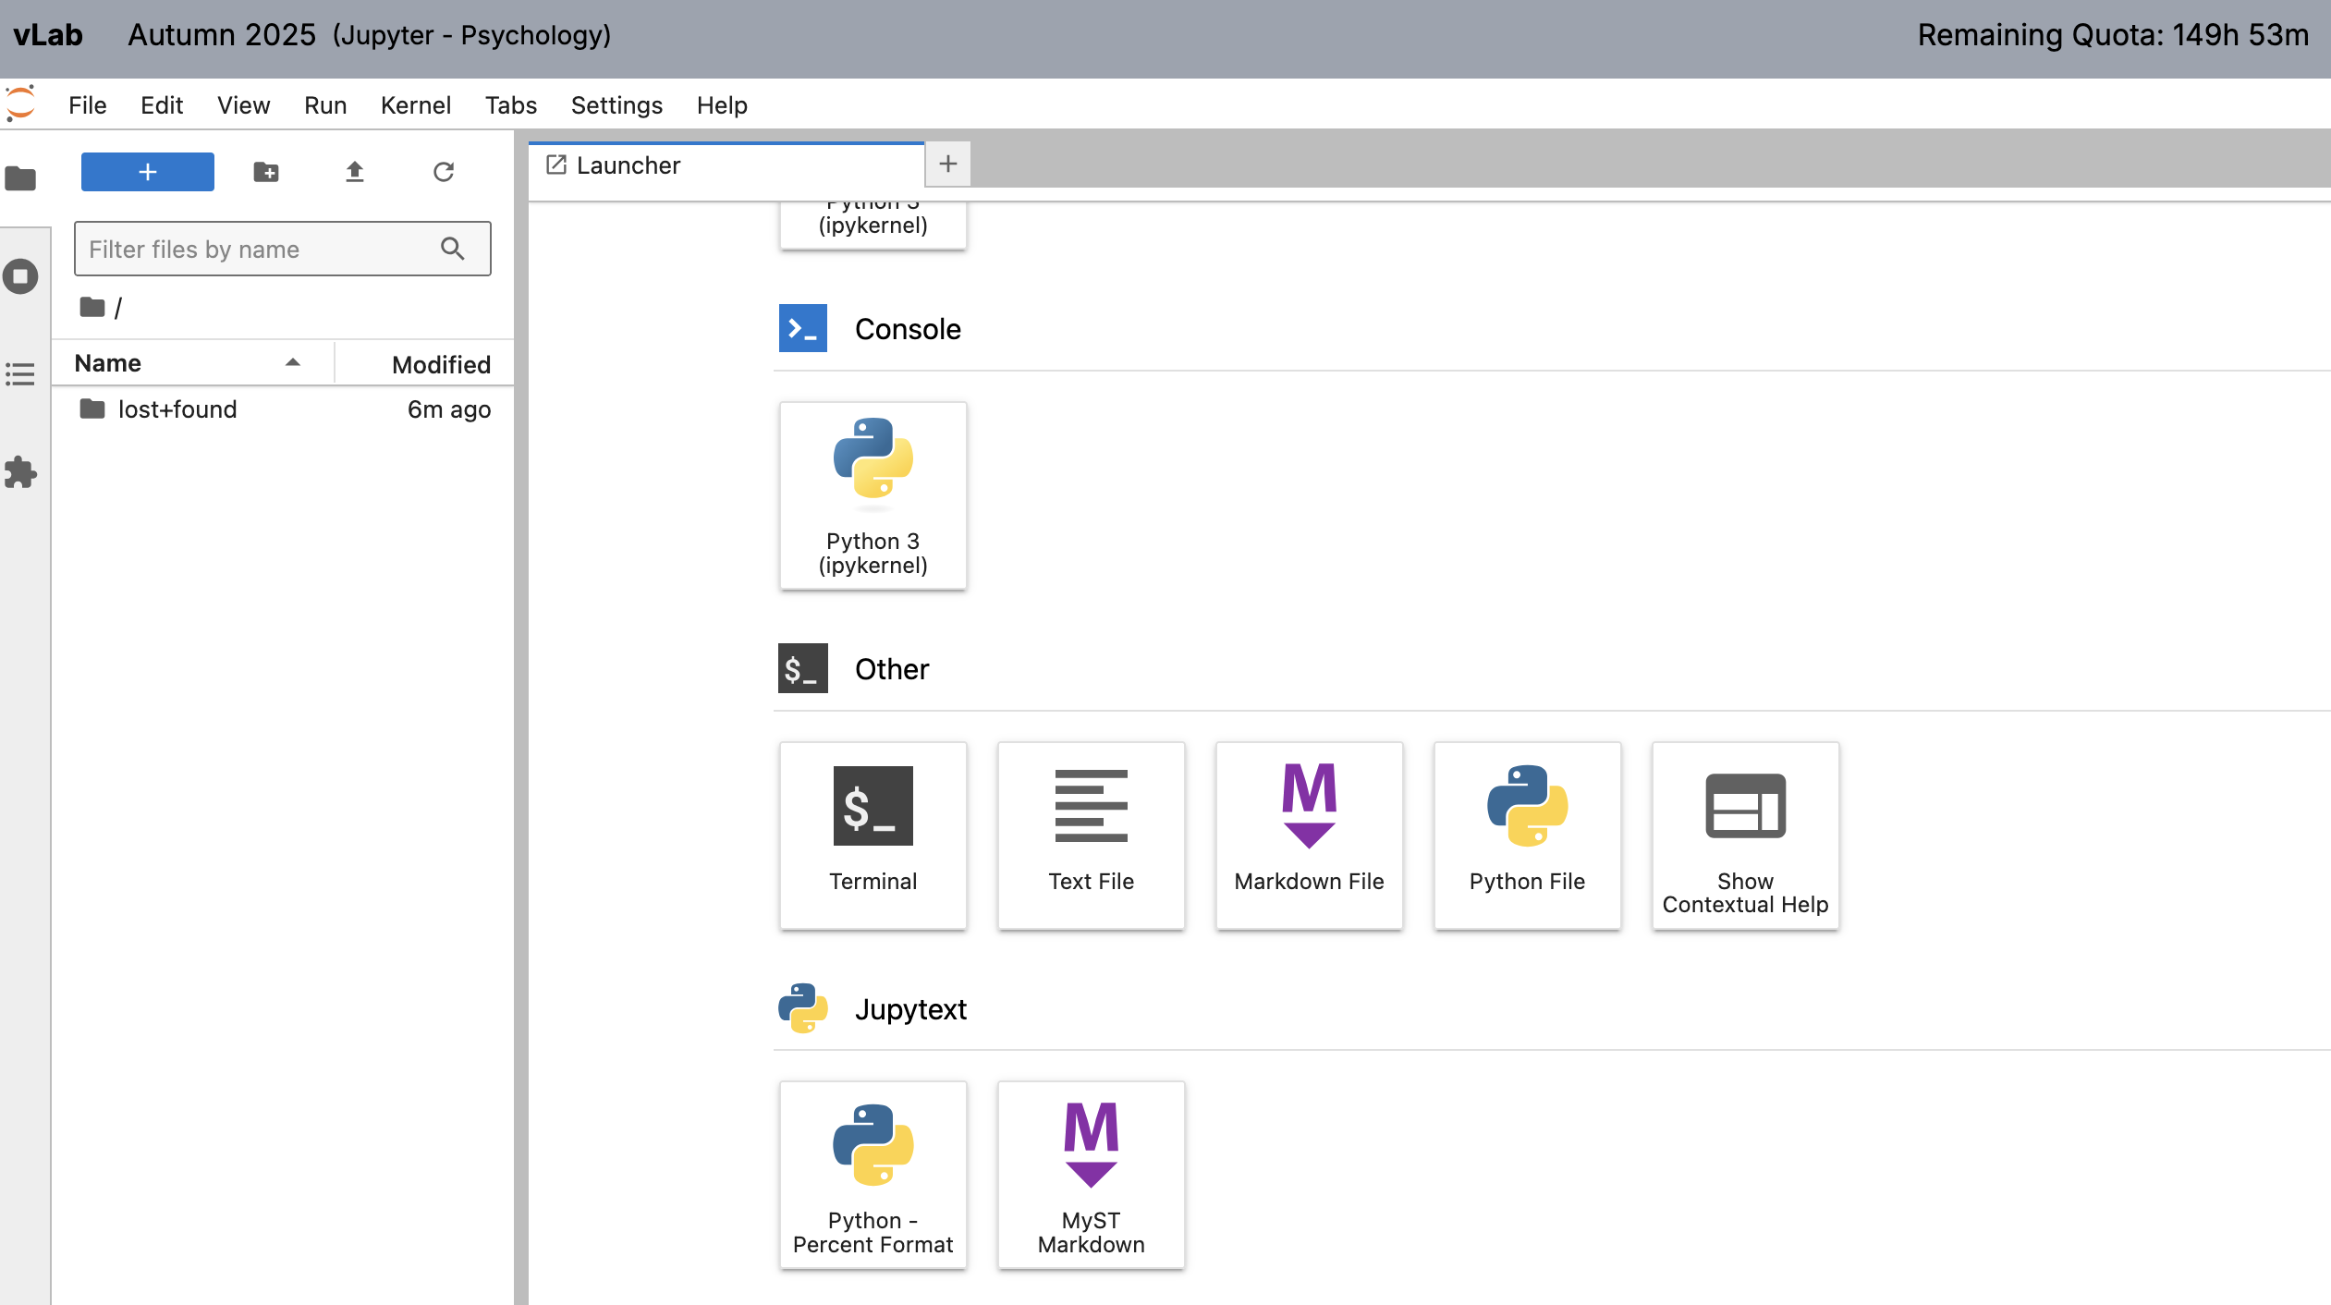
When the environment starts you will see:
navigate here
Look for lecture notes
and exercises in folders
that will appear here

Slide 16
Setting up for getting exercises and notes
We use a popular system for sharing code – ‘git’ and ‘github’
We only need to set up once
Start a terminal – Click on the ‘terminal’ icon

Slide 17
DO NOT DO THIS: Type the ‘git clone’ command to connect to the ‘repository’ where files are stored on the cloud
Copy the command below and paste into your terminal
git clone https://github.com/olsonac/Data_science_for_brain_and_behaviour25-26.git

Slide 18
Start a terminal
Type:
cd
python3 update_me.py
That’s it. This gets any new material from the cloud
It does not change anything you have worked on

Slide 19
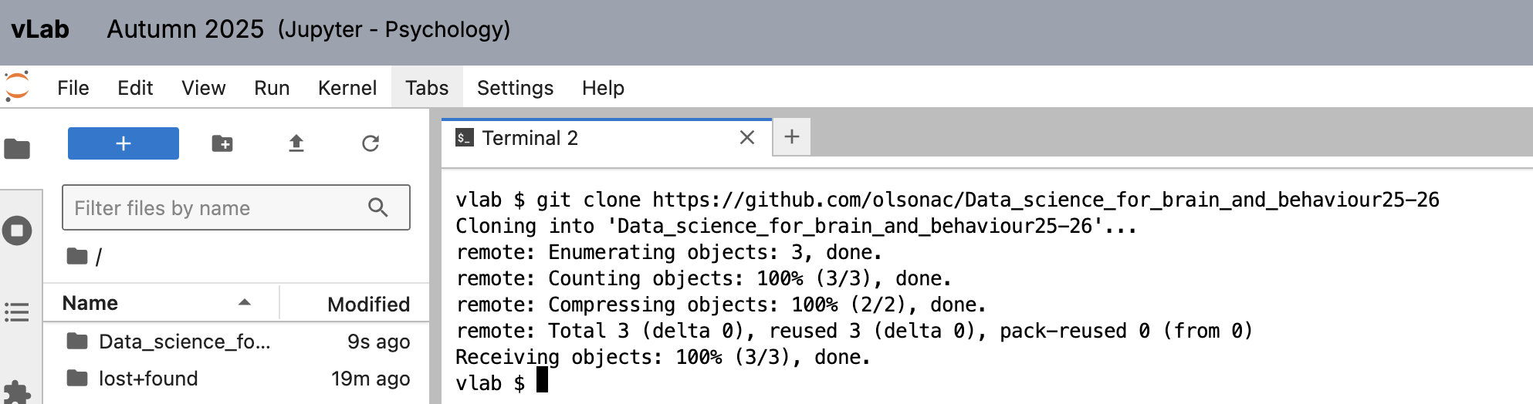
The result should match this:
Notice that you now have a folder for the course. This is where exercises and lecture notes will appear

Slide 20
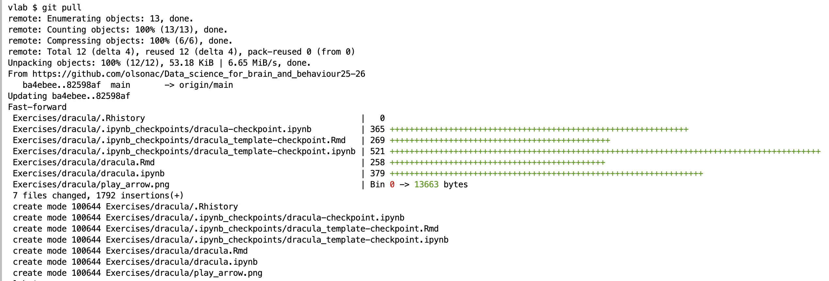
We only do that setup step once – from now on, each week…
Start a terminal
type ‘git pull’
new material will be added to your course folders
e.g.

Slide 21
Our tools: Do I need to install python on my own machine? Jupyter notebooks?
Most of our work is done through vlab.
Still, you might want to have a local copy of python and jupyter notebooks (e.g. for working offline)
If you are interested I can help with that – contact me

Slide 22
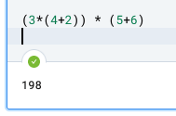
Jupyter notebook – how does it work?
VLab is run through a web browser on your computer
When you run a cell, it doesn’t do the computation on your machine.
When you click on “run” or <cmd><enter>
The browser sends the text you have typed in to the vlab machine somewhere in the networld (maybe California). The vlad machine is running your “kernel”.
The “kernel” is what executes your commands
the kernel does the arithmetic and sends back the answer
The answer comes over the web to your browser.
Your browser gets the message and shows it to you

Slide 23
Why do I need to know that?
Two reasons
1) VLab doesn’t work without a web connection
That may have been obvious already
2) There are two processes looking after you.
One on your machine (your web browser).
One out in the cloud where your kernel is running

Slide 24
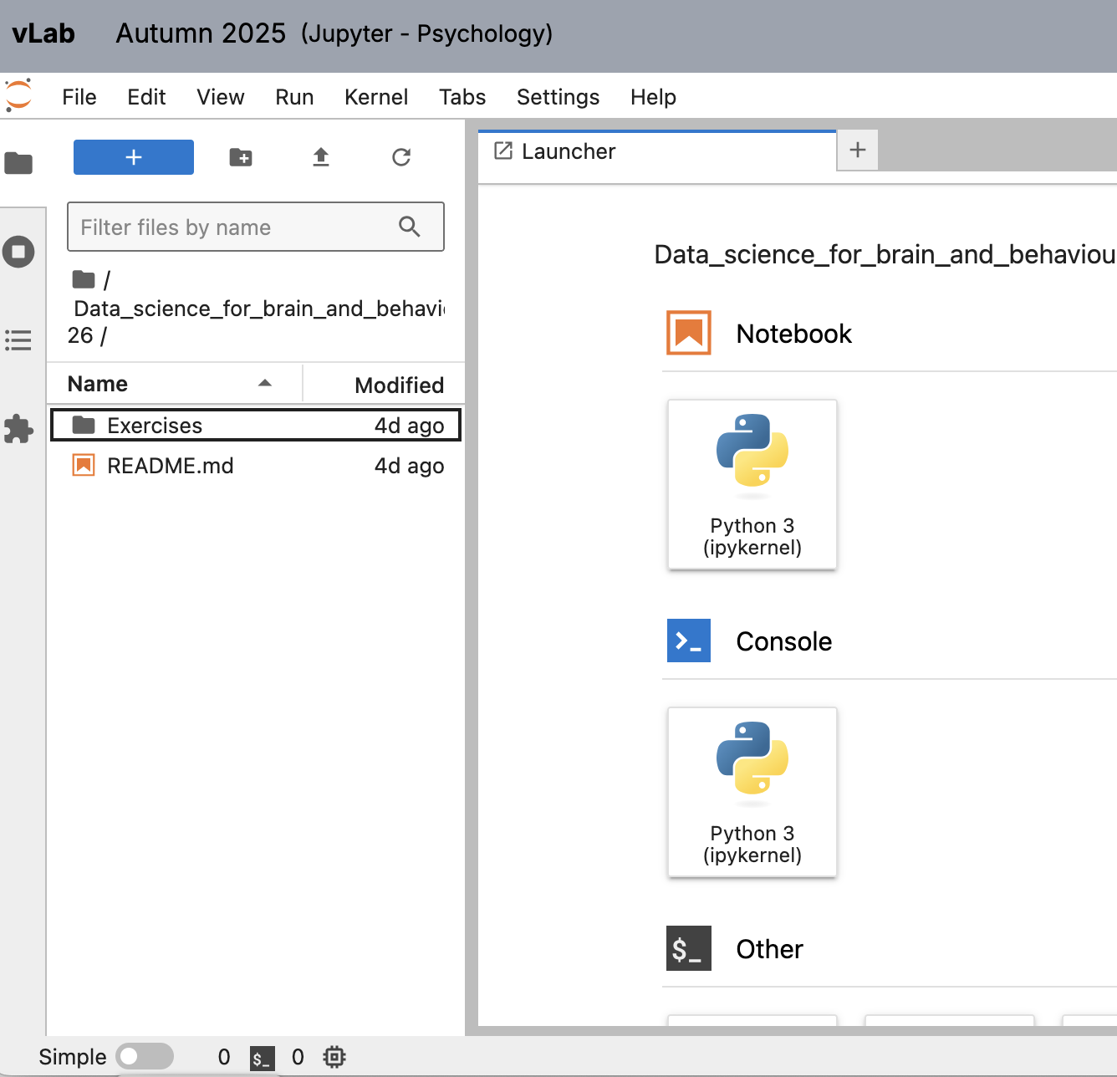
Your first exercise: Dracula
Click on the Data_science_for_brain_and_behaviour_25-26 folder
Click on the exercises folder underneath this

Slide 25
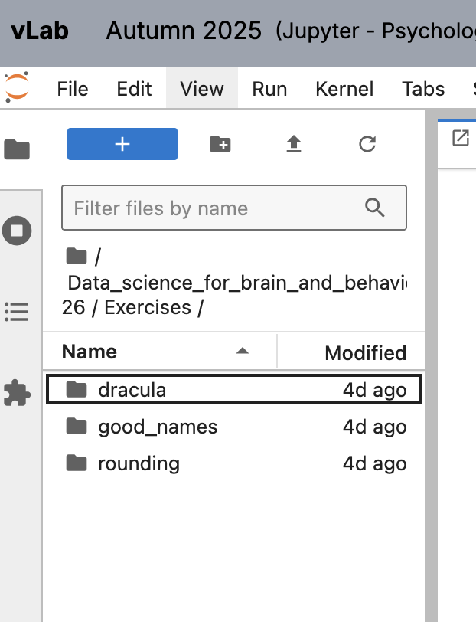
click on the ‘Dracula’ folder
Dracula is our first exercise

Slide 26
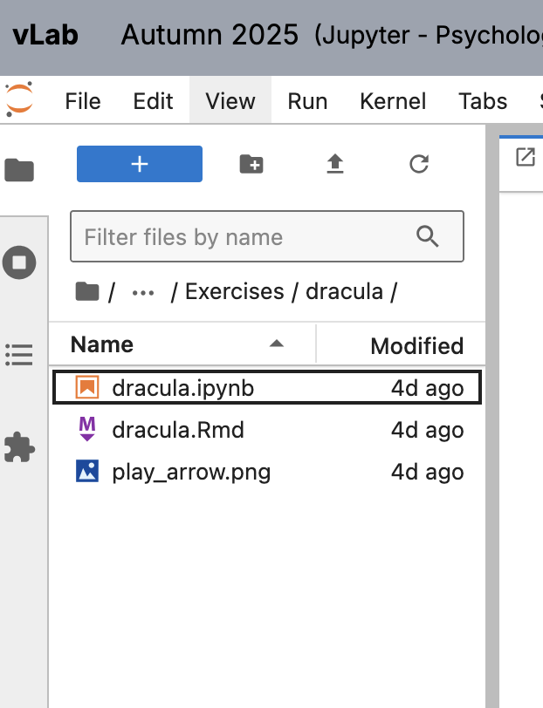
Double click on the ‘dracula.ipynb’ file
.ipynb files are jupyter notebooks
We will be using this type of file for our work
Double clicking on the file will open it

Slide 27
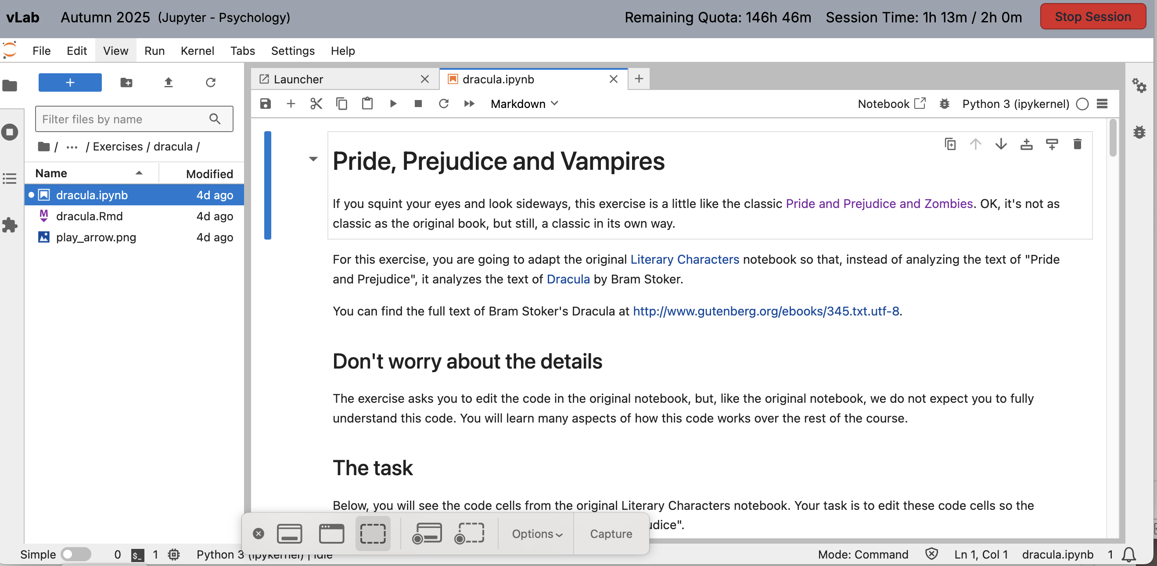
You should now see the notebook:

Slide 28
End of vlab setup
Now you are set up to use vlab to get exercises and notes
New material will appear each week
Remember to do ‘git pull’ before starting your work
Then click on folders to find the notebook you need
We will introduce notebooks in a separate step

Slide 29
Piazza – For questions/discussions
Ask questions!
There are no silly questions
sign up to Piazza using this link:
https://piazza.com/bham.ac.uk/fall2025/395303953140426/home

Slide 30
There are no silly questions about DS
If you have a question, several other people have it too
Guaranteed
Questions help me
Sometimes I don’t know how people are thinking about an issue
“Ooooh, I see how you’re thinking about it”
That can be very helpful

Slide 31
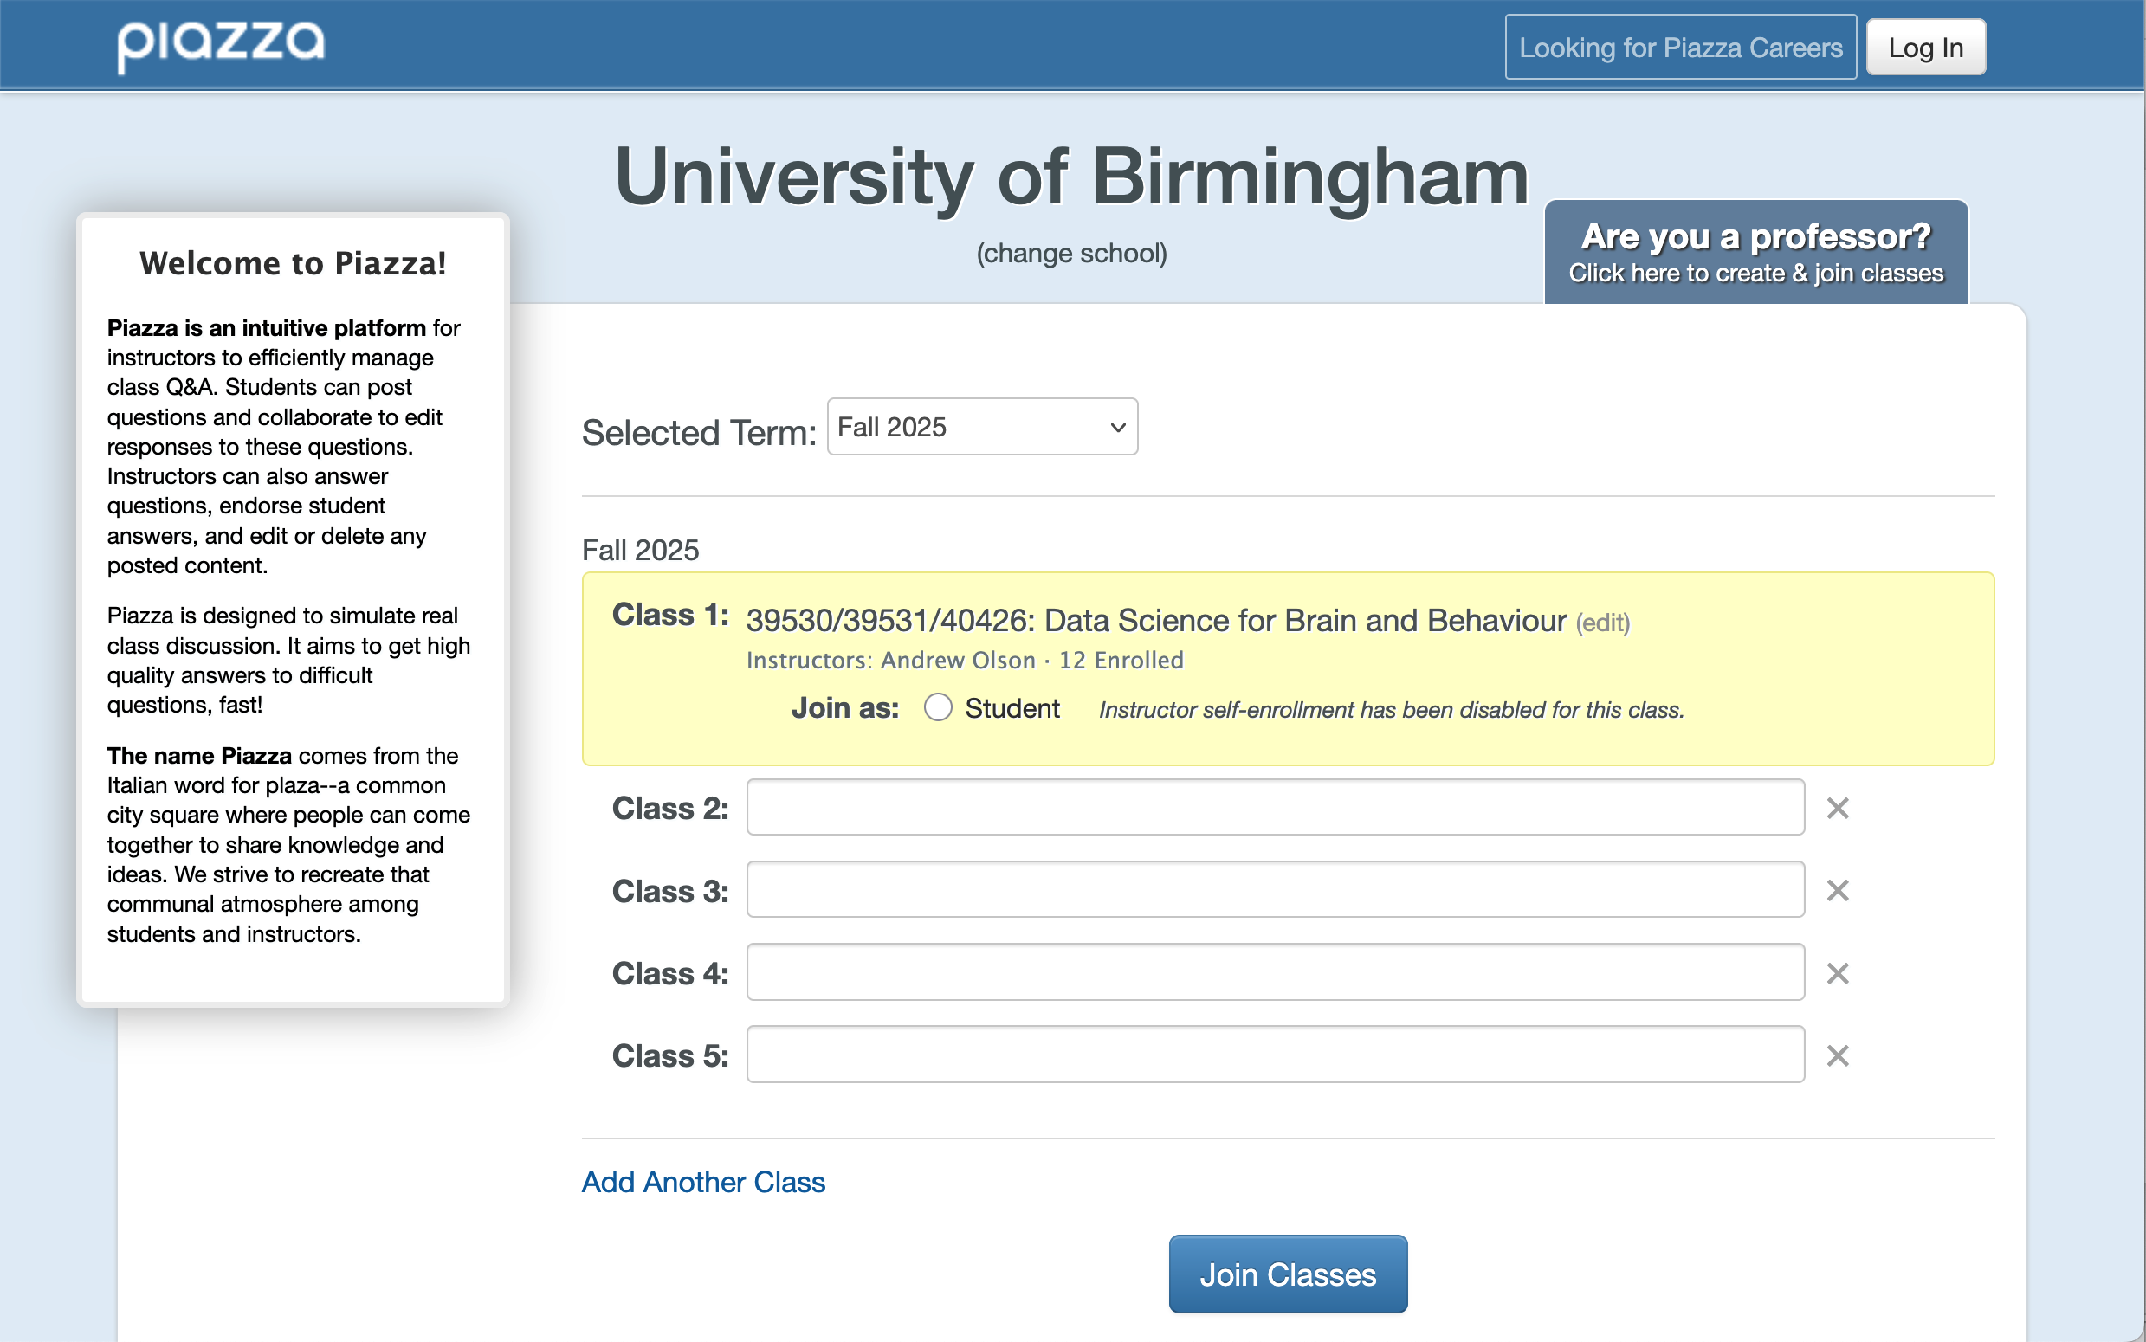
Signing up for piazza – enter your UoB email address
Signup page:
Select “Student”

Slide 32
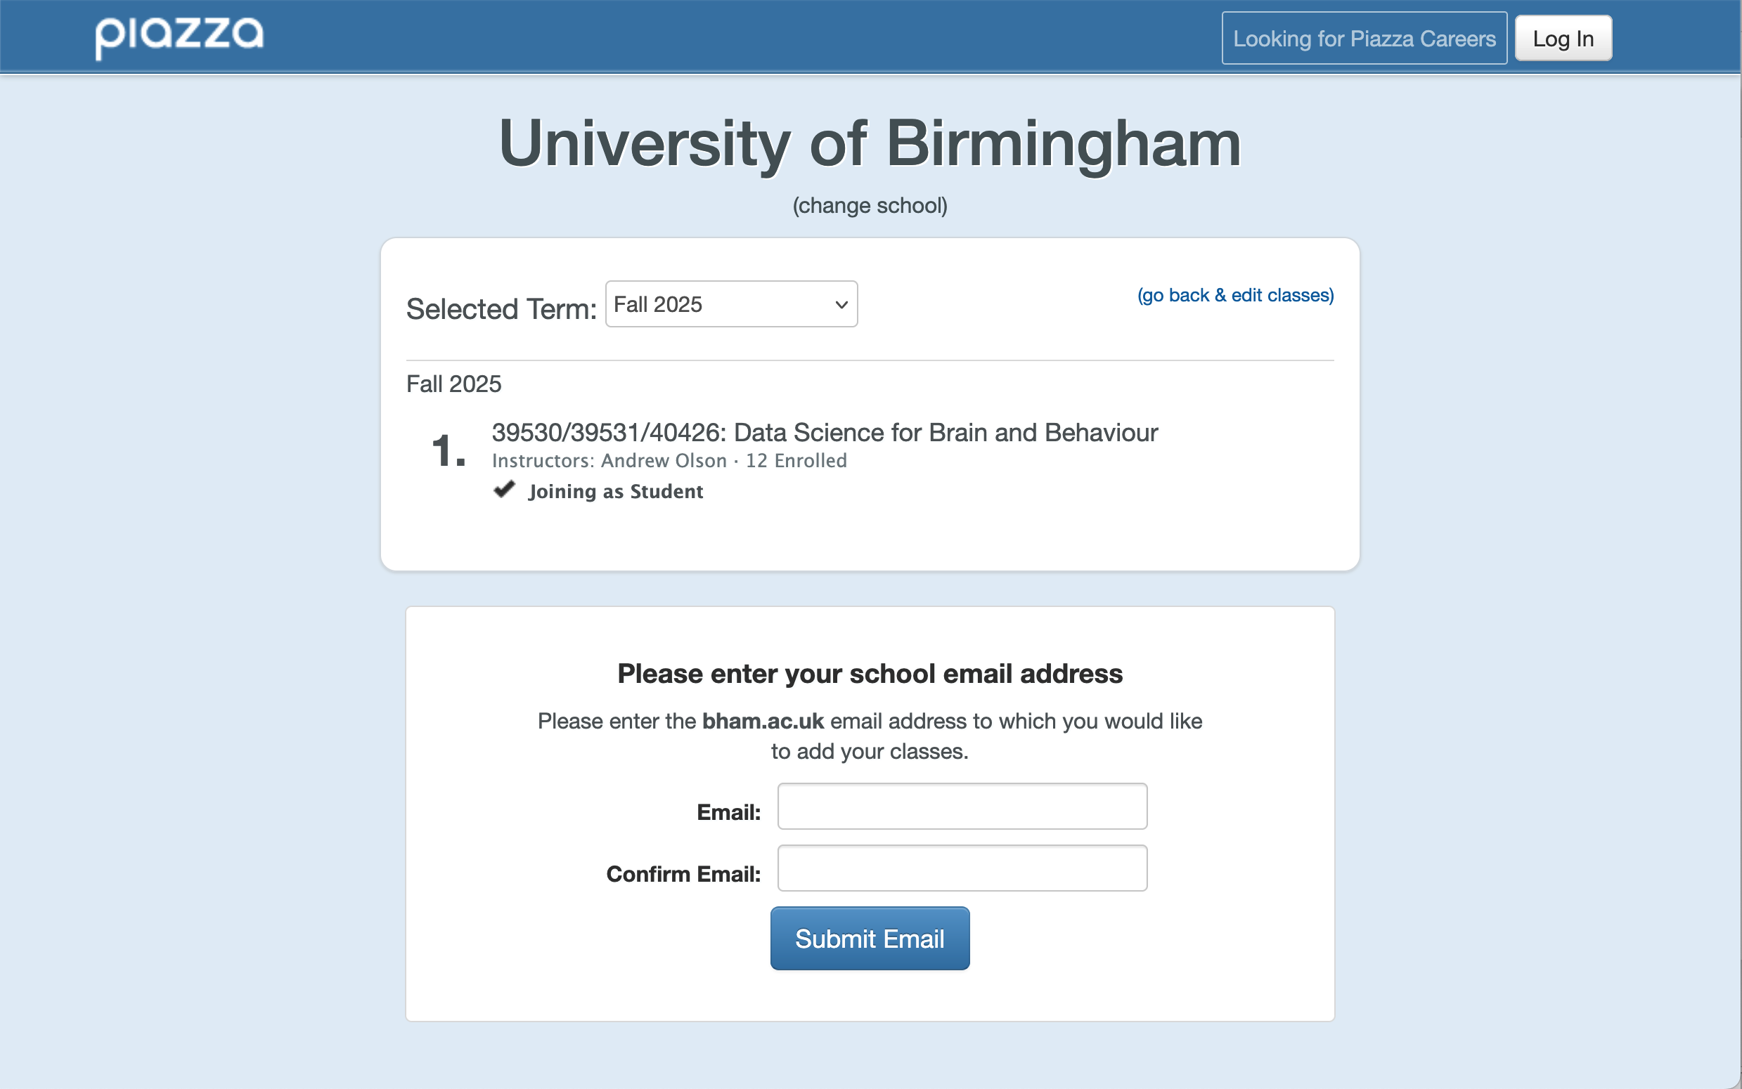
sign up with UoB email (needs to be UoB)

Slide 33
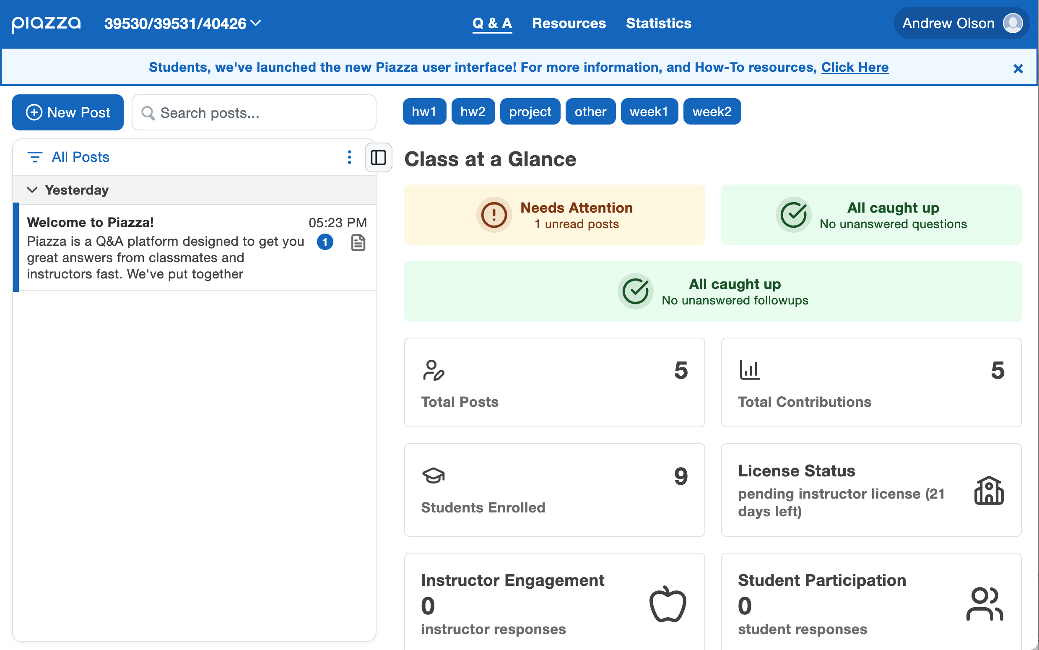
Piazza course page
folders with categories of questions
questions listed here

Slide 34
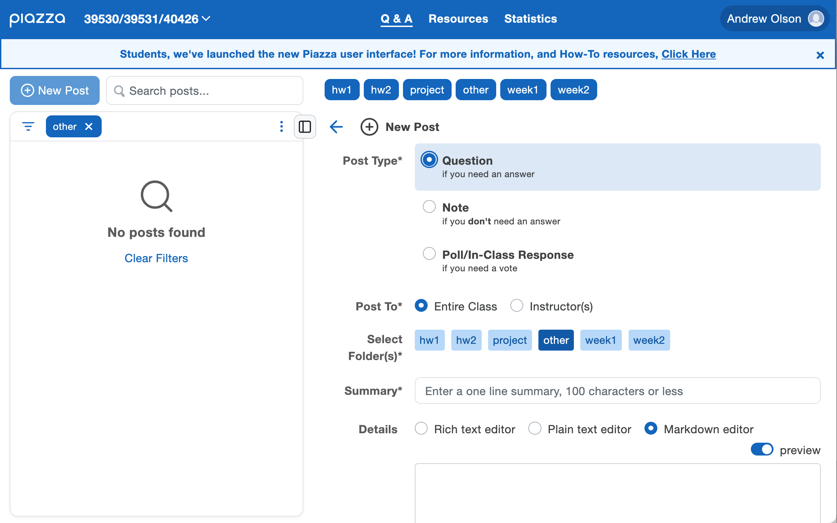
Ask a question
Choose a folder that fits your question

Slide 35
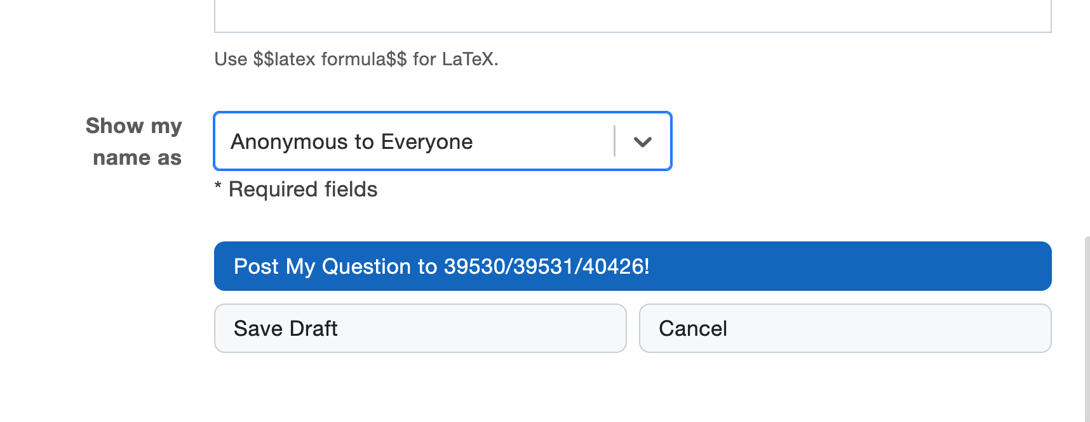
To make it anonymous
Change this to be anonymous
See the bottom of the post section:

Slide 36
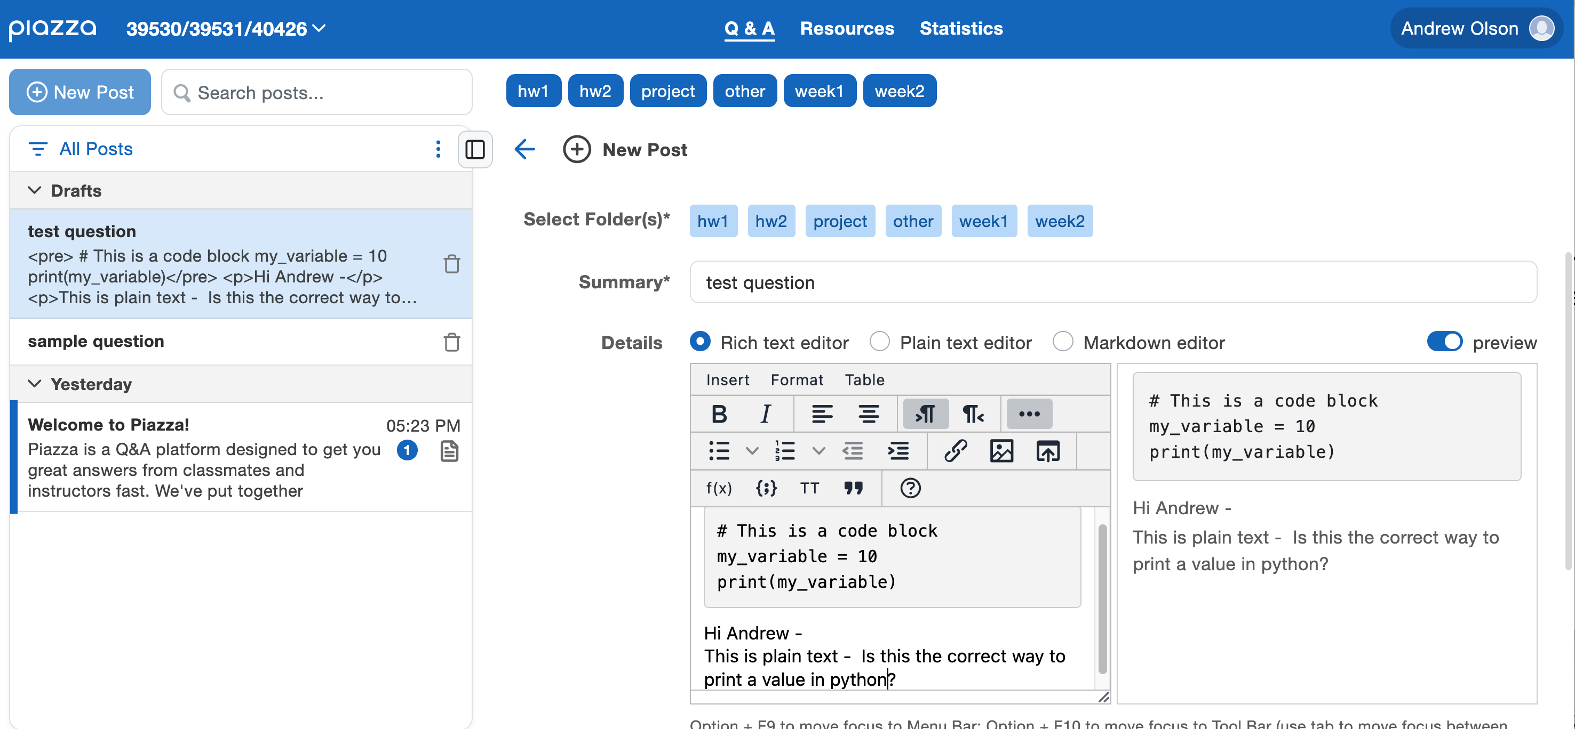
Piazza allows you to have code and text blocks.
1) Use the rich text editor
This can make your question easier to read
2) Click here to create a code block
3) the grey box is code
The white part is text

Slide 37
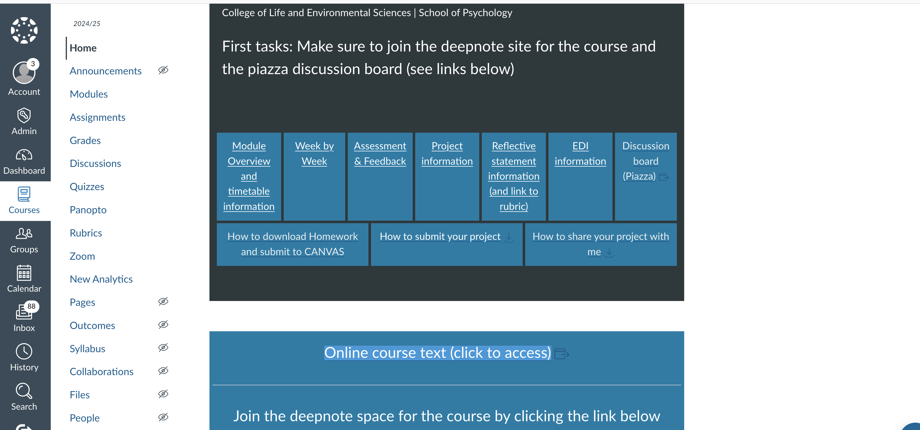
The CANVAS page and link to the online course text
Link on the CANVAS page – also here:
https://olsonac.github.io/textbook/intro.html
Assessment and feedback information
Link to the e-textbook
Link to the piazza discussion board
How to submit homework (TBA)

Slide 38
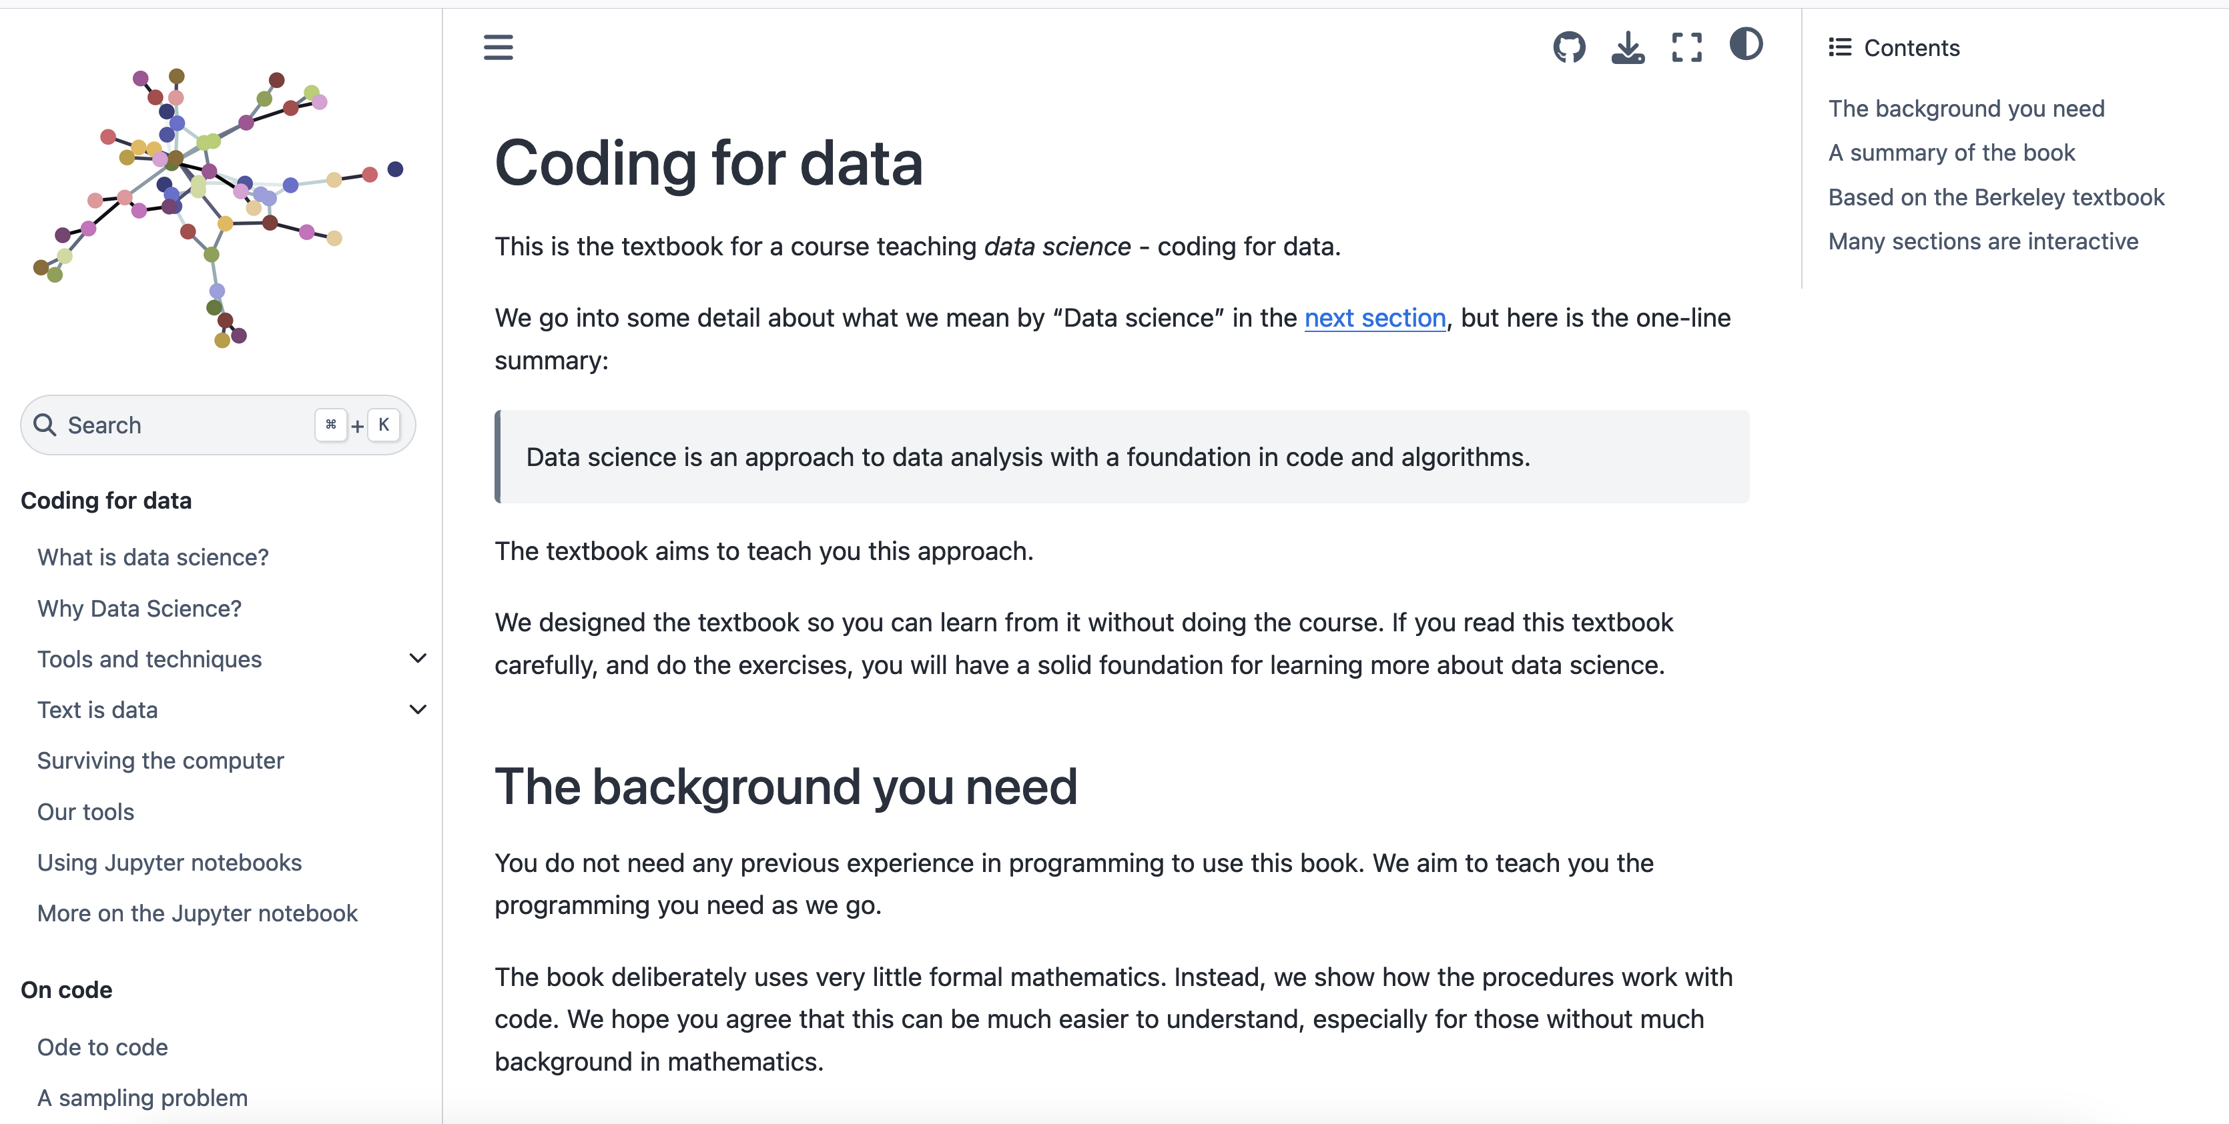
Course text page
Read the entries in the first section: “Coding for data”

Slide 39
Student organized Whatsapp group
Students have organized a Whatsapp group in the past
If you want to do that I will distribute the link
Send me an email and I will put it on the CANVAS page
I will not participate in the whatsapp group
no lurking

Slide 40
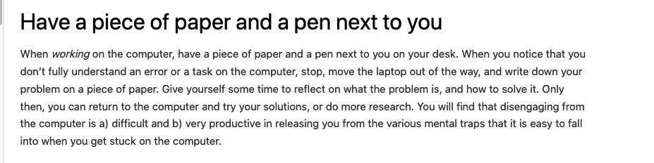
Surviving the computer
Good advice
Take a break. Get away from your machine. Think about something else. Then come back
Writing things down can also help you to think in a different way (e.g. diagrams)

Slide 41
The first exercise: Dracula Plotting the classics
You don’t have to understand the code (yet)
Checks that you can open a notebook and run the sections
Has some examples of what you can do…
Get text from the internet
break it up into chunks (words, chapters)
Count how often the principle characters are mentioned
Make a summary table by chapter (of cumulative numbers - important for interpretation [not numbers for each chapter])
Plot the summary
See what you can learn from the summary plot
e.g. who is the principle character
who is the “love interest”
when are secondard characters important

Slide 43
Summary
We’ve looked at VLab
We’ve seen the canvas page
We’ve seen how to access the course text
We’ve seen what jupyter notebooks look like and how to open them
We’ve seen piazza – Ask questions!
Dracula – Our first exercise
Plotting the classics (you don’t have to understand the code parts – we don’t expect that yet)
Just see what is possible, getting text from the internet, breaking it up, plotting the results
See what you can understand about a book from even a few lines of python code
Practice understanding what a graph is showing you (first identify the parts clearly)

