Slide 1
Complex Engineering Project (CEP)
STATISTICAL INVESTIGATION OF BREAST CANCER DIAGNOSIS AND PREDICTION
Course: STA281
Semester: Spring 2026
Institution: Computer science and Engineering

Slide 2
DATASET OVERVIEW & PREPROCESSING
569
31
TOTAL OBSERVATIONS
TOTAL VARIABLES
The Breast Cancer Wisconsin (Diagnostic) Dataset provides features computed from digitized images of fine needle aspirates (FNA) of breast masses.
Key Variables
Description
RadiusMean
Mean radius of tumor cells
TextureMean
Mean texture of tumor cells
AreaMean
Mean area of tumor cells
Medical Preprocessing: Essential for data integrity. All features are numerical (float64), ensuring suitability for advanced statistical modeling and inference.
Diagnosis
M = Malignant, B = Benign

Slide 3

QUANTIFYING TUMOR CHARACTERISTICS
RADIUSMEAN
AREAMEAN
COMPACTNESSMEAN
14.13
654.89
0.104
Std Dev: 3.52 Median: 13.37 Outliers: 5 (Z > 3)
Std Dev: 351.91 Median: 551.10 Outliers: 8 (Z > 3)
Std Dev: 0.053 Median: 0.093 Outliers: 9 (Z > 3)
Healthcare Implications: These metrics establish baseline benchmarks for identifying atypical and potentially malignant tumor cases.

Slide 4

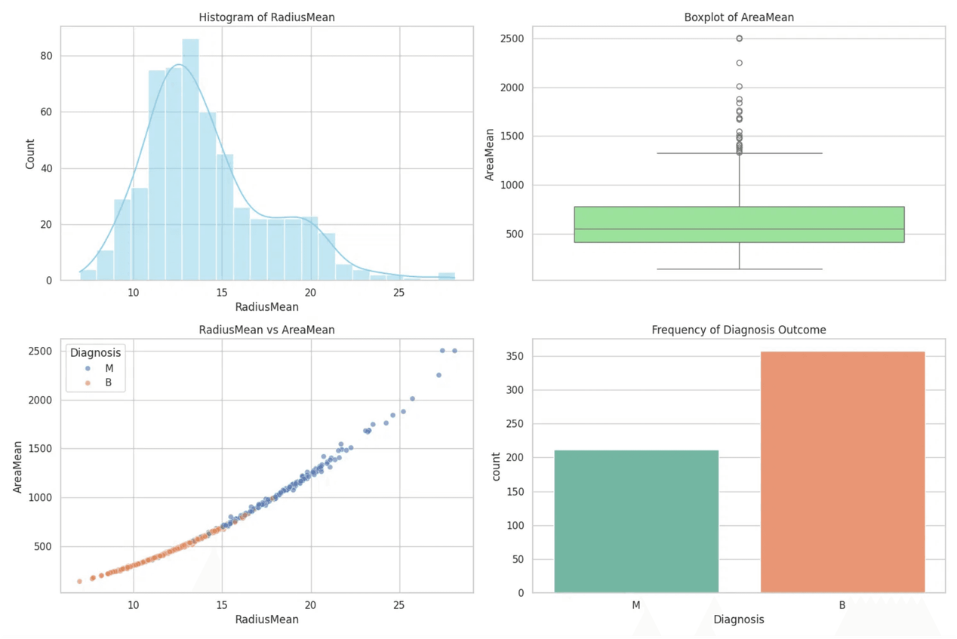
VISUAL INSIGHTS & PATTERNS
SIZE DISTRIBUTION
RadiusMean shows a right-skewed distribution, indicating that while smaller tumors are common, a significant tail of larger tumors exists.
OUTLIER ANALYSIS
AreaMean boxplots reveal extreme outliers, likely representing advanced-stage malignant cases requiring urgent intervention.
DIAGNOSTIC SEPARATION
Scatter plots demonstrate a clear linear relationship between radius and area, with malignant tumors clustering in the high-value region.
MALIGNANT TUMORS ARE OBJECTIVELY LARGER AND MORE IRREGULAR.

Slide 5

DIAGNOSTIC PROBABILITIES
BAYES' THEOREM APPLICATION
Condition:
RadiusMean > 18 mm
Prior P(M):
0.3726
37.26%
Likelihood P(R>18|M):
0.4340
Evidence P(R>18):
0.1617
P(M): BASELINE MALIGNANCY
Posterior P(M | R > 18mm) ≈ 100%
Healthcare Interpretation: Tumors exceeding 18mm in mean radius are almost definitive indicators of malignancy, requiring immediate clinical intervention.
93.06%
P(M | RADIUS > 15MM)

Slide 6
DISTRIBUTION ANALYSIS & MODELING
NORMALITY CHECK: RADIUSMEAN
EXPONENTIAL WAITING TIMES
0.94
0.22
SKEWNESS
RATE (Λ)
0.85
4.55
KURTOSIS
EXPECTED WAIT
The distribution is right-skewed. Q-Q plot analysis reveals significant deviations at the tails, indicating that the normality assumption is not fully reasonable for tumor radius analysis.
Models the time between consecutive diagnoses. An expected wait of 4.55 units helps in healthcare preparedness and managing diagnostic workloads effectively.

Slide 7

CENTRAL LIMIT THEOREM (CLT)
49
The Central Limit Theorem states that the sampling distribution of the mean will be approximately normal for n ≥ 30, regardless of the population distribution.
SAMPLE SIZE (N)
0.4286
Hypothesis Testing:
Enables Z-tests and T-tests for non-normal tumor data.
STANDARD ERROR (SE)
Confidence Intervals:
Provides the foundation for estimating population parameters.
0.98%
Generalizability:
Supports applying sample findings to the broader patient population.
P(X̄ > 15 MM)

Slide 8
CLINICAL INTERPRETATION
ESTIMATING POPULATION PARAMETERS
We are 95% confident that the true population mean radius of malignant tumors lies within this calculated range.
95% CONFIDENCE INTERVAL
This interval establishes a statistically sound benchmark for "typical" malignant tumor sizes in clinical practice.
15.51 – 16.89
Enables clinicians to evaluate individual patient measurements against reliable population-level thresholds.
Mean Radius (mm)
SAMPLE SIZE (N)
SAMPLE MEAN
64 Patients
16.20 mm
STD. DEVIATION
CONFIDENCE LEVEL
2.80 mm
95%

Slide 9

VALIDATING RESEARCHER CLAIMS
TEST 1: AVERAGE TUMOR AREA
TEST 2: COMPACTNESS MEAN
P-VALUE
P-VALUE
0.0021
< 0.0001
Claim:
Area = 650 mm²
Claim:
Compactness = 0.12
Sample Mean:
710 mm² (n=49)
Sample Mean:
0.10 (n=64)
Significance Level:
α = 0.05
Significance Level:
α = 0.01
RESULT: REJECT NULL HYPOTHESIS
RESULT: REJECT NULL HYPOTHESIS
Evidence suggests mean area is significantly greater than
650 mm².
Strong evidence that mean compactness is significantly less
than 0.12.

Slide 10

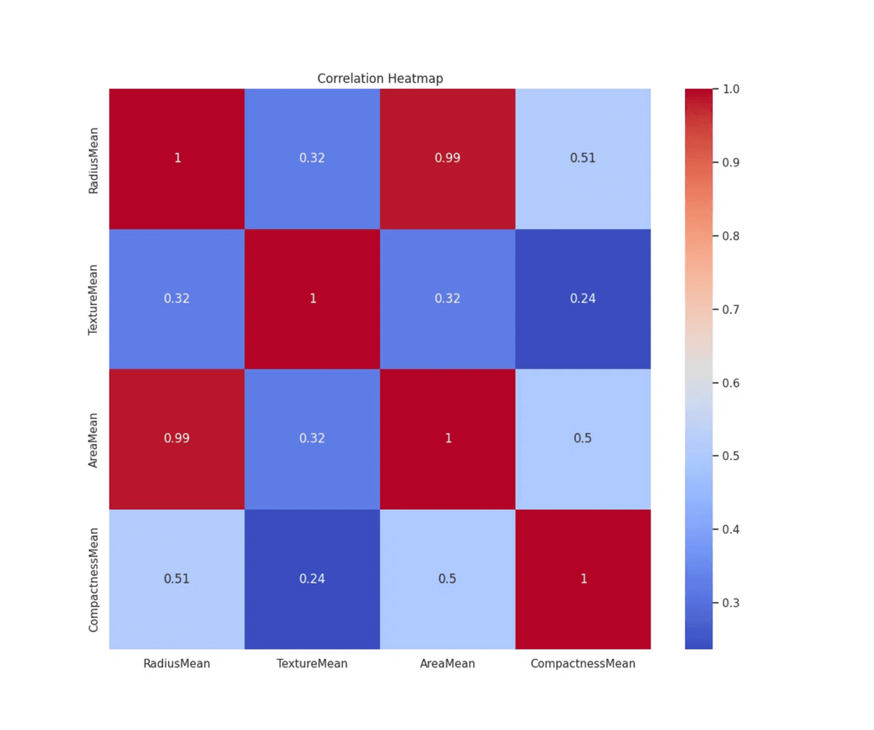
CORRELATION ANALYSIS
PREDICTIVE REGRESSION
LINEAR REGRESSION EQUATION
Area = -738.04 + 98.60 × Radius
CORRELATION (R)
SLOPE (Β)
0.9874
98.60
Predictive Interpretation: Every 1 mm increase in tumor radius predicts a 98.60 mm² increase in mean area.
This model allows for high-precision cross-verification of tumor measurements and aids in identifying suspicious growth patterns during diagnosis.
Strongest Link: RadiusMean vs AreaMean shows a near-perfect correlation.

Slide 11
DIFFERENTIATING MALIGNANT & BENIGN
RADIUSMEAN
AREAMEAN
T = 25.44
T = 23.94
P < 0.0001
P < 0.0001
TEXTUREMEAN
COMPACTNESSMEAN
T = 10.87
T = 17.70
P < 0.0001
P < 0.0001
HEALTHCARE SIGNIFICANCE
Extreme statistical significance across all key features confirms that malignant tumors are objectively larger, rougher, and more irregular than benign tumors.

Slide 12

EVIDENCE-BASED CONCLUSION
MAJOR DIAGNOSTIC INDICATORS
CLINICAL SIGNIFICANCE
Tumor Size: RadiusMean and AreaMean are the primary discriminators for malignancy.
Risk Assessment: Probabilistic models enable rapid clinical triage and risk stratification.
Tumor Shape: High compactness and concavity indicate irregular, suspicious growths.
Reliability: CLT and Hypothesis Testing ensure findings are statistically sound.
Texture: Surface heterogeneity (TextureMean) provides critical diagnostic context.
Outcomes: Data-driven insights facilitate early intervention and personalized care.
STATISTICAL INVESTIGATION IS INDISPENSABLE FOR ACCURATE BREAST CANCER DIAGNOSIS.

