Slide 1
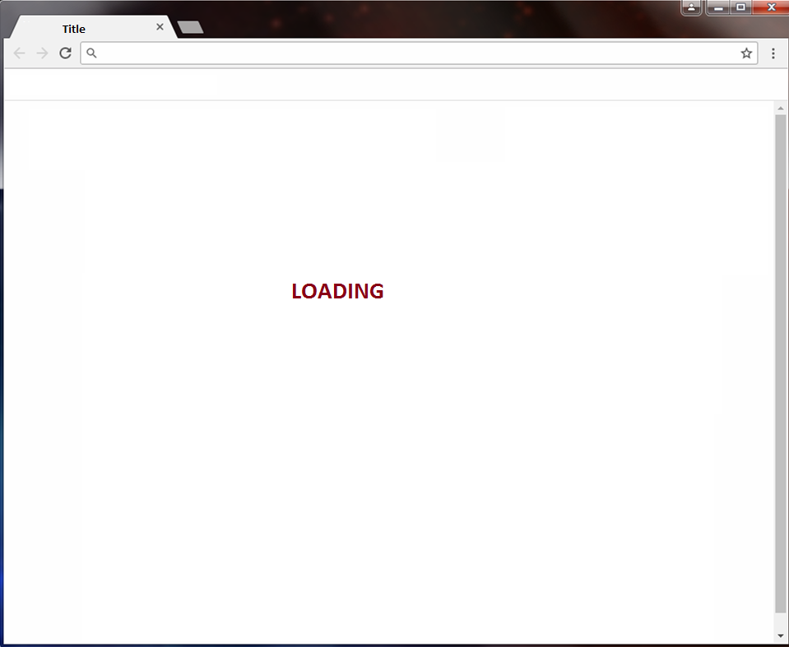
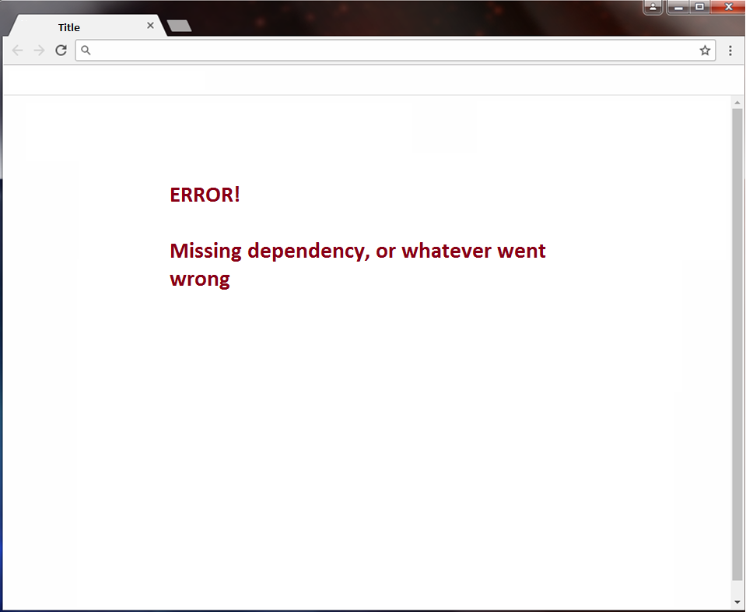
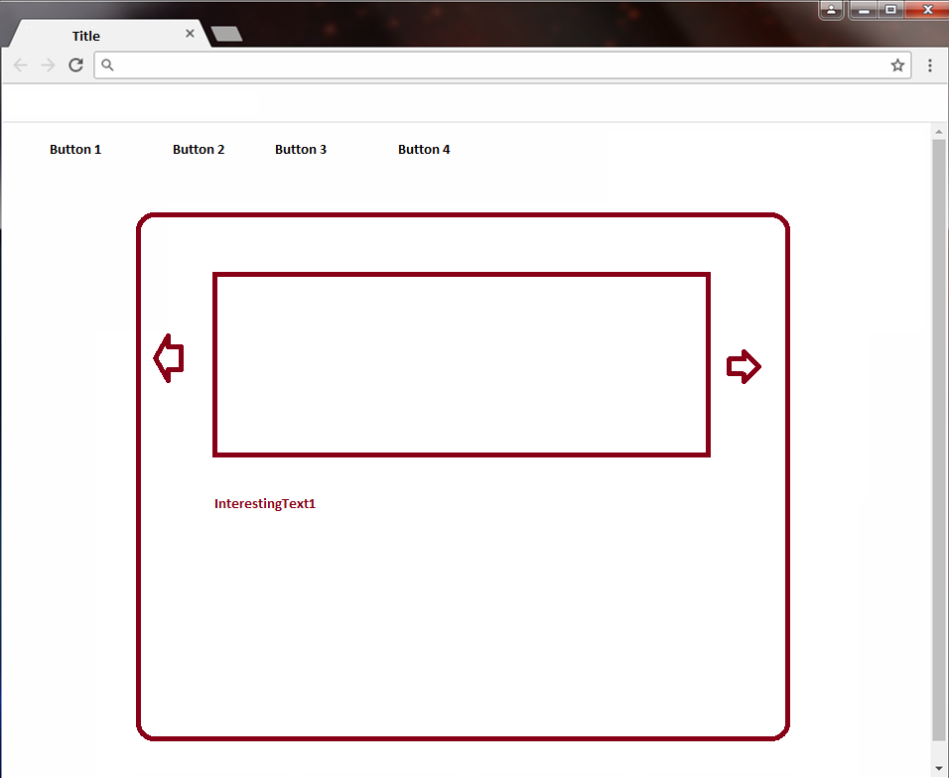
SERVER
CLIENT
JSON
Loading page
Title
Plugins
CoolMenu
AmazingSlider
FantasticArticle
NiceButton
InterestingText
Body
CoolMenu1
NiceButton1
NiceButton2
NiceButton3
FantasticArticle1
AmazingSlider1
InterestingText1
Oops!
CodeDrag
Render
Plugins
JavaScript and CSS

Slide 2
CodeDrag
GET JSON FROM SERVER
VALIDATE VARIABLES
SET TITLE
SET PLUGINS
PLUGINS WILL REGISTER THEMSELVES FOR CODEDRAG AS OBJECTS WITH FUNCTIONS
INITIALIZE EACH PLUGIN
IF PLUGIN DOESNT EXIST
UNIQUE NAME
CodeDrag_Plugin_UniqueName_ + OriginalName for CSS CLASSES, JS IDS, ETC
SET DEPENDENCIES OF SCRIPTS, (REPEAT THIS STEP)
RENDER PAGE

